Slide 1


Ghanaian Variation: exploiting the mathematical theme of
Invariance in the Midst of Change
John Mason
Dec
2023

Slide 2
Throat Clearing
I am interested in the lived experience of thinking, doing and teaching mathematics
Consequently my approach is to offer you some task-exercises with which to engage.
What you get from this experience will be founded upon, and largely what you notice happening to you.
Because of the zoom aspect, I can’t usefully garner your responses,
so I will make some remarks based on my own experience,
BUT
These, like everything said today, are CONJECTURES,
to be tested in your own experience.

Slide 3
The Principle of Variation (Variation Theory) raises certain questions:
What is made available to be learned?
Where and how can attention be focused?
What alternative foci of attention are possible for learners?
What generalisations are available?
What pedagogical actions are appropriate?
In each case, the answer should be
centred around one or more
Mathematical Relationships

Slide 4
From Previous Webinars
Aim is awareness of relationships and general properties
Key Variation-inspired questions:
  What is the same and what is different?
  (dimensions of possible variation)
  What might come next?
  (range of permissible change; example space)
There are many ‘levels’ of ‘critical features’ to attend to
  Often learners are expected to attend to more complex features before appreciating simpler ones
  May depend on how topic is introduced
It is sensible to expect a period of development of variation-relevant pedagogy rather than sudden alteration

Slide 5
Interrupted Calculations
I am about to subtract a two digit number from a three digit number,
when somebody suddenly:
  Adds one to both my numbers …. What difference will this make to my answer?
  Subtracts 2 from both my numbers … What difference will this make to my answer?
  Adds one to the larger number and subtracts 2 from the smaller number … What difference will this make to my answer?
What aspects might be critical but are being assumed?
‘digits’
‘Subtract’
What critical aspects are being addressed?
Invariance of difference under action;
Working with unspecified numbers;
Holding two things in mind;
‘difference’
One variation …
What is invariant
in the midst of what permissible change?
What might be next?
What now is invariant
in the midst of what permissible change?
What critical aspect(s) are being exposed?
What dimensions of possible variation could be being revealed?
What are the ranges of permissible change?
Variation:
One level: variation is in the learner’s mind
Another level: arithmetic actions on numbers before an action leads to relationships
What else could be varied?
Notes:
Here the variation is in the mind of the learner, which means that it may be necessary to use variation-relevant pedagogical actions

Slide 6
Stressing & Ignoring
The sum of the interior angles of a planar triangle is 180°.
For me, it is “a”.
Try saying the sentence putting emphasis on the “a”:
  The sum of the interior angles of a planar triangle is 180°.
  It is expressing the range of permissible change
Now try emphasising the other main words
  The sum of the interior angles of a planar triangle is 180°.
  The sum of the interior angles of a planar triangle is 180°.
  The sum of the interior angles of a planar triangle is 180°.
  The sum of the interior angles of a planar triangle is 180°.
  The sum of the interior angles of a planar triangle is 180°.
  The sum of the interior angles of a planar triangle is 180°.
What word for you is the most mathematically significant?
Stressing a word seems to invite
What if not?
Opens up generality
Stephen Brown &
Marion Walter

Slide 7
Example Spaces
What comes to mind when you hear the word triangle?
What about
How rich is your accessible example space?
What range of examples come to mind associated with ‘triangle’?
What about learners?

Slide 8
More Triangles
Is this a triangle?
Is this a triangle or is a triangle specified?

Slide 9
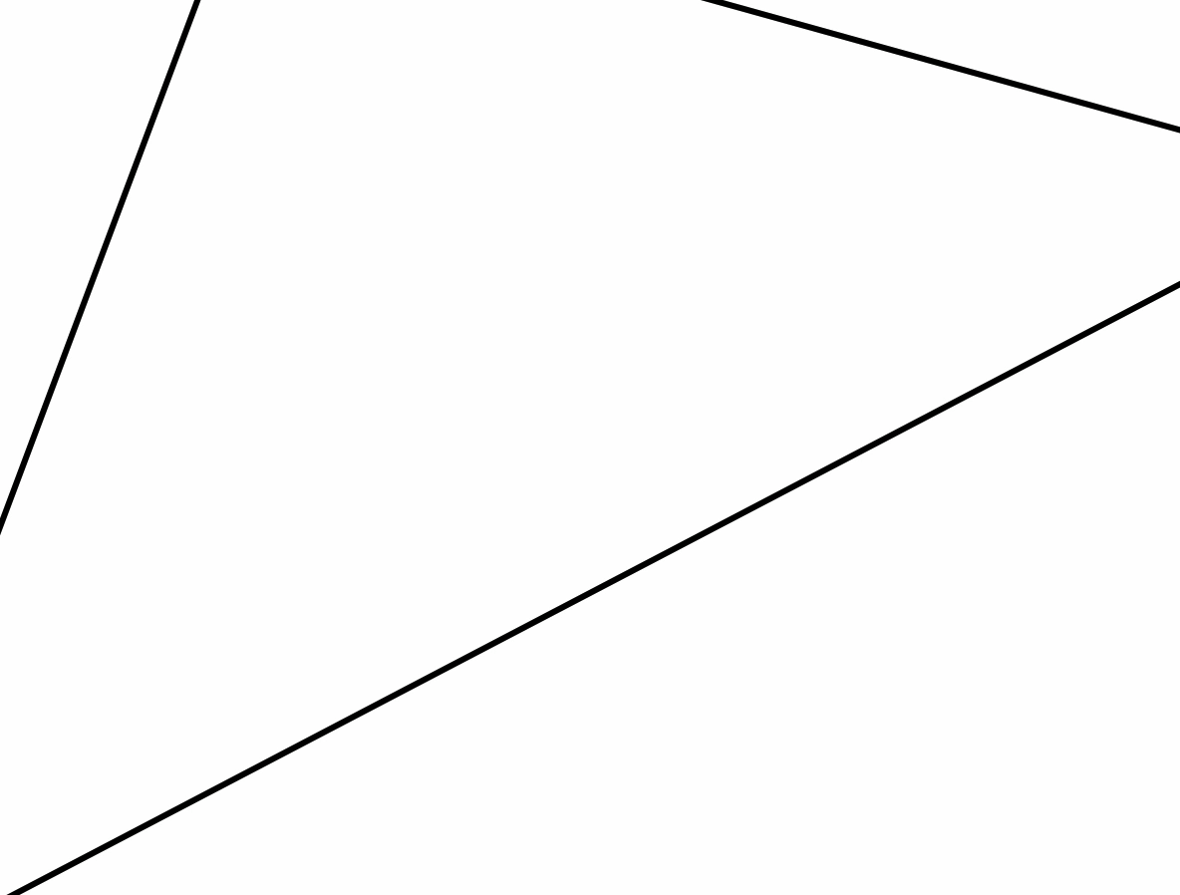
Notice the invariance: (a triangle shape)
in the midst of change (scaling)
What about this?

Slide 10
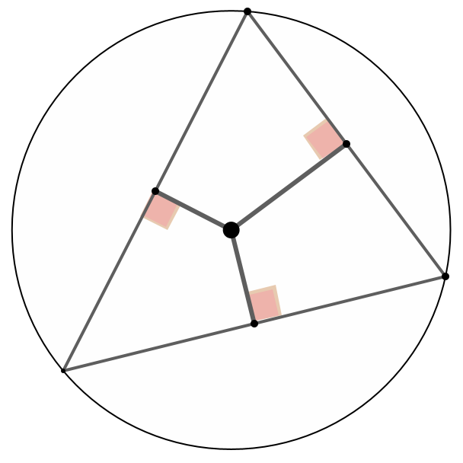
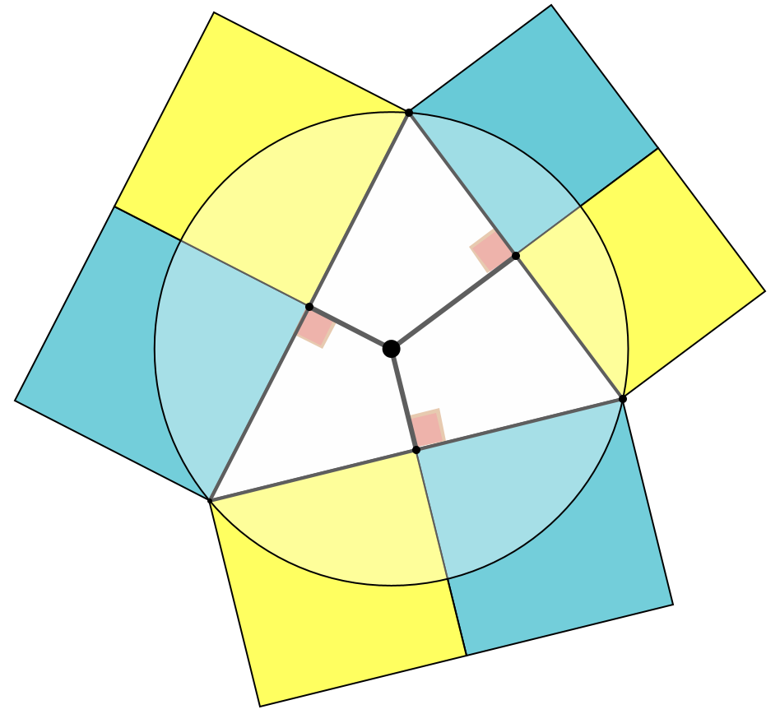
Alternating Sums
Imagine a triangle
Imagine the perpendicular bisectors of the edges, meeting at the circumcentre.
Erect squares on each portion of each edge.
Going cyclically around the triangle, the alternating sum of the areas of the squares is zero.
(sum of areas of Cyan squares = sum of areas of Yellow squares)
What aspects being assumed might be critical?
What might be varied?
What is invariant and what could be changing?

Slide 11
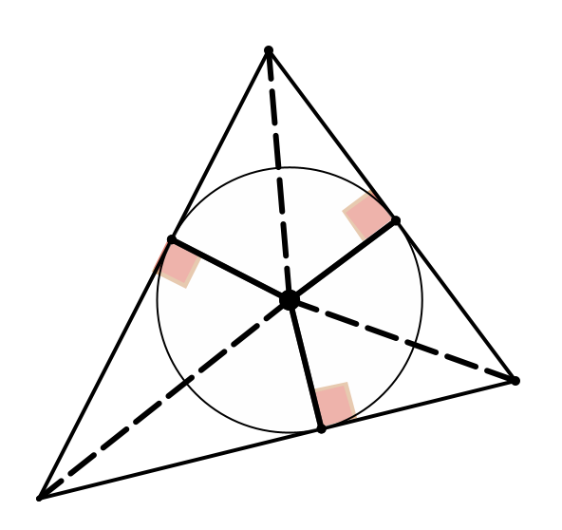
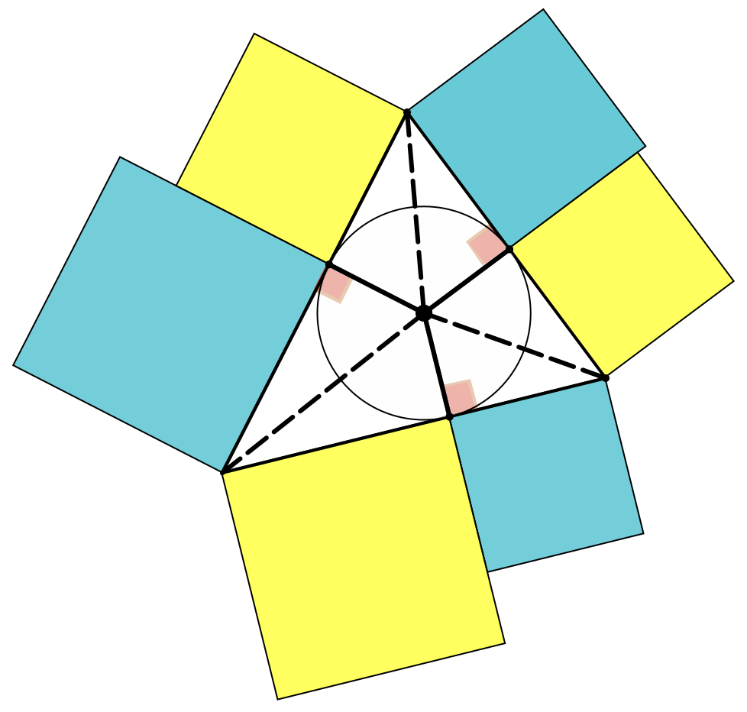
More Alternating Sums
Imagine a triangle
Imagine the angle bisectors, meeting at the incentre. Drop perpendiculars to the edges from the incentre.
Construct squares on the edge-segments.
Going around the triangle, the alternating sum of the areas of the squares is zero
(Sum of area of yellow squares = sum of areas of Cyan squares).
What is the locus of points from which
the dropped perpendiculars lead to squares
whose alternating sum is zero?

Slide 12
Marbles 1
If Anne gives one of her marbles to John, they will then have the same number of marbles.
  What can you say about the number of marbles they started with?
Buses
  If one person got off the first bus and got onto the second, there would then be the same number of people in both buses. What can you say …?
Ages
  Last year A was the age that J will be next year. What can you say about their ages?

Slide 13
Marbles 2
If Anne gives one of her marbles to John, and two of her marbles to Lydia, they will then all have the same number of marbles.
  What can you say about the number of marbles they started with?
Buses
  If one person got off the first bus and got onto the second, and two other people got off the first bus and got onto a third bus, What can you say …?
Ages
  Last year, A was the age that J will be next year, and two years ago she was the age that L will be in two years time. What can you say about their ages?

Slide 14
Marbles 3
If Anne gives one of her marbles to John, they will have the same number of marbles;
if instead John gives four of his marbles to Anne, she will then have twice as many as John then has.
  What can you say about the relation between John’s and Anne’s marbles to start with.
Buses
  If one person were to get off the first bus and onto the second, then the buses would have the same number of passengers;
  If instead four people got off the second bus and got onto the first bus, the first bus would have twice as many as the second bus then had.
Ages?

Slide 15
Marbles 4
If Anne gives John one of her marbles, she will then have one more than twice as many marbles as John then has.
If John started with 12 marbles, how many did Anne start with?
Buses
  If one passenger gets off the first bus and onto the second bus, then there will be one more than twice as many passengers on the first bus as on the second.
  If the second bus started with 12 passengers, how many did the first bus start with?
Ages!

Slide 16
Marbles 5
If Anne were to give John one of her marbles, she would then have one more than twice as many marbles as John then had.
However, if instead, John were to give Anne one of his marbles, he will have one more than a third as many marbles as Anne then had.
How many marbles have they each currently?
Buses!
Ages!

Slide 17
Reflection
Laurie Jacques in her webinar focused on
One-problem-multiple-changes,
referred to by Gu et al as Procedural Variation because of the variation in the sequence of choice of tasks intended to focus learner attention on the dimensions of possible variation constituting the ‘method’ of solution.
Put another way, the aim is to draw attention to what can be changed and still the method of solution remains invariant.
When learners encounter a problem, we hope that the various possible mathematical actions which become available to them lead to a solution. Sometimes this is ‘recognising the type’ of the problem, but not always.
Laurie’s investigations show how non-trivial is the design of such tasks.
Here I am offering the conjecture that working explicitly with and on the theme of invariance in the midst of change might enrich the design choices and alert learners to the scope of generality.
Learners become accustomed
to Same & Different,
to Varying things for themselves
to recognising invariance in the midst of change

Slide 18
Reflection
Hamsa Venkat drew attention particularly to the delicate matter of Variation-relevant Pedagogy
Offering learners some carefully constructed sequence of variations is NOT sufficient
What matters is how learners are engaged with the variation
  What they are stimulated and encouraged to do WITH the variation
  In other words, how they work with and on what they attend to
Expecting teachers to shift suddenly to variation-oriented pedagogy, or expecting them to use variation in every lesson is unreasonable and likely to fail.
Hamsa outlined a framework for developing and encouraging transition to variation-relevant pedagogy

Slide 19
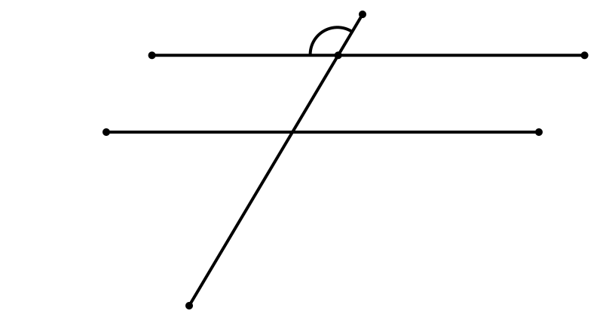
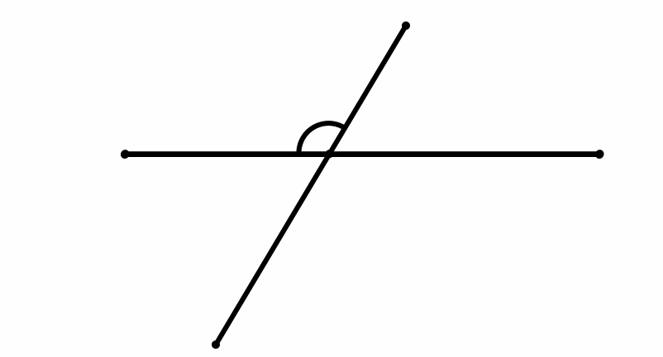
Static & Dynamic Geometry
A
A
A
B
Ideas developed from
conversation with Jenni Ingram

Slide 20
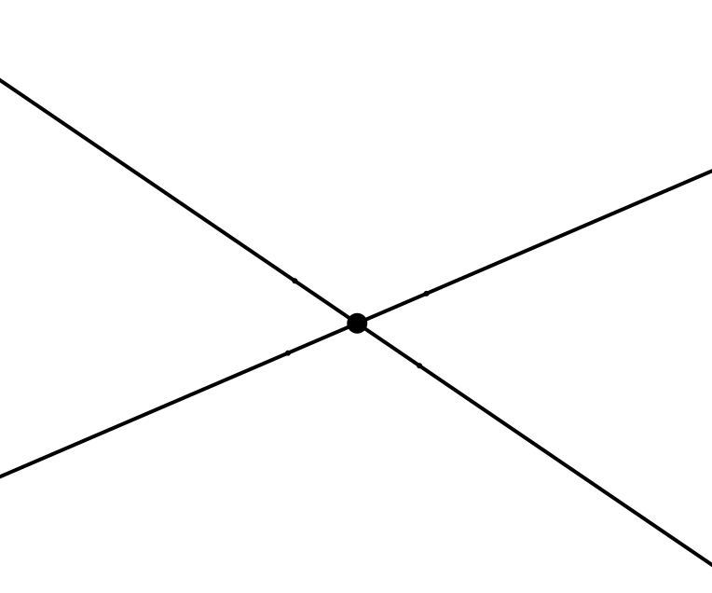
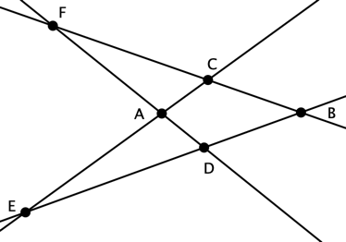
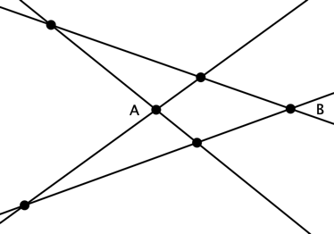
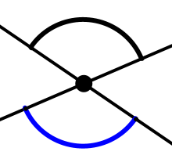
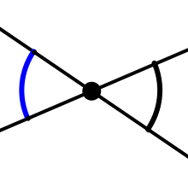
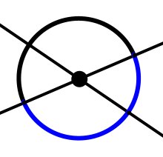
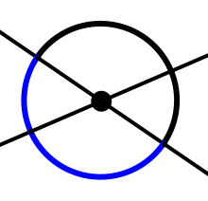
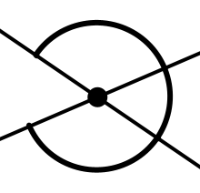
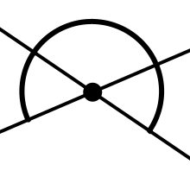
Opposite Angles
How many pairs of opposite angles can you see?
Name a pair of opposite angles
Discern an opposite angle for this angle
2?
3?
4?
more?
Developing facility in discerning opposite angles
before engaging with their equality
Critical aspect

Slide 21
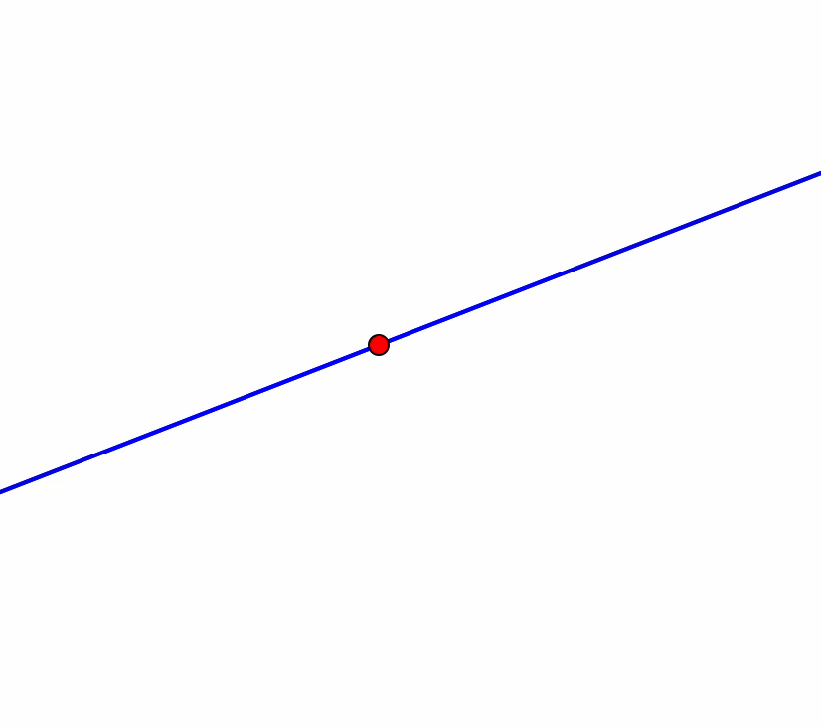
Alternatively, Develop and Bring to the Surface Awareness of Equality, before Naming
What equalities can you discern?
A lot depends on
- pedagogic choices of order
- what awarenesses can be called upon

Slide 22
Critical Aspects & Levels of Discernment
Ulla has stressed the importance of the students’ perspective on what are critical aspects.
Brent & Martina have discerned levels of critical aspects, of what might require attending to
Possible learner-critical aspects:
How points and angles are referred to
How points and angles are labelled
What constitutes
‘an angle’
What labels refer to
Awareness
of what happens
when a line rotates about a point

Slide 23
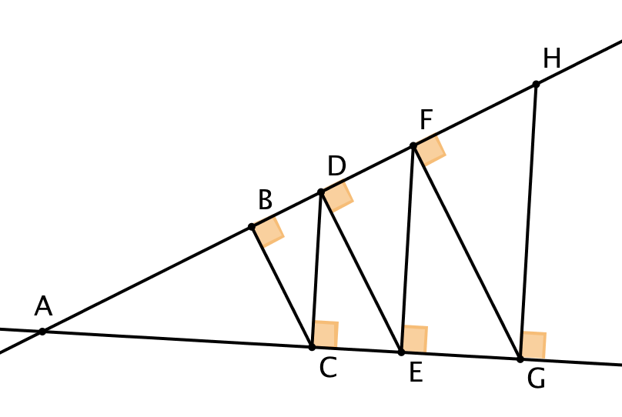
Similar Right Angled Triangles
How many right-angled triangles can you find with one angle equal to θ?
θ
Developing facility in discerning
right-angled triangles; then common angles;
only then consider consequences

Slide 24
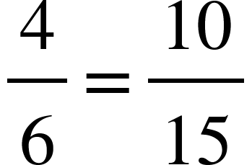
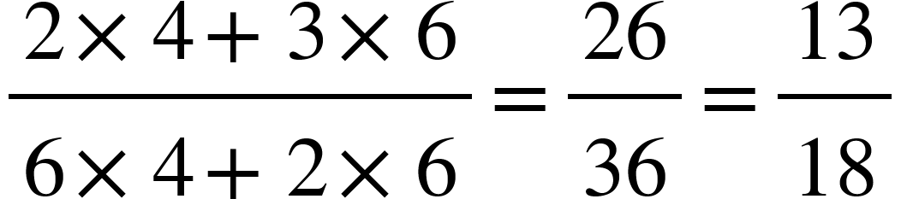
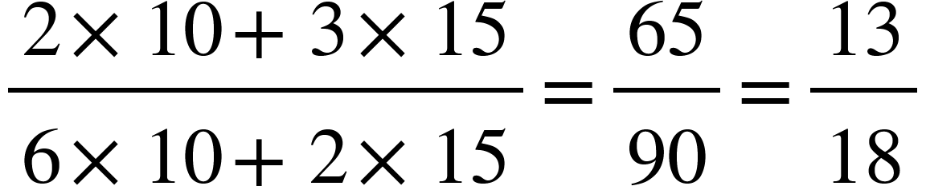

Preserving Equality
so
and
?
What is the same and what is different about these two calculations?
What are some dimensions of possible variation?
Terrible Example
Bad choice of particular numbers, generating possible confusion

Slide 25
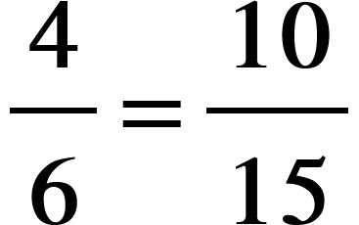
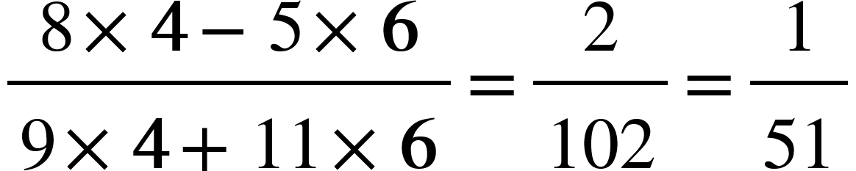
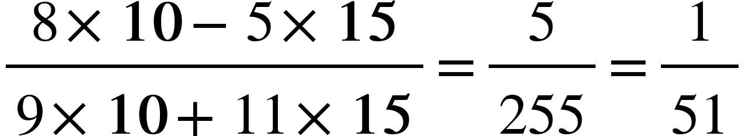
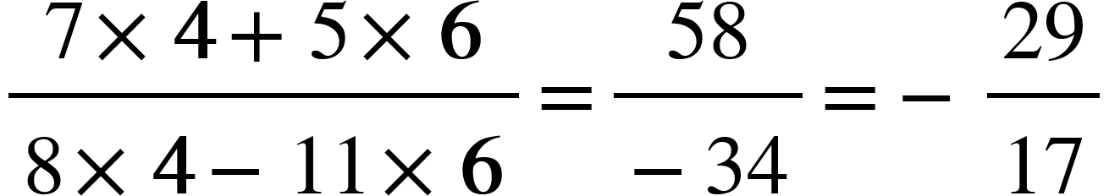
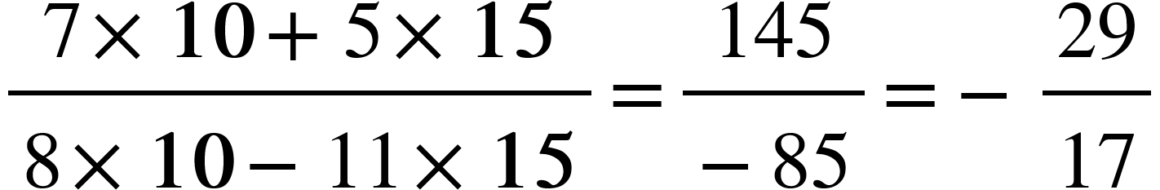


Preserving Equality
so
and
7
4
5
6
7
10
5
15
8
4
11
6
8
10
11
15
…
Using Bold font, Colour, … to stress a possible change
Using Bold font, Colour, … to stress an invariant
What is the same and what different?
But might this be
‘Doing for learners what they can already do for themselves?’
My aim is to
‘Do for learners only what they cannot yet do for themselves!’

Slide 26
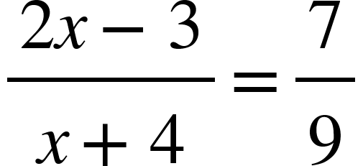
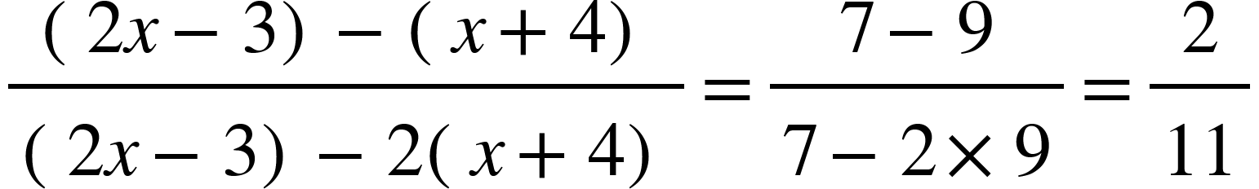
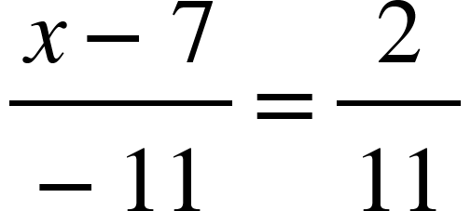

Application
To solve

Slide 27
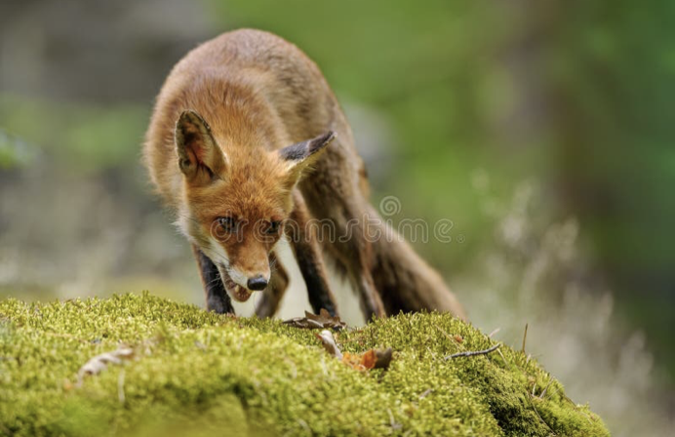
Expressing Invariance and Permissible Change
How can the theme of Invariance in the Midst of Change in arithmetic be expressed in particular cases?
Algebra!
Letters are used to indicate the scope of generality,.
Different letters correspond to the dimensions of possible variation.
Restrictions (constraints) on those letters indicate the corresponding Range of Permissible Change
Tracking Arithmetic is one way into algebra

Slide 28
Who creates the examples?
Please write down a decimal number between 2 and 3.
Please write down a decimal number between 2 and 3,
which does not use the digit 5;
Please write down a decimal number between 2 and 3,
which does not use the digit 5;
and which does use the digit 7;
Please write down a decimal number between 2 and 3,
which does not use the digit 5;
and which does use the digit 7;
and which is as close to 2½ as possible.
Students encounter
repeated 9’s phenomenon for themselves.
2.479999…
2.49999…9997
Stimulating discussion
and thought
2.49999…9997999…999

Slide 29
In How Many Different Ways …
can a unit fraction be expressed
as the difference of two unit fractions?
But!
Anticipating
Generalising
Organising
Critical aspects?
Notes:
If n = pqr then 1/n = 1/pr(q-r) - 1/pq(q-r) so there are as many ways as n can be factored as pqr with q>r
Multiple ways t present a task: as a generality; some systematic exambples; some random examples;
Task taken on by students can lead them to prctice subtracting frations
BECAUSE they want to know the answer, not simply to complete an exercise

Slide 30
Mutual Factors
x² + 5x + 6 = (x + 3)(x + 2)
x² + 5x – 6 = (x + 6)(x – 1)
x² + 13x + 30 = (x + 10)(x + 3)
x² + 13x – 30 = (x + 15)(x – 2)
But there are others!
x² + 25x + 84 = (x + 21)(x + 4)
x² + 25x – 84 = (x + 28)(x – 3)
x² + 41x + 180 = (x + 36)(x + 5)
x² + 41x – 180 = (x + 45)(x – 4)
Critical Aspects?
Notes:
But there are others!

Slide 31
Costings
I want 45 notebooks for participants in a workshop I am planning. I find suitable ones at £2.25 each or 6 for £11, but to get the reduced price I have to buy a loyalty card for £2. I will then have £9.25 left over from £95 for other purchases.
?
?
?
What could vary?
What functional relationships are involved?
Make up your own like this.
In what way is yours like this one
and in what way is it different?
Critical Aspects?
Notes:
What charge for the loyalty card would make the discount not worthwhile?
Based on an idea of Malcolm Swan

Slide 32
Doing & Undoing
What action undoes the action ‘adding 3’?
What action undoes the action ‘subtracting 4’?
What action undoes the action ‘subtracting from 7’?
=
7 –
=
7 –
Critical Aspects?
What action undoes the action ‘multiplying by 3’?
What action undoes the action ‘dividing by 4’?
What action undoes the action ‘dividing into 12’?
Undoing an action
Addition-subtraction
Multiplication-Division
What action undoes the action
‘multiplying by 3 then dividing by 4’?
What is another version of the action ‘divide by ¾’?

Slide 33
Summary
Mathematical Theme: Invariance in the midst of change
Expressing an invariance involves a range of permissible change
  What is the scope of generality?
  For number, usually some sort of algebraic labelling
Enriching learner’s accessible example space
  What is the scope of their example space?
Careful choice of critical aspects by observing learner behaviour
  Cf Brent & Martina’s levels
Getting learners to construct their own examples
(includes specialising!)
Need for Variation-Relevant Pedagogy
  What are learners expected to do with variation?
  Not expecting radical change for teachers or learners:… development over time

Slide 34
Objects of Learning
Planning Intended object of learning
Teaching Enacted object of learning
Learner Lived object of learning
Object of learning can be
Definition of concept
Use of labels or other notation
Mathematical relationship
Properties
…

Slide 35
Variation
Mathematical examples and questions always vary – we assume that practice with varied examples brings fluency
It may bring fluency, but often in a machine-like way
Controlling variation in examples and questions can, with appropriate pedagogy, bring understanding (appreciation and comprehension)
We notice what varies when other things are held stable
We notice what is constant when everything else varies
If everything varies we don’t know what to focus on
Mathematics is about relationships;
when we see the effects of one thing varying we can generalise about a relationship;
when we generalise about a relationship we are learning a concept through its defining properties.

Slide 36
Variation used in teaching
most school mathematics is about recognising and learning relationships
practice of procedures does not use perceptual and analytical experience of relationships
be clear about the intended concept to be learned, and work out how it can be varied (e.g. to focus in the ratio keep the total fixed, or vice versa)
the intended object of learning is often an abstract relationship that can only be experienced through examples - therefore control the variation in the examples
when a change in one variable causes a change in another, learners need several well-organised examples and reflection to ‘see’ relation and structure
draw attention to connections, similarities and differences by juxtaposition of examples

Slide 37
But this is not the whole story of learning
Variation theories are about what we might notice and therefore learn from …
Learning also needs language, handling things, social interaction, habits of thinking, purpose …. (Eleanor & James Gibson, 1955)

Slide 38
Follow up
Previous 5 webinars in this series
https://x.com/smartjacques/status/1701724696599761226?s=46&t=lbsRgg6JKM9L9t5yjZidEg
John.Mason@open.ac.uk
PMTheta .com
Leung, A. (2023). A pedagogical reflection on the interplay between variation and invariant: Variational thinking. Research Commentary. Asian Journal for Mathematics Education. 2(3) p261-273.
  Highly recommended. How variation and invariance lie at the heart of Chinese philosophy.
Norberg, M. (2023). Young students’ meaning-making when working with mathematics textbooks- A multimodal study focusing on th designed and the discovered. RME 25 (2) p194-218.
Kinnear, G. (2022). Comparing example generation with classification in the learning of new mathematics concepts. RME. doi.org/10.1080/14794802.2022.2152086

Slide 39
Who says what? (2)
  Ference Marton (Variation Theory): we notice what varies against an invariant background.
  Siegfried Engelmann (Theory of Learning): Everyone can discern what is the same/different about examples and non-examples. Everyone invents definitions/rules from the discerned qualities.
  Lingyuan Gu (Bianshi) Principles for teaching mathematics:
  One problem, multiple known solution methods
  One problem, multiple changes and contexts
  Multiple problems, one new solution method
  Procedural – progression to new idea by varying an old idea
  Conceptual – multiple experiences of new idea, e.g. representations

Slide 40

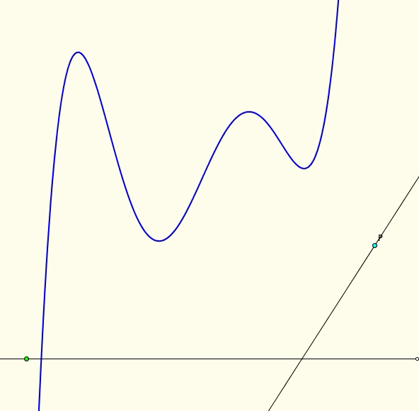
A Critical Aspects Tale
An experienced critical aspect amongst colleagues and students:
  What happens to graphs of polynomials as x ->
Definition:
  The tangent power of a point with respect to the graph of a function is the number of tangents to the graph that pass through the point.
Task: what is the tangent power of P with respect to the graph?

Slide 41
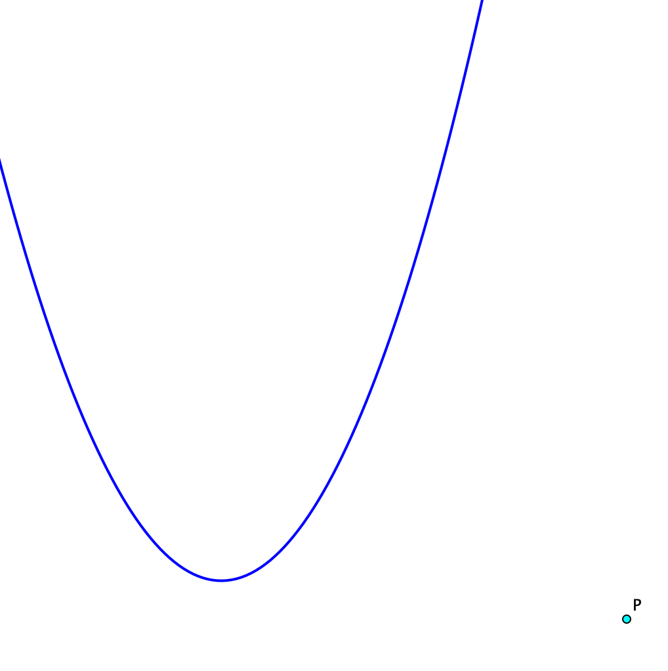
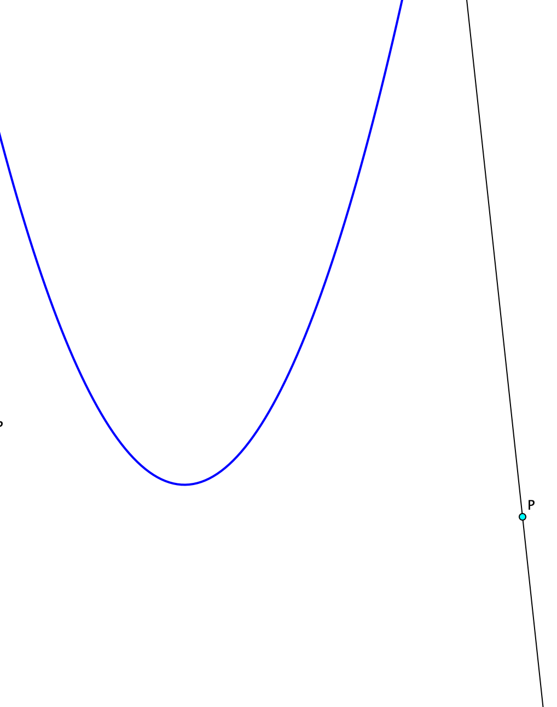
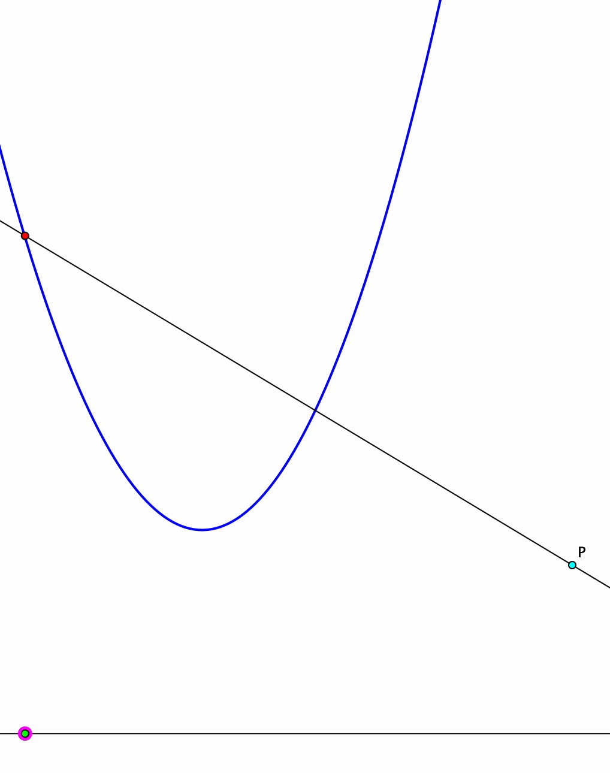
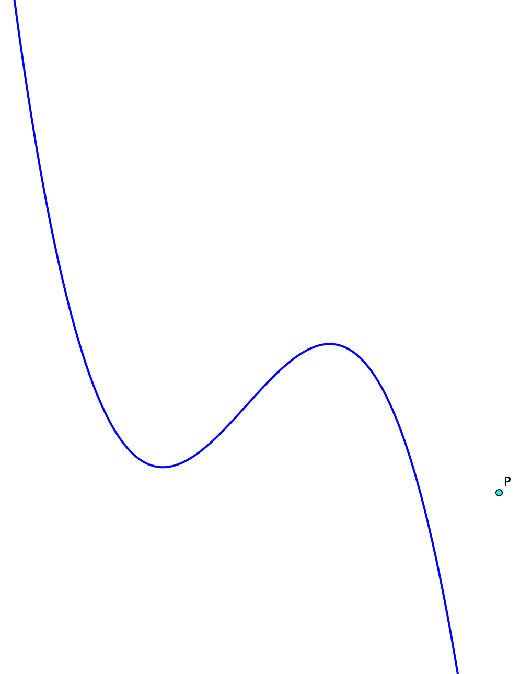
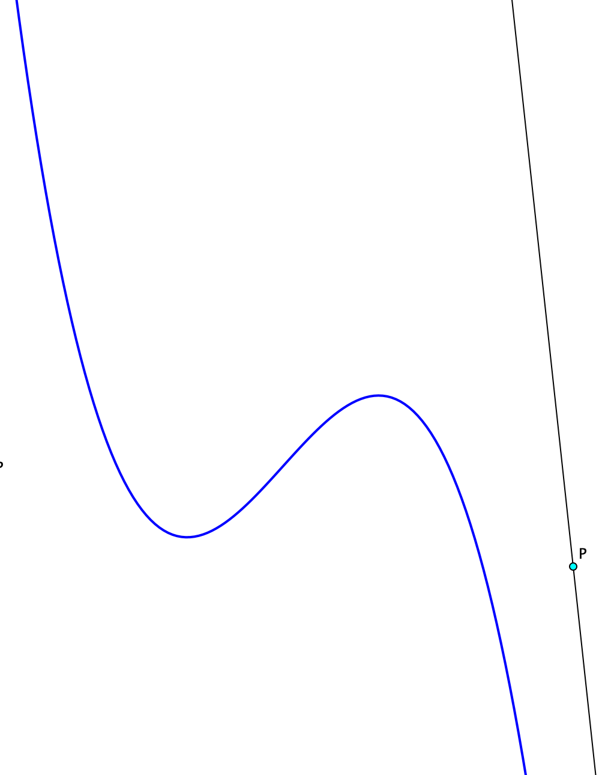
Tangent Power
The tangent power of a point with respect to the graph of a function is the number of tangents to the graph that pass through the point.
Notes:
Display quadratic through 3 points; vary the points;
Vary the extra point P
Allow time to estimate tangent power
Show line through P; Vary line
Still not clear about x large
Repeat for cubic
Drive tangent along quadratic
Drive tangent along cubic
Reveal boundary of regions
Use Counter to show regions

Slide 42
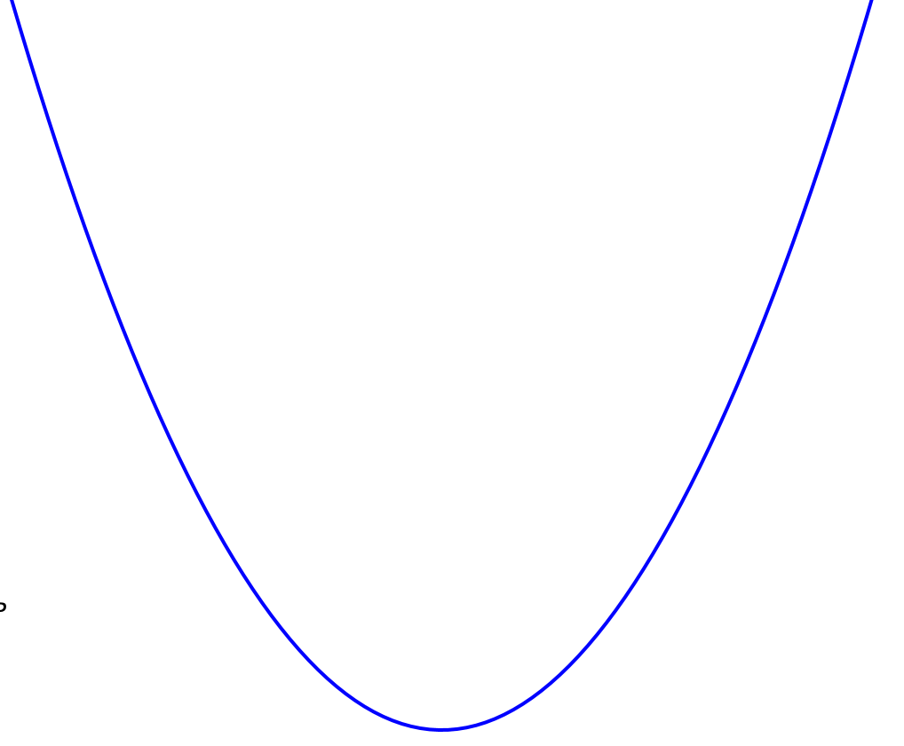
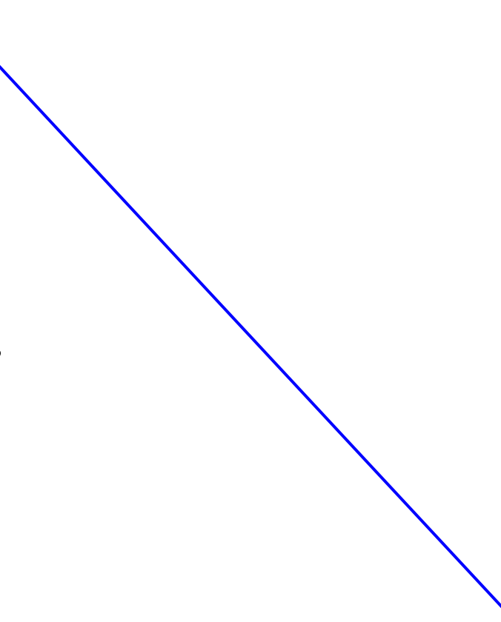
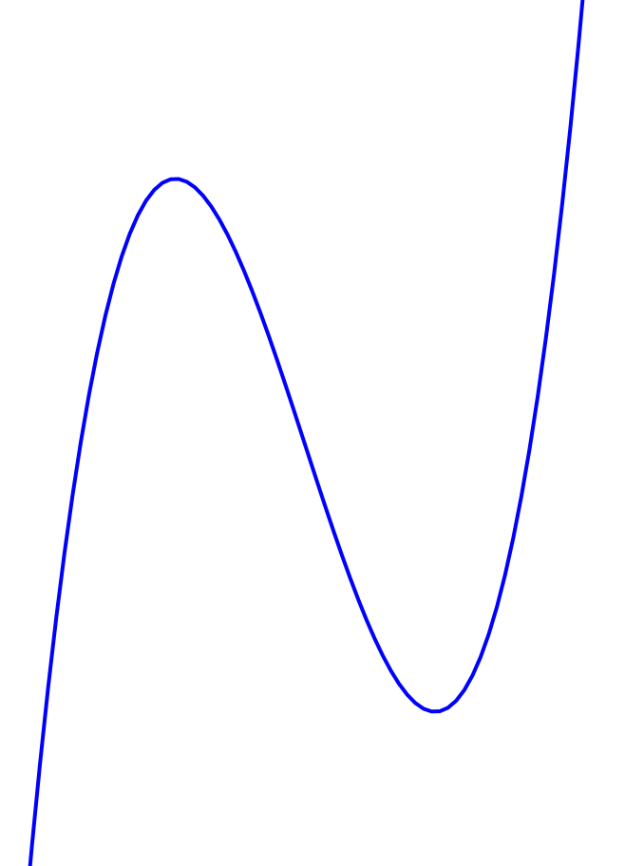
A Critical Aspects Tale continued
The task led to unanticipated Critical Aspects:
inflection tangent,
second derivative being zero (change of direction of tangent)
A second task emerged
  Imagine the graph of a quadratic equation.
  Through what angle can the graph be rotated,
  and still it is the graph of a function?
  What about a line?
  What about a cubic?

Slide 43
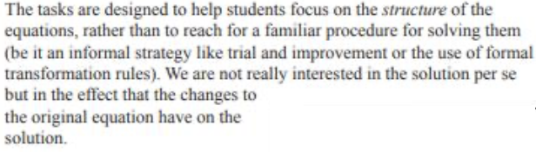
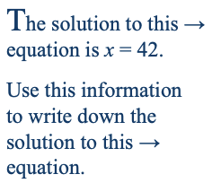

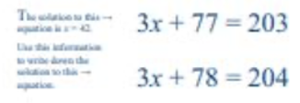
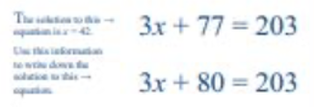
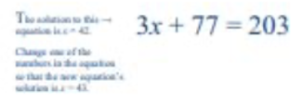
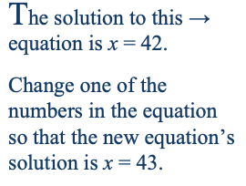
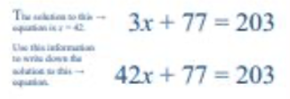
Prof Smudge Algebradabra

Slide 44
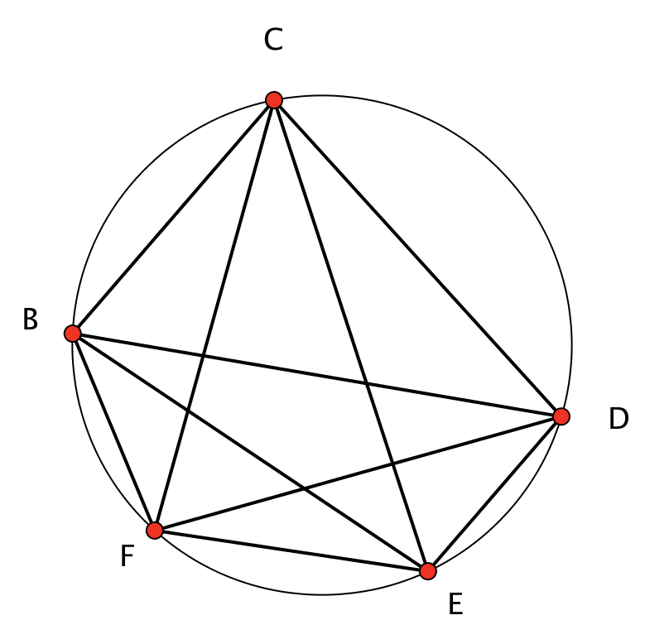
Subtended Angles
Find and describe three angles which are all subtended from the same chord.
Developing facility in recognising subtended angles before encountering a theorem about them
How few angles do you need to be told so as to work out all of the others?

Slide 45
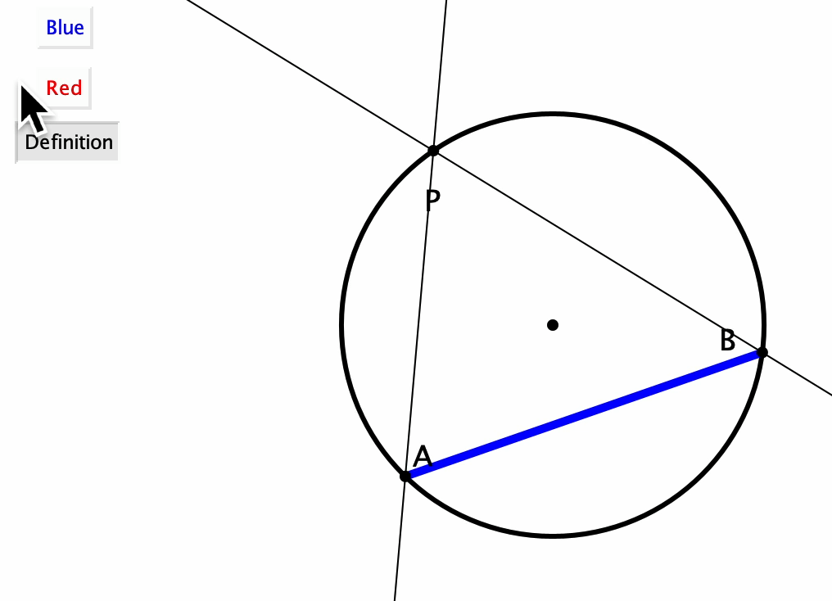
Subtended Angle Measuring

Slide 46
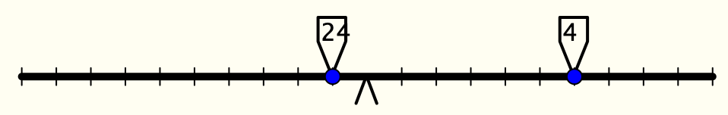
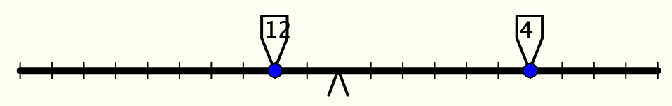




Fulcrum Reasoning
Critical Aspects?

Slide 47




More Fulcrum Reasoning
What relationship(s) are being preserved in order to maintain balance?

Slide 48

Double Fulcrum Reasoning
Here the arm has a mass of 2 units.
A mass on or between the fulcra can of course be removed without the bar tipping.
By carefully sliding the masses, can you arrange to clear all the masses from the balance, always keeping the arm from tipping?

