Slide 1
Technoleg ddigidol mewn addysgu mathemateg: newid y gweld a’r gweledigaeth Digital tech in mathematics teaching: changing the ‘see-scape’
Anne Watson
Abertawe /Swansea
mis Gorffennaf/July 2023
Notes:
Knowledge, culture, skills, and employability and industry and hence economy

Slide 2
Wales
…a 21st century powerhouse of new ways to see and learn mathematics - or more of the same?
Notes:
Why I wanted to talk about this in Wales
Small country: 3+ million
Loss and potential loss of 19th and 20th century industry
Communication necessary for collaborative change should be possible
Ground-up curriculum change had potential benefits: ownership, engagement, familiarity, mutuality
Ground-up change might have been restricted by day-to-day familiarity and constraints

Slide 3
Old maths taught through DT - old methods and pedagogy.
DT as substitute for chalkboard and textbook and teacher.
Notes:
Particularly after covid
Does this exercise engage with standard form?
Last one is More or less zero

Slide 4
Matrix Transformations – GeoGebra https://www.geogebra.org/m/P2nptPzP
Notes:
https://www.geogebra.org/m/P2nptPzP
Check matrix calculations is switched off
Start with some blanks to see original square
Gareth Daniels
Wwhat is poiissible? Exploration, new ideas, powerful thinking,
Cf. currrent uses of DT:
Firstly do reflection 0, -1, -1, 0
Then some others, not clear, use flag to see more about directions,m transformations
Some what if? Thinking, exploration in my power
Matrices not in curriculum? What is possible.

Slide 5
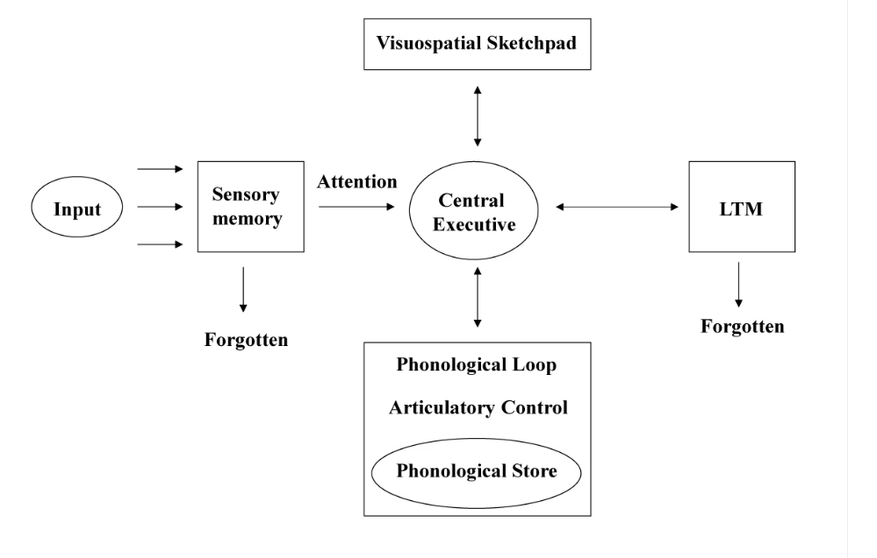
What does cognitive science say?
Baddeley, A. D., & Hitch, G. (1974). Working memory. In Psychology of learning and motivation (Vol. 8, pp. 47-89). Academic press.

Slide 6
Implications of going beyond:
Concrete, pictorial/representational, abstract
Enactive, iconic, symbolic
Manipulating, getting-a-sense-of, abstract

Slide 7
Decimal numberline
Fractions & Decimals - Promoting Mathematical Thinking (pmtheta.com)
http://www.pmtheta.com/fractions--decimals.html

Slide 8
Implications of going beyond:
symbolic
abstract
Concrete, pictorial/representational, abstract
Enactive, iconic, symbolic
Manipulating, getting-a-sense-of, abstract
animated
manipulative
material
enactive
diagrammatic
dragging
enactive
verbal
moveable
graphical
text
See-scape
auditory
Notes:
What have I shown you so far?
Pedagogy matters
Learning becomes conjecturing arising from questioning and experiment, and affirming by reasoning and building on previous knowledge

Slide 9
Some use of exploratory tools
Calculator Aware Number project (Shuard, H., Goodwin, J., Worcester, V., & Walsh, A. (1991). Calculators, children and mathematics: The calculator-aware number curriculum. Hemel Hempstead: Simon & Schuster.)
Computer Algebra System use in (e.g.) Denmark and Australia (Kissane, B. 1999 "The algebraic calculator and mathematics education." online: 123-132. forthcoming review by JMC)
Online manipulatives e.g. Mathsbot
Primary Laptop Project, (e.g. Ainley, J., & Pratt, D. (1995). Supporting Teachers’ and Children's Mathematical Thinking: a strategy for the effective use of information technology. Journal of Information Technology for Teacher Education, 4(1), 81-92.)

Slide 10
Primary Laptop Project
Year 6 laptops, using graphing software for experimental data, 1989/1990.
Mass and extension of spring, entering data in spreadsheet and exploring.
Relationships between variables: seeing them in real materials and seeing them graphically
Notes:
Ownership

Slide 11
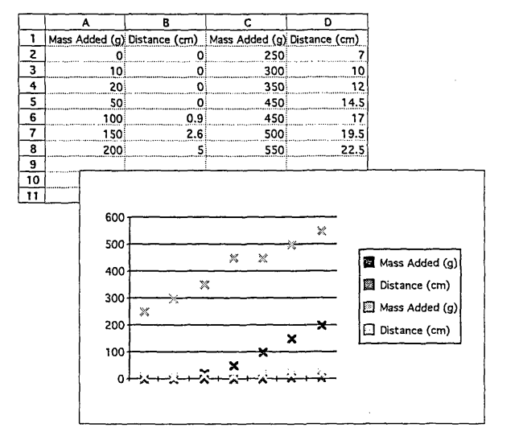
Mediation by teacher, what can be said (both get bigger together) and what cannot yet be said (how the ‘getting-bigger’s relate to each other).
Two kinds of knowledge: the mathematics (measures and axis scales) and the software (how it presents the data).
What is represented?
What are the relationships?
Notes:
Sarah’s graph of the rightmost two columns.

Slide 12
Relationships between variables
Seeing them in real materials and seeing them graphically
Notes:
Ownership

Slide 13
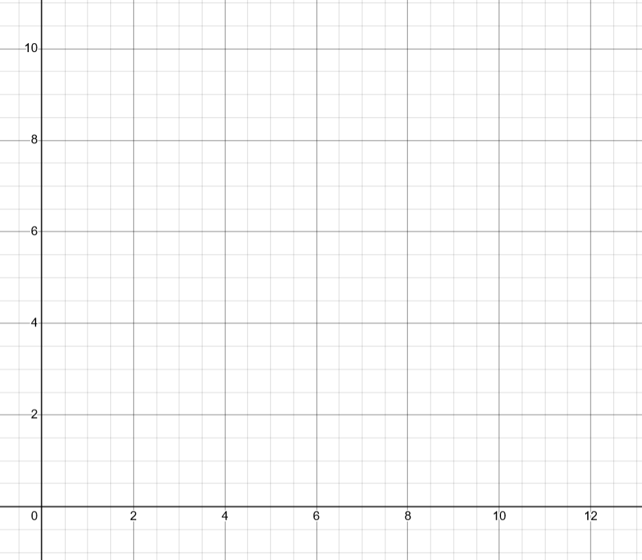
Are height and shoe size related?

Slide 14
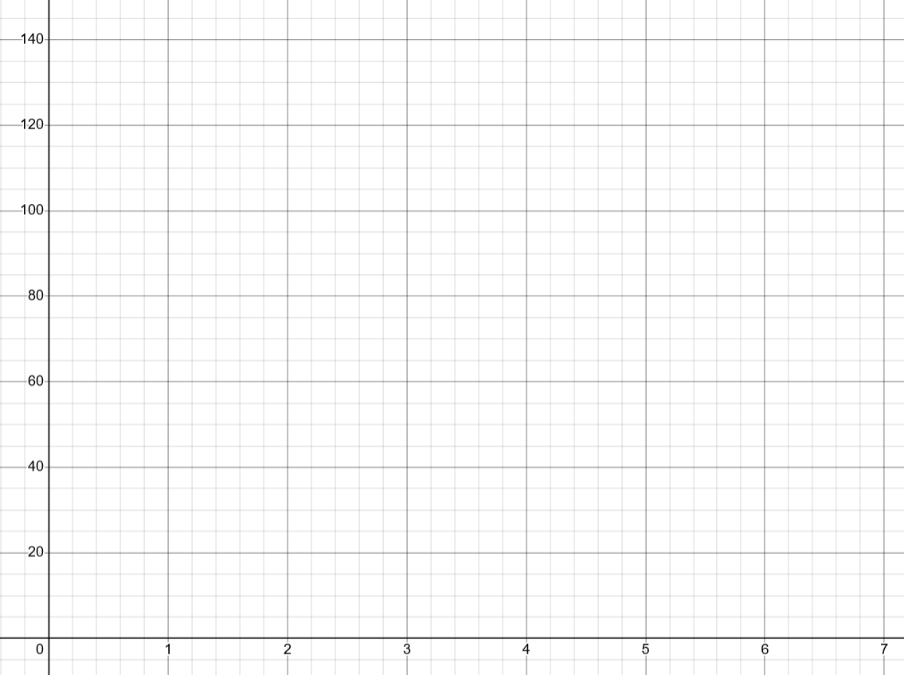
Are height and shoe size related?
Notes:
Why so many examples on internet plot foot size against height in the x-axis? Because the question they pose is whether foot size depends on height.

Slide 15
That’s me! (4,120)
Notes:
Why so many examples on internet plot foot size against height in the x-axis? Because the question they pose is whether foot size depends on height.
Go off into stuff about statistics, but instead could go into stuff about ordered pairs. Where is this person: (2, 100)? Where would this person be (7, 140)? Where would te teacher be? Why? Where would a teddy be? why?

Slide 16
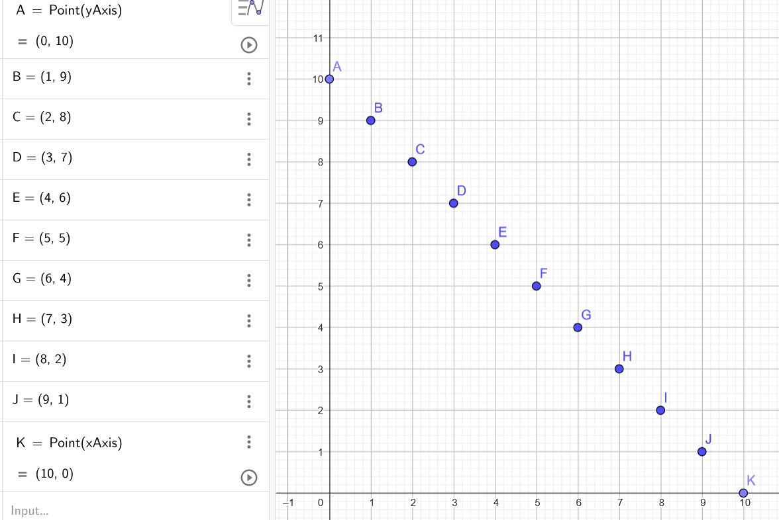
That’s me and Molly! (4, 6)

Slide 17
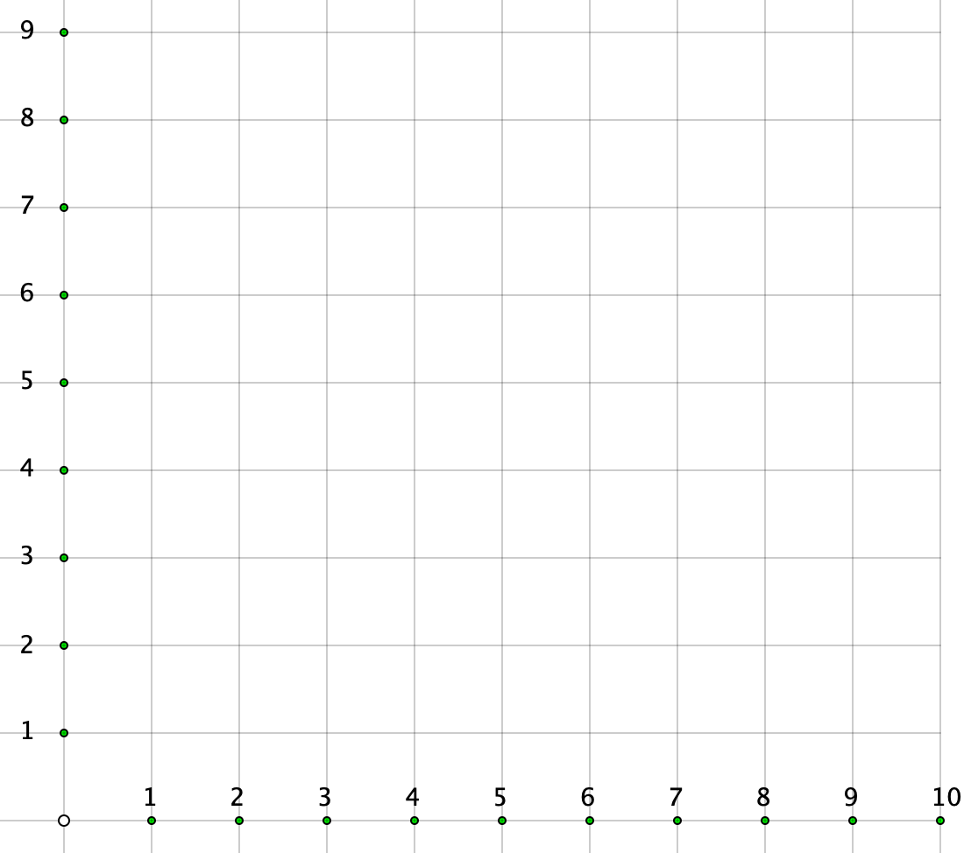
Sequences
Where am I? I was 6th in the line.
Notes:
Children’s prior experience of sequences can be expressed graphically
Is it ok to join the dots? y= –2x+10 as a function specified on the positive integers, but extendable

Slide 18
Implications of going beyond:
symbolic
abstract
Concrete, pictorial/representational, abstract
Enactive, iconic, symbolic
Manipulating, getting-a-sense-of, abstract
animated
manipulative
material
enactive
diagrammatic
dragging
enactive
verbal
moveable
graphical
text
See-scape
auditory

Slide 19
Relationships between variables
Connecting real materials to numerical data and then seeing the relationships graphically.
Representational competence.
Notes:
Ownership

Slide 20
What is meant by ‘representational competence’?
Visual understanding
Connection understanding
Visual fluency
Connection fluency
Meta competences: compare and choose
Two kinds of knowledge: the mathematics (measures and axis scales) and the software (how it presents the data).
What is represented?
What are the relationships?

Slide 21
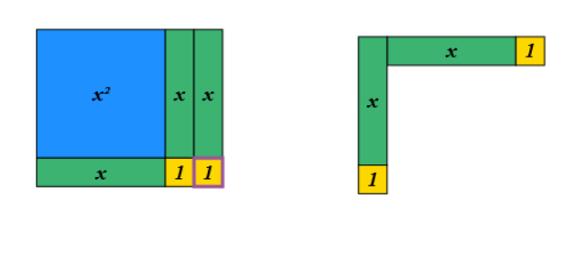
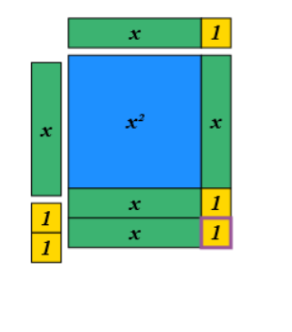
Representational competence or learning the software?
MathsBot

Slide 22
What is being lost or avoided if representational competence is not developed throughout school …?
Shaaron Ainsworth: connecting what you see, what you can change, what other changes take place, how changes in different registers interact
(e.g. Ainsworth, S. (2006). DeFT: A conceptual framework for considering learning with multiple representations. Learning and instruction, 16(3), 183-198.)
Martina Rau: representational competence, learning the representations and learning the mathematics – a symbiotic relationship
(e.g. Rau, M. A., & Matthews, P. G. (2017). How to make ‘more’better? Principles for effective use of multiple representations to enhance students’ learning about fractions. ZDM, 49, 531-544.)
Notes:
Not about using tech to teach same old topics and skills

Slide 23
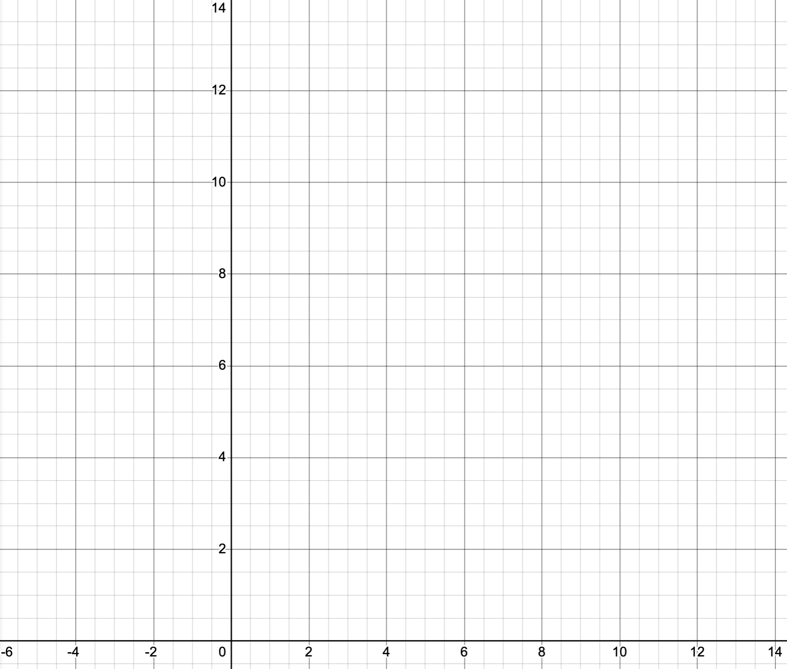
Seeing a graphical representation as a manipulative
What relationships are represented by the coloured lines?
Notes:
Issue of Discrete vs Continuous … when is it ok to join the dots?
Number bonds from KS1 so worth building on that experience
Extend the concept of number bonds to 3.7, 6.3, etc. and complements in general

Slide 24
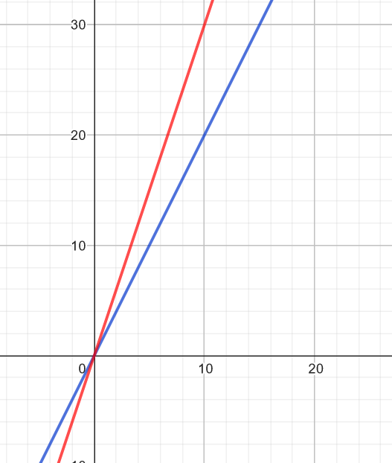
What relationships
are represented
by the coloured lines?
Seeing a graphical representation as a manipulative
Notes:
Any surprises?
Visual component of concept image can be powerful and informative

Slide 25
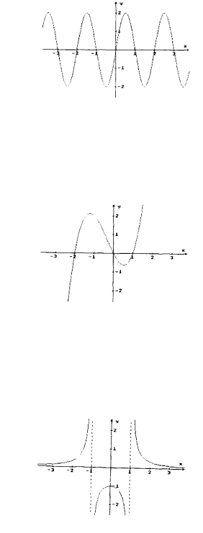
Ken Ruthven’s 1990 translation between graphic and algebraic forms

Slide 26
Translation between graphic and algebraic forms: exhibiting representational competence
Recognition/familiarity
Refinement for current situation, tweaking parameters (what if?)
Analytic construction/graphic trial (test)
Numerical trial, test with significant numbers (special cases)
A sense of ‘family’ groups from prior hands-on dynamic use (like what?)
Words, images, numbers/quantities, graphs, tracking change (so what?)
Notes:
Knowing the software is a starting point but not the endpoint; representational competence connects to mathematical concepts

Slide 27
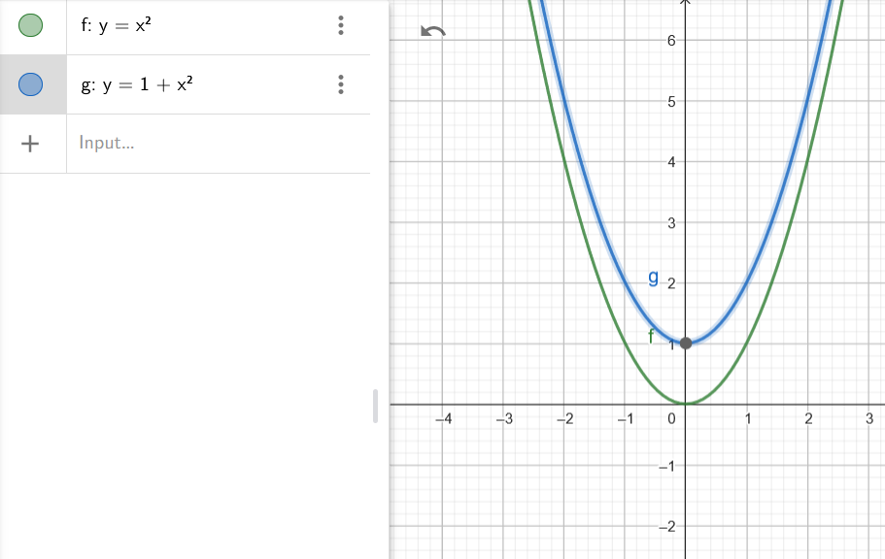
‘What if?’ explorations

Slide 28
‘What if?’ explorations
Seeing a graphical representation as a manipulative

Slide 29
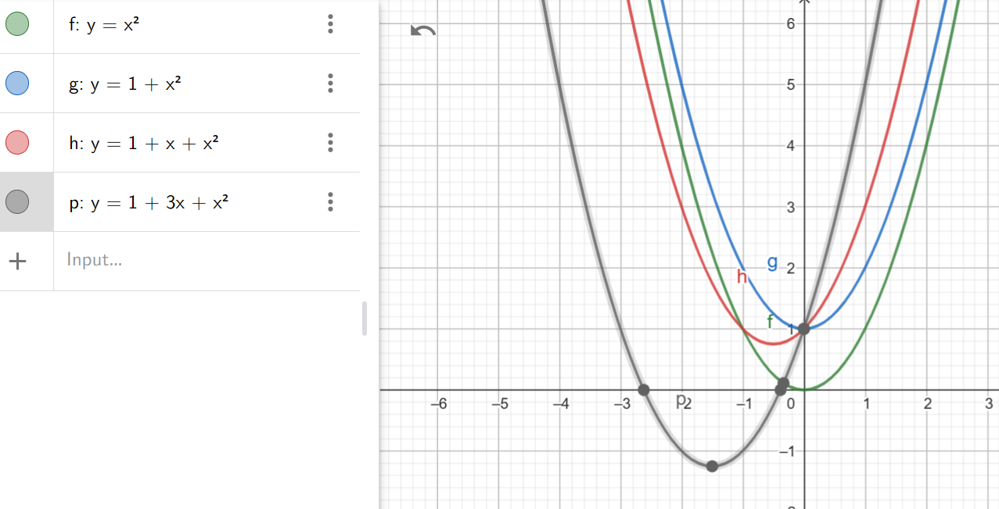
Seeing a graphical representation as a manipulative
The mathematical changes make the shape

Slide 30
What changes
if I change
the total?
What changes
if I change the x-values
by adding 2 to them all,
e.g. (x+2) + y = 10?
Notes:
Issue of Discrete vs Continuous … when is it ok to join the dots?
Number bonds from KS1 so worth building on that experience
Extend the concept of number bonds to 3.7, 6.3, etc. and complements in general

Slide 31
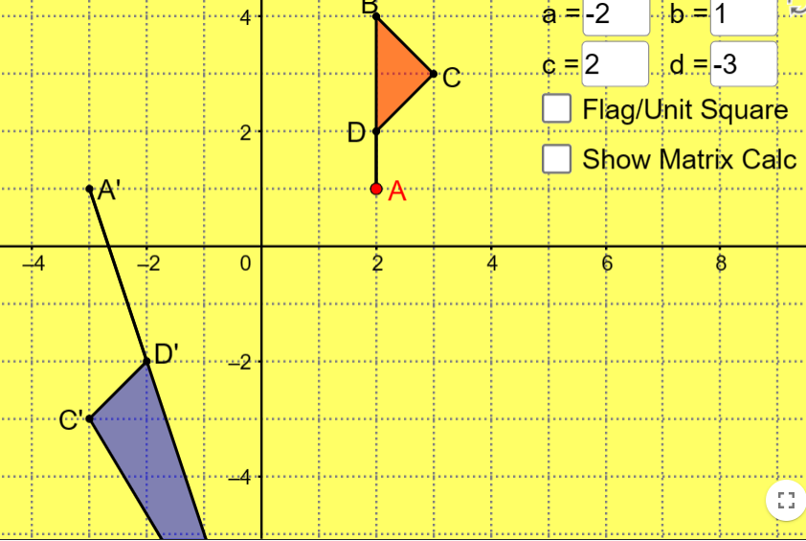

Slide 32
What is lost or avoided if we don’t expand the see-scape…?
New kinds of mathematical knowledge and learning and skills suitable for digitally-driven future
Notes:
Not about using tech to teach same old topics and skills

Slide 33
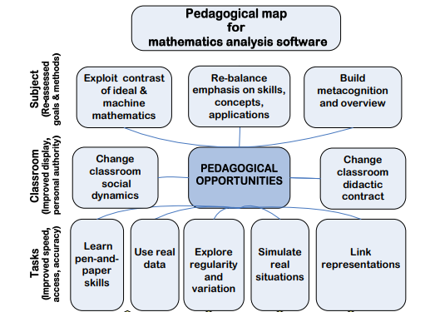
Pierce, R., & Stacey, K. (2010). Mapping pedagogical opportunities provided by mathematics analysis software. International Journal of Computers for Mathematical Learning, 15, 1-20.

Slide 34
Adapting the question
Not,
“How can I use DT to make children learn traditional curriculum better? “
But
“What mathematical ideas do people learn and create when given hands-on access and explanatory prompts for use with core visual digital tools?”
“What if the representation is not the end point of a task, nor the starting point of a task, but is the manipulable object that engages me with the concept?”

Slide 35
D'Souza, D., Brady, D., Haensel, J. X., & D'Souza, H. (2020). Is mere exposure enough? The effects of bilingual environments on infant cognitive development. Royal Society open science, 7(2), 180191.
… infants from bilingual homes may gather more information (sample more of their environment) by shifting their visual attention more frequently. … early bilingual adults are faster at disengaging attention to shift attention, and at noticing changes between visual stimuli, compared to late bilinguals.

Slide 36
Gobeithio fy mod wedi rhoi gweledigaeth ichi o
ddyfodol addysg fathemateg Cymru
I hope I have given vision to you for the
future of mathematics education in Wales

Slide 37
Follow-Up
PMTheta.com
the numberline can be found under: John > applets > fractions and decimals
annewatson1089@gmail.com

