Slide 1
Mathematical Pedagogy and Pedagogic Mathematics
Promoting Mathematical Thinking
John Mason
Phoenix
April 2016
The Open University
Maths Dept
University of Oxford
Dept of Education

Slide 2
Outline
Throat Clearing
Observing (noticing)
Observation invariant
Memory (experience) fragmented
Hanson, Goodman
Sensitising oneself to observe
Attention
Working on Your Own Teaching
Collecting actions (educating awareness)
Noticing opportunities (in retrospect, in prospect, in spect)
Assumptions made about human psyche
Cognition, affect, enaction, attention, will, witness

Slide 3
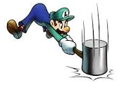
“Throat Clearing”
Everything said here is a conjecture …
… to be tested in your experience
My approach is fundamentally phenomenological … I am interested in supporting people to become aware of their lived experience.
So, what you get from this session will be mostly …
… what you notice (noticed) happening inside you!
Central role of attention:
… What is being attended to?
… How st it being attended to?

Slide 4
Definitions
Mathematical Pedagogy
Strategies for teaching mathematics;
Useful constructs
Frameworks consisting of useful distinctions
Mathematical Didactics
Tactics for teaching specific mathematical topics or concepts
Pedagogical Mathematics
Mathematical explorations useful for, and arising from, pedagogical considerations
Notes:
My approach to maths edn is based on my experience in mathematics, and is experiential:
Let’s start our pedagogical considerations with our own experience. (if only’s)

Slide 5
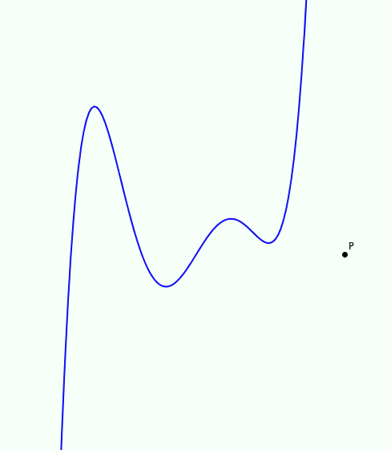
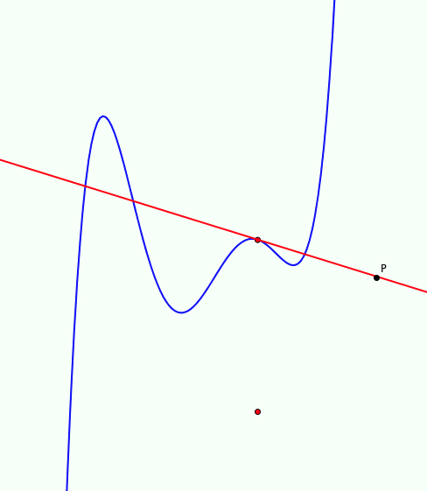
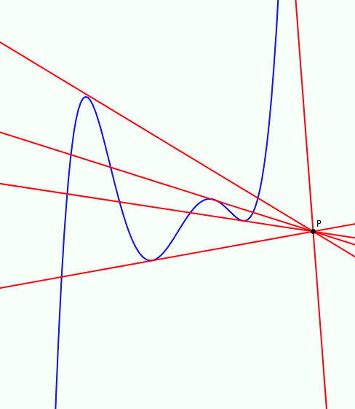
Tangent Power
The tangent Power of a point P with respect to a twice differentiable function f is the number of tangents to f through P.
Dual perception:
Lines through P rotating to tangency positions
Tangents to f running along the curve
Notes:
Parking so as to Gaze
Imagery
Choice of actions
Immersed in repetition

Slide 6
Mid-Points of Chords
What is the locus of mid-points of chords of a polynomial?
Specialise!
What about a quadratic?
What about a cubic?
Power of a dual perception
Arbitrary chords
One end varying, one end fixed
Chord width varying, midpoint x-coordinate fixed

Slide 7
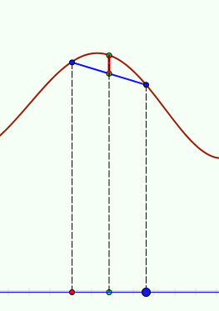
Chordal Gaps
Imagine the graph of a polynomial
Imagine a chord on it
Imagine the mid-point of the chord
Imagine the vertical segment between that mid-point and the curve
What can be said about this mid-point-gap?

Slide 8
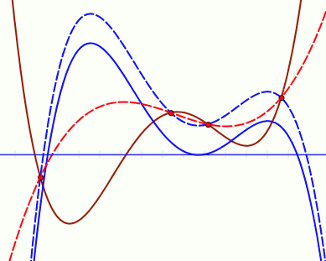
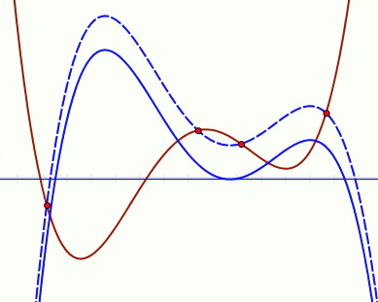
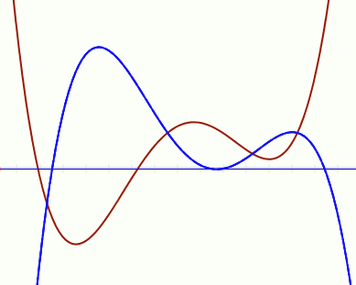
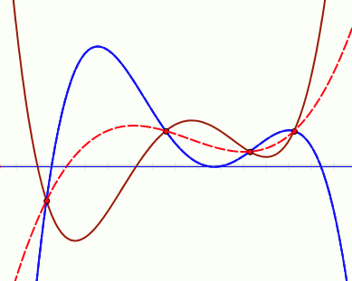
Poly Shifts
Here are the graphs of two polynomials of degree 4
They intersect in 4 points
There is a unique cubic through those four points
Translate the blue poly vertically
How will the poly through the intersection points change?

Slide 9
Opportunities
Attention
Gazing (holding wholes)
Discerning Details
Recognising Relationships
Perceiving Properties
Reasoning on the basis of agreed properties
Powers
Imagining & Expressing
Specialising & Generalising
Conjecturing & Convincing
Organising & Classifying
Themes
Invariance in the midst of change
Doing & Undoing
Dual Perceptions
Fixed end & fixed width chords
Tangent thru a point & Line thru a point as tangent

Slide 10
Opportunities
Pedagogic Strategies
Own-explanations & personal-narratives
Say What You See (SWYS)
Enactive-Iconic-Symbolic
Manipulating–Getting-a-sense-of–Articulating
(Babbling & Gargling)
Educating Awareness
Internalising actions
Harnessing Emotions
Surprise & Intrigue
Desire & Disposition
Training Behaviour
inflexible
Tasks
As introduction
For encounters with concepts
As revision (releasing attention)
As assessment
Dual Perceptions
Fixed end & fixed width chords
Tangent thru a point & Line thru a point as tangent
Variation Theory
What is available to be learned is what is varied in local time and space
Immersion & repetition

Slide 11
Some Follow Up
www.PMTheta.com
john.mason@open.ac.uk
Thinking Mathematically (1982/2010, Pearson)
Designing & Using Mathematical Tasks (2004, Tarquin)
Mathematics Teaching Practice (2002, Elsevier)
Questions & Prompts for Mathematical Thinking (ATM Derby 1998)
Thinkers (ATM Derby 2004)

Slide 12
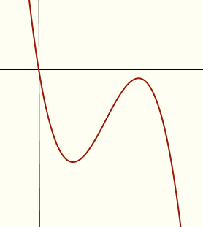
Constrained Construction
Sketch the graph of a cubic polynomial which goes through the origin
and which also has a local maximum
and which has only one real root
and which also has a positive inflection slope
Note the task structure: use of constraints to challenge usual/familiar examples
What combinations of
Local maximum or not;
Numbers of real roots;
Sign of inflection slope;
are possible?
Notes:
Extending and enriching accessible example spaces

Slide 13
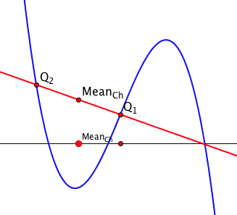
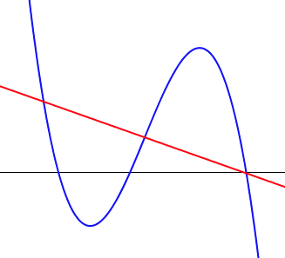
Cubic Phenomenon
Imagine the graph of a cubic polynomial
Imagine a chord and mark its mid-point x-coordinate
Now imagine other chords whose mid-points have the same x-coordinate

Slide 14
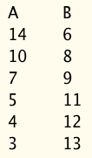
Proizvolov’s Relation
Write down a starting number, s
Now write down the eleven numbers s+1, s+2, … s+11.
3, 4, 5, 6, 7, 8, 9, 10, 11, 12, 13, 14
Now circle 6 of your numbers Put them in a column (A) in descending order going down
Put the other 6 numbers in a column (B) beside A, in ascending order going down.
Sum the absolute value of the differences
Because you too have 36

Slide 15
Some Slogans
A lesson without the opportunity for learners to generalise (mathematically) is not a mathematics lesson
Try to do for learners only what they cannot yet do for themselves
Teaching takes place in time; learning takes place over time.
Sleep is to the hunter what excitement is to students
Wounds are to a patient what assessment is to students
Seek opportunities for learners to make mathematically significant choices for themselves
Moving from learners assenting to learners asserting

Slide 16
Learning-Teaching Tensions
Procedural & Conceptual ...
Instrumental & Relational ... (Skemp)
Surface & Deep ...
Syntactic & Semantic ...
Metonymic & Metaphoric
Didactic Tension
... approach
... understanding
... competence
... appreciation
Holisitic ––> Strategic studying
Holisitic ––> Strategic studying
The more clearly the teacher indicates the behaviour sought, required or expected,
the easier it is for learners to display that behaviour without generating it from themselves
Notes:
Which we will come to later

Slide 17
Reflection
In what ways have you been acting procedurally, instrumentally, syntactically, metonymically?
In what ways have you been acting conceptually, relationally, semantically, metaphorically?
How would you describe your approach on a scale of surface ---- deep?
Notes:
Distinctions in mathematics education are rarely along ‘natural cleavage lines’.
There is often a fuzziness which carries power as well as the potential weakness,
analogous to the multiple use of notation and the use of specific terms as generalities in mathematics.

Slide 18
Exemplification Paradox
In order to appreciate a generality, it helps to have examples;
In order to appreciate something as an example, it is necessary to know the generality being exemplified;
so, I need to know what is exemplary about something in order to see it as an example of something!
What can change and what must stay the same, to preserve examplehood?
Concept Image
Example-Space

Slide 19
Pedagogical Issues
what examples to show learners?
what needs to be done with learners for them to appreciate what is exemplary?
Where does their attention need to be?
How can one probe learners’ sense of examplehood, effectively?
Dimensions of possible variation
Range of permissible change
Invariance in the midst of change
Notes:
OMIT NEXT SLIDE: JUMP TO 16

Slide 20
Conjecture
When learners construct their own examples of mathematical objects they:
Extend and enrich their own example spaces
Become more engaged with and more confident about their studies
Make use of their own mathematical powers
Experience mathematics as a constructive and creative enterprise
Are therefore more likely to function ‘mindfully’
Notes:
‘Mindful’ learning means greater likelihood of access in the future, being able to reconstruct for oneself when need be, …
(Elaine Langer)

Slide 21
Observations
Learners often depend on visual images which may be misleading.
Learners are developing their example spaces and building concept images
To ‘enrich my example space’ means:
Not just ‘more examples’ (cf practice)
but also Explicit Construction Tools
and organisation-categorisation of the space (abstraction; structural awareness)
Tasks and Activity are not sufficient for learning!
Notes:
What does it mean to ‘enrich’ an example space?
not only add more examples’ but become aware of ‘construction tools’

Slide 22
Tasks & Teaching
Tasks are only a vehicle for engaging in mathematical thinking
Learners need to be guided, directed, prompted, and stimulated to make sense of their activity: to reflect
To manifest a reflection geometrically as a rotation, you need to move into a higher dimension!
The same applies to mathematical thinking!

Slide 23
Procedural-Instrumental Conceptual-Relational
Human psyche is an interweaving of behaviour (enaction) emotion (affect) awareness (cognition)
Behaviour is what is observable
Teaching:
Expert awareness is transposed into instruction in behaviour
The more clearly the teacher indicates the behaviour expected, the easier it is for learners to display it without generating it from and for themselves
transposition didactique
didactic tension

Slide 24
Pedagogic Structure of a Topic/Concept
Awareness: concept images, example spaces; obstacles
Behaviour: language patterns; techniques, procedures & incantations
Emotions: root problems; dispositions; other uses
Three interwoven strands corresponding to three strands of the psyche:
behaviour (enaction) affect (emotion) cognition (awareness)

Slide 25
Probing Awareness
What is meant by ‘conceptual understanding’
Conceptual appreciation?
Conceptual comprehension?
How might a learner display this?
How might we probe for this?
Justifying or explaining 'as if to a peer’
Developing a personal narrative; “self-explanation”
Withdrawing from the action so as to ‘reflect’

Slide 26
Reconceptualising Assessment
Opportunity to display evidence of becoming a ‘pro’:
Production of examples and counter-examples, conjectures and justifications;
Proficiency in carrying out specific techniques;
Profundity & Profusion of concept images, example spaces; appreciation of mathematical themes, heuristics and interconnectivity;
Propensity to pose problems, make and test conjectures, and to see opportunities for mathematical thinking outside of mathematics;
Probing of own awareness of concepts, definitions, theorems, etc.;
Processing unfamiliar mathematics;
Promoting mathematical thinking among others;
Progress in all of these.
Notes:
I am aware of the stimulating work being done through PIMS in the area of applied mathematics particularly.
I am suggesting that mathematics seen as a creative enterprise is NOT the preserve of the really dedicated learners
Indeed, many more learners might become more dedicated if they were encouraged to take a creative stance,
To make mathematically significant choices in EVERY LESSON!

Slide 27
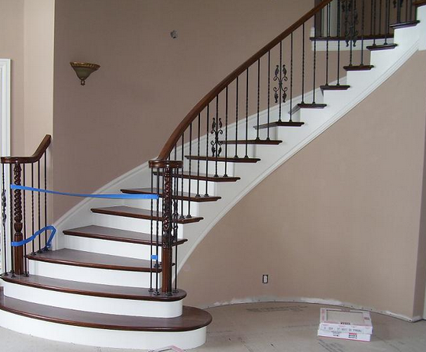
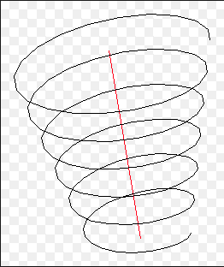
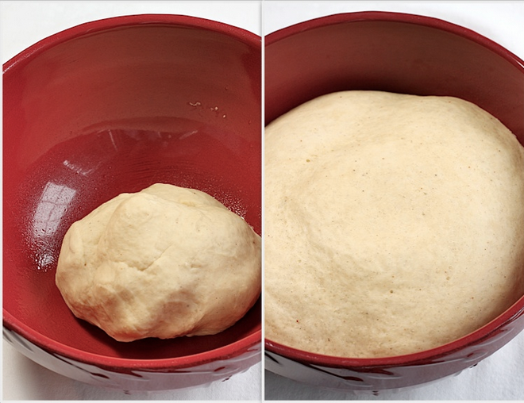
Conceptions of Learning
Staircase
Spiral
Maturation

Slide 28
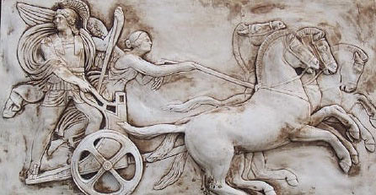
Human Psyche
Intellect (cognition)
Imagery
Attention & Will
Emotions (affect)
Body (enaction)
Habits Practices

Slide 29
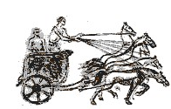
Structure of a Topic
Language Patterns & prior Skills
Imagery/Sense-of/Awareness; Connections
Root Questions
predispositions
Different Contexts in which likely to arise; dispositions
Standard Confusions & Obstacles
Techniques & Incantations
Emotion
Awareness
Behaviour
Only Emotion is Harnessable
Only Awareness is Educable
Only Behaviour is Trainable
Only Attention can be Directed

