Slide 1
Finding Meno
Anne Watson
MA conference
Oxford 2016
University of Oxford
Dept of Education
PMTheta

Slide 5
What did the slave know already?

Slide 6
Notes:
Tiree Argyll and Bute

Slide 7
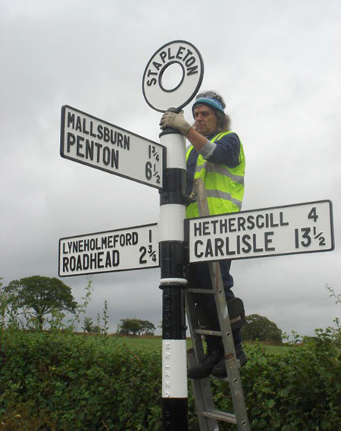

Slide 8
What did you need to know already?

Slide 9
Radii are equal in length
Radius is perpendicular to tangent at the point of tangency
Base angles of an isosceles triangle are equal
A triangle whose base angles are equal is isosceles

Slide 10
Express the radius of the bigger circle in terms of the other two radii

Slide 12
What did Socrates say about learning?
Learning is recall
Questioning brings innate knowledge to the fore, or enables us to appreciate its limits

Slide 13
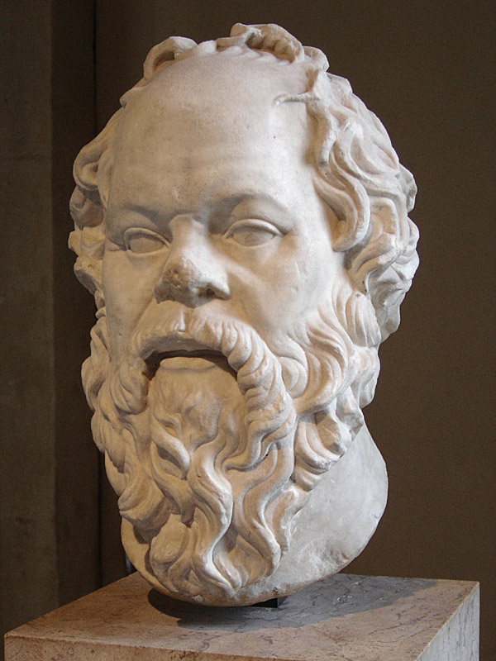
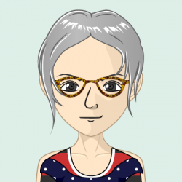
Sorted
How?

Slide 14
Inspiring teachers

Slide 15
What is knowledge in school mathematics?
Most knowledge is abstract (like virtue); most knowledge we learn through examples of new ideas (generalising/inductive reasoning) and/or reasoning from what we already know (deductive/abductive reasoning).

Slide 17
y = x

Slide 18
What observations have you made?
What questions have you asked yourself?
How did you learn to make those observations and ask those questions?
How do you want to proceed?
What other ways to proceed might there be?

Slide 19
y = x
2y + x = 3

Slide 20
What if y = 2x?

Slide 21
y = 2x
2y + x = 3

Slide 22
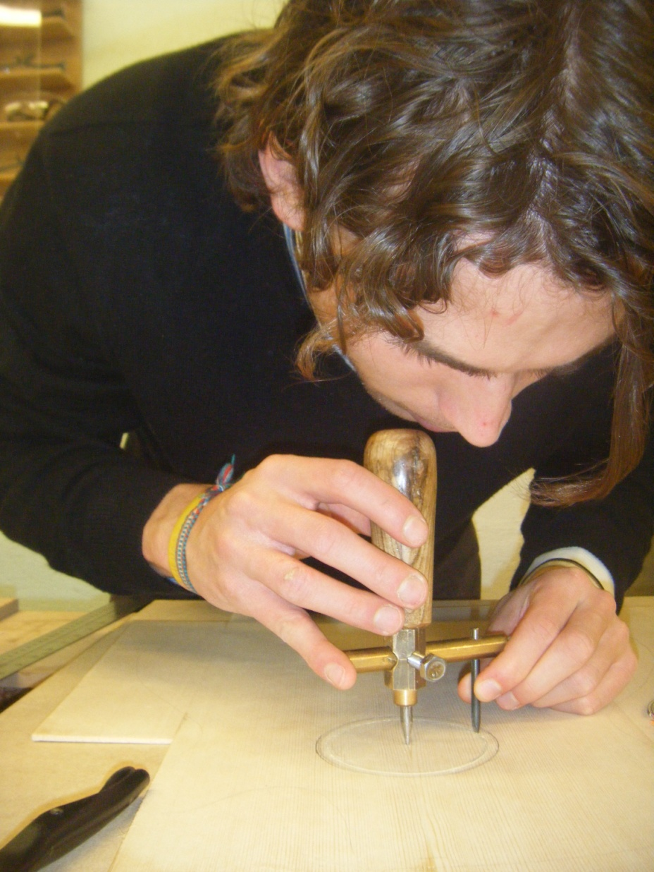

Slide 23
Where’s Meno?
What can we learn from Meno?

Slide 24
Socratic method
is a form of discussion based on asking and answering questions to stimulate critical thinking and to illuminate ideas so that the student comes to know a new idea, or comes to appreciate the limits of knowledge, by ‘merely’ answering questions (‘yes/no’ might not be sufficient)
models deductive reasoning; starts with something to resolve

Slide 25
What questions?
“we don’t have time”
“it is not in the test so we won’t do it”
“the awarding bodies do not really test reasoning”
“we cannot do it with all students, only the highest attaining”
“not all teachers know how to do this”

Slide 26
Where’s Nemo?
What can we learn from Nemo?

Slide 27
Keep swimming!
Swim together
Professional associations

Slide 28
Keep swimming
annewatson1089@gmail.com
Pmtheta.com
(Promoting Mathematical Thinking)

