Slide 1


Learning to Notice in order to act
Freshly
Ghana Webinar
June
2023

Slide 2
Ways of Working
I am interested in the lived experience
  of doing mathematics,
  of thinking mathematically,
  of teaching mathematics
  of supporting people who wish to support and foster mathematical thinking in others
Consequently I am going to offer you some tasks
through which, and on the basis of which,
I can make some observations about noticing and about attention
Everything said, especially by me, is to be taken as a conjecture
to be tested in your experience
These slides will be on my website after the session

Slide 3
Retro-spective – Pro-spective – Spective
Have you ever finished a lesson and wished that you had acted differently?
  I was interacting with one of my grandsons recently,
  and suddenly realised that when he asked me for help,
  I had told him what to do,
  rather than enquiring into his thinking.
Have you ever intended, when planning,
to initiate some pedagogical action,
then forgotten all about it in the moment?
The Discipline of Noticing is designed to
  Sensitise oneself to the possibility of acting freshly
  Make it more likely that a suitable action becomes available when needed
  Turn this work into a respected research activity
Retrospectively recognising
Imperative Pedagogy:
telling learners what to do
In the session last month,
focus was on one particular
kind of situation in which noticing is vital
Here is an opportunity
to try to catch
how your attention works
Learner’s response to a task

Slide 4
Adjustments
You have 43 paper clips and I have 27.
How many must you give to me so that you have only 4 more than I do?
Strategy 1
Strategy 2
Strategy 3
0
43 – 27 = 16
43 – 27 = 16
43 + 27 = 70
1
42 – 28 = 14
(43-8) – (27+8) = 0
70/2 = 35
2
41 – 29 = 12
(43-6) – (27+6) = 4
35 – 35 = 0
…
…
37 – 33 = 4
37 – 33 = 4
6
37 – 33 = 4
Give John 6
Give John 6
Give John 6

Slide 5
Attention
Conjecture:
  An initial phase of gazing at the screen
  For each strategy in turn, initial gazing as details revealed,
  Then discerning details in what is revealed,
  perhaps relating to own experience
  or checking calculations
  Recognising relationships between steps in a strategy;
  how the ‘answer’ is found in the working
  Below the surface is a personal narrative as to what the strategy is (cf looking at children’s work)
  Perceiving properties (generality) Can you see how to use each strategy for other differences? For other constraints?
  Does it always work?
  What is the same and what different about the three strategies?
  (relationships between strategies)

Slide 6
Adjustments
You have 43 paper clips and I have 27.
How many must you give to me so that you have only 4 more than I do?
Strategy 1
Strategy 2
Strategy 3
0
43 – 27 = 16
43 – 27 = 16
43 + 27 = 70
1
42 – 28 = 14
(43-8) – (27+8) = 0
70/2 = 35
…
…
35 – 35 = 0
(43-6) – (27+6) = 4
6
37 – 33 = 4
37 – 33 = 4
37 – 33 = 4
Give John 6
Give John 6
Give John 6
What can be changed and still use the same method?
If you were to help
a colleague or learner,
what pedagogical actions
might be useful?
What relationships must hold between starting numbers and final difference?
What properties must hold for an answer to be possible??
What if you are to have 4 more than twice as many?

Slide 7
More on Attention
I conjecture that very early on you asked yourself
  “Could I use this with my learners?”
  ”Why would I choose to use this type of task?”
Noticing
opportunity for learners to encounter being systematic
opportunity to promote generalisation
opportunity to promote learners constructing their own variations

Slide 8
Inserting
Find three different numbers (as fractions) between 7/4 and 8/5
Conjecture:
  when you first saw the task, you gazed at the two fractions.
  At some point you saw them as numbers, and guessed which was the larger (did you check?)
  You wondered how to find fractions in between
  You may have contemplated converting to decimals
Conjecture:
  At some point a mathematical action became available
  something to do with discerning finer distinctions,
  to create more fractions (increase the denominators)
  with a ‘sense’ of how that produces the desired numbers.
There are several strategies that tend to come to people

Slide 9
Inserting
Find three different numbers (as fractions) between 7/4 and 8/5
Strategy 1
Strategy 3
8/5 = 32/20
7/4 = 35/20
8/5 < 15/9 < 7/4
So 33/20, 34/20,
and their mean 67/40
So 8/5 < 23/14 < 15/9 < 22/13 < 7/4
Strategy 2
Strategy 4
8/5 = 32/20
7/4 = 35/20
7/4 – 8/5 = 3/20
Mean is 67/40
Need 3 numbers between,
so 1/20 not big enough gap
So 8/5 < 67/40 < 7/4
8/5 + 1/40 = 65/40
8/5 + 2/40 = 66/40
8/5 + 3/40 = 67/40
Use means again
So 8/5 < 131/80 < 67/40 < 137/80 < 7/4
Which strategy uses the smallest possible denominators?
Always?

Slide 10
Inserting
Find three different numbers (as fractions) between 7/4 and 8/5
Strategy 1
Strategy 3
8/5 = 32/20
7/4 = 35/20
8/5 < 15/9 < 7/4
So 33/20, 34/20,
and their mean 67/40
So 8/5 < 23/14 < 15/9 < 22/13 < 7/4
Conjectures
How might learner attention be drawn to these as possible actions?
Strategy 2
With each reveal …
Moment of gazing
8/5 = 32/20
7/4 = 35/20
Mean is 67/40
Discerning detail
Begins with your noticing your own attention (what and how)
So 8/5 < 67/40 < 7/4
Recognising relationships
Use means again
Perceiving properties
So 8/5 < 131/80 < 67/40 < 137/80 < 7/4
Reasoning with properties

Slide 11
Attention Summary
Noticing arises from a shift of attention
Different States
Holding Wholes (Gazing)
NOT cyclic
NOT in specific order
NOT levels
Discerning Details
Recognising Relationships
Perceiving Properties
Interpreting
Reasoning on the basis of properties
Responding
Considerately
Automatically

Slide 12
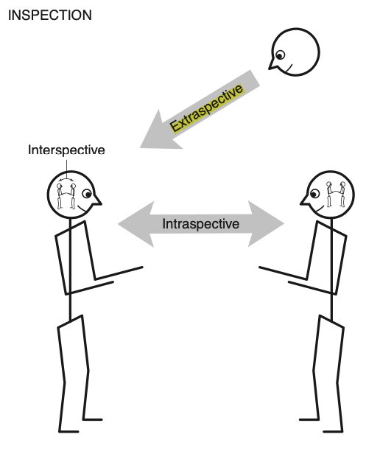
Types of Research

Slide 13
Say What You See
A 12 year old was asked to talk about the expression 3x + 6:
  “3 is an odd number, and I don’t like odd numbers. 6 is ok, ‘cos it’s even.
What do you make of this incident?
No reference to the x
No reference to the +
What can be said of what is being attended to?
The x and the + may have been overlooked (not-noticed)
or
the pupil may not have known what to say about them
or
didn’t see them as being as important as the numbers
Emotions guiding and focusing attention

Slide 14
Say What You See
Applies to
Recognising
mathematical patterns
Recognising learner’s behavioural patterns
Recognising opportunities afforded by tasks
Recognising possible
pedagogic actions
Brain as predicter of imminent action
Gestalt tendency to ‘fill in’ or ‘complete’
Recognising possible use as research data
Notes:
Seeing what is not there

Slide 15
Is 51 + 51 = 50 + 52?
How do you know?
What is Fran attending to?
Fran: Like fifty-one plus fifty-one are one hundred and two, but fifty-one, if you subtract fifty, you can add to fifty-one, one from the other, one more, and you get fifty-two.
Teacher-Researcher: Ah, that is interesting. You said that you can take one from here [pointing to the first fifty-one] and add it to this one [pointing to the second fifty-one]. Isn’t it? Is that what you said?
Fran: And you get there, one hundred… fifty plus fifty-two.
How is her attention shifting?
Babbling or Gargling?
What is being attended to?
Listening-to or
listening-for?
Teaching Action:
selecting/editing
What is Fran attending to?
Notes:
Mason, J. (2012). You Can Lead a Horse to Water…: Issues in Deepening Learning Through Deepening Teaching. In S. Hegedus & J. Roschelle (Eds.) Democratizing Access to Important Mathematics through Dynamic Representations: Contributions and Visions from the SimCalc Research Program. Berlin: Springer-Verlag.
Nicolina Malara; Brent Davis

Slide 16
Observing a 7 year old with two adults
Adult 1
  Grandad is 79 years old. Can you work out when he was born?
Child:
  Thinks briefly, then announces “2040?”
Adult 2
  Pretend Grandad is 80
Child:
  Thinks briefly, then announces “1940?”
Adult 1:
  What is 100 take away 80?
Child
  20
What is each adult
attending to?
What happens to child’s attention?
Each act of teaching is an intervention in
the learners’ attention
The adult’s questions
are instructions
but do not reveal to the learner
how the question arose
Teacher attention may be on general method
Learner attention can only be on specific questions

Slide 17
Negative, Positive, and Neutral Attending
Hearing and seeing what is negative (wrong) in what someone says or does (focus is on should be: deficit)
  In contrast to thoughts in own head
  Distinction/difference is what catches attention
  Hard not to follow with corrective action (imperative, negatively directed inquisitive pedagogies)
Hearing and Seeing what is positive in what someone says or does (focus is on what could be: potential)
  When aligned with own thinking, can lead to imperative or directively inquisitive pedagogies
  When not aligned, opens possibility for genuine enquiry and listening pedagogies
Minimizing judgement of what someone says or does
(focus is on what is)
  Opens possibility for genuine enquiry and listening pedagogies
  Colleagueal: Learner does not feel judged
What would I have to be attending to
that would lead me to say or do what the learners has said or done?
Classroom ethos

Slide 18
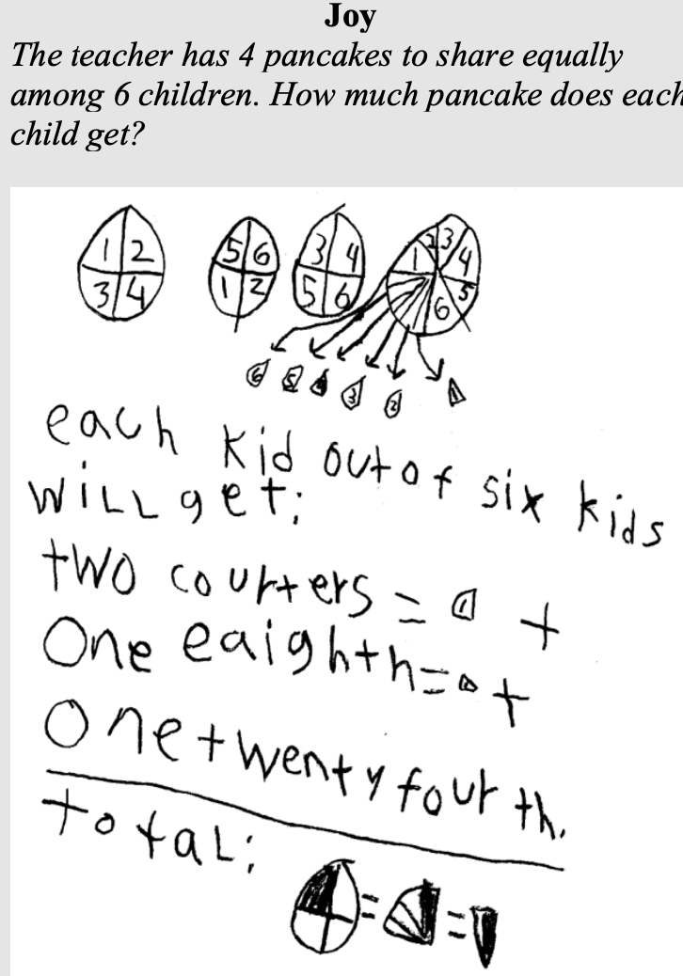
From Previous Webinar
Noticing
Interpreting
Responding
What would you be attending to,
if you did what this person did?
How might you be attending to it?
Very often something you notice
triggers an action.
In between there has been
either resonance (often metaphoric)
or association (metonymic)
What pedagogic actions might draw learner attention to
important aspects?
An action becomes not just available,
but is enacted
The Discipline of Noticing
is intended to
help trap automatic actions and
make other actions become available

Slide 19
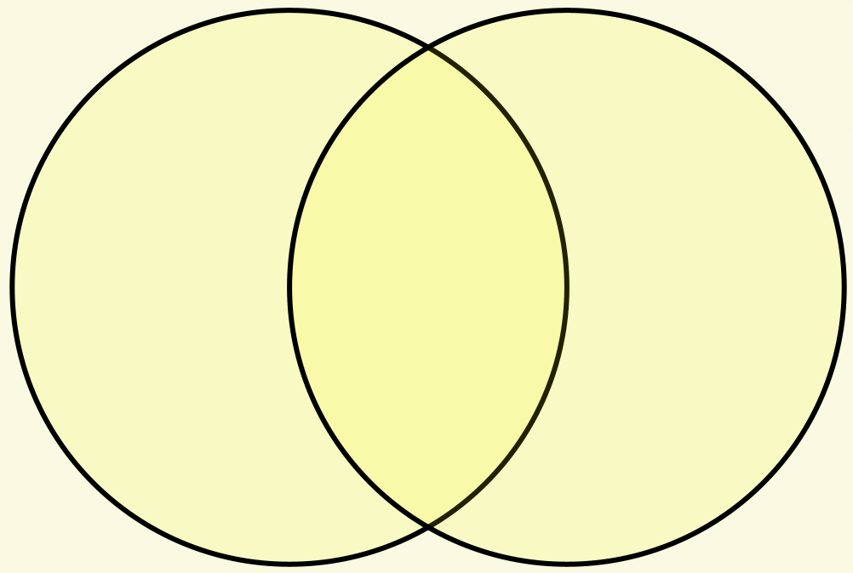
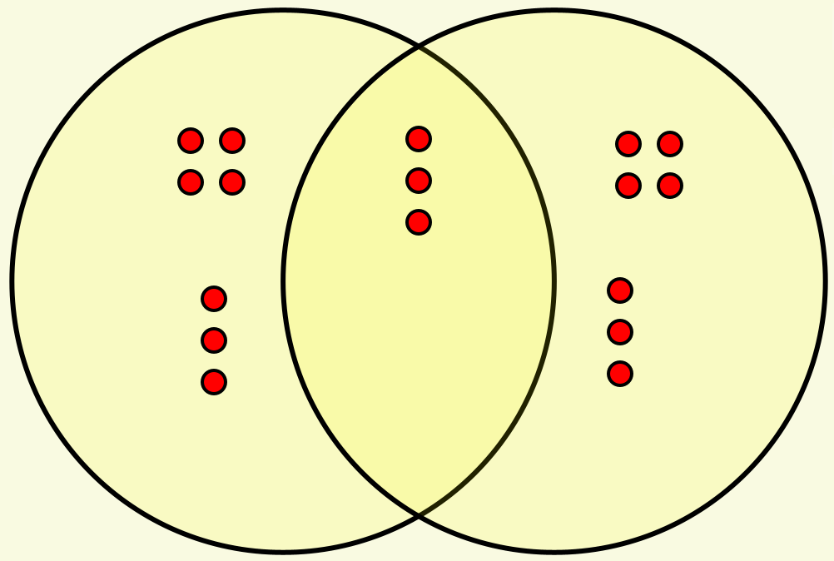
Set Ratios
Two overlapping sets. In how many different ways can 17 objects be allocated to the sets so that there are the same number of objects in the two sets?
For example
Set A
Set B
overlap
Mathematical Action 1
Try putting objects in more or less at random
What is the role of ‘17’?
Mathematical Action 2
Pause to think about necessary relationships
What else could it be?
Mathematical Action 3
Simplify the work: change 17 to 7?
What actions helped?
Mathematical Action 4
Switch to working systematically

Slide 20
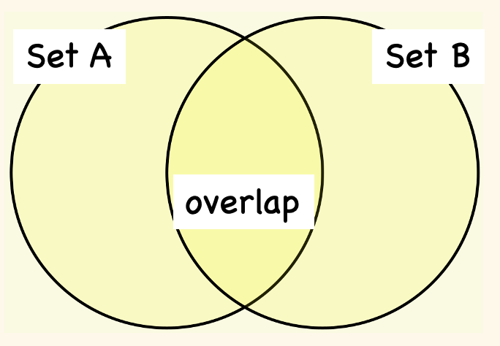
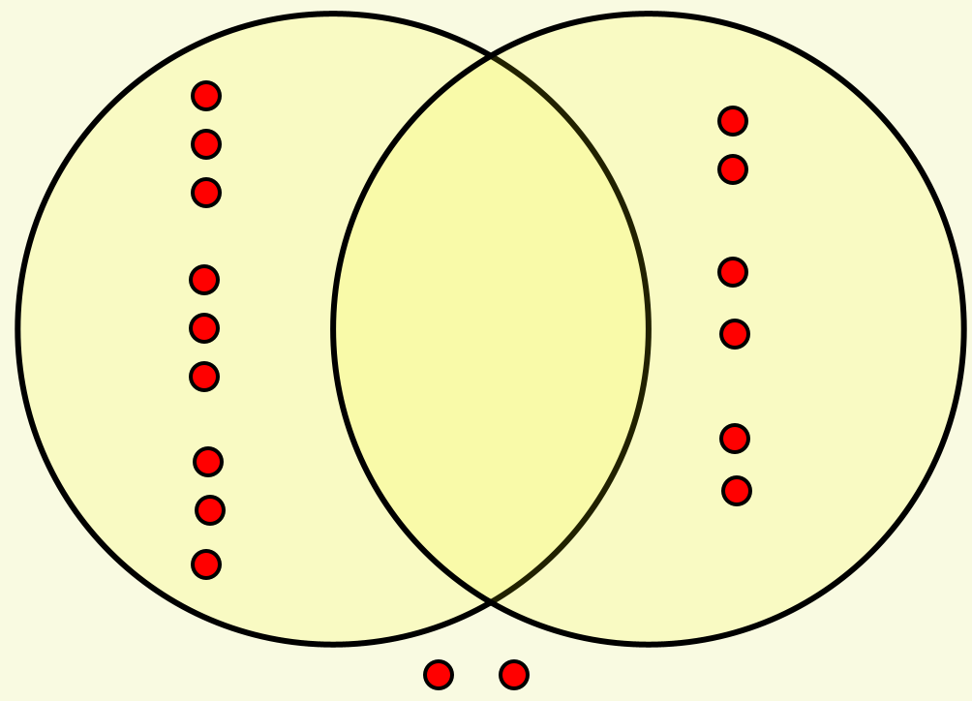
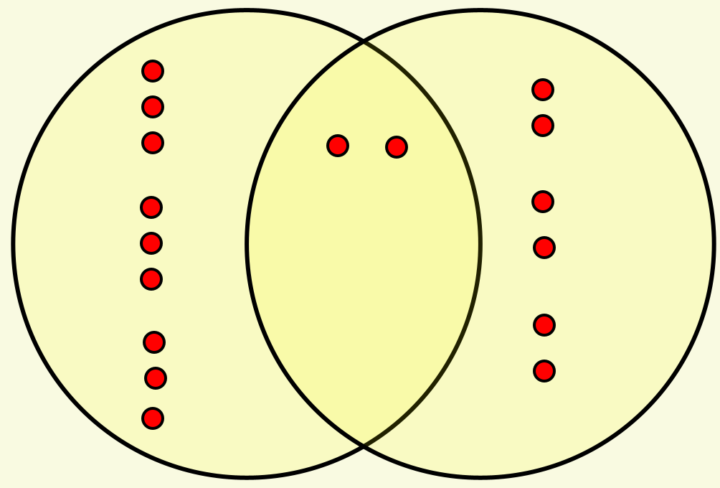
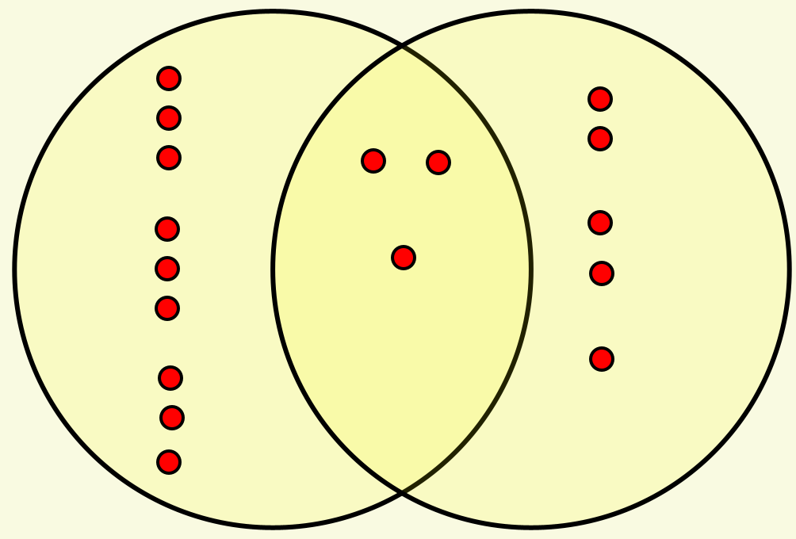
More Set Ratios
Two overlapping sets. In how many different ways can 17 objects be placed in the sets so that the ratio of the number of objects in set A to the number of objects in set B is 3 : 2?
Waiting for/ Looking for
a mathematical action to initiate
Get started!
Look for an action that preserves ratios
Modify that action to cope
with 2 additional objects

Slide 21
Differences
I have been given two numbers and I am to subtract the second from the first.
Just before I start, someone adds 2 to both of my numbers. What difference will that make?
What if they add 2 to the first number and subtract 1 from the second: what difference will that make?
What can be varied?
How does that change the thinking?

Slide 22
Closing in
As soon as an action becomes available, it is hard to resist enacting it
Please write down
  A decimal number between 2 and 3,
  which also does NOT use the digit 5,
  and which also uses the digit 7,
  and is as close to 5/2 as possible.
Learning to PARK the first idea:
maybe there is a better way?
Action 1
Use the 7, then adjoin more digits to make it closer to 5/2
2.479999…
Action 2
Make it close to 5/2, then throw in a 7
2.499999…97
Action 3
Combine the two
2.499999…97999…

Slide 23
Types of Pedagogical Actions
Imperative Actions
  Do this; do that; …
Interrogative Actions masking as Imperative
  What do ‘we’ do next?
  How do we know …?
  How many (how much) …
Inquisitive Actions (Genuine Enquiry)
  How do you know …?
  What did you do (next)?
  Please tell me what to do next
  In how many different ways can you …?
  Looking-into NOT Looking-for
Listening Actions
  What is another way to … ?
  Can you tell someone else how to do another question like this?
  Listening-to NOT listening-for

Slide 24
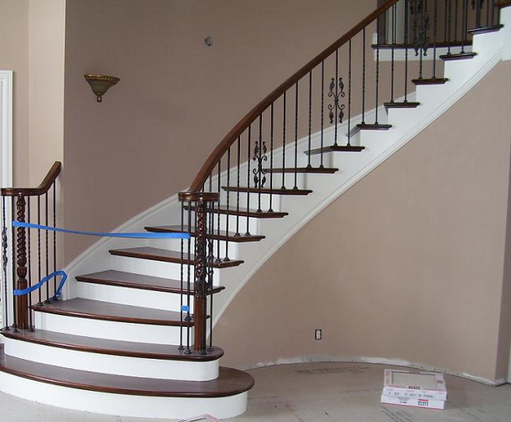
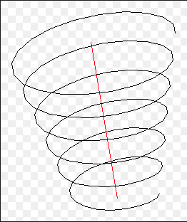
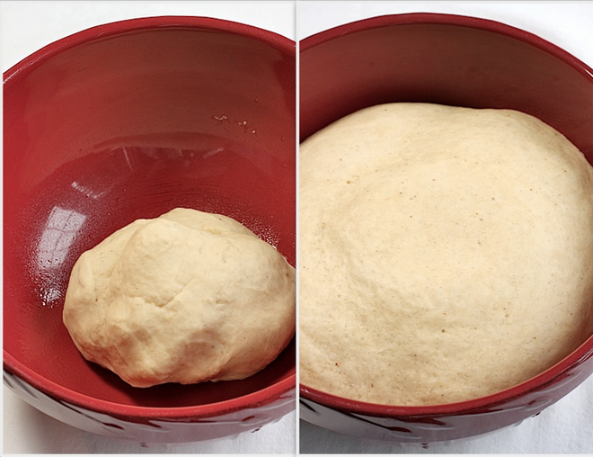


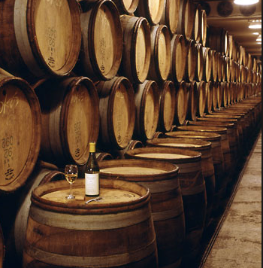
Conceptions of Learning
Staircase
Spiral
Maturation

Slide 25
Noticing and Attention
As Susan & Vicki pointed out last time,
Noticing is about attending to details that might otherwise be overlooked.
There are different ways of attending
Susan & Vicki pointed to some teachers
had only a rough overview of
what the learners were doing
Holding Wholes
(Gazing)
In order to detect mathematical thinking
it is necessary to pay attention to details
Discerning Details
Noticing
But which details?
It is a matter of what you are sensitised to
Recognising Relationships
Interpreting
Perceiving Properties
Not just the details,
But what relationships you recognise
Responding
Reasoning about and with those properties
As teacher, as mathematical thinker
What matters is the background generality

Slide 26
Attending to …
Mathematics
Pedagogy
Learners
  Mathematics (cognition)
  Affect (emotions; propensities, …)
  Enaction (behaviour, language, …)
Emotional support from being attended to

Slide 27
Conjectures about Noticing
The more details you discern, the more I learn about your sensitivity to notice.
Interpreting what someone is doing or saying is attending to relationships.
In the Discipline of Noticing care is taken to stick with details comprising relationships, avoiding spinning stories about what might be going on..
In the Discipline of Noticing, try to catch background assumptions which lead to unwarranted assumptions
First Relationships/Interpretation:
  What would I have to be attending to, and how, in order to do or say what this person is doing and saying?
Powerful analysis seeks at least two different possible interpretations/relationships …
… because human beings are rarely one-dimensional

Slide 28
Noticing
As shifts in WHAT is attended to, and HOW it is attended to
Noticing – Interpreting – Responding
  In context of working with learners
Retro-spective – Pro-spective – Spective (in the moment)
Having an action become available – initiating that action
Discerning what others are noticing/attending to
cf What would be useful to attend to mathematically, or socially
  (Outer/Inner/Meta tasks)
  Hence each act of a teacher is an intervention in learner attention

Slide 29
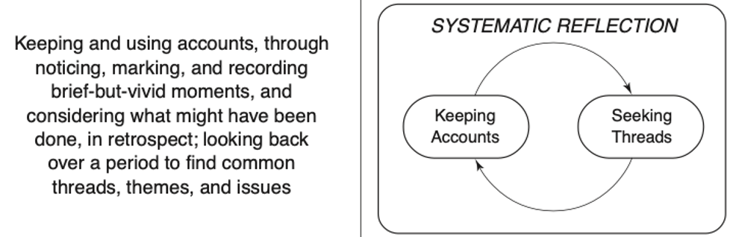
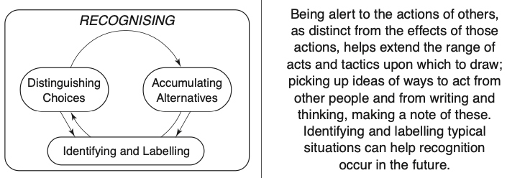
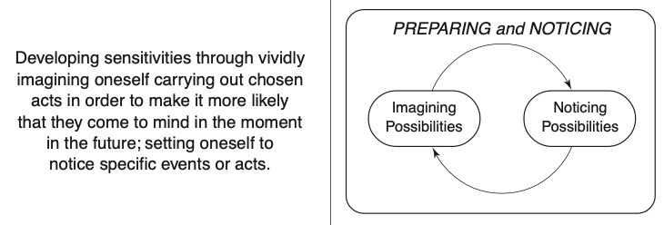
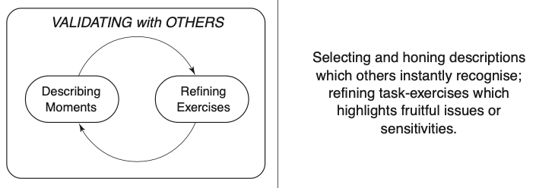
Summary of Discipline of Noticing

Slide 30
Summary of Noticing in any Research Paradigm
Each act of Noticing is a shift in attention
  What is attended to
  How it is attended to
Before undertaking analysis
  Declare something to be ‘data’
  Accounts-of NOT Accounting-for
  Ask yourself what you would be attending to, and how,
  in order to say and do what is said and done in the data
Using the Discipline as a life-long endeavour
  To be present in-the moment so as to have access to choice of action to initiate

Slide 31
Finally
As with any professional development, or indeed any lesson
Is there something that has struck you (that you noticed) during this session which you might want to work on or develop or use in the future?
If so, imagine yourself in an appropriate place
working on that idea,
perhaps even making use of it in some lesson
That is the
retro-spective element
being transformed into
the pro-spective element of the Discipline of Noticing
which can contribute to spective noticing in-the-moment.

Slide 32
Follow-Up
John.Mason@open.ac.uk
PMTheta.com
Researching Your Own Practice using the Discipline of Noticing (Routledge)
Questions & Prompts for Mathematical Thinking (ATM Derby)
Primary version of Questions & Prompts (ATM Derby)

Slide 33
When Telling is ‘Telling’
Nothing wrong with telling people things
  Just don’t assume that they now know what you have told them!
  Even if they pick up something of what they are told, they will not comprehend and appreciate it the way you do!

Slide 34
Six Modes of Interaction with Theory
Enquirer
Situation
Theory
Theory
Enquirer
Situation
Situation
Theory
Enquirer
Describing
Explaining
Evaluating
Enquirer
Situation
Theory
Situation
Theory
Enquirer
Theory
Enquirer
Situation
Illustrating
Probing
Informing
Predicting

Slide 35
Six Modes of Classroom Interaction
Teacher
Student
Content
Student
Content
Teacher
Content
Teacher
Student
Expounding
Examining
Expressing
Teacher
Student
Content
Content
Teacher
Student
Student
Content
Teacher
Explaining
Exploring
Exercising
Notes:
Example of consequences arising from theory

Slide 36
Essence: theories as webs
Format for findings
Action
View of validation
Insight
Methods:
view of data; analysis
Basis of
perception
Background
Foreground
Coherent view of objects
Vocabulary
Desire
to know,
to understand
to act
Formulate enquiry

Slide 37
Outline
Lived Experience
Intensity of Noticing
  Not at all; can recall when prompted; can initiate remark (marked); record made;
Purpose of Noticing: to initiate an action;
  as a learner: a mathematical action
  as a teacher; a pedagogic action (cf details; interpreting; responding);
  as a researcher; something to code, accumulate, even count
To Notice is to attend: different ways to attend
  Holding Wholes etc. (provide experiences)
  creating and analysing data: what and how would I have to attend to in order to do/say that?
Problem of Forgetting; Problem of automaticities (coordinations)
Being aware is one thing; establishing an awareness (having a suitable action become available) is another
Use of mental imagery;
  post-flecting; flecting; re-flecting
  pre-membering; membering; re-membering
  Pre-paring; paring; post-paring
Researching Own Practice
  Sensitising yourself to notice

