Slide 1
Key Understandings in Mathematics Learning
Anne Watson
AMET 2010

Slide 2
How would you slice a regular hexagon into 5 equal parts?

Slide 4
It’s not what you know, but how you know it - how your knowledge and experience is structured - what is variable?

Slide 5
Preparing to Teach Framework (Open University Centre for Mathematics Education)
Notes:
Our role to help prospective teachers think hard about what they need to teach and the nature of understanding - they can get ideas and tips off countless websites and books, but how to choose? CMTP - away from tasks, resources, and ‘what works for me’ to ‘what are the fundamental ideas we would like students to learn, so how can we help them learn?

Slide 6
Prior knowledge; entailed understandings (BSRLM Trigonometry Working Group)
Similarity: proportionality; multiplicative relationships: scaling of one line is experienced differently to enlargement of one line in relation to another.
Angle; measuring the amount of turn, embodied sense of turn. Eventual understanding of angle as independent variable in functions.
Length: why comparing lengths multiplicatively is appropriate, rather than additively
Enlargements as transformations; trigonometric activity as transforming enlargements
Angle as variable; functions

Slide 7
Key ideas in mathematics
number, ratio, equivalence, growth and change, variation, co-variation, representation, very small and very large things, functional relationships, …
Notes:
Procedural, tested, knowledge

Slide 8
Nuffield Synthesis (Terezinha Nunes, Peter Bryant, Anne Watson)
Whole numbers
Rational numbers
Relations between quantities
Spatial understanding
Algebraic reasoning
Modelling
problem-solving; modelling; understanding complexes of concepts

Slide 9
www.nuffieldfoundation.org
http://www.nuffieldfoundation.org/go/grants/education/page_683.html

Slide 10
‘Prior knowledge’as previous experience of:
Spatial reasoning
Numerical reasoning
Additive reasoning
Multiplicative reasoning
Algebraic reasoning …

Slide 12
Spatial reasoning
early knowledge of space is relational, not just descriptive:
size and transitivity
distance between
corners and edges
fitting in and together
turn
length, volume and angle are more intuitive than area
Notes:
12
12

Slide 13
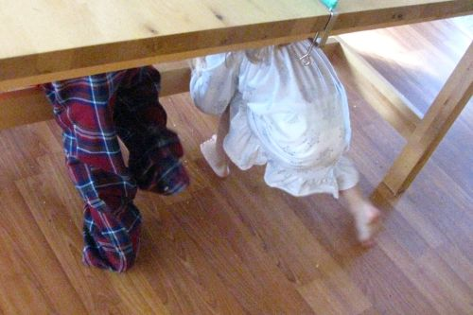

Slide 14
Spatial understanding
length and capacity/volume are intuitive
elementary properties of shapes are intuitive and perceptual
the concept of area is not intuitive
numerical measures of area, volume and angle are not intuitive
comparing quantities is easier than measuring them
some properties of shapes that depend on relationships are intuitive
Notes:
14
14
14

Slide 15
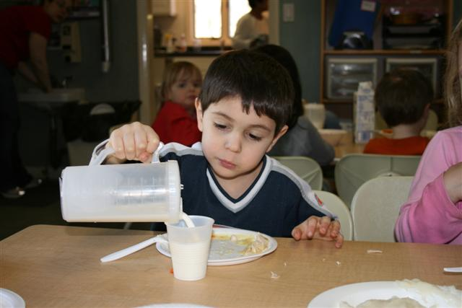

Slide 16
Numerical reasoning
knowledge of quantities and counting develop separately through:
interacting with objects
one-to-one and many-to-one correspondence
stretching/scaling
fitting
sharing out
pouring
cutting up
Notes:
16
16
16

Slide 17
Additive reasoning
a + b = c c = a + b
b + a = c c = b + a
c – a = b b = c - a
c – b = a a = c - b

Slide 18
Multiplicative reasoning
a = bc bc = a
a = cb cb = a
b = a a = b
c c
c = a a = c
b b
Notes:
18

Slide 19
Inexact measurement: what do children do?

Slide 21
49 + 37 – 49
100000 x 10000
99 + 1
+

Slide 22
29 x 42
x 3 +
x 10
of (
x 2)

Slide 23
Non-computational arithmetic
knowledge of quantities and counting develop separately
additive understanding does not precede multiplicative
three principles relate to success in mathematics: the inverse relation between addition and subtraction; additive composition; one-to-many correspondence
thinking about relations is key to later success
Notes:
23
23

Slide 24
Thinking about teaching relationally

Slide 25
Secondary school mathematics (Keith Jones, Dave Pratt , Anne Watson)
1. Fundamentals including: variation; generalising; proving; reasoning; explaining; defining; visualisation; representation; dimensionality; graphing; ICT
2. Measurement and decimals
3. Relations between quantities and algebraic reasoning
4. Ratio and proportional reasoning
5. Spatial and geometrical reasoning
6. Functions: links relations and modelling; calculus
7. Modelling from experimental and observational data
8. Modelling uncertainty

Slide 26
So …
what do we do with our students?

Slide 27
anne.watson@education.ox.ac.uk

