Slide 1
What is the a Problem in Mathematics?
The Open University
Maths Dept
University of Oxford
Dept of Education
Promoting Mathematical Thinking
Edinburgh ATM Branch
Anne Watson & John Mason Edinburgh
March 2019

Slide 2
Questions about problem-solving in mathematics
What is a problem?
What is problematising?
Who poses problems? Why? How? When?

Slide 3
a
b

Slide 4
a + b = 20
a – b = 7
Find a and b

Slide 5
What could you do next?
Find a and b
… find a and b using a different method
… and another method

Slide 6
and so where is (a - b)?
So where might (a + b) be?
a

Slide 7
a + b = 11
a – b = 1
Variation pattern draws attention to … ?
a + b = 11
a – b = 3
a + b = 11
a – b = 5
a + b = 11
a – b = 7
a + b = 11
a – b = 9
a + b = 11
a – b = 2
a + b = 11
a – b = 4

Slide 8
a + b = 11
a – b = 1
Variation pattern draws attention to …. ?
a + b = 12
a – b = 1
a + b = 13
a – b = 1
a + b = 14
a – b = 1

Slide 9
What questions can you now ask?
that focus on structures/relationships?
that relate to known methods for solving those equations?

Slide 10
a + b = 11
a – b = 1
Variation pattern draws attention to ….?
a + 2b = 11
a – 2b = 1
a + 3b = 11
a – 3b = 5

Slide 11
So where might (a + 2b) be?
and so where is (a - b)?
a

Slide 12
The problem space
Coinciding relationships
Retrieving values from coinciding relationships
“Simultaneous equations”

Slide 13
Choose two …….
The sum of two numbers is 20
The difference of two numbers is 4
The difference of two numbers is 20
The ratio of two numbers is 2:3
The product of two numbers is 16
The sum of two numbers is 17
The product of two numbers is 60
The ratio of two numbers is 4:7
The difference of two numbers is 15
The sum of the squares of two numbers is 202
Make up your own relationship between two numbers
Notes:
Diophantus is alive and well!!

Slide 14
Welsh Problem Solving Actions
Identify variables
Construct expressions (choose representation)
material objects
diagrams
graphs
symbols
verbal
…
Equate expressions (relationships)
Technical manipulation

Slide 15
Students posing problems

Slide 16
Lesson about proportionality
Students are asked to suggest a situation in which two variables increase together:
‘As a videotape plays, time increases.’
Students are then asked to pose a specific problem:
There is a videotape 10 m. long, rewound to the start on the left. One minute after ‘play’ has been pressed, it has advanced 1 m. to the right. If it is examined at the end of each elapsed minute, how far will the right have increased?

Slide 17
Reflections
What is a problem?
What is problematising?
Who poses problems? Why? How?
What is problem-solving?
Cognitive science/psychology
Mathematics

Slide 18
Two Candles
Recently installed in a garret room on the Left Bank, Painter was moodily staring out the window watching the darkness close over Paris at 9 p.m. Just then his one light bulb blinked feebly several times and went out, leaving him in total darkness. Luckily the concierge had left him a supply of two candles reserved for such emergencies, and he lit one immediately. An hour and a half later Painter decided that he needed more light and put the second candle into use, remembering that it was an inch shorter than the first one had been originally.
After two and a half hours more, Painter suddenly noticed that the candles were of equal height. He mulled this fact over for an hour and a half before he concluded that perhaps candles burn at different rates. Just then, out winked the candle which originally had been shorter. Half an hour later the other one went out, leaving painter in complete blackness to contemplate Paris and his mathematical problem.
How tall was each candle initially?

Slide 19
Two Candle Situation
Imagine two candles, the first is f cm. taller than the second.
The first is lit.
t₁ hours after that the second is lit.
t₂ hours after that they are the same height.
t₃ hours after that the second candle burns out.
t₄ hours after that the first candle burns out.
3 cm
1.5
2.5
1.5
0.5
What relationships must there be?
What else can be determined?
How tall were the candles originally?
Notes:
Jacoby, O. with Benson, W. (1992 Dover reprint). Intriguing Mathematical Problems Ch 2 Problem 11

Slide 20
Diagram!
First is lit
Second is lit
Equal heights
Second burns out
First burns out
What do I know?
What do I want?

Slide 21
Candle-Workings
d
h₁
h₂
h
Candle stories?
t₁
t₂
t₃
t₄
First candle burns at a constant rate
Second candle burns at a constant rate
Notes:
Candle 1 burns at a constant rate
Candle 2 burns at a constant rate

Slide 22
Candle Height Difference
d
h₁
h₂
Two constraints
t₁
t₂
t₃
t₄
Isaac Newton
Mostly solved word problems in general, then used the general to resolve the particular

Slide 23
Two Other Candles
Imagine you have two candles of the same height but different diameters so that they burn at different rates
What happens if the candles are lit at the same time?
What sorts of questions might be asked?
Focused free play
Suppose you are told the time taken to burn each completely.
What else do you know?
Example:
If one takes 4 hours and the other 5 hours to burn down, when will one candle be 3 times the length of the other?

Slide 24
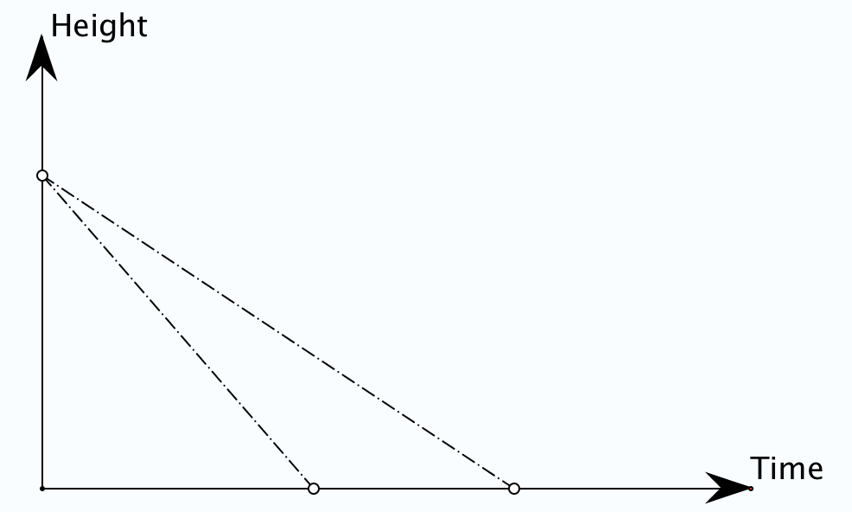
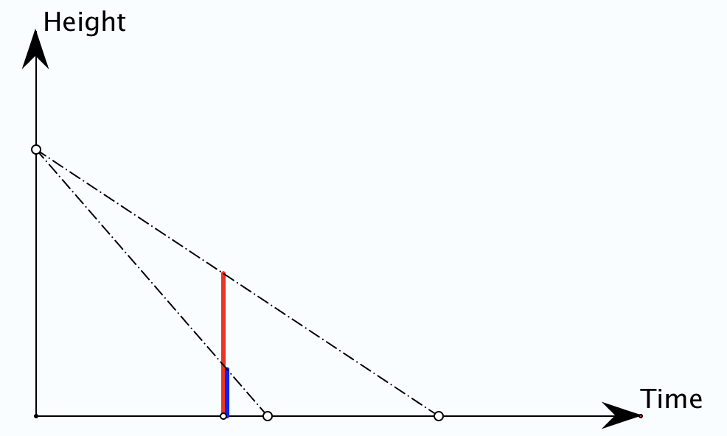
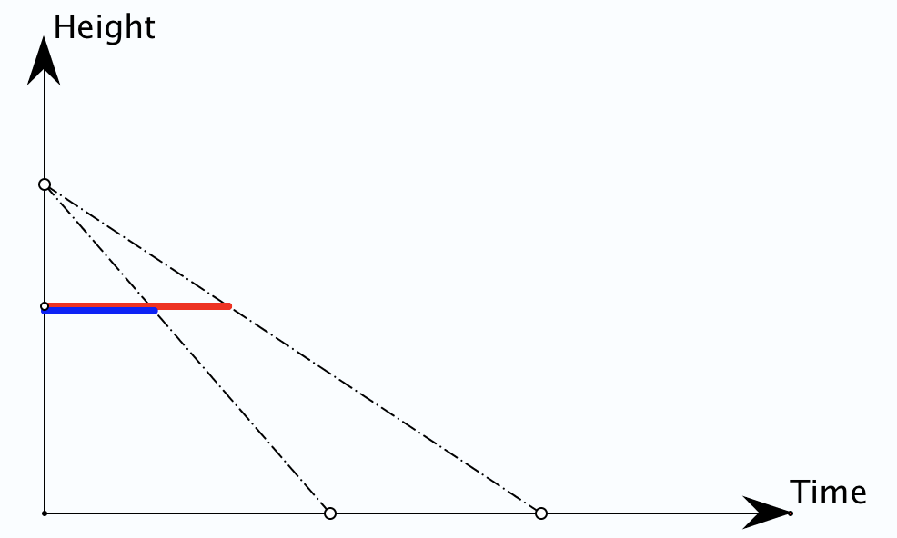
If one takes 4 hours and the other 5 hours to burn down, when will one candle be 3 times the length of the other?
What might the question be?

Slide 25
Candle Algebra
If one takes 4 hours and the other 5 hours to burn down, when will one candle be 3 times the length of the other?
Let the candles burn for t hours from a height of 1 unit.
The heights at time t are
Oops!
Ok!

Slide 26
General Candles
Two candles of the same height take a and b hours respectively to burn down.
Is there a time at which one candle is h times as high as the other?
So must have either
or
Is there a height from which it will take one candle k times as long to burn down as the other?

Slide 27
Candle Questions
What mathematical questions could be asked about candles burning?

Slide 28
Sharing Bread
There were two men, the first of whom had 3 loaves of bread and the other 2 loaves, and they took a walk to a certain fountain where they met together sitting and eating, and a soldier passed by; they invited him to join them, and he sat down and ate with them, and when they had eaten all the bread the soldier departed leaving them 5 bezants for his share.
Of this the first took 3 bezants for his three loaves; the other truly took the other two bezants for his two loaves. It is sought whether the division was just or not.
Fibonacci: Liber Abacci p403-404

Slide 29
Sharing Bread Reasoning
A certain person asserted that the division was correct as each had 1 bezant for each loaf, but this is false because the three ate all five loaves.
Whence each took 1 2/3 loaves, the soldier ate 1 1/3 loaves, that is 4/3, from the loaves which the first had. Of the loaves truly the other ate only so much as 1/3 of one loaf. Therefore the first man took 4 bezants and the other 1 bezant. (p403-404).
The first contributed 4/3 of loaf to the soldier and the second contributed 1/3 of a loaf so they should share the fee in the ratio 4 : 1.

Slide 30
Collaborative Selling
Imitation Punished: Two market-women were selling apples, one at 2 for 1 cent and the other at 3 for 2 cents. They had 30 apples apiece. In order to end their competition they formed a trust, pooling their stocks and selling the apples at 5 for 3 cents. This was to their advantage since under the new arrangement they took in a total of 36 cents, while under the old system they would have received a total of only 35 cents.
Their example was contagious. Two other women, who also had 30 apples apiece and who were selling them at 2 for 1 cent and 3 for 1 cent, formed a trust to sell their apples at 5 for 2 cents. But instead of the total of 25 cents which they would have taken in operating separate enterprises, their trust grossed only 24 cents. Why? [Kraitchik, q41 p35.]

Slide 31
Follow Up
PMTheta.com
John.Mason@open.ac.uk
Questions & Prompts for Mathematical Thinking (ATM)
Thinkers (ATM)
Mathematics as a Constructive Activity (Erlbaum)
Thinking Mathematically (Pearson)

