Slide 1
Algebra workshop
Anne Watson
South West 2013

Slide 2
Key ideas
Generalise relationships
Equivalent expressions
Solve equations
Express situations
Relate representations
New from old
Notation

Slide 3
Non-statutory Guidance yr 6
Pupils should be introduced to the use of symbols and letters to represent variables and unknowns in mathematical situations that they already understand, such as:
missing numbers, lengths, coordinates and angles
formulae in mathematics and science
arithmetical rules (e.g. a + b = b + a)
generalisations of number patterns
number puzzles (e.g. what two numbers can add up to).

Slide 4
Searching for hidden algebra in the primary draft curriculum, yrs 1-2
Year 1
counting as enumerating objects
patterns in the number system
repeating patterns
number bonds in several forms
add or subtract zero.
Year 2
add to check subtraction (inverse)
add numbers in a different order (associativity)
inverse relations to develop multiplicative reasoning
Generalise
Equivalence
Solve
Express
Representations
New from old
Notation

Slide 5
Additive reasoning
Generalise
Equivalence
Solve
Express
Representations
New from old
Notation
a + b = c c = a + b
b + a = c c = b + a
c – a = b b = c - a
c – b = a a = c - b

Slide 6
different kinds of pattern
Repeating
a, b, b, a, b, b, ...... (3n+1)th square is red
Continuing (arithmetic, linear ...)
1, 4, 7, 10 .... (nth term is 3n+1)

Slide 7
enumeration
12 = 3 lots of 4
12 = 4 lots of 3
12 = two groups of 6
12 = 6 pairs
12 = 2 lots of 5 plus two extra
c= ab = ba = 2( ) = 2( - 1) + 2 etc.

Slide 8
Enumeration
different ways of counting relate to different combinations of lengths and different orders of operations

Slide 9
Hidden in years 3-4
Generalise
Equivalence
Solve
Express
Representations
New from old
Notation
Year 3
mental methods
commutativity and associativity
Year 4
write statements about the equality of expressions (e.g. use the distributive law 39 × 7 = 30 × 7 + 9 × 7 and associative law (2 × 3) × 4 = 2 × (3 × 4))
write and use pairs of coordinates, e.g. (2, 5)
one or more lengths have to be deduced using properties of the shape

Slide 10
distributivity
39 x 7=30 x 7+ 9 x 7
j x m
k x m
m
j
k

Slide 11
Multiplicative reasoning
a = bc bc = a
a = cb cb = a
b = a a = b
c c
c = a a = c
b b
Generalise
Equivalence
Solve
Express
Representations
New from old
Notation

Slide 12
Hidden in years 5-6
Generalise
Equivalence
Solve
Express
Representations
New from old
Notation
perimeter of composite shapes
order of operations
relate unit fractions and division.
derive unknown angles and lengths from known measurements.
use all four quadrants, including the use of negative numbers
quadrilaterals specified by coordinates in the four quadrants

Slide 13
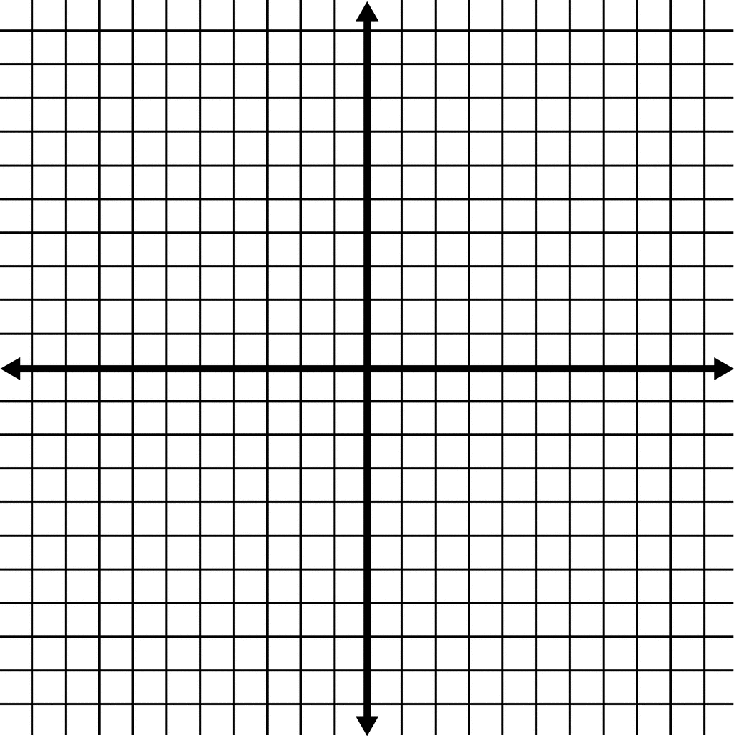
(5,3)
(0,k)
(a,b)

Slide 14
Non-statutory Guidance yr 6
Pupils should be introduced to the use of symbols and letters to represent variables and unknowns in mathematical situations that they already understand, such as:
missing numbers, lengths, coordinates and angles
formulae in mathematics and science
arithmetical rules (e.g. a + b = b + a)
generalisations of number patterns
number puzzles (e.g. what two numbers can add up to).

Slide 15
anne.watson@education.ox.ac.uk

