Slide 1



Working Mathematically with students, with colleagues, and with yourself
The Open University
Maths Dept
Promoting Mathematical Thinking
University of Oxford
Dept of Education
John Mason
PGCE
Oxford
May 2019

Slide 2
Conjectures
Everything said here today is a conjecture … to be tested in your experience
The best way to sensitise yourself to learners …
  is to experience parallel phenomena yourself
So, what you get from this session is what you notice happening inside you!
To be awake, sensitive, and responsive to students, it is vital to be thinking mathematically oneself

Slide 3
Outline
Some mathematical tasks centred on the role of generality
with reflection on pedagogical actions
Awareness of mathematical powers & themes
My focus
  Attention: its role and nature
Meta-Task for you
  What pedagogic actions do you notice me initiating?
  The role of pedagogic reflections
Slogan
  It is not the task that is rich, but whether the task is used richly

Slide 4
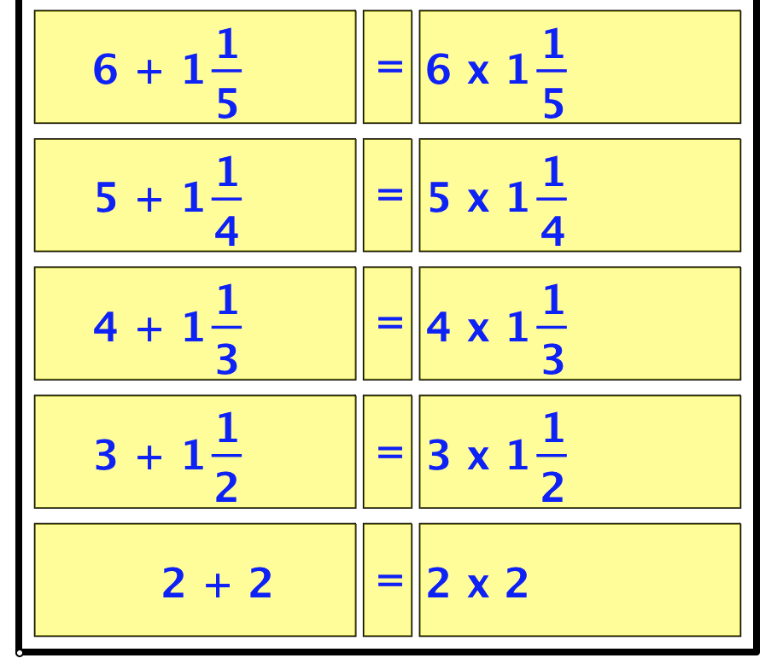
Patterns from 2
What does experience of the task contribute to mathematical thinking?
SVGrid

Slide 5
Sundaram’s Grid:
What is in the 4th row and 5th column?
An infinite grid in which
each row is an arithmetic progression
each column is an arithmetic progression
16 | 27 | 38 | 49 | 60 | 71 | 82
13 | 22 | 31 | 40 | 49 | 58 | 67
10 | 17 | 24 | 31 | 38 | 45 | 52
7 | 12 | 17 | 22 | 27 | 32 | 37
4 | 7 | 10 | 13 | 16 | 19 | 22
Claim: N ≥ 4 will appear in the table iff 2N + 1 is composite
What number will appear in the R^{th} row and the Cth column?
Sundaram

Slide 6

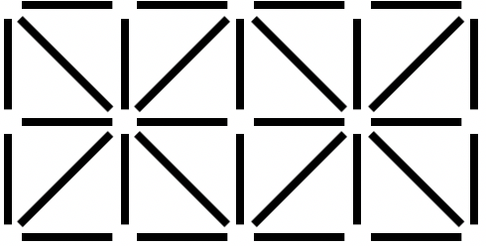
Match Sticks
How many sticks are required to make a figure like this with r rows and c columns?
In how many different ways can a number S of sticks be the number of sticks needed for a grid like this?
What could experience of the task contribute to mathematical thinking?
Doing & Undoing
Expressing Generality

Slide 7
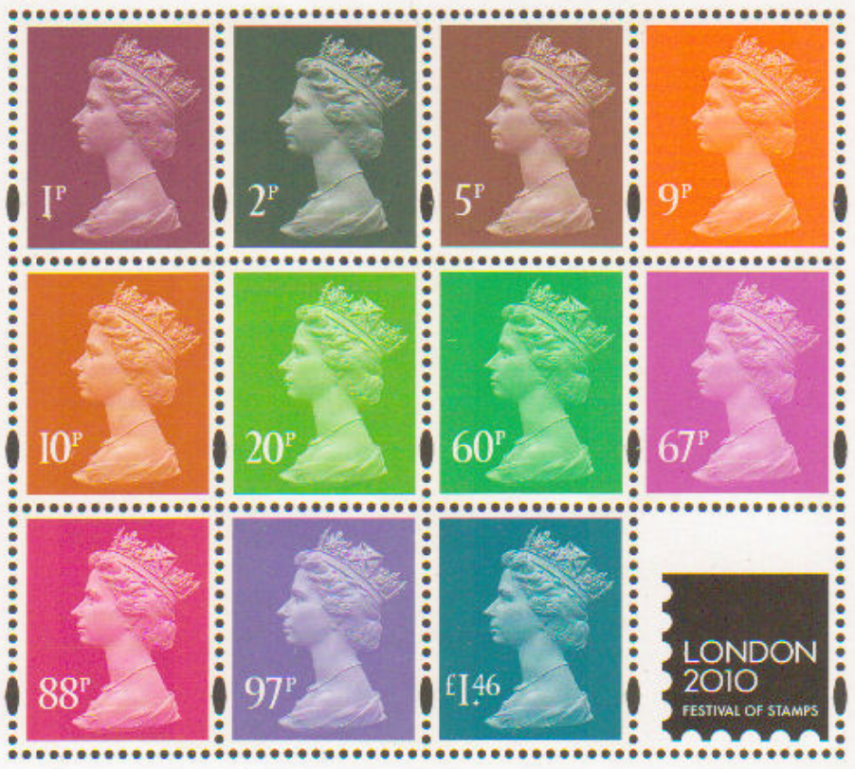
Perforations
Each stamp has 13 small-hole perforations on each side, 14 top and bottom, and one in each corner.
How many small-holes are in a sheet with r rows and c columns?
What could experience of the task contribute to mathematical thinking?
Doing & Undoing
Expressing Generality
Variation

Slide 8
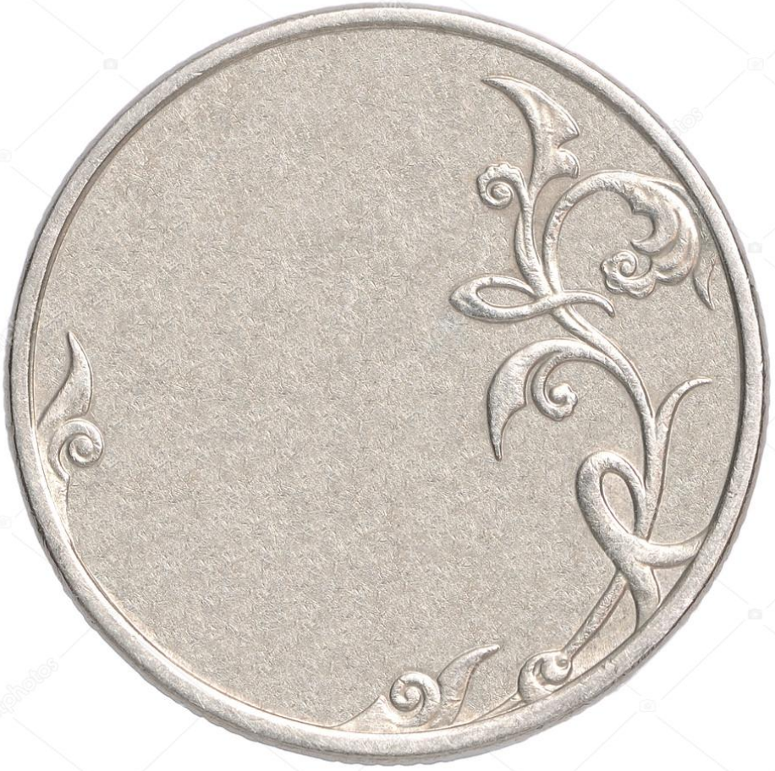
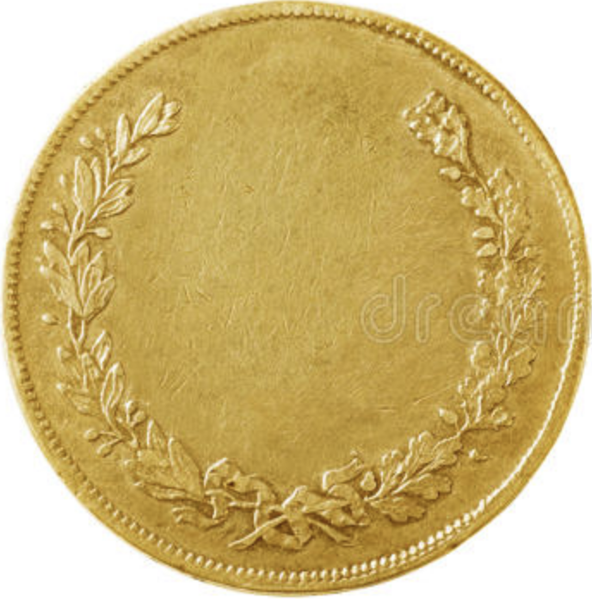
Restricted Coins
In a certain country embarking on independence, there are only two coins.
What is the largest value that cannot be made up from these coins?
Generalise the coin denominations!
5
7
James Joseph Sylvester in 1882
Notes:
For relatively prime a and b, given m ≥ (a-1)(b-1), the numbers m-ka for k = 0..(b-1) are all distinct modulo b, so one of them is divisible by b, showing uniqueness. However
(a-1)(b-1)-1 cannot be formed because

Slide 9
Leap Frogs
The task is to interchange the counters so the yellow ones are on the left and the brown ones on the right, subject to the rule that a counter can only slide into an adjacent empty space, or jump over exactly one counter into the empty space.
What is the minimum number of moves when there are L counters on the left, and R counters on the right?
Dudeney gave a 2D version
Notes:
Go to 42 (variation)

Slide 10
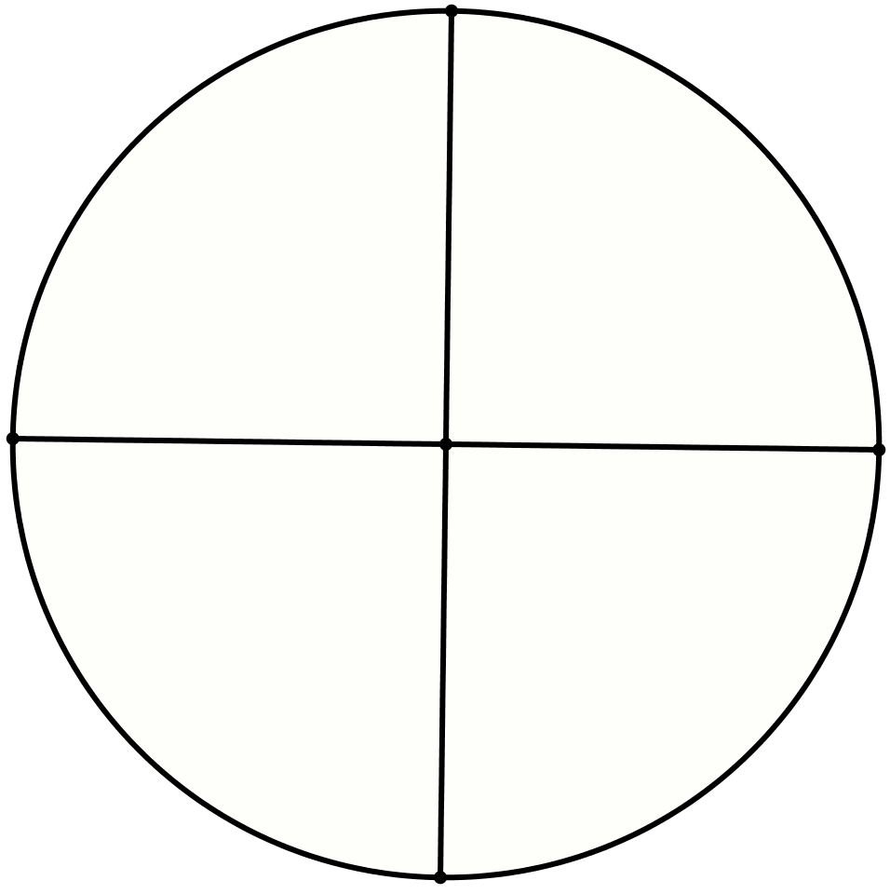
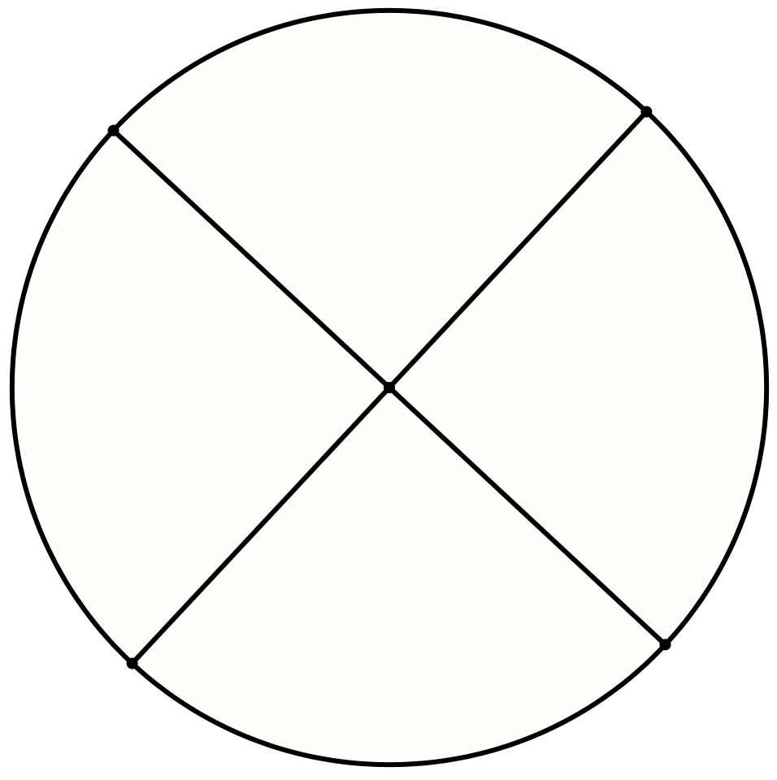
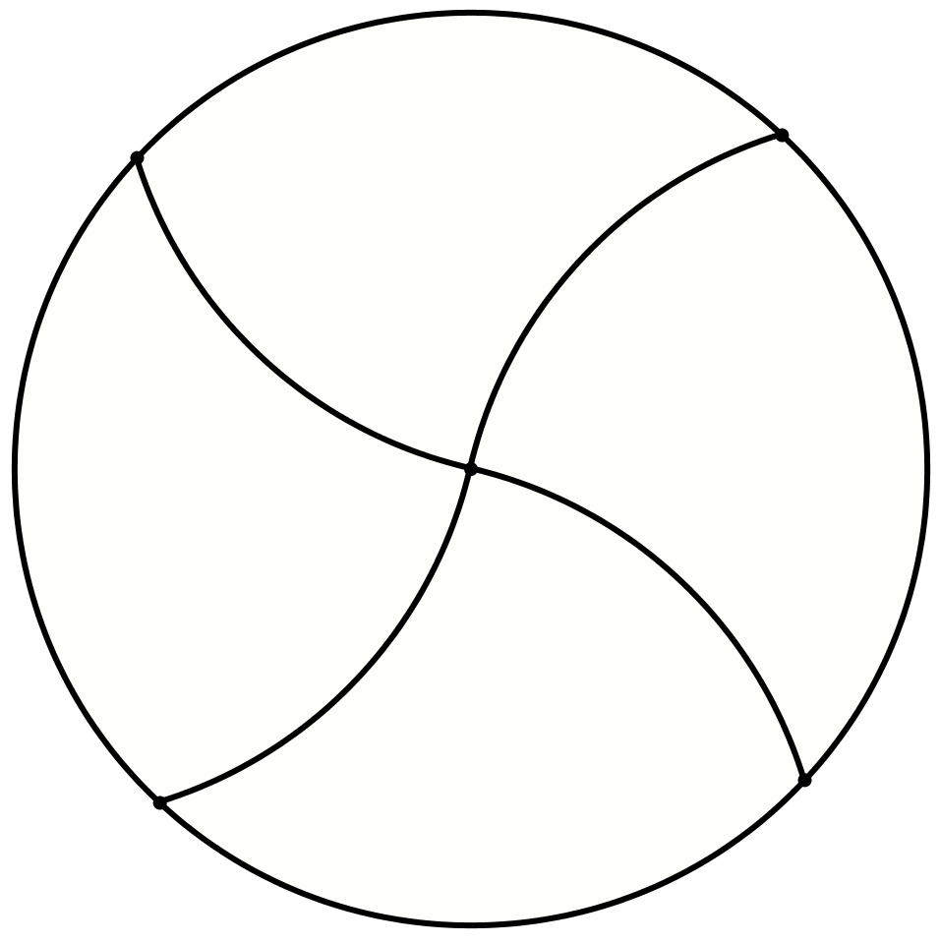
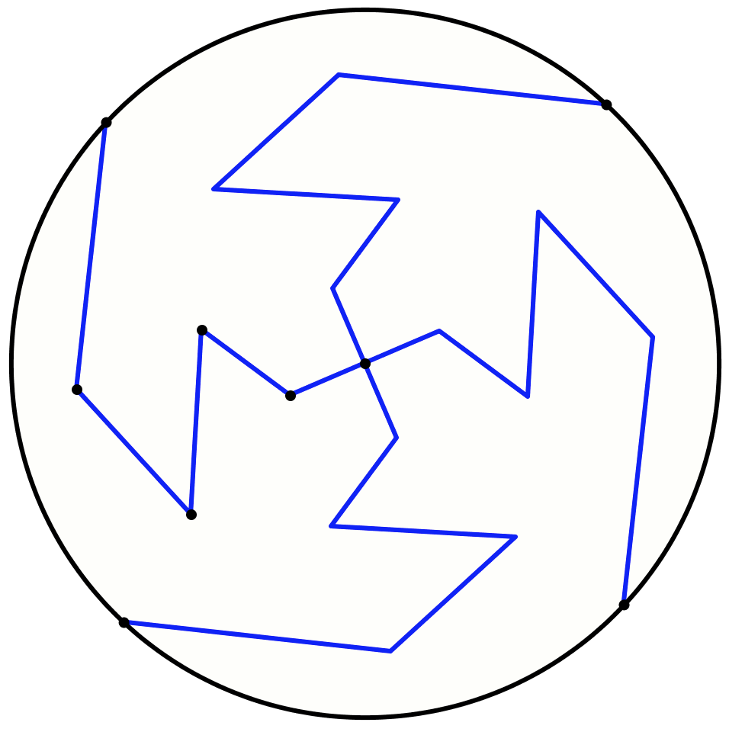
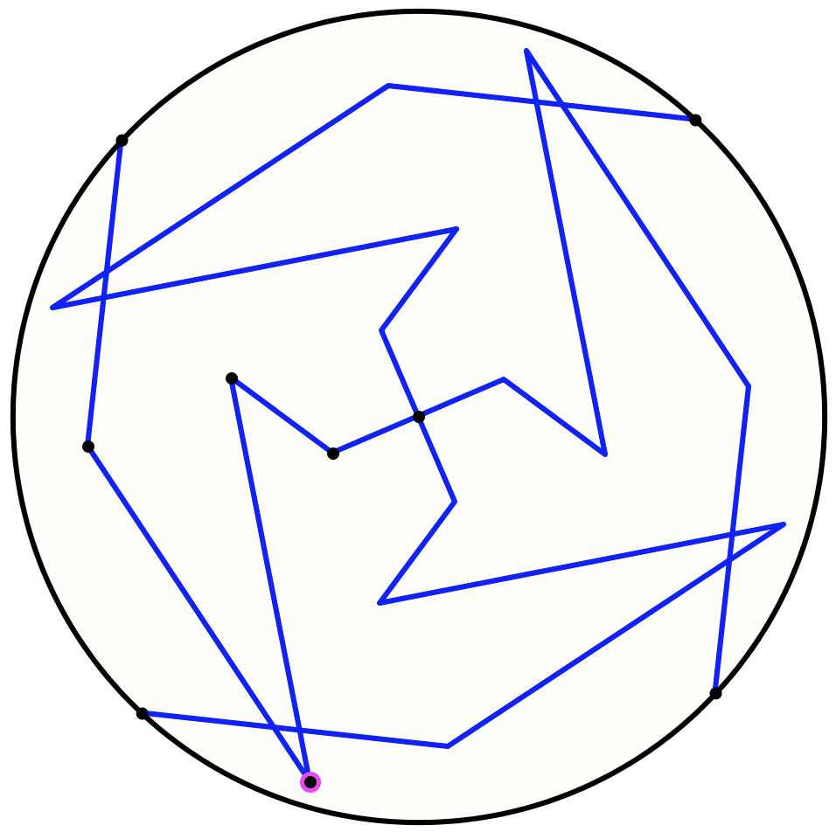
Another & Another
Draw a circle and divide it into four congruent pieces
Do it another way
Do it another way
What could experience of the task contribute to mathematical thinking?
Negotiating
‘same & different’
What could be varied?
What seems to be invariant?
What constrains variation?
Personal Narrative
Self-Explanation

Slide 11
Increasing Constraints
Draw a quadrilateral
Draw a quadrilateral with one pair of opposite sides perpendicular
Draw a quadrilateral with both pairs of opposite sides perpendicular
What does experience of the task contribute to mathematical thinking?
Revealing
Awarenesses
Enriching accessible
example space

Slide 12
Multi-Level Initiating of Tasks
In how many different ways can a unit fraction be expressed as the difference of two unit fractions?
Notice that
Notice that
Purposeful Practise
(recent ATM publication)
Notes:
Ways of initiating activity through presentation of a task

Slide 13
Calleja Spiral

Slide 14
Over Flow
Imagine a bucket containing water (not necessarily full)
Imagine an empty open-topped can being immersed in the bucket.
Imagine what happens to the water.
What variations
might make a difference?
What questions might be asked?
What could work on the task contribute to mathematical thinking?

Slide 15
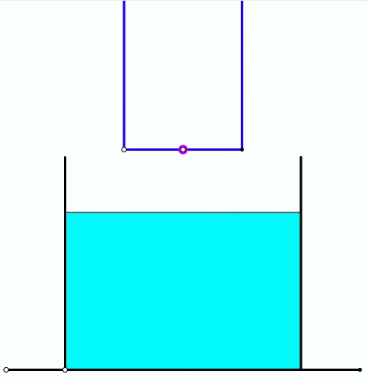

Slide 16
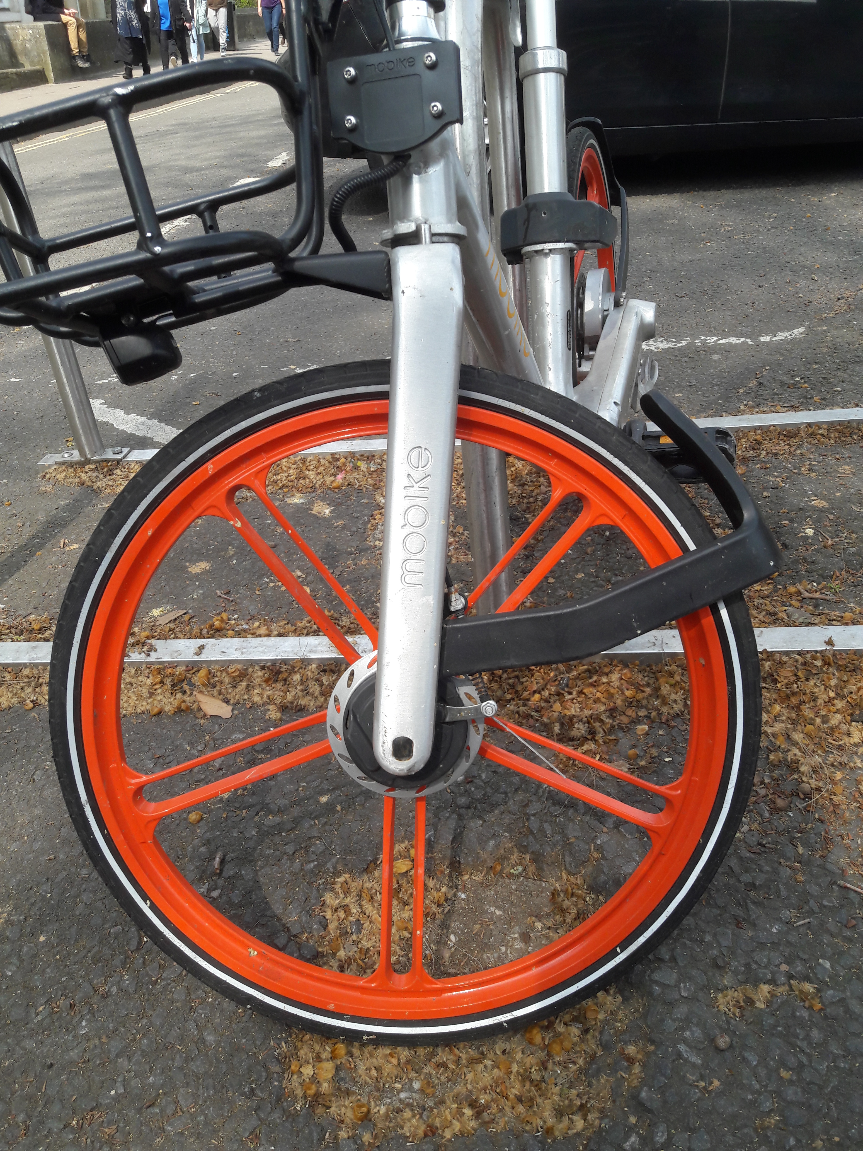
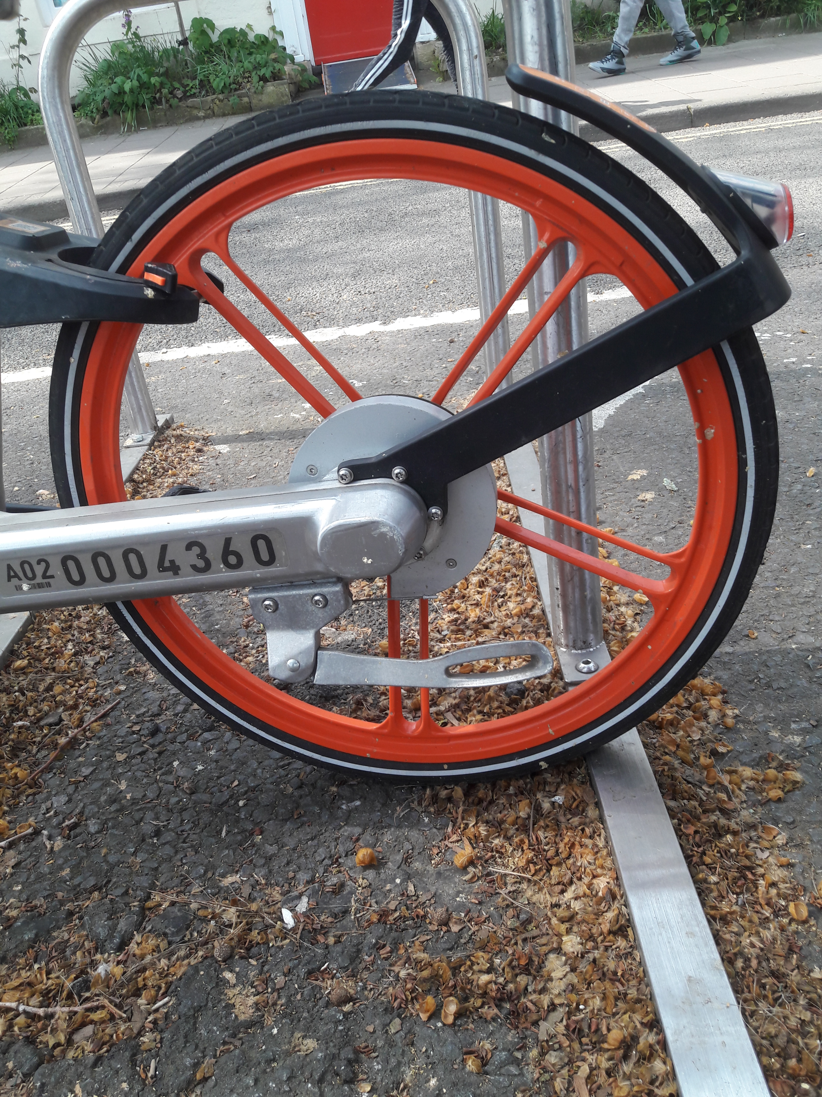
Mud-Guards
What strikes you about these mud-guards?

Slide 17
Ratio-Combining Tasks
Imagine you have some cans of paint of various sizes and colours.
What sorts of questions might arise involving ratios?

Slide 18
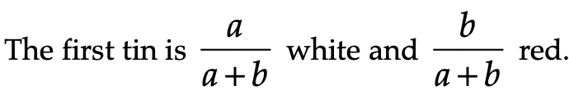
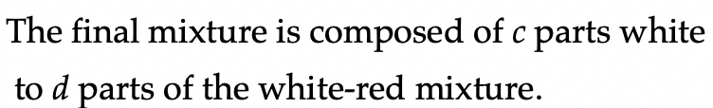
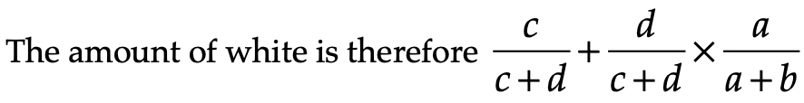
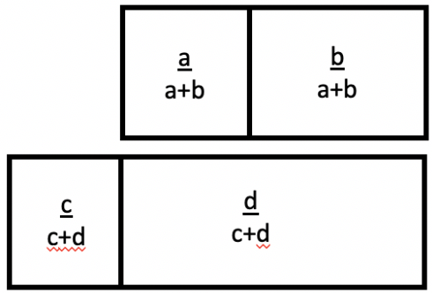
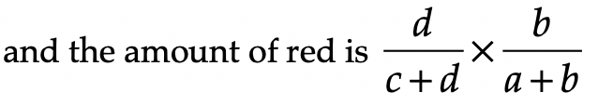
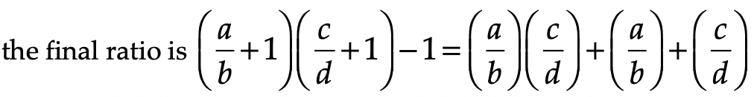
Re-Mix
You have a tin of paint made by mixing white to red in the ratio of 2 : 3. You then mix a new tin using white to your mixed tin in the ratio 4 : 5. What is the final ratio of white to red?

Slide 19
Mixed Up
There are three ingredients to a fruit drink: sugar, fruit and water. The ratio of sugar to non-sugar is 6 : 19. The ratio of fruit to non-fruit is 2 : 3. What is the ratio of sugar to fruit to water?

Slide 20
Using Ratios
Rods A and B have lengths in the ratio a : b
Rods C and D have lengths in the ratio c : d
Given that rods A and B together are μ times as long as rods C and D together, find the ratios of lengths A : B : C : D
Correct?

Slide 21
Tracking Arithmetic as Entry to Algebra
Elaboration of ideas of Mary Boole

Slide 22

Think Of A Number (ThOANs)
Think of a number
Add 2
Multiply by 3
Subtract 4
Multiply by 2
Add 2
Divide by 6
Subtract the number you first thought of
Your answer is 1
7
7
+ 2
3x + 6
7
7
3x + 2
6x + 4
7
6x + 6
7
+ 1
7
1

Slide 23

Differing Sums of Products
Write down four numbers in a 2 by 2 grid
4
7
5
3
Add together the products along the rows
28 + 15 = 43
Add together the products down the columns
20 + 21 = 41
43 – 41 = 2
Calculate the difference
That is the ‘doing’
What is an ‘undoing’?
Now choose positive numbers
so that the difference is 6
Notes:
Mathematical context
What probaby matters most is not eh context, but whether students ‘think’ they can solve the problem!

Slide 24
Differing Sums & Products
4
7
Tracking Arithmetic
5
3
4x7 + 5x3
4x5 + 7x3
4x(7–5) + (5–7)x3
= (4-3)x (7–5)
How much freedom and what constraints make 6 be the difference?
How much freedom and what constraints make n the difference?
Notes:
Revealing Structure by attending to relationships not calculations

Slide 25
Varied Multiplication Differences
62 x 54 – 64 x 52
72 x 64 – 62 x 74
61 x 53 – 63 x 51
71 x 63 – 73 x 61
Invariance in the midst of change
What can vary?
What constraints?
(60 + 2) X (50 + 4) – (60 + 4) X (50 + 2)
= (60 X 50 + 60 X 4 + 2 X 50 + 2 X 4
- (60 X 50 + 60 X 2 + 4 X 50 + 2 X 4)
= 60 X 4 - 60 X 2 + 2 X 50 – 4 X 50 )
= 60 X (4 – 2) + (2 –4) X 50
= 60 X (4 – 2) – (4 – 2) X 50 = (60 – 50) X (4 – 2)
= 10 X (6 – 5) X (4 – 2)

Slide 26
Pyramids
67
?
3+4x7
+6x4+
4x1+8
37
30
3+3x7
+3x4+1
7+3x4
+3x1+8
21
16
14
10
11
5
9
3+2x7
+4
7+2x4
+1
4+2x1
+8
3
7
4
1
8
3+7
7+4
4+1
1+8
3
7
4
1
8
What could be varied?
Notes:
Applies to Pascal’s triangle; Leibniz’s triangle, multiplication and other tables
Example of Chinese Pudian … foretaste of Pascal’s triangle

Slide 27
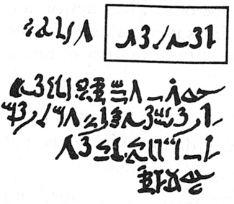
Rhind Mathematical Papyrus problem 28
Two-thirds is to be added.
One-third is to be subtracted.
There remains 10.
2/3 of this is to be added.
+2/3 x
= 5/3 x
1/3 of this is to be subtracted.
5/3 x – 1/3 x 5/3 x
=10/9 x
There remains 10.
10/9 x = 10
= 9
Notes:
Problem 28 of the Rhind Mathematical Papyrus Gillings p182

Slide 28
Rhind Mathematical Papyrus problem 28
Two-thirds is to be added.
One-third is to be subtracted.
There remains 10.
Make 1/10 of this,
there becomes 1.
The remainder is 9.
/10
– /10
2/3 of this is to be added.
The total is 15.
1/3 of this is 5.
Lo! 5 is that which goes out,
And the remainder is 10.
9x /10
+2/3x
9x /10
5/3 x9x /10
=3x /2
/2
The doing as it occurs!
Notes:
Problem 28 of the Rhind Mathematical Papyrus Gillings p182

