Slide 1
Working Mathematically with Students:
The Open University
Maths Dept
Promoting Mathematical Thinking
University of Oxford
Dept of Education
John Mason
PGCE
Oxford May 2018

Slide 2
Conjectures
Everything said here today is a conjecture … to be tested in your experience
The best way to sensitise yourself to learners …
is to experience parallel phenomena yourself
So, what you get from this session is what you notice happening inside you!

Slide 3
Outline
Some mathematical tasks
Some pedagogic reflection
Some mathematical powers & themes
Some pedagogical actions
The role and nature of attention
My focus
Attention: its role and nature
Meta-Task for you
What pedagogic actions do you notice me initiating?
The role of pedagogic reflections
Slogan
It is not the task that is rich, but whether the task is used richly

Slide 4
Calleja Spiral

Slide 5
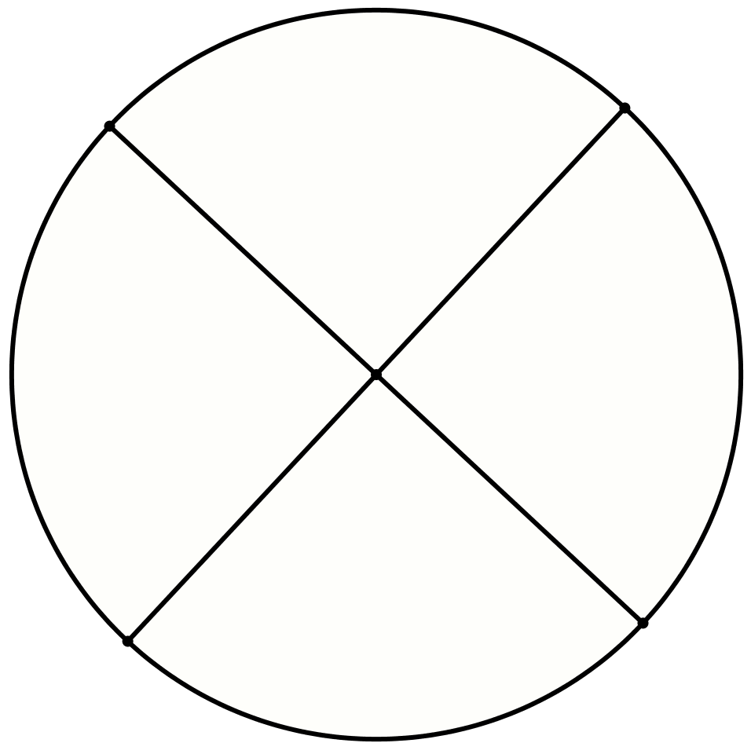
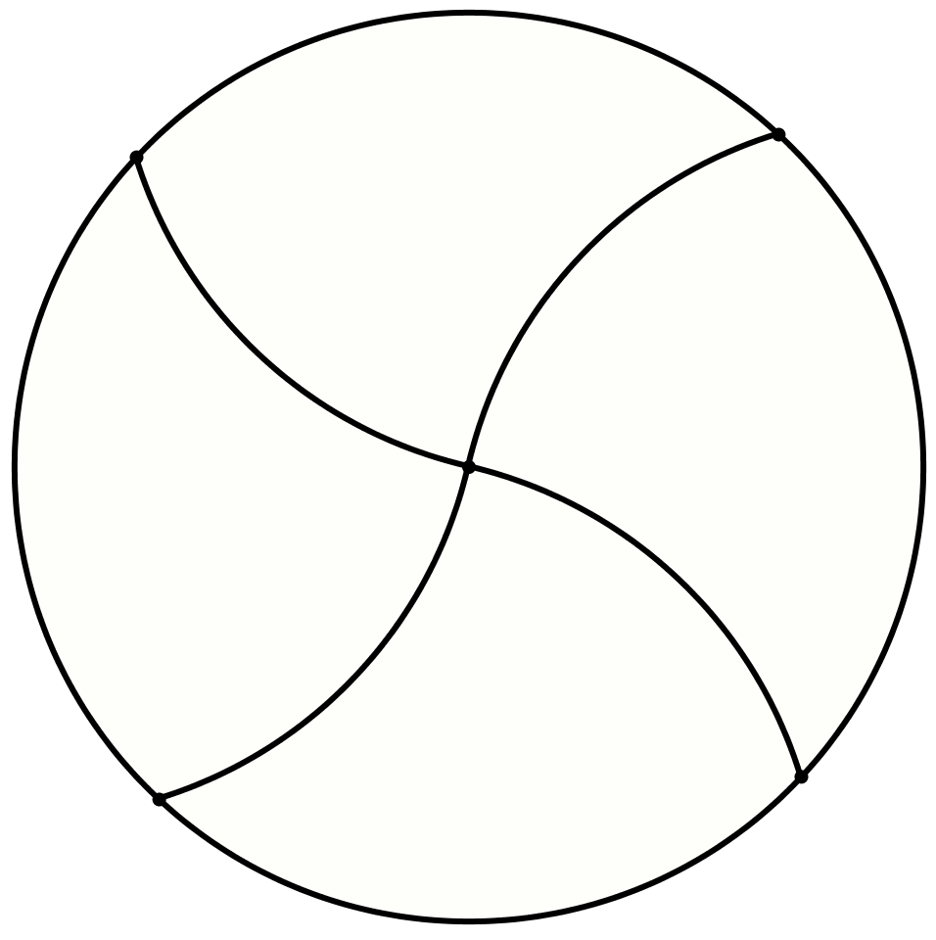
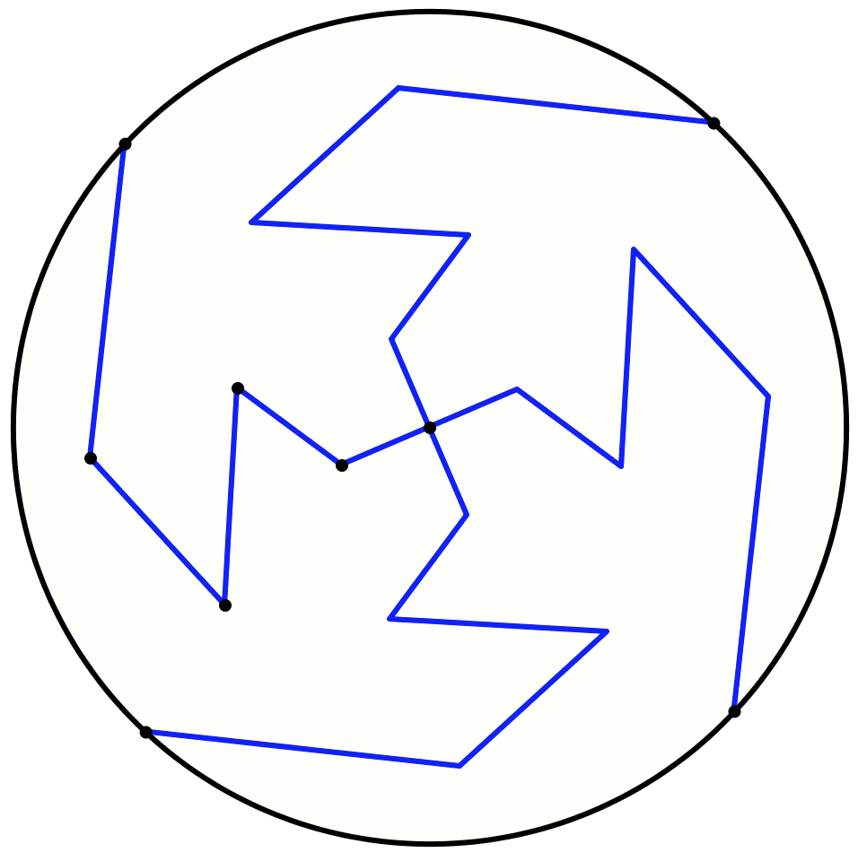
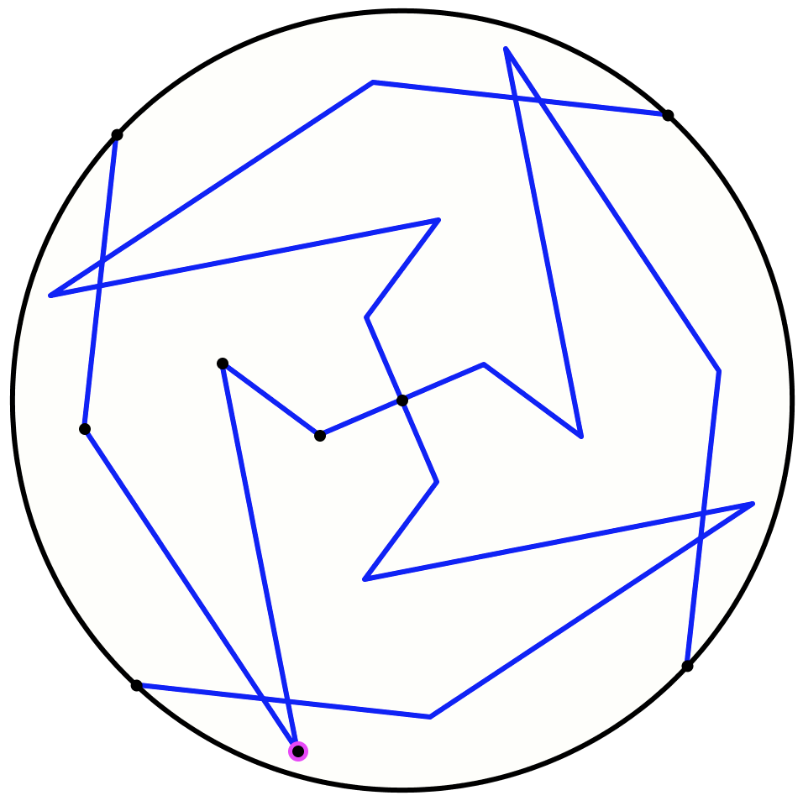
Another & Another
Draw a circle and divide it into four congruent pieces
Do it another way
Do it another way
What does experience of the task contribute to mathematical thinking?
Negotiating
‘same & different’
What could be varied?
What seems to be invariant?
What constrains variation?
Personal Narrative
Self-Explanation

Slide 6
Increasing Constraints
Draw a quadrilateral
Draw a quadrilateral with one pair of opposite sides perpendicular
Draw a quadrilateral with both pairs of opposite sides perpendicular
What does experience of the task contribute to mathematical thinking?
Revealing Awarenesses
Enriching accessible example space

Slide 7
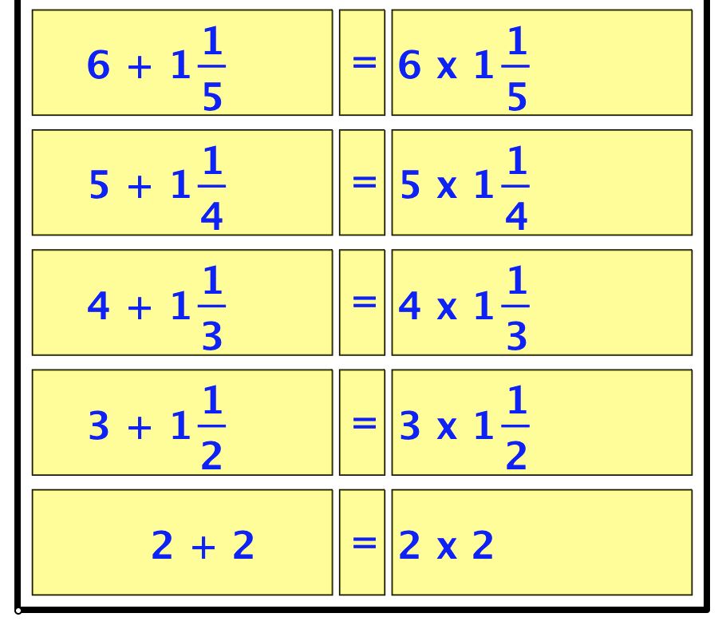
Patterns from 2
SVGrid

Slide 8
Patterns from 2
What does experience of the task contribute to mathematical thinking?
Discerning Details
Recognising Relationships
Perceiving Properties
Imagining & Expressing
Conjecturing & Convincing
Specialising & Generalising
SVGrid

Slide 9
Multi-Level Initiating of Tasks
In how many ways can a unit fraction be expressed as the difference of two unit fractions?
Notice that
Notice that
Purposeful Practise
(recent ATM publication)
Notes:
Ways of initiating activity through presentation of a task

Slide 10
Over Flow
Imagine a bucket containing water (not necessarily full)
Imagine an empty open-topped can being immersed in the bucket.
Imagine what happens to the water.
What variations might make a difference?
What questions might be asked?
What might work on the task contribute to mathematical thinking?

