Slide 1




When Counting Counts
Promoting Mathematical Thinking
John Mason
Affinity
Leicestershire
Feb 2016
The Open University
Maths Dept
University of Oxford
Dept of Education

Slide 2

Throat Clearing
Everything said here is a conjecture …
  … to be tested in your experience
My approach is fundamentally phenomenological …
I am interested in lived experience.
Radical version: my task is to evoke awareness (noticing)
So, what you get from this session will be mostly …
  … what you notice happening inside you!
Avoid the teaching of
speculators,
whose judgements are
not confirmed
by experience.
(Leonardo Da Vinci)
Who takes initiative?
Who makes choices?
What is being attended to?

Slide 3
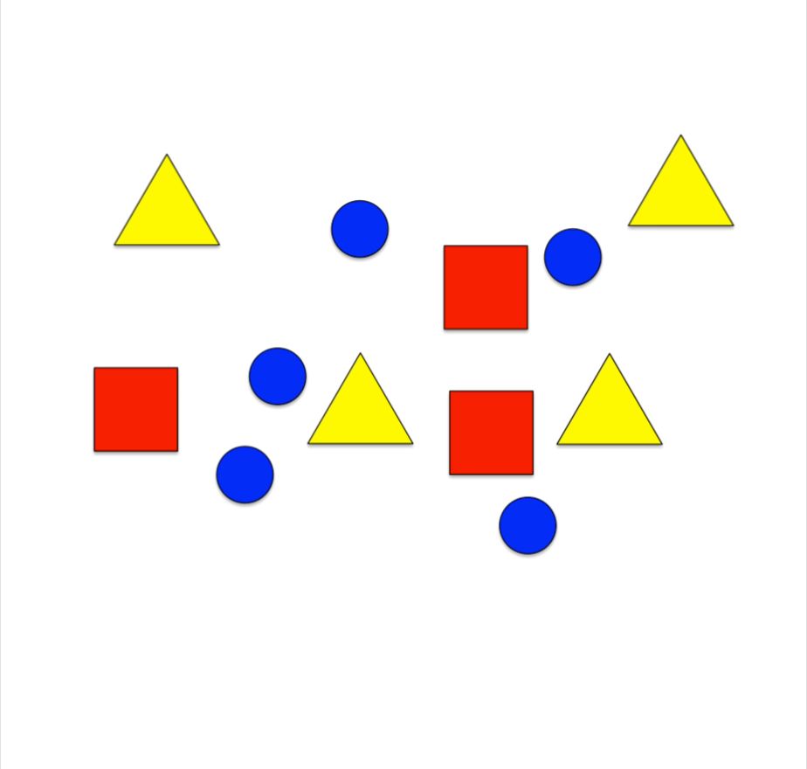
Counting
What if the objects were still, but your attention was darting about?
Notes:
What if the objects were still, but your attention was flitting about, not knowing what to settle on?

Slide 4
Counting
What if the objects were still, but your attention was darting about?
Notes:
What if the objects were still, but your attention was flitting about, not knowing what to settle on?

Slide 5
Count
How many white squares are there?
How did you do it?
How were you attending?
In how many different ways can you count the white squares?
Count blacks and subtract
  Notice 6 rows of 3 blacks & 3 rows of 1 black
  Notice 6 columns of 3 black & 3 columns of 1 black
  Notice diagonal stripes of blacks
  Columns: 3 lots of (3 + 3 + 1) blacks
Similar for whites
Notice the effect on your attention between these two task types
Notice what you do with your attention to make sense of these ways
Resolución de Problemas de Final Abierto Chile 2013 p67
Notes:
Introduction to Frequency Tables and means
Seeking relationships

Slide 6
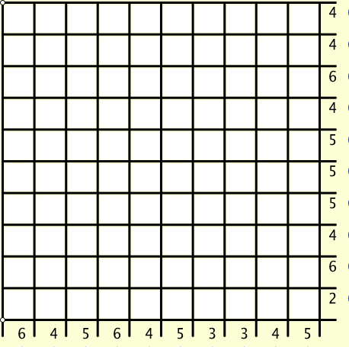
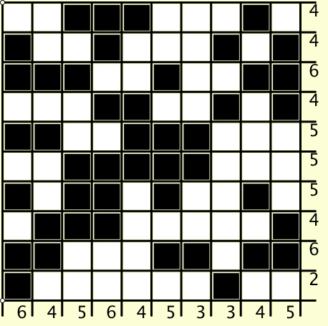
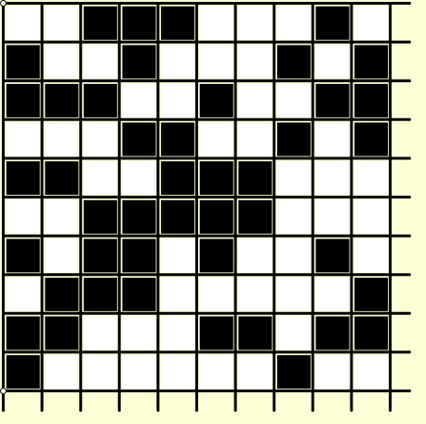
Grid Counts
For each row and column, how many cells are black?
Too Hard!
What did you
(have to) do
with your attention?
Too Hard!
That is a ‘doing’
What would be an
‘undoing’?
Notes:
What might be interesting is how you need to control your attention.

Slide 7
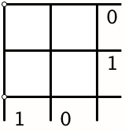
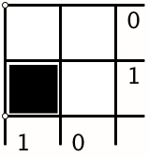
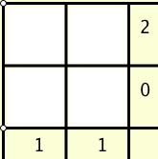
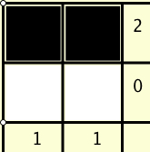
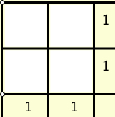
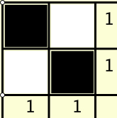
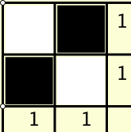
Specialising Undoing Grid Counts
What’s the same
and
what is different?
Invariance in the midst of change
Notes:
Withdrawing from action and reflecting
Immersion in mathematical thinking, not ‘memorising’ classroom rubric!

Slide 8
Grid Counts
For each row and column, how many cells are coloured?
1
1
2
1
1
2
2
1
2
0
1
1
1
1
1
1
3
1
1
1
1
1

Slide 9
Reflection
Withdrawing from action
Becoming aware of an action, or a relationship
NOT ‘telling them so they remember’
BUT rather
immersing them in a culture of mathematical practices

Slide 10
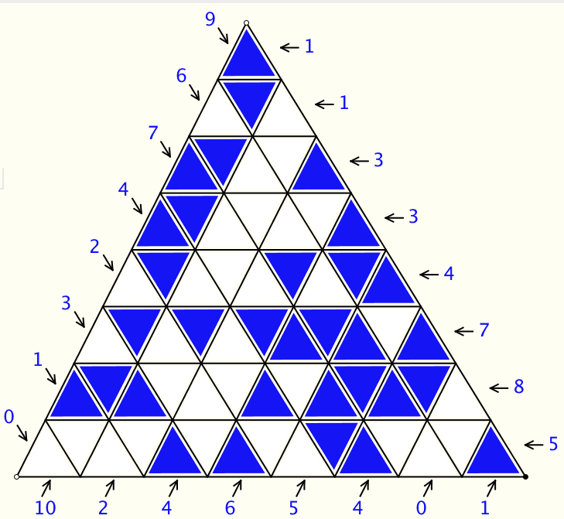
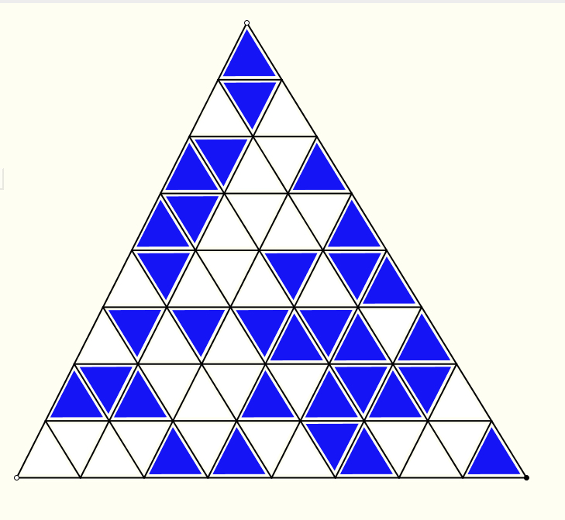
How Many Cells are Blue on Each Line?
What do you have to do with your attention?

Slide 11
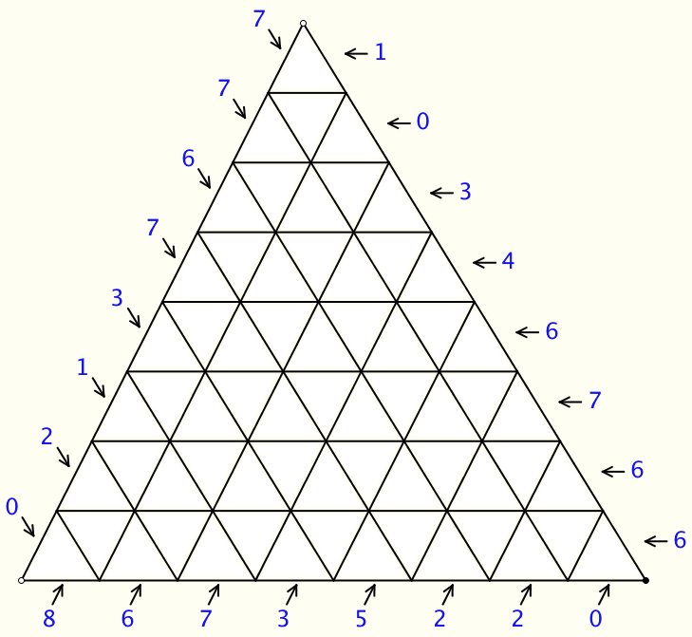
Which Cells are Coloured?
Doing & Undoing

Slide 12
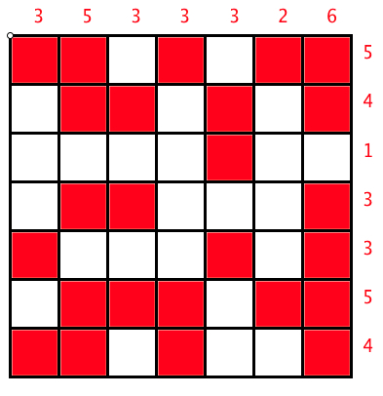
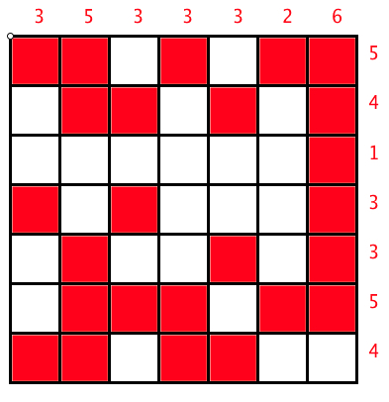
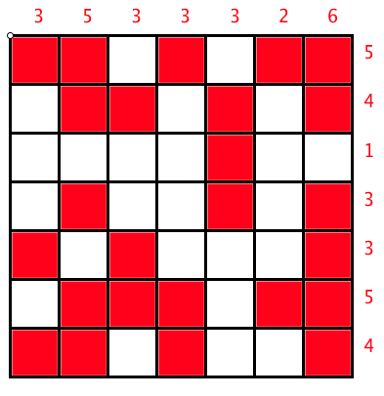
Same & Different
What’s the same and what different between these?
How did you use your attention?

Slide 13
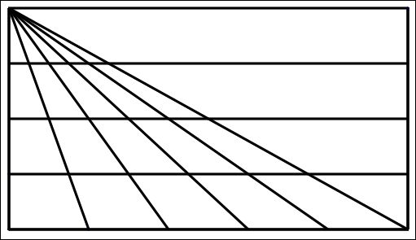
Triangle Count
In how many different ways might you count the triangles?
(5 + 4 + 3 + 2 + 1) x 4 + 1
What are you attending to?
Notes:
15 x 4 + 1

Slide 14
Square Count
How many squares can you see?
What question am I going to ask you?
In how many different ways can you count them?
What were you doing with your attention?
Notes:
16?

Slide 15
Set Ratios
In how many different ways can you place 17 objects so that there are equal numbers of objects in each of two sets?
What about requiring that there be twice as many in the left set as in the right set?
What about requiring that the ratio of the numbers in the left set to the right set is 3 : 2?
What is the largest number of objects that CANNOT be placed in the two sets in any way so that the ratio is 5 : 2?
What can be varied?
S₁
S₂

Slide 16
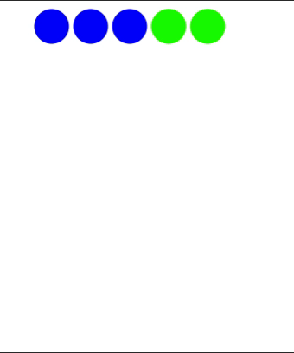
Three for Me and Two for You
Language of multiplicative comparison
Notes:
What fraction of the whole will be a given colour? What fraction of one colour is another colour?
What percentage will be a given colour?
What is the ratio between two different colours?
What ratios can there be between different combinations of colours?
Make up your own!

Slide 17

Sharing
In how many different ways can you express the relationships?
Notes:
What fraction of the whole will be a given colour? What fraction of one colour is another colour?
What percentage will be a given colour?
What is the ratio between two different colours?
What ratios can there be between different combinations of colours?
Make up your own!

Slide 18
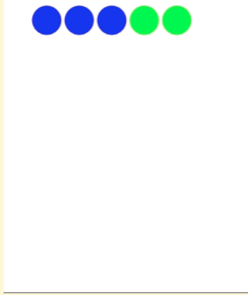

Same & Different
Notes:
What fraction of the whole will be a given colour? What fraction of one colour is another colour?
What percentage will be a given colour?
What is the ratio between two different colours?
What ratios can there be between different combinations of colours?
Make up your own!

Slide 19
Frieze
It is known that this frieze pattern is generated by a repeating block of cells, and that a generating block appears at least twice.
What question(s) might you ask?
What colour is the 100th cell?
In what position is the 100th green cell?
Make up your own
  Make an easy one
  Make a challenging one
What makes it challenging?
Notes:
Chant the sequence of colours … you might find your chanting falling into a rhythm! (Watch What You Do)

Slide 20
Problem Solving
What is a ‘problem’?
  When is a problem?
  When someone experiences something as problematic, as curious, or in need of explanation
Where do suitable ‘problems’ come from?
  From people’s experiences
  So promoting ‘problem-posing’ is vital
    Just as expressing generality is a precursor to being asked to manipulate algebraic expressions
    So is posing your own questions a precursor to problem solving.
How do learn what sorts of questions are mathematically interesting?
  By being asked such questions
  From experience

Slide 21
Teaching More by Teaching Less
Getting learners to make significant choices
  Especially mathematical choices
Prompting Learners to pose questions
  Co-emerging with learning what questions might be fruitful
Trying to do for learners only what they cannot yet do for themselves
  Scaffolding & Fading
Invoking and Evoking their powers
  Imagining & Expressing
  Specialising & Generalising
  Conjecturing & Convincing
  Organising & Characterising
Encountering Pervasive Mathematical Themes
  Doing & Undoing
  Invariance in the midst of change
  Freedom & Constraint
Notes:
Assigning one person to be in charge of choosing numbers for that lesson
Assigning one person to be in charge of choosing letters (for algebra)
Each person constructing their own example(s) to try things out on (specialising)
Co-emergence of problem posing and problem solving: Jenni Ingram

Slide 22
Reflection as Self-Explanation
What struck you during this session?
What for you were the main points (cognition)?
What were the dominant emotions evoked? (affect)?
What actions might you want to pursue further? (Awareness)
Notes:
Chi et al

Slide 23
To Follow Up
PMTheta.com and mcs.open.ac.uk/jhm3
john.mason@open.ac.uk
Designing & Using Mathematical Tasks (Tarquin)
Mathematics as a Constructive Enterprise (Erlbaum)
Thinking Mathematically (Pearson)
Key Ideas in Mathematics (OUP)
Researching Your own Practice Using The Discipline of Noticing (RoutledgeFalmer)
Questions and Prompts: (ATM)
Annual Institute for Mathematical Pedagogy
(end of July: see PMTheta.com)

Slide 24
Bag Constructions (1)
Place coloured objects into four bags such that for each pair of bags, there is just one colour for which the total number of that colour in the two bags is 3.
Back
Notes:
Minimising one aspect may not minimsie the other!

Slide 25
Bag Constructions (2a)
For b bags, how few objects can you use so that each pair of bags has the property that there are exactly two colours for which the difference in the numbers of that colour in the two bags is exactly 1.
Back
Notes:
Minimising one aspect may not minimsie the other!

Slide 26
Bag Constructions (2b)
Here there are three bags. If you compare any two of them, there is exactly one colour for which the difference in the numbers of that colour in the two bags is exactly 1.
For four bags, what is the least number of objects to meet the same constraint?
For four bags, what is the least number of colours to meet the same constraint?
17 objects
3 colours
Back
Notes:
Minimising one aspect may not minimsie the other!

Slide 27
Bag Constructions (3)
Here there are 3 bags and two objects.
There are [0,1,2;2] objects in the bags and 2 altogether
Given a sequence like [2,4,5,5;6] or [1,1,3,3;6] how can you tell if there is a corresponding set of bags?
In how many different ways can you put k objects in b bags?
Back
Notes:
Encountering unfamiliar notation: Charachterising
The last is a very difficult, possibly even unsolved problem!

Slide 28
Marbles
If John gives one of his marbles to Chris, they will then have the same number of marbles.
If John gives three of his marbles to Anne and Anne gives two of her marbles to Kate, they will all then have the same number of marbles.
If John gives two of his marbles to Quentin, then Quentin will have twice as many marbles as John then has.
What can be varied?
How does that change the thinking?
Back

Slide 29
Doing & Undoing
What operation undoes ‘adding 3’?
What operation undoes ‘subtracting 4’?
What operation undoes ‘subtracting from 7’?
What are the analogues for multiplication?
  What undoes ‘multiplying by 3’?
  What undoes ‘dividing by 4’?
  What undoes ‘multiplying by 3/4’?
    Two different expressions!
    Dividing by 3/4
    or Multiplying by 4 and dividing by 3
What operation undoes dividing into 12?
Notes:
Dave Hewitt’s THOAN sequences

Slide 30
Composite Doing & Undoing
I am thinking of a number …
What’s my number?
I add 8 and the answer is 13.
What’s my number?
I add 8 and then multiply by 2;
the answer is 26.
I add 8; multiply by 2; subtract 5;
the answer is 21.
What’s my number?
I add 8; multiply by 2; subtract 5; divide by 3;
the answer is 7.
What’s my number?
HOW do you turn +8, x2, -5, ÷3 answer into a solution?
7
Generalise!

Slide 31

Think Of A Number (ThOAN)
Think of a number
Add 2
Multiply by 3
Subtract 4
Multiply by 2
Add 2
Divide by 6
Subtract the number you first thought of
Your answer is 1
7
7
+ 2
3x + 6
7
7
3x + 2
6x + 4
7
6x + 6
7
+ 1
7
1

Slide 32
Using Tracking Arithmetic
?
3+4x7
+6x4+
4x1+8
3+3x7
+3x4+1
7+3x4
+3x1+8
3+2x7
+4
7+2x4
+1
4+2x1
+8
3
7
4
1
8
3+7
7+4
4+1
1+8
3
7
4
1
8
What could be varied?
Notes:
Applies to Pascal’s triangle; Leibniz’s triangle, multiplication and other tables

Slide 33
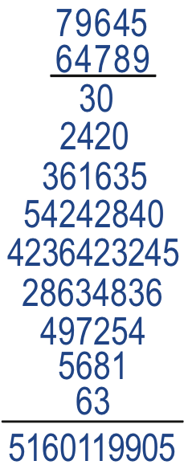
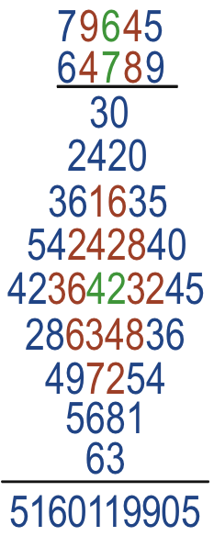
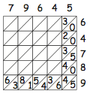
Diamond Multiplication
Notes:
What is going on here?

Slide 34
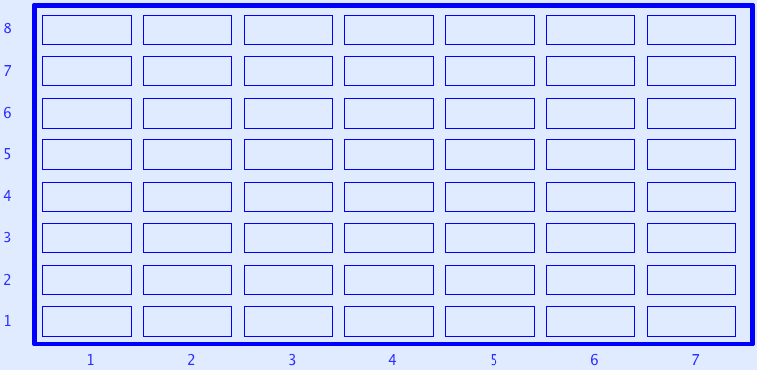
Sundaram Grids
7
12
4
7
If a number appears in this grid (extended to the right and up) then
doubling it and adding 1
gives a composite number.
All rows and columns are arithmetic progressions
How many entries do you need to fill out the grid?
Notes:
Drc=6, Dr=4 Dc=3 S=1 –> numbers that are the product of two numbers, one odd, the other congruent to 1 mod 3
Drc*rc+r(Dr-Drc)+c(Dc-Drc)+Drc-Dr-Dc+S
Disturbance; challenge + Trust that it is not excessive

