Slide 1


What varies and what stays the same? Insights into mathematics teaching methods based on variation
University of Oxford
Dept of Education
Promoting Mathematical Thinking
Anne Watson
Middlesex March 2015

Slide 2
Plan for this workshop
Direct experience of the use of variation
Examples from textbooks
Mapping variation and invariance
Variation principles in area learning
Critical features
Directing attention

Slide 3
Taxi cab geometry
Dt(P, A) is the shortest distance from P to A on a two-dimensional coordinate grid, using horizontal and vertical movement only. We call it the taxicab distance.
For this exercise A = (-2,-1). Mark A on a coordinate grid.
For each point P in (a) to (h) below calculate Dt(P, A) and mark P on the grid:
P = (1, -1)
(b) P = (-2, -4)
(c) P = (-1, -3)
(d) P = (0, -2)
(e) P = ( , -1 )
(f) P = (-1 , -3 )
(g) P = (0, 0)
(h) P= (-2, 2)

Slide 6
Variation and invariance
Coloured rods
Length Colour Shape
v v v
Plain rods
Length Colour Shape
v i v

Slide 7
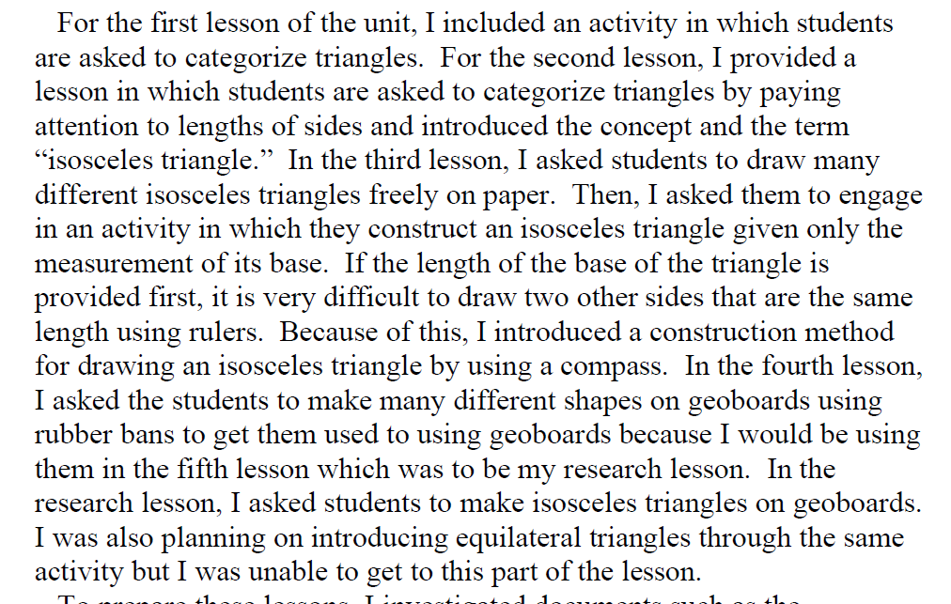
A student-teacher’s planning notes: Japan

Slide 8
Overall plan (six lessons)
Categorise triangles
Categorise according to length: name isosceles and equilateral
Draw isosceles triangles freehand
Construct on a given base using pair of compasses
Make different shapes on geoboard
Make isosceles triangles on geoboard (and repeat for equilateral triangles)

Slide 9
Variation theories
Chinese:
One problem multiple methods of solution (OPMS)
One problem multiple changes (OPMC)
Multiple problems one solution method (MPOS)
Swedish (English):
We notice the feature that varies against a background of invariance (inductive reasoning from patterns)

Slide 10
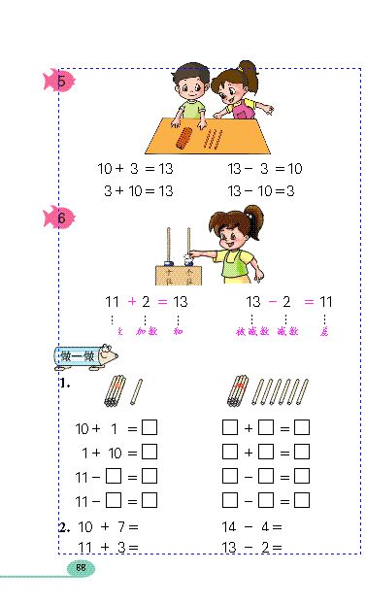
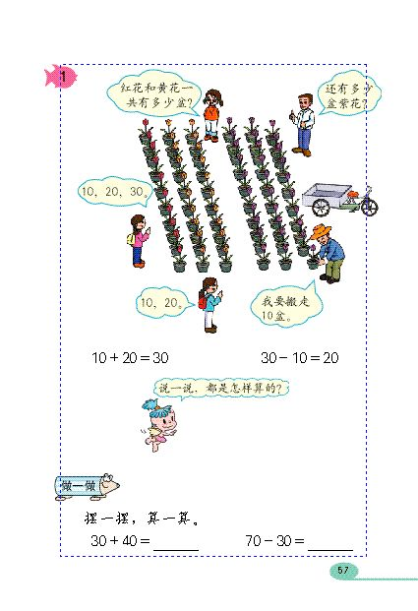

Slide 11
Variation and invariance
lesson stage | parts | whole | relationship | materials | format | operation | OPMS, OPMC, MPOS?
1
2
3
4
5

Slide 12
Variation and invariance
lesson stage | parts | whole | relationship | materials | format | operation | OPMS, OPMC, MPOS?
1 | i | i | i | i | v | v
2 | v | i | i | v | i | i
3 | i | i | i | i | v | v
4 | i | i | i | i | v | v
5 | v | v | i | none | v | v

Slide 13
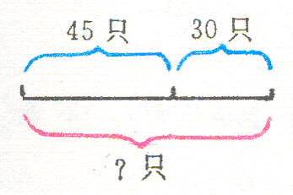
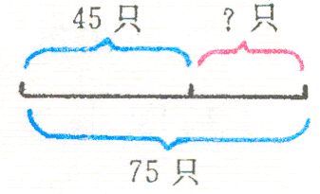
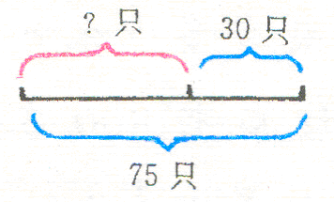
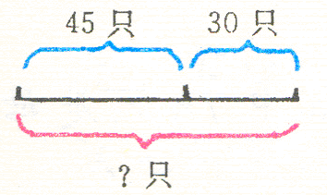
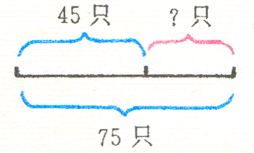
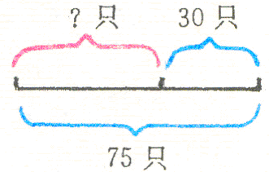
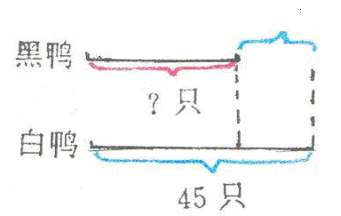
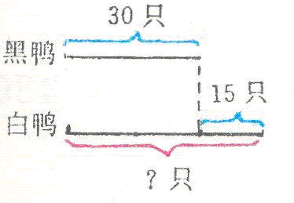
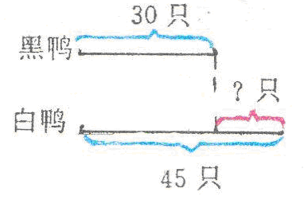
First solve the nine problems below. Then explain why they have been arranged in rows and columns in this way, finding relationships.
In the river there are 45 white ducks and 30 black ducks. All together how many ducks are there? | In the river there are white ducks and black ducks. All together there are 75 ducks. 45 are white ducks. How many black ducks are there? | In the river there are white ducks and black ducks. All together there are 75 ducks. 30 are black ducks. How many white ducks are there?
(1) In the river there is a group of ducks. 30 ducks swim away. 45 ducks are still there. How many ducks are in the group (at the beginning)? | (2) In the river there are 75 ducks. Some ducks swim away. There are still 45 ducks. How many ducks have swum away? | (3) In the river there are 75 ducks. 30 ducks swim away. How many ducks are still there?
(1) In the river there are 30 black ducks. White ducks are 15 more than black ducks (black ducks are 15 less than white ducks). How many white ducks are there? | (2) In the river there are 30 black ducks and 45 white ducks. How many white ducks more than black ducks (How many black ducks less than white ducks)? | (3) In the river there are 45 white ducks. Black ducks are 15 less than white ducks (white ducks are 15 more than black ducks). How many black ducks are there?

Slide 14
Examples
Finland textbook
17 - 9 =
27 – 9 =
37 – 9 =
47 – 9 =
...

Slide 15
Variation and invariance
variation | invariance | what can be reasoned from patterns? | OPMS, OPMC, MPOS? Control variables for inductive reasoning
Tens digit in ‘whole’ Tens digit in ‘answer’ | Part-whole relationship Subtraction Units digits | Nine-ness
Suggest next variation, and why it might be useful

Slide 16
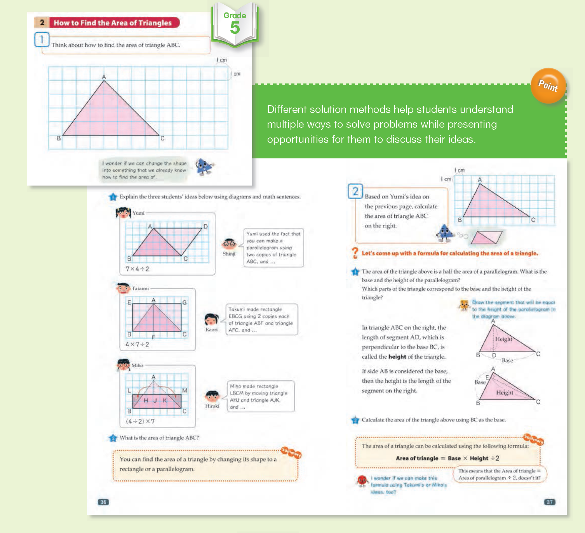
Area of triangles

Slide 19
I wonder if we can make this formula using Takumi’s and Miho’s ideas too

Slide 20
OPMS
One problem, multiple solution methods:
multiple ways of finding area
multiple ways of finding formula
So far, only two problems, so now we need OPMC – what changes can be made?
What changes have been made so far?
What other changes could be made?

Slide 21
Varying a critical feature: anticipate problems students will have
  Multiplication facts
  Not on squared paper
  Identifying base and height
  Orientation
  How does area vary when height varies?
  How does area vary if the base moves?
Is this an obstacle?
Is now the right time?
Vary base and height
Vary orientation
Control variation to explore relationship (graph)
Control relationship to explore area (theorem)

Slide 22
Theorem?
4 cm
4 cm

Slide 23
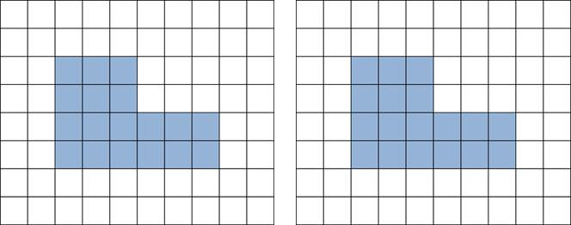
How could you find the area of this shape? (China)
What could the conceptual aim be?
Then what?

Slide 24
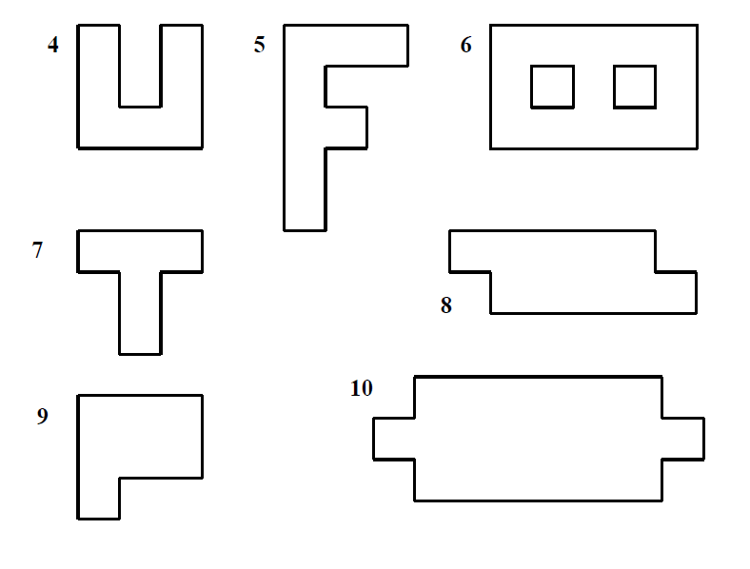

Slide 25
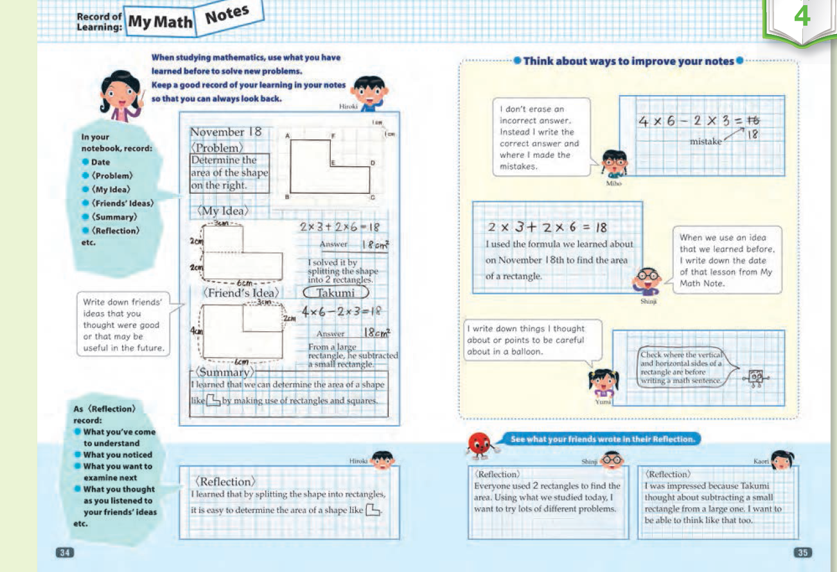
Japan, same task ...

Slide 26
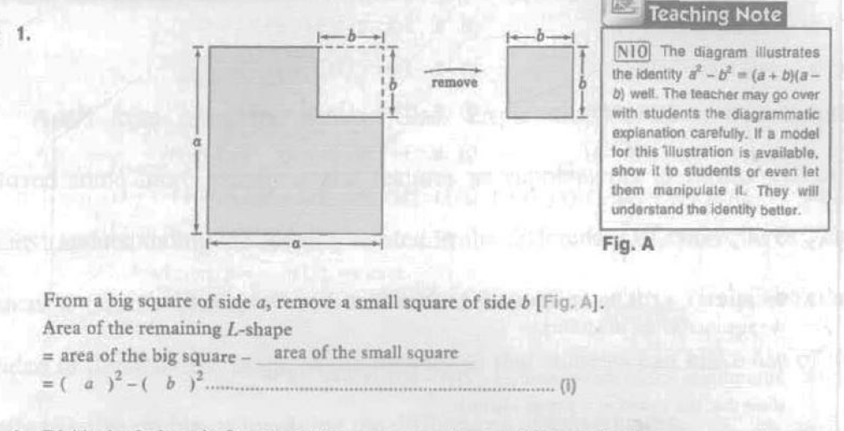
Lost textbooks .....

Slide 27
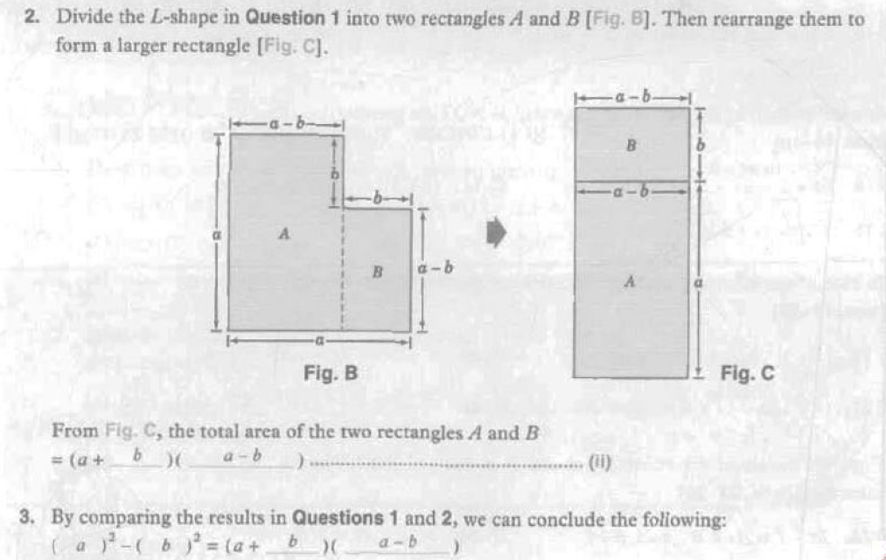

Slide 28
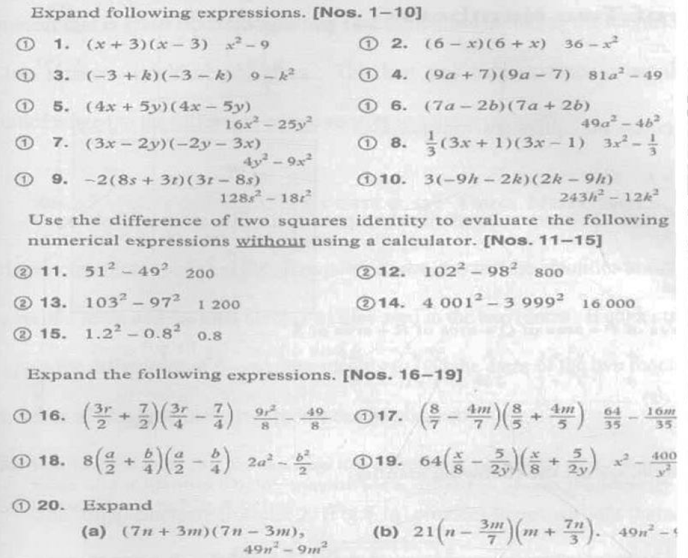

Slide 29
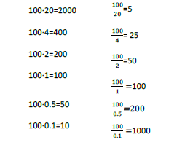
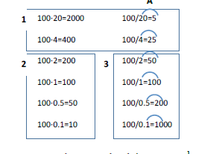
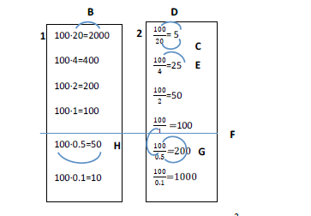
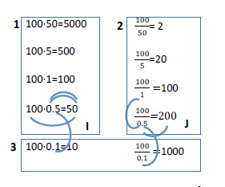

Slide 30
Purposeful exercises to generalise
…
( x – 2 ) ( x + 1 ) = x² - x - 2
( x – 3 ) ( x + 1 ) = x² - 2x - 3
( x – 4 ) ( x + 1 ) = x² - 3x - 4
…
Notes:
What comes after … in form; in detail? With the grain
What comes before …

Slide 31
Notes:
Also the role of diagram, visual effects, (e.g. the simultaneous graphs) interplay of variation with invariance

Slide 32
2,4,6,8 …
5,7,9,11 …
9,11,13,15 …

Slide 33
2,4,6,8 …
2,5,8,11 …
2,23,44,65 …

Slide 34
2,4,6,8 …
3,6,9,12 …
4,8,12,16 …

Slide 35
Find a number half way between:
28 and 34
2.8 and 3.4
38 and 44
-34 and -28
9028 and 9034
.0058 and .0064

Slide 36
Ordering rational numbers: deep knowledge (China)
List these names of rational numbers largest to smallest:
-6 -1
Why these?
Teachers’ notes:
can be 3 – 2 1 – 2 – 1 ...
all ordered pairs representing the same rational number are called equivalent ordered pairs, e.g. (x,y) where x + = 1 + y.
Teachers have strong idea of the underlying generality they are teaching, and the set from which examples can be drawn, and that approaching them this way means we can have negative rational numbers.

Slide 37
Variation used in teaching
be clear about the intended concept to be learned, and work out how it can be varied
matching up varied representations of the same example helps learning
the intended object of learning is often an abstract relationship that can only be experienced through examples (e.g. additive relationship), so control the variation in the examples
when a change in one variable causes a change in another, learners need several well-organised examples and reflection to ‘see’ relation and structure
variation of appropriate dimensions can sometimes be directly visible, such as through geometry or through page layout
draw attention to connections, similarities and differences
use deep understanding of the underlying mathematical principles

Slide 38
University of Oxford
Dept of Education
Promoting Mathematical Thinking
Anne Watson: anne.watson@education.ox.ac.uk

