Slide 1



Variations on Variation as an Educational Principle
The Open University
Maths Dept
Promoting Mathematical Thinking
University of Oxford
Dept of Education
John Mason
London Hubs
Oct 2017

Slide 2
Conjectures
Everything said here today is a conjecture … to be tested in your experience
The best way to sensitise yourself to learners
  is to experience parallel phenomena yourself
So, what you get from this session is what you notice happening inside you!

Slide 3
Inner & Outer Aspects
Outer
  What task actually initiates explicitly
Inner
  What mathematical concepts underpinned
  What mathematical themes encountered
  What mathematical powers invoked
  What personal propensities brought to awareness

Slide 4
Using Variation to Prepare a Lesson
Dimensions of possible variation (scope of the concept)
Dimensions of necessary variation (to bring difficult points and hinge points into focus)
Range of possible (permissible?) change
What conjectures?
What generalisations? (the difficult points)
Conceptual variation
Procedural variation (process; proceed; progress)
Who provides the variation?
Scaffolding (Pu Dian)

Slide 5
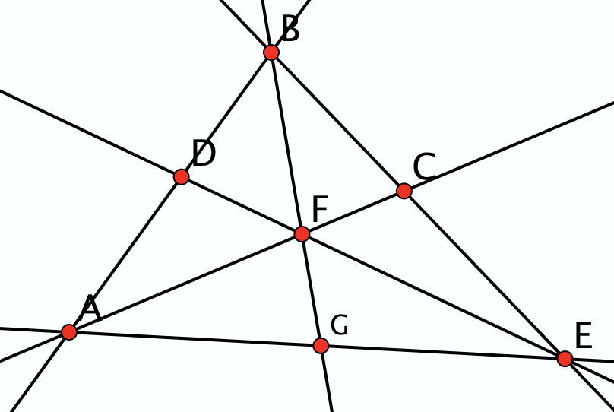
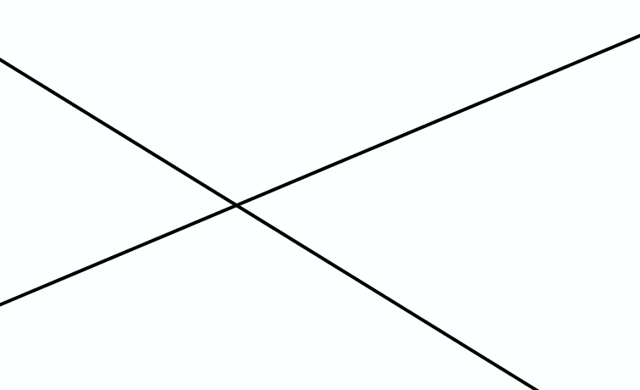
Opposite Angles
How many pairs of opposite angles can you find?
Developing facility in discerning opposite angles
Before engaging with their equality

Slide 6
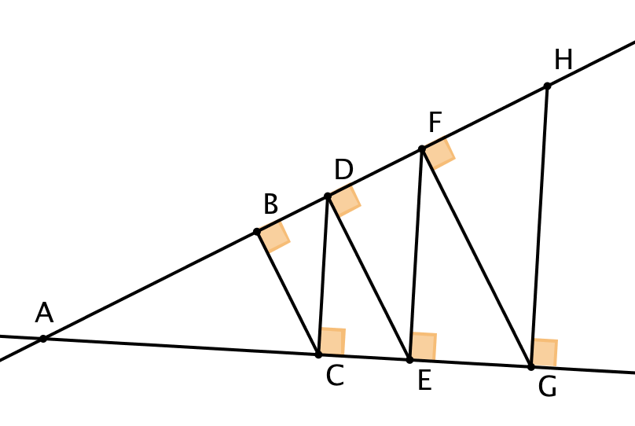
Similar Right Angled Triangles
How many right-angled triangles can you find with one angle equal to θ?
θ
Developing facility in discerning
right-angled triangles; then common angles;
only then consider consequences

Slide 7
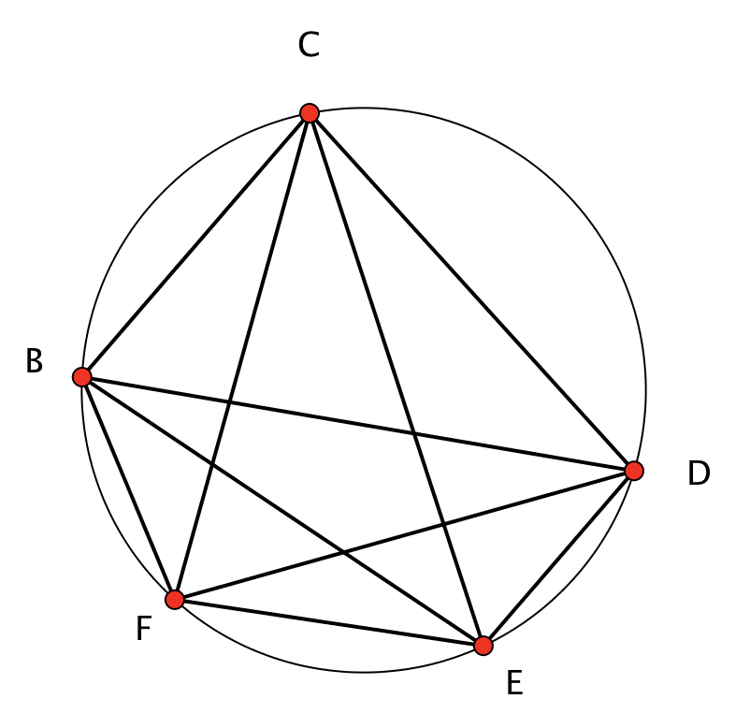
Subtended Angles
Find and describe three angles which are all subtended from the same chord.
Developing facility in recognising subtended angles before encountering a theorem about them
How few angles do you need to be told so as to work out all of the others?

Slide 8
Marble Sharing 1
If Anne gives one of her marbles to John, then she will have one more than twice as many marbles as John then has.
However, if instead, John gives Anne one of his marbles, he will have one more than a third as many marbles as Anne then has. How many marbles have they each currently?

Slide 9
Marble Sharing
Anne and John both have some marbles. They are going to share them: Anne will give John some of hers and John will then give Anne some of his.
Imagine you are observing this situation. How might you determine how many each are to give to the other?

Slide 10
Marble Sharing 2
If Anne gives John one of her marbles, she will then have one more than twice as many marbles as John then has.
If John started with 12 marbles, how many does Anne have?
What do I know?
What do I want?
John
Anne
What if …?
12
12 + 1
2 x (12 + 1) + 1
2 x (12) + 3

Slide 11
Raise your hand up when you can see …
Something that is 3/5 of something else
Something that is 2/5 of something else
Something that is 2/3 of something else
Something that is 5/3 of something else
What other fractional actions can you see?

Slide 12
Adding Fractions
Ready to practise?

Slide 13
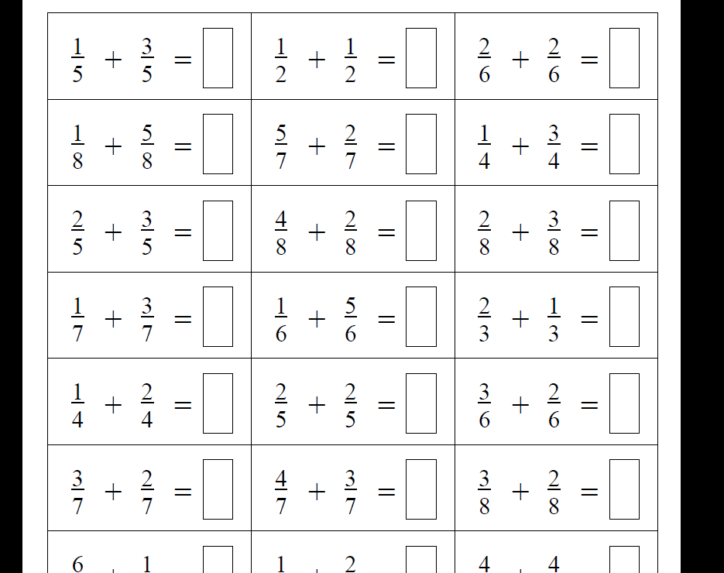
Notes:
Actually do some! Notice what you do and how you feel
Choice: work horizontally or vertically?

Slide 14
What are you doing?
What are you attending to?
What aspect of fractions do you have to think about?
Once a pattern-action is noticed, it keeps being repeated!
Notes:
A:

Slide 15
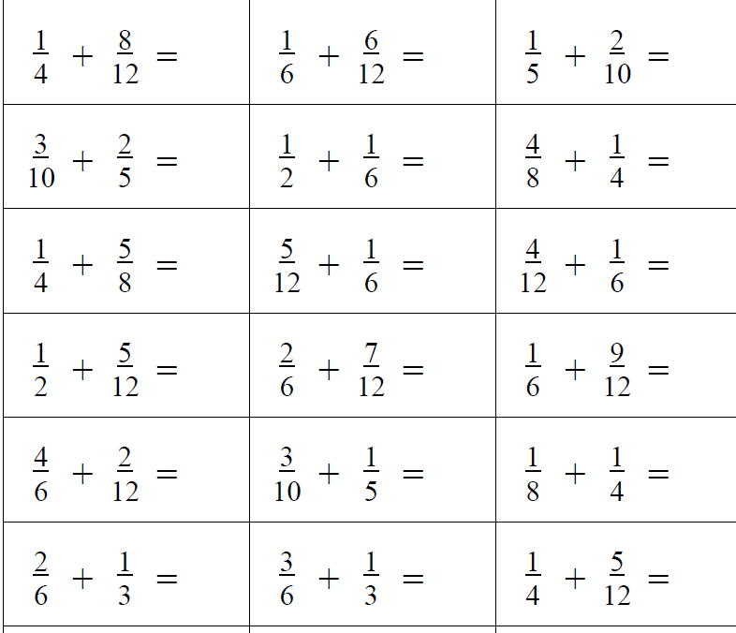
Notes:
Do Some! What is the same and what different about your experience with these?
Scanning mentally to locateaffordances or essence of task?

Slide 16
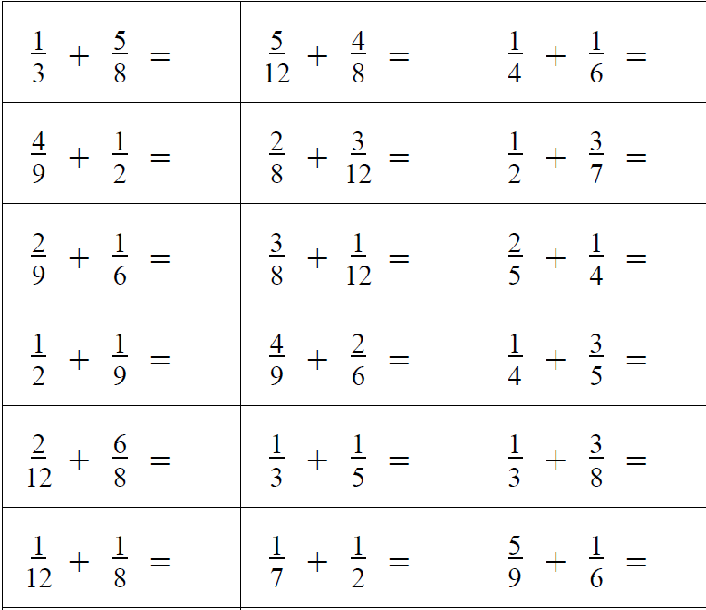
Notes:
What structural relationships do you detect?

Slide 17
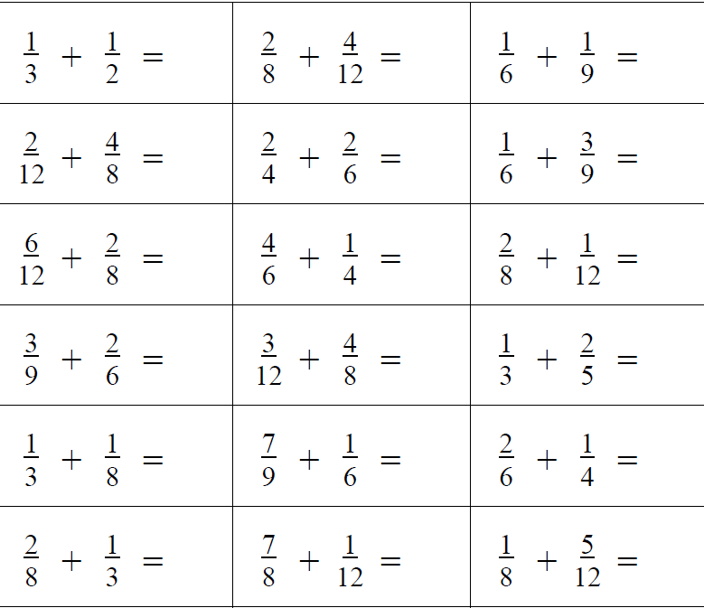
Would or could ‘it’ work?
Notes:
It was reported that “it worked” (in a class)

Slide 18
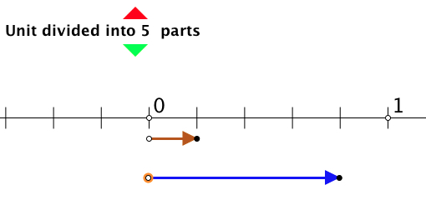
Number Line Fractions
Fractions applet offers model for sums to 1 of fractions with the same denominator,
i.e. you can position one fraction and predict where the second will take you.
Vary the denominator, also do sums to < 1, and then do sums to > 1 so as to model the meaning of mixed fractions.
Extend to different denominators where one is a multiple of the other.
Notes:
J: If using same denominators, then why not work with complements to the unit (parallels early number work) part-part-whole
Not showing the sum, because you want learners to be enacting the sum for themselves, not merely interpreting something as the sum.
Common (invariant) image not simply varying at random
Self-explanation (own story)

Slide 19
SWYS

Slide 20
Describe to Someone How to See something that is …
1/3 of something else
1/5 of something else
1/7 of something else
1/15 of something else
1/21 of something else
1/35 of something else

Slide 21
Considerations
Intended / enacted / lived object of learning
  Author intentions
  Teacher intentions
  Learner experience
Task
  Author intentions
  Teacher intentions
  As presented
  As interpreted by learners
  What learners actually attempt
  What learners actually do
  What learners experience and internalise
Didactic Transposition
Expert Awareness
is transformed into
Instruction in Behaviour
Notes:
A:
J: Didactic transposition
Expert teacher: knowledge of lived experiences of learners

Slide 22
More Considerations
critical aspects
focal points
difficult points
hinges
Notes:
A:
Invariance: individual aspect or multiplicity?

Slide 23
Talk and Plan
What could you do differently to ensure the lived object of learning is some critical aspect of fractions?
How might it be imperative & necessary to think about fractions while doing addition tasks?
Notes:
A:

Slide 24
Design of a question sequence for number line fractions applet
Content
  Same denominator
  Coordinating different denominators
  Sums to 1
  Going beyond 1
  Tenths
  Comparing to decimal notation etc.
Pedagogy
  Diagram maintaining link with meaning
  Teacher choice of examples
  Why tenths?
  Order (e.g when to do sums to 1 and why)
  Learner generated examples
Mathematical Questioning
vs
Generic Questioning
Notes:
A:
Giving power back to maths teachers to say what constitutes good questioning
in mathematics and away from generic senior management team

Slide 25
Reflection
Intended enacted lived object of learning
Critical aspects; focal point; difficult point; hinge
Use of variation to bring lived object of learning and intended object of learning together
Notes:
J: then A:

Slide 26
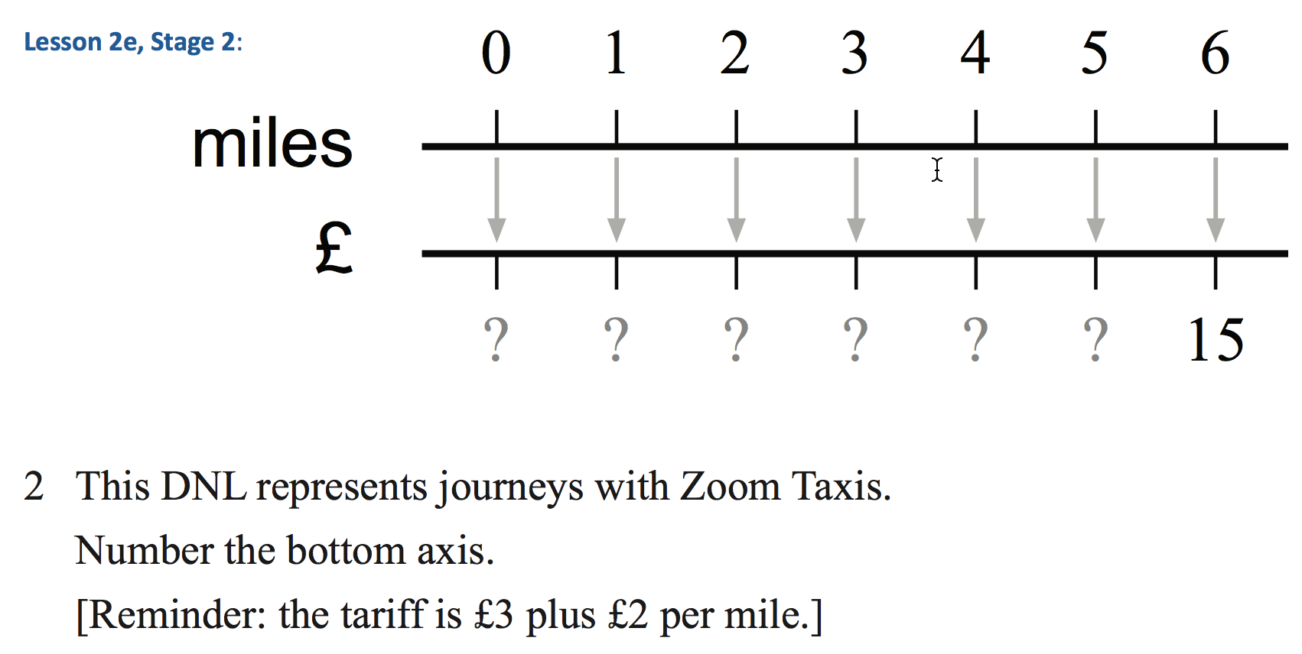

Slide 27
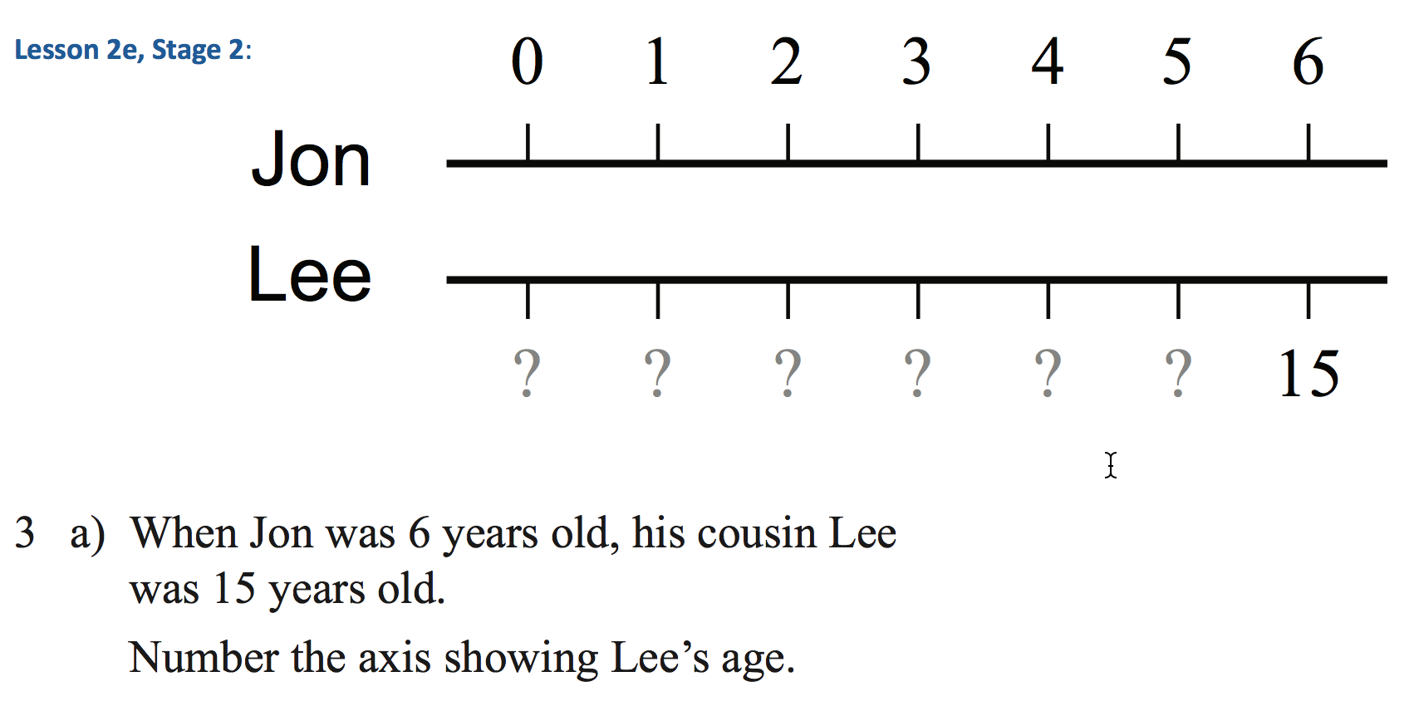

Slide 28
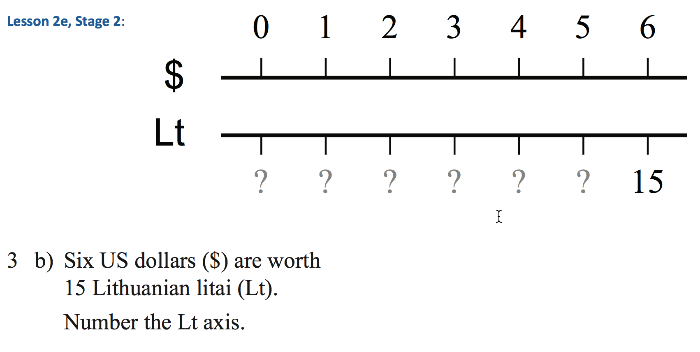

Slide 29
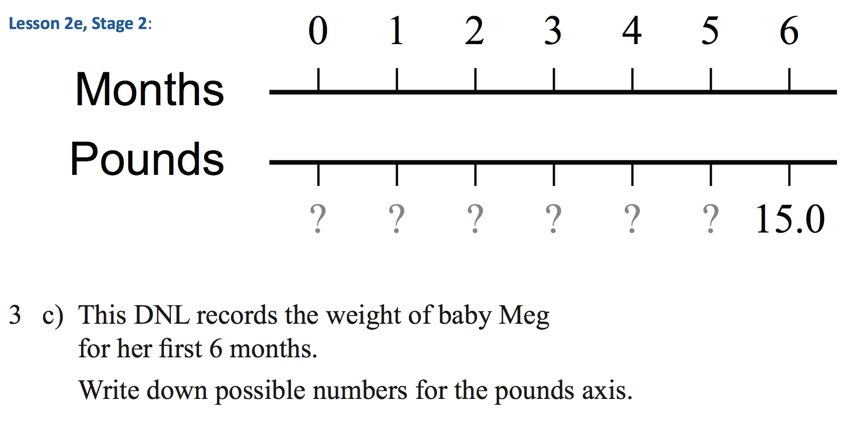

Slide 30
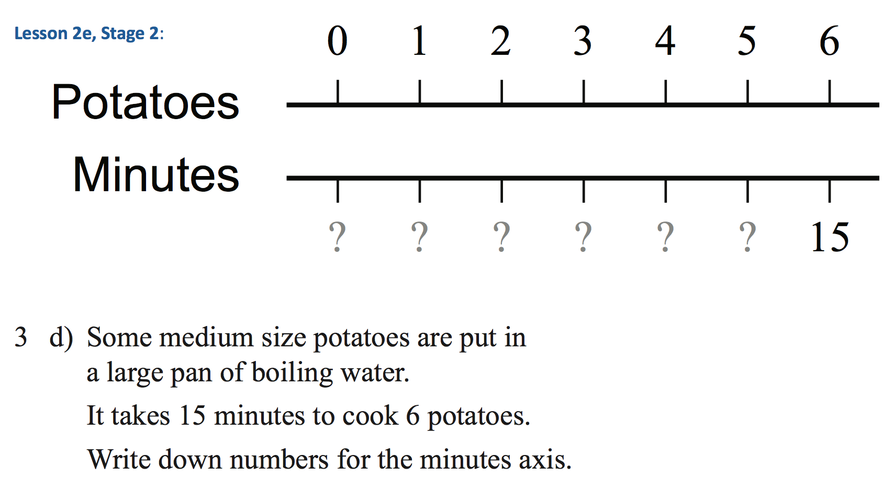

Slide 31
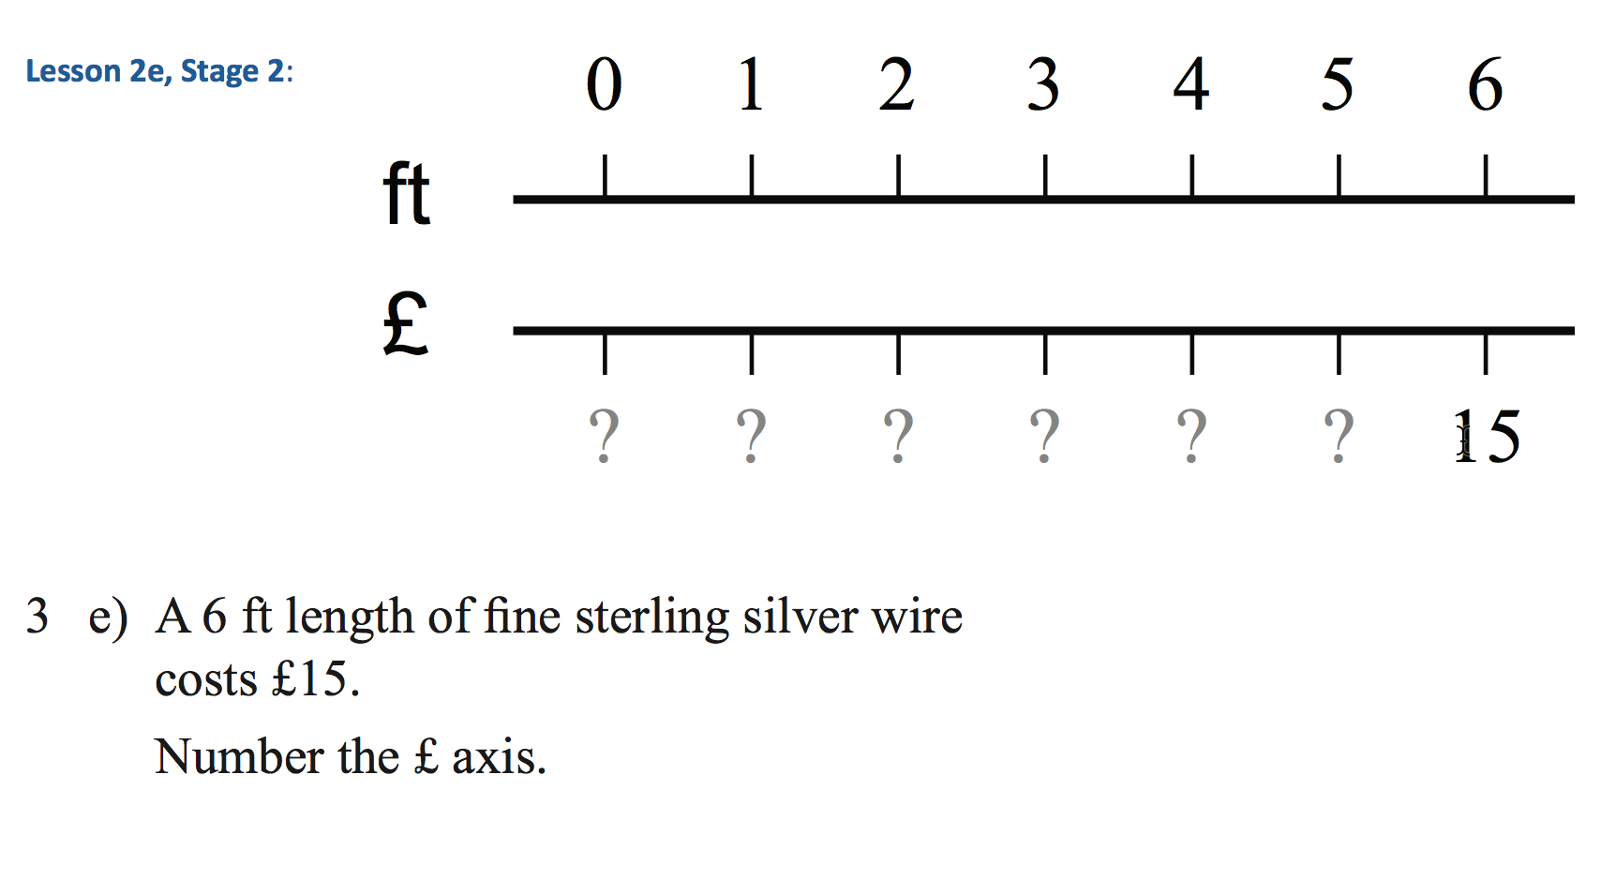

Slide 32
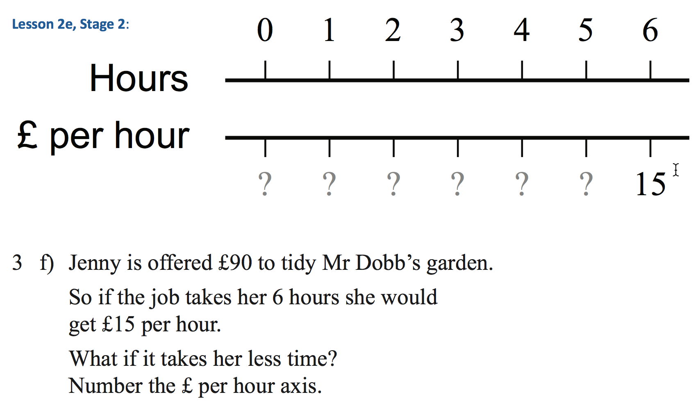

Slide 33
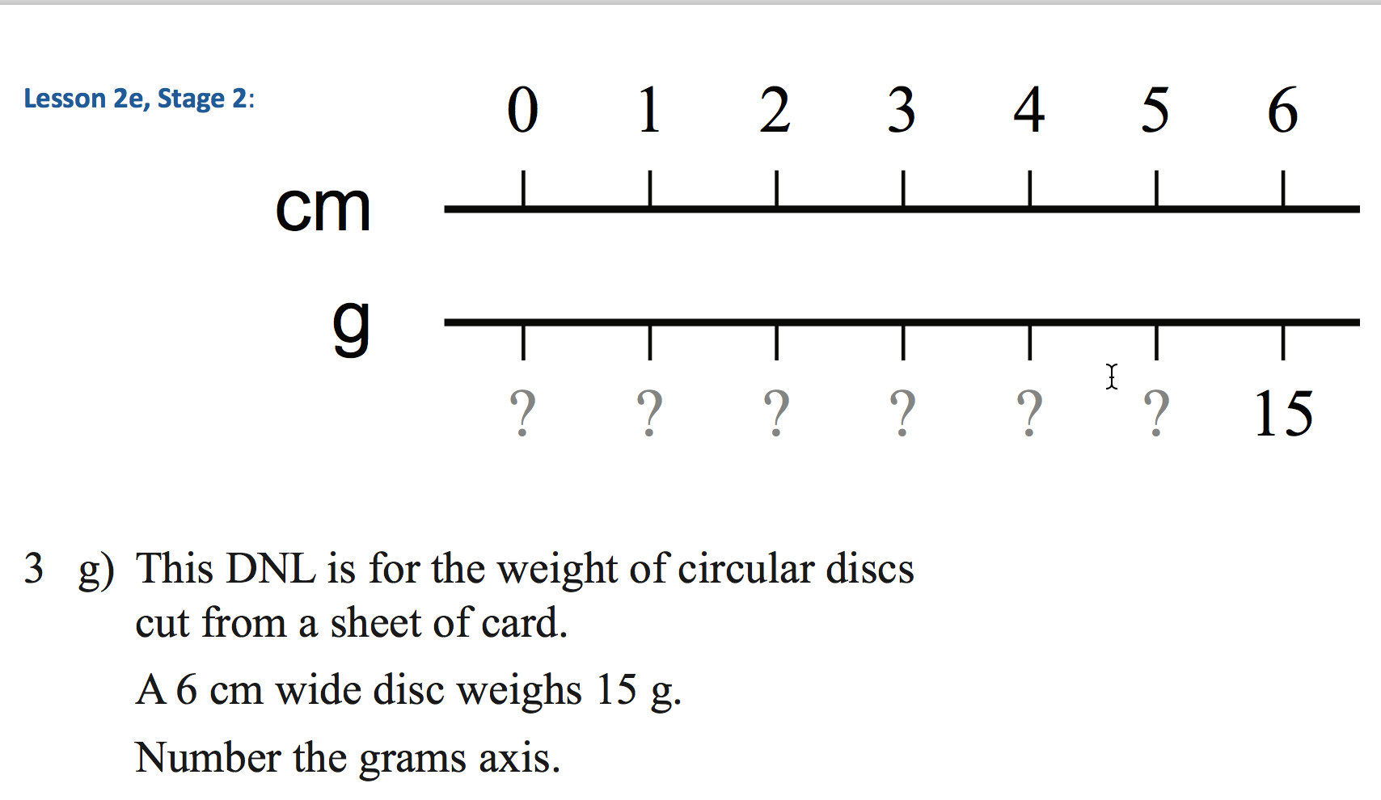

Slide 34
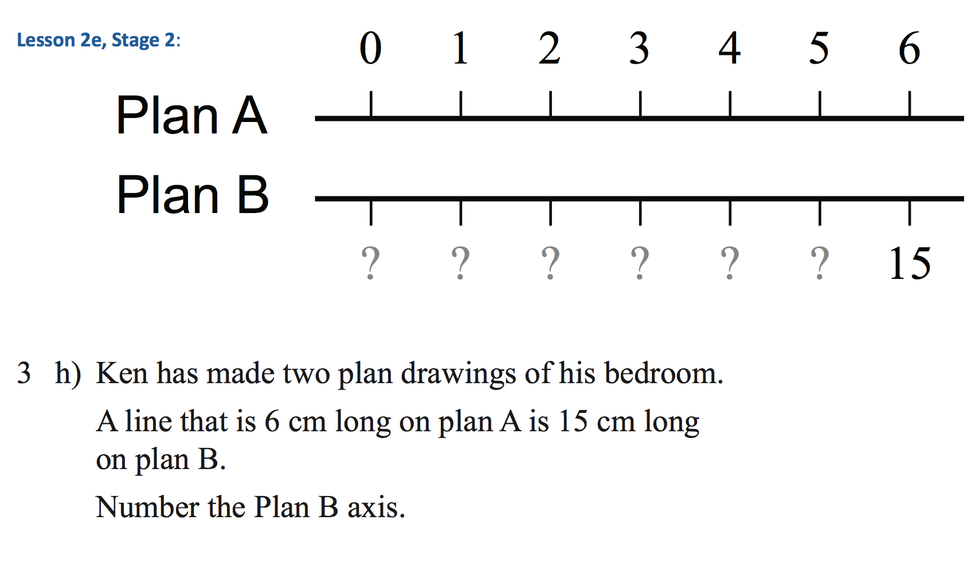

Slide 35
9 Variations
???
2xm + 3
J + 1
5x$/2
Oops!
5xft/2
90/Hours
5xcm/2
5xPlanA/2

Slide 36
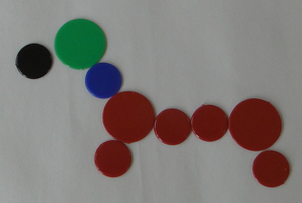
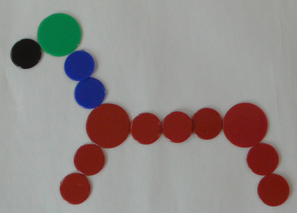
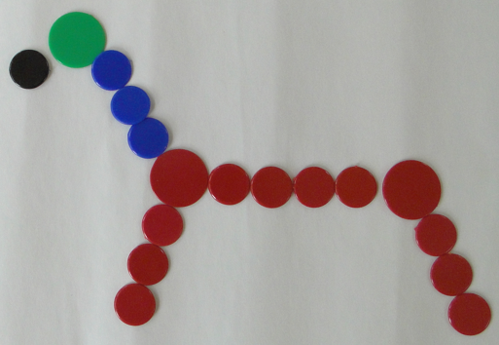
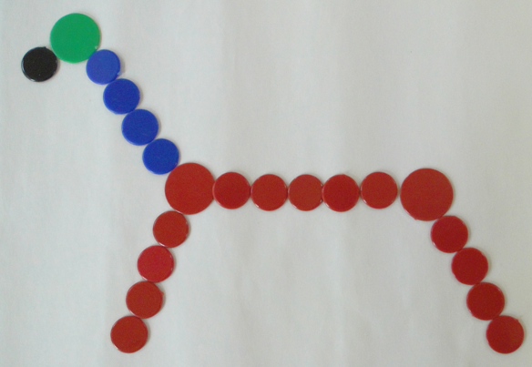
Counter Animals
What is the same and what is different about these animals?
For the missing animal, how many
  Green counters do you need?
  Black counters?
  Blue counters?
  Red counters?
  Large red counters?
1
2
3
I have a friend in Canada who wants to make one of my animals but I don’t know which one.
How can we tell her how many counters she needs of each colour and size?
4

Slide 37
Constrained Pictures
Make up a way of drawing a sequence of pictures which uses
  Picture-number red counters,
  2 lots of Picture-number blue counters
  2 less than 3 lots of Picture-number green counters
…
What is wrong with this diagram?
…
…
…
…
…
…
…
…
Picture-number

Slide 38
Calculation
278 + 341 – 248 – 371 = ?
Think First!
Depict in some way?
Denote in some way?
What did you catch yourself doing?
  Immediate calculating?
  Gazing at the whole? Discerning details?
  Recognising some relationships?
How is it being attended to?
  Holding Wholes (gazing)
  Discerning Details
  Recognising Relationships
  Perceiving Properties
  Reasoning solely on the basis of agreed properties
“No task is an island, complete unto itself”
Make up your own task like this one
How is your’s the same and different to mine?
Notes:
Advantage to ‘SWYS’ to yourself before embarking on an action

Slide 39
19th Century ‘Word-Problem’
A horse and a saddle together cost $10.00. The horse costs $2.00 more than the saddle. What does the horse cost?
Kahneman & Frederick have studied large numbers of people on this task. A large percentage start with the reaction $8.00.
Some check and modify, others do not.
Other studies: multiple solution strategies
Think First!
Depict in some way?
Denote in some way?

Slide 40
Reacting & Responding
If 2 eggs take 6 minutes to hard boil, how long will 20 eggs take to hard boil?
If 18 of 24 students take a test lasting 45 minutes, how long will the test last when all 24 take it?
If the captain of a ship takes on board 14 sheep, 5 cows, 35 chickens and 12 goats, how old is the captain?
English HighSchool students given some word problems in Chinese (Arabic Numbers) and other word problems in English performed better on the problems in …
  Chinese!
What is being studied?
deficiency
What they can’t do
What they didn’t do
Alternative
or
Joint
explanations
Didactic Contract
What they did do
What they can do
S1 automatism
Situated proficiency

Slide 41
Doing & Undoing
What operation undoes ‘adding 3’?
What operation undoes ‘subtracting 4’?
What operation undoes ‘subtracting from 7’?
What are the analogues for multiplication?
  What undoes ‘multiplying by 3’?
  What undoes ‘dividing by 4’?
  What undoes ‘multiplying by 3/4’?
    Two different expressions!
    Dividing by 3/4
    or Multiplying by 4 and dividing by 3
What operation undoes dividing into 12?
Notes:
Dave Hewitt’s THOAN sequences

Slide 42
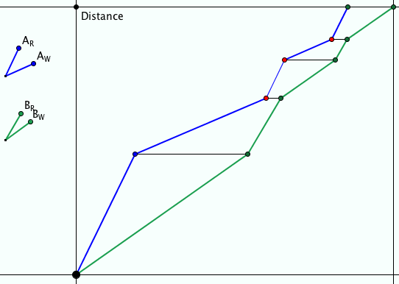
Ride & Tie
Two people have but one horse for a journey. One rides while the other walks. The first then ties the horse and walks on. The second takes over riding the horse …
They want to arrive together at their destination.
Imagine and sketch

Slide 43
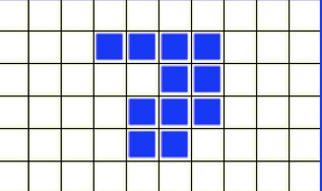
Area & Perimeter
Well known stumbling block for many students
An action becomes available so it is enacted
Perhaps because …
  to find the area you count squares
  To find the perimeter you (seem to) count squares!
Notes:
Conjectures to consider and modify:
The perimeter is always the perimeter of the smallest rectangle that just covers the shape
The perimeter is always 4 less than the number of squares needed to make a frame around the shape.

Slide 44

Two-bit Perimeters
What perimeters are possible using only 2 bits of information?
2a+2b
Holding one feature invariant
a
Tell yourself, then
tell a friend what you can vary and what is invariant
b
Notes:
Here I am changing what is invariant (previously perimeter, now bits of data).

Slide 45
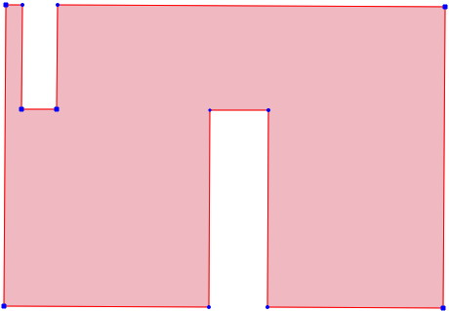
Two-bit Perimeters
What perimeters are possible using only 2 bits of information?
4a+2b
a
b
Notes:
How do you use your attention to verify the perimeter?

Slide 46
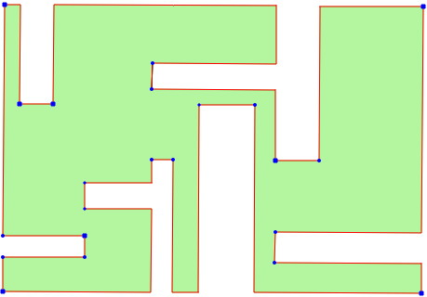
Two-bit Perimeters
Draw yourself a shape that requires only two pieces of information, made from an initial rectangle that is a by b, and having a perimeter of 6a + 4b.
Holding one feature invariant
Tell yourself, then
tell a friend what you can vary and what is invariant
a
b
Notes:
So, make a conjecture about what is possible!
Next task would be to articulate in words, then try to justify!

Slide 47
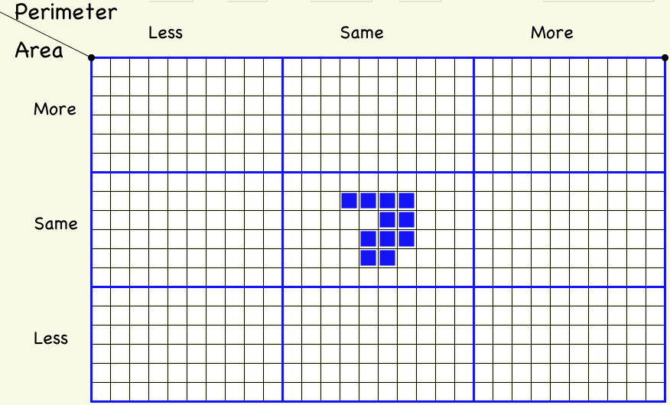
More or Less Grid
Notes:
The perimeter is always the perimeter of the smallest rectangle that just covers the figure.
It is also 4 less than the number of squares needed to make a frame to surround the shape.
This is an example

Slide 48
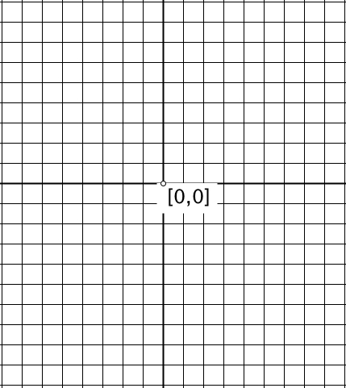
Another & Another
Draw, sketch or write an equation for …
a straight line through (0, 5)
Draw, sketch or write an equation for …
a straight line through the origin
Draw, sketch or write an equation for …
a straight line through both points
And another
And another
Notes:
A: Draw, sketch, or write an equation for a straight line through the origin.
Another & Another

Slide 49
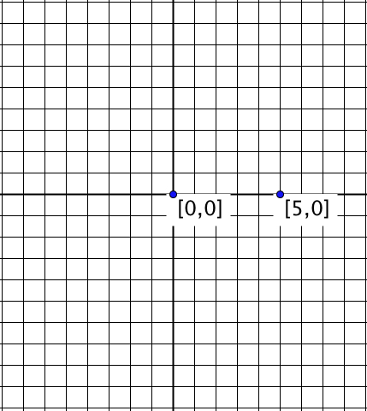
Notes:
Quadratic; Parabola Equation or plot or sketch
Another & Another

Slide 50
Gradients
Draw or write down two straight lines
whose x-intercepts differ by 1
And another pair
And another pair
Draw or write down two straight lines whose
x-intercepts differ by 1 and
whose y-intercepts differ by 1
And another pair
And another pair
Now draw or write down two straight lines whose
x-intercepts, whose y-intercepts and
whose slopes differ by 1
And another; And another

Slide 51
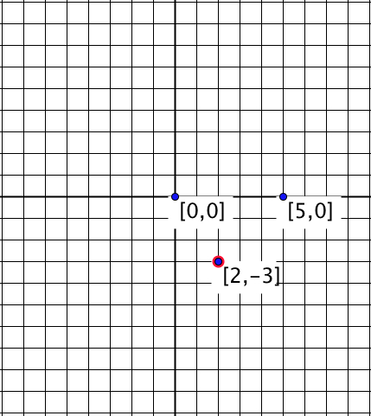
Notes:
Another & Another?? Why not?
Might need quite a bit of algebraic facility?
Return to earlier set up

Slide 52
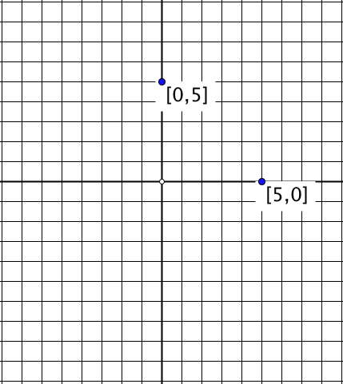
Notes:
Quadratics through these two points

Slide 53
Task 3: Design of Question Sequence
Construct an object
  and another
  and another
Variation on the object (and another, and another)
Introduce a new constraint (no others ...)
Ask similar questions of a new object
  and another
  and another
Variation in method
New kind of question/insight/concept
  and another
  and another (opportunity to experience)
Notes:
A:

Slide 54
Types of variation
Conceptual:
  presentations;
  representations;
  examples/non examples approaches;
  connections with what we already know;
  what mathematical problems this new idea is going to help us with;
  multiple experiences and perspectives; various critical aspects
Procedural:
  Multiple problems - one solution method
  One problem - multiple solution methods
  One situation - multiple presentations
Notes:
A:

Slide 55
Implications for quality of teaching
Anticipate what variation is necessary to develop procedural mastery (process; proceed; progress), and conceptual mastery
Critical aspects; focus; difficult points; hinges
Dimensions of variation to draw attention to the critical aspects and focus
Ranges of change that will focus attention
Examples and non-examples to delineate the concept
Representations (because the concept is abstract)
Lived object of learning;
  what they see, hear, do;
  what generalisations is it possible to make from their experiences?
Notes:
A:

Slide 56
Powers & Themes
Are students being encouraged
to use their own powers?
Powers
or
are their powers being usurped by textbook, worksheets and … ?
Imagining & Expressing
Specialising & Generalising
Conjecturing & Convincing
(Re)-Presenting in different modes
Organising & Characterising
Themes
Doing & Undoing
Invariance in the midst of change
Freedom & Constraint
Restricting & Extending
Exchanging

Slide 57
Summary
Concepts
  Vary aspects or features that can be varied without changing the concept
Problems
  Vary parameters
  Vary contexts while retaining the same calculations
Above all else …
  What can be varied (dimensions of possible variation)
  Over what range or scope (range of permissible change)

Slide 58
Reflection as Self-Explanation
What struck you during this session?
What for you were the main points (cognition)?
What were the dominant emotions evoked? (affect)?
What actions might you want to pursue further? (Awareness)
Notes:
Chi et al

Slide 59
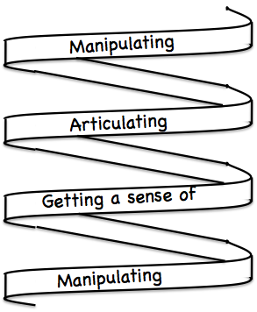
Frameworks
Enactive – Iconic – Symbolic
Doing – Talking – Recording
See – Experience – Master
Concrete – Pictorial– Symbolic

Slide 60
Reflection
It is not the task that is rich
  but the way the task is used
Teachers can guide and direct learner attention
What are teachers attending to?
  powers
  Themes
  heuristics
  The nature of their own attention

Slide 61
Forms of Attention
Holding Wholes (gazing): unfocused
Discerning Details
Recognising Relationships (in the situation)
Perceiving Properties (as being instantiated)
Reasoning on the basis of agreed properties
NOT levels as in van Hiele
BUT stances which may last for a very short time,
or which may be habitual or persistent
Conjecture:
if teacher and students are attending to different things
OR attending to the same thing but differently
Effective communication may be difficult!

Slide 62
To Follow Up
pmtheta.com
john.mason@open.ac.uk
Thinking Mathematically (new edition 2010)
Developing Thinking in Algebra (Sage)
Designing & Using Mathematical Tasks (Tarquin)
Questions and Prompts: primary (ATM)

