Slide 1
Teaching for Mastery: Variation Theory
Promoting Mathematical Thinking
Anne Watson and John Mason
NCETM Standard Holders’ Conference
March 18 2016
The Open University
Maths Dept
University of Oxford
Dept of Education

Slide 2
Ways of Working
We work through lived experience, ours and yours
We offer tasks for you, with colleagues
Notes:
J

Slide 3
Task 1: Taxi Cab Geometry
Taxi-cab distance Dist(P, A) is the shortest distance from P to A on a two-dimensional coordinate grid, using horizontal and vertical movement only. We call it the taxicab distance.
For this exercise A = (-2,-1). Mark A on a coordinate grid.
For each point P in (a) to (h) below calculate Dist(P, A) and mark P on the grid
P = (1, -1)
(b) P = (-2, -4)
(c) P = (-1, -3)
(d) P = (0, -2)
(e) P =
(f) P =
(g) P = (0, 0)
(h) P= (-2, 2)
Notes:
A using squared paper 15-20 minutes
Choice: point by point or plot them all first
In groups, can afford to take a risk

Slide 4
Reflection
How was it for you?
How did the variation in the examples influence what happened for you?
Have you made progress towards ‘mastery’ of taxi-cab geometry? What progress?
Notes:
J Worth writing down conjectures about relationships between mastery and variation
arising from your experience in this example

Slide 5
Task 2: Adding Fractions
Ready to practise?

Slide 6
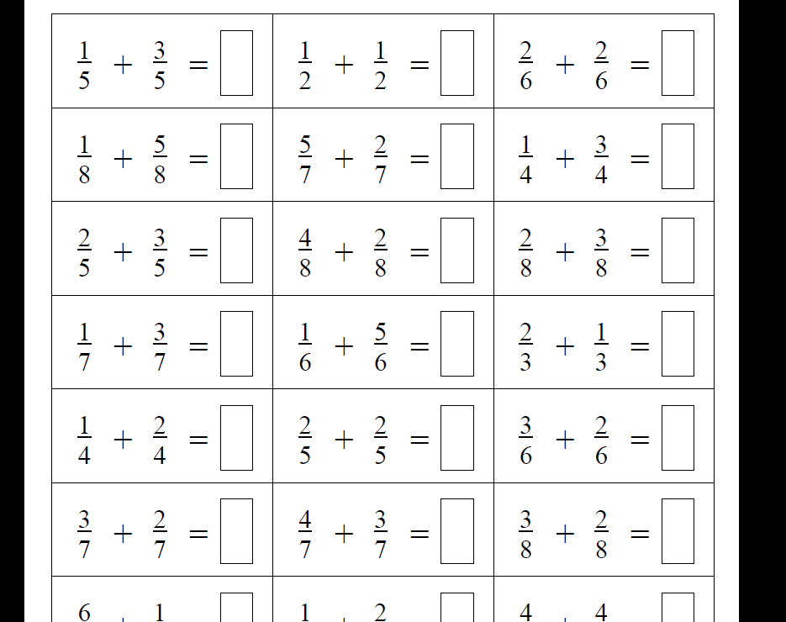
Notes:
Actually do some! Notice what you do and how you feel
Choice: work horizontally or vertically?

Slide 7
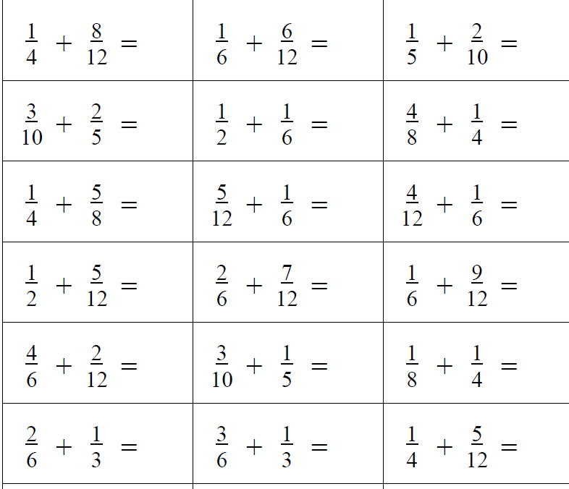
Notes:
Do Some! What is the same and what different about your experience with these?
Scanning mentally to locateaffordances or essence of task?

Slide 8
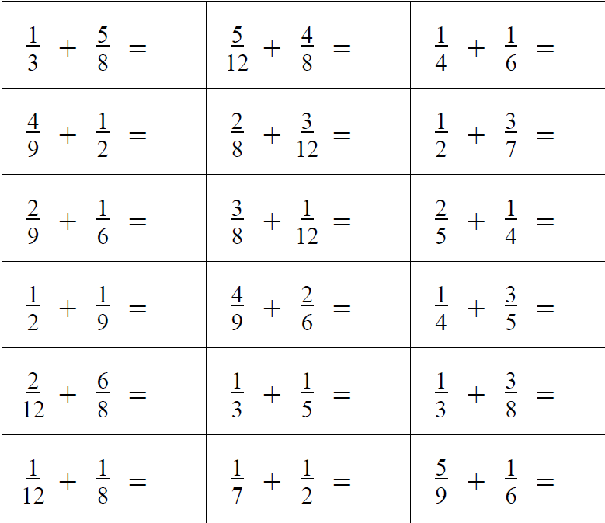
Notes:
What structural relationships do you detect?

Slide 9
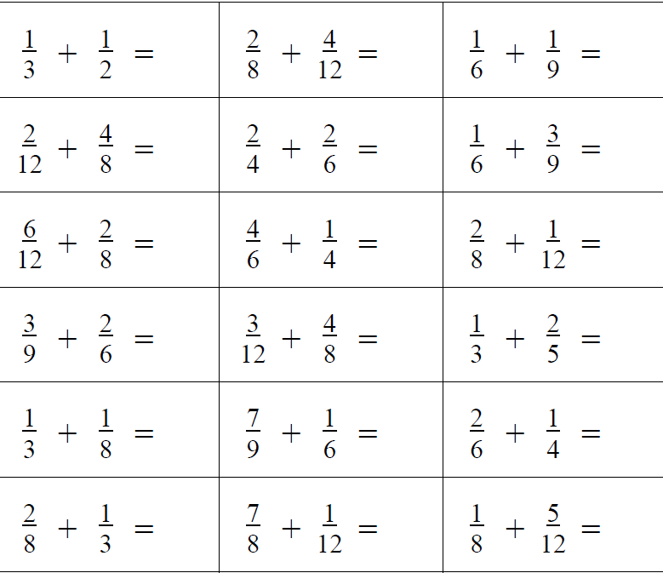
Would or could ‘it’ work?
Notes:
It was reported that “it worked” (in a class)

Slide 10
Considerations
Intended / enacted / lived object of learning
Author intentions
Teacher intentions
Learner experience
Task
Author intentions
Teacher intentions
As presented
As interpreted by learners
What learners actually attempt
What learners actually do
What learners experience and internalise
Didactic Transposition
Expert Awareness is transformed into Instruction in Behaviour
Notes:
A:
J: Didactic transposition
Expert teacher: knowledge of lived experiences of learners

Slide 11
More Considerations
critical aspects
focal points
difficult points
hinges
Notes:
A:
Invariance: individual aspect or multiplicity?

Slide 12
What are you doing? What are you attending to? What aspect of fractions do you have to think about?
Once a pattern-action is noticed, it keeps being repeated!
Notes:
A:

Slide 13
Talk and Plan
What could you do differently to ensure the lived object of learning is some critical aspect of fractions?
How might it be imperative & necessary to think about fractions while doing addition tasks?
Notes:
A:

Slide 14
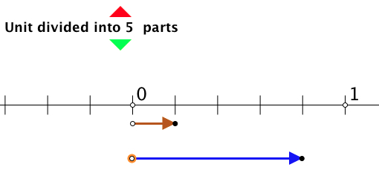
Number Line Fractions
Fractions applet offers model for sums to 1 of fractions with the same denominator, i.e. you can position one fraction and predict where the second will take you.
Vary the denominator, also do sums to < 1, and then do sums to > 1 so as to model the meaning of mixed fractions.
Extend to different denominators where one is a multiple of the other.
Notes:
J: If using same denominators, then why not work with complements to the unit (parallels early number work) part-part-whole
Not showing the sum, because you want learners to be enacting the sum for themselves, not merely interpreting something as the sum.
Common (invariant) image not simply varying at random
Self-explanation (own story)

Slide 15
Design of a question sequence for numberline fractions applet
Content
Same denominator
Coordinating different denominators
Sums to 1
Going beyond 1
Tenths
Comparing to decimal notation etc.
Pedagogy
Diagram maintaining link with meaning
Teacher choice of examples
Why tenths?
Order (e.g when to do sums to 1 and why)
Learner generated examples
Mathematical Questioning
vs
Generic questioning
Notes:
A:
Giving power back to maths teachers to say what constitutes good questioning
in mathematics and away from generic senior management team

Slide 16
Reflection
Intended enacted lived object of learning
Critical aspects; focal point; difficult point; hinge
Use of variation to bring lived object of learning and intended object of learning together
Notes:
J: then A:

Slide 17
Words, Meanings and Practice
Mastery is ....
Variation is ....
Avoid the teaching of speculators, whose judgements are not confirmed by experience. (Leonardo Da Vinci)

Slide 18
Mastering
Mastery is a state of mind – an outcome of learning
“Mastery Learning” as a method – all can learn; what differs is the time requirement (1950s Bloom)
Quality of teaching is important: what is available to be learnt?
Lived object of learning
Habits of learning; habits of mind
Mastering a technique
Mastering a concept
Notes:
A:

Slide 19
Mastery
Mastering a technique
reducing the amount of attention required to carry through the technique accurately (procedures)
Mastering a concept
having a strong personal narrative
awareness of all of the possible dimensions of possible variation
using the concept to express mathematical relationships in a variety of contexts
access to a rich space of examples and tools for example construction and use

Slide 20
Variation
Variation theory is a theory of learning
What is available to be learnt (not what will be learnt)

Slide 21
Variation
Dimensions of possible variation (scope of the concept)
Dimensions of necessary variation (to bring difficult points and hinge points into focus)
Range of possible (permissible?) change
What conjectures?
What generalisations? (the difficult points)
Conceptual variation
Procedural variation (process; proceed; progress)
Who provides the variation?
Scaffolding (Pu Dian)

Slide 22
Task 3
Notes:
A:

Slide 23
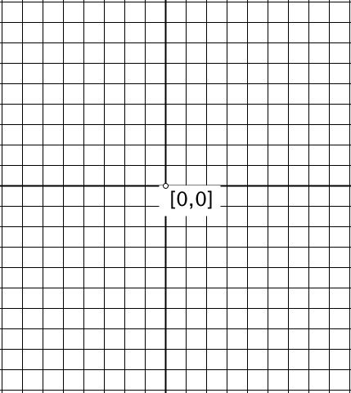
Notes:
A: Draw, sketch, or write an equation for a straight line through the origin.
Another & Another

Slide 24
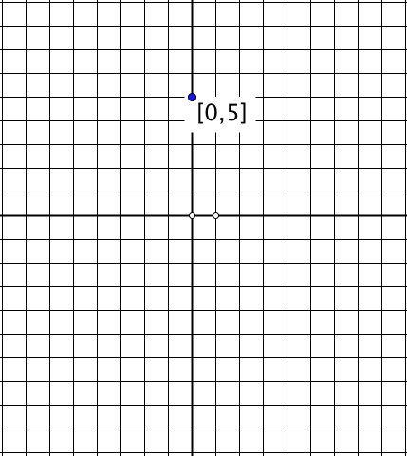
Notes:
Draw, sketch or write down the equation of a straight ;line through [0, 5]
Another & Another
Can you use one you already had?

Slide 25
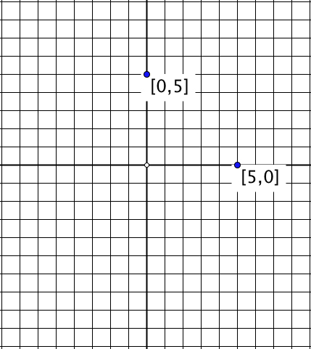
Notes:
Straight line through [0, 5] and [5, 0]
Another & Another!!??!!

Slide 26
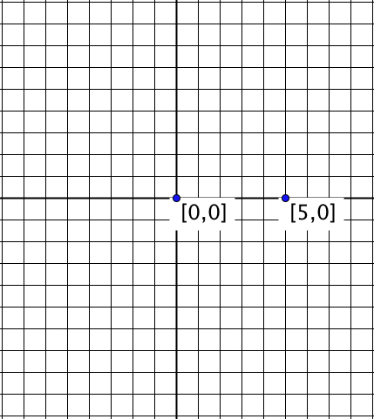
Notes:
Quadratic; Parabola Equation or plot or sketch
Another & Another

Slide 27
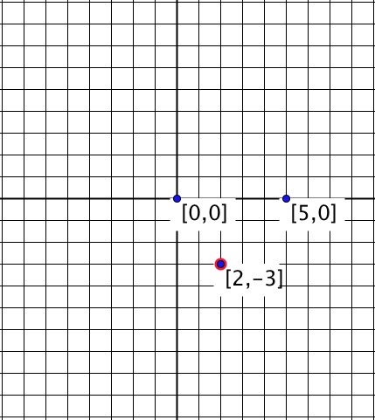
Notes:
Another & Another?? Why not?
Might need quite a bit of algebraic facility?
Return to earlier set up

Slide 28
Notes:
Quadratics through these two points

Slide 29
Reflections
What happened for you?
How did the variations influence what happened for you?
Notes:
Earlier conjectures about mastery and variation, connections

Slide 30
Task 3: Design of Question Sequence
Construct an object
and another
and another
Variation on the object (and another, and another)
Introduce a new constraint (no others ...)
Ask similar questions of a new object
and another
and another
Variation in method
New kind of question/insight/concept
and another
and another (opportunity to experience)
Notes:
A:

Slide 31
Types of variation
Conceptual:
presentations;
representations;
examples/non examples approaches;
connections with what we already know;
what mathematical problems this new idea is going to help us with;
multiple experiences and perspectives; various critical aspects
Procedural:
Multiple problems - one solution method
One problem - multiple solution methods
One situation - multiple presentations
Notes:
A:

Slide 32
Implications for quality of teaching
Anticipate what variation is necessary to develop procedural mastery (process; proceed; progress), and conceptual mastery
Critical aspects; focus; difficult points; hinges
Dimensions of variation to draw attention to the critical aspects and focus
Ranges of change that will focus attention
Examples and non-examples to delineate the concept
Representations (because the concept is abstract)
Lived object of learning;
what they see, hear, do;
what generalisations is it possible to make from their experiences?
Notes:
A:

Slide 33
Reflection on the effects of variation on you
What struck you during this session?
What for you were the main points (cognition)?
What were the dominant emotions evoked (affect)?
What actions might you want to pursue further? (awareness)
How might you alter what you wrote earlier about mastery and variation?
Notes:
J:
Chi et al

Slide 34
Teachers’ subject knowledge.
Research in subject teaching.
Educating teachers
Designing teacher education programmes
Research methods in teacher education
www.education.ox.ac.uk/courses/msc-teacher-education/

Slide 35
Follow-Up
annewatson1089 @ gmail.com
PMTheta.com
Questions & Prompts for Mathematical Thinking (ATM)
Thinkers (ATM)
Mathematics as a Constructive Activity: learner generated examples (Erlbaum)

