Slide 1



Using Tasks Richly
John Mason
March 20
2023

Slide 2
Outline
Underpinning Assumptions
Some Tasks
  How might they be used richly?
Some Useful Constructs
  Generated by thinking about potential foci of lesson-study sessions
Everything said here is a conjecture to be tested
against your past experience
and in your future experience
What you ‘get’ from the session will be anchored in
what you notice happening for you
and what you resolve to do in the future

Slide 3
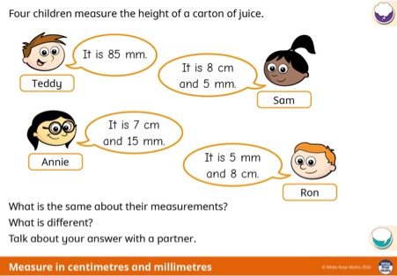
Learner Attention
Each example of a task is taken from a context of a sequence of tasks, so assume that there has been suitable build-up to this task which you are planning to use.
What are learners supposed to attend to?
What mental images might be useful?
Do they need reminding?
What is the role of
‘same & different’?
Make up your own task like this one.
Can you make a tricky one?
What makes it tricky?

Slide 4
Underpinning Assumptions
Learning consists of developing increasingly sophisticated ways of attending to situations, and having appropriate mathematical actions become available to be enacted.
Accurate performance indicates the effectiveness of trained behaviour: carrying out procedures with a minimum of attention
Quality performance indicates educated awareness (availability of suitable actions in response to challenge)
Doing ≠ Construing
There are several constructs on which I shall draw
  However, I intend these to emerge in your experience of engaging with tasks
  I will summarise them later
Attention: at any and every moment, ask yourself
  What is being illustrated or exemplified in the way this task is being or could be used?
  What do learners need to attend to in order to
    carry out this task successfully?
    Encounter what was intended?

Slide 5
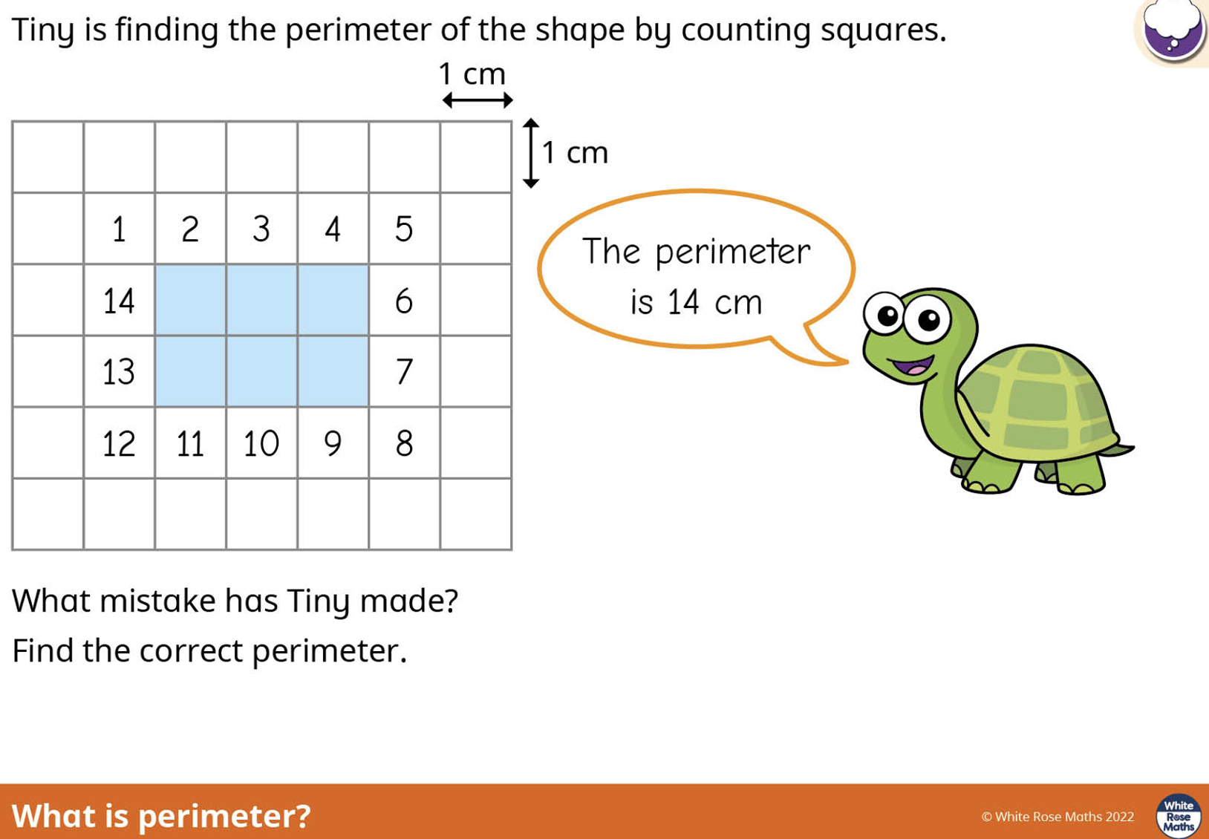
What Might the Author Want Learners to Attend to?

Slide 6
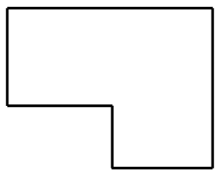
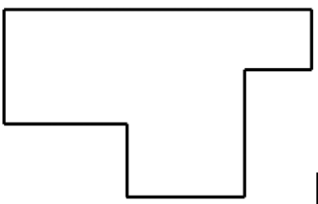
Exploiting a Task
How few lengths need to be measured in these two diagrams, in order to measure the perimeters?
How few lengths need to be measured in order to find the area?
Worthwhile listing the various sets of lengths from which the area can be deduced. Which is the most complicated? What relationships can be detected?
f
h
a
g
a
e
f
b
b
c
d
c
d
e
Can you find a shape that requires
4 measures for perimeter and 8 measures for area?

Slide 7
Say What You See

Slide 8
Describe to Someone How to See
Something that is …
1/3 of something else
1/5 of something else
1/7 of something else
1/15 of something else
1/21 of something else
1/35 of something else
1/105 of something else

Slide 9
Constructs
It is not the task that is rich, but whether the task is used richly
No task is an island, complete unto itself
Doing is not sufficient for Construing
  Attending appropriately to appropriate details
  Role of personal narrative
Didactic Contract
  Version 1: Learners attempt tasks, and learning occurs. So teacher responsible for setting tasks that will bring about learning.
  Version 2: Learners attempt tasks in an ethos of increasingly sophisticated use of mathematical powers, encountering of mathematical themes, and recognition of mathematical actions. Teacher directs attention and displays ways of attending.
Didactic Tension
  The more explicitly and specifically the teacher indicates the behaviour being sought, the easier it is for learners to behave appropriately but without generating that behaviour from themselves.

Slide 10
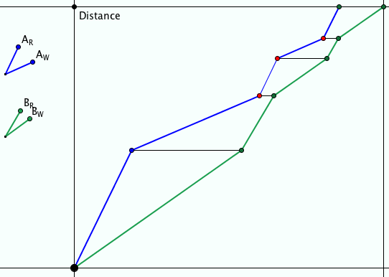
Ride & Tie
Two people have but one horse for a journey. One rides while the other walks. The first then ties the horse and walks on. The second takes over riding the horse …
They want to arrive together at their destination.

Slide 11
Ride & Tie
Two people have but one horse for a journey. One rides while the other walks. The first then ties the horse and walks on. The second takes over riding the horse …
They want to arrive together at their destination.
What is wrong with this graph?
What is likely to be the practice in a classroom
for which one of these would be appropriate to insert?
Tell me about the horse
No additional prompt or probe

Slide 12
Constructs
Inner, Outer & Meta Tasks
  Outer task is what learners (construe) they are asked to do
  Inner task is what learners are likely to encounter in the way of mathematical themes, the use of their powers, particular mathematical relationships and particular mathematical actions (like imagining and expressing mathematical relationships, specialising and generalising, conjecturing and convincing, being systematic and being creative)
  Meta Task is socio-cultural aspects of mathematics (like benefiting from working in groups; opportunity to take initiative)
Task Design, Adoption and Adaptation
  Involves selecting tasks, and modifying so as to bring learners into contact with concepts, procedures, and mathematical themes, and to develop their use of their powers.
  This means preparing possible pedagogical actions to initiate in order to achieve these aims, in other words, to use the task(s) richly.

Slide 13
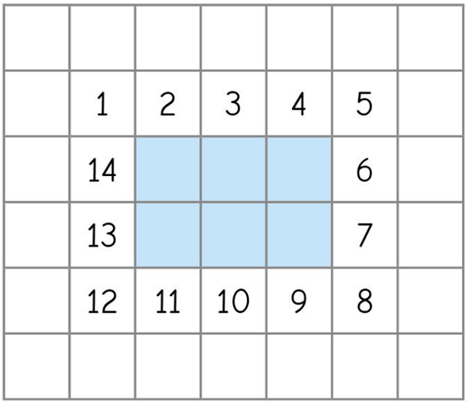
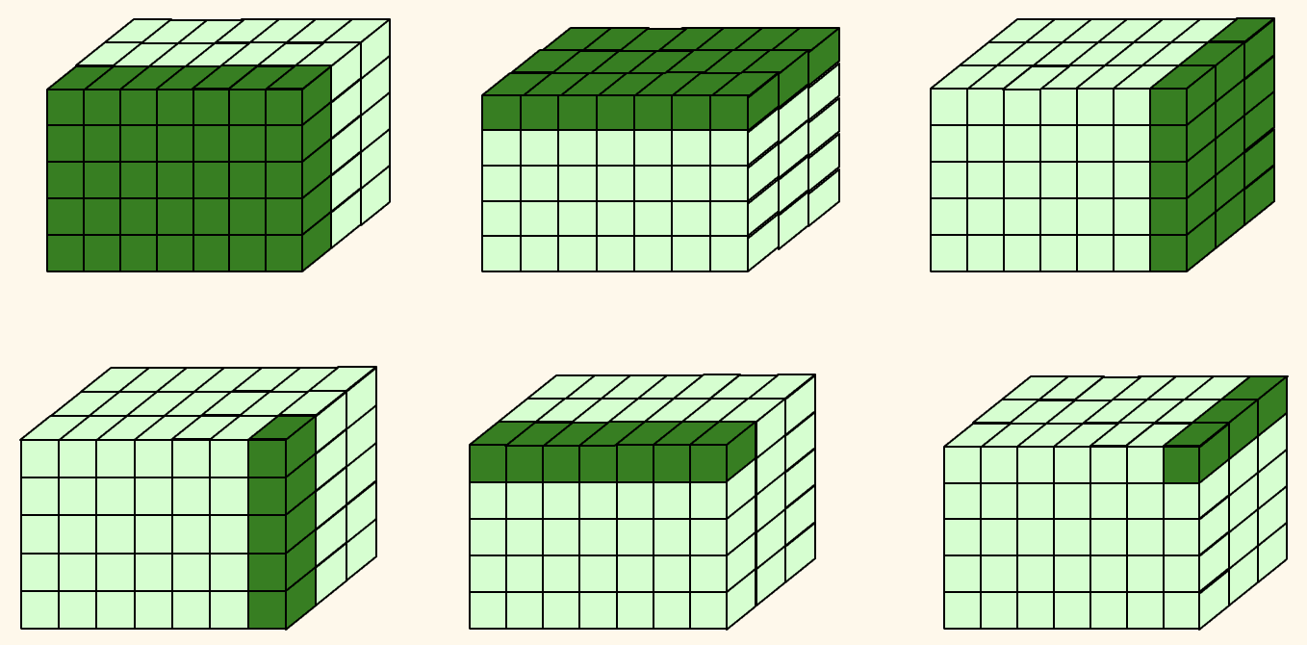
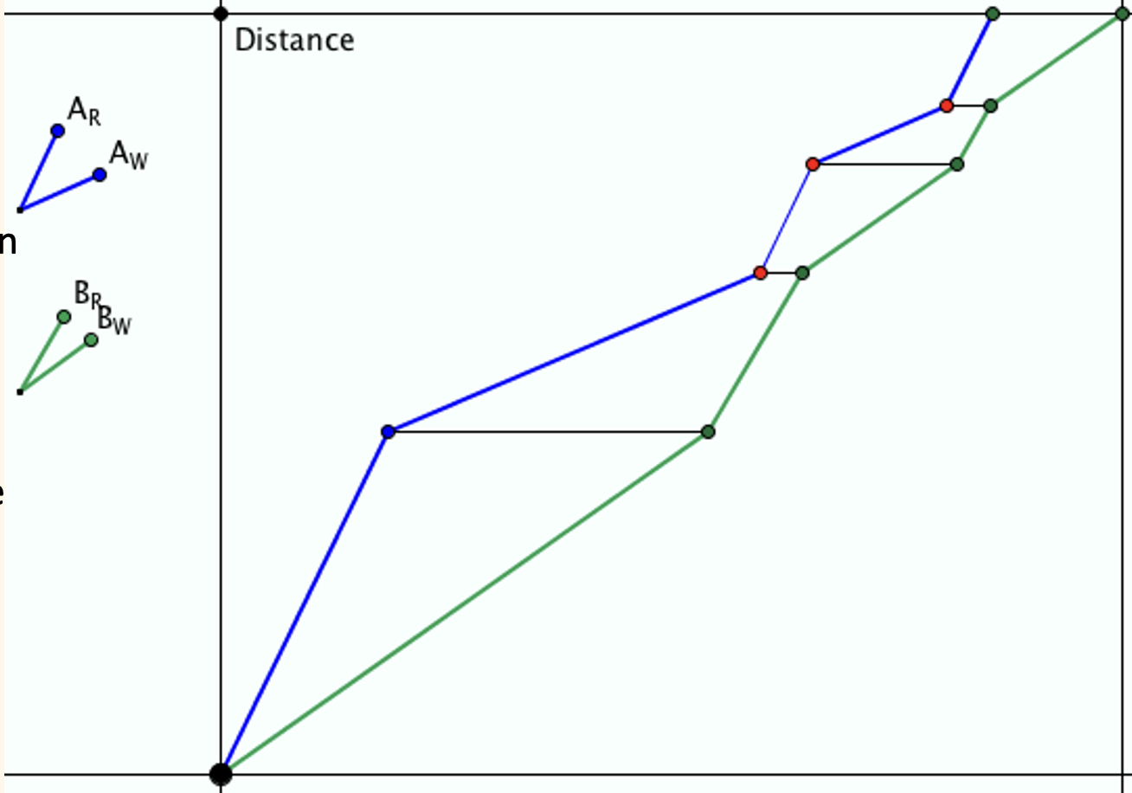
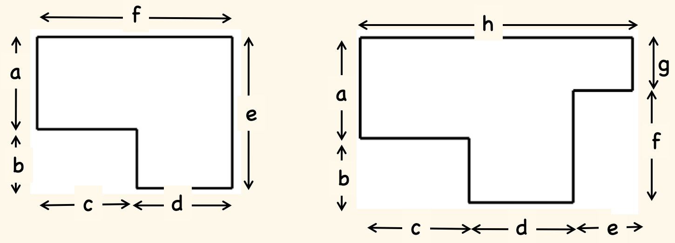
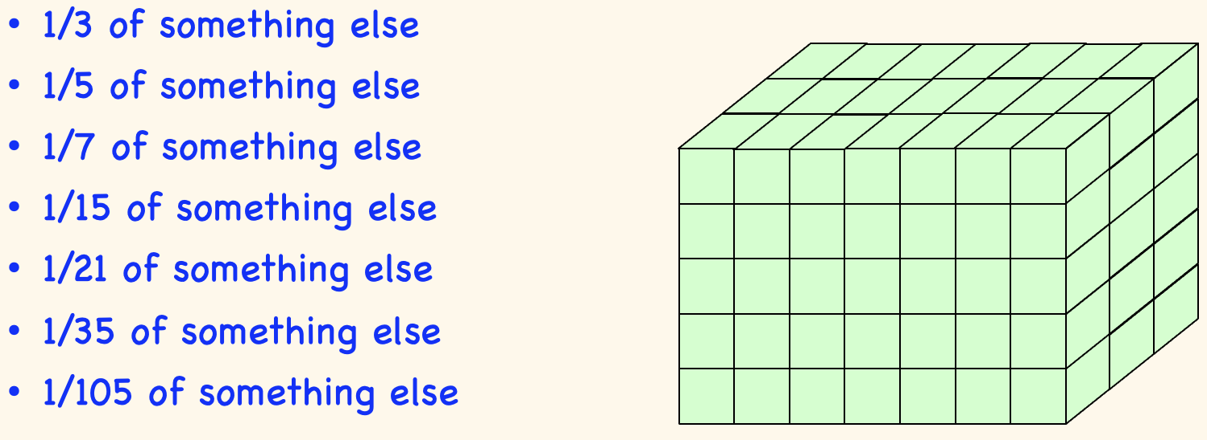
In order to use a task richly, it is necessary to be aware of potential inner tasks.
Of what mathematical phenomena is this task an example?
What does the task-author expect learners to encounter?
In what way is mental imagery called upon?
In what way are learners encouraged to express their images, and the relationships that they become aware of?
Variation Principle: what can be varied and still the same approach will work, or still the object will be an example of the concept?
How can the initiative be passed to learners so that they engage with their own tasks rather than ones imposed by others, and so they appreciate the general scope of similar tasks?

Slide 14
Attention
Every act of teaching is an intervention in learner attention.
What needs to be the focus of attention?
and How is it necessary to attend?
Holding Wholes (gazing)
Discerning Details
Recognising Relationships
Perceiving Properties as being instantiated
Reasoning on the basis of agreed properties

Slide 15
Issue of Time
If learners are learning to approach tasks more and more mathematically, then time spent inducting them into mathematical thinking will release time as the year progresses.
  Contrast this with a sequence of sessions in which behaviour is trained, but not internalised in connection with situations in which that action is pertinent.

Slide 16
Powers & Themes
Are students being encouraged
to use their own powers?
Powers
or
are their powers being usurped by textbook, worksheets and … ?
Imagining & Expressing
Specialising & Generalising
Conjecturing & Convincing
(Re)-Presenting in different modes
Organising & Characterising
Themes
Are themes emerging explicitly?
Doing & Undoing
Invariance in the midst of change
Freedom & Constraint
Restricting & Extending
Exchanging
or
do they remain in the background?

Slide 17
Follow-Up
PMTheta.com
john.mason@open.ac.uk
Designing and Using Mathematical Tasks
Fundamental Constructs in Mathematics Education

