Slide 1
The role of examples in mathematical reasoning
Anne Watson
University of Southampton
January 2013

Slide 2
Working mathematically
For what values of a₀ does this sequence have a limit?
a_{n+1}= (a_{n}² + 1)/₂
(i.e. is increasing and bounded above)

Slide 3
Examples
an example is a particular case of any larger class about which students generalise and reason: concepts, representations, questions, methods etc. (Watson & Mason)

Slide 4
How do we use examples?
Different kinds of relationship between examples and what they exemplify
Examples – of
specific instantiations of a previously defined class
Examples – for
genesis for identifying an uncharacterised class
Human agency: intention, disposition

Slide 5
Didactic object
How does the didact didacticise?
Rissland Michener
start-up examples motivate definitions and build a sense of what is going on
reference examples are “standard cases” that link concepts and results, and are returned to again and again
model examples indicate generic cases and can be copied or used to generate specific instances
counter-examples sharpen distinctions and definitions of concepts
Examples – for: action or understanding
Non-examples
Human agency: of or for

Slide 6
Counter examples
Lakatos: counter-examples generate enquiry into new classes
Goldenberg and Mason: depends on attention and emphasis

Slide 7
Didacticising
Do different purposes indicate different dimensions of variation and ranges of change in examples?
How do people act on examples?

Slide 8
Analysing (Watson & Chick ZDM)
a_{n+1}= (a_{n}² + 1)/₂ (an example of a sequence)
a₀ = 1/2
a₁ = 5/8
a₂ = 89/128
a₃ = …
analyse sequence

Slide 9
Generalising (Watson & Chick)
converges when a₀ is 0, ½, ⅓
generalise to unit fractions?

Slide 10
Abstracting from examples (Watson & Chick)
a_{n+1}= (a_{n}² + 1)/₂ converges when 0 < a₀ ≤ 1 and diverges when a₀ > 1
a_{n+1}= (a_{n}² + 1)/₂
a_{n+2}= (a_{n+1}² + 1)/₂
2(a_{n+2} - a_{n+1}) ₌ (a_{n+1 –} a_{n})( a_{n+1 +} a_{n}) etc.
treating it as a new entity makes it an example – for, e.g. for developing techniques

Slide 11
Analysis: analysis involves seeking plausible relations between elements of an example, from which conjectures might be generated
Generalisation: generalisation involves describing similarities among examples
Abstraction: abstraction goes further and classifies similar examples, naming the similarity as a concept or class with its properties

Slide 12
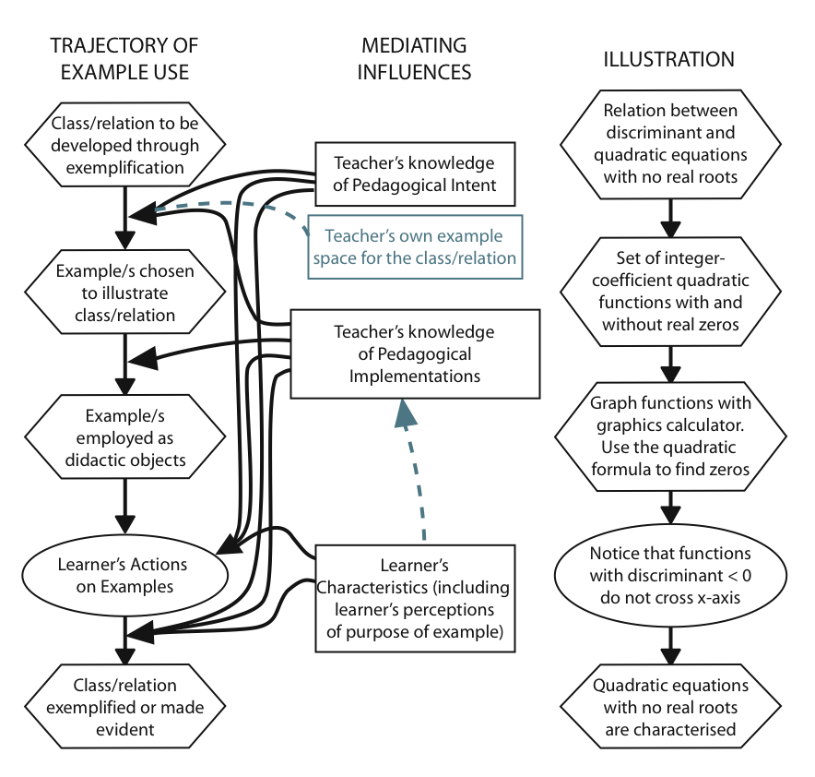

Slide 13
Inductive generalisation (Bills & Rowland)
empirical—generalisation from patterns in sequential examples
structural—the expression of underlying structures or procedures, which could have arisen through analysis.

Slide 14
Zara’s use of examples (Watson & Chick)
Extend a class beyond obvious examples: construct new cases
Indicate a class – but subclass does not represent class
Examples and sets of examples to show relation between classes - layout invites structural induction
Elementary cases used to generate others
Examples which express equivalence (representations)
Templates to deal with other class members
Sets of examples to span possibilities, subtypes
Sets of examples to identify relations within class
Examples to infer superficial (possibly incorrect) relations
Examples as situations in which to develop language

Slide 15
New example purposes
examples used to build other examples (RBC: Schwarz, Hershkowitz and Dreyfus)
examples that afford a shift of focus (new ways of thinking) (Vygotsky)

Slide 16
construct
inductive generalise
conjecture
build with
empirical
- of
deductive (existence and counter-example)
example
generalise
structural
recognise
sets of examples
generic example
new for whom?
abstract – a formative act (Harel)
reasoning about structure
analyse
- for
reasoning about
properties
deductive:
symbolic manipulation
equivalence

Slide 17
References
Harel, G. & Tall, D. (2004)The general, the abstract, and the generic in advanced mathematics, For the Learning of Mathematics, 11 (1), 38-42
Mason, J., & Pimm, D. (1984). Generic examples: Seeing the general in the particular. Educational studies in mathematics, 15, 277–289.
Watson, A. & Chick, H. (2011). Qualities of examples in learning and teaching. ZDM 43 (2) p283-294.
Watson, A. & Mason, J. (2005). Mathematics as a constructive activity: Learners generating examples. Mahwah: Erlbaum.

Slide 18
Another situation ...
For what pairs of numbers can 48 be the LCM?
For what triples?

