Slide 1
Teaching Mathematics in Primary Schools Using Problem Solving in the NC
Anne Watson
2014

Slide 2
Aims of the maths NC
The National Curriculum for mathematics aims to ensure that all pupils:
  become fluent in the fundamentals of mathematics, including through varied and frequent practice with increasingly complex problems over time, so that pupils develop conceptual understanding and are able to recall and apply their knowledge rapidly and accurately to problems

Slide 3
  reason mathematically by following a line of enquiry, conjecturing relationships and generalisations, and developing an argument, justification or proof using mathematical language
  can solve problems by applying their mathematics to a variety of routine and nonroutine problems with increasing sophistication, including breaking down problems into a series of simpler steps and persevering in seeking solutions.

Slide 4
then ...
competence in solving increasingly sophisticated problems

Slide 5
progression ...
challenge through being offered rich and sophisticated problems

Slide 6
Problems about ‘problem solving’
What is meant by 'problem solving'?
What is learnt through 'problem solving'?
What are the implications for pedagogy?

Slide 7
Problem solving – three kinds
Having been subtracting numbers for three lessons, children are then asked: ‘If I have 13 sweets and eat 8 of them, how many do I have left over?’
A question has arisen in a discussion about journeys to and from school: ‘Mel and Molly walk home together but Mel has an extra bit to walk after they get to Molly’s house; it takes Mel 13 minutes to walk home and Molly 8 minutes. For how many minutes is Mel walking on her own?’
If two numbers add to make 13, and one of them is 8, how can we find the other?

Slide 8
Problem solving – three kinds
Procedural
  Teach stuff and practise it
Application
  Teach stuff and spot when to use it
Conceptual
  Use problem solving as the reason for learning maths

Slide 9
Where are we going with this? KS3
Solve problems
  develop their mathematical knowledge, in part through solving problems and evaluating the outcomes
  develop their use of formal mathematical knowledge to solve and devise problems, including in financial mathematics
  begin to model situations mathematically and express the results using a range of formal mathematical representations
  select appropriate concepts, methods and techniques to apply to unfamiliar and non-routine problems.

Slide 10
Primary problem-solving summary
Year 1: concrete, pictorial, objects, quantities
Year 2: materials, arrays, repeated addition, problems in contexts, deciding which operation
Year 3: money; number problems and practical problems; missing number problems; problems in which n objects are connected to m objects; select operation
Year 4:number and practical problems; problems needing distributive law; integer scaling
Year 5: multi-step problems; scaling with fractions and rates; missing angle; comparisons using graphs
Year 6:contexts; calculations; ratio

Slide 11
Things to sort out when we see the assessments
‘solve problems’ can also mean ‘answer questions’
what makes problems ‘increasingly sophisticated’?

Slide 12
Routine procedures
If I have 13 sweets and eat 8 of them, how many do I have left over?
If I have 13 metres of rope and use 8 metres of it, what length do I have left over?

Slide 13
What is 'problem solving'?
apply the procedure you have just been learning
OR
decide what operation(s) to use

Slide 14
What is learnt?
practice using the procedure with a range of contexts
know how the procedure applies to real situations and what sort of answers it produces

Slide 15
Implications for pedagogy
Focusing on:
  developing procedures from manipulating quantities
  formalising what we do already
  understanding procedures as manipulating relations between quantities
  methods that arise within mathematics that can be applied outside
  reflect on outcomes of procedures – why does it work?
  ‘doing’ and ‘understanding’

Slide 16
Non-routine application
Mel and Molly walk home together but Molly has an extra bit to walk after they get to Mel’s house; it takes Molly 13 minutes to walk home and Mel 8 minutes. For how many minutes is Molly walking on her own?

Slide 17
What is 'problem-solving'?
Represent the structure, maybe using diagrams
Understand the situation and the relations between quantities involved – not just use a recent procedure
Apply maths to a real(istic) problem
Compare and reflect on outcomes of procedure, why does it work?

Slide 18
What is learnt ?
Modelling or representing a situation
Experience at how to sort out the mathematical structure of a problem
Understanding what different operations do for us
Experience at knowing what situations need what procedures

Slide 19
Implications for pedagogy
Do students know what a particular procedure can do for them?
Focus on relationships between quantities and variables – not on answers only
The importance of diagrams and other representations
TIME to discuss afterwards; maybe collect situations that need addition, subtraction, multiplication and division
Make up own stories

Slide 20
Warning
One non-routine problem is not enough!

Slide 21
Additive problem sequence involving counting
Barry had 8 dinosaurs and Granny gave him four more, how many dinosaurs does he now have?
Aunty Anne gave me two dinosaurs every week for the last five weeks, how many do I have?
If Aunty Anne carries on like this, how many will I have after two more weeks?
How many dinosaurs should I then give Barry so we have the same number?
If we line them up in pairs, how many pairs will we have?

Slide 22
Additive problem sequence involving measuring
Poppy has a tape measure which is five metres long but it is rolled up. She unrolls it gradually. First she unrolls 50 centimetres, then another 50 centimetres. How much does she have unrolled now? Now she unrolls another 75 centimetres, ...... Has she unrolled enough to measure your desk yet?

Slide 23
What is 'problem-solving'?
Not just answering questions
Analysing the situation
Multi-step reasoning
Needing to record and keep track of subproblems

Slide 24
What is learnt ?
Clarity about length and units
Clarity about measuring
Additive reasoning is not always about counting and involves juggling accumulation and difference

Slide 25
Implications for pedagogy
Present a range of problems that need
  different images
  different combinations of key ideas

Slide 26

Shrek
Draw a picture of Shrek using pencil and compasses; dynamic geometry software; CAD
Which gives a better picture and why?

Slide 27
What is 'problem-solving'?
Conjecture and test geometrical decisions using various media:
  Practical drawing equipment
  Software choices

Slide 28
What is learnt ?
Introduce knowledge and language of centre and radius
Knowledge of fixed and variable features of circles
Identifying same shapes
Comparing similar shapes
Geometrical precision compared to artistic drawing

Slide 29
Implications for pedagogy
Students need freedom to explore methods
Teacher needs to decide whether, when and how to introduce software
In this case geometrical method may not be better
Create a genuine need for new mathematics

Slide 30

Can we make this?

Slide 31
What is meant by 'problem solving'?
What is learnt through 'problem solving'?
What are the implications for pedagogy?

Slide 32
Mathematical problem solvers need:
Repertoire of structures and questions (knowledge and strategies)
Experience in using these
Combinations of knowledge and experience
Teachers who are themselves mathematical problem-solvers

Slide 33
Example: Correspondence problems
What does it mean? Matching two sets of objects.
Using intuitive actions to develop many meanings for × and ÷ and when and why we use these operations
Reasoning about the meaning of situations - the relations between quantities
Should run throughout primary maths, including early years

Slide 34


Slide 35
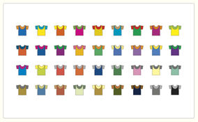

Slide 36
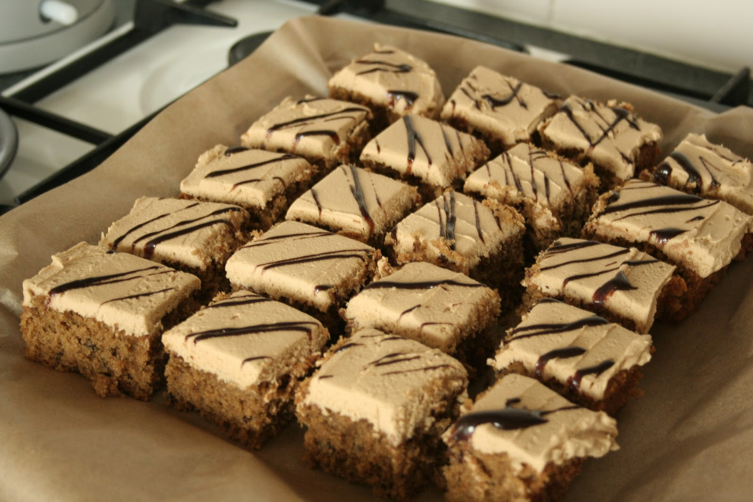
.
Type: | JPG

Slide 37



Slide 38
Conceptual purpose
  Use problem solving as the reason for learning maths
  If two numbers add to make 13, and one of them is 8, how can we find the other?

Slide 39
Ratio through problem solving
Year 6
solve problems involving the relative sizes of two quantities ... using multiplication and division ...
solve problems involving the calculation of percentages
solve problems involving similar shapes where the scale factor is known or can be found
solve problems involving unequal sharing and grouping using knowledge of fractions

Slide 40
Practical implications for pedagogy
How large will the working groups will be?
How will participation be managed?
How should findings be presented?
How long should this take?
How to manage non-mathematical aspects?
Managing materials?
What new mathematics will students meet?
How will they all meet it?
TIME for reflection, comparison, discussion, language, formalisation

Slide 41
Mathematical implications for pedagogy (summary)
focus on relationships between quantities and variables
representing and formalising: whether, how, when and who?
understanding procedures as a way to manipulate relations between quantities
the importance of diagrams, images, models, representations
non-standard situations
freedom and tools and TIME to explore cases and make conjectures

Slide 42
anne.watson@education.ox.ac.uk
PMƟ
Promoting Mathematical Thinking

