Slide 1


Summing Infinite GPs: a study in shifts of attention
Kings Maths School
KCLMS Outreach
July 2021
in the time of Corona

Slide 2
Outline
GP Sums
Ratio = ½
  Ways of working on a diagram or animation
Ratio < ½
  Variations
Ratio > ½
  Full Expansion
  Shifting
  Internal
Vertex Tracking
  Relation to sine and cosine
Non-Uniform Sequences
Slope Diagrams
= 1/2
< 1/2
> 1/2
Varied Ratios
Directly Varied Ratios

Slide 3

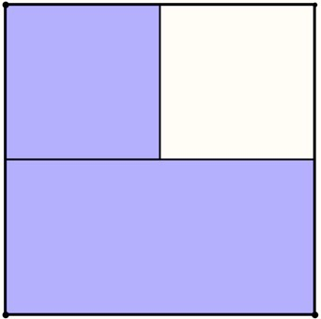
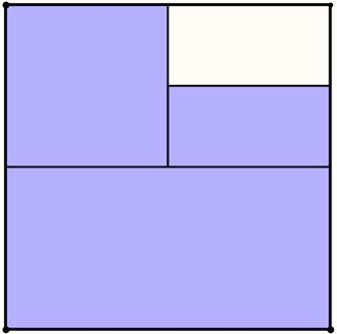
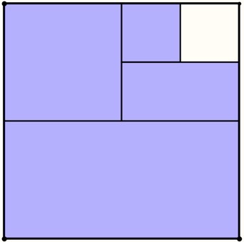
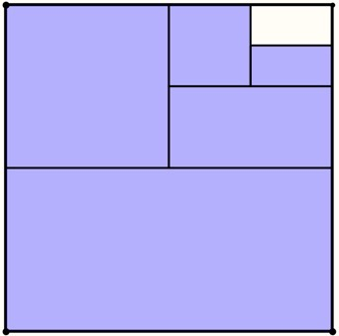
First Sequence
…

Slide 4
Attention
How did the focus of your attention shift?
When did a story start to emerge?
What other shifts did you notice when the arithmetic appeared?
Holding Wholes (gazing)
Discerning Details
Recognising Relationships between details
Attention drawn to regions where change happened
What did ‘…’ trigger?
• mental imagery of completion?
• ‘sense of’ completion?
• nothing much?
Unchanged bits part of gaze
To locate change, need to discern details
Arithmetic –> discerning details and recognising relationships

Slide 5
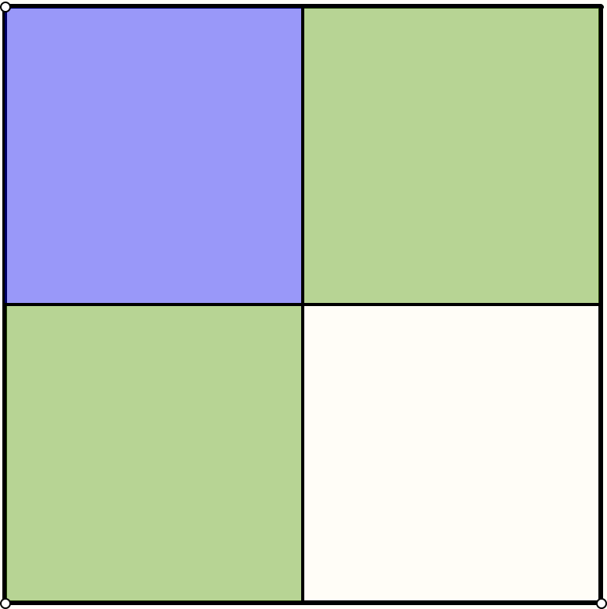
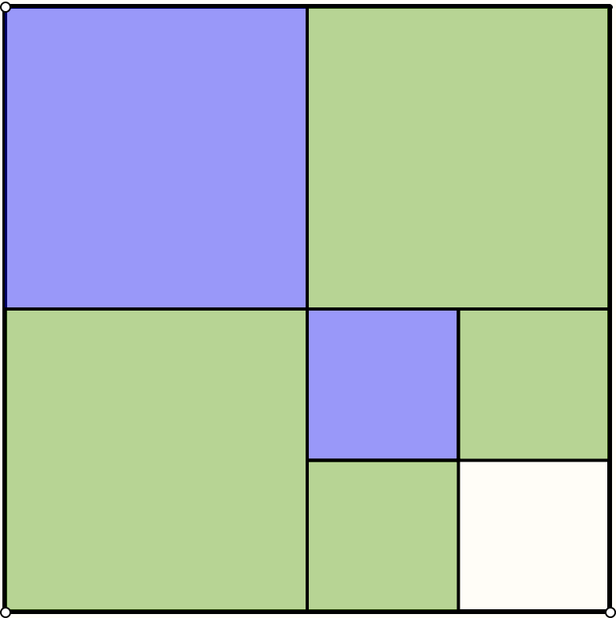
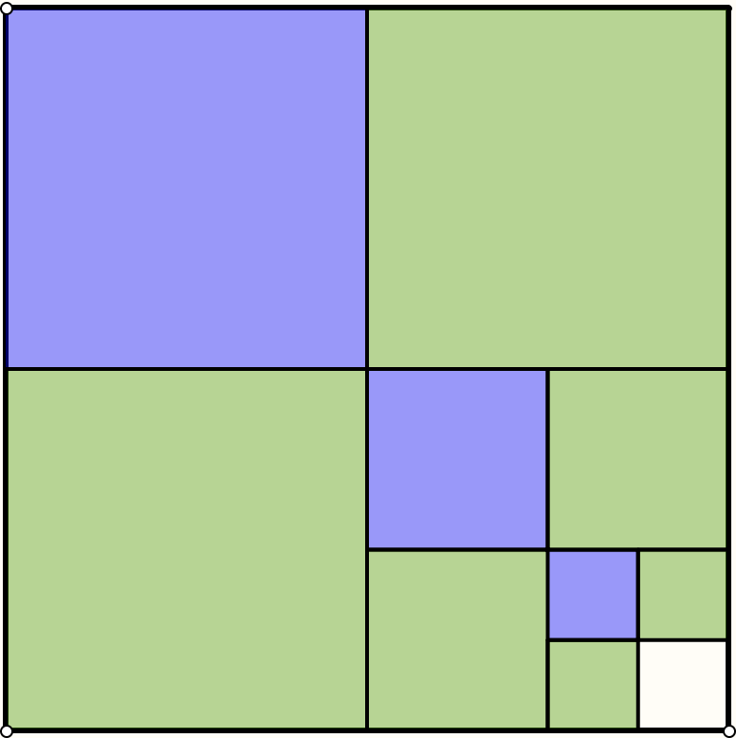
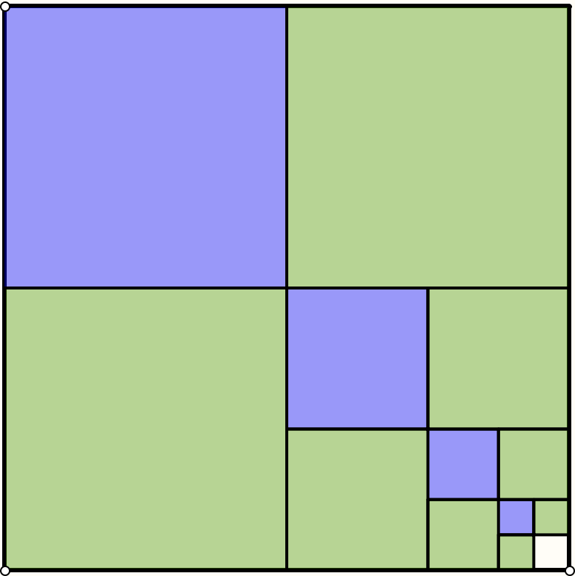
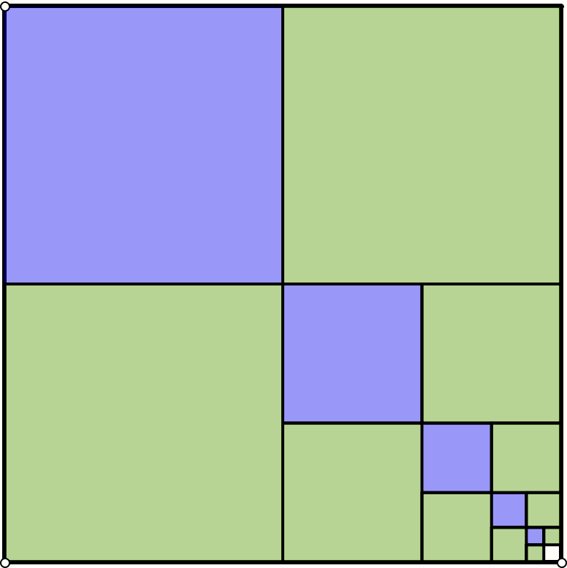
Second Sequence

Slide 6
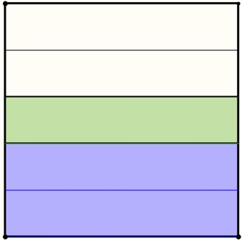
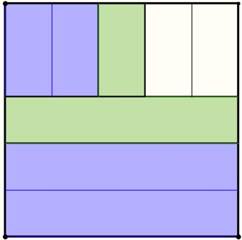
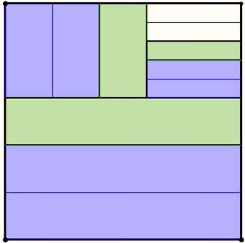
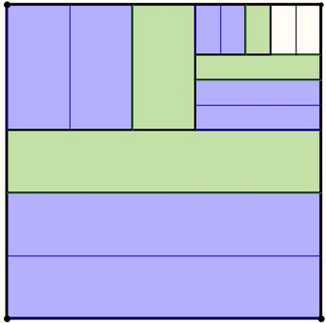
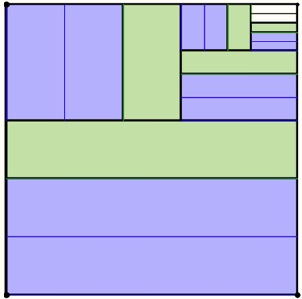
Another Sequence

Slide 7
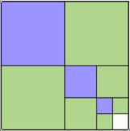
Attention
What generality can you detect and express concerning these two sequences?
For

Slide 8
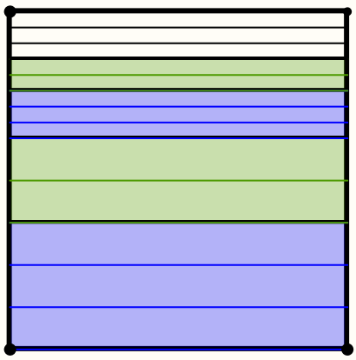
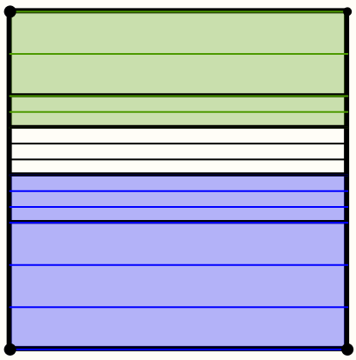
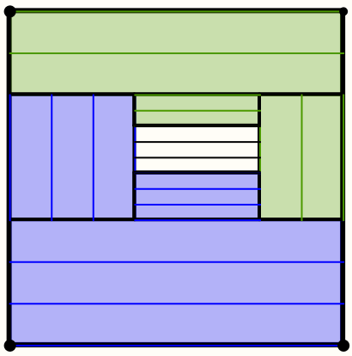
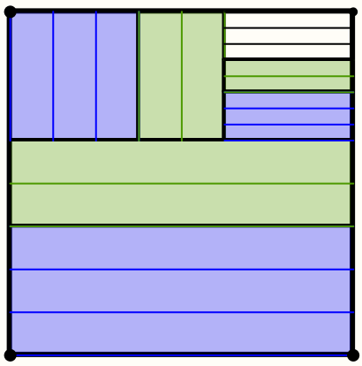
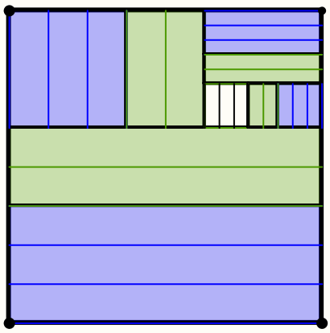
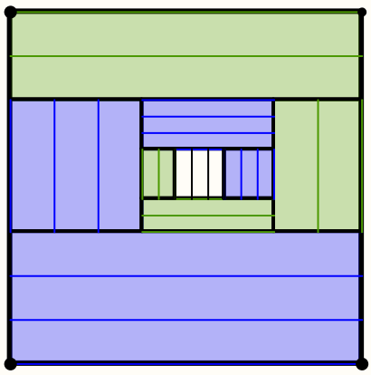
Different Formats
What is the same and what different about these formats?
Holding Wholes
Discerning Details
Recognising Relationships
Perceiving Properties
Reasoning

Slide 9
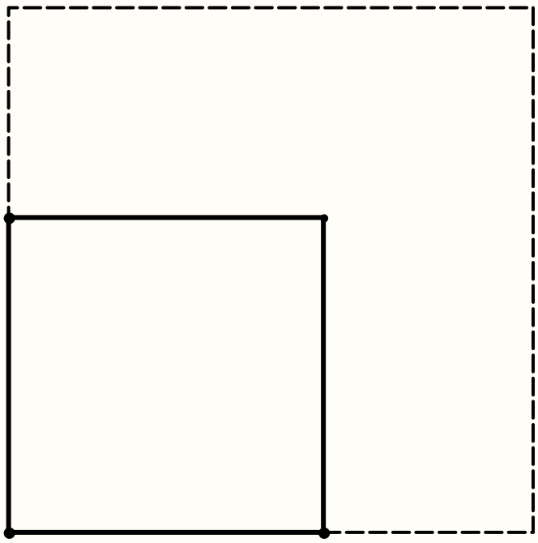
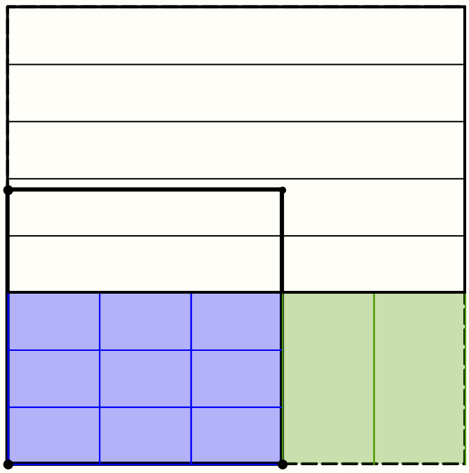
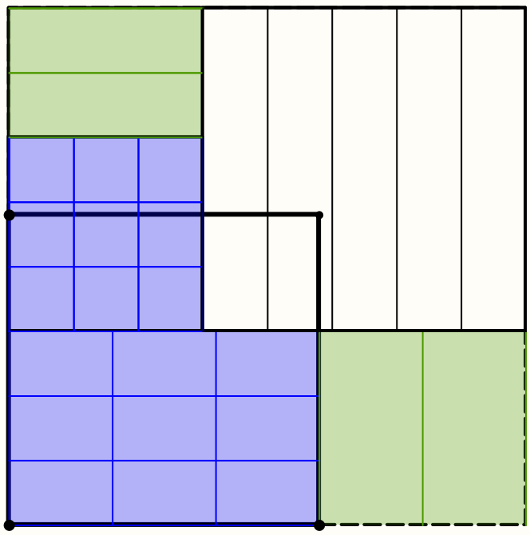
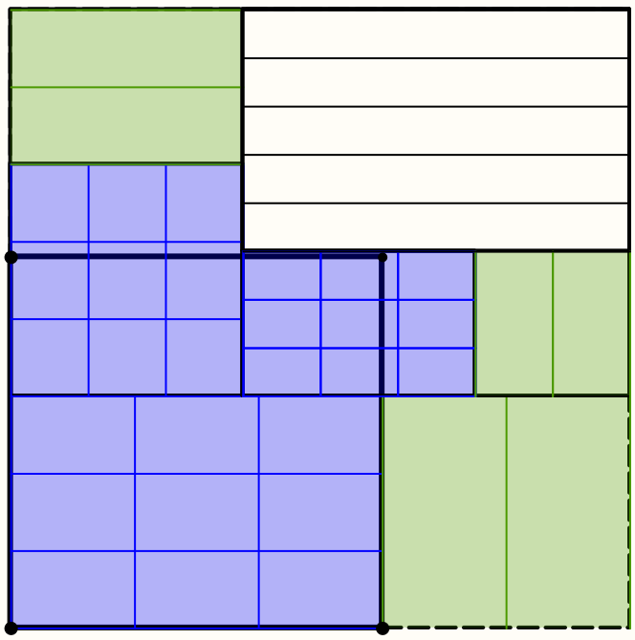
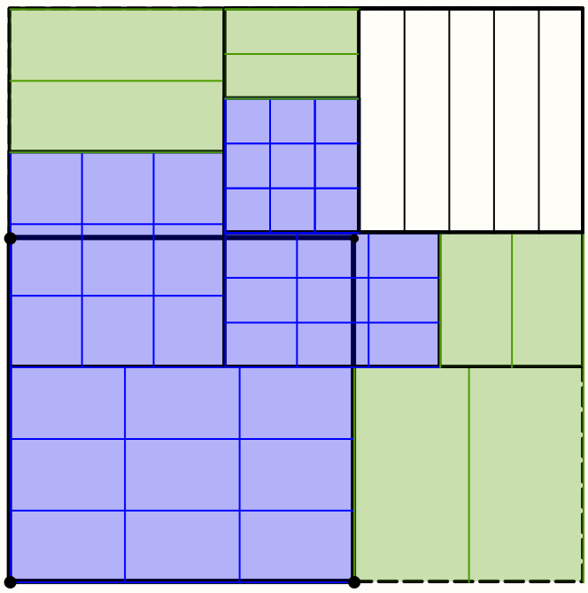
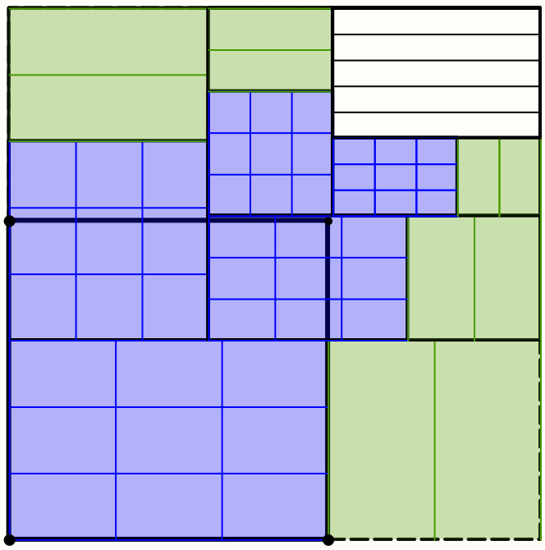
Ratio > ½
Express a generality
and a further generality

Slide 10
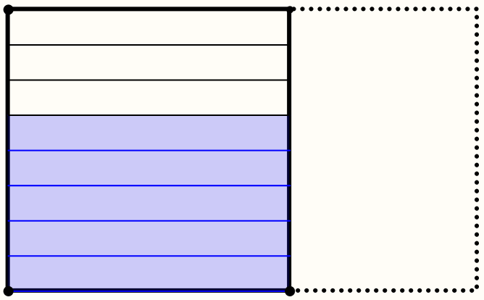
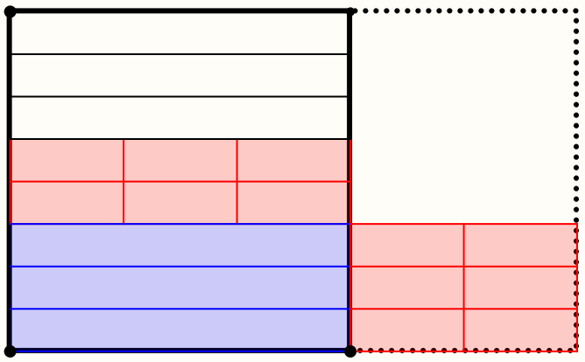
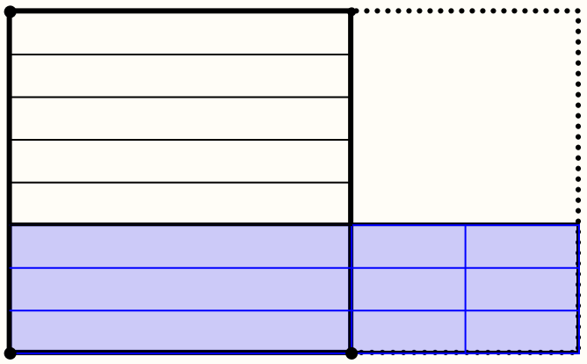
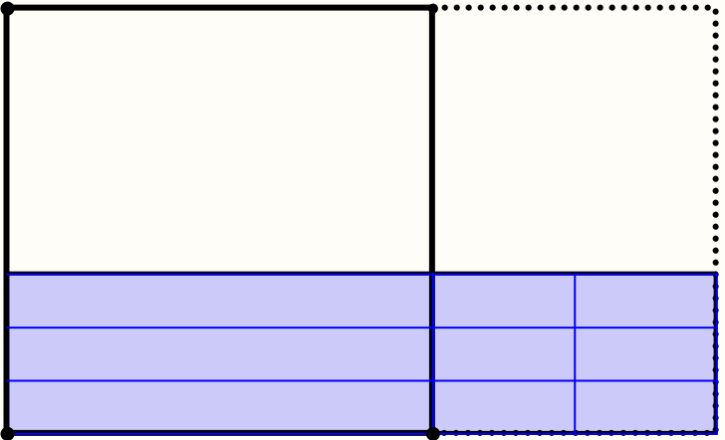
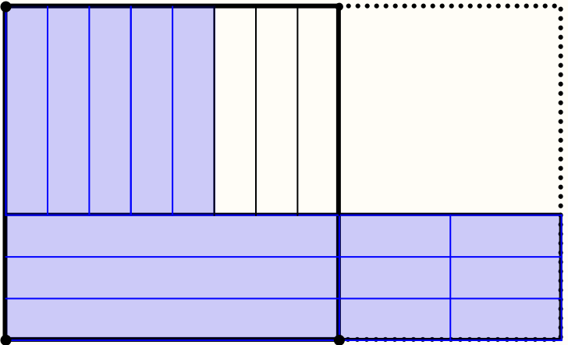
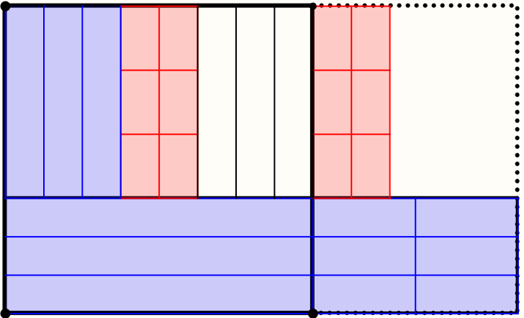
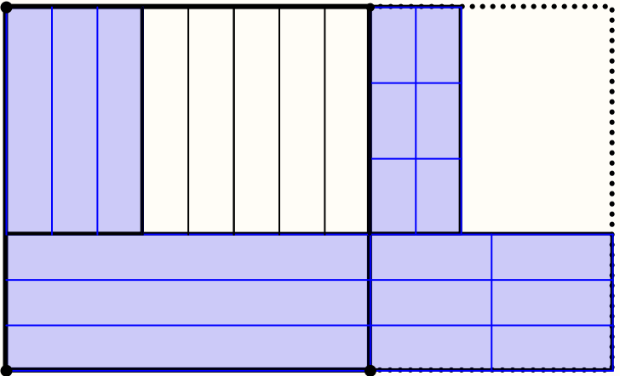
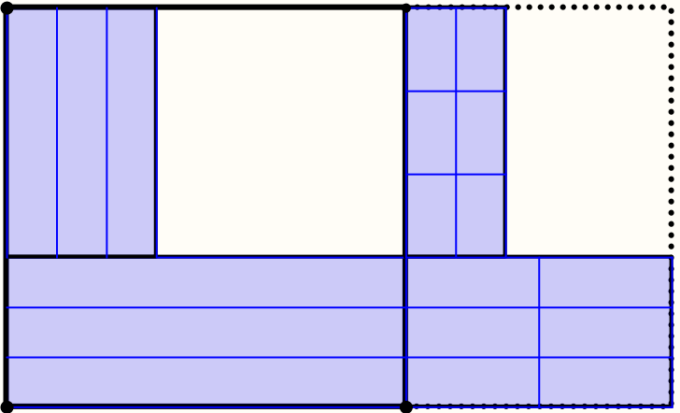
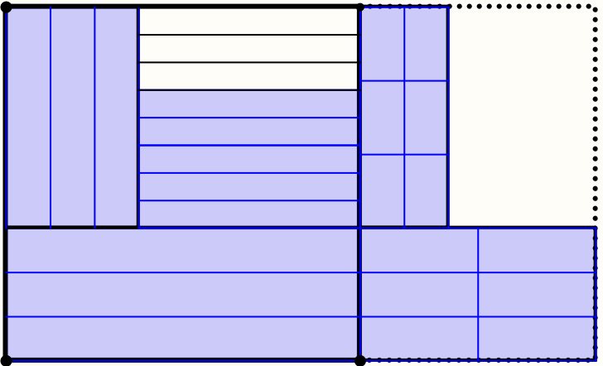
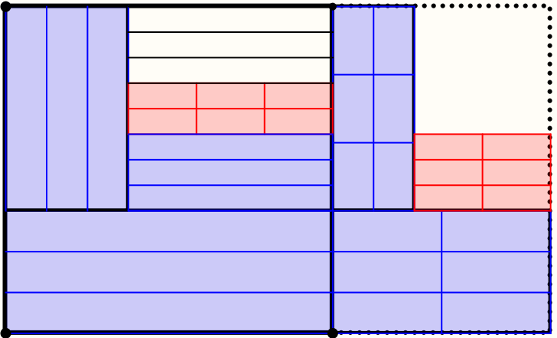
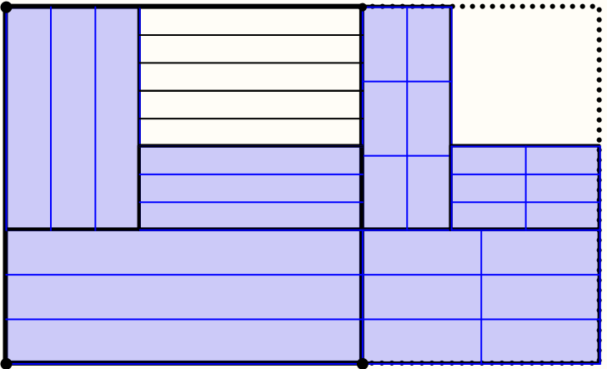
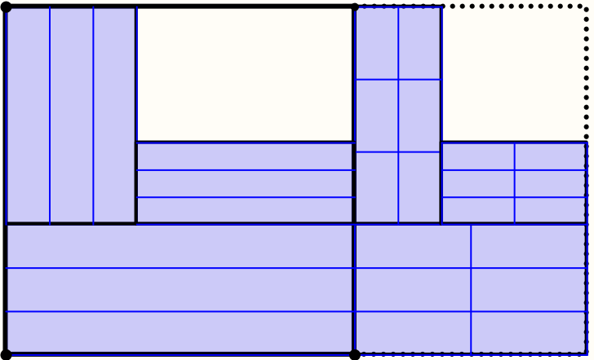
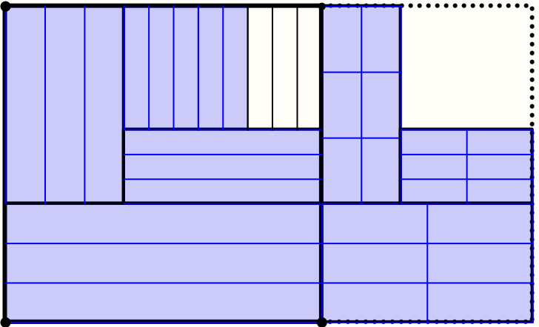
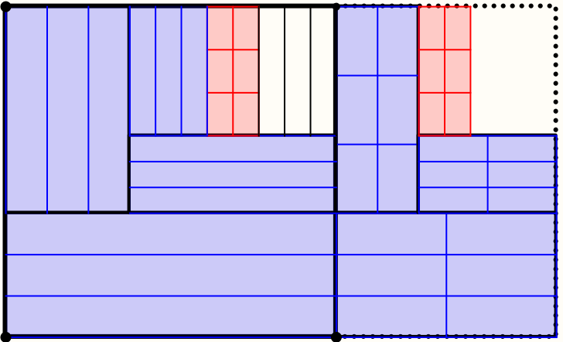
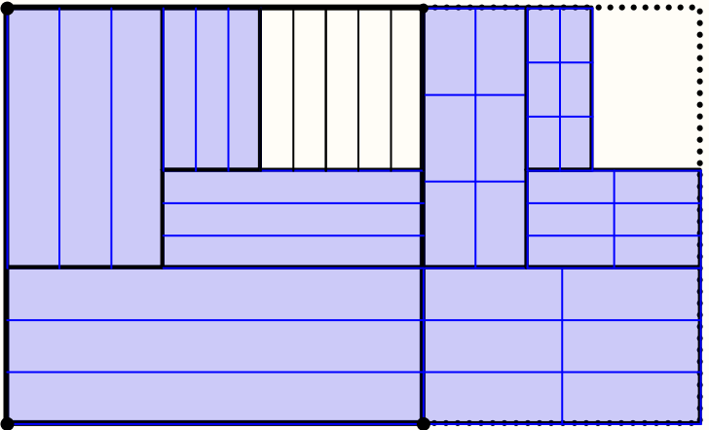
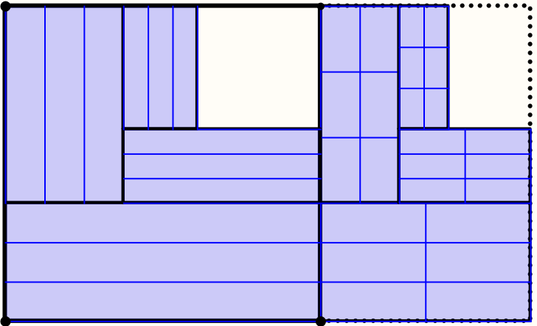
Ratio > ½

Slide 11
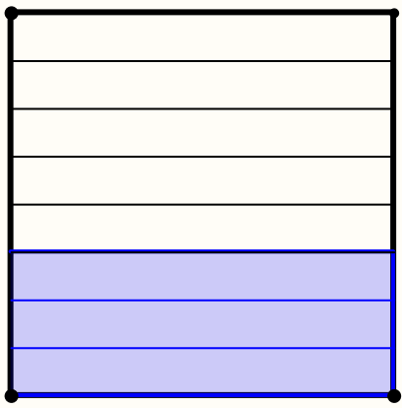
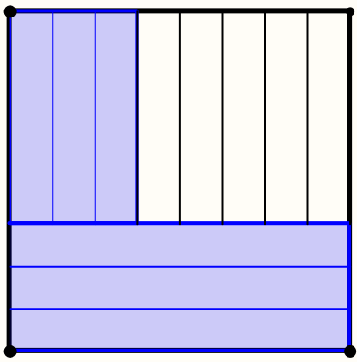
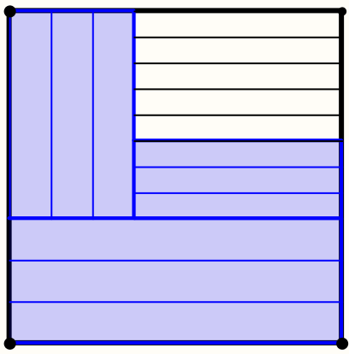
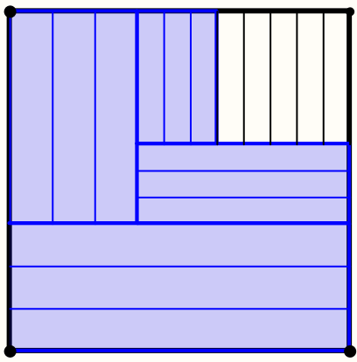
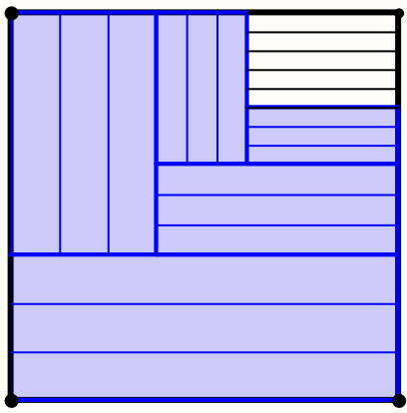
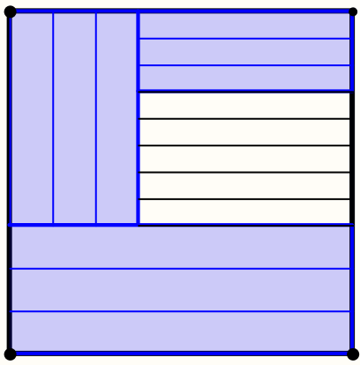
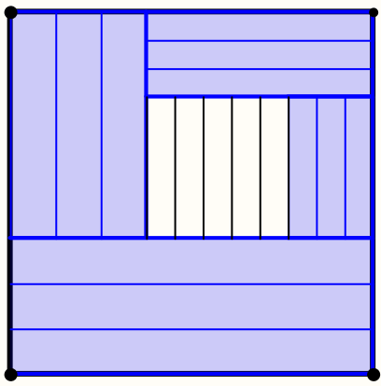

Ratio > 1/2
Two variants

Slide 12










Tracking Vertices

Slide 13
Attention Conjectures
If a teacher and learner are attending to different things …
Communication can be at best
partial & incomplete
If a teacher and learner are attending in different ways …
Every act by a teacher
is an intervention
in learner attention
Conjecture:
These forms of attending apply in every lesson

Slide 14




Varied Ratios

Slide 15

Systematic Variation
Systematically varied ratios (blue) and their complements (green)

Slide 16




Summing Using Slopes
Pay attention to the horizontal red segments along the x-axis
Later, pay attention to the vertical pink segments.
For exploration: varying the ratios but retaining the straight line

Slide 17
To Follow Up
PMTheta.com go to JHM presentations; Applets; publications
john.mason@open.ac.uk
Mason, J. (2010). Attention and Intention in Learning About Teaching Through Teaching. In R. Leikin & R. Zazkis (Eds.) Learning Through Teaching Mathematics: development of teachers' knowledge and expertise in practice. p23-47. New York: Springer.
Mason J. (1998). Enabling Teachers to be Real Teachers: necessary levels of awareness and structure of attention, Journal of Mathematics Teacher Education, 1 (3) p243-267.

