Slide 1




Using
Mathematical Structure to Inform Pedagogy
Promoting Mathematical Thinking
Anne Watson & John Mason
NZAMT
July 2015
The Open University
Maths Dept
University of Oxford
Dept of Education

Slide 2
Outline
A familiar and pervasive structure
  Extending the domain of action
A pervasive structure
  Extending the domain of action (implied)
Structuring something less familiar
  Extending the domain of action
  Something new to explore

Slide 3
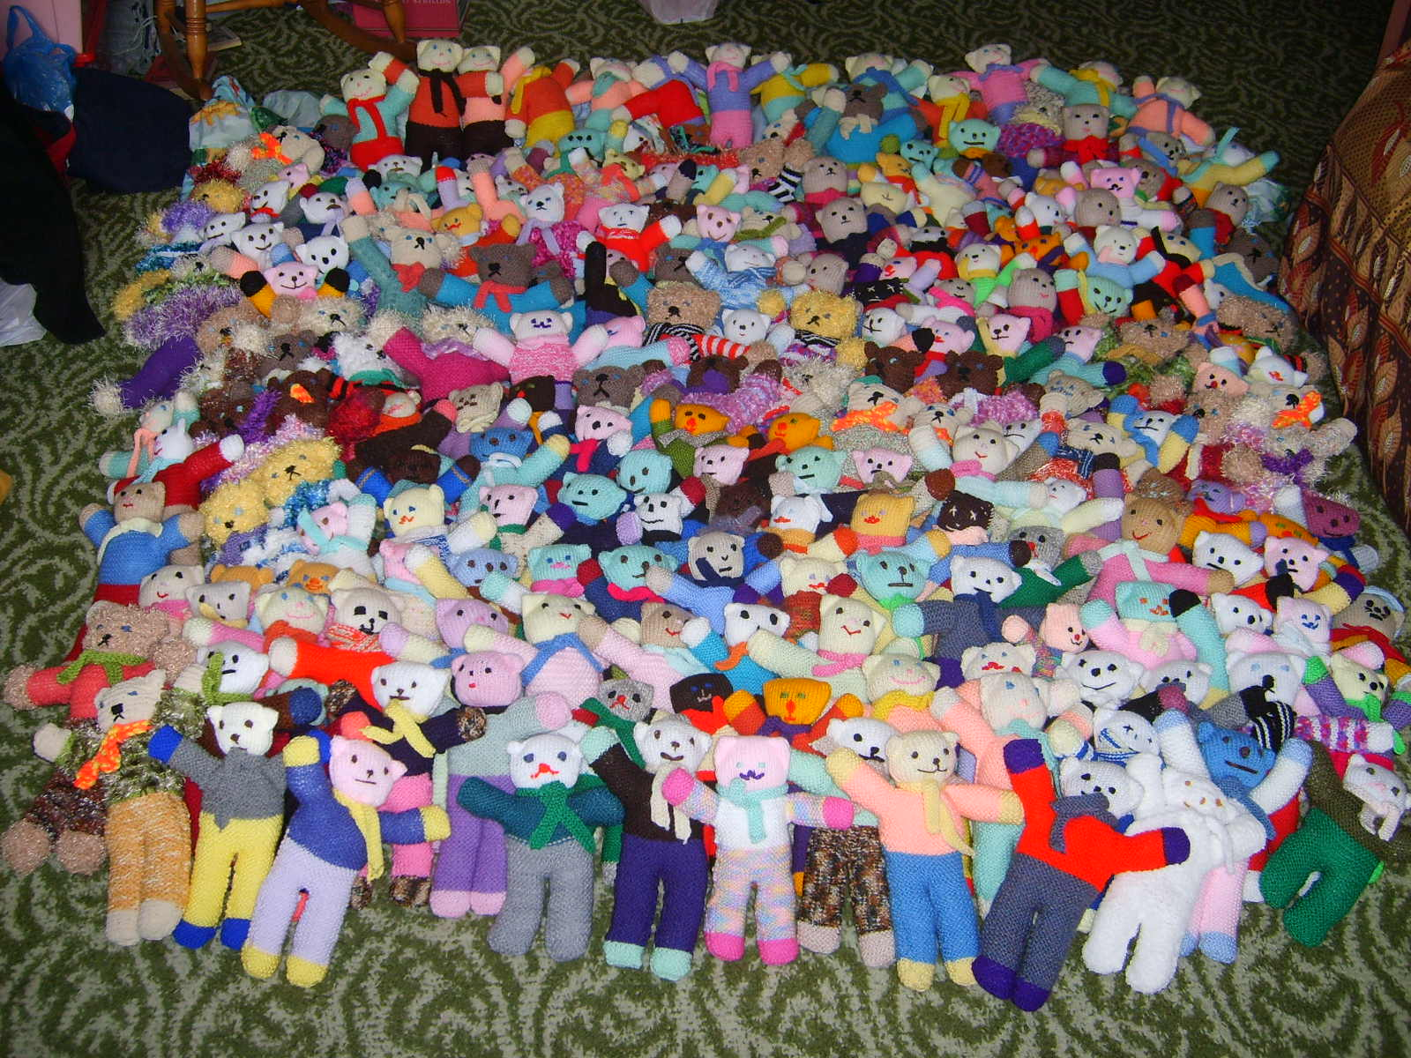
What does addition mean if you add 27 to 48 using teddies?

Slide 4

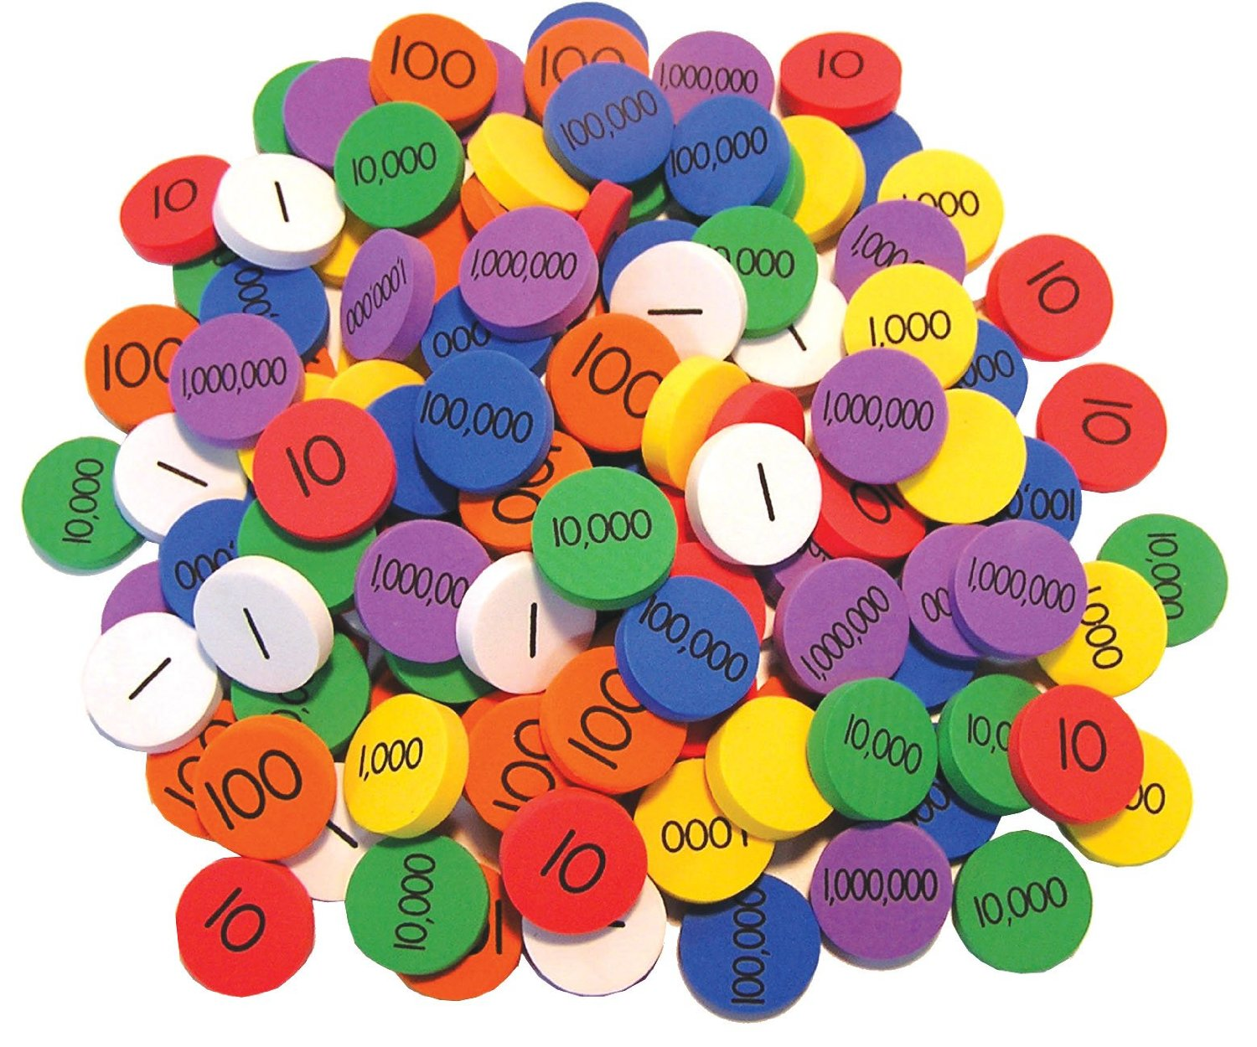
What does addition mean if you add 27 to 48 with place value counters ... or coins?

Slide 5
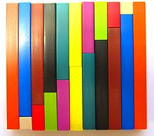
What does addition mean if you add 27 to 48 using Cuisenaire rods?

Slide 6

What does addition mean if you add 27 to 48 using liquid measure?

Slide 7
What does addition mean if you add 27 to 48 using the steel measure?

Slide 8
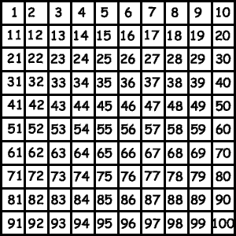
What does addition mean if you add 27 to 48 using the hundred square?

Slide 9
(and other grids)?
1 | 2 | 3 | 4 | 5 | 6 | 7
8 | 9 | 10 | 11 | 12 | 13 | 14
15 | 16 | 17 | 18 | 19 | 20 | 21
22 | 23 | 24 | 25 | 26 | 27 | 28
29 | 30 | 31 | 32 | 33 | 34 | 35
36 | 37 | 38 | 39 | 40 | 41 | 42
43 | 44 | 45 | 46 | 47 | 48 | 49

Slide 10
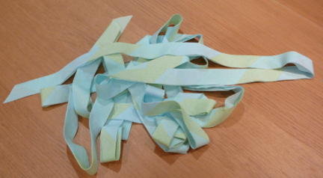
What does addition mean if you add 27 to 48 using tape?

Slide 11

What does addition mean if you add 27 to 48 using squared paper?

Slide 12
Expressing the structure of addition
a + b = c c = a + b
b + a = c c = b + a
    c – a = b b = c - a
    c – b = a a = c - b

Slide 13
Extending the meaning of addition
What can addition mean if you add 27 to 48 using area under y = 1?
What can addition mean if you add 27 to 48 using area under y = 3?
What can addition mean if you spot that 27 and 48 have common factors and re-write it as 3(9 + 16)?
What can addition mean if you add 27 to 48 using area under y = 2x?

Slide 14
Difference
Write down two numbers/lengths/quantities with a difference of 3
… and two more numbers with a difference of 3
… and another very different pair
Write down two definite integrals on the same interval that differ by 3
… and two more
… and another very different pair

Slide 15
Reprise
Enactive experiences towards an appreciation of addition and building of iconic images
Symbolic generalisation of additive relationships (structure)
Extending to new contexts
Focus on some feature (difference)

Slide 16
Multiplicative structure
a = bc
bc = a
a = cb
cb = a
a
a
b =
= b
c
c
a
a
c =
= c
b
b

Slide 17
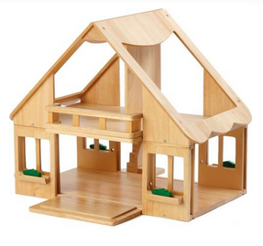
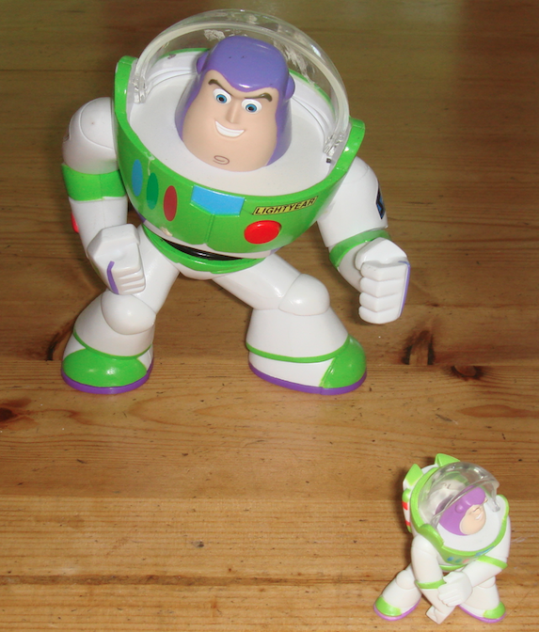
Questions about multiplicative structure
How many …. in ….?
How many times ….?
How many times bigger/smaller … ?

Slide 18
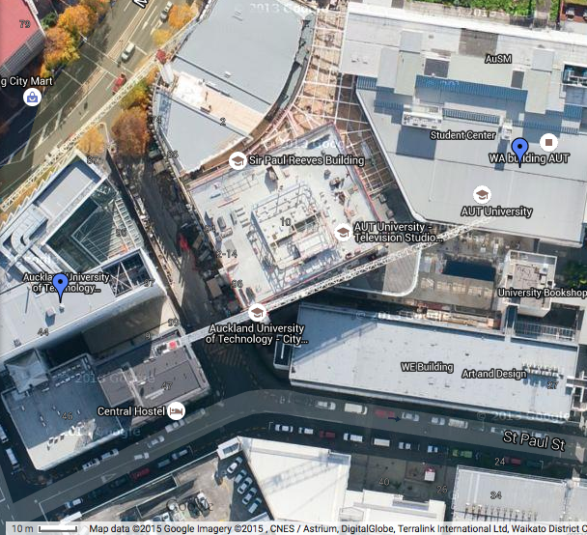
What is the Scale Factor?

Slide 19
Ratio
Write down two numbers/lengths/quantities with a ratio of 3 : 4
… and two more numbers with a ratio of 3 : 4
… and another very different pair
Write down two measurements in the ratio 3 : 4
… and another
… and another
Draw a rectangle whose sides are in the ratio 3 : 4
… and another
… and another

Slide 20
Reprise
Enactive experiences towards an appreciation of multiplication (as repetition and as scaling) and building of iconic images
Symbolic generalisation of multiplicative relationships (structure)
Extending to new contexts (implied)
Focus on some feature (ratio)

Slide 21
LCM & GCD
What is the LCM of
27 and 48?
What is the LCM of two numbers?
What is the GCD (HCF) of 27 and 48?
What is the GCD (HCF) of two numbers?
The smallest number exactly divisible by both numbers
The largest number that divides exactly into both numbers

Slide 22
LCM & GCD of Fractions
What is the LCM of 27/14 and 48/35?
What is the GCD (HCF) of 27/14 and 48/35?
The smallest fraction exactly divisible by both numbers
The largest fraction that divides exactly into both numbers
‘Exactly’ means
‘integer result’

Slide 23
LCM
What is the LCM of 27/14 and 48/35?
The smallest fraction exactly divisible by both numbers
Want these to be integers
So w has to be divisible by both 27 and 48
& z has to divide into both 14 and 35
Numerator LCM
LCM =
Denominator GCD

Slide 24
GCD
What is the GCD (HCF) of 27/14 and 48/35?
The largest fraction that divides exactly into both numbers
Want these to be integers
So x has to divide into both 27 and 48
& y has to be divisible by both 14 and 35
Numerator GCD
GCD =
Denominator LCM

Slide 25
LCM & GCD
What is the LCM of 27/14 and 48/35?
What is the GCD (HCF) of 27/14 and 48/35?
The smallest fraction exactly divisible by both numbers
The largest fraction that divides exactly into both numbers
Numerator LCM
Numerator GCD
LCM =
GCD =
Denominator GCD
Denominator LCM

Slide 26
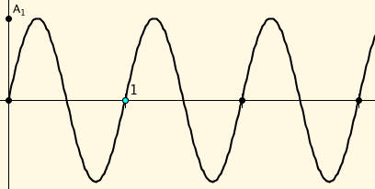
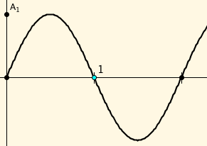
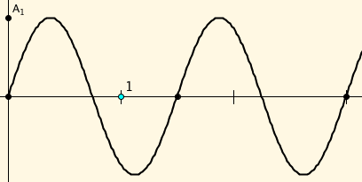
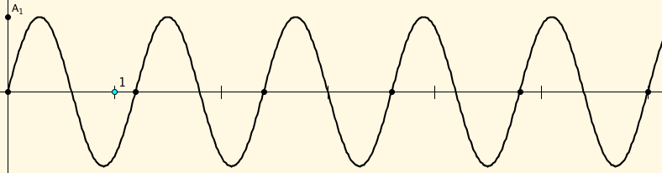
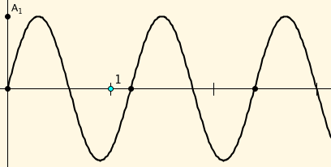
What is the period?
Period 1
Period 2
Period 3/2
Period 6/5

Slide 27
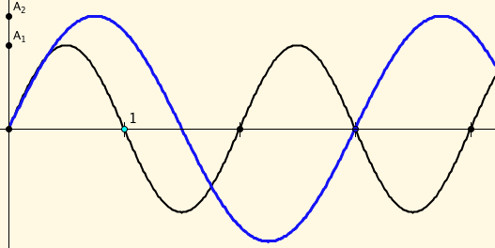
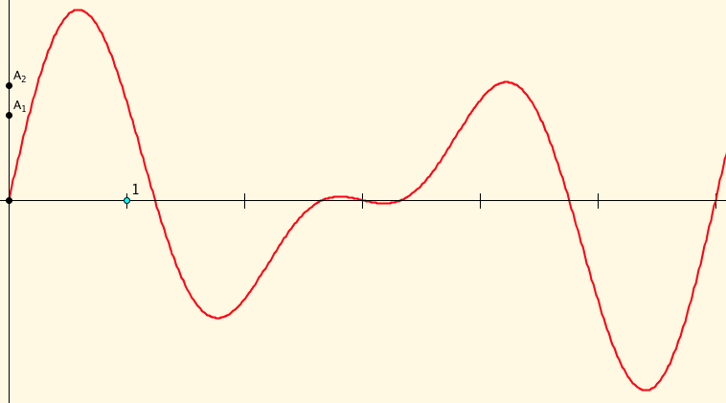
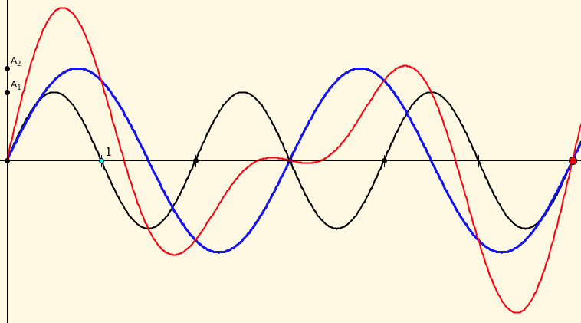
Combined Periods
Period 2
Period 3
The red is the sum of the blue and the brown
Period 6

Slide 28
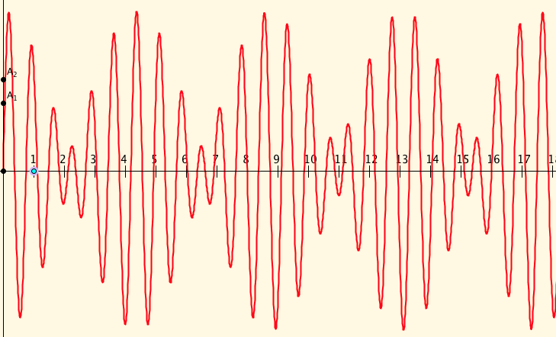
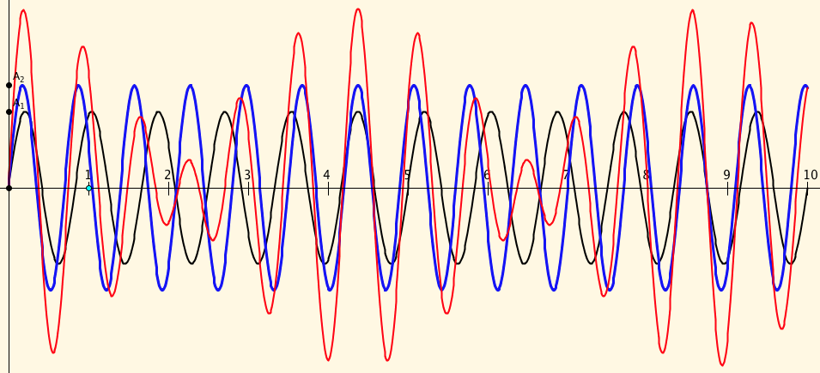
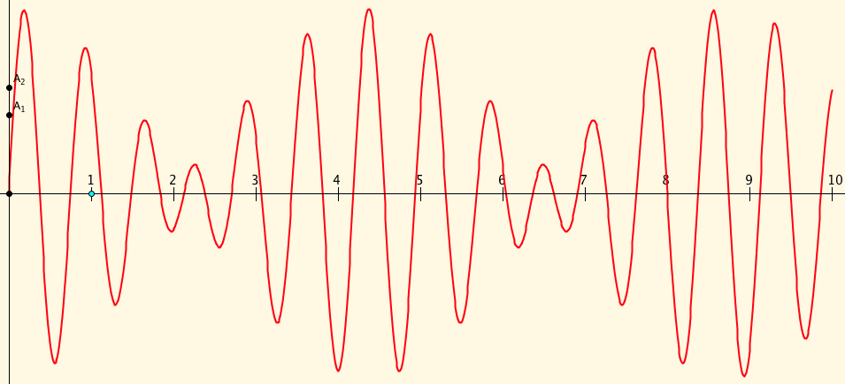
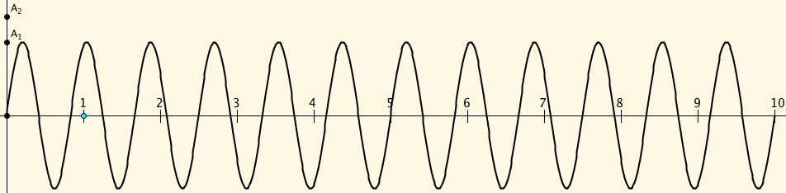
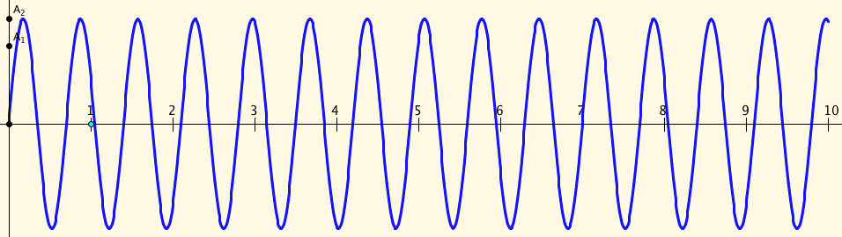
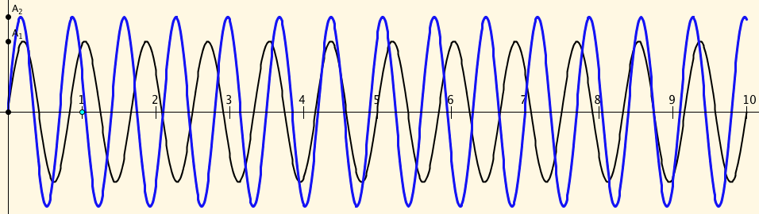
Two Fractional periods
Period 5/6
Period 7/10
Period 35/2

Slide 29
Reprise
A familiar and pervasive structure (addition)
  Extending the domain of action
A pervasive structure (multiplication)
  Extending the domain of action (implied)
Structuring something less familiar (lcm, gcd, periodicity)
  Extending the domain of action
  Something new to explore (periodicity)

Slide 30
Follow Up
Anne.Watson@education.ox.ac.uk
John.Mason@open.ac.uk
Mathematics as a Constructive Activity: learner generated examples (Erlbaum)
PMTheta.com for applets, PPTs, and more

Slide 31

Differing Sums of Products
Write down four numbers in a 2 by 2 grid
4
7
5
3
Add together the products along the rows
28 + 15 = 43
Add together the products down the columns
20 + 21 = 41
43 – 41 = 2
Calculate the difference
That is the ‘doing’
What is an undoing?
Now choose positive numbers
so that the difference is 11
Notes:
Mathematical context
What probaby matters most is not eh context, but whether students ‘think’ they can solve the problem!

Slide 32
Differing Sums & Products
4
7
Tracking Arithmetic
5
3
4x7 + 5x3
4x5 + 7x3
4x(7–5) + (5–7)x3
= 4x(7–5) – (7–5)x3
= (4-3) x (7–5)
So in how many essentially different ways can 11 be the difference?
So in how many essentially different ways can n be the difference?
Notes:
Revealing Structure by attending to relationships not calculations

Slide 33

Think Of A Number (ThOANs)
Think of a number
Add 2
Multiply by 3
Subtract 4
Multiply by 2
Add 2
Divide by 6
Subtract the number you first thought of
Your answer is 1
7
7
+ 2
3x + 6
7
7
3x + 2
6x + 4
7
6x + 6
7
+ 1
7
1

