Slide 1


Striking a Chord: getting to grips with calculus concepts
ATM
April 2021
in the time of Corona

Slide 2
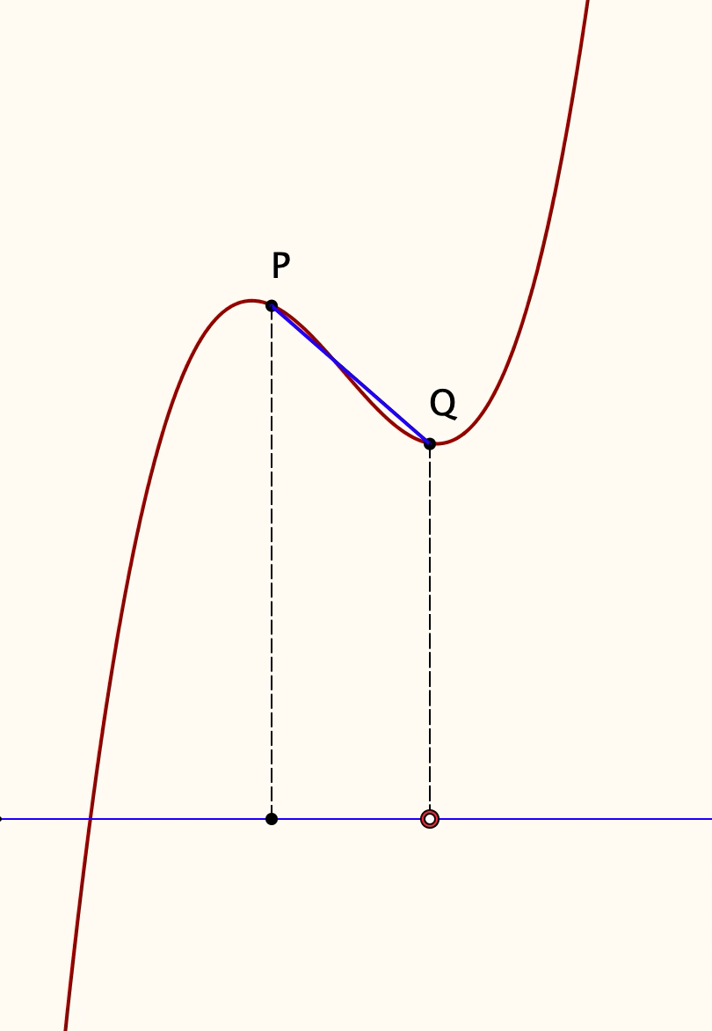
Fixed End Chords
Imagine the graph of a function f.
Imagine two points P & Q on the graph with the chord joining them.
Attention is focused on the point P and what happens as Q approaches P.
Consider the rise of the chord.
Graph the rise as Q changes (dashed red)
It approaches 0 as Q approaches P.
How quickly does it go to 0?
Form the ratio of the rise to the chord width.
Graph the as Q changes (solid green)
As the width goes to 0, the ratio tends to the slope (gradient) of the tangent at that point, if it exists.
When P is allowed to change, the limit point traces out the derivative.
It offers no image of what the graph of the derivative looks like.

Slide 3
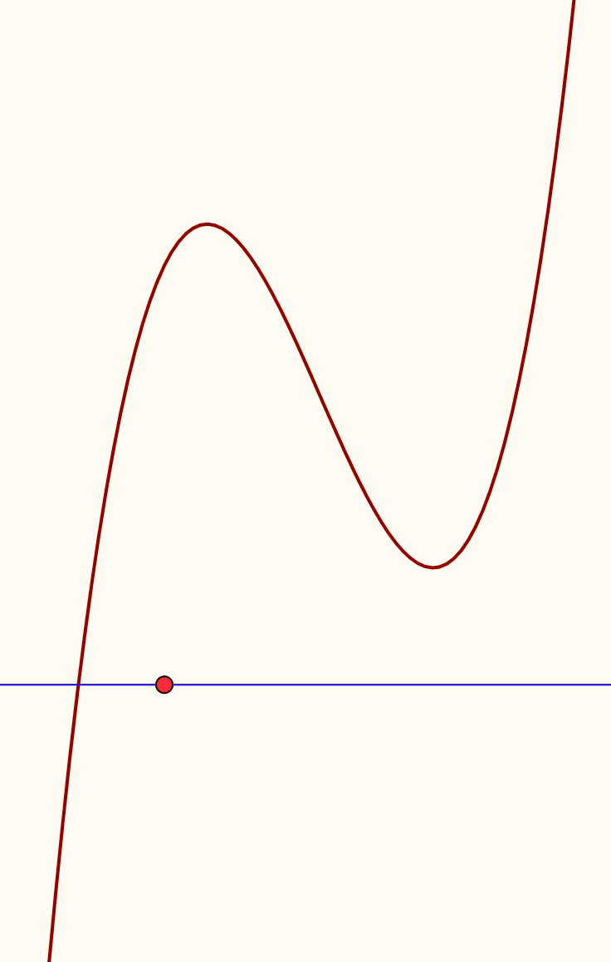
Fixed Width Chords
Imagine the graph of a function f.
Imagine a chord joining two points P and Q, of constant width.
Attention is focused on the relation between P and Q for a fixed chord width
Graph the rise of the chord, (dashed red)
It approaches 0 as the chord-width approaches 0.
How fast does it go to 0?
Graph the slope (gradient) of the chord at each point (solid green)
The limit of the ratio as the chord-width approaches 0 ‘looks like’ the derivative of the function (solid blue);

Slide 4
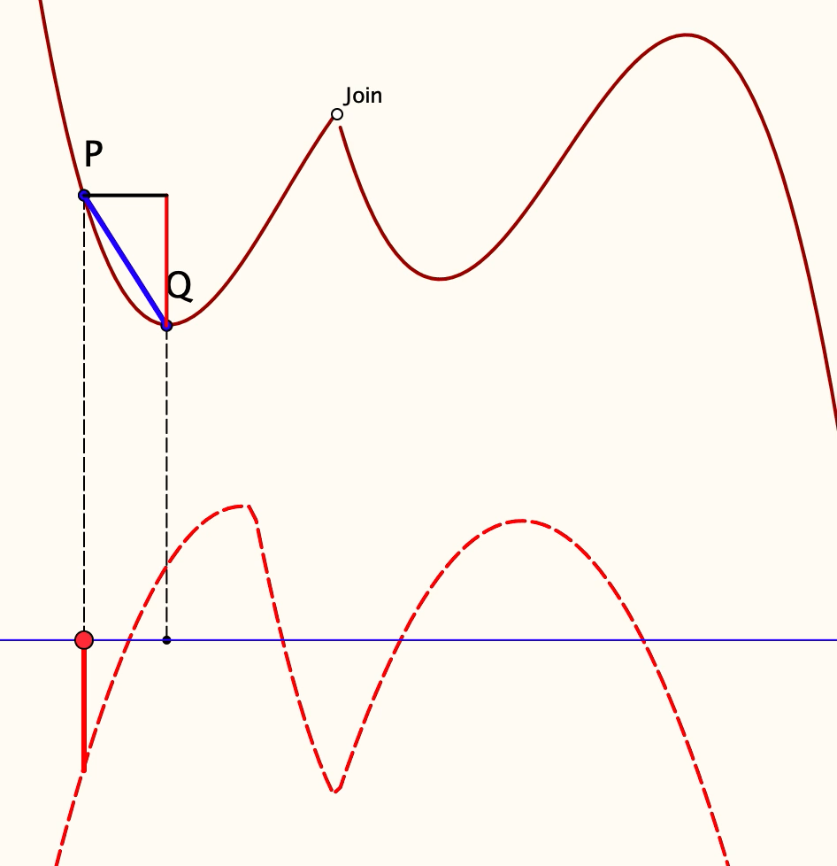
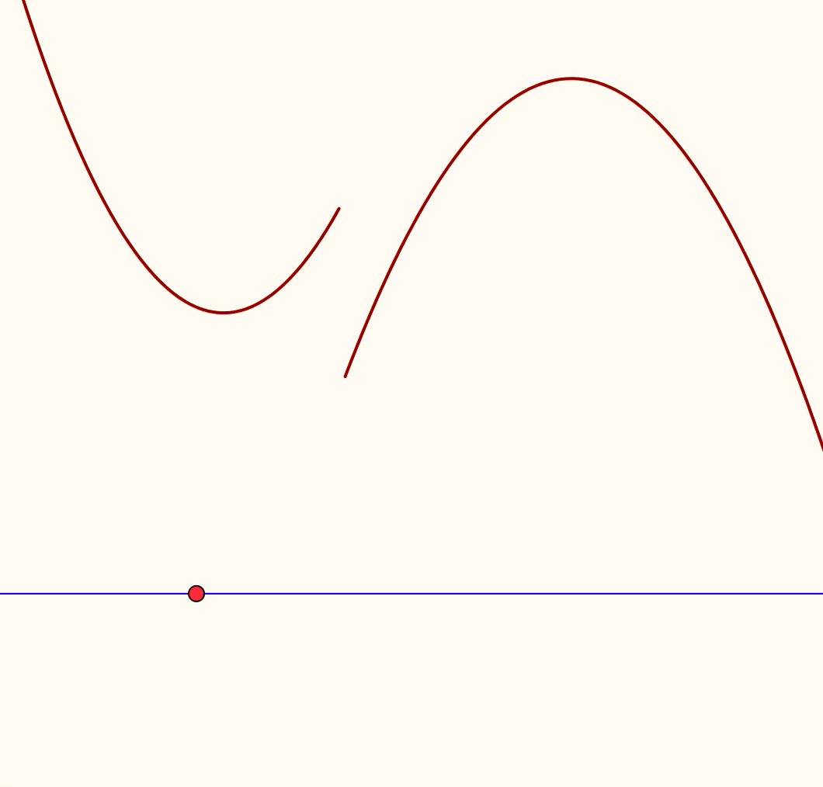
Wrinkles
What happens when the original function is not differentiable at some point?
What if the original function is not even continuous at some point?

Slide 5
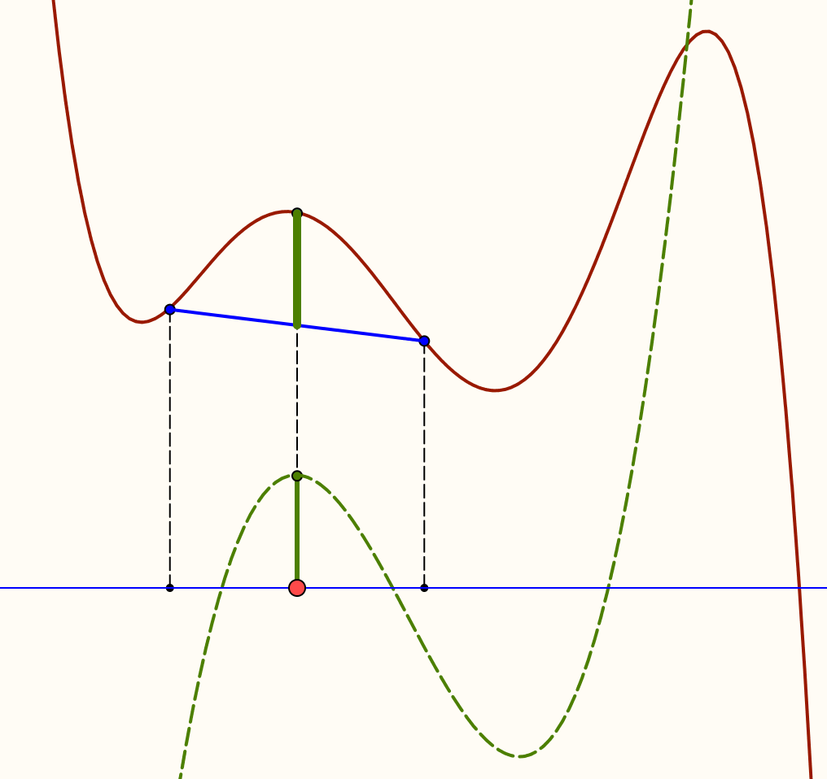
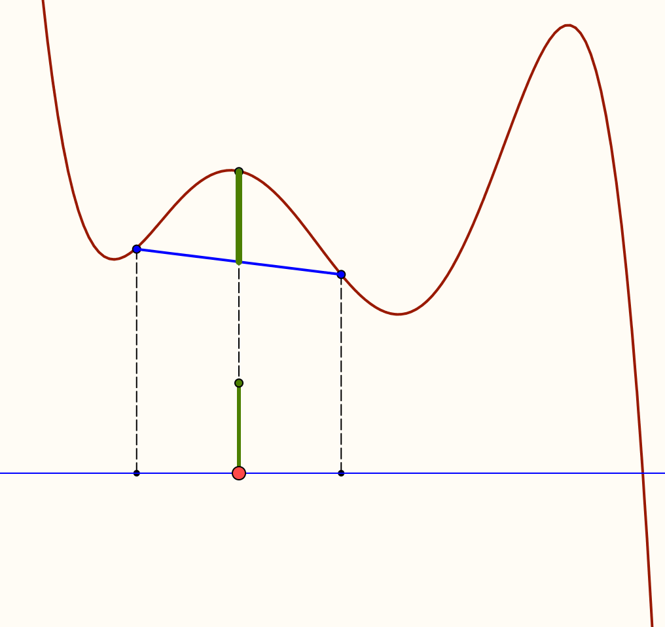
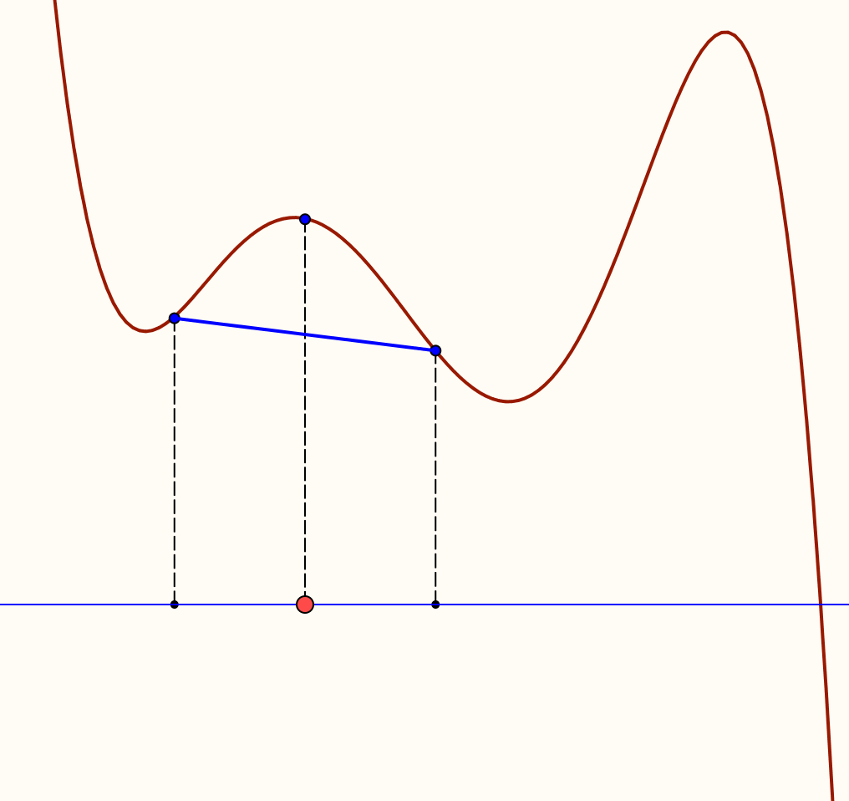
Chordal Gaps
Imagine the graph of a function, and a chord of interval width w centred at x.
Now draw in the line segment between the midpoint of the chord and the corresponding point on the graph, called ‘the gap’.
Imagine the graph of this ‘gap’ height as x moves along the x-axis.
As the chord width goes to 0, the gap goes to …?
At what rate? What power of w must you divide by to get a finite limit?
Order is 2.
If the gap is taken at the mu-point,
When

Slide 6
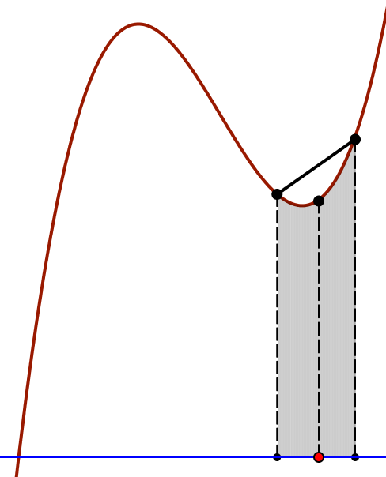
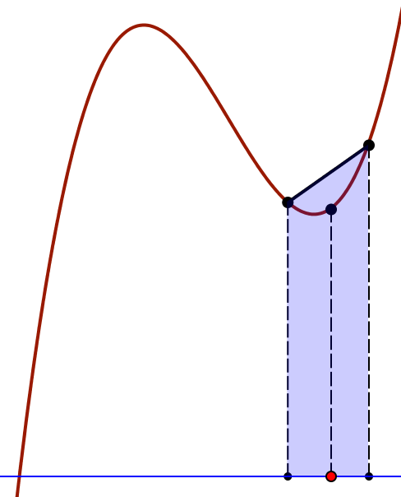
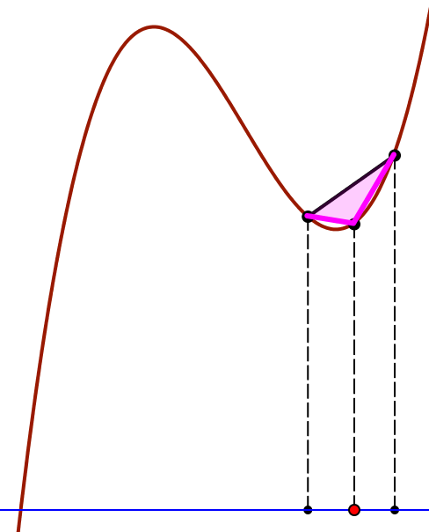
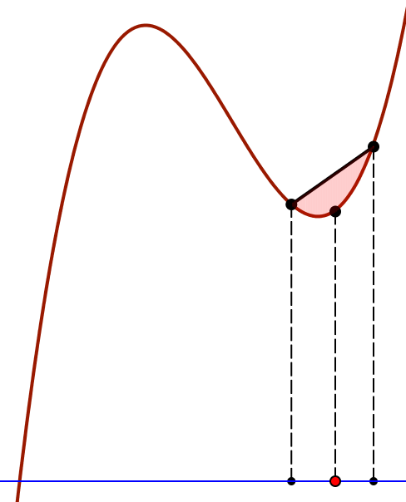
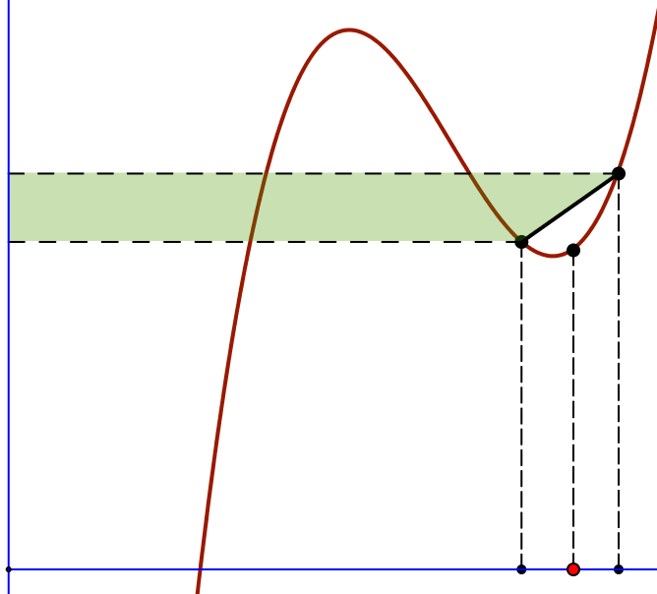
Chordal Areas
Faced with a chord on the graph of a function there are several regions whose area might be of interest:
Area below
curve
Area below
chord
Area of
triangle
Area
between
They all tend to 0 as the chord width goes to 0.
But how quickly? As what power of w?
Does mu matter?
In limit, chordal triangle ≤ ¾ area-between
Area beside

Slide 7
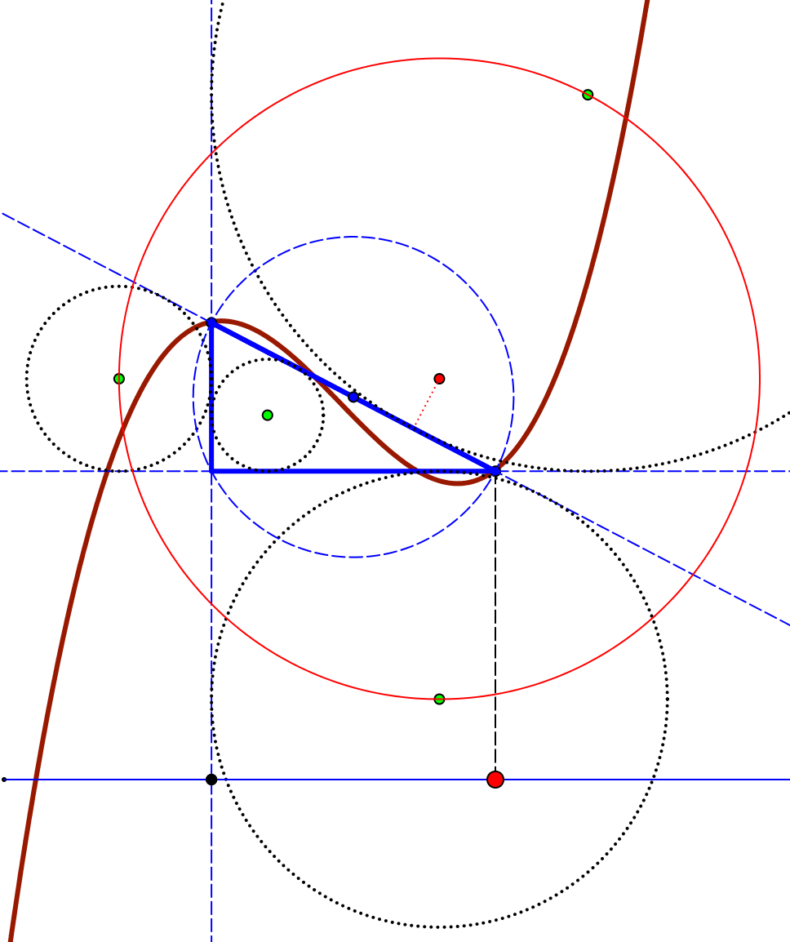
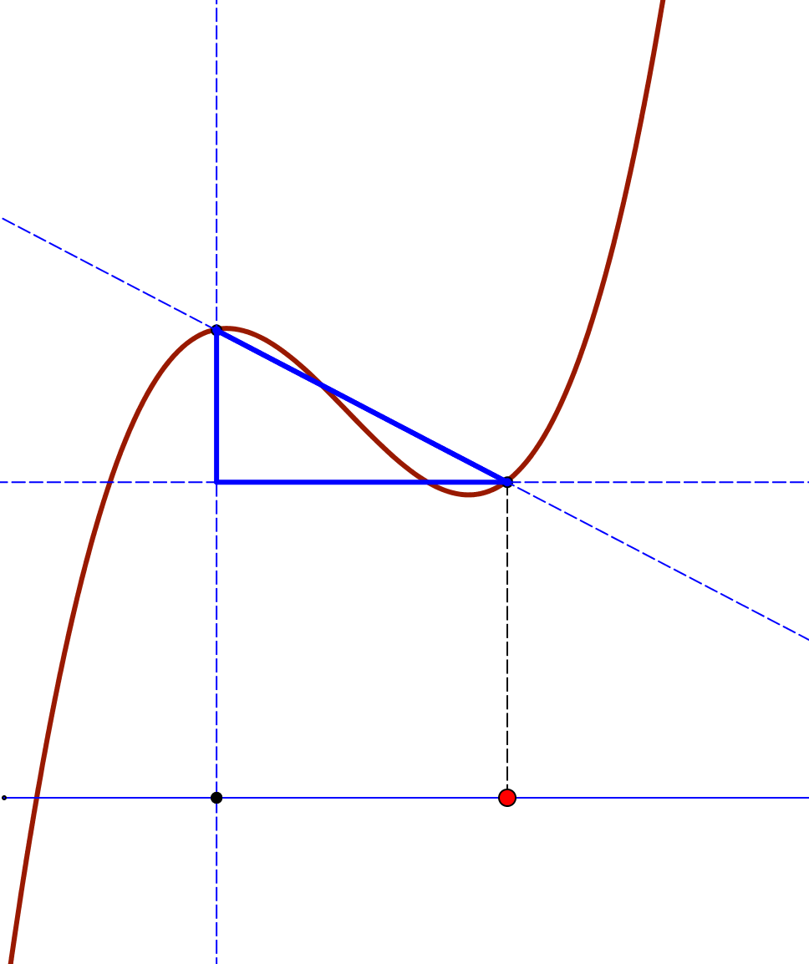
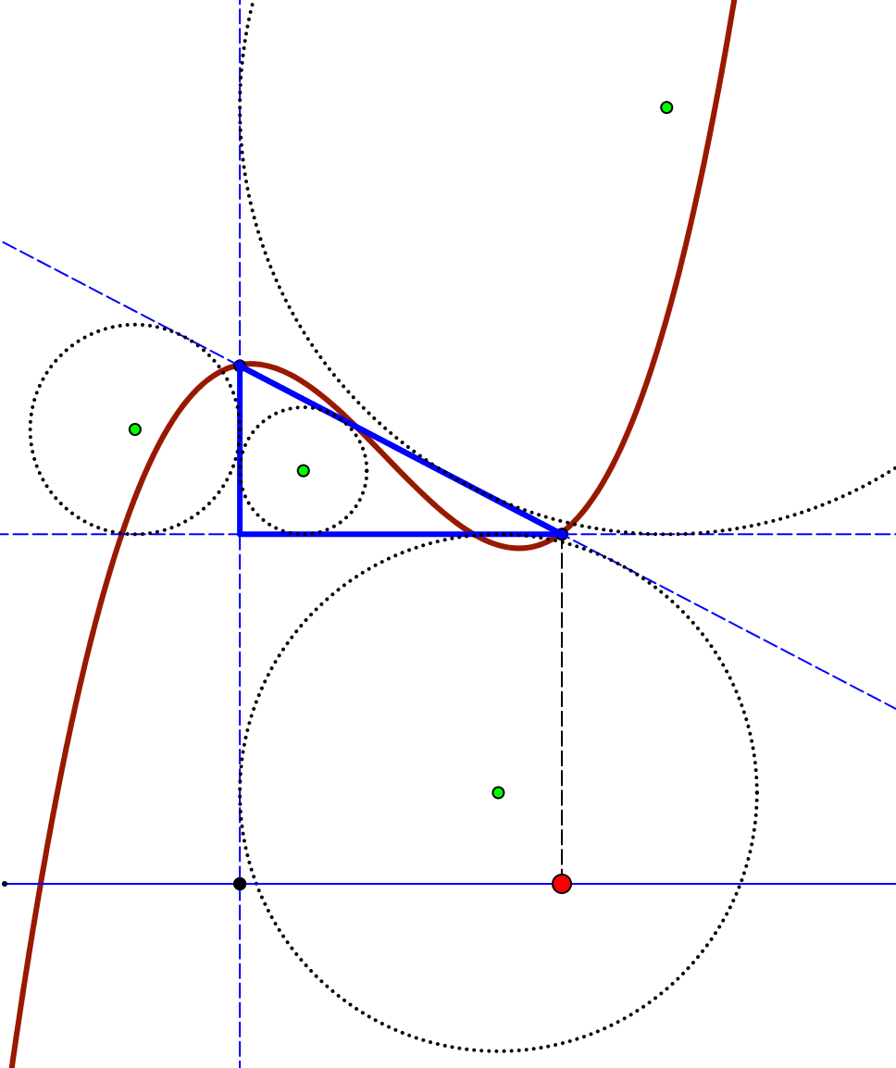
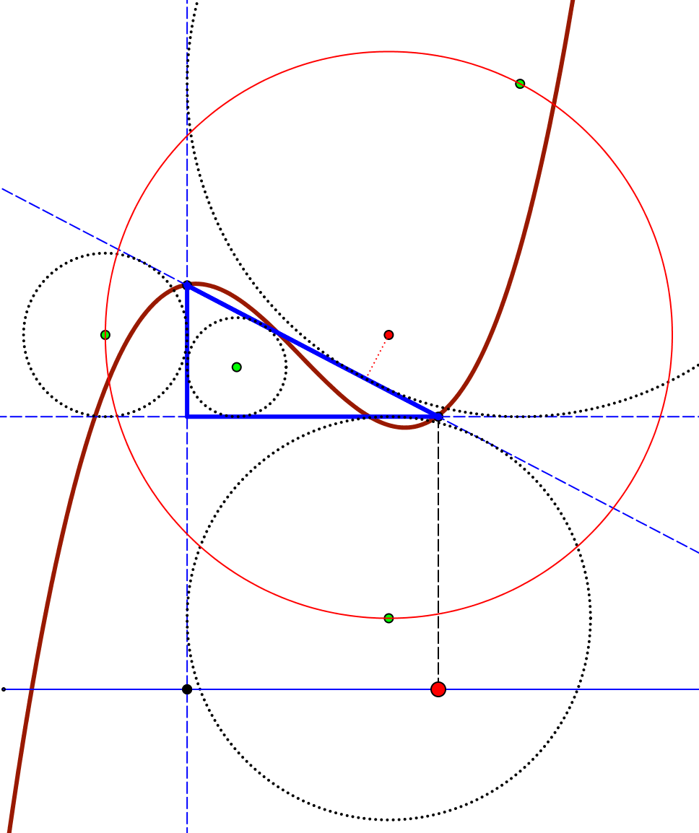
Chordal Circles
Chordal Triangle
In- & Ex-circles
Bevan Circle
Circumcircle
What happens to their radii as the chord width goes to 0?
How fast (what power of width must be used as divisor to get a finite ratio?

Slide 8
Chordal Lengths

