Slide 1




The Discipline of Noticing and
It’s use in researching, teaching and learning
Promoting Mathematical Thinking
John Mason
Sheffield
Jan 2016
The Open University
Maths Dept
University of Oxford
Dept of Education

Slide 2
Outline
Throat Clearing
Observing (noticing)
  Observation invariant
  Memory (experience) fragmented
  Hanson, Goodman
Sensitising oneself to observe
Attention
Working on Your Own Teaching
  Collecting actions (educating awareness)
  Noticing opportunities (in retrospect, in prospect, in spect)
Assumptions made about human psyche
  Cognition, affect, enaction, attention, will, witness

Slide 3
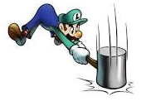
Throat Clearing
Everything said here is a conjecture …
  … to be tested in your experience
My approach is fundamentally phenomenological …
I am interested in people’s lived experience.
So, what you get from this session will be mostly …
  … what you notice (noticed) happening inside you!
Central role of attention:
… What is being attended to?
… How it is being attended to?

Slide 4
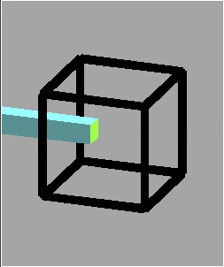
Attention & Will

Slide 5
Say What You See
Notes:
What you notice depends on what you are attuned or sensitised to notice

Slide 6
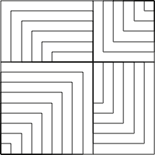
Present or Absent?

Slide 7


What’s The Same & What is Different?
Notes:
Expectations based on partial information

Slide 8
Observation
  A name or label immediately shapes what is seen and what is recalled (Frederick Bartlett 1932)
  Observation is theory laden
  (George Hanson 1958)
  We want our theories to be as fact laden as our facts are theory laden
  (Nelson Goodman 1978)

Slide 9
Find each of the single digit numerals

Slide 10
Say What You See
Notes:
Can you see boy reading?, boy copying or checking? Girl thinking?

Slide 11
Fragments Conjectures
Experience is recalled in fragments
Experience is fragmentary
  Contrast with William James and “stream of consciousness”

Slide 12
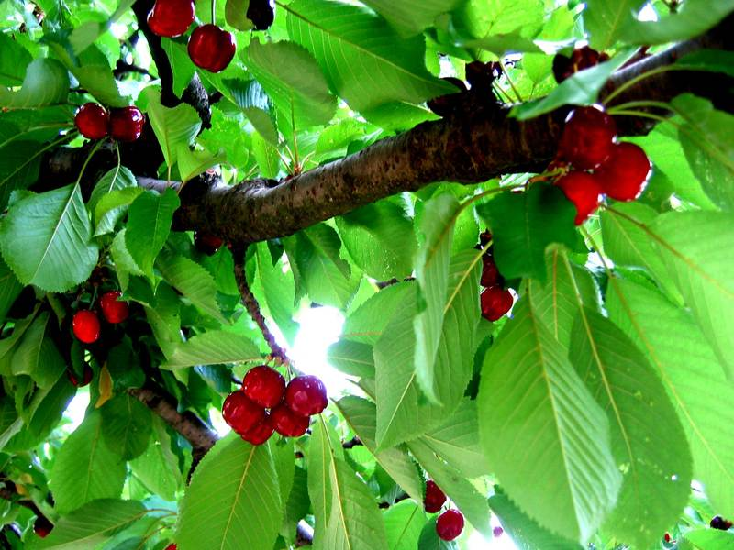
Major Influences
Bennett, Gattegno, Tahta. James
Heidegger, Husserl
… Plato
… Upanishads; Rg Veda, Baghavad Gita; Sankya, Zen
Cherry Picking
Bricolage
Distinctions that I can use;
Distinctions that resonate or challenge
but that ultimately make sense

Slide 13
Journey Back To Roots of Human Psyche
Exploitation of dual systems theory to promote statistical education and elementary mathematics as a route to a more rational society, coming from a society founded on rationalist principles and a rationalist view of human beings.
Kahneman
Norretranders
McGilchrist
The User Illusion (also Mandler …)
Right & Left Brain functions
only awareness is educable;
only behaviour is trainable;
only emotion is harnessable;
integration through subordination;
Gattegno
Fischbein
Freudenthal
…
Vygotsky
ZPD as a way of thinking about how actions are made accessible to S1 through development from requiring external cueing and participation of S2;
Higher psychological processes first encountered in the social
Notes:
Not to mention thousands of authors of novels, stories, poems.

Slide 14
Journey Continues
Assimilation & Accommodation; Reflective Abstraction
Piaget
Skinner; Pavlov (behaviourism)
stimulus-response (cf S1)
Rationalism
expecting actions to be chosen rationally (Enlightenment; 20th century America)
Habermas
Forms of rationality
“Man is not a rational animal, but an animal capable of reason”
Focus on intellect-cognition; trying to avoid emotion-affect;
Swift
(Gulliver’s Travels)

Slide 15
Journy’s End – Original Ideas
Buddhism
Mind is more than cognition; mind as a fusion of intellect-emotion-behaviour directed by will.
Plato
Psyche as a society (workers in a mansion; sailors on a ship); absence of will
Upanishads
Human psyche as a chariot:
intellect, emotion, behaviour and attention-will;
Action requires the transformation of energy
Enactive-affective-cognitive-attentive coordinations or adhesions in the psyche:
(micro-identities; multiple selves);
Each coordination/adhesion has characteristic habits, dispositions, lines of thought, socialability and transformations of energy

Slide 16
Attention
What is being attended to (focused on)?
How is it being attended to?
  Holding Wholes
  Discerning Details
  Recognising Relationships
  Perceiving Properties as being instantiated
  Reasoning on the basis of agreed properties
Focus on particular
Focus on generality
being instantiated

Slide 17
Is 51 + 51 = 50 + 52?
How do you know?
What is Fran attending to?
Fran: Like fifty-one plus fifty-one are one hundred and two, but fifty-one, if you subtract fifty, you can add to fifty-one, one from the other, one more, and you get fifty-two.
Teacher-Researcher: Ah, that is interesting. You said that you can take one from here [pointing to the first fifty-one] and add it to this one [pointing to the second fifty-one]. Isn’t it? Is that what you said?
Fran: And you get there, one hundred… fifty plus fifty-two.
How is her attention shifting?
Babbling or Gargling?
What is being attended to?
Listening-to or
listening-for?
Teaching Action:
selecting/editing
What is Fran attending to?
Notes:
Mason, J. (2012). You Can Lead a Horse to Water…: Issues in Deepening Learning Through Deepening Teaching. In S. Hegedus & J. Roschelle (Eds.) Democratizing Access to Important Mathematics through Dynamic Representations: Contributions and Visions from the SimCalc Research Program. Berlin: Springer-Verlag.
Nicolina Malara; Brent Davis

Slide 18
CopperPlate
Multiplication

Slide 19
Giacomo Candido 1871-1941
What does it say?
+
[x² + y² + (x + y)²]²
=
2[x⁴ + y⁴ + (x + y)⁴]

Slide 20
Some Arithmetic
34 + 83 – 34 = ?
278 + 341 – 248 – 371 = ?
Which is larger, 47 x 29 or 49 x 27?
Is 38 helpful?
Calculate
What were you attending to?
Reaction-Response
Direct Calculation
How did your attention shift?
Balk (affective block)
Structural-Relation informed calculation
Relational Thinking
Notes:
Marta Mollina; Castra; Max Stephens; …

Slide 21
Examples (from Blum and elsewhere)
If 2 eggs take 6 minutes to hard boil, how long will 20 eggs take to hard boil?
If 18 of 24 students take a test lasting 45 minutes, how long will the test last when all 24 take it?
If the captain of a ship takes on board 14 sheep, 5 cows, 35 chickens and 12 goats, how old is the captain?
English HighSchool students given some word problems in Chinese (Arabic Numbers) and other word problems in English performed better on the problems in …
  Chinese!
What is being studied?
Deficiency
What they can’t do?
What they didn’t do?
Alternative
or
Joint
explanations
Didactic Contract
What they did do?
What they can do?
S1 automatism
Situated proficiency

Slide 22
Extract
What is each speaker attending to?
How is attention shifting?
Teacher: If I count [there] the beads are six, but the number prepresented on the abacus is fifteen. Would anybody like to try explaining how to do it?
Giulia: This is the ten (points to wire on left) and these are the units (points to 5 beads on right)
Teacher: Giulia says that on the wire on the left is the ten-bead, while on the wire on the right there are …
Chorus: Units
Cloze technique
Invoking S1?

Slide 23
Extract
T: Right, let’s see who wants to be my helper.
T: Megan’s been sitting beautifully, oh no, Megan’s been reading a poetry book.
M: No [inaudible, shakes head].
T: That should be on my desk, thank you. Put your hand up please, you know the rule. Yes Harry,
H: You could both have three, if you give one to your neighbour.
T: I could that’s a very good point, H. I’m not going to do that today though. I’m just going to talk about the difference. Megan, if you had a pond, how many frogs would you like in it?

Slide 24
Extract
(The fact that the difference between 5 and 4 is 1 has been said several times)
T: One, now can anyone, does anyone know how we can write this as a takeaway sum. Right, sit down you two.
Z, can you come to the front. How would you write this as a take away sum to show the difference? Nice and big. [writes 5 - 4] So she’s written 5 take away 4 equals [Z returns to board, writes =] and what’s the answer, what’s the difference? G?
G: One.
T: Equals One. [Z completes 5 - 4 = 1] Thank you. Can you see cos if we had these five frogs in Megan’s pond, and we took away four of them, there’d be one left over. One extra one. Right, who else would like a pond?

Slide 25
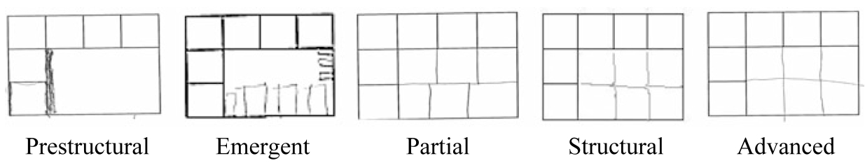
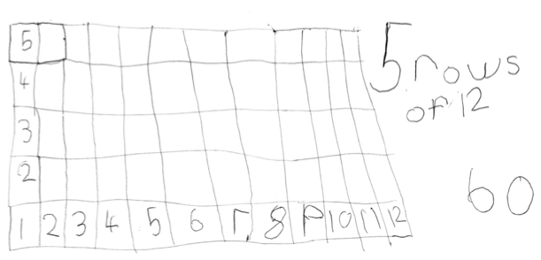
Grid Completion
Figure 1 Structural development in a grid completion task (Mulligan & Mitchelmore, 2013, p. 39)
Figure 2. Kindergarten child’s grid showing transition of reasoning from structural to a more advance level of development

Slide 26
Reporting Data
Accounting For
Account of
“They couldn’t …”
“They can’t”
“They didn’t display
evidence of …”
“They don’t display
evidence of …”
“I didn’t detect
evidence of …”
“I don’t detect
evidence of …”

Slide 27
Precision Conjecture
The more precisely the data is specified,
the more we learn about
the researcher’s sensitivities to notice
The universe is a mirror
in which we can contemplate
only
what we have learned
to know about ourselves
(Italo Calvino)

Slide 28
Accounts-of & Accounting-for
I cannot evaluate your analysis
if I cannot distinguish it
from the data itself
Accounts-of: brief-but-vivid accounts
Reduce-remove theorising, judgement,
excuses, evaluations, justifications

Slide 29
Essence of Discipline of Noticing
Systematic Reflection
  Past (accounts-of not accounting-for)
Preparing & Noticing
  Actions and situations (educating awareness)
  For Future & Present
Recognising Choices
  Could-have & Could-be
  (not should-have or shoul- be)
Validating
  for Self & with Others

Slide 30
Systematic Reflection
Keeping
Accounts
Seeking
Threads
Recognising Choices
Distinguishing
Choices
Accumulating
Alternatives
Preparing & Noticing
Identifying & labelling
Imagining
Possibilities
Noticing
Possibilities
Validating with Others
Describing
Moments
Refining
Exercises

Slide 31
Specting
Intraspective
Extraspective
Introspective
Interspective

Slide 32
What are the significant products of research?
Transformations of the ‘being’ of the researchers
Increased sensitivity to notice what was previously not noticed
Refined vocabulary for discussing, discerning and analysing
Awareness which informs future choices of action
  Self
  Others

Slide 33
Interwoven Worlds
Own
world of experience
Colleague's
world of experience
Trying
Seeking
resonance
Reflecting
Recognising
Possibilities
with others
Preparing
Expressing
World of observations
& theories

Slide 34
Protases
I cannot change others;
I can work at changing myself
To express is to over stress
One thing we do not seem to learn from experience,
is that we do not often learn from experience alone

Slide 35
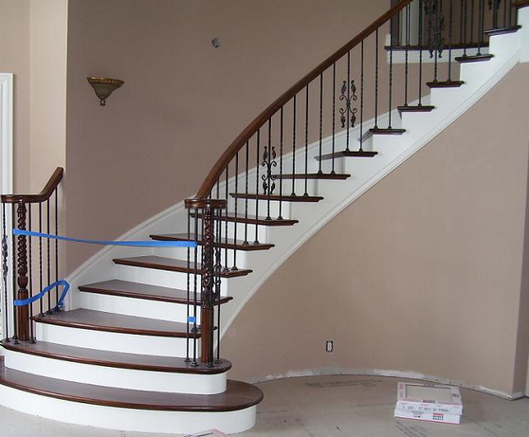
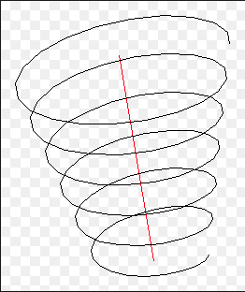
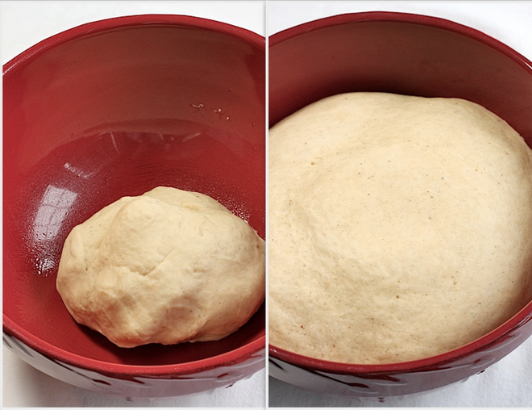


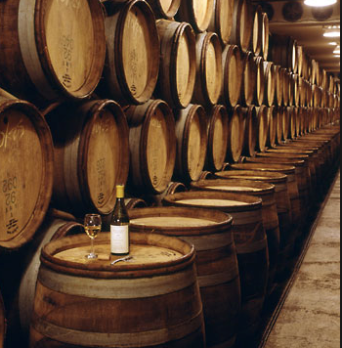
Conceptions of Learning
Staircase
Spiral
Maturation

Slide 36
Assumptions
The purpose of Research in Mathematics Education is to to work at
  Improving the experience of learners as they encounter mathematics …
  … by understanding how people develop & enrich their mathematical thinking from the experiences they undergo
  … and by developing practices which promote the development of mathematical thinking through drawing upon the human psyche and the social conditions.

Slide 37
Questions
Do you assume that people’s choices reflect what is the case for them?
Do you assume that people’s choices are well considered?

Slide 38
Dual Systems Theory
(Kahneman; Frederick; Leron)
Human Beings have two modes of functioning:
  S1: automatic reactions; habit;
  internalised functionings;
  awarenesses enabling actions;
  default parameters;
  educated intuitions;
  S2: considered responses; intellect-cognition
Conscious control-direction of action is (mostly) an illusion (Norretranders)
  Human beings as narrative animals (Bruner; …)
S1 offers up possibilities; S2 is “lazy”
Have you encountered learners
who do or say the first thing that comes to them?
“They don’t think before they act!”

Slide 39
Educating & Re-Educating Intuitions (S2 -> S1)
Adding makes bigger
  Adding something to a number does not always make it bigger
Multiplying makes bigger
  Multiplying a number by a number does not always make it bigger
Squaring a positive number makes it bigger
  only when it is bigger than one
A function can be differentiable at a point but have arbitrarily large slope arbitrarily close to that point
While a differentiable function of one variable on a closed interval attains its extreme values,
a differentiable function of two variables on a closed set may not attain its extreme values

Slide 40
Stances
Deficiency
  What learners cannot (do not) do at different ages and stages
  What teachers do not know, do, or appreciate about different topics and pedagogical strategies
Proficiency
  What learners & teachers & policy makers do already
  Not doing for learners & teachers what they can already do for themselves
Efficiency & Effectiveness
  Seeking efficient and effective ways of enhancing, extending, and enriching
    Peoples’ sensitivities to notice what matters
    Peoples’ powers,
    Peoples’ appreciation of mathematical themes,
    Peoples’ experience of mathematical thinking
    Peoples’ internalisation of effective actions

Slide 41
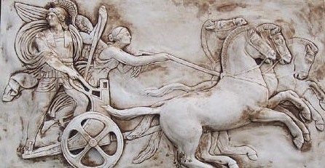
Human Psyche
Intellect (cognition)
Imagery
Attention/Will
Emotions
(affect)
Body (enaction)
Habits
Practices

Slide 42
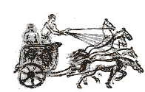
Structure of a Topic
Language Patterns
& prior Skills
Imagery/Sense-of/Awareness; Connections
Root Questions
predispositions
Different Contexts in which likely to arise;
dispositions
Standard Confusions
& Obstacles
Techniques & Incantations
Emotion
Awareness
Behaviour
Only Emotion is Harnessable
Only Awareness is Educable
Only Behaviour is Trainable
Only Attention can be Directed

Slide 43
Why Might This Matter?
Do simple causes have complex effects?
Constructing probes:
  Beware of likelihood of S1 reactions as well as S2 responses
Integrating Social and Psychological explanations
Orientation (of learners; of teachers);
  Seeking proficiency (what they do do)
  Rather than seeking deficiency (what they do not do)
How can findings inform the future practices of
  Learners
  as well as Teachers
  as well as Researchers
Activation: Cognitive, Affective, Enactive and Attentive
  Activation is from outside; aim is to reduce dependency and develop autonomy and self-regulation

Slide 44
Results
From a strong or radical phenomenological stance, results are the ‘sense’ you made of what you noticed, together with possible task-exercises you can modify and use with others to alert them to noticing.
Commentary & Explanation are human narratives
Theories are frameworks of distinctions to help discern details, recognise relationships, and to perceive properties as being instantiated
Distinctions supported by rich descriptions are awarenesses that can enable actions to be enacted which …
  Act as explanations
  Enable predictions
  Inform future actions
and so improve the experience of learners, teachers, researchers, policy makers, …

Slide 45
Possible Discussion Questions
What assumptions about human nature underpin your own data collection?
What assumptions about human nature underpin your analysis of your data?
Do you see learning as a staircase or a spiral or maturation or …
cause
influence
activty
learning
Do teachers’ actions student ?
Contact me at
  john.mason @ open.ac.uk
  www.PMTheta.com

