Slide 1


Shaping Thinkers’ Thinking
Anne Watson & John Mason
Joint Conference
of
Mathematics Subject Associations
March 2024

Slide 2
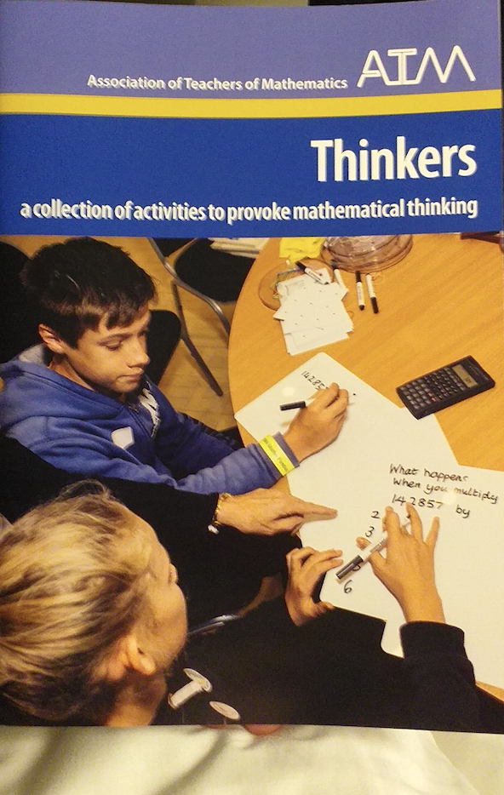
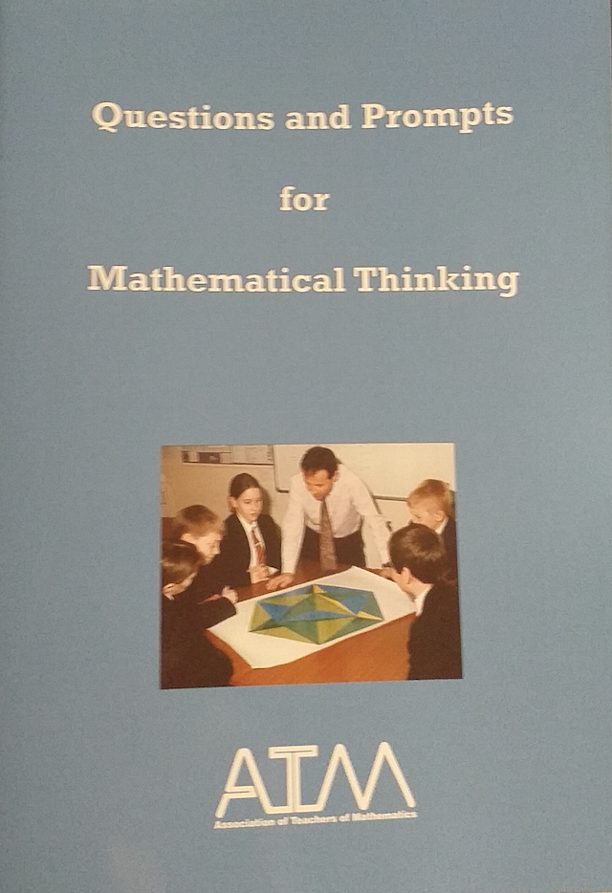
Before we begin
Treat everything that is said as a CONJECTURE
to be tested in and against your experience
Worth attending to
  The specifics of a task
  The task structure
  The place of the task in the sequence
A succession of experiences
does NOT add up to
an experience
of that succession

Slide 3
First steps
Draw a triangle
Draw another triangle that is different …
… and another that is different from those two
For each pair of your triangles:
what do they have in common that the third does not have?
Put your triangles in some kind of order
and explain your order to your neighbour

Slide 4
Getting Together
With your neighbour, put your six triangles into some kind of order
… and another kind of order
Counting something?
Measuring something?
In retrospect,
what else could have been used?
Hierarchy of properties
Make another triangle that fits into your order
Make another triangle that doesn’t fit into your order

Slide 5
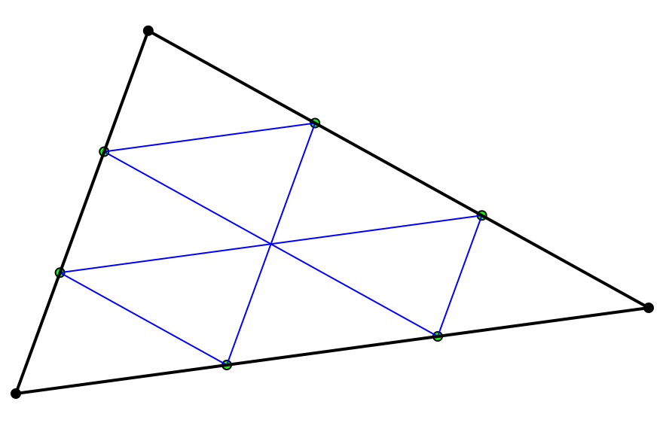
Singling out for scaling
Choose one of your triangles
Draw one that is the same but roughly half the size
What meaning did you give to ‘size’? What else would make sense?
Draw one that is the same shape but one-quarter of the perimeter
Draw one that is the same shape but one-third of the perimeter

Slide 6
Recognising Relationships & Perceiving Properties
Do you have a triangle in which the sum of the lengths of two sides is more than the length of the third side?
Do you have a triangle in which the sum of the lengths of two sides is less than the length of the third side?
Do you have a triangle in which the sum of the squares of the lengths of two sides is less than the square of the length of the third side?
Do you have a triangle in which the sum of the squares of the lengths of two sides is more than the square of the length of the third side?
Draw a triangle in which the sum of the squares of the lengths of two sides is equal to the square of the length of the third side
Order your triangles according to this less than, equal to, more than relationship …..

Slide 7
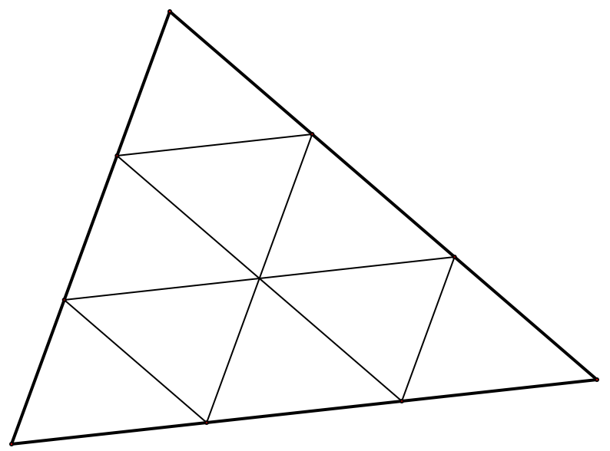
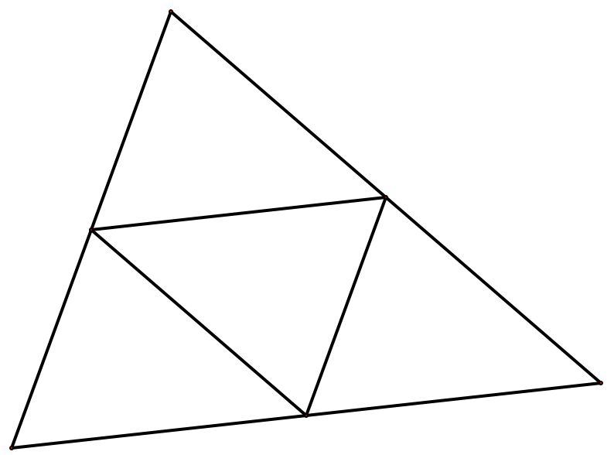
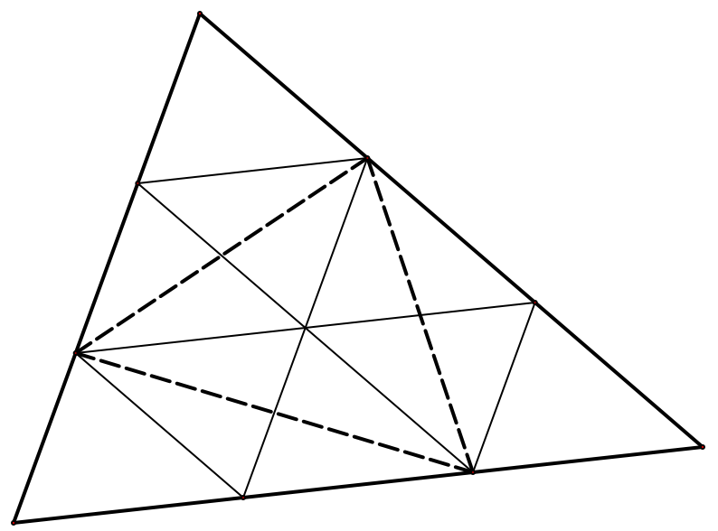
More Scaling
Draw one that is the same shape but one-quarter of the area
Draw one that is the same shape but one-third of the area

Slide 8
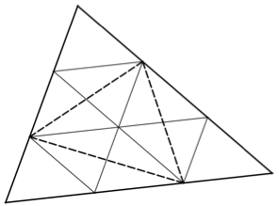

Slide 9
Pedagogical Actions
You Do – We (You and I) Do – I Do
What does ‘I’ do?
  Direct attention to …
  Pose a planned sequence of prompts
  Provide conventional language
  Pose exploratory questions
    Construct an example which shows …
    Is it always true that … ?

Slide 10
Responsible Teaching
”It can go anywhere”
  NOT if we are being responsible !
  There may be several places ‘it can go’
  As a teacher I have prepared worthwhile directions
Classifying perceived properties
Reasoning with properties
Reasoning about relationships

Slide 11
Homage to Bob Burn: Ferrers’ Graphs
4 = 3 + 1 = 2 + 2 = 2 + 1 + 1 = 1 + 1 + 1 + 1
Explain to a neighbour how to read a Ferrers’ graph
Interchanging rows and columns is called conjugation
4 is said to have
five partitions
Which pairs of diagrams for 4 are conjugate?
Are any self-conjugate?
Exhibit the seven partitions of 5
Exhibit the eleven partitions of 6
Which numbers have
at least one self-conjugate diagram?
…
If a number has a self-conjugate partition,
must it have at least one partition into odd parts?
If a number has a partition into odd parts,
must it have at least one self-conjugate partition?

Slide 12
Thinkers Reflections
1 Give An Example Of … (another and another)
2 Pointing Toward Generality (particular, peculiar, general)
3 Hard and Easy
4 Additional Conditions
5 Comparing/Contrasting Three
6 Confounding Expectations
Impossible Constructions
On the Spot Generalisation
9 Open and Closed Questions //Exhaustive Lists
10 Always, Sometimes, Never true
11 Odd-One-Out
12 Sorting
13 Ordering
14 Equivalent Statements
15 With and Across the Grain 16 Burying the Bone

Slide 13
Your Reflections
What has struck you
that you might want to work on or develop?

Slide 14
Follow-Up
Thinkers (ATM)
Questions & Prompts (Secondary & Primary versions) (ATM)
PMTheta.com
AnneWatson1089@gmail.com
John.Mason@open.ac.uk
Mathematics as a Constructive Activity (Watson & Mason)
R.P.Burn: A Pathway into Number Theory
Mason, J. & Watson, A. (2009). The Menousa. flm. 29 (2) p33-38.

