Slide 1
Scaling New Heights in order to
Master Multiplication
John Mason
Birmingham ATM
Oct 5 2017

Slide 2
Assumption
We work together in a conjecturing atmosphere
  When we are unsure, we try to articulate to others;
  When we are sure, we listen carefully to others;
  We treat everything that is said as a conjecture, to be tested in our own experience.

Slide 3
Plan
We work together on a sequence of tasks.
We try to trap our thinking, our emotions, and what we actually do as we go.
Some tasks will advance from Primary to Secondary level, but all are within reach to appreciate, if not fully comprehend, no matter what your current phase of work and mathematical experience.
  That too is a conjecture!

Slide 4
Elastics & Scaling
Imagine an elastic stretched between your two hands.
Imagine stretching it, and letting it shrink.
Now imagine that the middle of the elastic has been marked.
  Where is the mark to be found as you stretch and shrink the elastic?
Now imagine that a point one-third of the way along has been marked as well.
  Where is that mark as you stretch and shrink the elastic?
You now have a way of measuring fractions of things!
Note the invariance of the relative position in the midst of change: stretching and shrinking
You can enact a fraction
as an action

Slide 5
Imagining the Situation
What questions occur to you about this situation?
How might the situation be exploited mathematically?
Make a copy of your elastic on a piece of paper in its original unstretched length.
  Keep one end fixed. If you scale by a factor of 2, where does the 1/3 point correspond to on the original elastic?
  If you stretch the elastic so that the 1/3 point aligns with the 1/2 way point on the original, what was the scale factor?

Slide 6
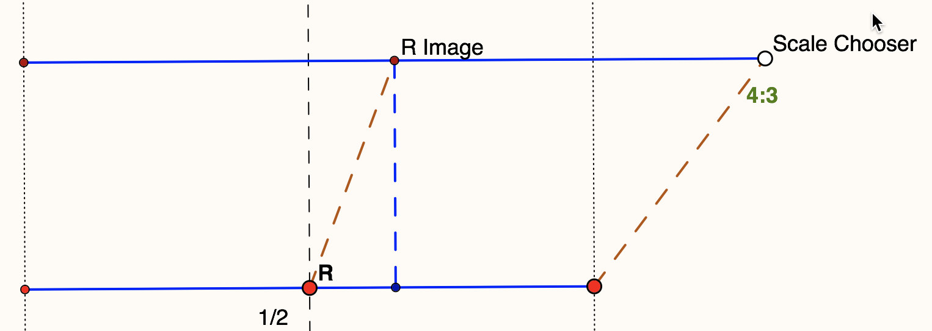
Depicting Elastic Stretching
How might you depict both the original elastic and when it is stretched?

Slide 7
The Ant’s Question
An ant has ended up at the fixed end on your elastic.
As the ant walks away from that end, at constant speed along the elastic, the elastic stretches, again at some constant speed.
Imagine this happening!
Can the ant hope to get to the other end of the elastic?

Slide 8
Ant on the Elastic: additive stretch reasoning
Suppose the ant walks a distance a along the elastic at the beginning of each time period.
Suppose the elastic stretches by an additive amount e at the end of each time period, starting with length L.
In the first time interval, the ant walks a distance a along L. The elastic stretches to length L+e and the ant is carried to the point along the elastic.
In the second time interval, the ant walks a further a and is then carried by the elastic stretching to L+2e So
the ant has reached
along the elastic.

Slide 9
Additive Stretch Reasoning Continued
In successive time periods the ant reaches
of the elastic
of the elastic
of the elastic

Slide 10
Multiplicative Stretch Reasoning
Suppose the ant starts at one end that is fixed and travels a distance a each time period, at the end of which the elastic scales by a scale factor of s.
  Can the ant ever reach the end of the elastic?
End of 1st time period: ant has walked a which has been scaled by s so ant is at as on an elastic sL long.
End of 2nd time period: ant has walked a + as which has been scaled by s so ant is at a(1+s)s on an elastic s²L long.
End of 3rd time period: ant has walked a + a(1+s)s which has been scaled by s and so ant is at a(1+s+s²)s on an elastic s³L long.
End of n^{th} time period: ant has walked a(1+s+s²+…+s^{n-1}) which has been scaled by s so ant is at a(1+s+s²+…+s^{n-1})s along an elastic s^{n}L long.
So to reach the end, r ≥ 1
Ant is at point
r of the way
along the elastic.

Slide 11
Scaling on a Number Line
Imagine a number line, painted on a table.
Imagine an elastic copy of that number line on top of it.
Imagine the number line is stretched by a factor of 2 keeping 0 fixed.
  Where does 4 end up on the painted line?
  Where does -3 end up?
  Someone is thinking of a point on the line; where does it end up?
Return the elastic line to match the original painted line.
Imagine the number line is stretched by a factor of 2 but this time it is the point 1 that is kept fixed.
  Where does 4 end up on the painted line?
  Where does -3 end up?
  Someone is thinking of a point on the line; where does it end up?

Slide 12
More Scaling on a Number Line
-8
-7
-6
-5
-4
-3
-2
-1
0
1
2
3
4
5
6
7
8
9
Now imagine the number line is further stretched by a factor of 3 but this time it is the point 5 that is kept fixed.
  Where does the original 4 end up on the painted line?
  Where does the original -3 end up?
  Someone is thinking of a point on the original line;
  where does it end up?

Slide 13
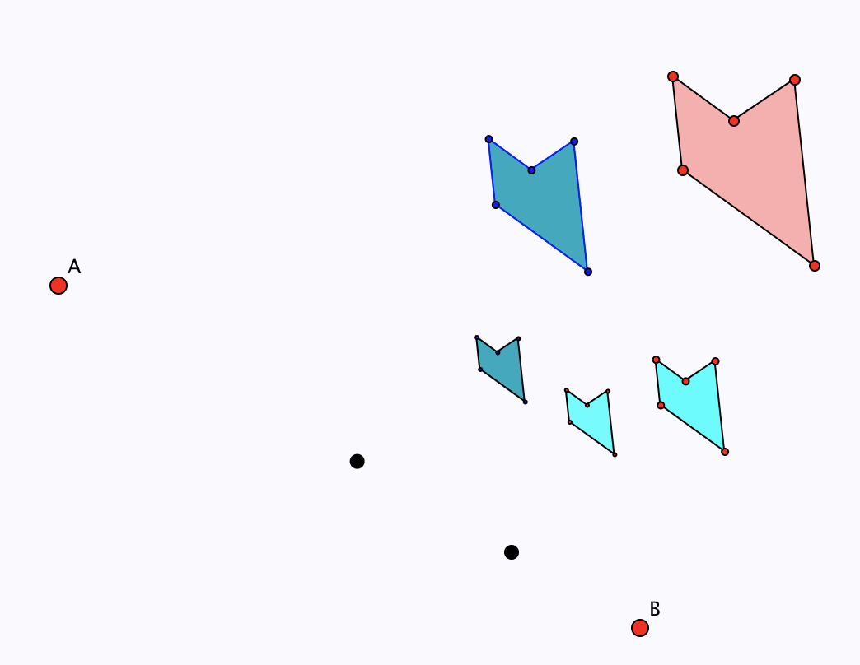
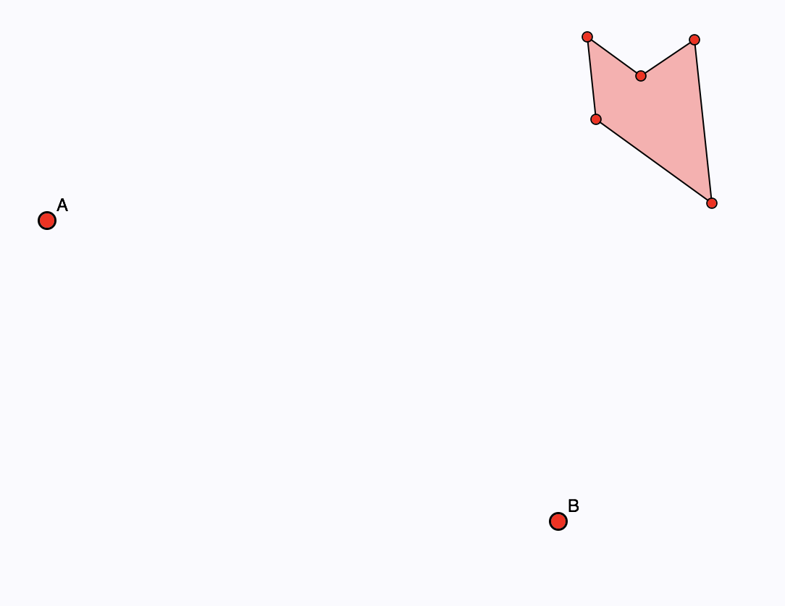
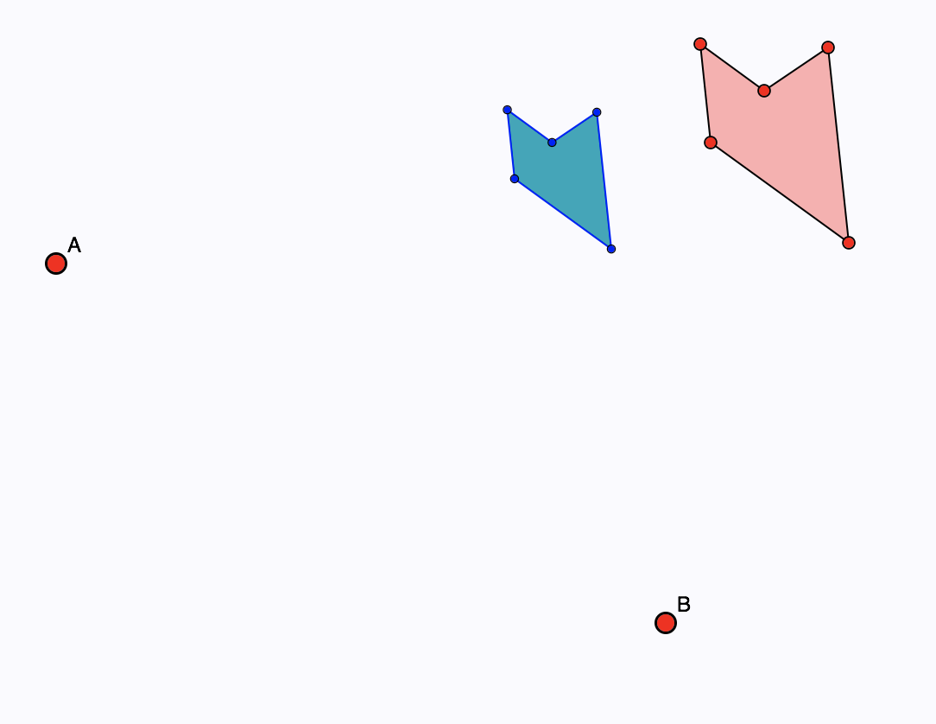
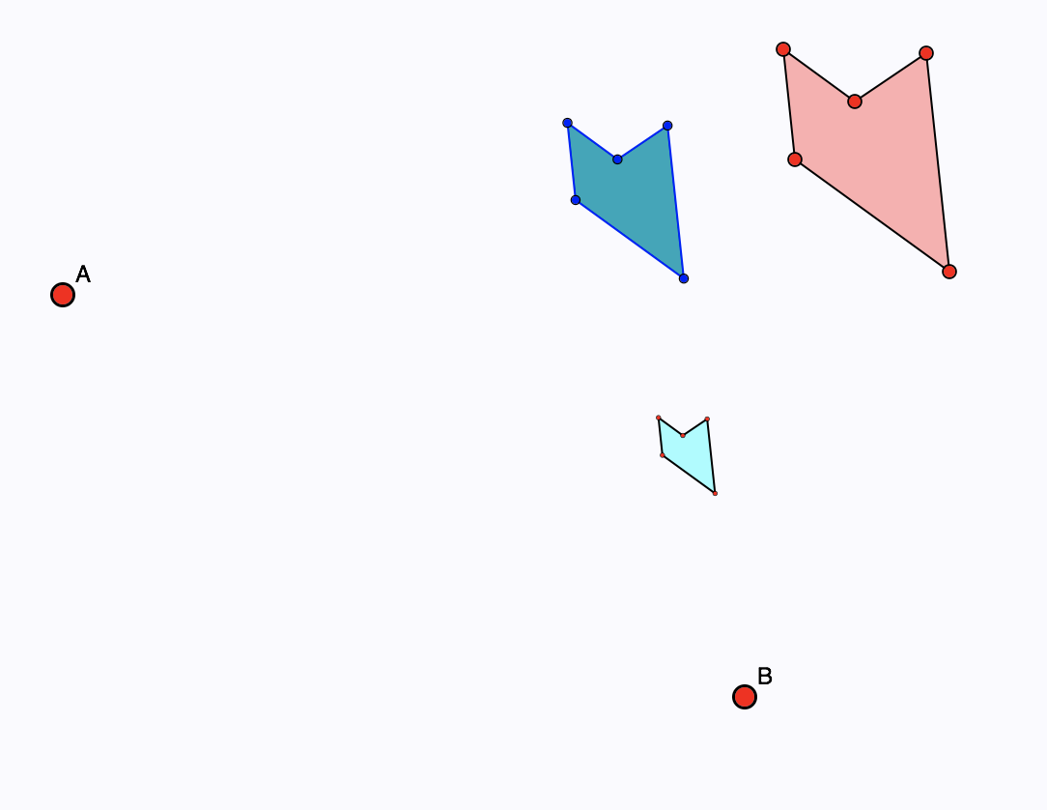
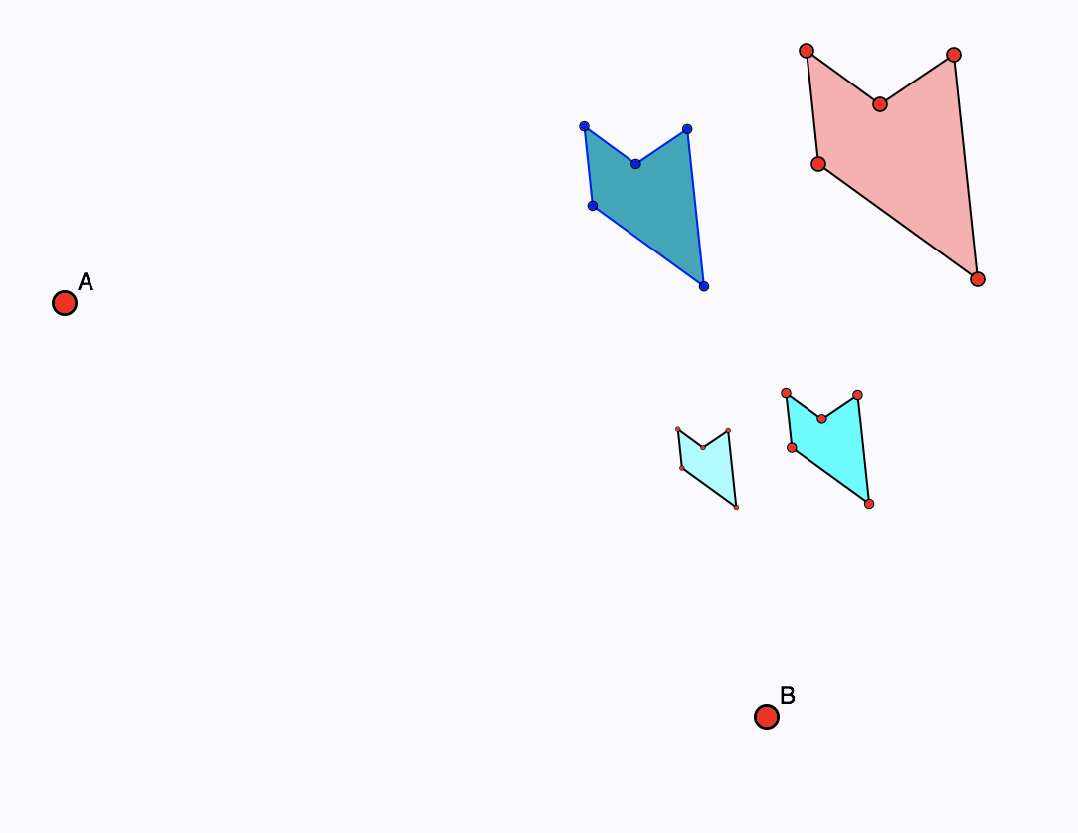
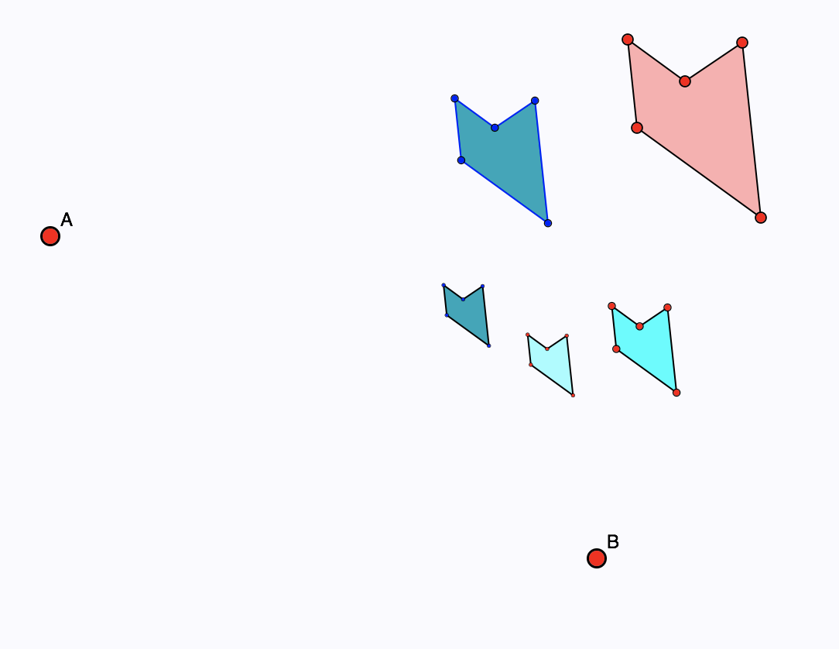
Compound Scaling
Imagine scaling a picture by some scale factor, and then scaling that again by a different scale factor.
  What is the overall effect?
  Does the order matter?

Slide 14
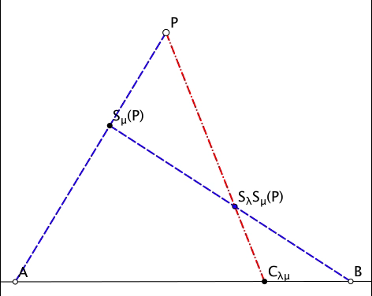
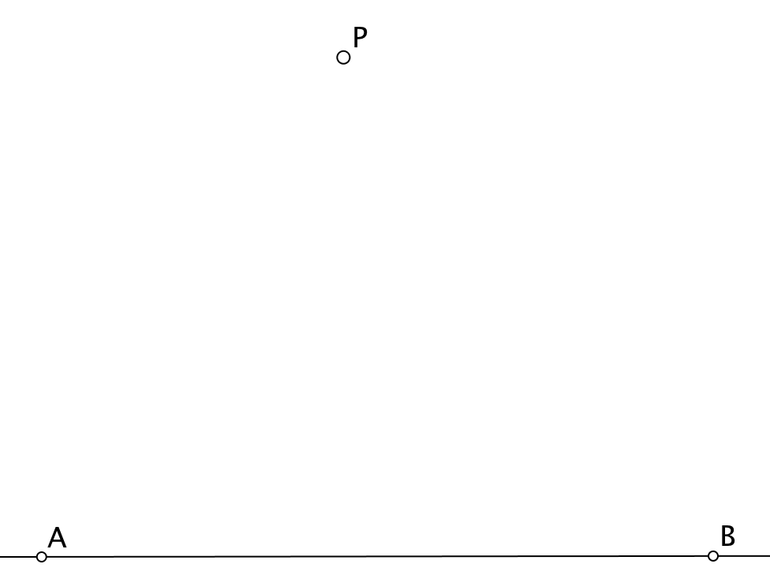
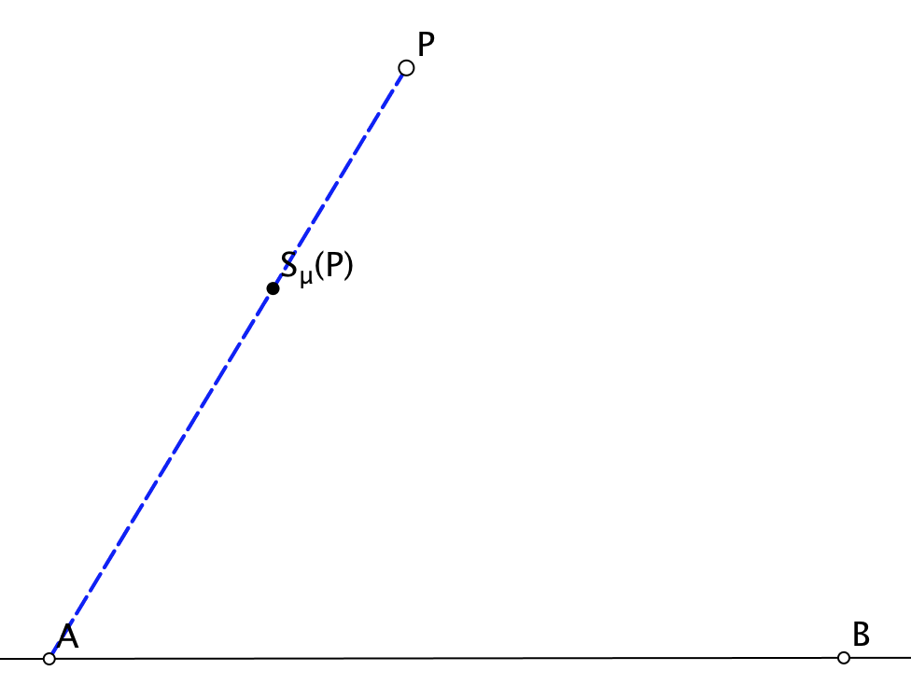
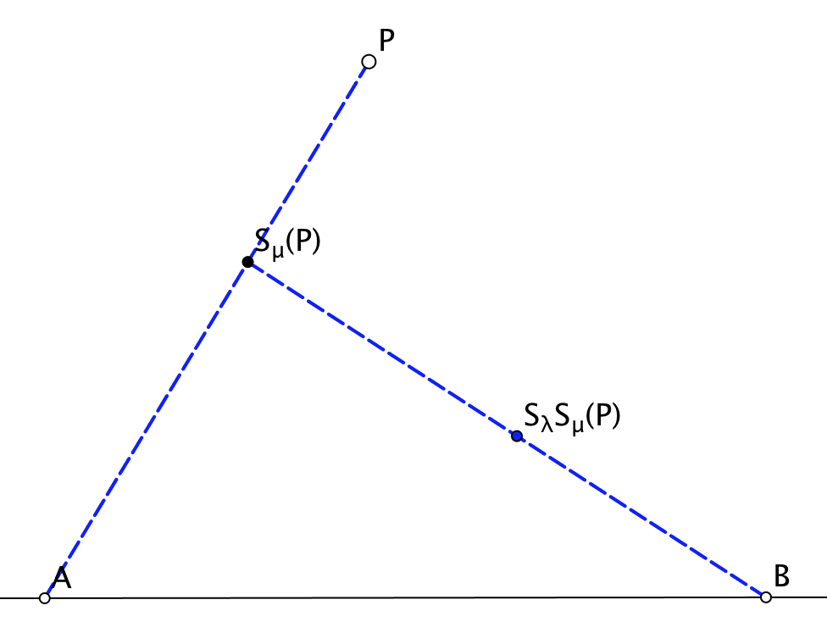
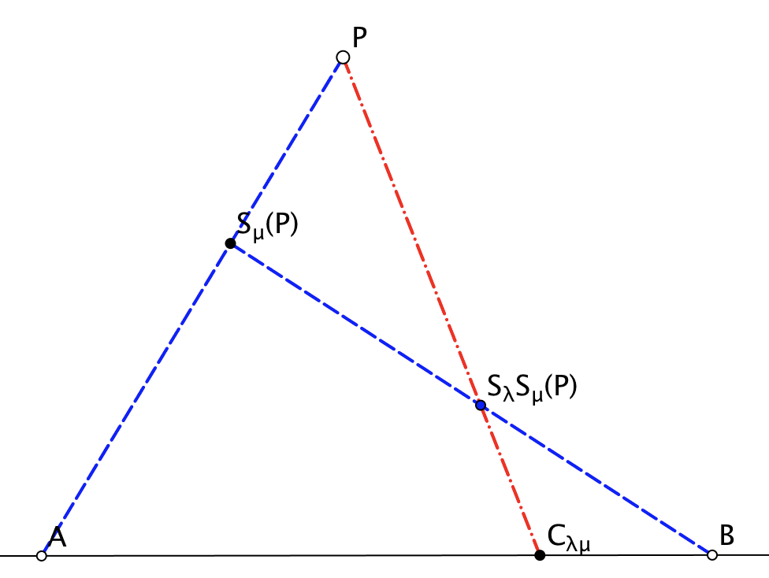
Scaling from Different Centres

Slide 15
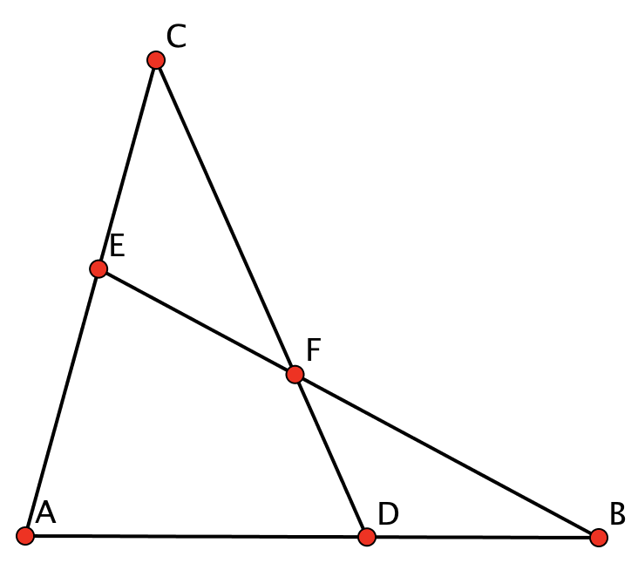
The Scaling Configuration
P | 1st Centre | 2nd Centre | Combined Centre | Image of P
C | A | B | D | F
B | A | C | E | F
A | B | C | E | F
F | D | E | B | A
E | F | D | C | A
There are 48 different ways of ‘seeing’ the diagram!

Slide 16
Three Scalings (associativity)
Depict for yourself the situation of three scalings looked at associatively.
You might recognise Desargues’ Configuration!

Slide 17
Reflection
What mathematical actions did you experience?
What emotions came near the surface?
What mathematical powers and themes were you aware of?

Slide 18
Some Observations
Use of mental imagery
Use of Variation
Inviting imagining the situation before setting a word problem.
Inviting depiction before presenting a diagram
Pace when using animations
Role of attention in
  Holding Wholes
  Discerning details
  Recognising Relationships
  Perceiving Properties as being instantiated
  Reasoning on the basis of agreed properties

Slide 19
To Follow Up
PMTheta.com
  JHM Presentations
John.Mason@open.ac.uk

