Slide 1



Reasoning Masterfully in Mathematics
The Open University
Maths Dept
University of Oxford
Dept of Education
Promoting Mathematical Thinking
Mathematics in Action Conference:
ready to reason
John Mason
Leatherhead
Oct 2017

Slide 2
Conjectures
Everything said here today is a conjecture … to be tested in your experience
The best way to sensitise yourself to learners …
  is to experience parallel phenomena yourself
So, what you get from this session is what you notice happening inside you!
Principle Conjecture
  Every child in school can reason mathematically
  What often holds them back is lack of facility with numbers
  So it is worth looking out for opportunities to reason that do not involve arithmetic

Slide 3
Outline
We work on some tasks together
We try to catch ourselves reasoning
We consider what pedagogical actions (moves, devices, …) might inform our future actions

Slide 4
Intentions
Participants will be invited to engage in reasoning tasks that can help students make a transition from informal reasoning to reasoning solely on the basis of agreed properties.
Keep track of awarenesses and ways of working
  For discussion, contemplation, and pro-spective pre-paration
Background
Successful Reasoning Depends on making use of properties
This in turn depends on Types of Attention
  Holding Wholes (gazing)
  Discerning Details
  Recognising Relationships
  Perceiving Properties (as being instantiated)
  Reasoning solely on the basis of agreed properties

Slide 5
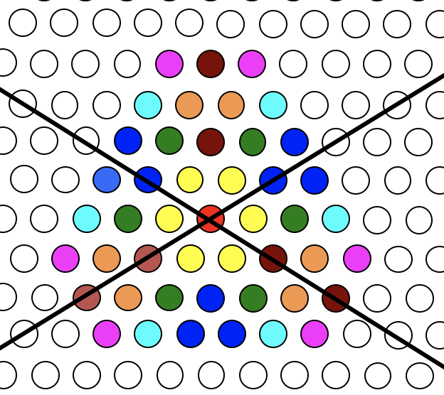
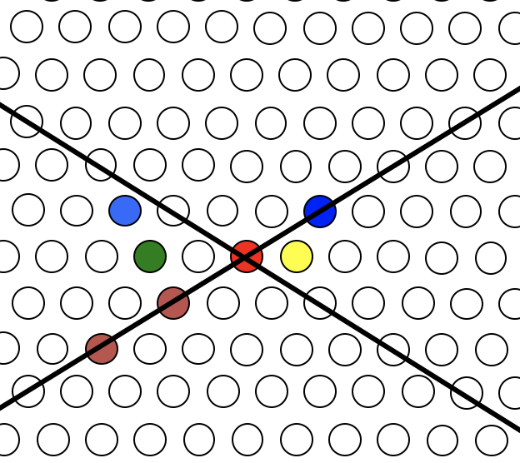
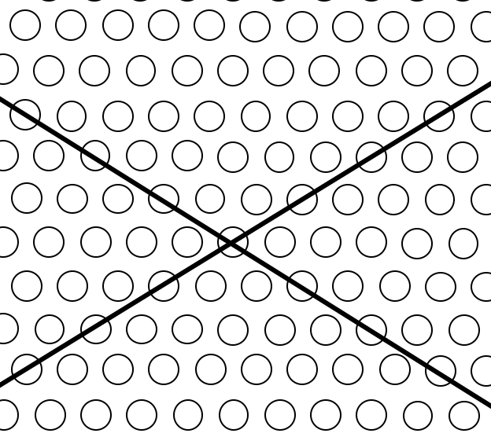
Symmetry-Based Reasoning
The black lines are mirrors
What MUST be the case?
Are there any conflicts?
Is there any redundancy?
How do you know?

Slide 6
Some Stages in Symmetry Reasoning
What mathematical questions might arise?
How few can you specify from which I can work out all the others?
What awarenesses are being made available?

Slide 7
Set Ratios
In how many different ways can you place 17 objects so that there are equal numbers of objects in each of two possibly overlapping sets?
What about requiring that there be twice as many in the left set as in the right set?
What about requiring that the ratio of the numbers in the left set to the right set is 3 : 2?
What is the largest number of objects that CANNOT be placed in the two sets in any way so that the ratio is 5 : 2?
S₁
S₂
What can be varied?

Slide 8
Queue Reasoning
Imagine you are in a Queue
Someone calls you and asks where you are in the Queue

Slide 9
Cylinder Immersion
Imagine a large cylindrical open-topped can full of water
Imagine a smaller cylindrical open-topped can which is empty.
Slowly immerse the smaller can in the larger can
  What happens?
  Describe to a neighbour what you imagine happening
What mathematical questions might you ask about this situation?

Slide 10
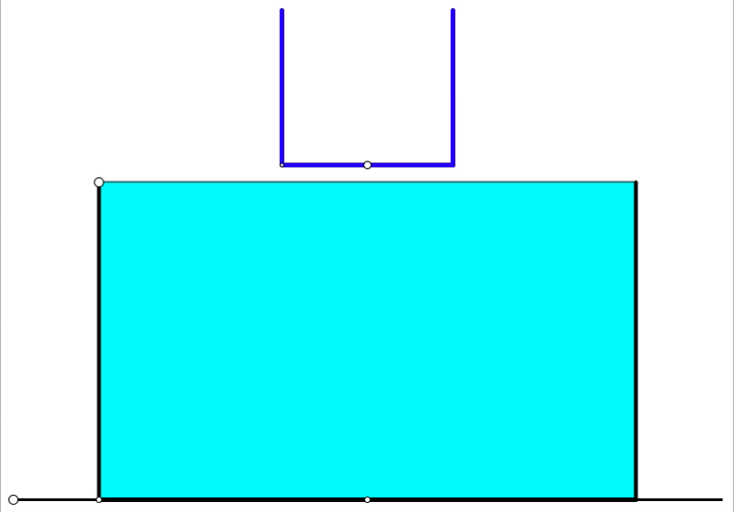
Cylinder Immersion

Slide 11
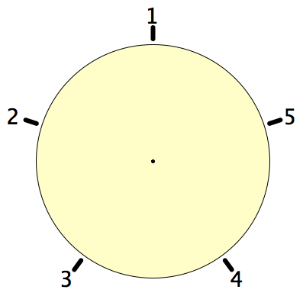
Secret Places
One of these five places has been chosen secretly.
You can get information by clicking on the numbers.
If the place where you click is the secret place, or next to the secret place, it will go red (hot), otherwise it will go blue (cold).
How few clicks can you make and be certain of finding the secret place?
Can you always find it in 2 clicks?
Notes:
Imagine a round table …

Slide 12
Magic Square Reasoning
What other
configurations
like this
give one sum
equal to another?
6
7
2
2
1
5
9
Try to describe
them in words
2
8
3
4
Any colour-symmetric
arrangement?
Sum(
)
=
Sum( )
Notes:
Think of all the patterns obtained like this one but with different choices of the red line and the blue line.
Sketch a few
Here is another reasoning
What about this pattern: is it true?
did you have difficulty recognising the components? This may be why learners find it hard to remember what they were taught recently!

Slide 13
More Magic Square Reasoning
Sum(
)
=
Sum( )

Slide 14
Wason’s cards
Each card has a letter on one side and a numeral on the other.
Which cards must be turned over in order to verify that
  “on the back of a vowel
  there is always an even number”?
A
2
B
3

Slide 15
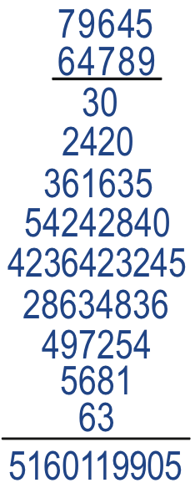
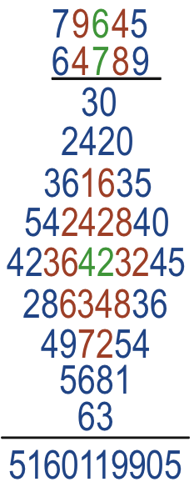
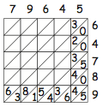
Diamond Multiplication

Slide 16
Bags, Buses, and Number-line Walks

Slide 17
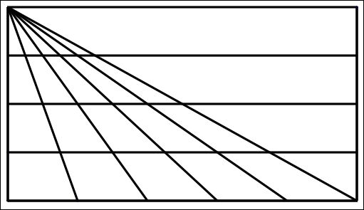
Triangle Count
In how many different ways might you count the triangles?
(5 + 4 + 3 + 2 + 1) x 4 + 1
What are you attending to?
Notes:
15 x 4 + 1

Slide 18
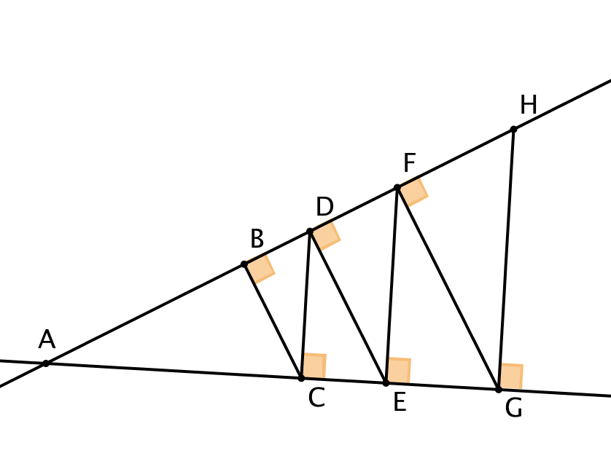
Right-Triangle Count
How many right-angled triangles can you find?
Discerning Geometric Details
Seeking relationships

Slide 19
Two Candles
Imagine you have two candles of different diameters so that they burn at different rates
What happens if the candles are lit at the same time?
What sorts of questions might be asked?
Suppose you are told the time taken to burn each completely.
What else do
you know?
Example:
  If one takes 4 hours and the other 5 hours to burn down, when will one candle be 3 times the length of the other?

Slide 20
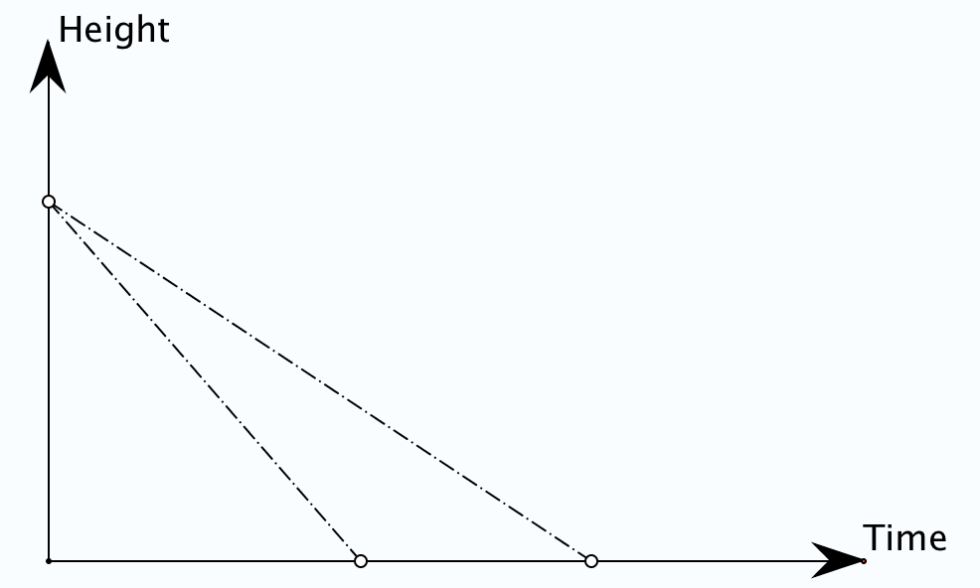
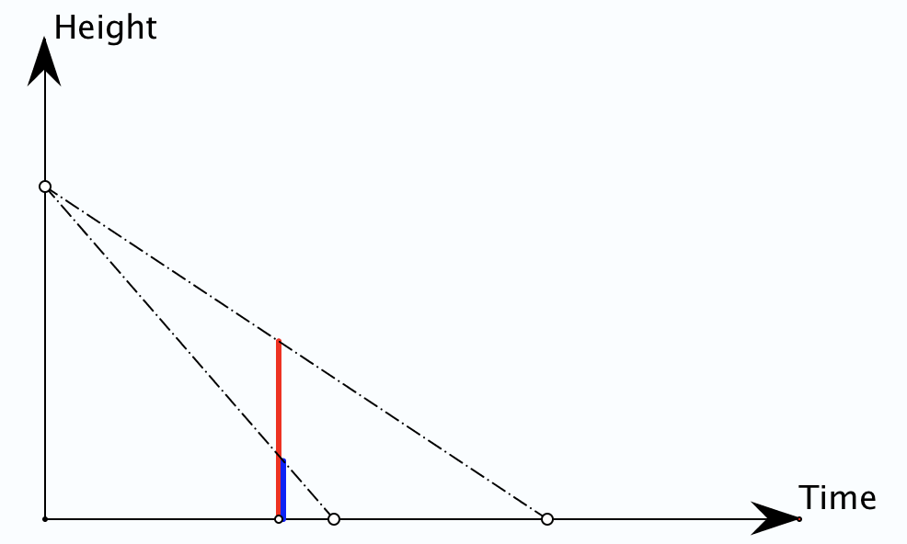
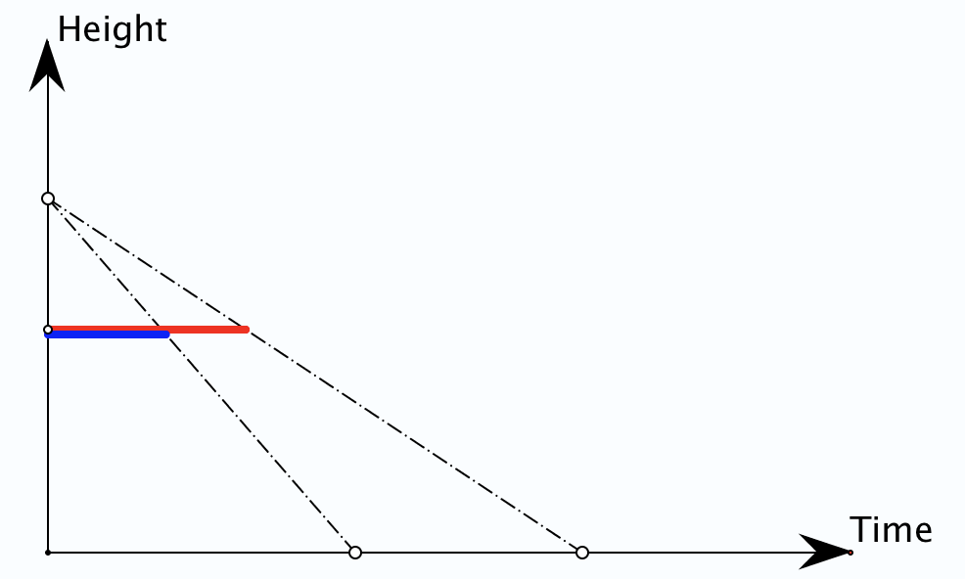
If one takes 4 hours and the other 5 hours to burn down, when will one candle be 3 times the length of the other?
What might the question be?

Slide 21
Candle Algebra
Let the candles burn for t hours from a height of 1 unit.
The heights at time t are
Oops!
Ok!

Slide 22
General Candles
Two candles take a and b hours respectively to burn down.
Is there a time at which one candle is h times as high as the other?
So must have either
or
Is there a height which will take one candle t times as long to burn down as the other?

Slide 23
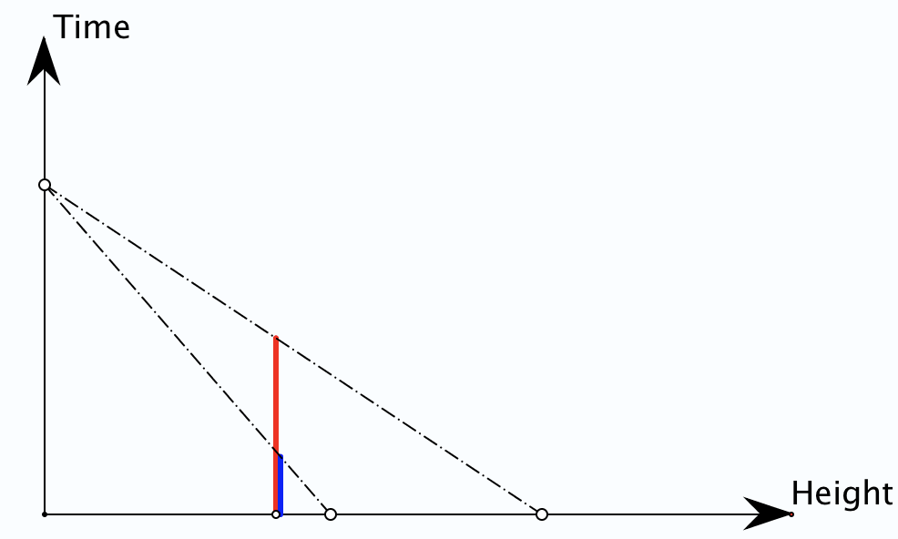
Same and Different Candles
Two candles of different sizes take the same time to burn down.
If they are 4 units and 5 units in height respectively, is there a height from which it will take one candle 3 times as long to burn down as the other?

Slide 24
Clubbing
In a certain club there are 47 people altogether, of whom 31 are poets and 29 are painters.
How many are both? (Everyone is in at least one!)
How many painters are not poets?
How many poets are not painters?
47 total
poets
31
47–29
47–31
31
painters
31–(47–29)
29–(47–31)
Tracking Arithmetic
31 + 29 – 47
Tracking Arithmetic
Notes:
Tracking Arithmetic

Slide 25
In a certain club there are 28 people.
There are 14 poets, 11 painters and 15 musicians;
there are 22 who are either poets or painters or both,
21 who are either painters or musicians or both
and 23 who are either musicians or poets or both.
How many people are all three: poet, painter and musician?
15 musicians
28 total
21 poets or musicians
23 musicians or painters
28–22
14
poets
11
painters
28–23
28–21
22 poets or painters
11+15–23
14+15–21
14+11–22
(14+15-21) + (14+11-22) + (11+15-23) – (28– ((28-23) + (28-22) + (28-21))
2
Notes:
Tracking Arithmetic

Slide 26

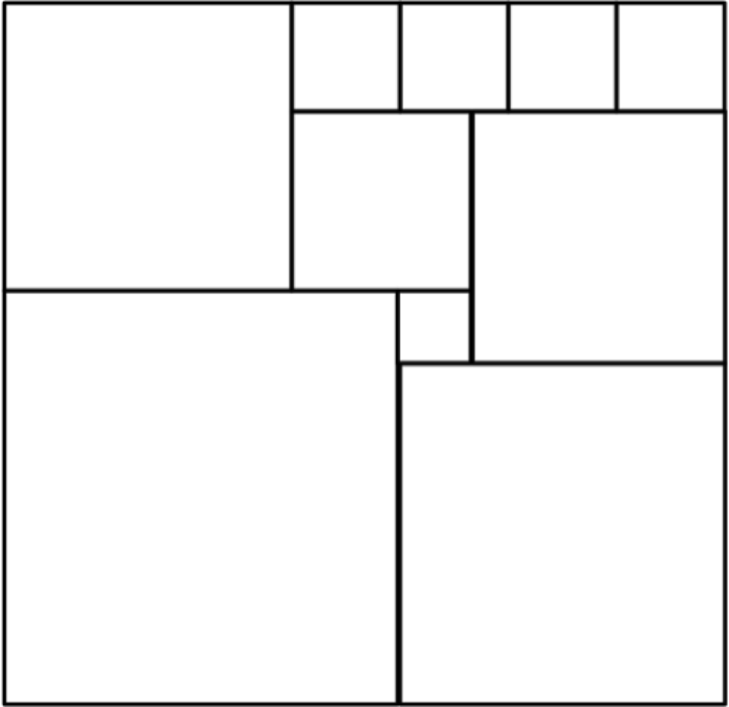
Square Deductions
Each of the inner quadrilaterals is a square.
Can the outer quadrilateral
be square?
15a = 6b
4(4a–b) = a+2b
4a–b
Acknowledge ignorance:
denote size of edge of
smallest square by a;
4a
b
a+b
Adjacent square edge by b
a
To be a square:
7a+b = 5a+2b
3a+b
So 2a = b
2a+b

Slide 27
31: a game for two players
At each move you choose a whole number from 1 to 5.
Each chosen number is added to the running total. The first person to get the total to be 31 wins.
What is your (best) strategy?
How might you alter the game?

Slide 28
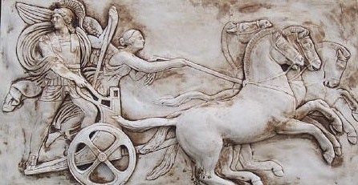
Human Psyche
Awareness (cognition)
Imagery
Will
Emotions
(affect)
Body (enaction)
Habits
Practices

Slide 29
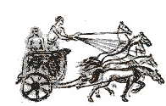
Three Only’s
Language Patterns
& prior Skills
Imagery/Sense-of/Awareness; Connections
Root Questions
predispositions
Different Contexts in which likely to arise;
dispositions
Standard Confusions
& Obstacles
Techniques & Incantations
Emotion
Awareness
Behaviour
Only Emotion is Harnessable
Only Awareness is Educable
Only Behaviour is Trainable

Slide 30
Reasoning Conjectures
What blocks children from displaying reasoning is often lack of facility with number.
Reasoning mathematically involves seeking and recognising relationships, then justifying why those relationships are actually properties that always hold.
Put another way, you look for invariants (relationships that don’t change) and then express why they must be invariant.

Slide 31
Some Pedagogic Actions
“How do you know?”
“What do you Know” &
“What do you Want (to find out)”?
Imagining the Situation before diving in

Slide 32
Scaffolding & Fading
Directed – Prompted – Spontaneous
Developing Independence NOT Building Depenednecy
Use of label for some mathematical action
Gradually using less direct, more indirect prompts
Learners spontaneously using it for themselves
This is what Vygotsky actually meant by ZPD
  What learners can currently do when cued, and re on the edge of being able to initiate for themselves.

Slide 33
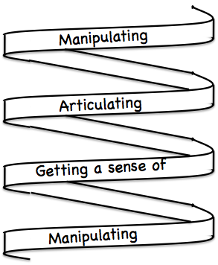
Frameworks
Doing – Talking – Recording
(DTR)
(MGA)
See – Experience – Master
(SEM)
Enactive – Iconic – Symbolic
(EIS)
Specialise …
in order to locate structural relationships …
then re-Generalise for yourself
Stuck?
What do I know?
What do I want?

Slide 34
Mathematical Thinking
How might you describe the mathematical thinking you have done so far today?
How could you incorporate that into students’ learning?

Slide 35
Actions
Inviting imagining before displaying
Pausing
Inviting re-construction/narration
Promoting and provoking generalisation
Working with specific properties explicitly

Slide 36
Possibilities for Future Action
Listening to children
  (not listening for what you hope to hear)
Getting children to listen to each other
Trying small things and making small progress;
telling colleagues
Pedagogic strategies encountered today
Provoking mathematical thinking as happened today
Question & Prompts for Mathematical Thinking (ATM)

Slide 37
Follow Up
john.mason @ open.ac.uk
PMTheta.com → JHM –>Presentations
Questions & Prompts (ATM)
Key ideas in Mathematics (OUP)
Learning & Doing Mathematics (Tarquin)
Thinking Mathematically (Pearson)
Developing Thinking in Algebra (Sage)

