Slide 1


A Lesson without Opportunity for Learners to
Generalise Mathematically is NOT a Mathematics Lesson.
John Mason
ATM Reading
Oct 2018

Slide 2
Assumption
We work together in a conjecturing atmosphere
  When we are unsure, we try to articulate to others;
  When we are sure, we listen carefully to others;
  We treat everything that is said as a conjecture, to be tested in our own experience.

Slide 3
Plan
We work together on a sequence of tasks.
We try to trap our thinking, our emotions, and our (mathematical) actions as we go.
Some tasks will advance from Primary to Secondary level, but all are within reach to appreciate, if not fully comprehend, no matter what your current phase of work and mathematical experience.
  That too is a conjecture!

Slide 4
Possibilities
Copperplate Multiplication
  Not simply doing, but treating as a method/procedure
Two Numbers between 100 and 1000 designed to be the smallest and the largest of all those written down here
“Lots of” numbers; “Lots of” bases
Tracking Arithmetic
  ThoaNs
SVGrids
  Sundaram
J S Mill
Remainders of the day
1+2 = 3
Divisible differences

Slide 5
Core
Generalisation is the antidote to, the antithesis of rote memorisation
It is how the mind works to internalise action(s)
Zoltan Dienes assumed that with sufficient variation in examples, learners would generalise
Caleb Gattegno proposed that to internalise is to withdraw attention from the action (integration through subordination)

Slide 6
What’s The Difference?
–
=
What then
would be
the difference?
First, add one to each
What then
would be
the difference?
First,
add one to the larger and subtract one from the smaller
What could
be varied?
Notes:
• 153 – 87 = ? Orally; visibly;
•That is arithmetic; Now let’s do some mathematics!
Two volunteers: think of a three digit number and a two digit number.
• We’re going to subtract the smaller from the larger but before we do, lets add one to both.
What’s the difference now?

Slide 7
What’s The Ratio?
÷
=
First, multiply each by 3
What is the ratio?
What is the ratio?
First,
multiply the larger by 2 and divide the smaller by 3
What could
be varied?
Notes:
• 153 – 87 = ? Orally; visibly;
•That is arithmetic; Now let’s do some mathematics!
I am thinking of two numbers the first larger than the second
• We’re going to divide the smaller int othe larger but before we do, lets multiply both by 3.
What’s the rationow?

Slide 8
Imagine This
A teaching page from a textbook you used today;
or a worksheet or a task you used today
What was the generality to which learners were being exposed?

Slide 9
Two Numbers
Please write down two numbers,
both between 100 and 1000
Now write down two numbers both between 100 and 1000,
  one of which you hope will be the smallest such number that no-one else in the room writes down,
  and the other you hope will be the largest such number that non-one else in the room will write down.
What was different about the second task?
Scoping your example space?

Slide 10
Reflection
What mathematical actions did you experience?
What emotions came near the surface?
What mathematical powers and themes were you aware of?

Slide 11
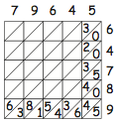


Diamond Multiplication
Find the mistake!

Slide 12
Reflection
What mathematical actions did you experience?
What emotions came near the surface?
What mathematical powers and themes were you aware of?

Slide 13
Raise your hand when you can see …
Something that is 3/5 of something else
Something that is 2/5 of something else
Something that is 2/3 of something else
Something that is 5/3 of something else
What other fractional actions can you see?

Slide 14
A Generalisation Story
Punchline:
A mathematician is never finished generalising

Slide 15

Differing Sums of Products
Write down four numbers in a 2 by 2 grid
4
7
5
3
Add together the products along the rows
28 + 15 = 43
Add together the products down the columns
20 + 21 = 41
43 – 41 = 2
Calculate the difference
That is the ‘doing’
What is an undoing?
Now choose positive numbers
so that the difference is 11
Notes:
Mathematical context
What probaby matters most is not eh context, but whether students ‘think’ they can solve the problem!

Slide 16
Differing Sums & Products
4
7
Tracking Arithmetic
5
3
rows
4x7 + 5x3
columns
–
4x5 + 7x3
4x(7–5) + (5–7)x3
= 4x(7–5) – (7–5)x3
= (4-3) x (7–5)
So in how many essentially different ways can 11 be the difference?
So in how many essentially different ways can n be the difference?
Notes:
Revealing Structure by attending to relationships not calculations

Slide 17

Think Of A Number (ThOANs)
Think of a number
Add 2
Multiply by 3
Subtract 4
Multiply by 2
Add 2
Divide by 6
Subtract the number you first thought of
Your answer is 1
7
7
+ 2
3 x + 6
7
7
3 x + 2
6 x + 4
7
6 x + 6
7
+ 1
7
1

Slide 18
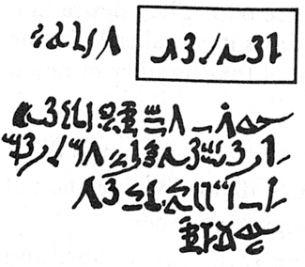
Rhind Mathematical Papyrus problem 28
Two-thirds is to be added.
One-third is to be subtracted.
There remains 10.
2/3 of this is to be added.
+2/3 x
= 5/3 x
1/3 of this is to be subtracted.
5/3 x – 1/3 x 5/3 x
=10/9 x
There remains 10.
10/9 x = 10
= 9
Notes:
Problem 28 of the Rhind Mathematical Papyrus Gillings p182

Slide 19
Rhind Mathematical Papyrus problem 28
Two-thirds is to be added.
One-third is to be subtracted.
There remains 10.
Make 1/10 of this,
there becomes 1.
The remainder is 9.
/10
– /10
= 9x /10
2/3 of this is to be added.
The total is 15.
1/3 of this is 5.
Lo! 5 is that which goes out,
And the remainder is 10.
+2/3x
9x /10
9x /10
5/3 x9x /10
= 3x /2
/2
The doing as it occurs!
Notes:
Problem 28 of the Rhind Mathematical Papyrus Gillings p182

Slide 20
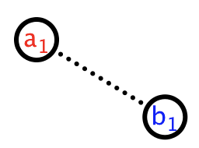
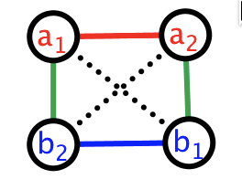
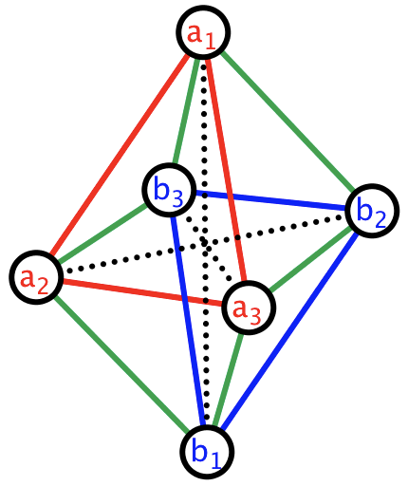
Extension?
Products of n numbers:
Positive terms:
If n odd, products of odd numbers of red and even numbers of blues
If n even, products of even numbers of red and even numbers of blues
Negative terms:
If n odd, products of even numbers of red and odd numbers of blues
If n even, products of odd numbers of blues and odd numbers of red
For a long time I could not find any extensions
I put it aside
Happening upon it one day I suddenly realised …
(a₁ – b₁)
(a₁a₂ + b₁b₂) – (a₁b₂ + a₂b₁)
= (a₁ – b₁)(a₂ – b₂)
(a₁a₂a₃ + a₁b₂b₃ + b₁a₂b₃ + b₁b₂a₃)
– (a₁a₂b₃ + a₁b₂a₃ + b₁a₂a₃ + b₁b₂b₃)
= (a₁ – b₁)(a₂ – b₂)(a₃ – b₃)

Slide 21
Reflection
What mathematical actions did you experience?
What emotions came near the surface?
What mathematical powers and themes were you aware of?

Slide 22
Related Polygons
Perimeter and Area

Slide 23
Remainders of the Day
Please write down a whole number that leaves a remainder of 2 when divided by 5.
  and another
  and another
Now use what you have learned to inform how you write down a description of all possible whole numbers which leave a remainder of 3 when divided by 17.
Implicit generalisation
prompted by challenging particular

Slide 24
Divisible Differences
17
18
19
20
21
22
23
24
25
10
11
12
13
14
15
16
5
6
7
8
9
2
3
4
1
…
n² – n + 1
1, 3, 7, 13, 21, 31, 43, 57, 73, 91, 111, 133, 157, 183, 211, 241, 273, 307, 343, …
2, 4, 6, 8, 10, 12, 14, 16, 18, 20, 22, 24, 26, 28, 30, 32, 34, 36, …
2, 2, 2, 2, 2, 2, 2, 2, 2, 2, 2, 2, 2, 2, 2, 2, 2,
Perceiving Potential Generality
Where will multiples of
3, 7 and 13 coincide?
Expressing Generality

Slide 25
Pebble Arithmetic (J. S. Mill)

Slide 26
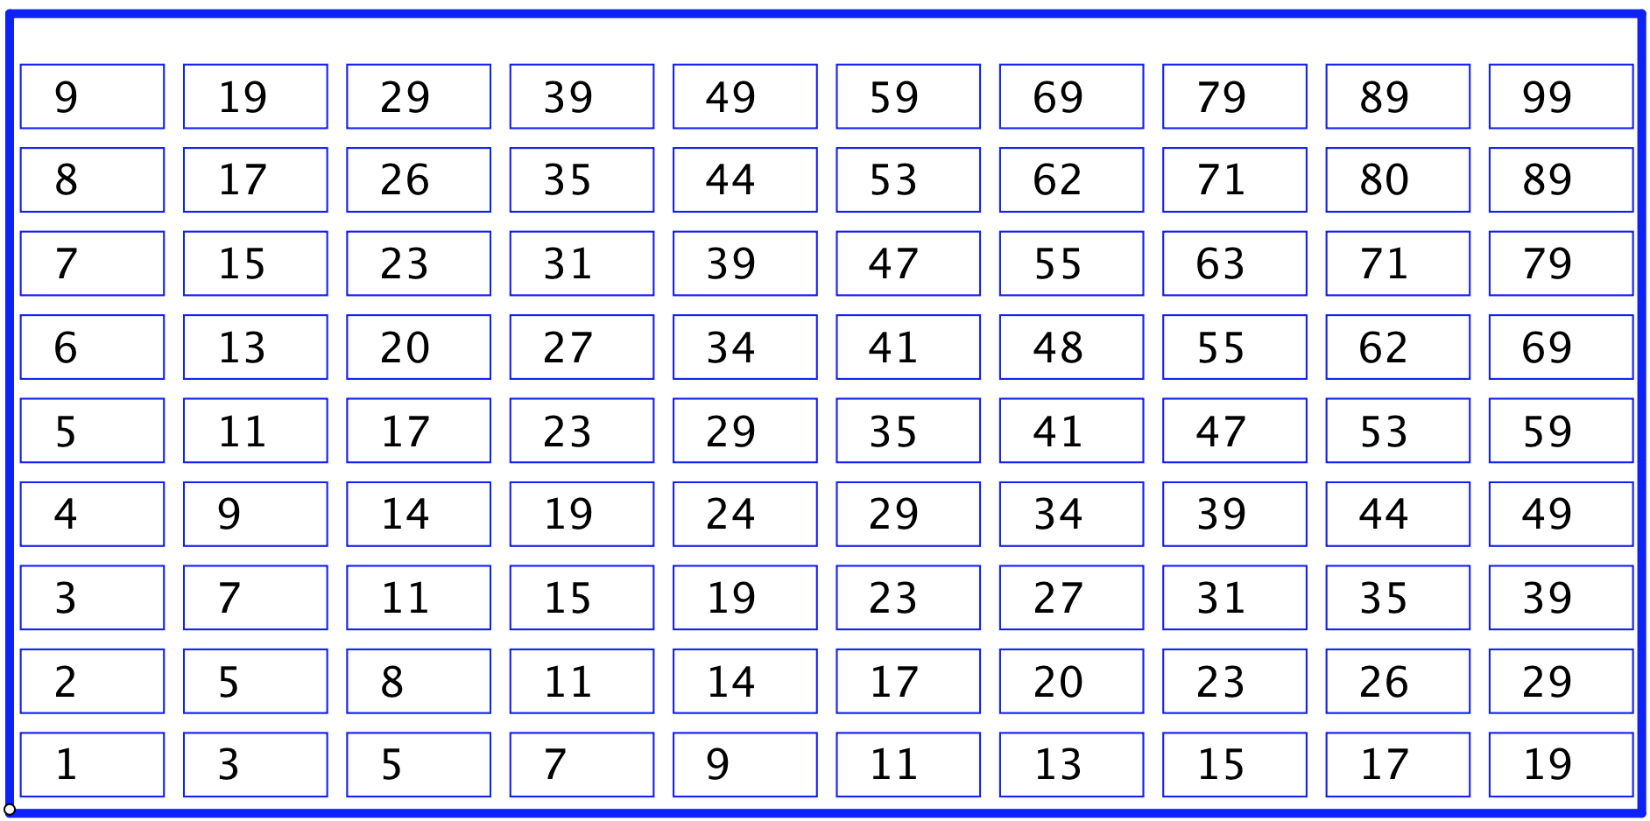
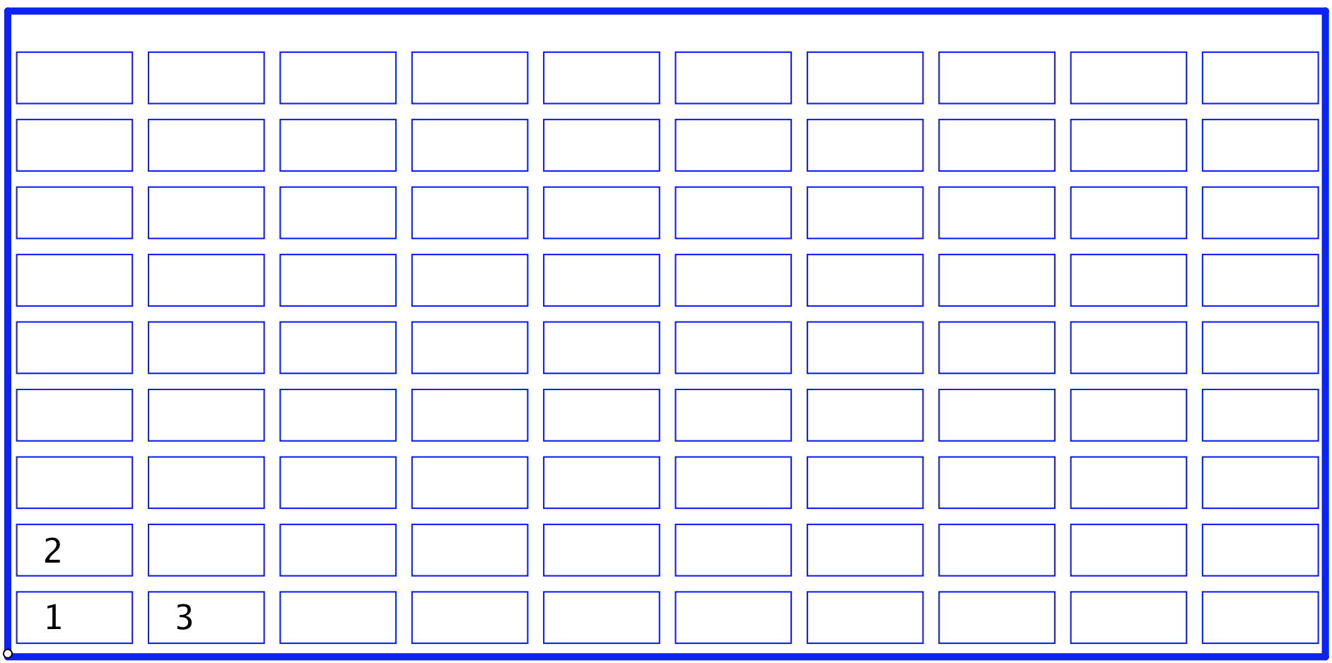
Sundaram Grids
Each row and each column are “goes-up-ins” (arithmetic progressions)
5

Slide 27
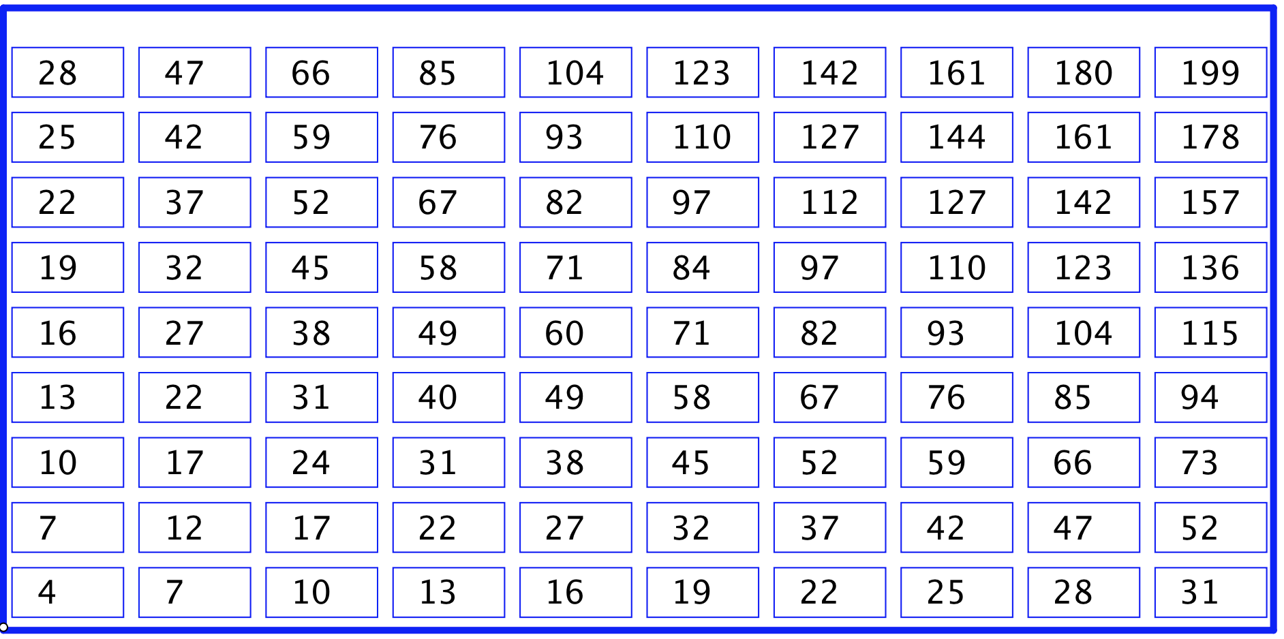
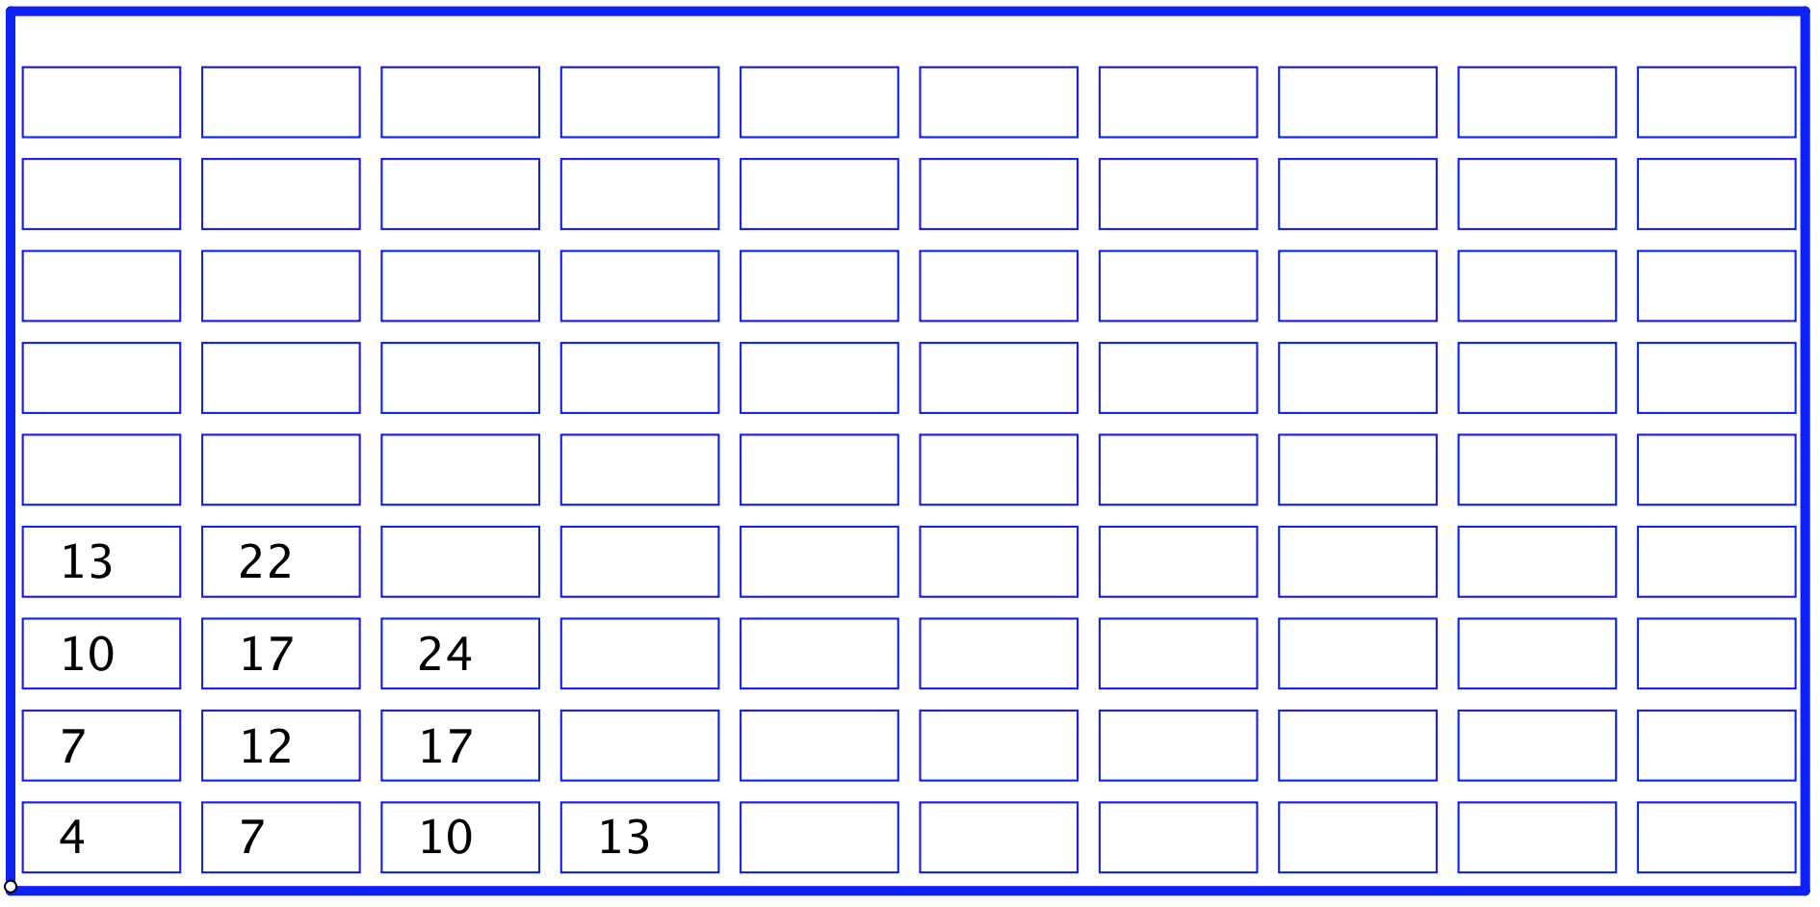
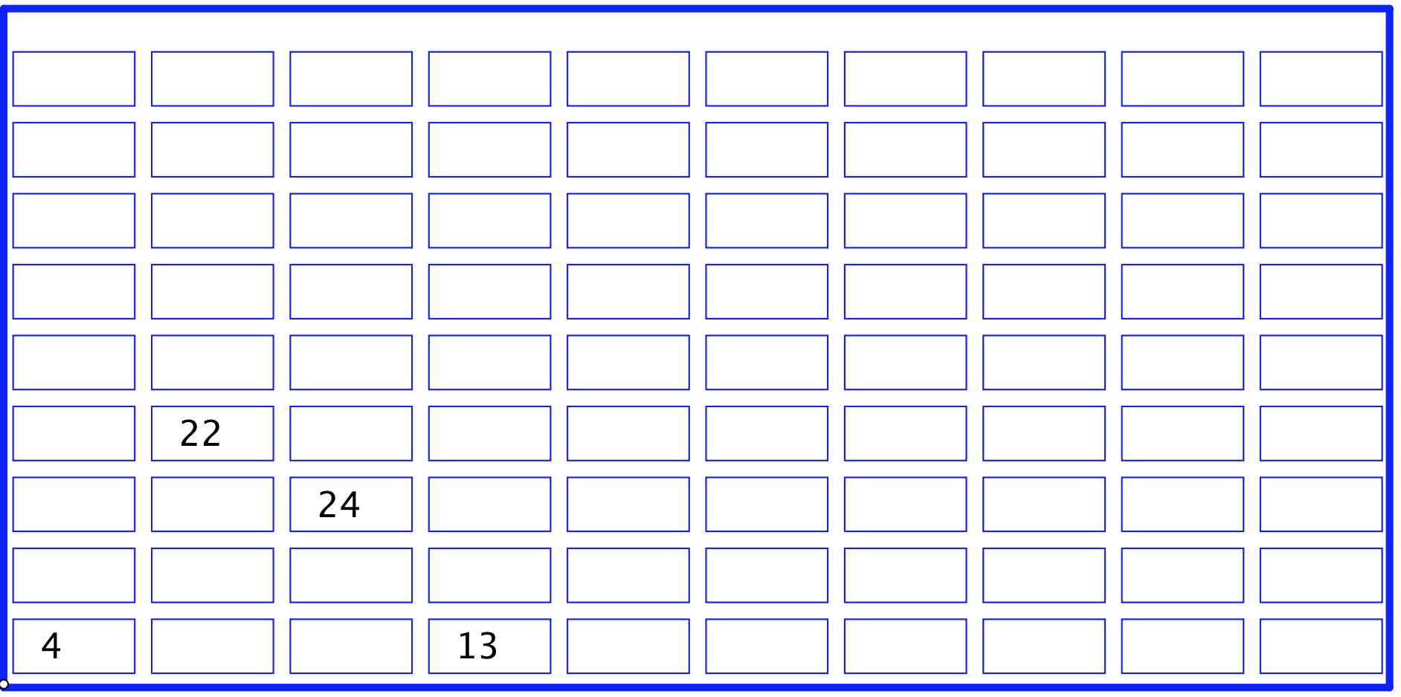
Original Sundaram
Sundaram’s claim: a number appears in this grid
(going to the right and or up) only if
one more than double it is a composite number
How few numbers, and how placed,
so that the entire grid can be reconstructed?

Slide 28
Reflection
What mathematical actions did you experience?
What emotions came near the surface?
What mathematical powers and themes were you aware of?

Slide 29
Imagine This
A teaching page from a textbook you used today;
or a worksheet or a task you used today
What was the generality to which learners were being exposed?

Slide 30
Re-flecting and Pro-flecting
What has caught your attention particularly?
What actions have you undertaken that might inform your actions or your students’ actions in class?
What ideas have you encountered that might inform your thinking?
What emotions have arisen inside you that might relate to students’ experiences?
What pedagogical actions did you notice being enacted?

Slide 31
Actions
Inviting imagining before displaying
Pausing
Inviting re-construction/narration
Promoting and provoking generalisation
Working with specific properties explicitly

Slide 32
To Follow Up
John.Mason@open.ac.uk
PMTheta.com
Developing Thinking in Algebra (Sage)
Questions & Prompts for Mathematical Thinking (ATM)
Thinkers (ATM)

