Slide 1
Questioning in Mathematics
Anne Watson
Cayman Islands Webinar, 2013

Slide 2
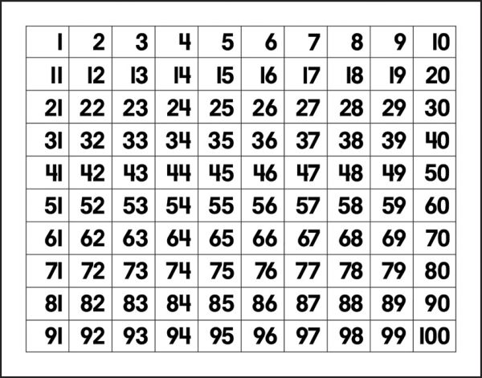

Slide 4
What can you say about the four numbers covered up?
Can you tell me what 4-square shape would cover squares: n, n-1, n+10, n+11?
What 4-square shapes could cover squares: n - 3 and n + 9?

Slide 5
1 | 2 | 3 | 4 | 5 | 6 | 7
8 | 9 | 10 | 11 | 12 | 13 | 14
15 | 16 | 17 | 18 | 19 | 20 | 21
22 | 23 | 24 | 25 | 26 | 27 | 28
29 | 30 | 31 | 32 | 33 | 34 | 35
36 | 37 | 38 | 39 | 40 | 41 | 42
43 | 44 | 45 | 46 | 47 | 48 | 49
1
2
3
4
5
6
7

Slide 6
1 | 2 | 3 | 4 | 5 | 6 | 7 | 8
9 | 10 | 11 | 12 | 13 | 14 | 15 | 16
17 | 18 | 19 | 20 | 21 | 22 | 23 | 24
25 | 26 | 27 | 28 | 29 | 30 | 31 | 32
33 | 34 | 35 | 36 | 37 | 38 | 39 | 40
41 | 42 | 43 | 44 | 45 | 46 | 47 | 48
49 | 50 | 51 | 52 | 53 | 54 | 55 | 56
57 | 58 | 59 | 60 | 61 | 62 | 63 | 64
1
2
3
4
5
6
7

Slide 7
What can you say about the four numbers covered up?
Can you tell me what 4-square shapes could on what grids could cover squares: n, n-1, n+10, n+11?
What 4-square shapes on what grids could cover squares: n - 3 and n + 9?

Slide 8
What are the principles of question design?
Start by going with the flow of students’ generalisations: What do they notice? What do they do?
Check they can express what is going on in their own words?
Ask a backwards question (in this case I used this to introduce symbolisation)
Ask a backwards question that has several answers

Slide 9
Effects of questions
Going with the flow – correctness and confidence
Focus on relationships or methods, not on answers
Backwards question, from general to specific/ and notation
Backwards question with several answers – shifts thinking to a new level, new objects, new relations

Slide 10
Find roots of quadratics
Go with the flow – correctness and confidence
Focus on relationships or methods, not on answers
Backwards question – what quadratic could have these roots?
Backwards question (several answers) – what quadratics have roots that are 2 units apart?

Slide 11
Focus on relationships or methods, not on answers
There must be something to generalise, or something to notice
e.g. x² + 5x + 6 x² - 5x + 6
x² + 5x – 6 x² - 5x – 6

Slide 12
or (x – 3)(x – 2)
(x - 3)(x - 1)
(x - 3)(x - 0)
(x - 3)(x + 1)
(x - 3)(x + 2)
(x - 3)(x + 3)
- practice with signs but also some things to notice

Slide 13
How students learn maths
All learners generalise all the time
It is the teacher’s role to organise experience and direct attention
It is the learners’ role to make sense of experience

Slide 14
Sorting f(x) =
2x + 1 3x – 3 2x – 5
x + 1 -x – 5 x – 3
3x + 3 3x – 1 -2x + 1
-x + 2 x + 2 x - 2

Slide 15
Effects of the sorting task
Categories according to differences and similarities
Need to explain to each other
What would you need to support this particular sorting task?
cards; big paper; several points of view
graph plotting software; sort before or after?

Slide 16
More sorting questions
Can you make some more examples to fit all your categories?
Can you make an example that is the same sort of thing but does not fit any of your categories?

Slide 17
More sorting processes
Sort into two groups – not necessarily equal in size
Describe the two groups
Now sort the biggest pile into two groups
Describe these two groups
Make a new example for the smallest groups
Choose one to get rid of which would make the sorting task different

Slide 18
Make your own
In topics you are currently teaching, what examples could usefully be sorted according to two categories?

Slide 19
Comparing
In what ways are these pairs the same, and in what ways are they different?
4x + 8 and 4(x + 2)
5/6 or 7/8
½ (bh) and (½ b)h

Slide 20
Effects of a ‘compare’ question
Decide on what features to focus on: visual or mathematical properties
Focus in what is important mathematically
Use the ‘findings’ to pose more questions

Slide 21
These ‘compare’ questions
4x + 8 and 4(x + 2)
5/6 or 7/8
½ (bh) and (½ b)h
What is important mathematically?
What further questions can be posed?
Who can pose them?
What mathematical benefits could there be?

Slide 22
Make your own
Find two very ‘similar’ things in a topic you are currently teaching which can be usefully compared
Find two very different things which can be usefully compared

Slide 23
Ordering
Put these in increasing order of size without calculating the roots:
6√2 4√3 2√8 2√9 9 4√4

Slide 24
Make your own
What calculations do your students need to practise? Can you construct examples so that the size of the answers is interesting?

Slide 25
Enlargement (1)

Slide 26
Enlargement (2)

Slide 27
Enlargement (3)

Slide 28
Enlargement (4)

Slide 29
Effects of enlargement sequence
Need to progress towards a supermethod and know why simpler methods might not work
e.g.
find the value of p that makes 3p-2=10
find the value of p that makes 3p-2=11
find the value of p that makes 3p-2=2p+3
find the value of p that makes 3p-2=p+3

Slide 30
When and how and why to make things more and more impossible
Watch what methods they use and vary one parameter/feature/number/variable at a time until the method breaks down
e.g. Differentiate with respect to x:
x²; x³ ; x⁴ ; x^{1/2} ; x ; 3x² ; 4x³ ; 5x⁴ ; y² ; e²

Slide 31
Another and another …
Write down a pair of fractions whose midpoint is 1/4
….. and another pair
….. and another pair

Slide 32
Beyond visual
Can you see any fractions?

Slide 33
Can you see 1½ of something?

Slide 34
Effects of open and closed questions
Open ‘can go anywhere’ – is that what you want?
Closed can point beyond the obvious – is that what you want?

Slide 35
The less obvious focus
e.g.
inter-rootal distance
a less obvious fraction
looking backwards
Thinking about a topic you are currently teaching, what is an unusual way to look at it? What features does it have that you don’t normally pay attention to?

Slide 36
Questions as scaffolds
Posing questions as things to do
Reflecting on what has been done
Generalising from what has been seen & done, saying it and representing it
Using new notations, symbols, names
Asking new questions about new ideas
This scaffolds thinking to a higher level with new relations and properties

Slide 37
Suggested reading
Questions and prompts for mathematical thinking (Watson & Mason, ATM.org.uk)
Thinkers (Bills, Bills, Watson & Mason, ATM.org.uk)
Adapting and extending secondary mathematics activities (Prestage & Perks, Fulton books)

