Slide 1


Bringing Enquiry into
My Classroom part 3
PLATINUM
Webinar 2
May 2021
in the time of Corona

Slide 2
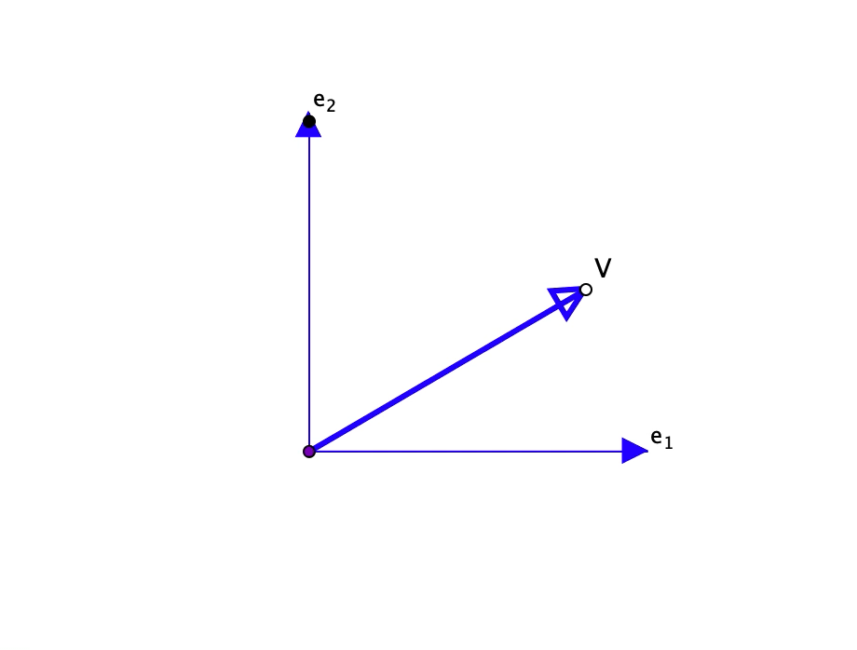
Task 4: Linear Algebra Animations
Tell yourself a story about what you saw happening

Slide 3
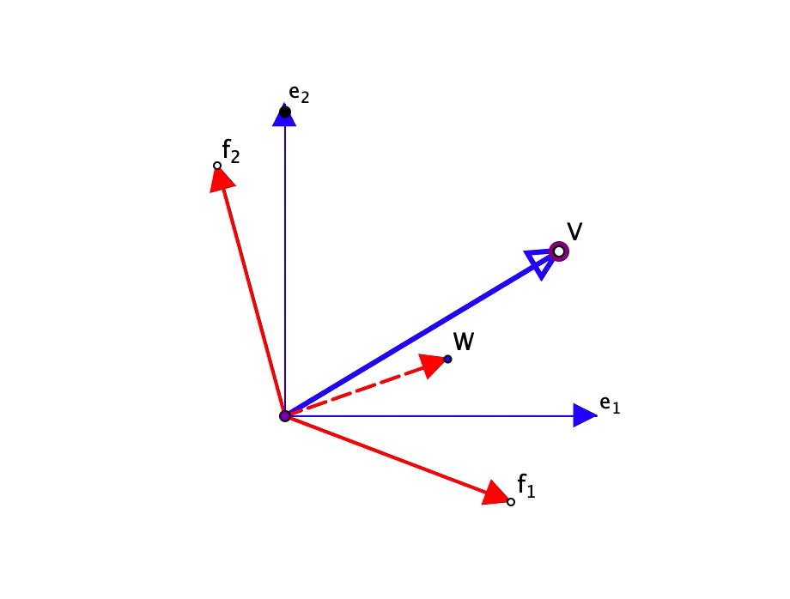
Linear Transformation 1
Tell yourself a story about what you see happening

Slide 4
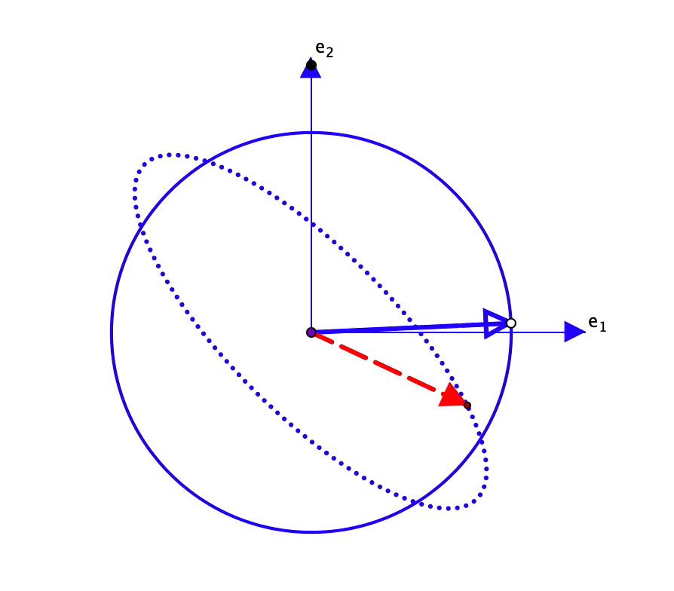
Linear Transformation 2
Tell yourself a story about what you see happening

Slide 5
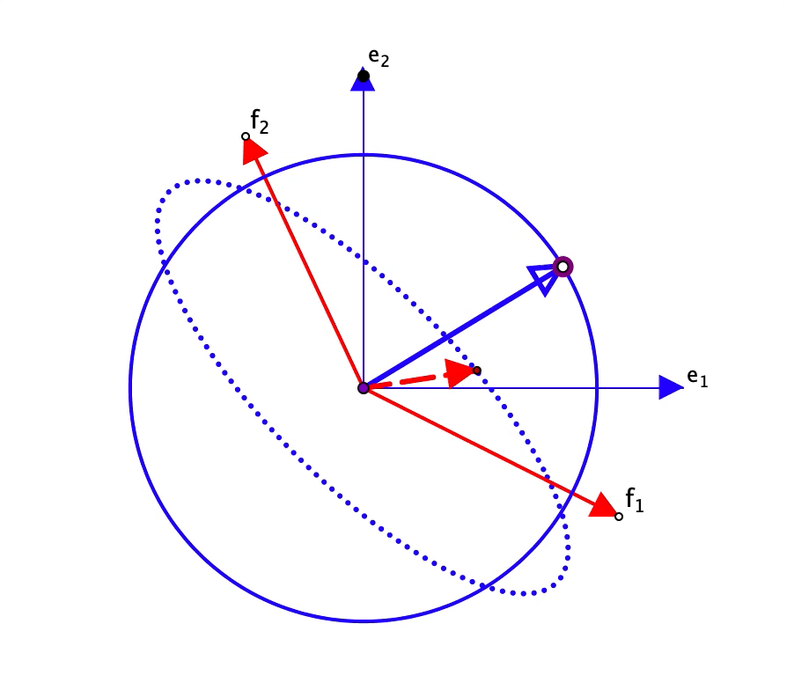
Linear Transformation 3
Tell yourself a story about what you see happening

Slide 6
Immediate Reflection
What did you see happening in one of the animations?
(personal narrative)
What did you find yourself asking about, or wanting to explore?
Can you think of any concepts that you teach which could be introduced and-or reviewed by displaying a phenomenon?

Slide 7
Say What You See (SWYS)
When you first meet a diagram, or an exercise, it can be very helpful to first Say What You See (SWYS), using only language familiar to everyone in the group. There is no prize for being clever. Stick to details that catch your attention.
As a study strategy, and even an exam strategy, SWYS enables you to pause and consider possibilities rather than diving in and carrying out the first action that becomes available.
Invite learners to ‘tell a story’ about what they see/saw happening.
Constructing your own personal narrative (PN) makes a big contribution to your concept image.
By using SWYS & PN in class, and at some point drawing attention to them explicitly, you can help learners integrate them into their own functioning.

Slide 8
Reflections, Questions & Discussion
What is your uppermost concern now?
To pose questions to the panel and to offer your reflections
  A link to submit your reflections and questions for the panel discussion will be provided in the CHAT.
  Please ensure that your question is written in the column for the intended purpose: reflections or panel

Slide 9
Follow-Up
John.Mason@open.ac.uk
PMTheta.com go to Applets then Linear Algebra

