Slide 1


Bringing Enquiry into
My Classroom
PLATINUM
Webinar 2
May 2021
in the time of Corona

Slide 2
Focus for Today
My concern is with the lived experience of learners of mathematics
  The best way I have found to access that is to start with inspecting my own experience
To this end, you will be offered some mathematical phenomena
  Situations in which something happens, or fails to happen, and which therefore open possibilities for exploration, leading to enriched comprehension of concepts
  Situations intended to provide immediate experience from which to learn about problem posing, exploration, and mathematical thinking
My interest today is particularly in
  how questions worthy of exploration arise;
  why some might be chosen to use with learners;
  pedagogical actions which promote exploration and which provoke mathematical thinking.
From my experience, it is when I pose myself questions that I engage most fully, and learn most deeply.

Slide 3
Conjecturing
Mathematical thinking can only thrive in an atmosphere of conjecturing
Everything said today is to be treated as a conjecture, said with the intention to modify it as and when necessary:
You mustn’t believe anything I say; it must be tested in your experience
Nothing said is ‘wrong’, but rather, may be in “need of modification”!
Those who think they ‘know’, listen attentively and perhaps ask questions or offer examples which challenge or indicate useful foci of attention.
Those who think they do not ‘know’, take opportunities to try to express their thinking and their uncertainties.

Slide 4
Assumptions
I am well aware that many of you are teaching people for whom mathematics is at best a tool
Nevertheless, in order to use mathematical tools appropriately it is extremely valuable to learn how to question and probe mathematical phenomena
Everyone has innate curiosity that can be brought to the surface
Every mathematical concept, technique, or tool has at its heart, one or more mathematical phenomena

Slide 5
Ride & Tie
In the 18th and 19th centuries, people who did not have access to their own horses would sometime journey together, sharing a horse.
One would walk and the other ride; then the rider would tie the horse and walk on, while the walker, arriving at the horse, would mount up and ride past the walker, before tying the horse and walking on. The aim was to adjust their trip so that they arrived at the destination at the same time, while also allowing the horse suitable time resting between riders.
Henry Fielding in Chapter II of his 1742 novel Joseph Andrews mentions Ride & Tie as a means of travel often used.
It is said that two people crossed the Adirondacks using ride-and-tie, in order to attend Harvard together. One became president of the US, the other, president of Harvard!
There are still competitions involving Ride & Tie.
Pólya (1962) Mathematical Discovery problems 2.60 and 2.61

Slide 6
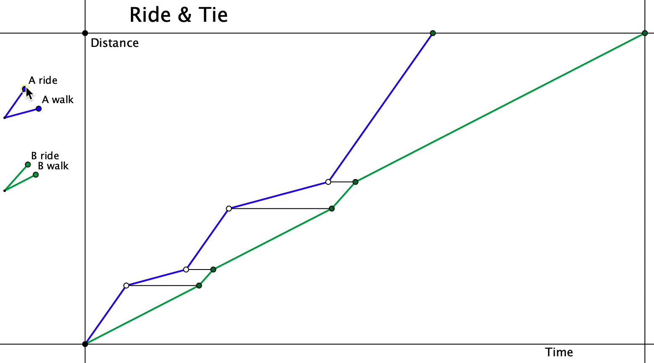
I am going to display a graph
Before doing anything else,
Say What You See (pick out various details that catch your attention)
Say What You See
Pick out various details before enacting any other action

