Slide 1



Balance in Mathematics
It will be helpful to have paper and pen handy!
John Mason
Oxford
May 2020

Slide 2
Throat Clearing
Everything said here today is a conjecture
  It must be tested in your experience
What matters most is what you notice happening for you as you engage with the tasks
  How might you alter the task to use with your learners?
  What pedagogic actions might you initiate?
Some Pedagogic/Didactic Questions

Slide 3
Plan
My plan is to indicate how the notion of balance is fundamental to mathematical thinking, at all levels.
Start with some simple reasoning
  See how it can become more complex as learners become more sophisticated
    Tilted Reasoning
    Balanced Reasoning
Other Places where Balance is Used
  Magic Square Reasoning
Building on and developing intuitions about
the Centre of Mass
  Leads to the principle of moments
Balance beams
  Single, Double and Complex Fulcra
Seeking Actions which preserve an Invariance

Slide 4

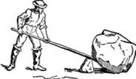
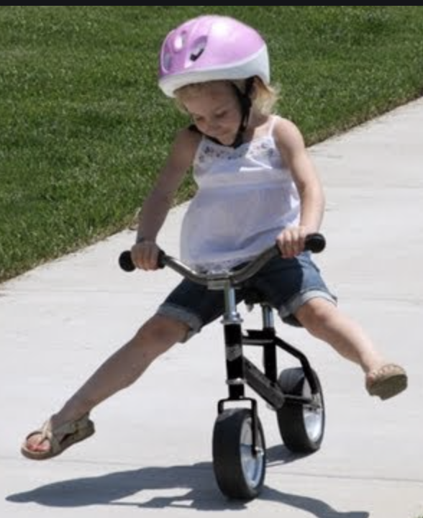
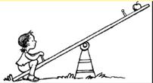

Slide 5
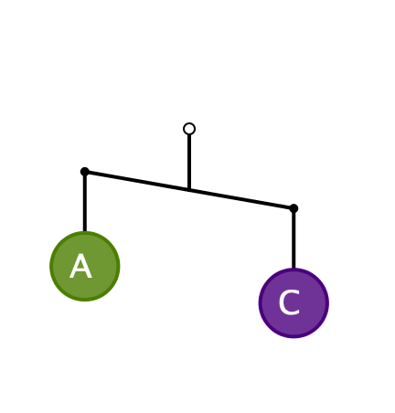
First Encounter
What can you say about the masses A and C?
  It is meant to be a
  2-dimensional picture,
  not 3-dimensional!

Slide 6
Pedagogic Issue
The diagram is WRONG, physically!
Is it appropriate to use misleading or wrong ideas at one stage, when they have to be corrected later?
  “Multiplication makes bigger”
  “to multiply by 10 put a zero at the end”
  …

Slide 7

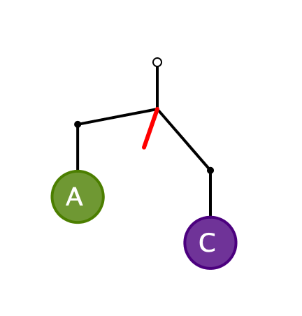
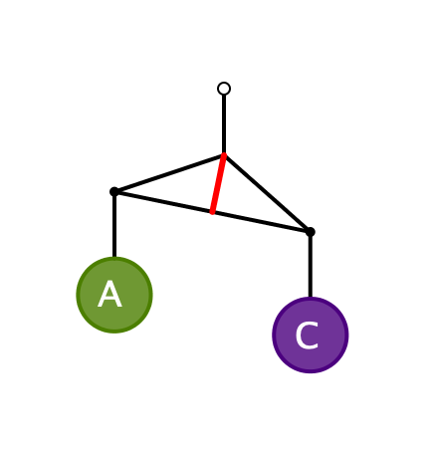
Physically Correct Diagrams
The angle of tilt takes into account both the masses A and C,
and the mass of the ‘bar’ or ‘coat hanger’

Slide 8
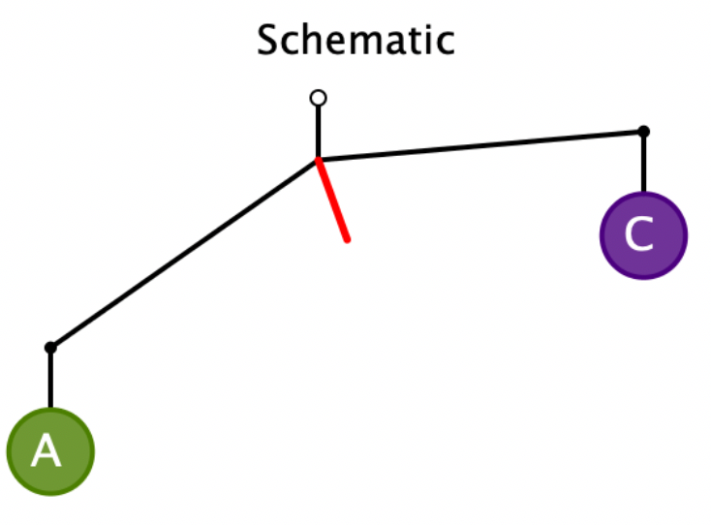
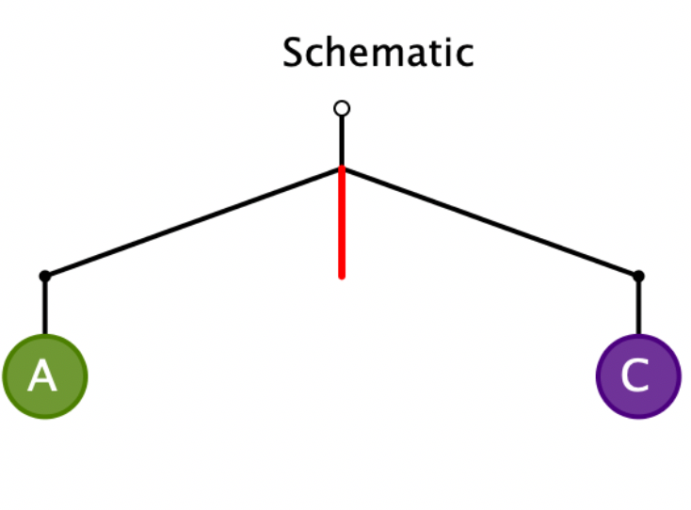
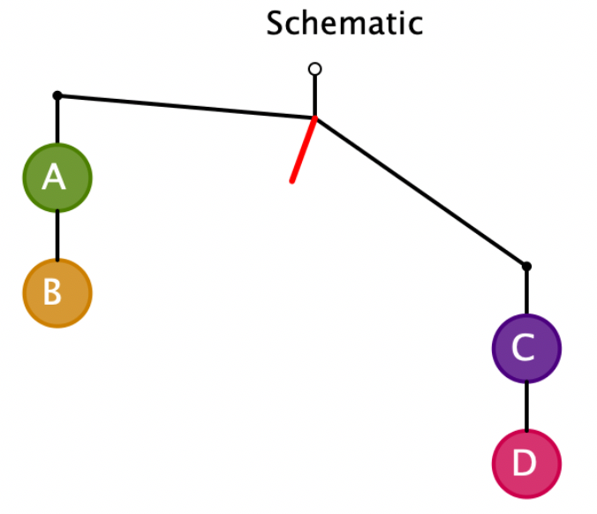
Systematic Development
Express a relationship between the masses
A > C
A = C
C + D > A + B

Slide 9
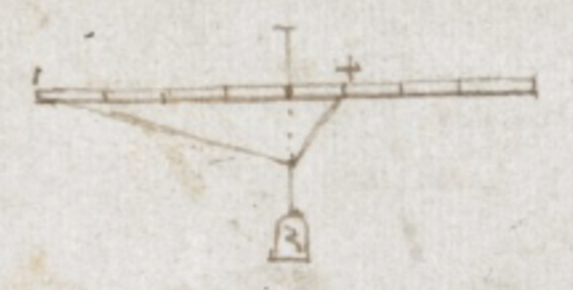
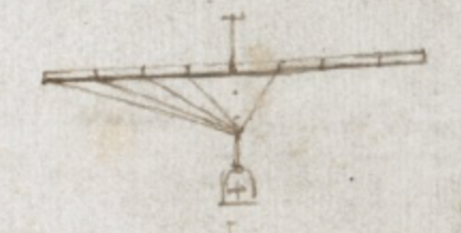
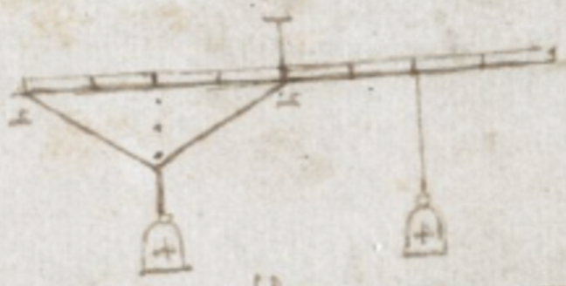
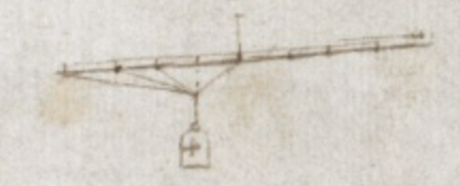
Leonardo da Vinci
What is being illustrated here?

Slide 10
Systematic Development
A > C
A = C
C + D > A + B
Express to someone else yourself
what principles you have recognised
Now draw a schematic bent-bar
which would be read as
A + F > D
And another!
And another!

Slide 11
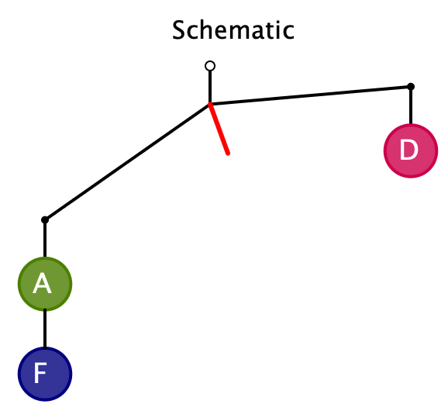
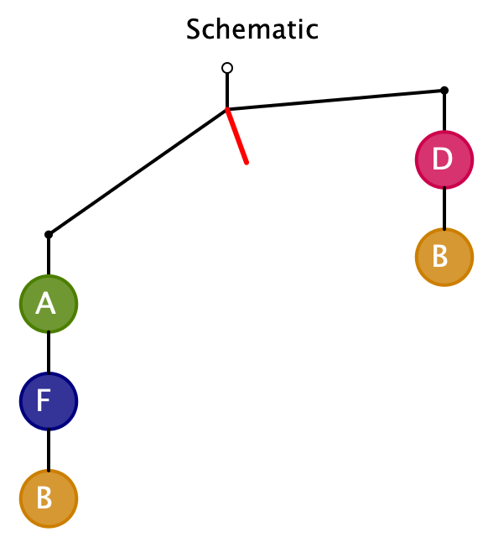
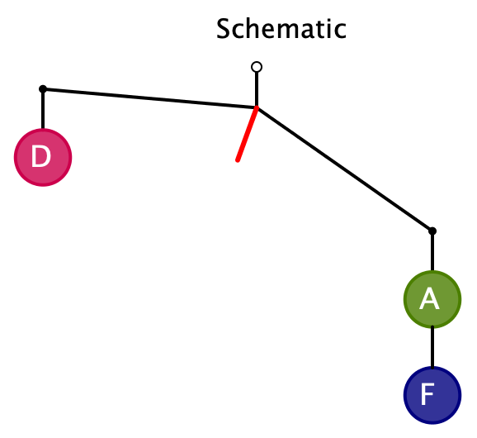
Resolution: A + F > D
…
Learners can create possibilities
and become aware of principles

Slide 12
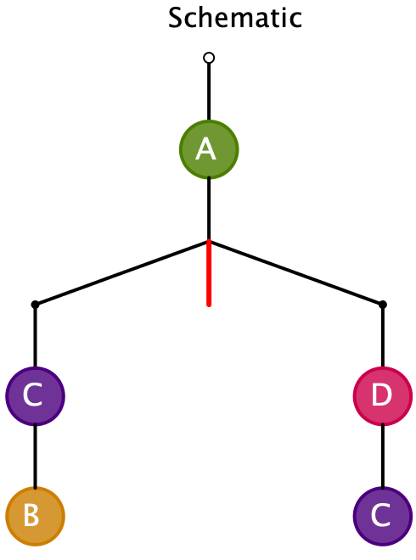
From Actual Masses to Diagram
Pre-release Diagram
Here the diagram shows BEFORE the configuration has been released!
Given the following masses, draw a suitable bent-bar diagram
A = 1
B = 3
C = 2
D = 4
Note the pedagogical
shift of direction
Assign masses so that it tilts the other way

Slide 13
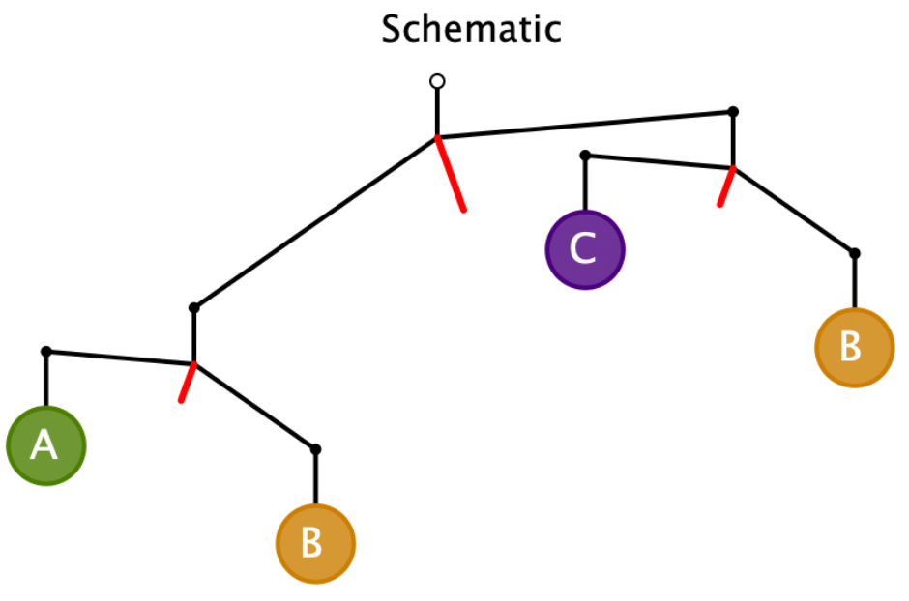
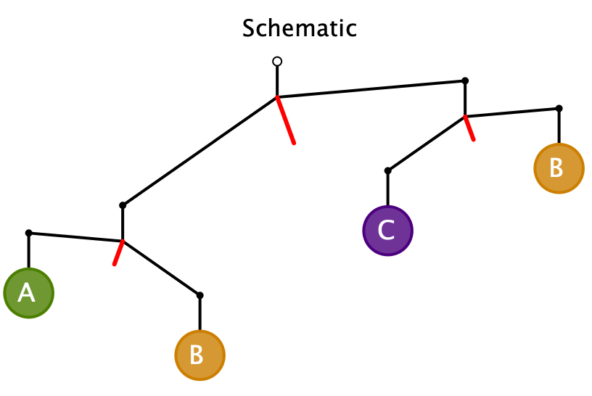
Further Development
B > A
C > B
B > C
B + A > B + C
A > C and C > B > A
A > C
Contradiction!
B > A > C
It is impossible!
Express to someone else yourself
what further principles you have recognised

Slide 14
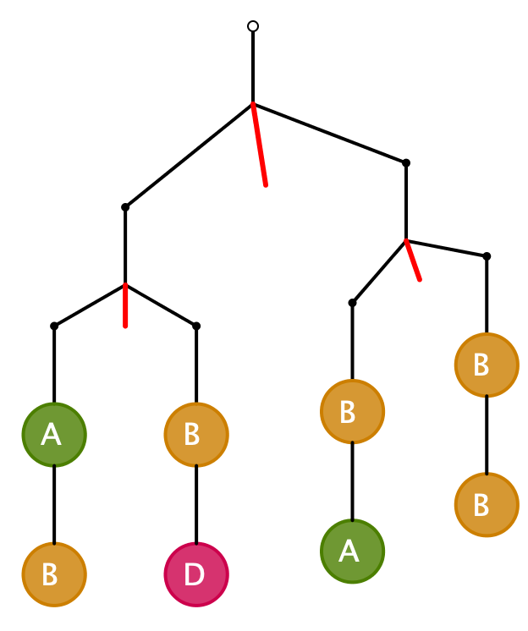
More Challenging
What can be said about the relative masses in each case?
What would be suitable masses to assign to each letter?
A + B = B + D
A = D
A + B > B + B
A > B
A + 2B + D > A + 3B
A = 2; D = 2; B = 1
D > B
D = A > B

Slide 15
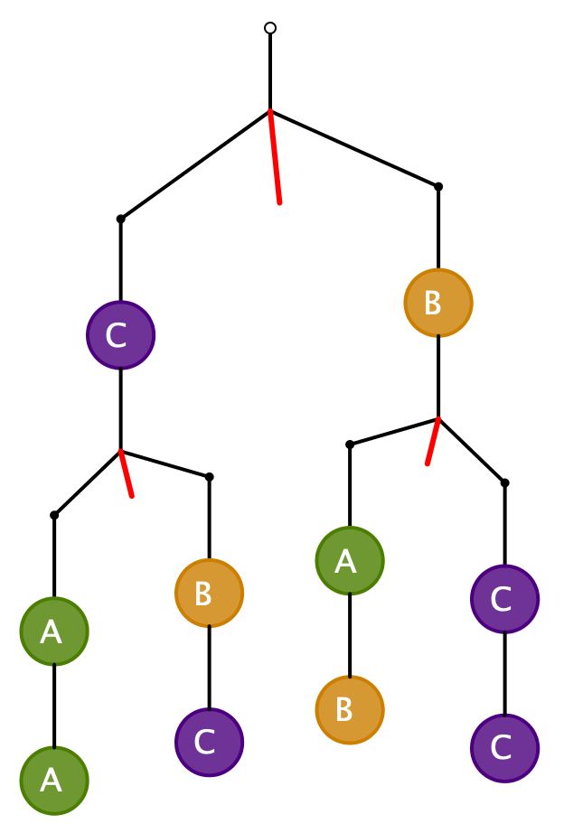
More Challenging
What can be said about the relative masses in each case?
What would be suitable masses to assign to each letter?
2A > B + C
2C > A + B
2A + B + 2C > A + 2B + 2C
A > B
2C > B + B = 2B
C > B
B = 1, C = 3, A = 4
So no conclusion
about A and C
B = 1, C = 4, A = 3
Need to check all relations, not just conclusions
B = 2, C = 4, A = 4
Notes:
John Golden configuration https://www.geogebra.org/m/h2hkQWj2

Slide 16
Challenge
How many tasks like this are needed in order to learn from the experience?
Do you feel a need to practice? To rehearse?
By constructing your own, you can explore boundaries and problematic situations

Slide 17
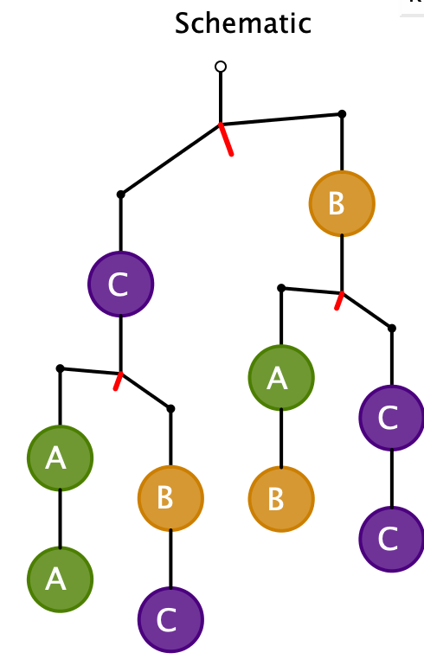
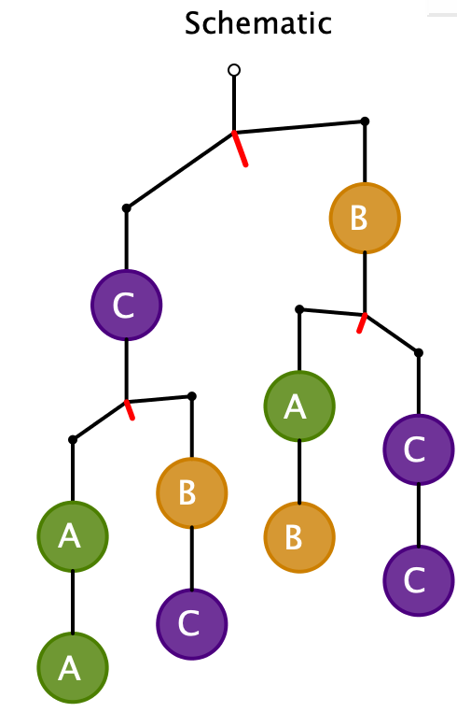
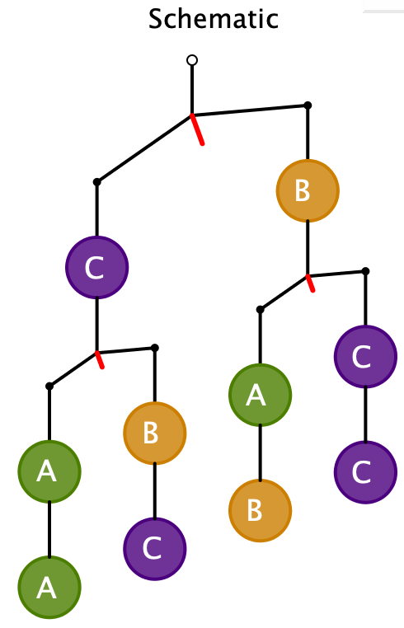
Variations
Notes:
All John Golden Config

Slide 18
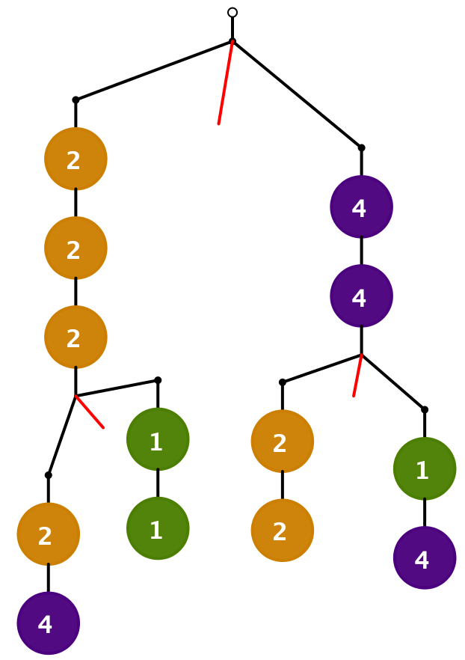
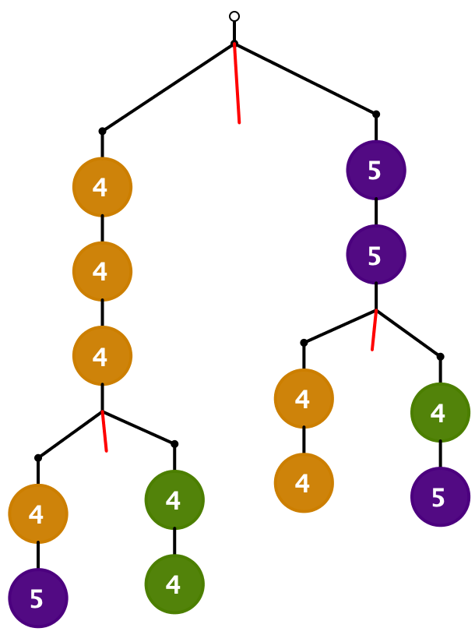
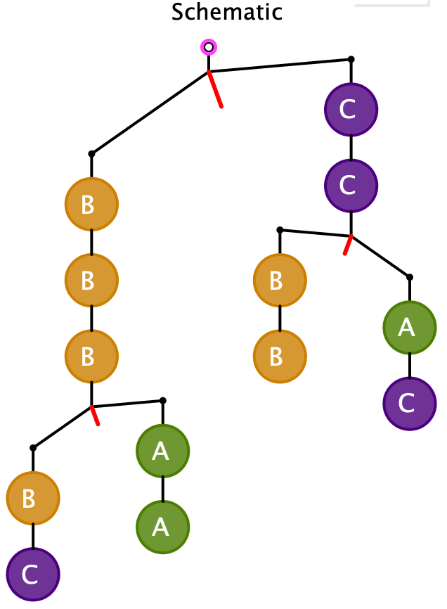
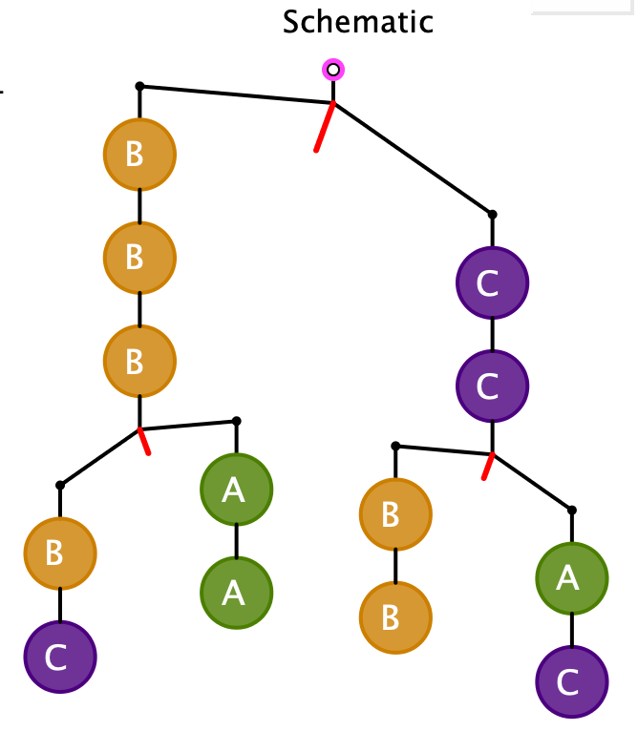
Constructing My Own
Notes:
All sorts of questions, such as, if only 3 masses involved and reduced config, how many of the fully tilted variations can be solved? (probability?)

Slide 19
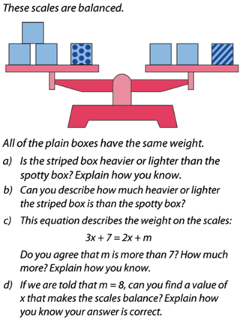
Balanced Reasoning
Richard Perring

Slide 20
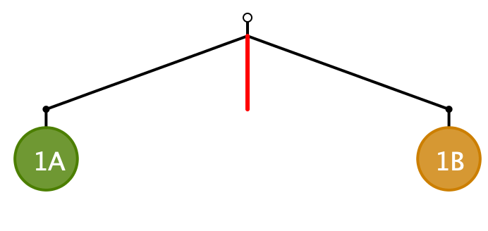
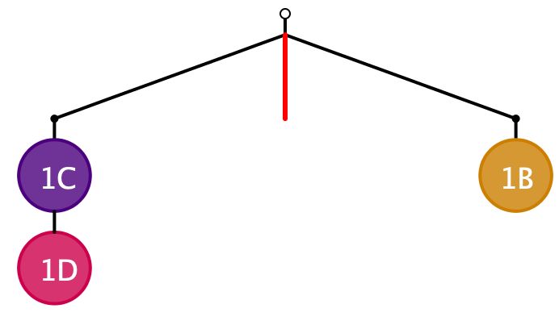
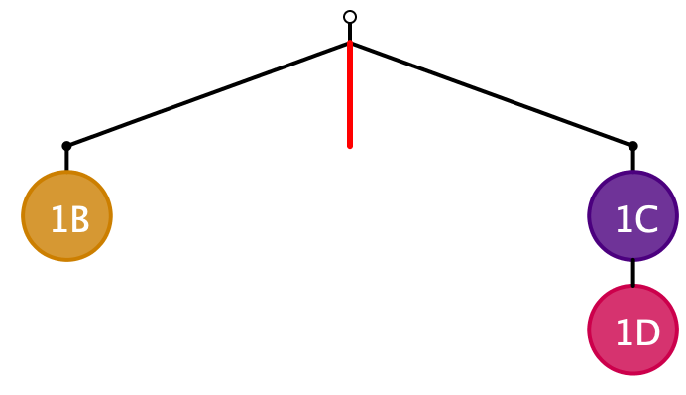
Balanced Reasoning
1A = 1B
1C + 1D = 1B

Slide 21
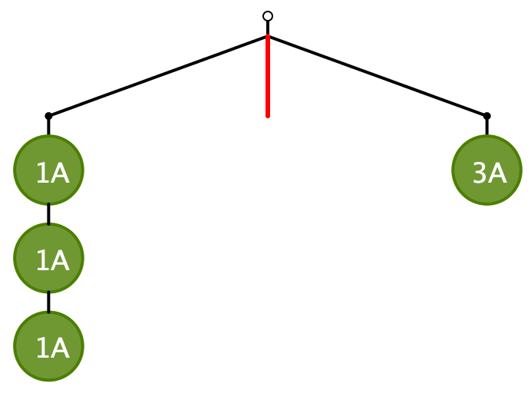
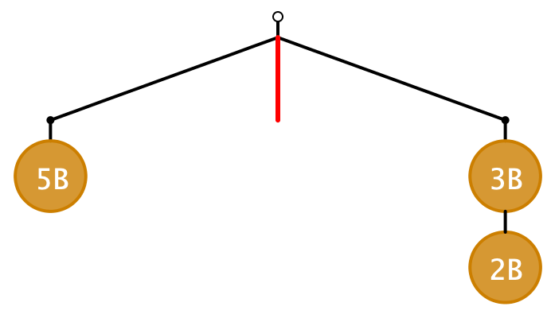
1A + 1A + 1A = 3A
5B = 3B + 2B

Slide 22
Change to?
2A + B = 3C
3A + 5B = 7C
7A = 8C and 7B = 5C
5(2A + B) + (7C) = (3A + 5B) + 5(3C)
7A = 8C
3(2A+B) + 2(7C) = 3(3C) + 2(3A +5B)
5C = 7B
2A + B = 3C
3A + 5B = 7C
7A = 8C and 7B = 5C
5(2A + B) + (7C) = (3A + 5B) + 5(3C)
7A = 8C
3(2A+B) + 2(7C) = 3(3C) + 2(3A +5B)
5C = 7B

Slide 23
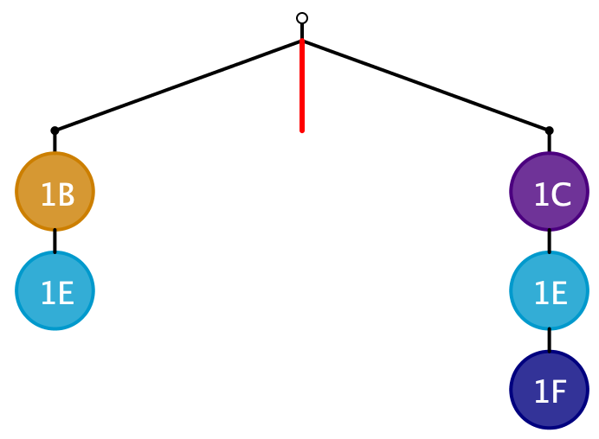
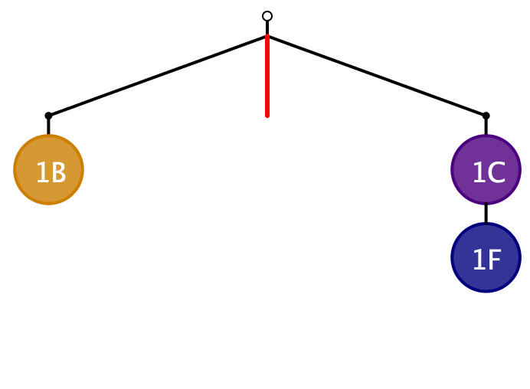
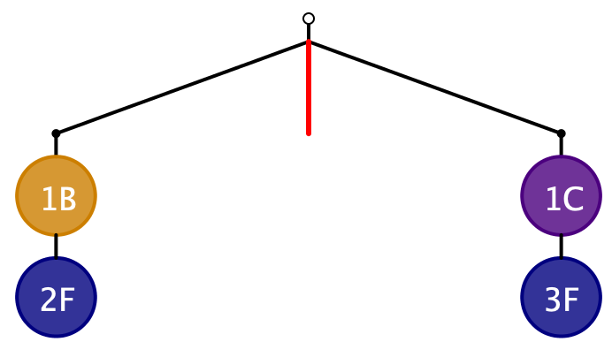
What is the same, and what different?
1B + 1E = 1C + 1E + 1F
1B = 1C + 1F
1B = 1C + 1F
1B + 2F = 1C + 3F

Slide 24
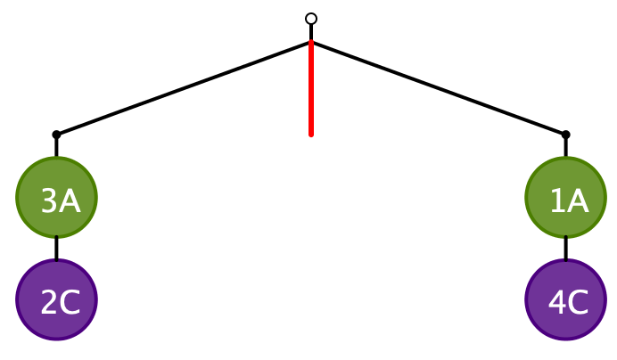
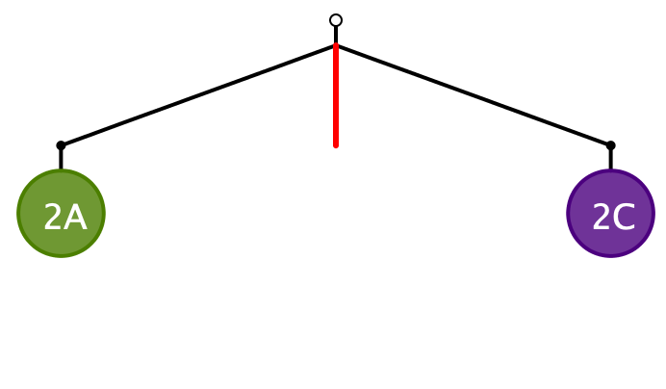

What is the same and what different?
3A + 2C = 1A + 4C
2A = 2C
2A = 2C
1A = 1C
What principle(s) or action(s) are suggested

Slide 25
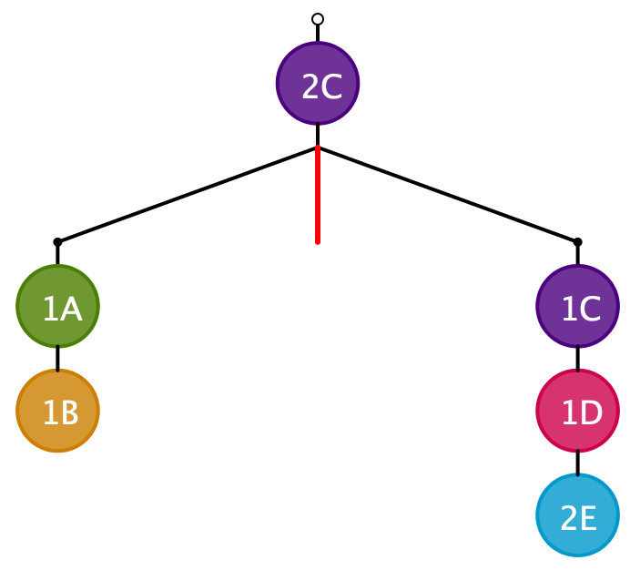
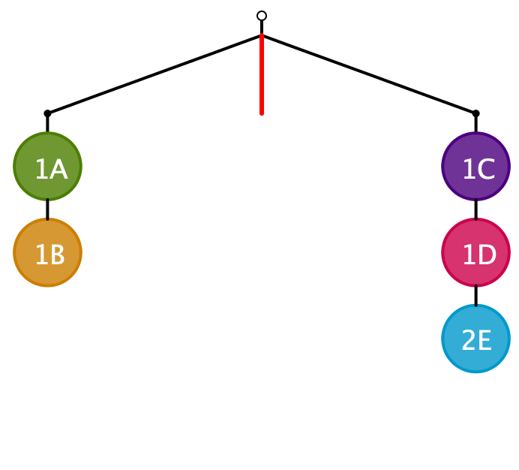
1A + 1B = 1C + 1D + 2E
1A + 1B = 1C + 1D + 2E
What principle, or action, is suggested?

Slide 26
Principles
What actions can be enacted on a balanced configuration so as to maintain that balance?
  Adding the same mass to both sides
  Subtracting the same mass from both sides
  Scaling the masses on both sides
  Inserting masses in common above the fulcrum

Slide 27
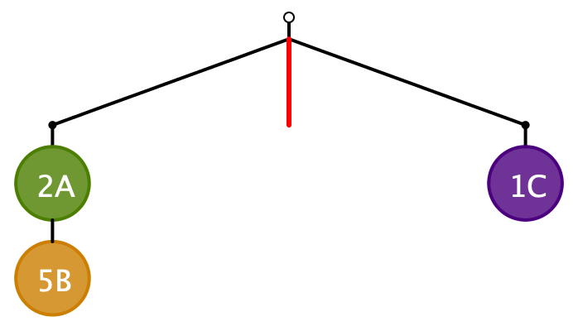
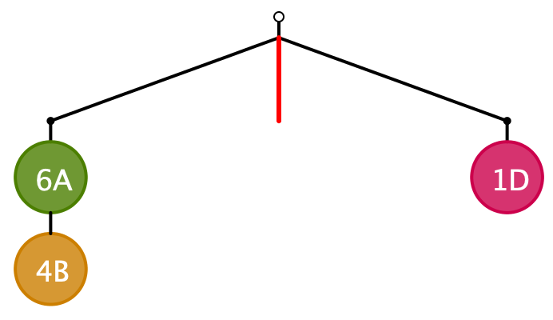
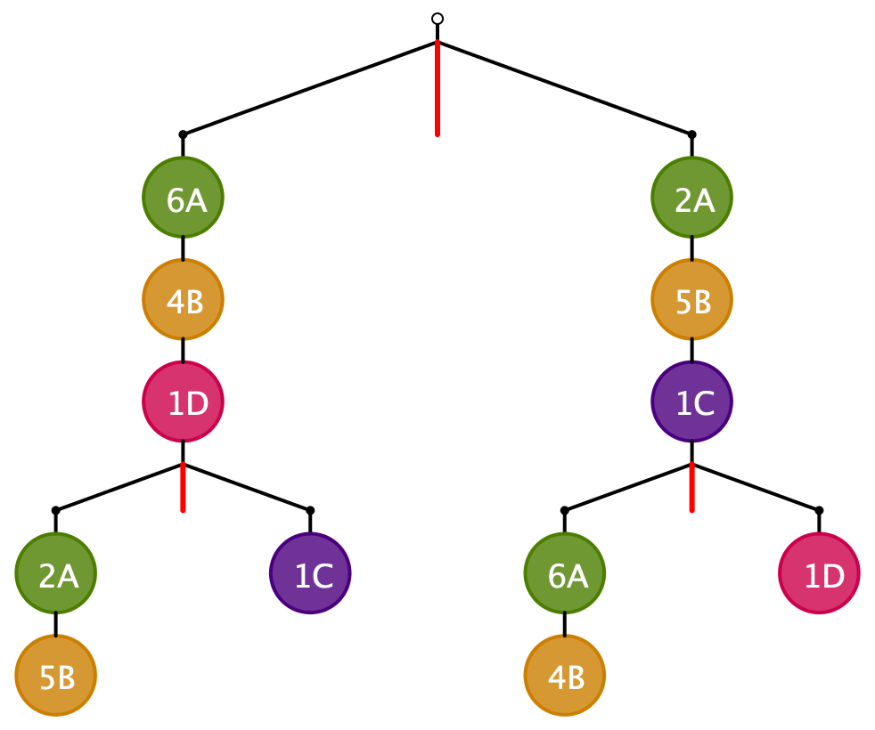
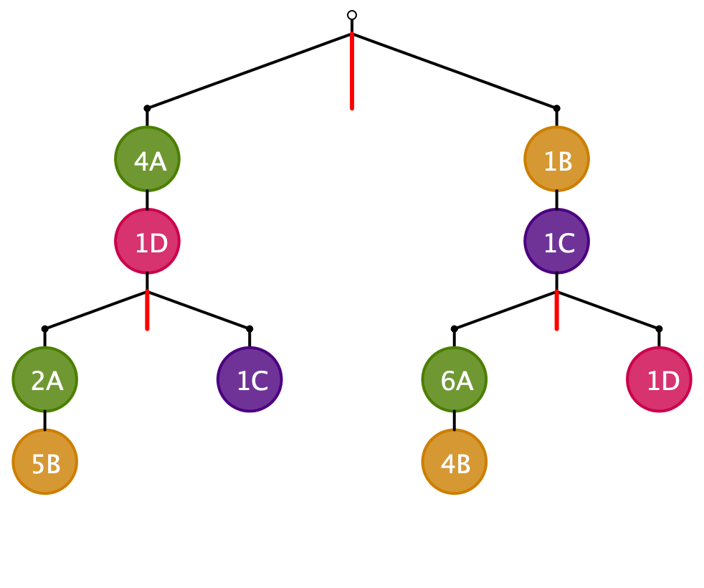
2A + 5B = 1C
6A + 4B = 1D
How else could the two equations be
combined in a single mobile?
2A + 5B = 1C
6A + 4B = 1D
2A + 5B = 1C
6A + 4B = 1D
8A + 9B +1C + 1D = 8A + 9B +1C + 1D

Slide 28
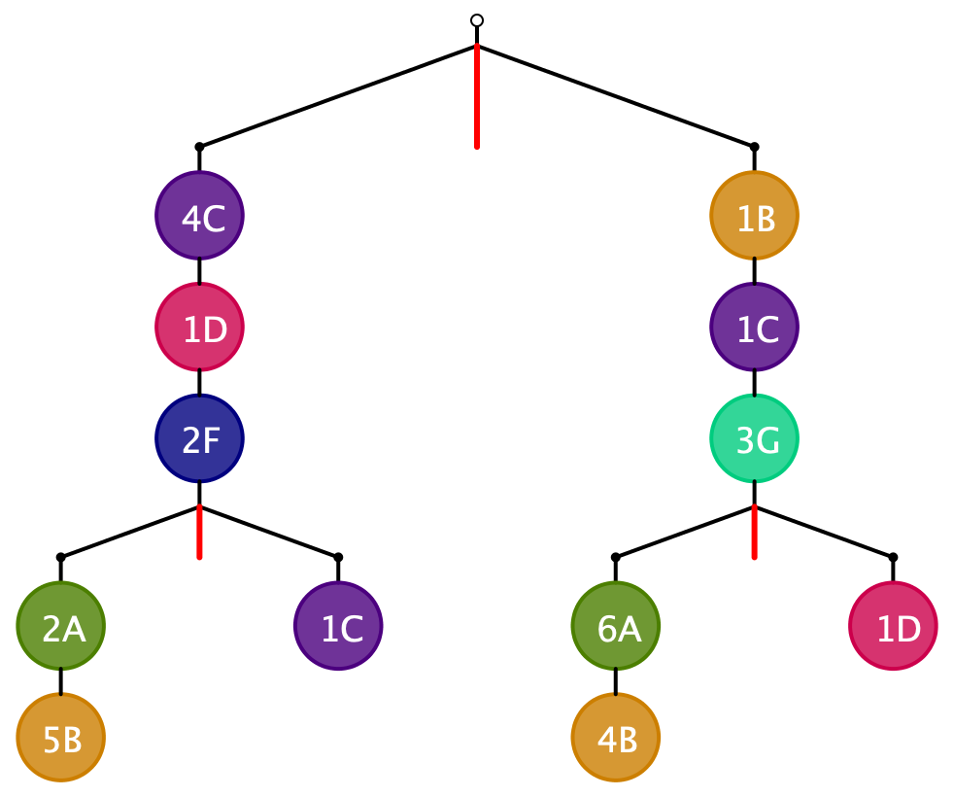
2A + 5B = 1C
6A + 4B = 1D
2F + 4C = 3G

Slide 29
Manipulating Equations
Given values for A and B,
values for C and D are
easy to find
2A + 5B = 1C
6A + 4B = 1D
Eliminate A's
6A + 4B +3(1C) = 1D + 3(2A + 5B)
3C = 1D + 11B
2A + 5B = 1C
6A + 4B = 1D
Eliminate B’s
4(2A + 5B) + 5(1D) = 4(1C) + 5(6A + 4B)
5D = 4C + 12A
3C = 1D + 11B
Now, given values for C and D,
values for A and B are
easy to find
5D = 4C + 12A

Slide 30
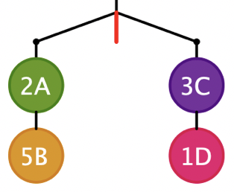
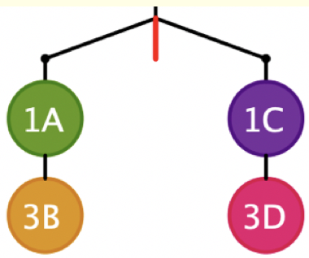
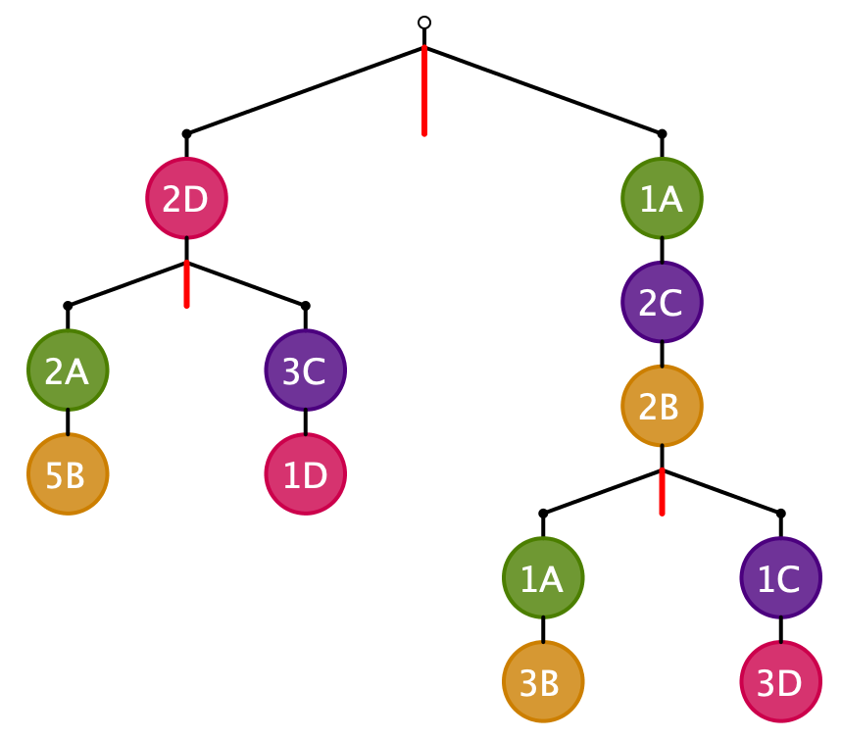
Combining Equations
How might these balances be assembled into a single balance which still forces these relationships?
2A + 5B = 3C + 1D
1A + 3B = 1C + 3D
Any other ways?

Slide 31
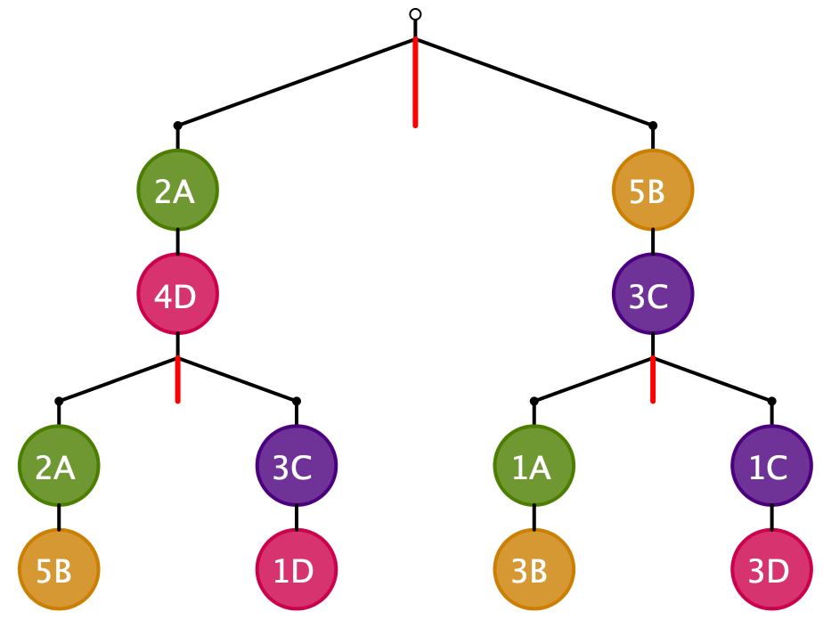


Exploiting Compounds
4A + 5B + 3C + 5D
= 1A + 8B + 4C + 3D
2A + 5B = 3C + 1D
1A + 3B = 1C + 3D
Over-all balanced
Suppose also want to impose
3A + 2D = 3B + 1C
How might this be done?
Any other ways?
2A + 6B + 3C + 1D
= 5A + 3B + 2C + 3D
Notes:
A=4; B=3; C=7; D=2

Slide 32

More than 3 Eqns?
How many equations can be buried in such a diagram?

Slide 33






2A + 5B = 3C + 1D
1A + 3B = 1C + 3D
5D = 1B + 1C
2A + 5B = 3C + 1D
Having eliminated A,
this gives one of B, C or D
in terms of the other two
2A + 6B = 2C + 6D
Isolating B by balancing the A’s
Now eliminate B by balancing them,
to give A in terms of C and D

Slide 34





3(2A + 5B) = 3(3C + D)
5(1A + 3B) = 5(1C + 3D)
3(2A + 5B) + 5(1C + 3D) = 3(3C + D) +5(1A + 3B)
1A + 12D = 4C
Carry forward:
5D = 1B + 1C
Given values for C and D, now A and B can readily be found.
Could have eliminated C or D instead of B

Slide 35
Challenge
How many tasks like this are needed in order to learn from the experience?
Do you feel a need to practice? To rehearse?
By constructing your own, you can explore boundaries and problematic situations

Slide 36
Peculiar Phenomenon!
Instead of using two balances to create a new possibly simplified balance,
assemble the two balances into a compound balance

Slide 37





2A + 5B = 3C + 1D
1A + 3B = 1C + 3D
Re-balance
Over all balanced
(2A + 5B) + 2(1C + 3D) = (3C + 1D) +2(1A + 3B)
5D = 1B + 1C
Use these relationships to
create a new balance with no
compensatory A’s
Notice the compensatory masses needed to rebalance!

Slide 38

Newton’s Centre of Mass
Centre of mass
  Plumb lines
Principle of moments
To balance, the Centre of Mass must be at the fulcrum
Left-mass x distance to Fulcrum = Right-mass x distance to Fulcrum

Slide 39





Fulcra
Why is this beam balanced?
Will this beam balance?
Will this beam balance?

Slide 40







From Balances to Levers
Exploiting moments

Slide 41
Where we could go
I have a circular tray
It sits on a cylindrical post at its centre
How can I be sure that when I put things on the tray, it will not fall off the post?

Slide 42
Magic Square Reasoning
What other
configurations
like this
give one sum
equal to another?
6
7
2
2
1
5
9
Try to describe
them in words
2
8
3
4
Any colour-symmetric
arrangement?
Sum(
)
–
Sum( )
= 0
Notes:
Think of all the patterns obtained like this one but with different choices of the red line and the blue line.
Sketch a few
Here is another reasoning
What about this pattern: is it true?
did you have difficulty recognising the components? This may be why learners find it hard to remember what they were taught recently!

Slide 43
More Magic Square Reasoning
Notice how an invariance
(sum of entries)
is used to create new invariants (equalities)
Sum(
)
–
Sum( )
= 0

Slide 44

Set Ratios
You have 17 counters to place in the diagram so that the two sets A and B have the same number of counters.
Most people end up finding an action which rearranges the counters, but preserves both the set-equality and the number of counters
This is ‘preserving a balance’, or ‘keeping something invariant’
A
B
The same idea applies when you try to place the counters so that the ratio of the number in A to the number in B is some specified ratio like 3 : 2
Or indeed when you move to three sets!
Two kinds of action become important:
  Change positions so as to preserve the ratios AND the number of counters
  Change positions so as to preserve the ratios BUT change the number of counters used

Slide 45
Looking Forward
The mathematical theme
  Invariance in the midst of change
Leads to seeking actions that preserve invariance
  Which is a generalised version of ‘preserving balance’

Slide 46
Follow-Up
John.Mason@open.ac.uk
PMTheta.com

