Slide 1
From Worked Examples via Key ideas, Core Awarenesses and Variation to the issue of Student Attention
Promoting Mathematical Thinking
John Mason
Open University February 2017
The Open University
Maths Dept
University of Oxford
Dept of Education

Slide 2
Conjectures
Everything said here today is a conjecture … to be tested in your experience
The best way to sensitise yourself to learners
is to experience parallel phenomena yourself
So, what you get from this session is mostly what you notice happening inside you!

Slide 3
Outline
Worked Examples
Key Ideas & Core Awarenesses
Variation & Mastery
Student Attention

Slide 4
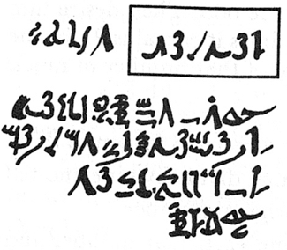
Rhind Mathematical Papyrus problem 28
Two-thirds is to be added.
One-third is to be subtracted.
There remains 10.
Make 1/10 of this, there becomes 1.
The remainder is 9.
2/3 of this is to be added.
The total is 15.
1/3 of this is 5.
Lo! 5 is that which goes out,
And the remainder is 10.
The doing as it occurs!
Notes:
Problem 28 of the Rhind Mathematical Papyrus Gillings p182

Slide 5
Worked Examples
A 4000 year old practice
“Thus is it done”; “Do it like this”; …
What is the student supposed to do?
Follow the sequence of acts
Distinguish structural relations and values from parameters
Templating
What does the student need from a worked example?
What to do ‘next’
How to know what to do next
Chi & Bassok
Renkl & Sweller
Watson & Mason
Notes:
Atkinson, R. Derry, S. Renkl, A. & Wortham, D. (2000). Learning from examples: Instructional principles from the worked examples research Review of Educational Research; 70(2), 181-214.
Renkl, A. (1997). Learning from worked-out examples: A study on individual differences. Cognitive Science, 21, 1-29.
Renkl, A. (2002) Worked-out examples: Instructional explanations support learning by self-explanations. Learning and Instruction, 12, 529–556.
Chi, M. & Bassok, M. (1989). Learning from examples via self-explanation. In L. Resnick (Ed.) Knowing, learning and instruction: essays in honour of Robert Glaser. Hillsdale, NJ: Erlbaum.
Chi, M. Bassok, M. Lewis, P. Reiman, P. & Glasser, R. (1989). Self-explanations: How Students Study and Use Examples in Learning to Solve Problems. Cognitive Science. 13 p145-182.
Watson, A. & Mason, J. (2006) Seeing an Exercise as a Single Mathematical Object: Using Variation to Structure Sense-Making. Mathematical Thinking and Learning. 8(2) p91-111.

Slide 6
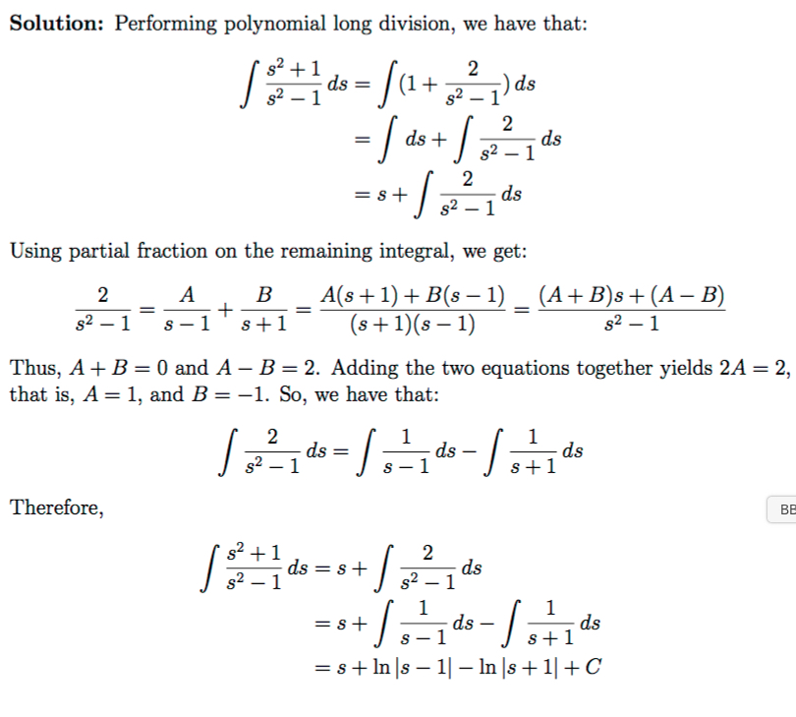
Integration
Key ideas?
Core Awarenesses
Notes:
Online solution to exercises from UBC

Slide 7
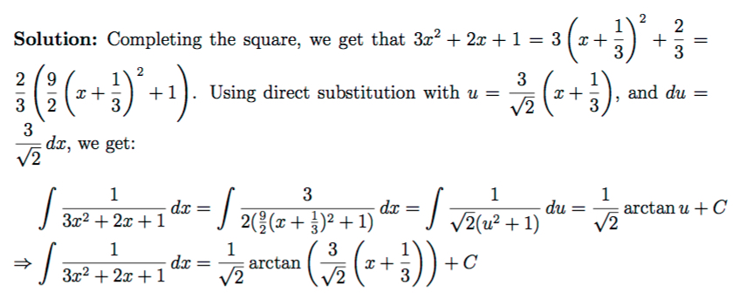
Another Integration
Key ideas?
Core Awarenesses
Notes:
Online solution to exercises from UBC
No attempt to factor first! No indication of the form being sought (a(x-b)^2+1)
No anaysis of appropriate domain!

Slide 8
Exercises
for developing facility
Varying type
Varying structure
Doing & Undoing
for deepening comprehension
for extending appreciation
Varying context
Complexifying
& Embedding
for enriching accessible example spaces
Extending, & Restricting
Learners generating own examples subject to constraints
Generalising & Abstracting

Slide 9
Key Ideas & Core Awarenesses
Carpet theorem
Reading Graphs (compound functions; ride & tie)
Linearity (in vector spaces)

Slide 10
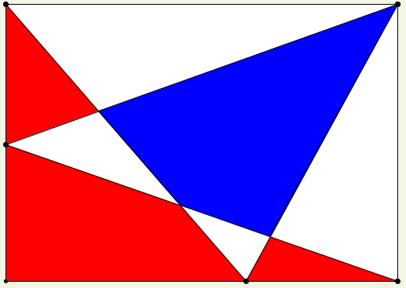
Two Areas
What is the relation between the areas of the red and blue regions?
How do you know?
What can be varied?

Slide 11
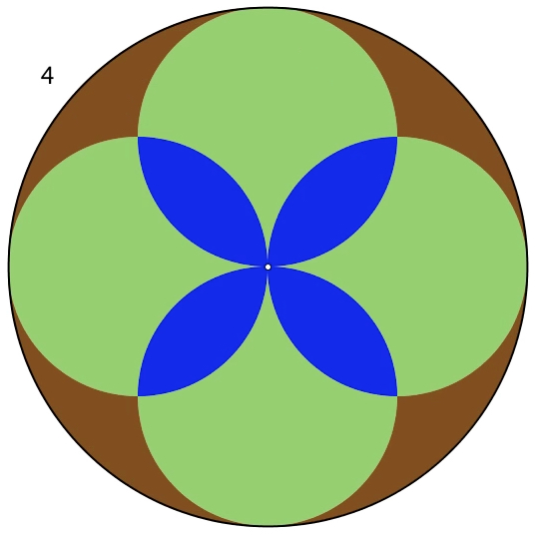
Brown & Blue Areas … how related?
Notes:
Broen = Blue

Slide 12
Carpet Theorem
Static: If two carpets exactly cover a floor without overlap, then when they are shifted so there is some overlap, the area of the overlap is the same as the area of the exposed floor.
Dynamic: if two carpets on the floor have their positions shifted, the change in area of overlap equals the change in area of exposed floor.

Slide 13
Brown Area = Blue Area
What are the radii?
Notes:
4 ≤ N ≤ 24 Brown area = Bue area so radii = 1/√N
N=3 Brown area = Blue area + 2 Red area
25 ≤ N ≤ ? Brown area = Blue area + (N-1) Red

Slide 14
√2 is irrational
Consider …
… the smallest integer square which is twice the area of an integer-sided square
Put two copies of the half-square into opposite corners
By the carpet theorem we have another such square ...
... which is also integer-sided
Contradiction!
There can be no such smallest integer-sided square and hence no such integer-sided square

Slide 15
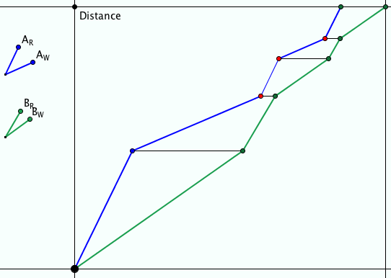
Ride & Tie
Two people have but one horse for a journey. One rides while the other walks. The first then ties the horse and walks on. The second takes over riding the horse …
They want to arrive together at their destination.
Imagine and sketch

Slide 16
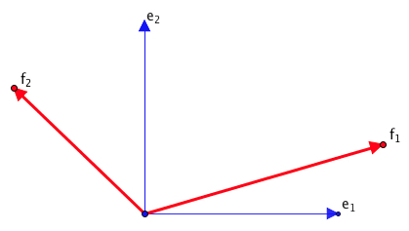
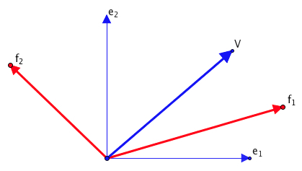
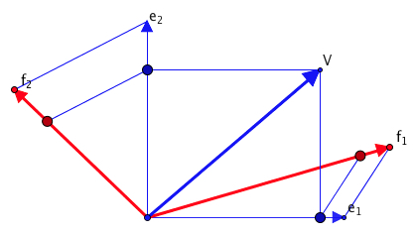
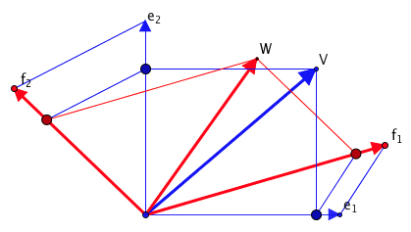
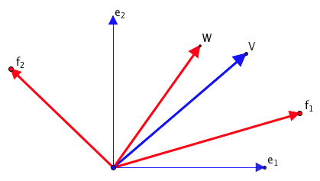
Linearity in vector Spaces
T maps e₁ to f₁ and e₂ to f₂
How do you find T(V)?

Slide 17
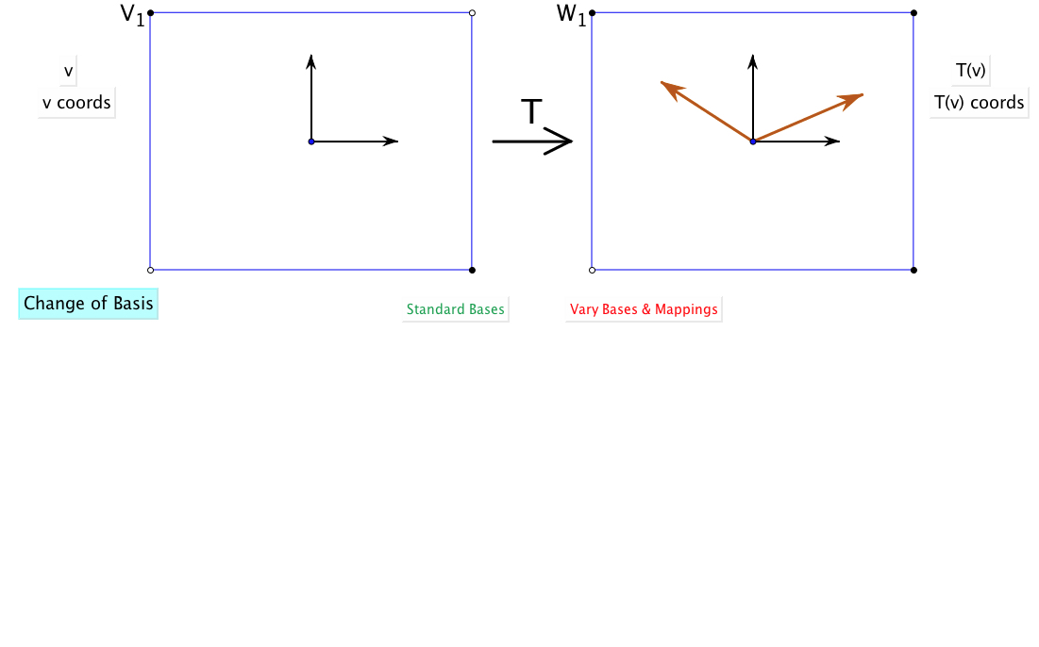
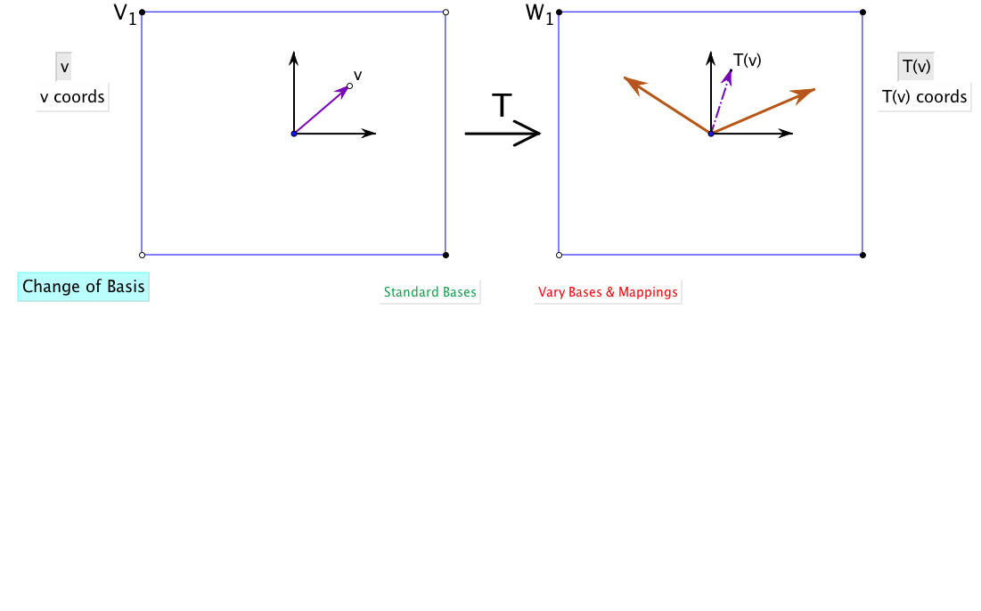
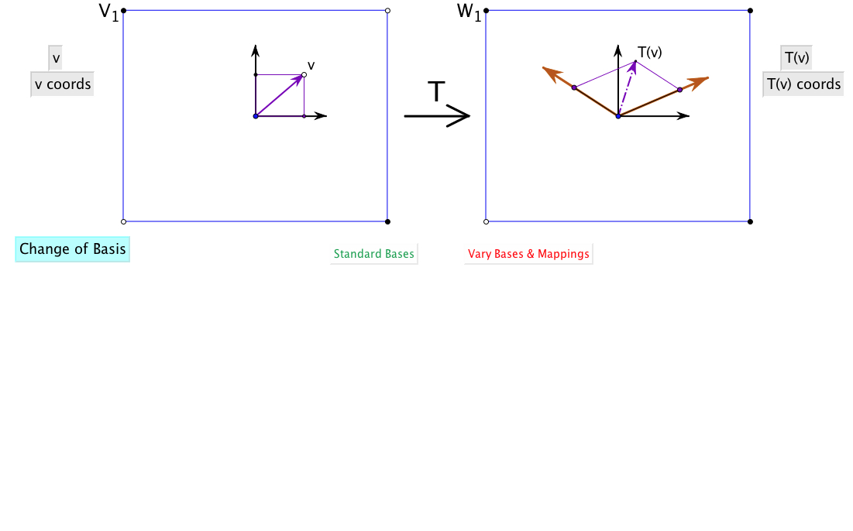
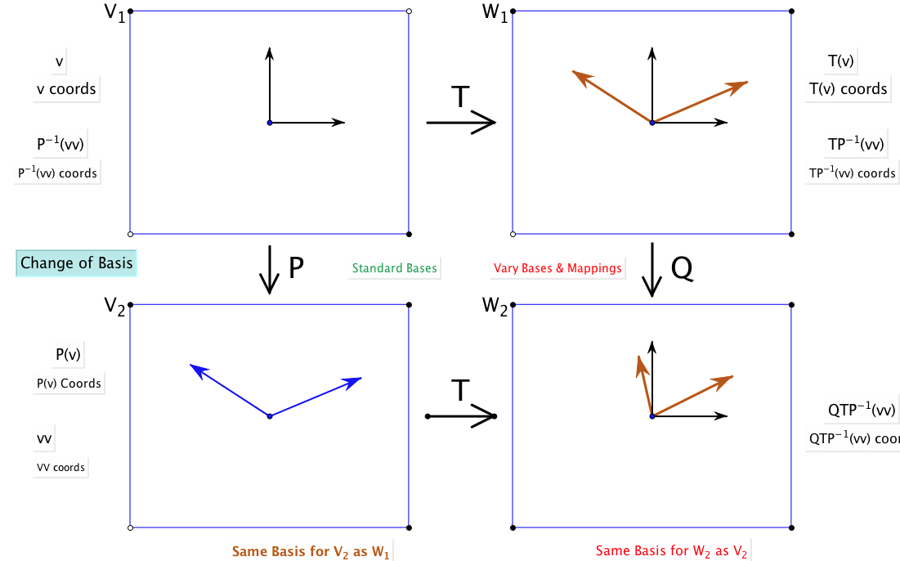
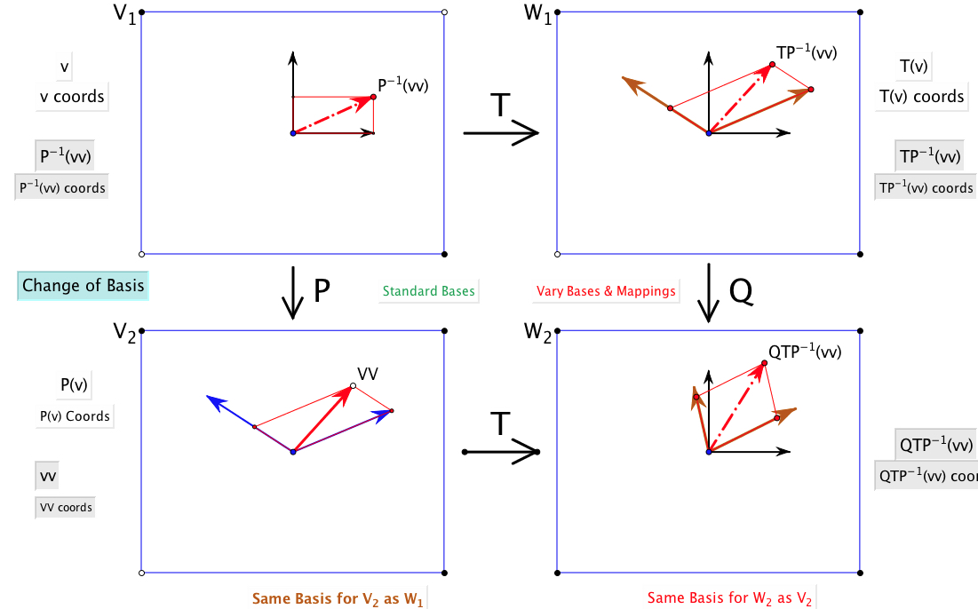
Change of Basis

Slide 18
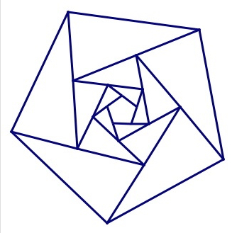
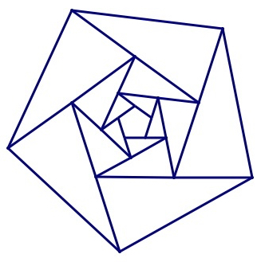
Expressing What is Seen
Sketch what you saw
What is the same and what different about the two diagrams?
What freedom is available?
What can be varied?
Notes:
Expectations based on partial information

Slide 19
Variation
Theorems
Invariance in the midst of change
What can change and yet something remains invariant
Existence theorems
Gothenburg Variation
Something is available to be learned only when critical aspects have been varied in local time and space
“Nettle of a Concept”
Shanghai (Confucian) Variation
Same problem different methods
Same method different problems
Same concept different contexts
Notes:
Nettle of a concept is from EM235 (1984)

Slide 20
Attention
What am I attending to?
What are students attending to? What do they need to attend to?
How are they attending to it?
How am I attending to it?
Conjecture:
if students and tutor are attending to different things
OR
if attending to the same thing but differently THEN communication is likely to be impoverished

Slide 21
Forms of Attention
Holding a Whole (gazing)
Discerning Details
Recognising Relationships in the particular situation
Perceiving Properties as being instantiated
Reasoning on the basis of agreed properties

Slide 22
Inner & Outer Aspects
Outer
What task actually initiates explicitly
Inner
What mathematical concepts underpinned
What mathematical themes encountered
What mathematical powers invoked
What personal propensities brought to awareness

Slide 23
Crossed Ladders
In an alleyway there is a ladder from the base of one wall to the opposite wall, and another the other way, reaching to heights 3m and 4m respectively on the opposite walls. Find the height of the crossing point.

Slide 24
Crossed Ladders Solution
Dimensions of possible variation
Harmonic or
Parallel Sum

Slide 25
Journeys
Couriers
A courier sets out from one town to go to another at a certain pace; a few hours later the message is countermanded so a second courier is sent out at a faster pace … will the second overtake the first in time?
Meeting Point
Some people leave town A headed for town B and at the same time some people leave town B headed for town A. They all meet at noon, eating lunch together for an hour. They continue their journeys. One group reaches their destination at 7:15 pm, while the other group gets to their destination at 5pm. When did they all start? [Arnold]

Slide 26
Meeting Point Resolution
Draw a graph!
B
Distance from A
Dimensions of possible variation?
A
time

Slide 27
Cistern Filling
A cistern is filled by two spouts, which can fill the cistern in a and b hours respectively working alone. How long does it take with both working together?
a
Dimensions of possible variation?
b
time

Slide 28
Crossed Planes
Imagine three towers not on a straight line.
Imagine a plane through the base of two towers and the top of the third; and the other two similar planes.
They meet in a point.
Imagine a plane through the tops of two towers and the base of the third; and the other two similar planes
They meet in a point
The first is the mid-point between the ground and the second.
Notes:
And it generalises to higher dimensions

Slide 29
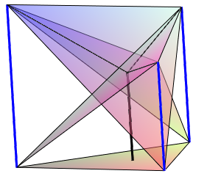
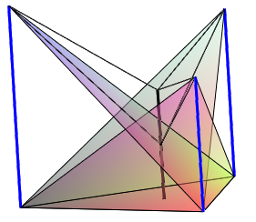
Tower Diagrams

Slide 30
Powers & Themes
Are students being encouraged to use their own powers?
Powers
or are their powers being usurped by textbook, worksheets and … ?
Imagining & Expressing
Specialising & Generalising
Conjecturing & Convincing
(Re)-Presenting in different modes
Organising & Characterising
Themes
Doing & Undoing
Invariance in the midst of change
Freedom & Constraint
Restricting & Extending
Exchanging

Slide 31
Reflection as Self-Explanation
What struck you during this session?
What for you were the main points (cognition)?
What were the dominant emotions evoked? (affect)?
What actions might you want to pursue further? (Awareness)
Notes:
Chi et al

Slide 32
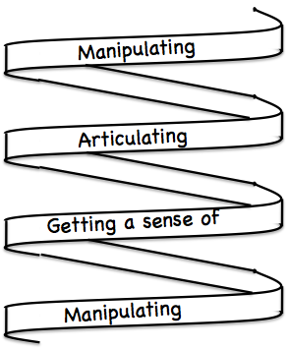
Frameworks
Enactive – Iconic – Symbolic
Doing – Talking – Recording
See – Experience – Master
Concrete – Pictorial– Symbolic

Slide 33
Reflection
It is not the task that is rich
but the way the task is used
Teachers can guide and direct learner attention
What are teachers attending to?
Powers
themes
Heuristics
the focus and form of their own attention

Slide 34
To Follow Up
pmtheta.com
john.mason@open.ac.uk
Thinking Mathematically (new edition 2010)
Developing Thinking in Algebra (Sage)
Designing & Using Mathematical Tasks (Tarquin)
Questions and Prompts (ATM)

