Slide 1


Open-Book On-Line
Assessment of Mathematics
TALMO
Sept 2020
in the time of Corona

Slide 2
Understanding (& Facility)
A curious word etymologically!
  Originally: ‘to stand among’
  perceive meaning or explanation of; sympathetic awareness of; be conversant or familiar with; have mastery of; realize fully; appreciate
I use appreciate and comprehend, as these speak more directly to my experience.
It seems to me that facility is something different, to do with performance
It might be assumed that open-book testing cannot include facility, since candidates can look things up in real time.
Edinburgh:
Open book makes far less difference to overall results than you might expect …
because students who have not engaged with the material may not even be able to find the appropriate section of their book or notes explaining a relevant method.
It is almost impossible to use a book or other course materials successfully in an examination without properly studying these beforehand. …
Observations show that students tend to use materials brought in to examinations relatively little and mainly as a check.

Slide 3
Fundamental Questions
What do I want students to get out of my course?
  Competence in the use of technical terms?
  Comprehension of concepts?
  Facility with procedures and techniques?
  Comprehension of particular proofs? Of proof in general?
  Exposure to particular proof techniques?
  Appreciation of places where topics have been used?
What constitutes evidence?
How do students encounter these explicitly in my teaching?
  Meaningful use of technical terms? … by them?
  What it means to comprehend a concept?
  How to gain facility with procedures and techniques?
  What it means to comprehend a proof?
  Explicit attention to proof techniques?
  Appreciation of places where topics have been used? … by them?
What experience have they had?

Slide 4
A Simple Example
Show me that you appreciate, comprehend, and have facility with |x|.
Definition: construct three examples to demonstrate how |x| works as a function on the reals and three for the complex numbers
Concept image: draw three different diagrams associated with |x|.
State in what way they are different!
Manipulation
|x + y| ≤ |x| + |y|
  Provide three different contexts from the course
  where this is used
|x – y| ≥ | |x| – |y| |
  Show how to deduce this from the previous,
  and vice versa
|x – y| ≤ |x – z| + |y – z|
  What does this say geometrically?
  How does it relate to |x + y| ≤ |x| + |y|?
Graphs Using |x|
  |x–y| + 2|x+y| = 3 etc.
What is wrong with … (a proposed graph of function)?
Technical Terms
Concepts
Core Procedures
Proofs/Justifications
Proof Techniques
Uses
( )

Slide 5
Topic-Webs
Construct a topic web for one of
  (list of topics from the course)
|xy| = |x| |y|
|x+y| ≤ |x| + |y|
Size of number
Continuous function differentiable on R\{0|
Distance from the origin
(real & complex)
|x|
|x – a|
Distance of x from a
Graph symmetric about y-axis
Used to measure closeness of x to a
Determinant
(of matrix)
Even function
Norm
(of vector)

Slide 6
Assessing Comprehension & Appreciation of |x|
Of what concepts (in this course) is |x| an example?
On which intervals is |x² – 1| ≥ |2– 2x|
Describe in simple terms that a high school student can grasp, what |x| means.
Using |.|, construct an example of a function which is differentiable everywhere except at 3 distinct points. Justify your construction.
Advise a colleague how to set about graphing a function like
Describe a different way to set about graphing it.
Comment on which you think the easiest.

Slide 7
Personal Narratives
Select a number of technical terms from the course:
  Construct some mathematically coherent sentences that link these terms together.
Select two technical terms from the course:
  Construct a mathematically coherent sentence that links these two terms together
Choose three theorems from the course and explain why you think these are significant in the topic.
These could be chosen randomly for each student on line

Slide 8
Measures of Appreciation & Comprehension
Concept
Complexity of topic-web:
  Increase in complexity of topic-web over time
Richness of accessible example-space:
  associated images;
  succinctness of personal narrative
Facility:
  Awareness of possible wrinkles, modifications, classic mis-takes when being used
Procedure
Facility:
  Awareness of required assumptions
  Awareness of possible wrinkles, modifications, classic mis-takes when being used
Theorem or Property
Necessity of assumptions
Awareness of uses

Slide 9
Example Construction
Construct an example of (an object from the course) which satisfies the following constraints …
For example
  A quadrilateral with exactly one pair of opposite sides equal
  A quadrilateral with two pairs of opposite sides equal
  A quadrilateral with exactly one pair of opposite sides equal
  and with with exactly one pair of opposite sides perpendicular as well;
  A quadrilateral with two pairs of opposite sides equal and with two pairs of opposite sides perpendicular.
Construct another integral like this one, which is also 0.
State in what way your example is like, but different from this one.
Known to be available:
Change interval;
Change function but keep linear
Change function
(polynomial; trigonometric)
And another
And another

Slide 10
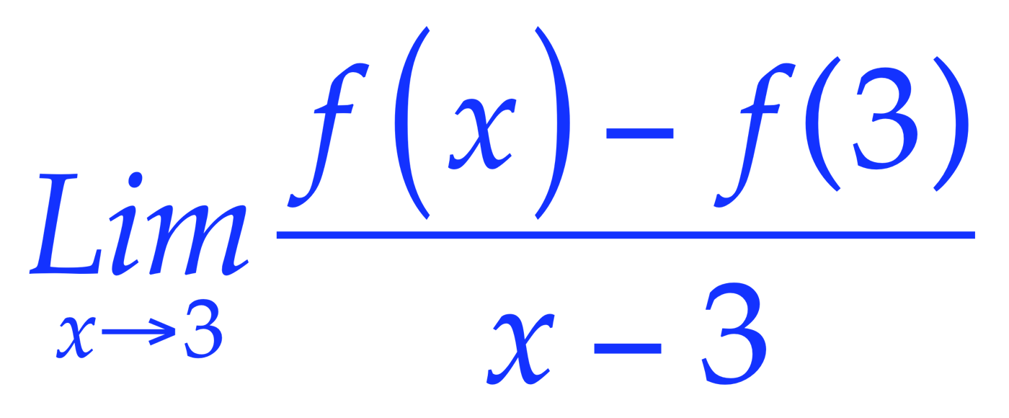
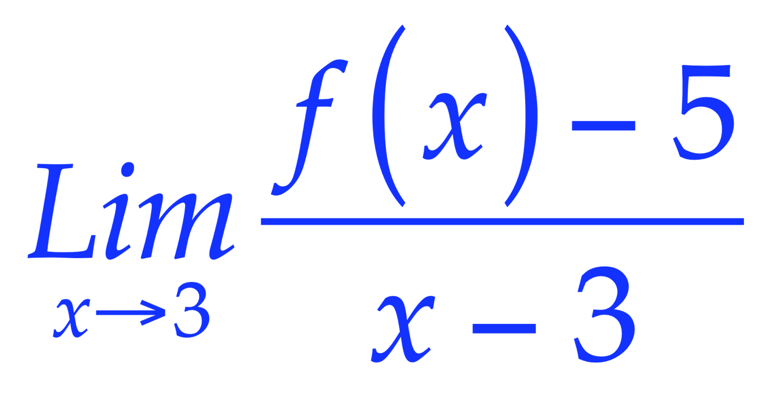
Reversing a Familiar Action
Familiar ‘doing’:
Given f find
Unfamiliar ‘undoing’:
What can be said about f if
= 2
Notes:
f(x) = 2x+1 + h(x)(x-3)^2 for any h(x) with a limit at 3.
f’(3) = 2

Slide 11
Example Construction
Choose and solve an example of a problem that can be resolved by use of (specific procedures from the course) and which shows that you are aware of what can happen when using them.
  Eg. partial fractions where a squared denominator is required
Construct an example of a problem like this (displayed problem) which cannot be solved in the same way (because of some missing condition)
Multiple applications:
  Construct an example of a limit problem which requires three uses of L’Hôpital’s rule;
  Construct an example of an integration problem which requires three uses of integration by parts to resolve.
Here is an example of a … (some course concept). In what ways can this example be modified, extended, generalised so as to remain an example of the same concept? In what ways might it be altered so as no longer to be an example?
What theorem(s) from the course does this mathematical object illustrate or exemplify? What can be varied in the example so that it remains an example? So that it ceases to be an example?

Slide 12
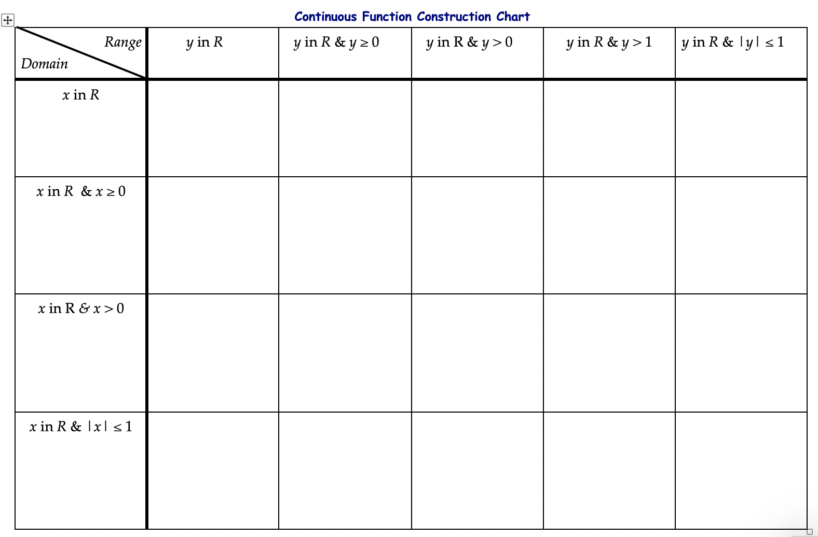
Property Chart: Domain & Range

Slide 13
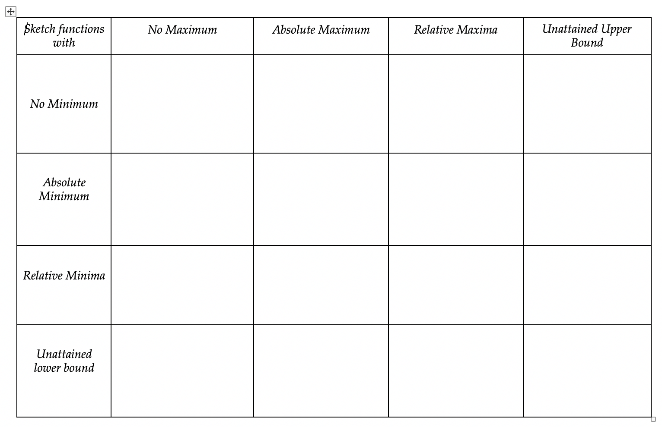
Property Chart: Extrema

Slide 14
Proof
Here is a purported proof of Theorem X. Insert the missing parts (gaps clearly indicated!).
Why is it necessary in line xx to show that …?
What justification can be given for the assertion in line yy
  (See Bickerton & Sangwin arXiv:2006.01581)
What is the same and what different about the proofs of theorem X and theorem Y?
Where in the proof is the fact that … used?
Construct an example for which the proof fails, and state why it fails in that case.

Slide 15
Tweaking
Physical Presence Question
Possible Tweaks for Online Open Book Assessment
What is missing or inappropriate in the following versions of Newton’s three laws?
(Randomised versions with mis-statements)
State Newton’s three laws of motion. [5]
For each of the following situations, state which of Newton’s three laws are acting or need to be assumed in order to make mathematical deductions:
Newton’s Cradle
For a light extensible string, it is assumed that the tension is the same everywhere in the string.
For a three-legged coffee table …

Slide 16
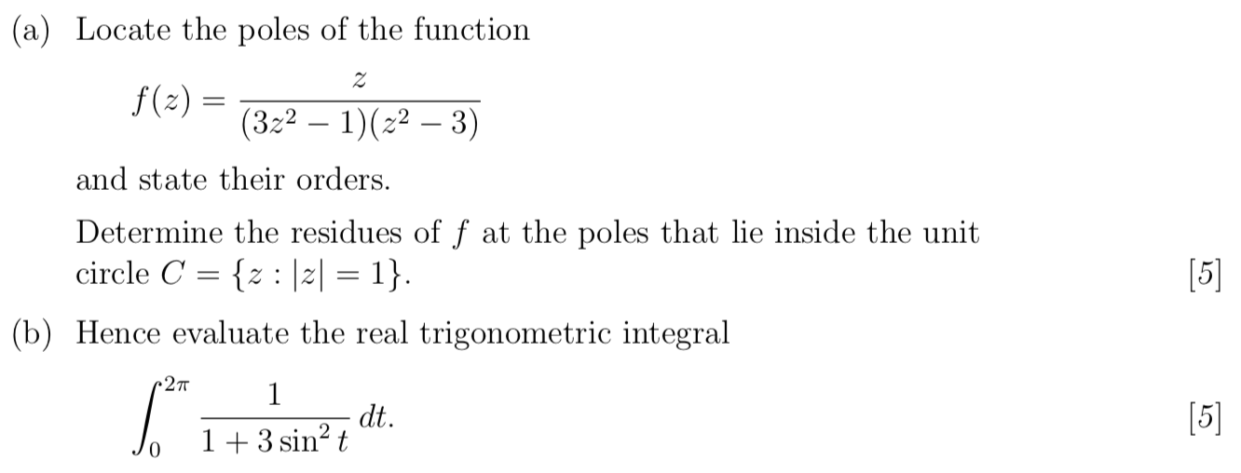
Calculations
What role do the 3’s play in finding the poles of f(z)?
Must the two 3’s be the same in order to achieve a similar result?
(why or why not?)
What role does the 3 play in evaluating the integral?
What number might the 3 be changed to in order to require a different method?

Slide 17
Validity
A major concern by administrators and colleagues is that the work may not be that of the named student. Assessment online is open to abuse because students my seek assistance elsewhere.
1) Require students to sign an honesty agreement
2) Limit the time for working on the assessment to a few hours (8? 12?) so that there is little chance of someone getting a response if they do ask for help. Make the time long enough for students to fit in with their own caring responsibilities.
3) Stress to students that the only person they harm is themselves if they seek outside assistance, because they will surely stumble in the next course.
4) Provide students with a protocol to use if another student approaches them for assistance. It could permit tutorial-type supportive questions but not answers.

Slide 18
Reflection
What has struck you particularly during this session?
Please post a note in the chat while the session continues
After the session, please send
observations, comments and questions to
  John.Mason@open.ac.uk
Questions will be addressed in follow-up notes to be posted on my website and on TALMO

Slide 19
Follow Up
John.Mason@open.ac.uk
www.PMTheta.com (Promoting Mathematical Thinking)
Mathematics as a Constructive Activity: learners generating examples. Mahwah: Erlbaum (2005)
  Practice of and theory behind learner generated examples.
Mathematics Teaching Practice: a guidebook for university and college lecturers, Horwood Publishing, Chichester. (2002)
  Over 100 tactics for teaching mathematics, based on OpenU experience; many applicable to online teaching.

Slide 20
Quotes
Edinburgh
  Open book makes far less difference to overall results than you might expect. Even if the exam is similar to one that might be given in a closed book format, it will not lead to a huge difference in mark distribution.
  This is because students who have not engaged with the material may not even be able to find the appropriate section of their book or notes explaining a relevant method. It is almost impossible to use a book or other course materials successfully in an examination without properly studying these beforehand.
  A book or notes can help, however, if examinees have forgotten the details of something that they do generally understand well. Observations show that students tend to use materials brought in to examinations relatively little and mainly as a check.
  What about giving the proof and asking examinees some questions on their understanding of it: "At what stage in the proof are we using the fact that the sequence tends to zero?", for example

Slide 21
Quotes
  Ask “Why does the proof of a theorem go wrong for this particular example?”.
  Students create an example that meets certain constraints and show it really is an example. This is hard to set if you have not set this type of question before. E.g., Give an example of a function with singular point x=3. The student answer f(x)=0 is valid and can show that the student really understands the definition. However, some students realise that using the zero function and other trivial examples often gives a suitable answer.
  Similar questions can be written asking for non-examples, i.e., examples which don’t satisfy a certain set of constraints.
Leeds
  http://www.kevinhouston.net/blog/wp-content/uploads/2020/03/philip-walker-math1010-sample.pdf
Edinburgh
  http://www.kevinhouston.net/blog/wp-content/uploads/2020/03/Modifying-closed-book-exams-for-use-as-open-book-exams.pdf

