Slide 1
Numbers of Formats of Numbers
Anne Watson & John Mason
ATM Exeter
Sept 2018

Slide 2
Background Assumptions
So much time is spent on adding in the early years that multiplication comes second in people’s thinking.
Developing multiplicative awarenesses is a vital component of mathematical thinking.
Becoming familiar with the multiplicative structure of numbers can contribute to multiplicative facility and awareness.

Slide 3
Questions Involving Format
How many zeroes are there in 20! = 1x2x3x…x20?
What numbers have the property that multiplying by 5 merely sends the units digit to the front?
How many copies of the digit 7 are used to make all of the numbers from 1 to 100?
  (what about other digits?)
What number less than 1000 has the most divisors?
For any number n, what is the longest possible minimal repeating block for 1/n?
What connections are there between the decimal representation of 1/19 and sums of powers of 2?
  https://thestarman.pcministry.com/math/rec/RepeatDec.htm
  1/49 behaves similarly
These depend on familiarity with structure of numbers and number formats

Slide 4

Opening Thoughts
Imagine the number 15 as a quantity
Imagine counters displaying your imagery
Now use the counters available!
Seeing as

Slide 5
Do Thou Likewise!
Working with two other people, arrange 12 counters in as many ways as possible to reveal multiplicative aspects of the structure of 12.
Were you led to find more ways for 12 than you did for 15?

Slide 6
Formatting 12
Seeing as

Slide 7
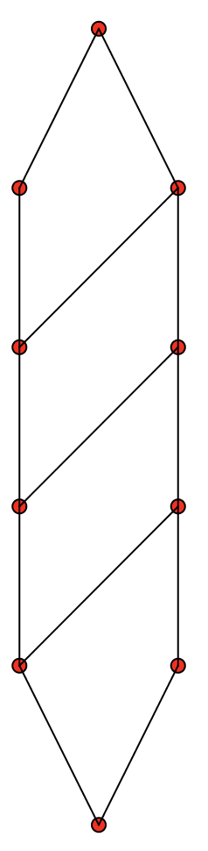
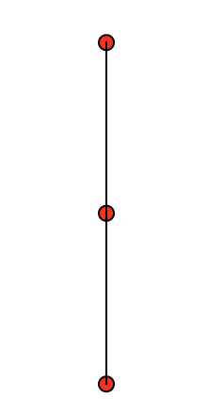
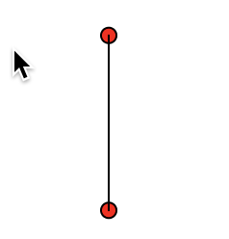
Three Consecutive Numbers
What could they be?
23, 24, 25
47, 48, 49
79, 80, 81
p⁴q – 1 is prime, p⁴q, p⁴q+1 = k²

Slide 8
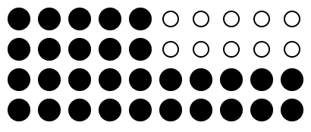
More Formatting of 12
In how many ways can 12 be presented as the difference of two squares?
As the difference of two triangles?
As the difference of two similar rectangles?
Seeing as

Slide 9
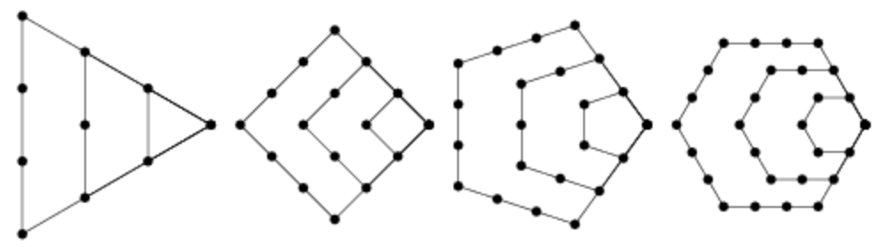
Formatting 12
As the sum of at most two odd numbers?
As the sum of at most 3 triangular numbers?
As the sum of at most 4 squares?
Triangular Numbers: proved by Gauss (not Euler)
Square Numbers: proved by LaGrange not Gauss
Guessed: Fermat, Proved by Jacobi:
any number can be written as
the sum of at most d polygonal-d numbers
Seeing as

Slide 10
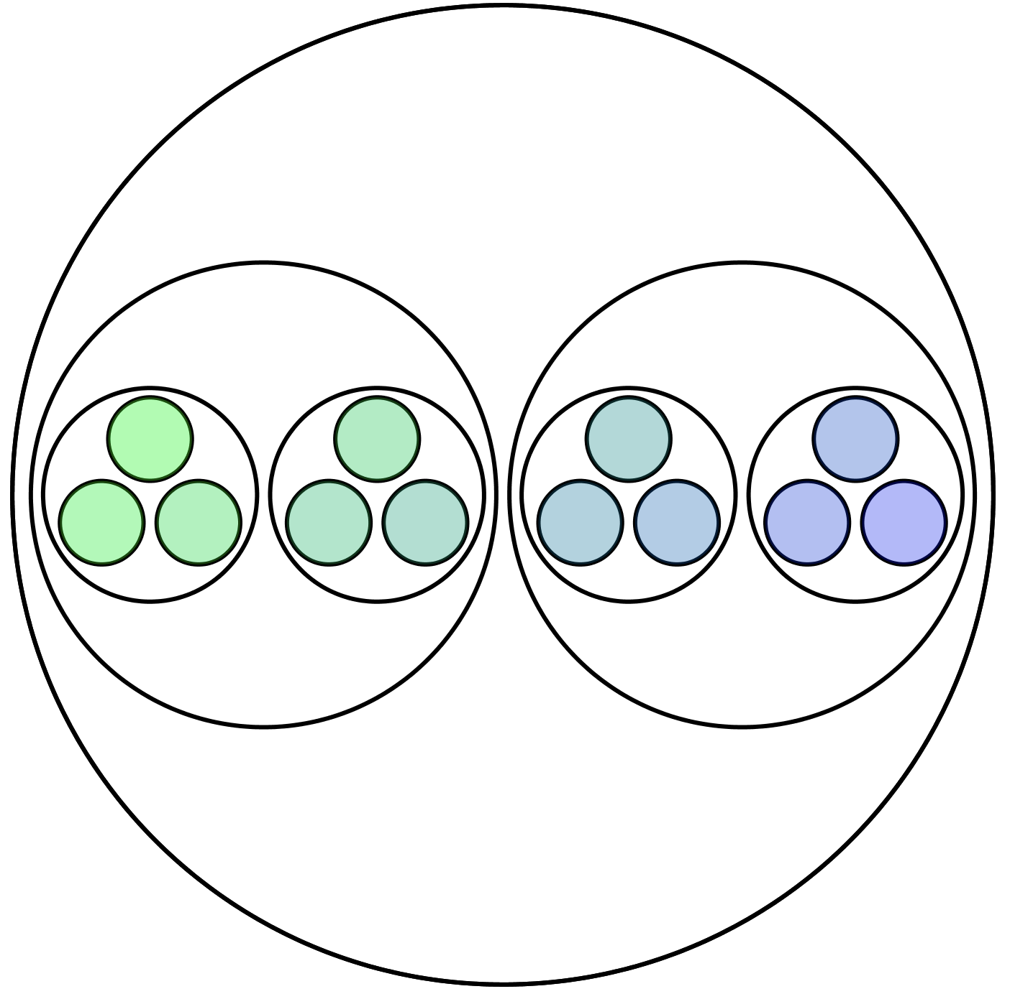
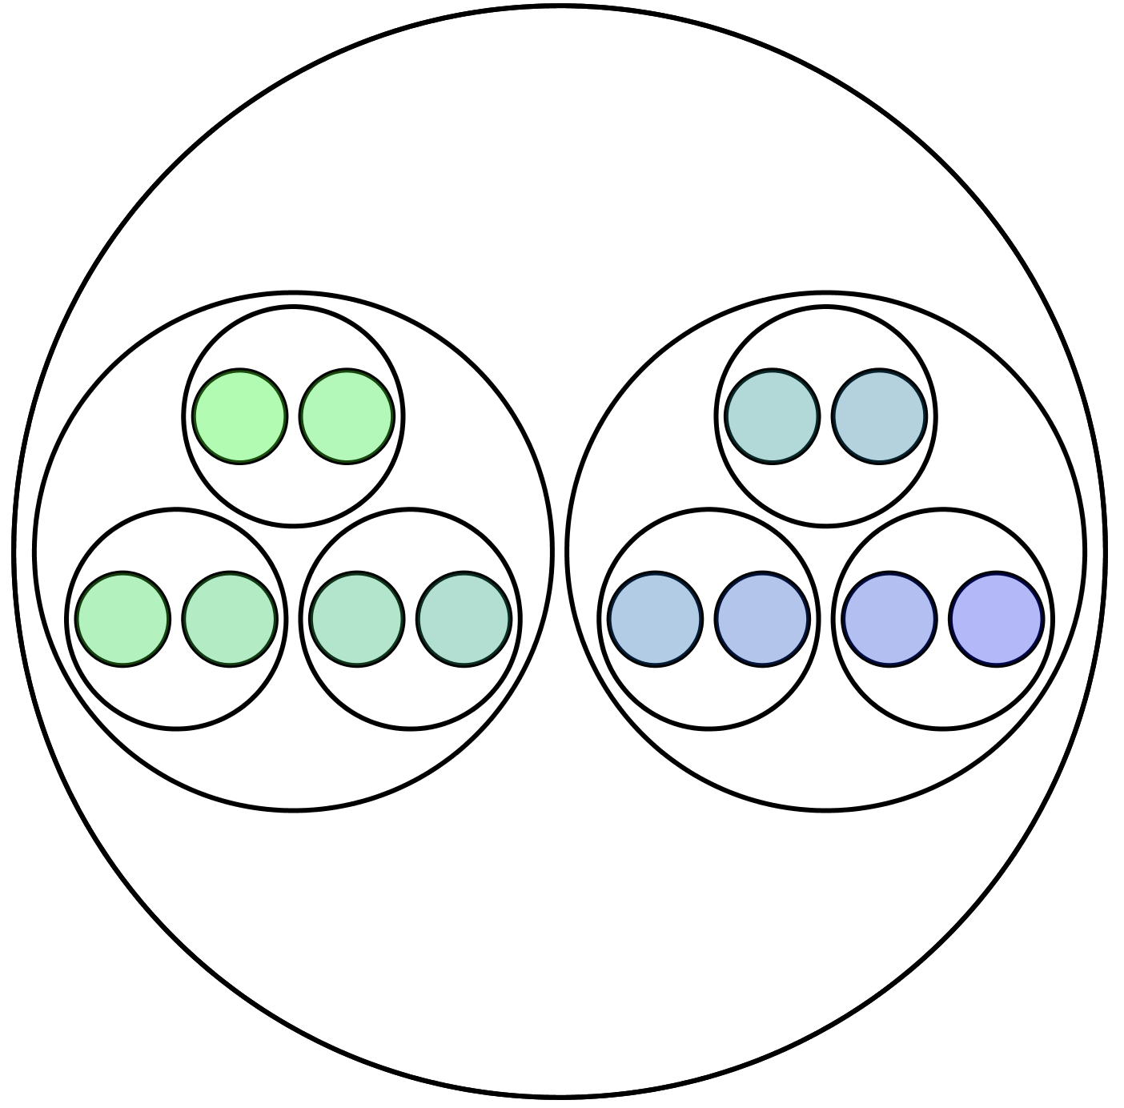
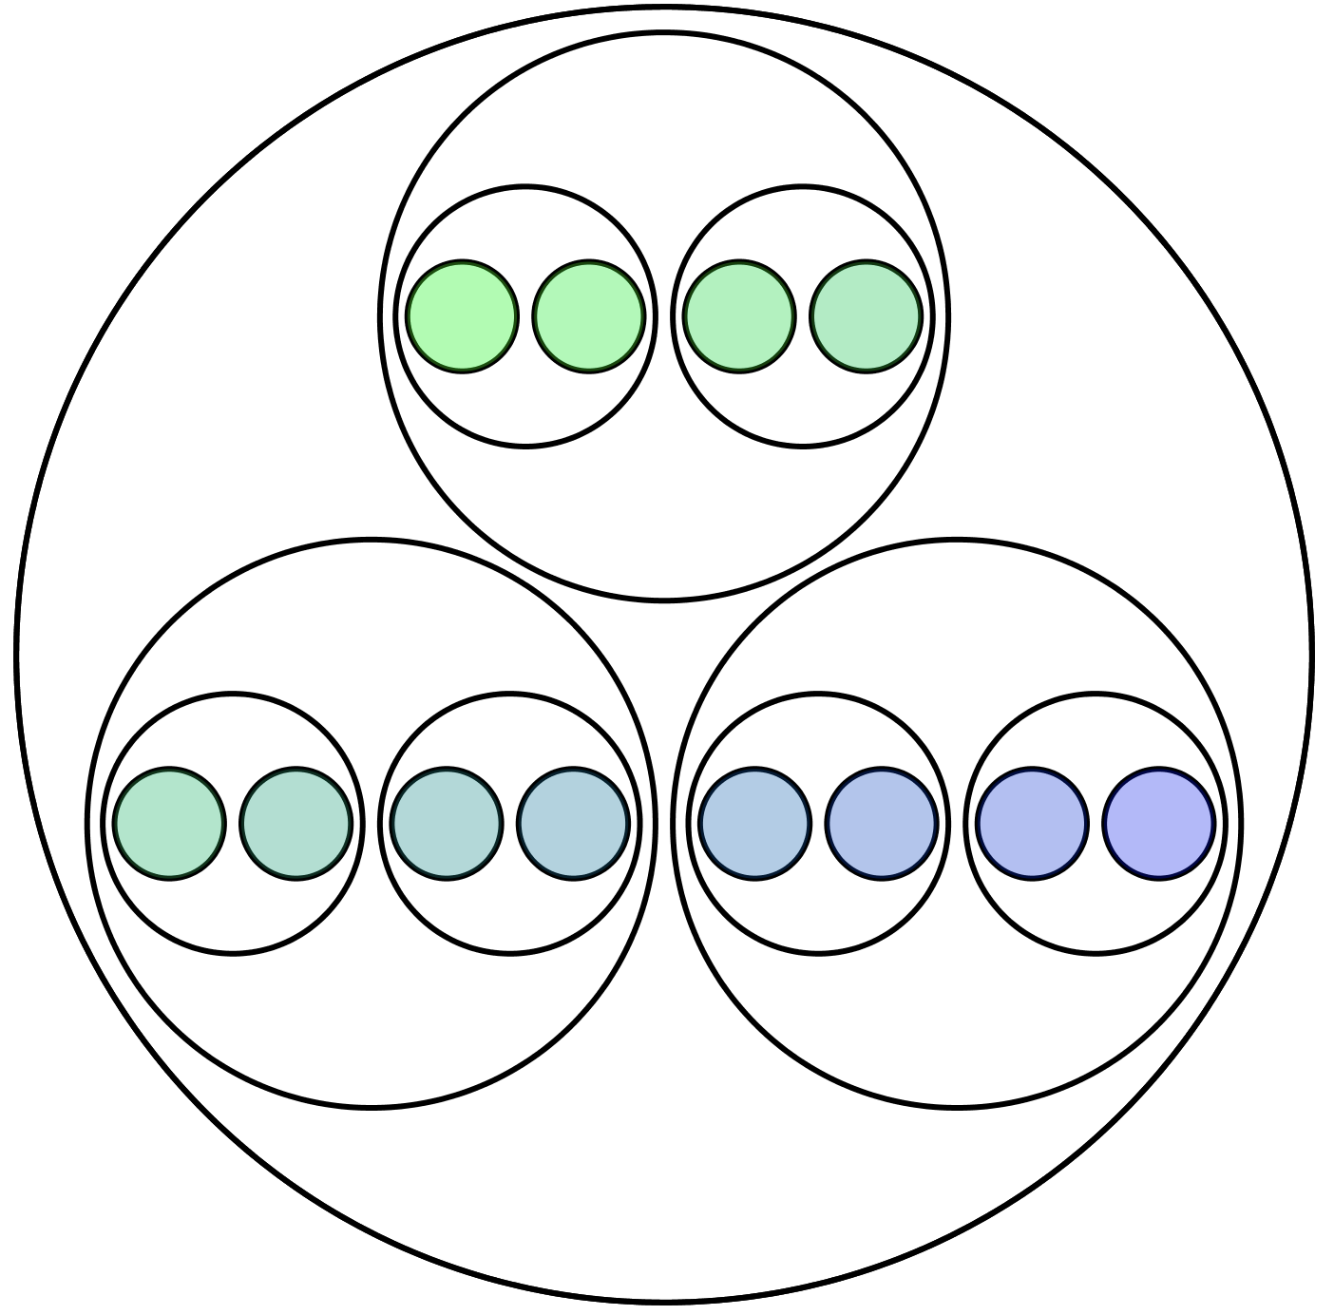
12 as Lots of …
2 lots of 2 lots of 3
2 lots of 3 lots of 2
3 lots of 2 lots of 2
Inspired by Brent Yorgey
and Stephen von Worley
Notes:
Von Worley, S. (2012). www.datapointed.net/2012/10/animated-factorization-diagrams
Yorgey, B. (2012). mathlesstraveled.com/2012/10/05/factorization-diagrams/

Slide 11
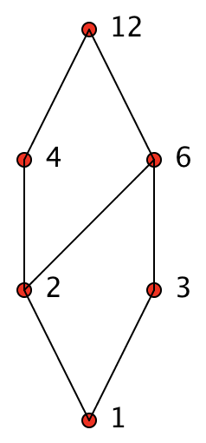
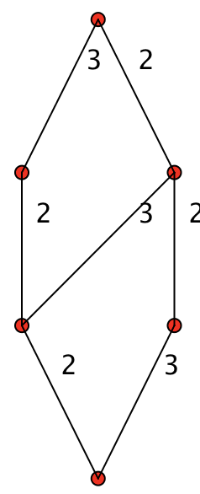
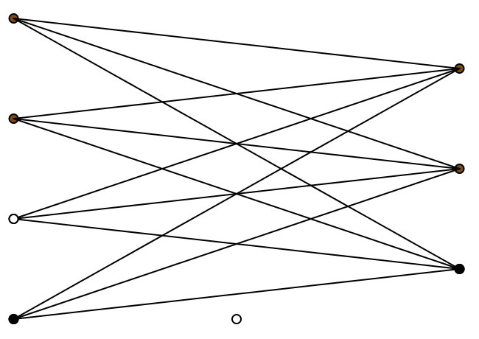
More Multiplicative Structure
Coordinating
“Lots of”
with
paths in the Lattice

Slide 12
Predicting Imaginatively
What would the circles diagrams look like for
24?
36?
17?
…

Slide 13
Pedagogic Choices
Variation of formats
Variation of kinds of mathematical thinking called upon
Who provides what?

Slide 14
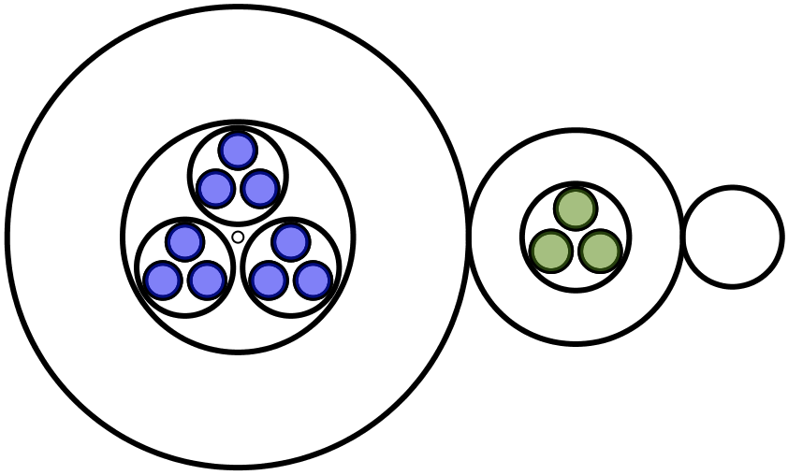
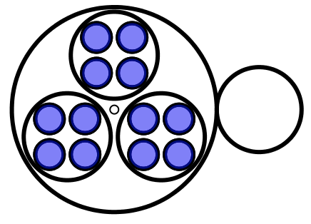
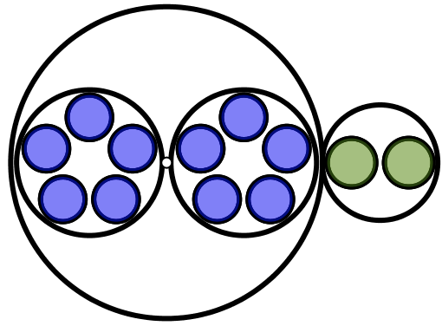
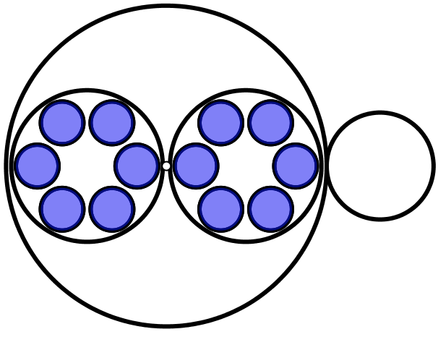
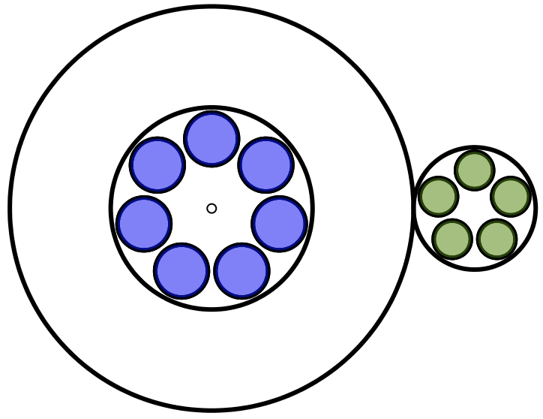
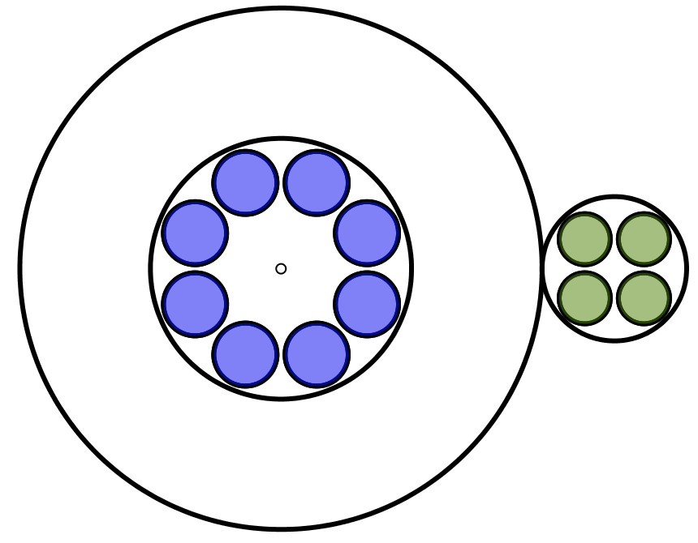
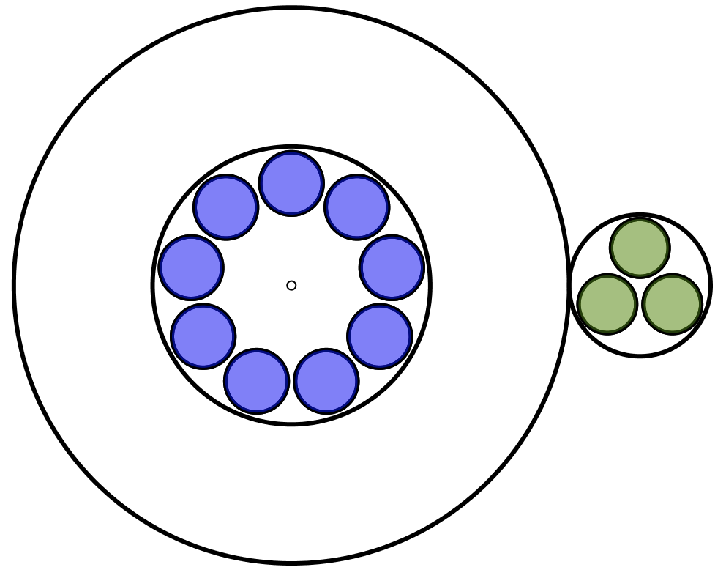
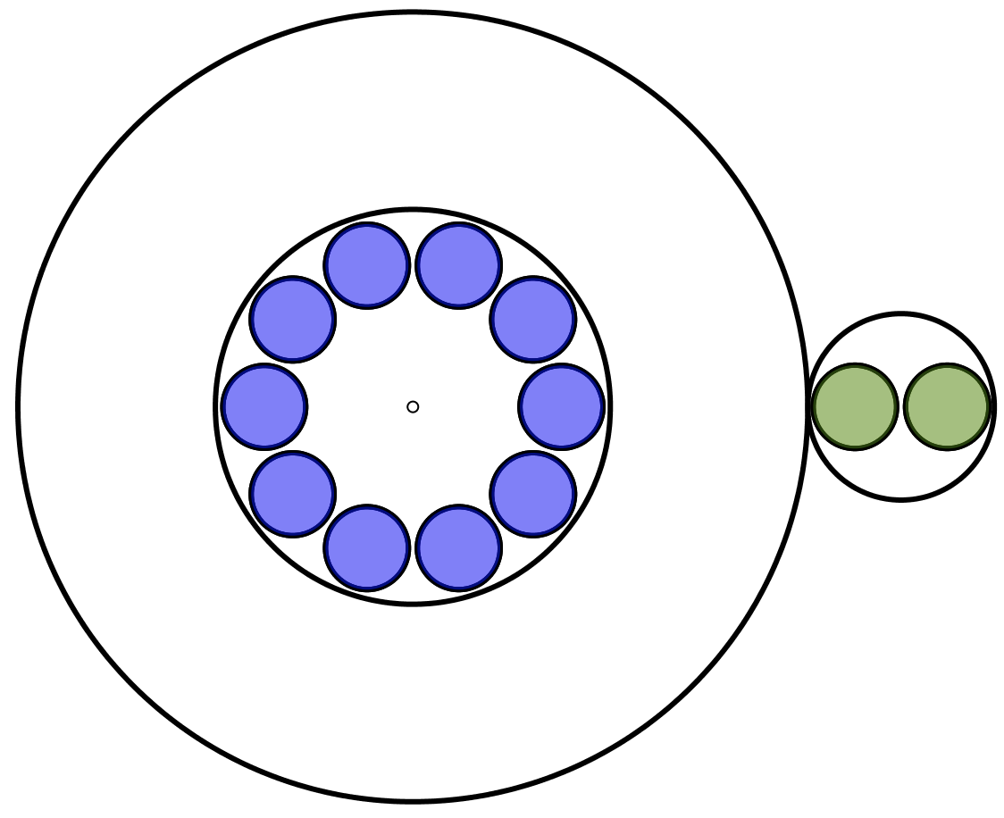
Changing Base
12 = 1x2³ + 1x2² + 0x2¹ + 0x2⁰= 1100₂
12 = 1x3² + 1x3 + 0 = 110₃
12 = 3x4¹ + 0x4⁰ = 30₄
12 = 2x5¹ + 2x5⁰ = 22₅
12 = 2x6¹ + 0x6⁰ = 20₆
12 = 1x7¹ + 5x7⁰ = 15₇
12 = 1x8¹ + 4x8⁰ = 14₈
12 = 1x9¹ + 3x9⁰ = 13₉
12 = 1x10¹ + 2x10⁰ = 12₁₀

Slide 15
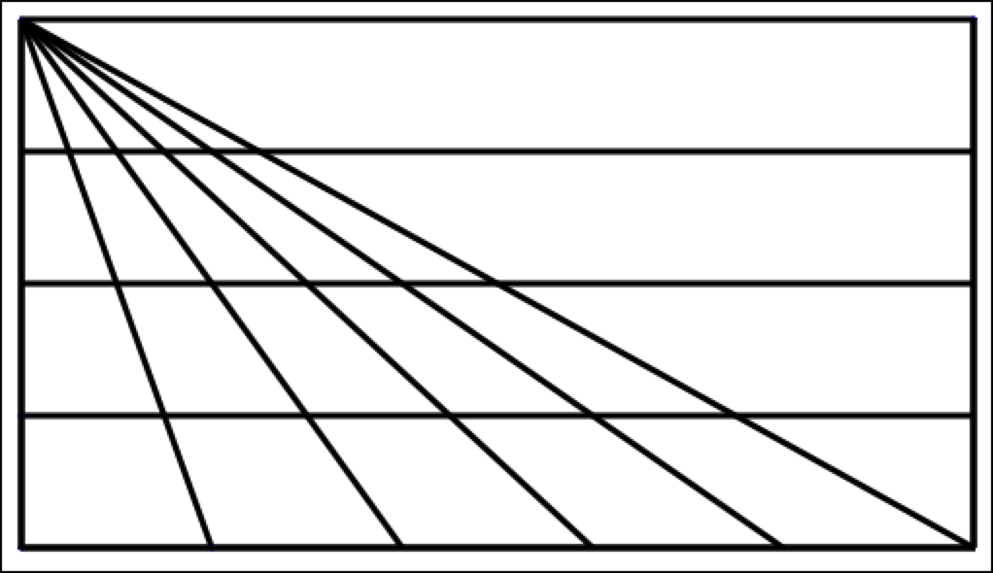
Triangle Count
How many triangles can you find in the diagram?
Generalise!

Slide 16
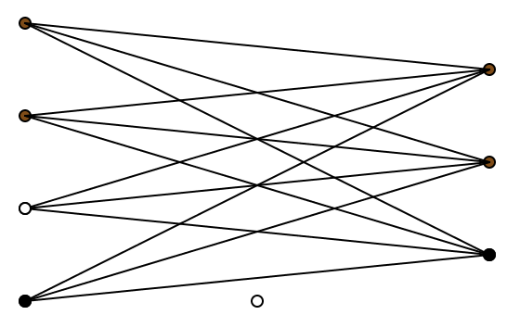
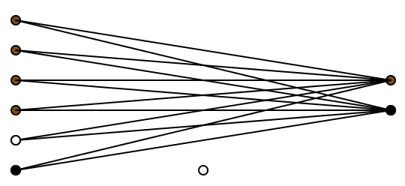
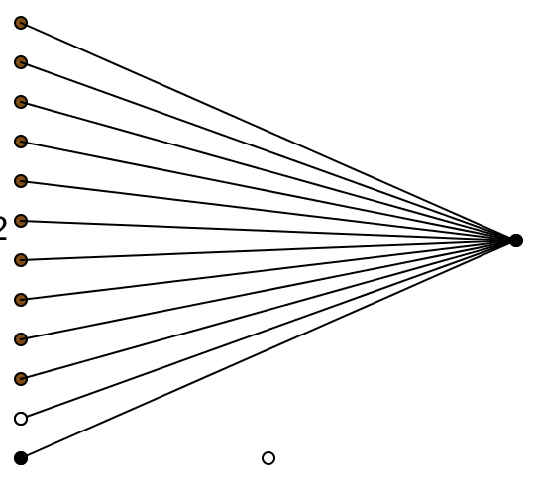
Edge Count
How many edges are there in each graph?
How do you know?

Slide 17
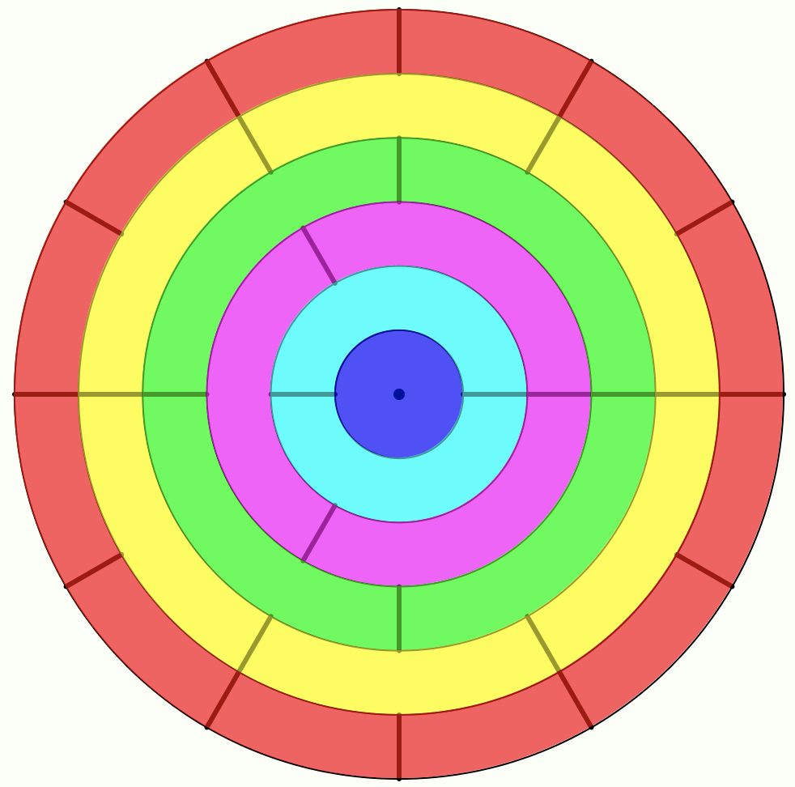
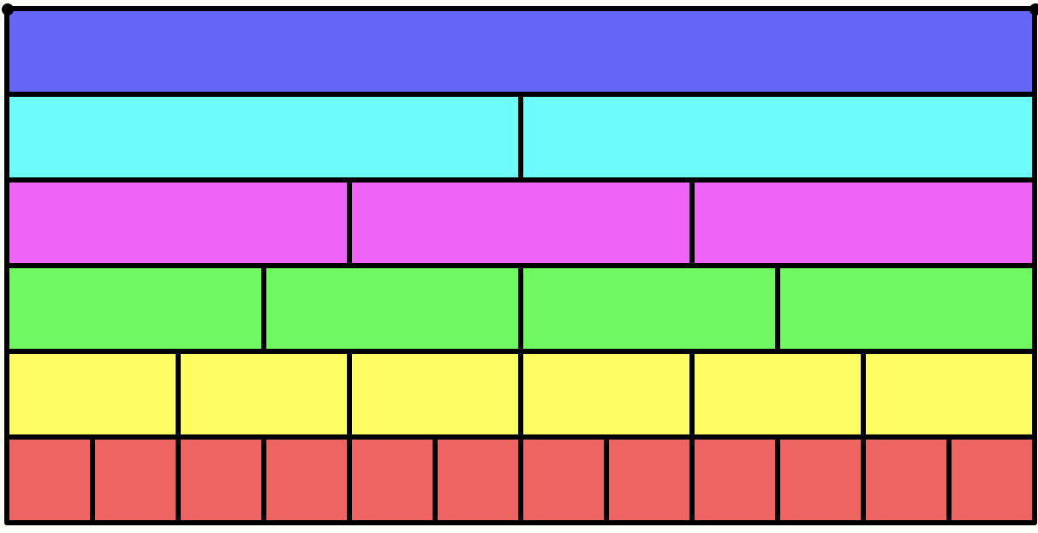
Factor Walls & Factor Disks

Slide 18
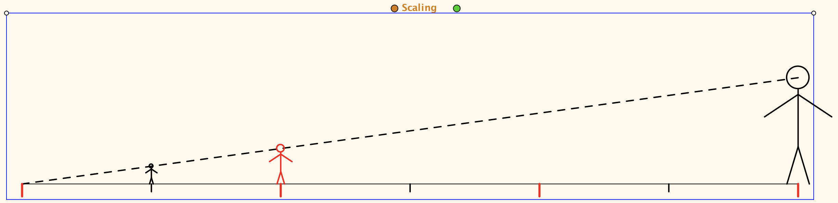
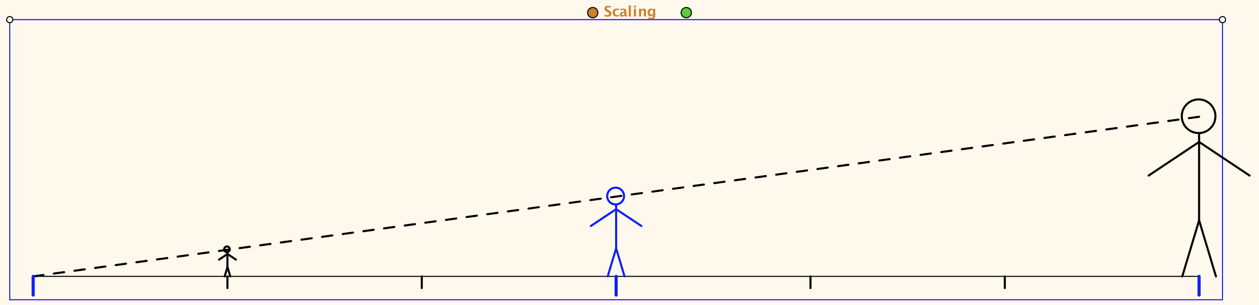
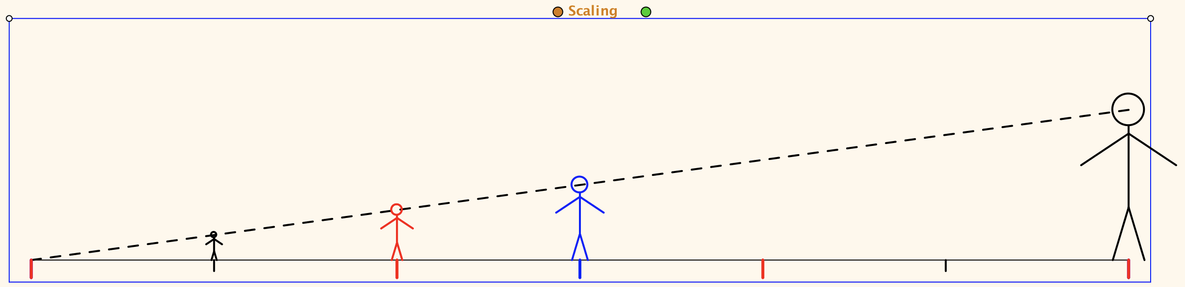
Multiplication as Scaling

Slide 19
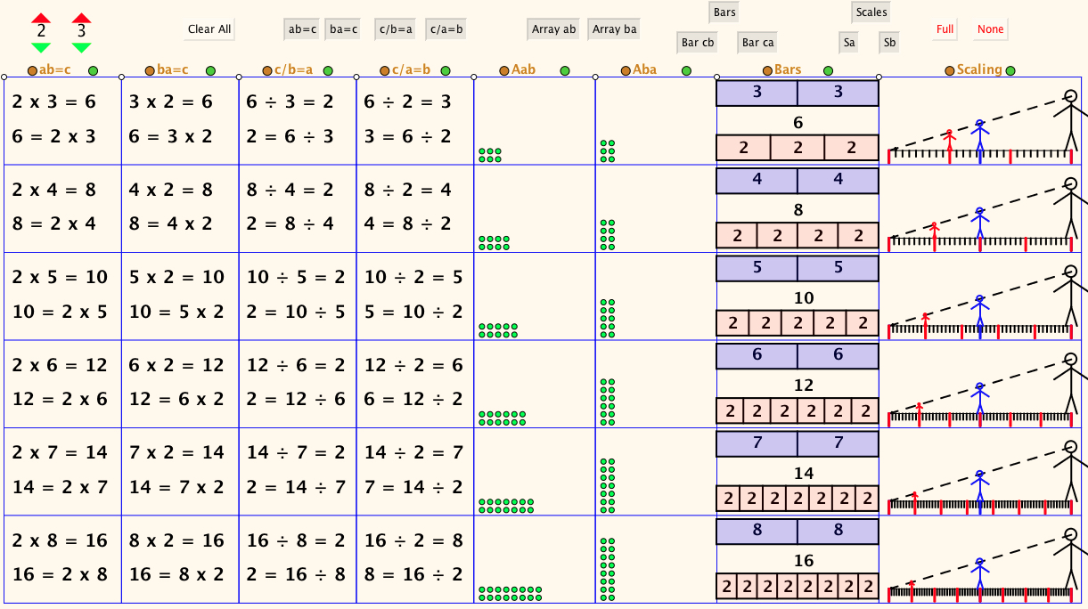
The Drakensberg Grid

Slide 20
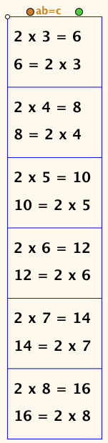
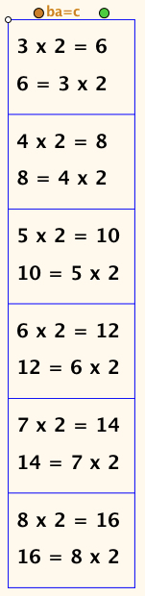
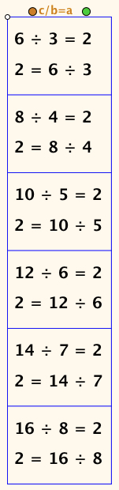
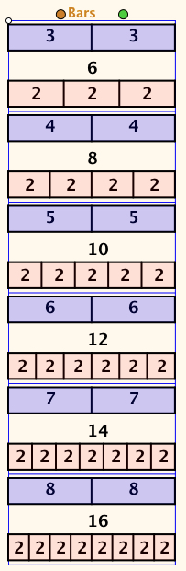
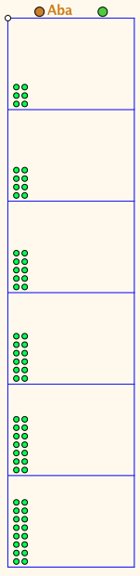
Selected Columns
Notes:
(I) full grid fully filled
(ii) first column fully filled
(iii) first two columns fully filled
(iv) first column, third column and bars fully filled
(v) first column, third column and bars first row only
(vi) all entries in, say, row 5 displayed together
(vii) full grid fully filled

Slide 21
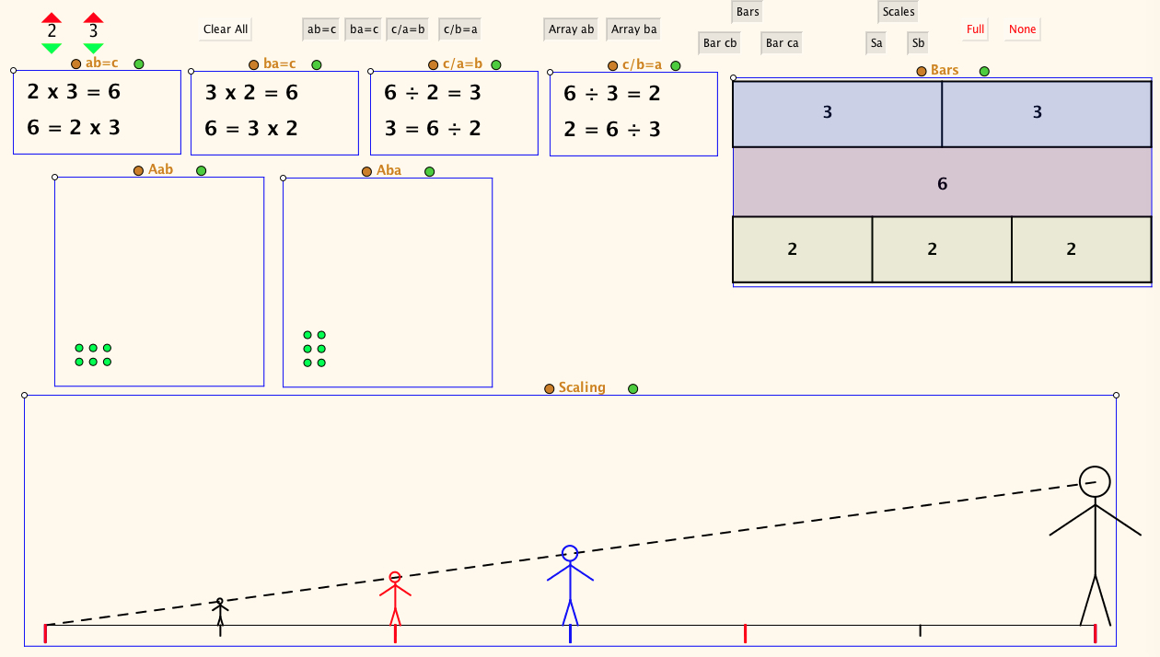
Single row expanded

Slide 22
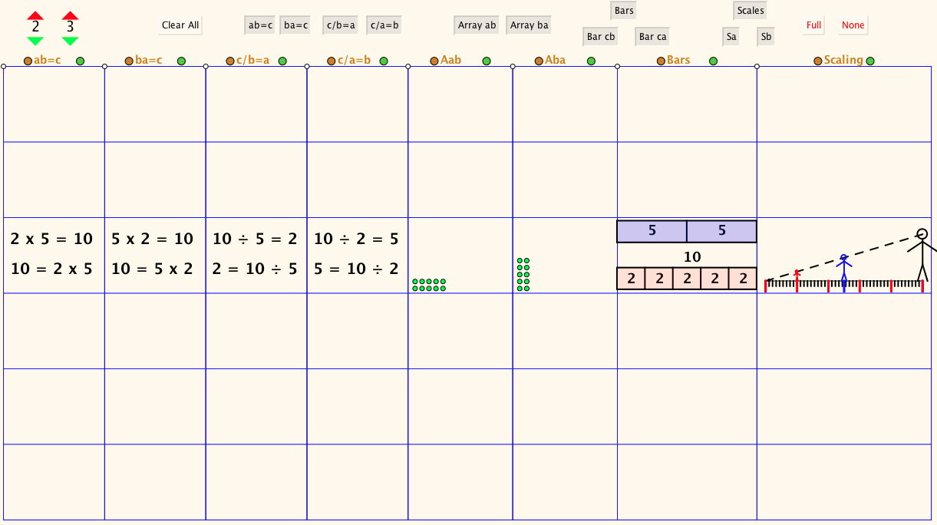
Selected Row

Slide 23
Follow Up
PMTheta (Joint Presentations; JHM/Applets)
Mason, J. , Watson, A. , Venkat, H. & Askew, M. (2018). Multiple Formats for Multiplication. Mathematics Teaching 262 .
AnneWatson1089@gmail.com
John.Mason@open.ac.uk

