Slide 1
Mathematics learning and the structure of elementary mathematics
Anne Watson
ACME/ University of Oxford
Sept 15th 2010

Slide 2
Evidence
Synthesis of research about what children can do in and out of educational contexts
What it means to understand and be able to do mathematics
Key Understandings in Mathematics Learning http://www.nuffieldfoundation.org/mathematics-education-0

Slide 3
Critical areas
Multiplication, ratio, proportionality
Algebra
Risk

Slide 4
An example
£250 at 2% interest, over two years; over 10 years; over 7 years; over 17 years
procedures for percentages
being able to set up a suitable model
ad hoc methods
simplistic assumptions
using technology effectively
understanding multiplication as scaling

Slide 5
Multiplication 1
What is special about 48? 49? 47? (recognition)
Why do we need to know this? (usefulness)
… and 49 x 47 = 48² - 1 (intrigue)
Five rows of cabbages with 10 cabbages in a row = 50 cabbages (application)
How many rows of ten cabbages are needed to get 50 cabbages? (division/inverse)
How many cabbages in a row if five rows have to give us 50 cabbages? (division/inverse)

Slide 6
Multiplication 2
a = bc bc = a
a = cb cb = a
b = a a = b
c c
c = a a = c
b b
Notes:
6

Slide 7
Multiplication, measuring, proportionality

Slide 8
Multiplication 3
Repeated addition
Area
Measuring
Stretching
Enlargement (141% on photocopier)
The importance of understanding. recognising, and representing relations

Slide 9
Algebraic reasoning 1
The expression of relations between quantities and other mathematical objects:
e.g. a(b+c) = ab + ac (always)
a(b+c) = ab (sometimes)

Slide 10
Algebraic reasoning 2
Language for expressing and using relations
i) The height off the ground of a ferris wheel pod
1 km. = 5/8 mile so p km. = 5p/8 miles
(a=>b & b=>c) => (a=>c)

Slide 11
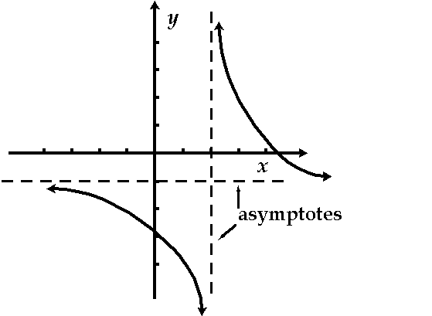
Algebraic reasoning 3
Adaptive tools for solving, representing, predicting and understanding quantitative and other mathematical relations
e.g. d²s/dt = 0
GDP = C + I + G + N

Slide 12
49 + 37 – 49
100000 x 10000
+

Slide 13
29 x 42
x 3 +
x 10
of (
x 2)

Slide 14
Non-computational arithmetic
knowledge of quantities and counting develop separately
additive understanding does not precede multiplicative
three principles relate to success in mathematics: the inverse relation between addition and subtraction; additive composition; one-to-many correspondence
thinking about relations is key to later success
Notes:
14
14

Slide 15
Risk
???
don’t rush
world leaders in a curriculum which includes risk

Slide 16
Growth of understanding
Horizontal slices (e.g. topics, textbooks, tests)
Vertical threads (key ideas, progression between intuitive and formal, formal and intuitive)

Slide 17
Learning mathematics usefully
There are no easy ‘what works’ answers
Teaching and learning maths is not about showing and telling and doing
Biggest (?) individual field in educational research worldwide

Slide 18
Anne Watson ACME University of Oxford anne.watson@education.ox.ac.uk

