Slide 1



Origins and Roots of
Knowing to Act in the Moment
John Mason
via Zoom
March 2022

Slide 2
Actions Becoming Available
How do mathematical actions become available in the moment to be enacted?
How do pedagogical actions become available in the moment (to teachers) to be enacted?
I shall offer you some tasks, through which to investigate these questions
What actions became available to be enacted?
Fringe or Focal Awareness?
What triggered those actions?
John & Annie Seldon
How did you gain facility with those actions?
Actions?
Triggered by?
Facility?
Notes:
Seldon, J. & Seldon, A. (2004) Consciousness In Mathematical Problem Solving: the focus, the fringe, and non-sensory perception. researchgate.net/publication/268576077_Consciousness_in_Mathematical_Problem_Solving_The_Focus_the_Fringe_and_Non-Sensory_Perception

Slide 3
What is 457 + 238 – 257 – 438?
Actions?
Triggered by?
Facility?
Some people start calculating before even reading the whole line
  Doing immediately whatever you can do.
Some people read then start calculating.
Some people recognise the repetition of 57 and 38 and look more closely.
Value in allowing a short space of time
for actions to become available
Form of Gazing,
of Holding a Whole
Choosing between available actions
Construct a simple example like this
that provokes the same actions
Construct a really complicated example like this
that provokes the same actions

Slide 4
Simplify
Actions?
Triggered by?
Facility?
Simplify
Some people start calculating
Some people look for relations in order to avoid effort
Most people look at the numerator first:
  Clustered around 10000 so put 10000 = x
Denominator:
  x² – (x + 1)(x – 1) = 1
Requires confidence
No need to enact
the first action
that becomes available
x(x + 4) – (x + 2)(x – 2) = 4
Construct an even more complicated version using similar ideas

Slide 5
Another Hungarian task
Actions?
Triggered by?
Facility?
Simplify
Need to read carefully, discerning details and recognising relationships
x(2x-1)– (x-1)
(x + 1)(2x + 1) – x
(x-1)(2x-1)+ (x)
x(2x + 1) + (x+1)
2x² - 2x + 1
2x² + 2x + 1
2x² - 2x + 1
2x² + 2x + 1

Slide 6
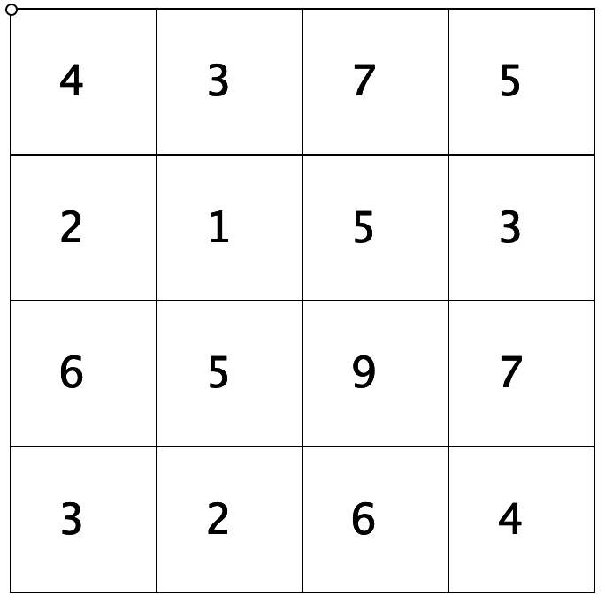
Covered Up Sums
Choose 4 cells, one from each row and from each column
Add them up.
Try another selection

Slide 7
Factor 9x⁴(z – 3)⁶ – 196(y + x)⁸
Actions?
Triggered by?
Facility?
Some people start expanding brackets,
or wilt in the face of such a complicated task
Some people allow a possible action to become available …
a lot depends on 196 being recognised as or tested for being a square!
Construct a sequence of difference of two squares tasks that exploit different ways to ‘bury the bone’
(make it hard to spot the difference of two squares)
Constructing for yourself prepares you to recognise a possible action (triggers it)

Slide 8
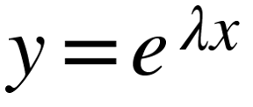
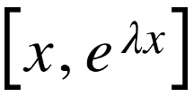
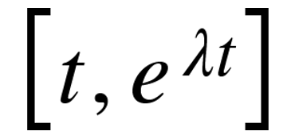
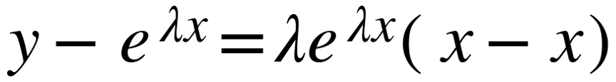
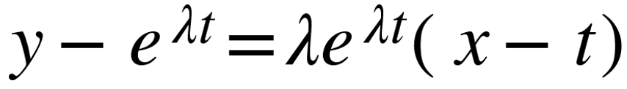
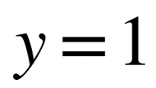
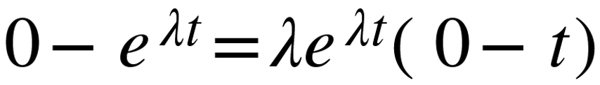

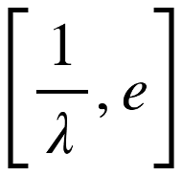
Tangents through the origin
Actions?
Triggered by?
Facility?
What is the locus of points at which
the curves have their tangent
pass through the origin?
Very easy to ‘abuse’ notation!
Point on curve:
Tangent:
Pass through origin condition:
All because of an initial inappropriate action
???
Point:
Locus:
Line parallel to x-axis at height e
Reflection (personal narrative; what can I take forward)
How do you know what to do at each stage?
Think: scaling of x-axis!
What variations can you think of?

Slide 9
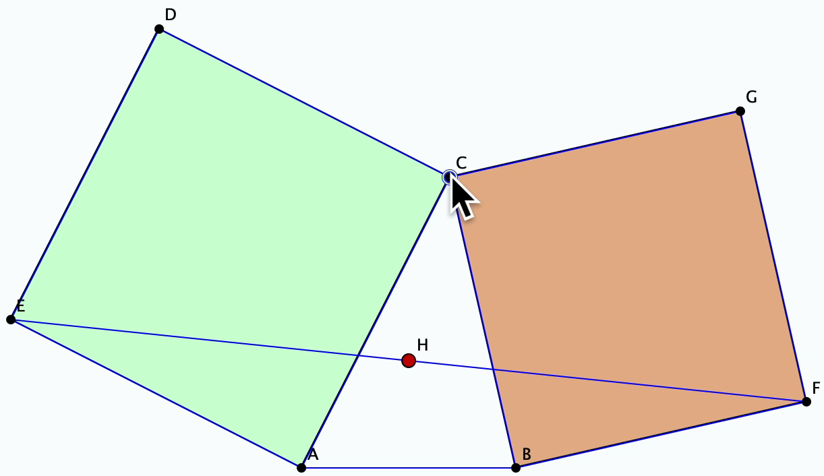
Bottema’s Theorem

Slide 10
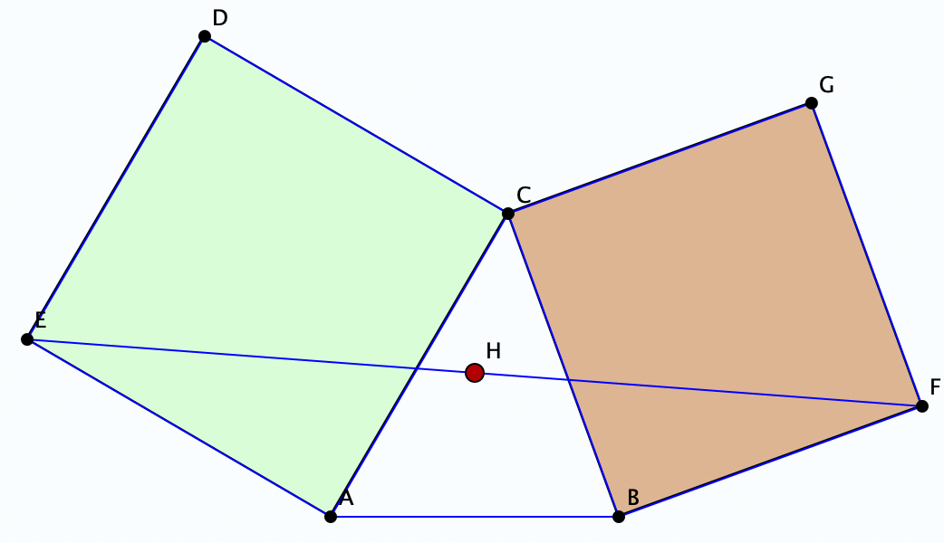
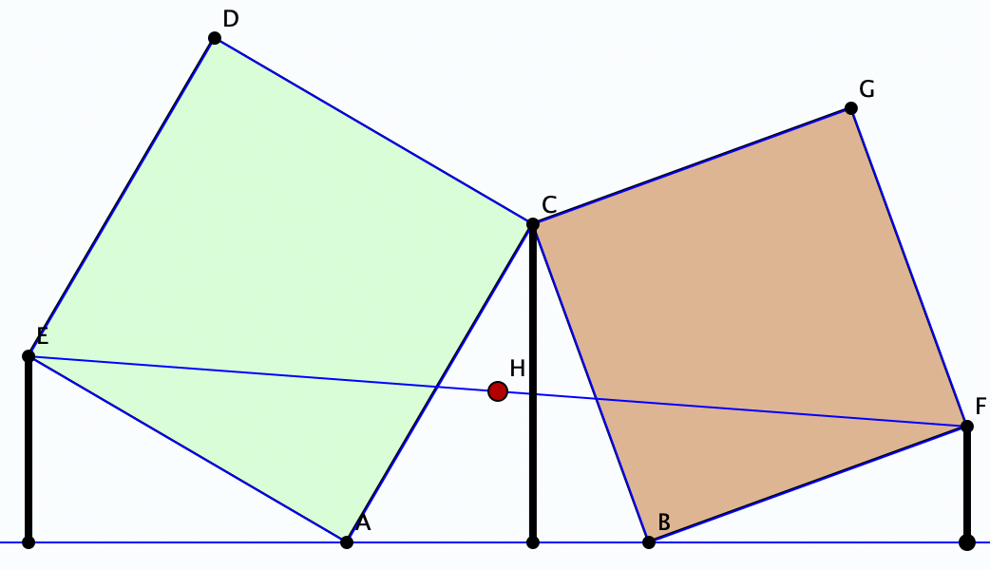
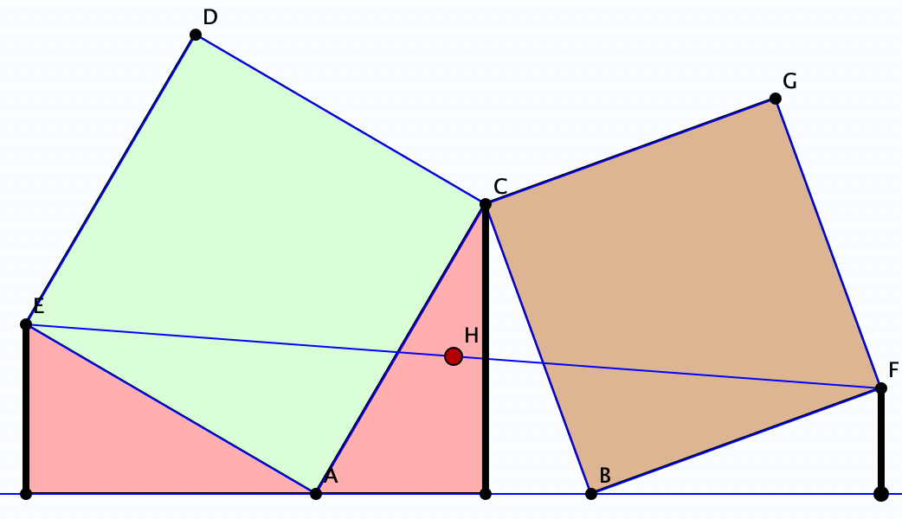
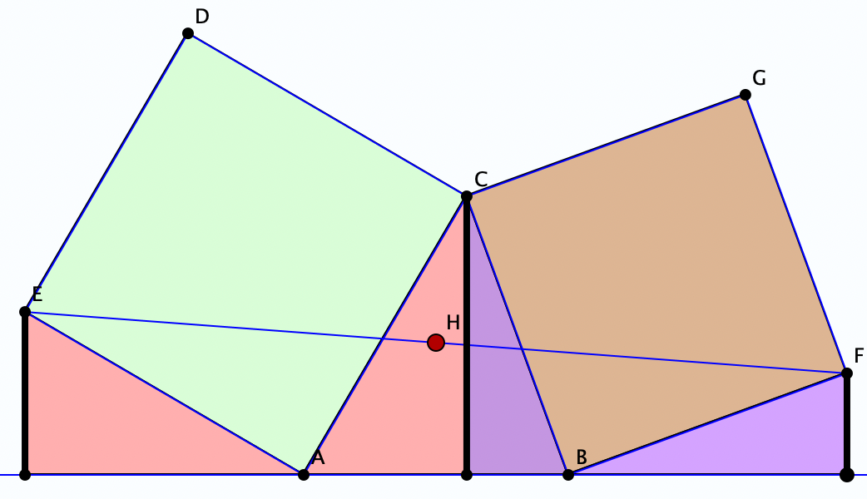
What Makes the Theorem Work?
Actions?
Triggered by?
Facility?
Telling your ‘story’; Feeling of correctness
How does one know to ‘drop perpendiculars’?
How does one (know to) seek relationships?

Slide 11
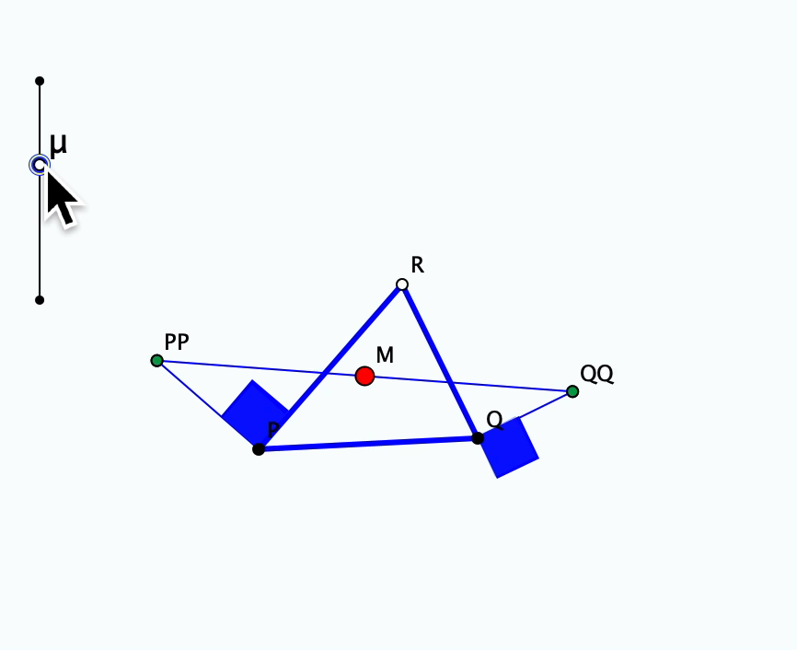
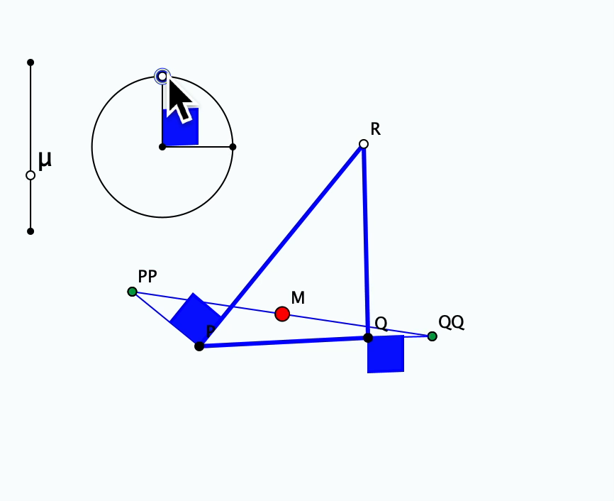
What Really Makes the Theorem Work?
What have the squares
to do with it?
If not the scale,
what about the angle?
How does one know to vary the squares by a scale factor, and to vary the angle?

Slide 12
Closure
Consider the set of numbers which can be expressed as a² + 5b².
Show that the product of any two is of the same form.
What is special about 5?
What about numbers of the form 3a² + 5b² ?
Actions?
Triggered by?
Facility?
How does one know to vary the 5?
How does on know when to seek counter-examples?

Slide 13
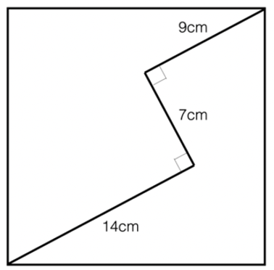

ZigZag
Actions?
Triggered by?
Facility?
What is the size of the square?
Diving in with …
trig (insert angle labels)?
diagonal?
extend lines?
23² + 7² = 2 x 17²
What similar tasks
can you now resolve?
Parametrise
Ola Helenius

Slide 14
Being Rational about Irrationals
Articulate how the following decimal numbers
would be continued indefinitely
  0.101001000100001…
  0.102003000400005…80000000090000000010…
  0.1234567891011121314…
Why must these be irrational?
Make up your own irrational using these ideas
  Justify your claim that it is irrational
Actions?
Triggered by?
Facility?

Slide 15
Deciding between Rationals and Irrationals
Write down a decimal ‘point’ followed by the numbers from 1 to 9 in sequence.
Now follow those by the ‘digits’ (10), (11), … and imagine continuing forever.
0.123456789(10)(11)(12)…
0.123456789
10
11
12
…
0.12345679012…
Now re-write as an ordinary decimal.
Is the result rational or irrational?
Actions?
Triggered by?
Facility?

Slide 16
Reflections
Facts & Procedures
  Knowing That and Knowing How,
  Knowing When and Knowing Why,
  Knowing To (in the moment)
All knowing is conditional …
  … on the situation and the psycho-social state of the individual and group

Slide 17
Further Reflections
Intentionally
  Seeking and Recognising Relationships
  This may involve gazing; discerning details as fodder;
  Perceiving relationships as (potential) instances of properties
Promoting Knowing-to-Act in the moment:
  Constructing variations for oneself
  (enriching one’s personal example space);
  applies to concepts, procedures, exercises
  (“bury the bone”; variation principle)
  Reflecting on
    What was effective,
    What not so effective
    learning to specialise & generalise;
    be systematic sometimes;
    developing a conjecturing-ethos;

Slide 18
Calling Upon the Whole Psyche
Training Behaviour
  Developing facility, through intelligent practice
Educating Awareness
  Linking actions and effects of actions
Harnessing Emotion
  Surprise; pleasure of generalisation
  Pleasure of connection and sense making
Developing an Inner Witness
Enriching Attention
Activating Will
  Making choices; initiating actions

Slide 19
Further Reflections
Why do Teachers offer learners tasks?
Why do mathematics educators offer teachers tasks?
Why have I offered you tasks?
Opportunities to encounter,
and to experience,
significant concepts and actions
Opportunities to reflect on
and learn from that experience
Involve the whole psyche, invoke creativity and involvement;
so generate
  pleasure, even amazement (perhaps at the power or scope of the example space?) [harnessing emotions]
  facility [training behaviour]
  educating awareness [sense of context]
  personal narrative construction

Slide 20
What Makes a Pedagogic Action Become Available?
The teacher is attending to the task:
  With a sense of pedagogic potential:
  why this task;
  what might learners encounter?
  What are learners attending to?
  What do they need to attend to in order to make progress?
  How do they need to be attending?
  Holding a Whole (Gazing)
  Discerning Details
  Recognising Relationships
  Perceiving Properties (as being instantiated)
  Reasoning on the basis of agreed properties
Pedagogic actions come to mind as a result of pro-flecting from past experiences of success

Slide 21
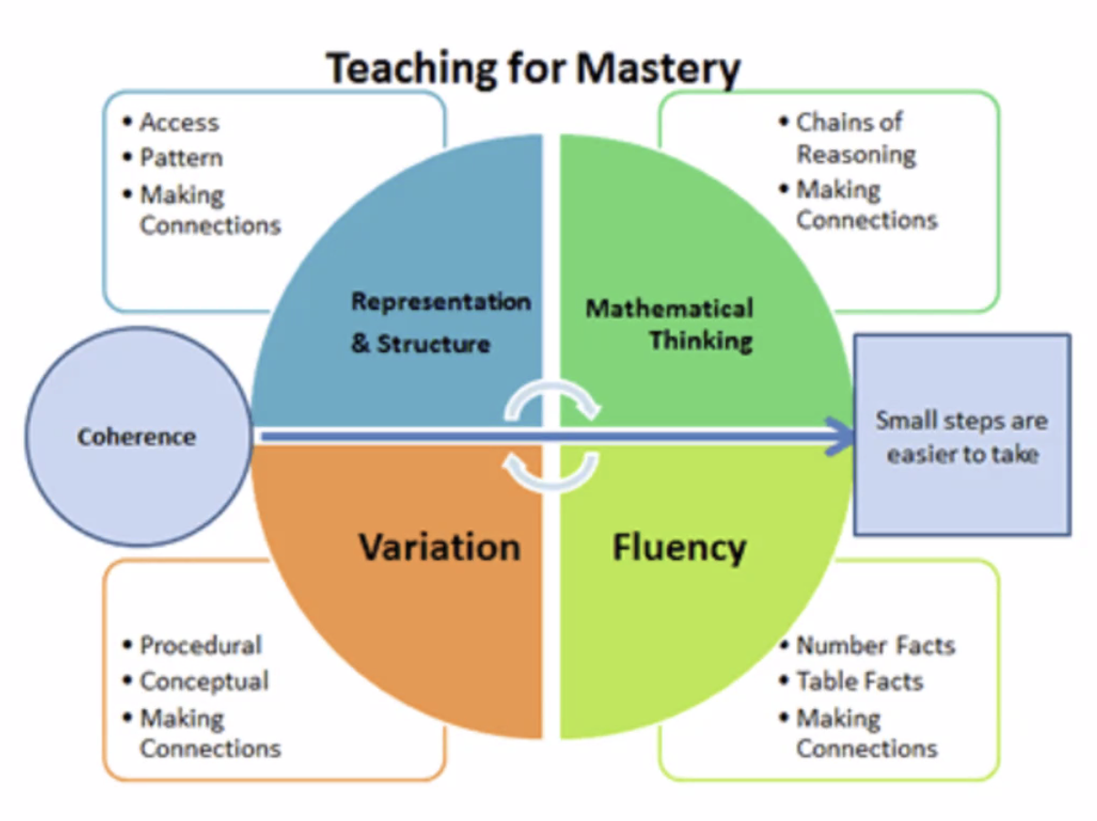
Connections?

Slide 22
Follow-Up
John.Mason@open.ac.uk
PMTheta.com
Mathematics as a Creative Enterprise (Watson & Mason)
Seldon, J. & Seldon, A. (2004) Consciousness In Mathematical Problem Solving: the focus, the fringe, and non-sensory perception. researchgate.net/publication/268576077_Consciousness_in_Mathematical_Problem_Solving_The_Focus_the_Fringe_and_Non-Sensory_Perception
Fundamental Constructs in Mathematics Education (Routledge)

