Slide 1
Mathematical (& Pedagogical) Literacy
Promoting Mathematical Thinking
John Mason
NAMA March 14 2017
The Open University
Maths Dept
University of Oxford
Dept of Education

Slide 2
Conjectures
Everything said here today is a conjecture … to be tested in your experience
The best way to sensitise yourself to learners …
… is to experience parallel phenomena yourself
So, what you get from this session is what you notice happening inside you!

Slide 3
Outline
Need for technical terms
Contexts for work on technical terms
Reasoning with terms

Slide 4
Return of the Narrative
Reconstructing for oneself
Solo – Group – Solo
Expressing for oneself
Communicating with oneself and with others
Notes:
Called self-explanations in the literature

Slide 5
Recognising Shapes

Slide 6
Recognising Shapes

Slide 7
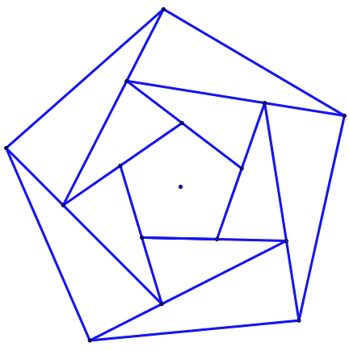
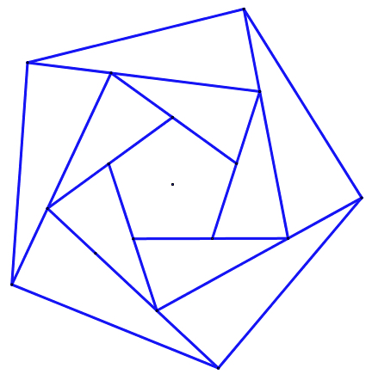
Expressing What is Seen
Sketch what you saw How would you extend it?
What is the same and what different about the two diagrams?
Notes:
Expectations based on partial information

Slide 8
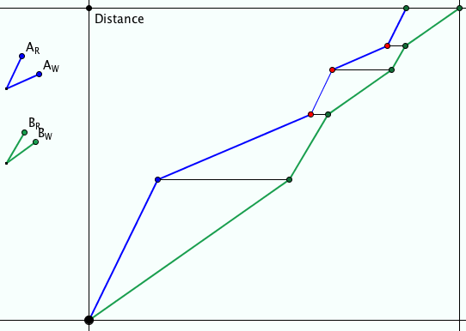
Ride & Tie
Two people have but one horse for a journey. One rides while the other walks. The first then ties the horse and walks on. The second takes over riding the horse …
They want to arrive together at their destination.
Imagine it happening
Imagine this happening

Slide 9
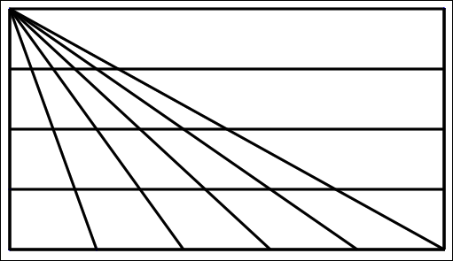
Triangle Count
In how many different ways might you count the triangles?
(5 + 4 + 3 + 2 + 1) x 4 + 1
What are you attending to?
Notes:
15 x 4 + 1

Slide 10
Find My Number
I am thinking of a number on a number line …
What sorts of yes/no questions might you ask me in order to determine what it is?
What are similarities and differences in reasoning called upon by different questions?

Slide 11
Limited Questions
Only ask
“to the left of” or “to the right of”
“is greater than” or “is less than”
“is farther from … than from ...” or “is closer to ... than to ...”
“is ... more than a multiple of ...” or “is ... Less than a multiple of ...|
Choose the domain
Positive whole numbers
Integers
Fractions
Decimals

Slide 12
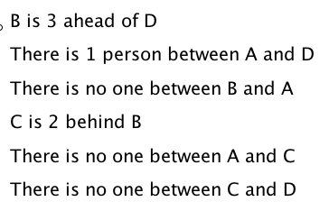
Queuing
B
A
C
D

Slide 13
Absolute Value
Imagine a Number Line
-10
-9
-8
-7
-6
-5
-4
-3
-2
-1
0
1
2
3
4
5
6
7
8
9
10
Imagine the point 6 marked in blue
Imagine the point -7 marked in yellow
Which number is larger?
Which number is farther from the origin?
The absolute value of a number is its distance to the origin

Slide 14
Absolute Value Relationships
-10
-9
-8
-7
-6
-5
-4
-3
-2
-1
0
1
2
3
4
5
6
7
8
9
10
Describe all the points p for which |p| ≤ 3
Describe all the points q for which |q – 5| ≤ 3
Describe all the points r for which |r – 2| ≤ 3
I have a number n which has the property that |n| + |2 – n| = 2
Where could my n be?
Make up another question like this for yourself!

Slide 15
Floors & Ceilings
The floor of a number is the largest integer less that or equal to that number
Construct three numbers whose floor is 5
Construct three numbers whose floor is -6

Slide 16
Reading Symbols
Constructing a Polynomial
Let and be fixed distinct real numbers. Show that the following pairs of expressions are identical without multiplying everything out

Slide 17
Symbol Reading
Without multiplying out and simplifying, what is
Chris Maslanka 18/02/17

Slide 18
Symbol Reading
?
?
LHS =
LHS =
terms
LHS =
=

Slide 19
Sub-Sequences
A number N such as 315246 has as its subsequences any number whose digits are obtained by deleting some (or no) digits of N.
For example 124 but not 25
We write to mean that n can be obtained from m by deleting some (or no) digits from m.
Given a set S of positive numbers, find the smallest set M(S) of numbers in S such that for all s in S there exists m in M such that .
Math Gazette 101 (550) March 2017 p60

Slide 20
Mathematical Narratives

Slide 21
Pedagogic ‘Literacy’
Labels for pedagogic actions developed
In a school
In a teacher education institution
In a wider CPD community
Mathemapedia
Discourse/Lexicon for discussing and justifying actions taken or not taken

Slide 22
Powers & Themes
Are students being encouraged to use their own powers?
Powers
or are their powers being usurped by textbook, worksheets and … ?
Imagining & Expressing
Specialising & Generalising
Conjecturing & Convincing
(Re)-Presenting in different modes
Organising & Characterising
Themes
Doing & Undoing
Invariance in the midst of change
Freedom & Constraint
Restricting & Extending
Exchanging

Slide 23
Mathematical Thinking
How might you describe the mathematical thinking you have done so far today?
How could you incorporate that into students’ learning?
What have you been attending to:
Results?
Actions?
Effectiveness of actions?
Where effective actions came from or how they arose?
What you could make use of in the future?

Slide 24
Reflection as Self-Explanation
What struck you during this session?
What for you were the main points (cognition)?
What were the dominant emotions evoked? (affect)?
What actions might you want to pursue further? (Awareness)
Notes:
Chi et al

Slide 25
Inner & Outer Aspects
Outer
What task actually initiates explicitly
Inner
What mathematical concepts underpinned
What mathematical themes encountered
What mathematical powers invoked
What personal propensities brought to awareness

Slide 26
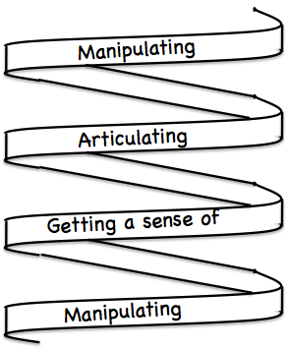
Frameworks
Enactive – Iconic – Symbolic
Doing – Talking – Recording
See – Experience – Master
Concrete – Pictorial– Symbolic

Slide 27
Reflection
It is not the task that is rich
but the way the task is used
Teachers can guide and direct learner attention
What are teachers attending to?
powers
Themes
heuristics
The nature of their own attention

Slide 28
To Follow Up
www.pmtheta.com
john.mason@open.ac.uk
Thinking Mathematically (new edition 2010)
Developing Thinking in Algebra (Sage)
Designing & Using Mathematical Tasks (Tarquin)
Questions and Prompts: primary (ATM)

