Slide 1
(Some) Psychology of Learning & Doing Mathematics
Promoting Mathematical Thinking
Oxford N1A §3 2012
The Open University
Maths Dept
University of Oxford
Dept of Education
Notes:
Think back to previous session:
were the relationships we worked on necessary and extant or were they created by us?

Slide 2
Seeing & Believeing

Slide 3
Psychology: study of the psyche
Cognition, intellect
Enaction, behaviour
Affect, emotion including disposition
Attention
Will
Witness
How these are influenced by the social
Notes:
Cutural influences on practices, beliefs, dispositions
Expectations (personal, peer, significant others)

Slide 4
What does it mean to ‘understand’ in mathematics?
To carry out procedures unaided
By templating
By re-constructing
To have appropriate procedures and concepts come to ‘mind’ or to ‘action’
To explain adequately to someone
Own narrative (self-explanation)
To a Novice
To a Peer/Colleague
To an Expert
To modify in order to meet new circumstances
To be familiar with a viable model (structural relationships treated as properties)
Understand(?) or Comprehend & Appreciate?
Notes:
Recall the coke can balancing act … I appealed to ‘continuity’ to justify the need for the CofG to move from the middle to the lowest point to the middle again without a sudden jump. What was needed to ‘understand’ or appreciate ‘continuity’ in that context?

Slide 5
Concept Image
“ … all the cognitive structure in the individual's mind that is associated with a given concept” (Tall & Vinner 1981)
the total cognitive structure that is associated with the concept, which includes all the mental pictures and associated properties and processes. It is built up over the years through experiences of all kinds, changing as the individual meets new stimuli and matures.
Concept Image ≠ Concept Definition
Notes:
It is quite hard to say what you mean by ‘understanding’ something.
Number; angle; function; continuity; group; ring; …

Slide 6
Concept Images: examples
What is
A fraction
Angle between two lines
Differentiability
Tangent to a curve
|x|

Slide 7
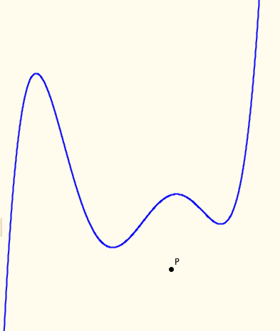
Tangent Power
The tangent power of a point with respect to a function is the number of tangents to the function through the point.
What numbers can appear as tangent powers of points for a given function, and where?

Slide 8
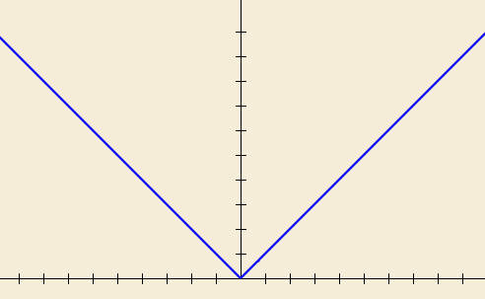
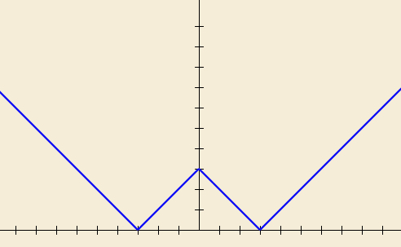
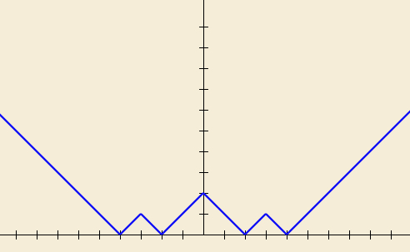
ZigZags
What does it mean to comprehend & appreciate x –> |x|?
Imagine the graph of f₁(x) = |x|
Imagine the graph of f₂(x) = |f₁(x) – 3|
Imagine the graph of f₃(x) = |f₂(x) – 1|
Constructing own examples
Enriching your example space
Notes:
What happens in the long run.
What about other sequences?

Slide 9
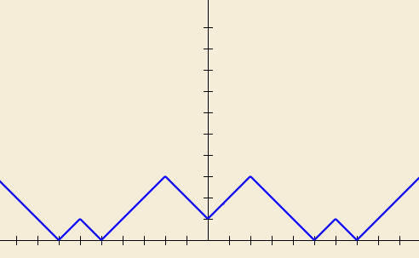
Undoing Zig Zags
What is the function?
||||x| – 2| – 4| – 1|
Notes:
Doing & Undoing:
An key mathematical theme, an important source of questions
||||x| – 2| – 4 –1|

Slide 10
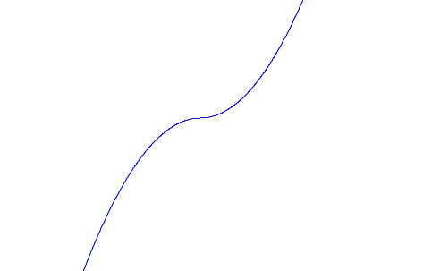
More |x|
What does the graph of x|x| look like?
What other specifications can you construct for it?
What variations might be worth considering?

Slide 11
Onion Model of Understanding
Image
Property
making
Observing
Inventising
Primitive
Image
noticing
having
Structuring
Formal
ising
Susan Pirie & Tom Kieren

Slide 12
Templating & Re-Constructing
Instrumental & Relational Understanding (Skemp 1971)
Following a Template & Reconstructing to Meet Circumstances
Procedural & Conceptual
Formal & Intuitive insight/comprehension
Trained Behaviour & Educated Awareness

Slide 13
Templating & Reconstruction: examples
Reverse Number Notation
What can be said about f if
Notes:
Challenging automatised procedures
Turning a ‘doing’ into an ‘undoing’

Slide 14
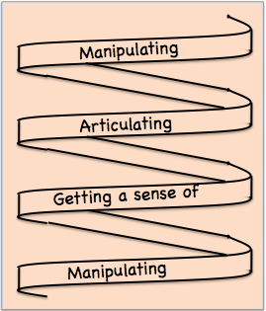
Development
Manipulating familiar confidence inspiring objects (specialising, particularising)
In order to get a sense of underlying structural relationships (modelling, axiomatising, justifying, proving …)
Bringing this experience to articulation, which over time, becomes more succinct and useable (manipulable)
Notes:
Stinulated by Bruner but rephrased to try to capture experience and provide a practical framework for teaching

Slide 15
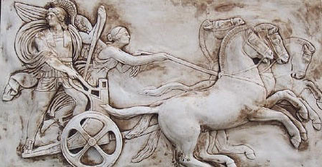
Structure of the Psyche
Awareness (cognition)
Imagery
Will
Emotions (affect)
Body (enaction)
Habits Practices
Notes:
From the Upanishad; reflected in modern psychology

Slide 16
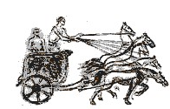
Structure of a Topic
Language Patterns & prior Skills
Imagery/Sense-of/Awareness; Connections
Root Questions
predispositions
Different Contexts in which likely to arise; dispositions
Standard Confusions & Obstacles
Techniques & Incantations
Emotion
Awareness
Behaviour
Only Emotion is Harnessable
Only Awareness is Educable
Only Behaviour is Trainable
Notes:
SoaT is NOT a checklist;
it is a source of inspiration when ideas dry up;
it is a reminder of dimensions of significance to draw upon.

Slide 17
Coming to Know in Mathematics
Observing
What strikes us (disturbance revealing expectation )
Probing and elucidating underlying structure (Modelling, Axiomatising, Proving)

Slide 18
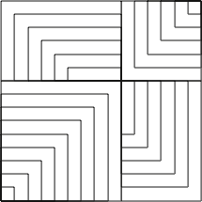
Present or Absent?

Slide 19
Attention & Will in Mathematics
Holding Wholes (gazing)
Discerning Details
Recognising Relationships (in the situation)
Perceiving Properties
Reasoning on the basis of agreed properties
Assenting & Asserting
Taking initiative (being agentive)

Slide 20
Worlds of Experience
Inner World of imagery
World of Symbols
Material World
Confidently manipulable
Imaginable
Articulable
Enactive
Iconic
Symbolic
(Bruner)
Notes:
Bruner

Slide 21
Summary
Concept Image & Concept Definition
Templating & Reconstructing
Awareness (ability to act) – Emotion – Behaviour
Only awareness is educable
Only behaviour is trainable
Only emotion is harnessable
Structure of a Topic
Onion model of coming to understand
Manipulating – getting-a-sense-of – Articulating
Enactive – Iconic – Symbolic modes or worlds
Attention:
Gazing (holding wholes) – Discerning Details
Recognising Relationships – Perceiving Properties
Reasoning on the basis of agreed properties
Will:
Assenting & Asserting; being agentive

