Slide 1
Nature of Mathematics as a Human Endeavour
The Open University
Maths Dept
University of Oxford
Dept of Education
Promoting Mathematical Thinking
Oxford N1A
§2 2018

Slide 2
Outline
Phenomena provoking mathematical thinking
Material; Imagined & Virtual; Symbolic
Ways of Working on Mathematics
Use of Powers/Processes
Mathematical Themes

Slide 3
Conjecturing Atmosphere
Everything said in this room is a conjecture …
To be tested out in your experience
To be tested mathematically
To be modified if it turns out to need modifying
If you KNOW immediately, take the opportunity to focus on what you know, or ask questions that might assist others to see what you see
If you are uncertain or stuck, take the opportunity to try to express what you do comprehend, or to ask about what you do not!

Slide 4
Pundits from the Past
A teacher who is not always thinking about solving problems – ones (s)he does not know the answer to – is psychologically simply not prepared to teach problem solving to students. [Halmos 1985 p322]
Moreover a mathematical problem should be difficult in order to entice us, yet not completely inaccessible, lest it mock at our efforts. It should be to us a guide post on the mazy paths to hidden truths, and ultimately a reminder of our pleasure in the successful solution. [Hilbert 1900]

Slide 5
Square Difference
If the difference of two whole numbers is even, then their product is the difference of two whole number squares
If the difference of two whole numbers is odd, then the product of either with one more than the other is a difference of two whole number squares
What did you do …
… that was successful?
Notes:
Where does your confidence lie?
Particular numbers first? Express generality?

Slide 6
One More Than …
What numbers can be expressed as one more than the product of four consecutive integers?
What did you do …
… that was successful?

Slide 7
Reminder
Being Stuck is an honourable and valuable state
It is then possible to learn something of advantage for the future
What matters is not so much ‘being stuck’ as what you do to get unstuck
You get the most from working on a problem/task when you stop, withdraw from the action, and think back over …
what were the key ideas
what actions you undertook
what actions were effective
what actions you might use in the future.
Tell yourself a mathematical ‘story’ of the result

Slide 8
Good Advice …
"The best way of overcoming a difficult Probleme is to solve it in some particular easy cases. This gives much light into the general solution. By this way Sir Isaac Newton says he overcame the most difficult things.” (David Gregory 1705 correspondence)
“The art of doing mathematics consists in finding that special case which contains all the germs of generality.
(David Hilbert quoted by Courant)
Specialising & Generalising

Slide 9
Divisible Differences
17
18
19
20
21
22
23
24
25
10
11
12
13
14
15
16
5
6
7
8
9
2
3
4
1
…
n² – n + 1
1, 3, 7, 13, 21, 31, 43, 57, 73, 91, 111, 133, 157, 183, 211, 241, 273, 307, 343, …
2, 4, 6, 8, 10, 12, 14, 16, 18, 20, 22, 24, 26, 28, 30, 32, 34, 36, …
2, 2, 2, 2, 2, 2, 2, 2, 2, 2, 2, 2, 2, 2, 2, 2, 2,
Perceiving Potential Generality
Expressing Generality
Where will multiples of 3, 7 and 13 coincide?
Generalise further

Slide 10
Count Down
We are going to count together,
starting at 101
counting down in steps of 1 & 1/10.
Are you ready?
It occurs to me that someone else might be counting up, starting at say 2, in steps of say 7/10.
What is going to happen if we all chant together?
Both counters will at some point cross over.
But will we ever all say the same number at the same time?
What numbers will we both say but at different times?

Slide 11
Generalised Count Down
Some people start at S and count down in steps of s
Others start at T and count up in steps of t.
Under what conditions will they say the same number?
S - ns = T + nt
n = (T – S)/(s+t)
So for what starting values must the up-counters with steps of 7/10 use so as to coincide with the down counters starting at 101 with steps of 1 & 1/10?
101 – T has to be divisible by 9

Slide 12
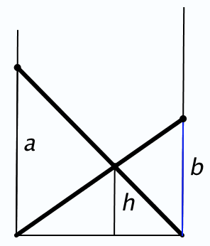
Crossed Ladders
In an alleyway there is a ladder from the base of one wall to the opposite wall, and another the other way, reaching to heights a and b respectively on the opposite walls. What is the height of the crossing point?
1
h
1
a
1
b
=
+
Folding paper in 7ths

Slide 13
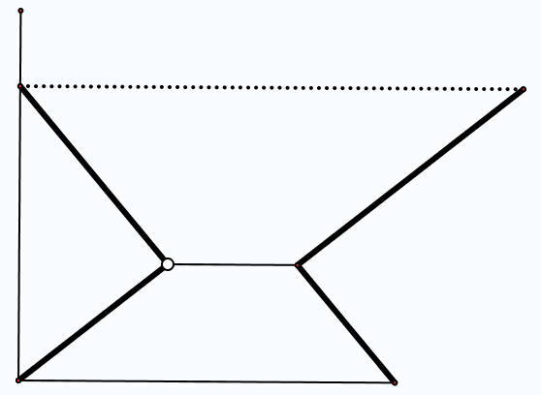
Arnold’s Picnic
People leave two towns at the same time, some going in each direction, and they all meet at noon, eating lunch together for an hour. One group continues and reaches the other town at 7:15 pm, while the other group gets to the first town at 5pm. When did they start?

Slide 14
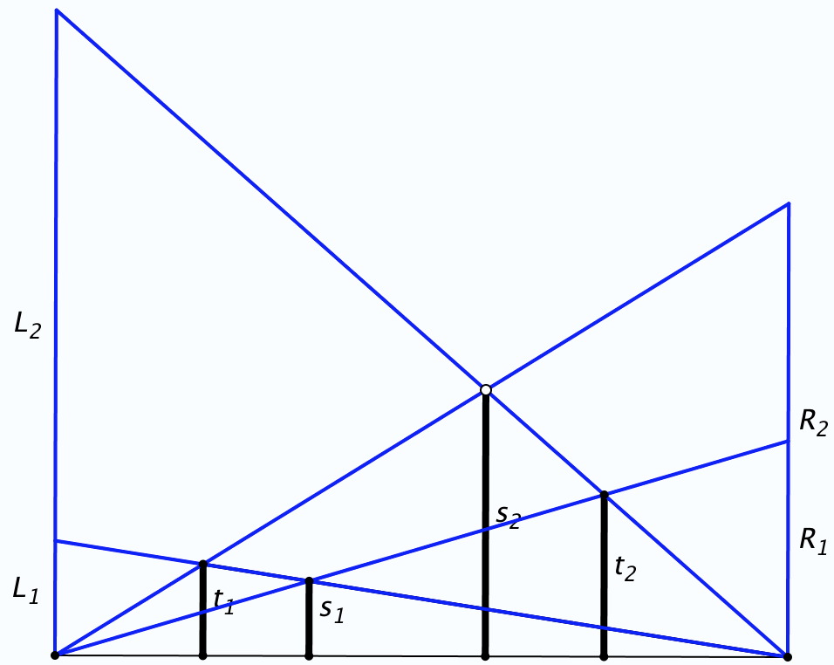
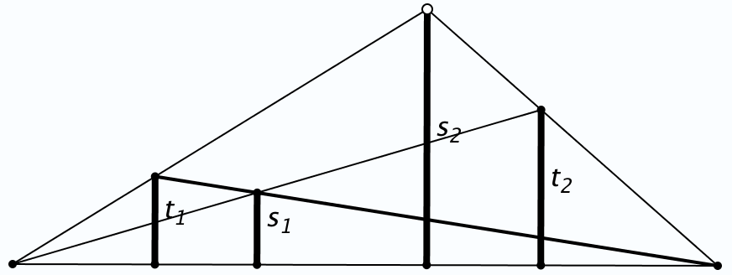
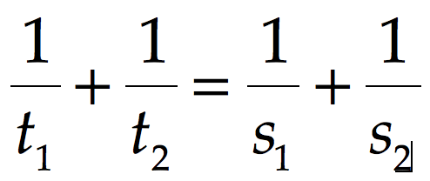
Extensions
More complex scaffolding

Slide 15
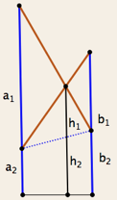
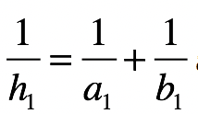
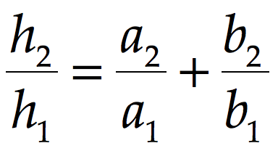
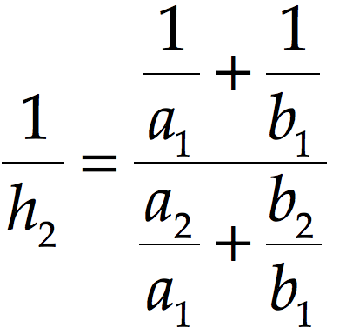
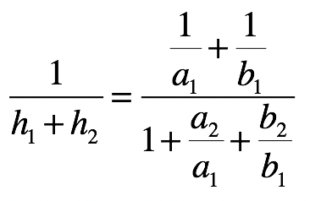
Extensions
More complex scaffolding

Slide 16
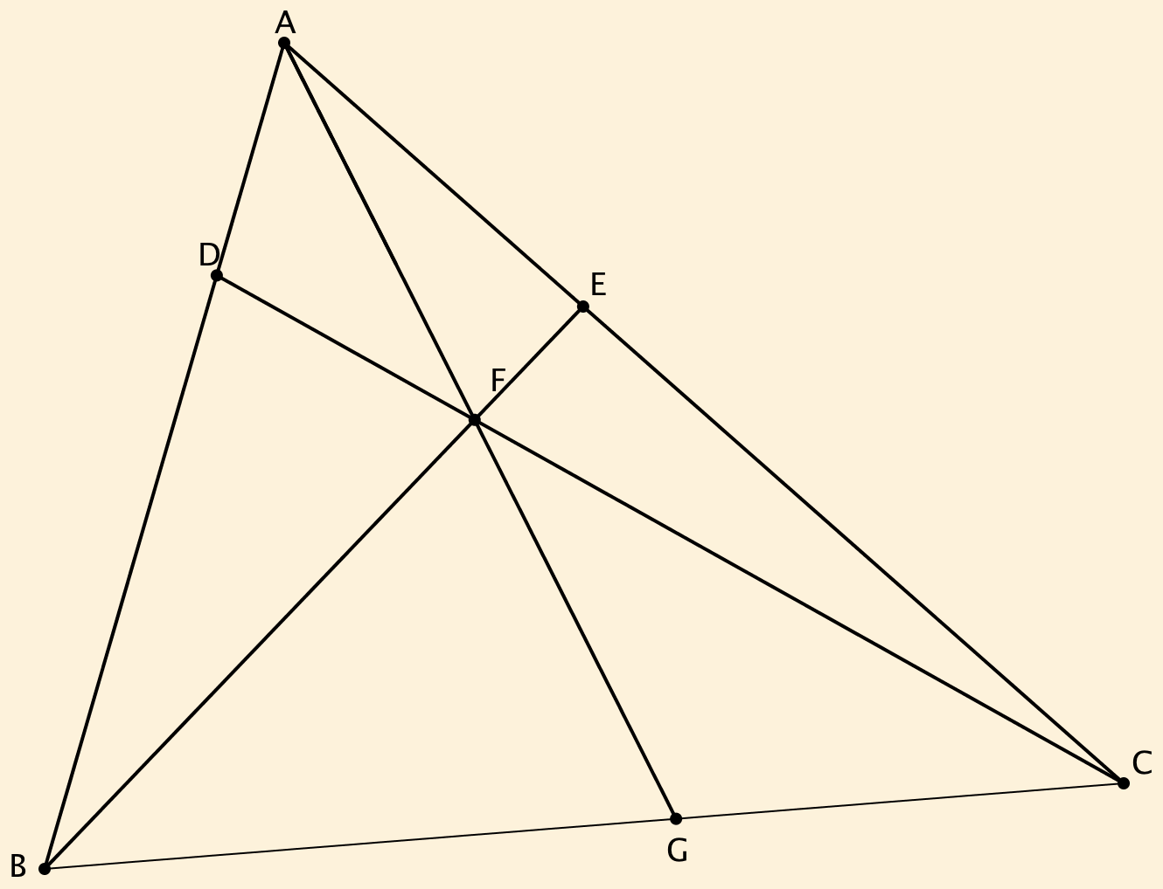
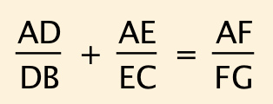
Extension to non-parallel

Slide 17
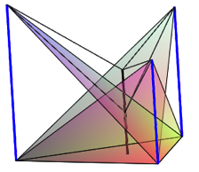
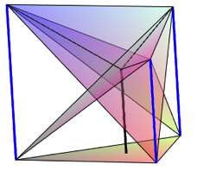
Extensions to three dimensions
Suppose there are three parallel towers (not in a straight line) of known heights.
The three planes formed by taking the tops of two of the towers and the bottom of the third all meet in a point;
the three planes formed by taking the bottom of two of the towers and the top of the third, all meet in a point;
the latter point is half way between and in a line parallel to the towers through the former point.

Slide 18
Working Together
A cistern is filled by two spouts, which can fill the cistern in a and b hours respectively working alone. How long does it take with both working together? (Todhunter 1887)
Two people can complete a job of work in a and b hours respectively. How long will they take working together? (Popular in Victorian Text books)
Resistance Situations

Slide 19
What will happen?
1x9 + 2 = 11
12x9 + 3 = 111
123x9 + 4 = 1 111
1234x9 + 5 = 11 111
12345x9 + 6 = 111 111
123456x9 + 7 = 1 111 111
1234567x9 + 8 = 11 111 111
12345678x9 + 9 = 111 111 111
123456789x9 + 10 = 1 111 111 111
1234567900x9 + 11 = 11 111 111 111
123456789(10)x9 + 11 = 11 111 111 111

Slide 20
Rational or Irrational?
0.1234567891011121314151617…
0.123456789
10
11
12
13
14
…
0.123456790123456790…

Slide 21
Fibonacci Decimal
0, 1, 1, 2, 3, 5, 8, 13, 21, 34, 55, 89, 144, …
.0112358
13
21
34
55
…
.01123595505617977528089887640449438202247191
= 1/89

Slide 22
Belted

Slide 23
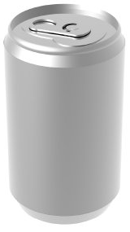
Canned Phenomenon
Imagine a drinks can
Where is the centre of gravity before it is opened?
Where is the centre of gravity when it is empty?
Where is the centre of gravity lowest?

Slide 24
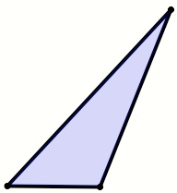
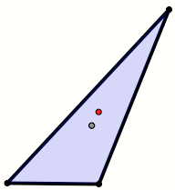
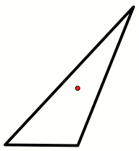
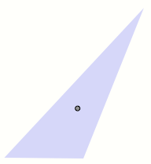
Centres of Gravity
Imagine a triangle
Where is the centre of gravity?
Vertices
Edges
Lamina
Notes:
For any N is there a polygon such that the polygon falls over when placed on any but two of its edges?

Slide 25
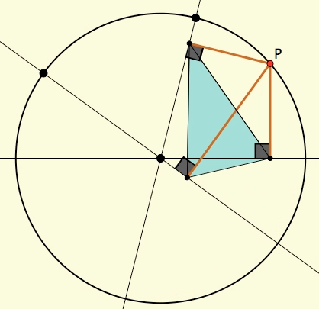
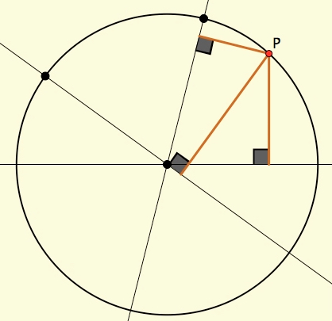
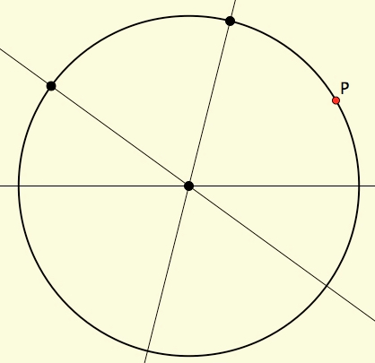
Rolling Polygons
Imagine a circle
Imagine a point P on the circle, moving around it
Imagine three lines each through the centre
From P, drop perpendiculars onto your three lines
As P moves, track the triangle formed by the feet of the perpendiculars

Slide 26
Rolling Polygons

Slide 27
Function Studies
Cubic Chords
Cobwebs
Rational Polynomials

Slide 28
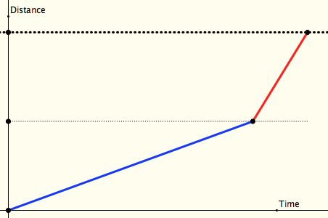
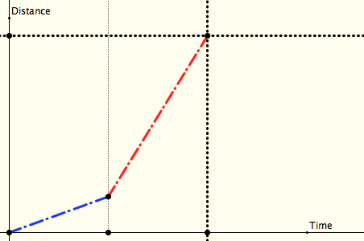
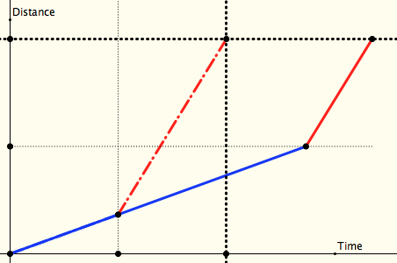
Half-Way, Half-Time
Peter Liljedahl
On two different occasions I make the same journey, each time travelling at two different speeds for two parts:
I travel half the distance at one speed, and half at the other
I travel half the time at one speed and half the time at the other
Which journey is shortest, or does it depend on the relative speeds?
distance
time
Notes:
Now recast in terms of other situations in which one thing varies directly and another inversely

Slide 29
Ride & Tie
Imagine that you and a friend have a single horse (bicycle) and that you both want to get to a town some distance away.
In common with folks in the 17th century, one of you sets off on the horse while the other walks. At some point the first dismounts, ties the horse and walks on. When you get to the horse you mount and ride on past your friend. Then you too tie the horse and walk on…
Supposing you both ride faster than you walk but at different speeds, how do you decide when and where to tie the horse so that you both arrive at your destination at the same time?

Slide 30
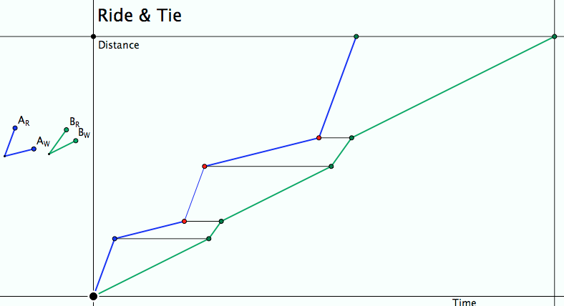
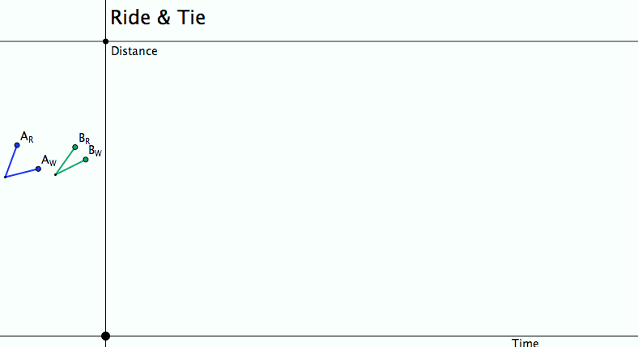
Ride & Tie
Imagine, then draw a diagram!
Seeking Relationships
Does the diagram make sense (meet the constraints)?
Notes:
Does the diagram meet the constraints?
What can be changed, what choices are there?
What relationships (does it really matter how many times the horse is swapped?)

Slide 31
Sundaram’s Sieve
16 | 27 | 38 | 49 | 60 | 71 | 82
13 | 22 | 31 | 40 | 49 | 58 | 67
10 | 17 | 24 | 31 | 38 | 45 | 52
7 | 12 | 17 | 22 | 27 | 32 | 37
4 | 7 | 10 | 13 | 16 | 19 | 22
Claim: N will appear in the table extended to the right and up
iff 2N + 1 is composite
What number will appear in the R^{th} row and the Cth column?

Slide 32
Max & Min
For any rectangular array of numbers,
For each row, calculate the maximum in that row
For each column calculate the minimum in that column
Calculate Min(Max): the minimum of the row maxima
Calculate Max(Min): the maximum of the column minima
Is there any necessary relationship between Max-Min and Min-Max (ie. true in all cases)? In some precisely specified cases?
Notes:
Re-organise the grid column by column; row by row
What if the table is infinite?

Slide 33
Reflection
Mathematics as a human endeavour
A way of making sense of phenomena often brought to attention via some sort of disturbance or fractured expectation in a world of experience: material, mental-virtual, symbolic
Modelling the material world in a manipulably expressive language;
Locating underlying structural relationships
Use of natural powers:
Imagining & Expressing Specialising & Generalising
Conjecturing & Convincing Organising & Classifying
Stressing & Ignoring Extending & Restricting
Ubiquitous Mathematical Themes
Invariance in the midst of change. Doing & Undoing Freedom & Constraint

Slide 34
Where is Mathematics?
Do we discover/uncover pre-existant relationships (invariances in the midst of change)?
Do we construct mathematical relationships as part of our sense-making of our experience of material and mental worlds?
Does it ever make sense to ask for a location for mathematics?

Slide 35
Follow-Up
PMTheta.com
(goto John Mason Presentations)
john.mason@open.ac.uk
Thinking Mathematically (2010 edition)
Cuoco, A. Goldenberg, P. & Mark, J. (1996). Habits of Mind: an organizing principle for mathematics curricula. Journal of Mathematical Behavior, 15, 375-402.

