Slide 1
Some Subtleties of
Multiplication
John Mason
Cambridge
May 2018

Slide 2
Assumptions
Everything that is said here is a CONJECTURE, which is probably articulated in order to consider whether it needs modifying.
It certainly must be tested in your experience

Slide 3
Outline
Multiplication is NOT repeated addition
  Repeated addition is one instance of multiplication
Multiplication in school is Scaling
  In school, multiplication is commutative
Multiplication in university is composition
  Composition is not always commutative

Slide 4
Aspects of Multiplication
Arrays
in order to appreciate repeated addition
Multiplicative Relationships
Elastics
in order to appreciate scaling
Scaling
number lines
Scaling
the Plane
Scaling
objects in the Plane
Fractions as operators
(actions)
Action on
Numbers, ...
Compounding

Slide 5
Scaling a Number Line
Imagine a number line, painted on a table.
Imagine an elastic copy of that number line on top of it.
Imagine the elastic is stretched by a factor of 3 keeping 0 fixed.
  Where does 4 end up on the painted line?
  Where does -3 end up?
  Someone is thinking of a point on the line; where does it end up?
  What can we change and still think the same way?
Return the elastic line to match the original painted line.

Slide 6
Side track
What would it mean to have a negative scale factor?
  Approach 1: What scaling would send 1 to -1, 2 to -2, etc.?
  Approach 2: simply multiply by the negative scale factor
  Approach 3: make connections with the effect of rotating the number line through 180° about 0
Note that the sequence of tasks being used for scaling could also be used for rotations through 180° about different points on the painted line

Slide 7
Scaling a Number Line
Imagine a number line, painted on a table.
Imagine an elastic copy of that number line on top of it.
Imagine the elastic is stretched by a factor of –1 keeping 0 fixed.
  Where does 4 end up on the painted line?
  Where does -3 end up?
  Someone is thinking of a point on the line; where does it end up?
  What can we change and still think the same way?
Return the elastic line to match the original painted line.

Slide 8

More Scaling on a Number Line
Imagine a number line, painted on a table.
Imagine an elastic copy of that number line on top of it.
Imagine the number line is stretched by a factor of 3 but this time it is the point 1 that is kept fixed.
Where does 4 end up on the painted line?
Where does -3 end up?
Someone is thinking of a point on the line:
where does it end up?
What can we change and still think the same way?
(4 - 1)x3 + 1
(-3 - 1)x3 + 1
( - 1)x3 + 1
is the point to be scaled
( – )
σ
+
σ is the scale factor
is the fixed point

Slide 9
Compound Scaling on a Number Line
Imagine a number line, painted on a table.
Imagine an elastic copy of that number line on top of it.
Imagine the number line is stretched by a factor of 6 keeping the point 1 fixed
Imagine that line now being scaled again by a further factor of 1/3 still keeping the point 1 fixed
Where does 4 end up on the painted line?
Where does -3 end up?
4 –> (((4 - 1)x6+1) – 1)/3 + 1
4 –> (4 – 1)x6/3 + 1
–3 –> ((-3 - 1)x6+1) – 1)/3 + 1
–3 –> (-3 - 1)x6/3 + 1
Someone is thinking of a point on the line:
where does it end up?
What can we change and still think the same way?
–> ( - 1)x6/3 + 1

Slide 10
Full Compound Scaling on a Number Line
-8
-7
-6
-5
-4
-3
-2
-1
0
1
2
3
4
5
6
7
8
9
Imagine the number line is stretched by a factor of 6 keeping 1 fixed.
Now imagine the number line is further stretched by a factor of 1/3 but this time it is the original point 5 that is kept fixed.
  Where does the original 4 end up on the painted line?
  Where does the original -3 end up?
  Someone is thinking of a point on the original line;
  where does it end up?
–> (( – 1)x6 + 1 – 5)/3 + 5
–> (( x6/3 – 1x6/3 + (1 – 5)/3 + 5

Slide 11
Expressing a Generality
A number line is to be scaled by a factor of σ₁ keeping F₁ fixed.
Then it is scaled by a factor of σ₂ keeping F₂ (on the original line) fixed.
What is the combined scaling?
→ (( – F₁) σ₁ + F₁ – F₂)σ₂ + F₂
→ σ₁ σ₂ + F₁(1 - σ₁)σ₂ + F₂(1 - σ₂)
What if we had done it in the other order?
→ (( – F₂)σ₂ + F₂ – F₁)σ₁ + F₁
→ σ₂ σ₁ + F₂(1 – σ₂)σ₁ + F₁(1 – σ₁)

Slide 12
When does order NOT matter?
It would require that:
σ₁ σ₂ + F₁(1 - σ₁)σ₂ + F₂(1 - σ₂)
= σ₂ σ₁ + F₂(1 – σ₂)σ₁ + F₁(1 – σ₁)
F₁(1 - σ₁)σ₂ + F₂(1 - σ₂)
= F₂σ₁(1 – σ₂) + F₁(1 – σ₁)
F₁(1 - σ₂)(1 - σ₁)
= F₂(1 – σ₁)(1 – σ₂)
Multiplication as scaling is NOT commutative unless
either σ₁ = 1 or σ₂ = 1 or F₁ = F₂

Slide 13
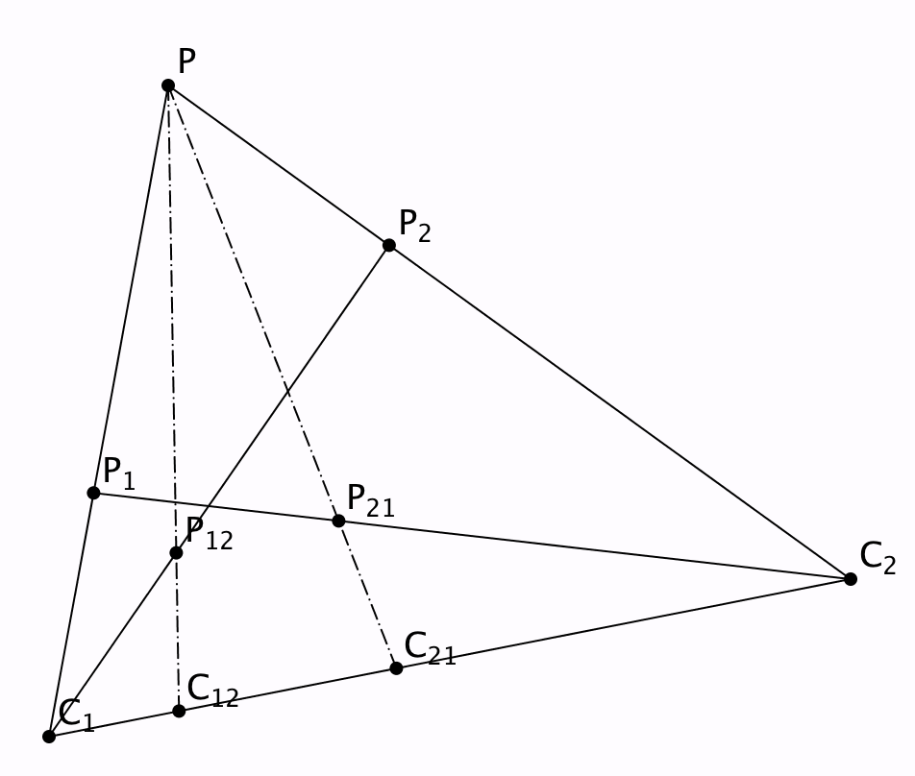
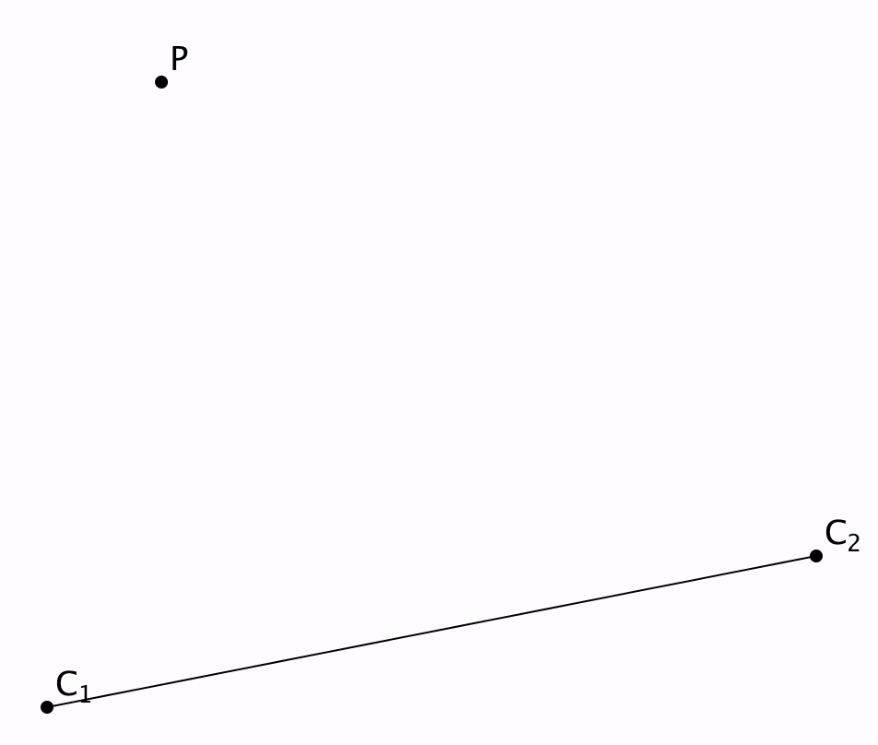
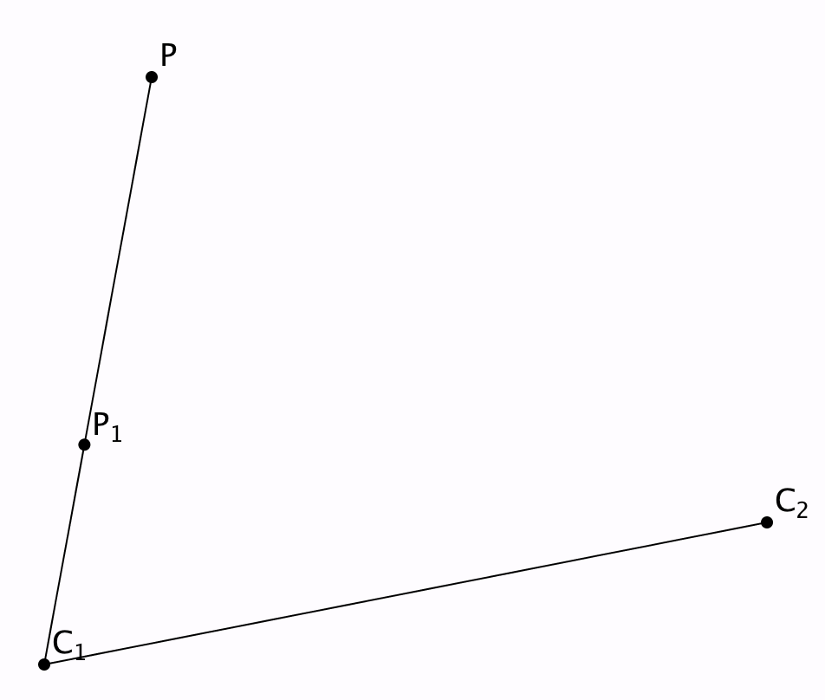
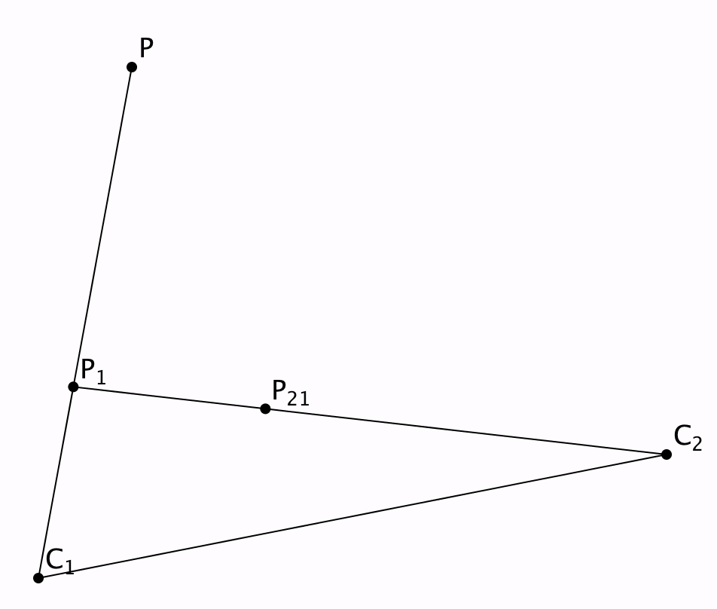
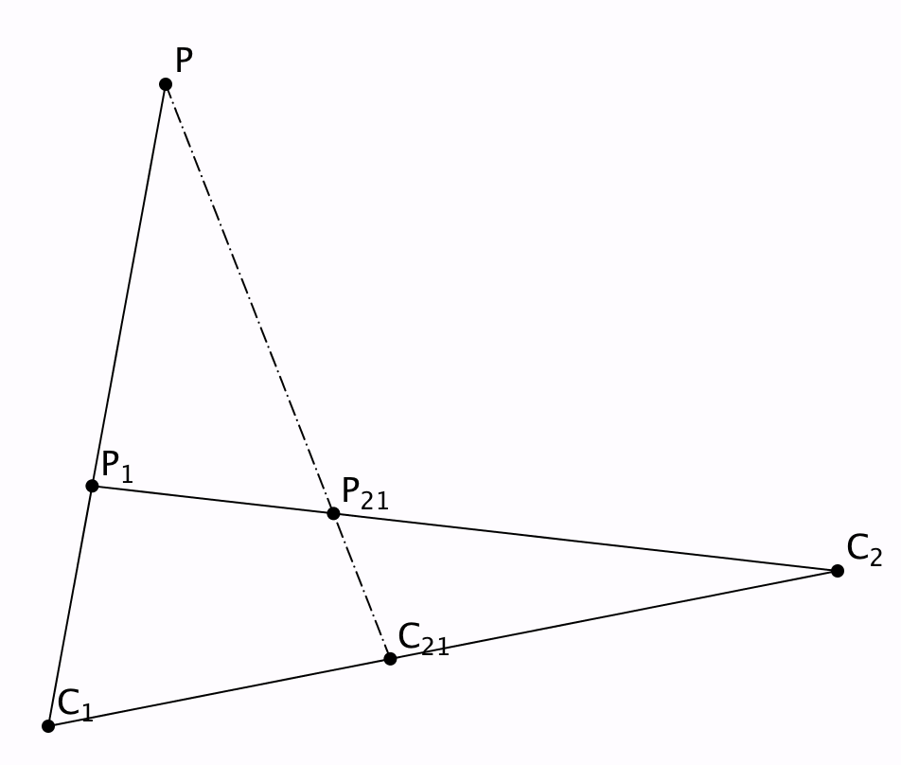
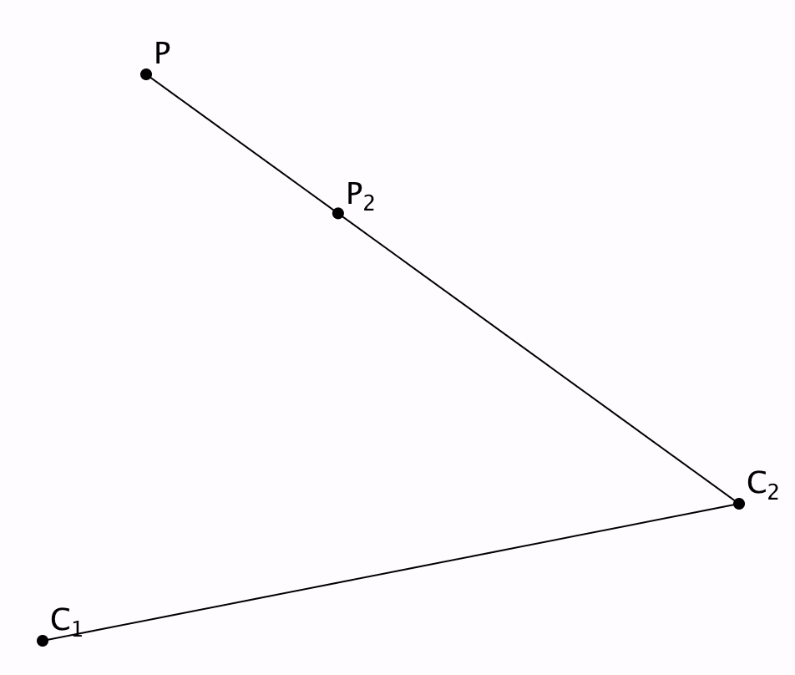
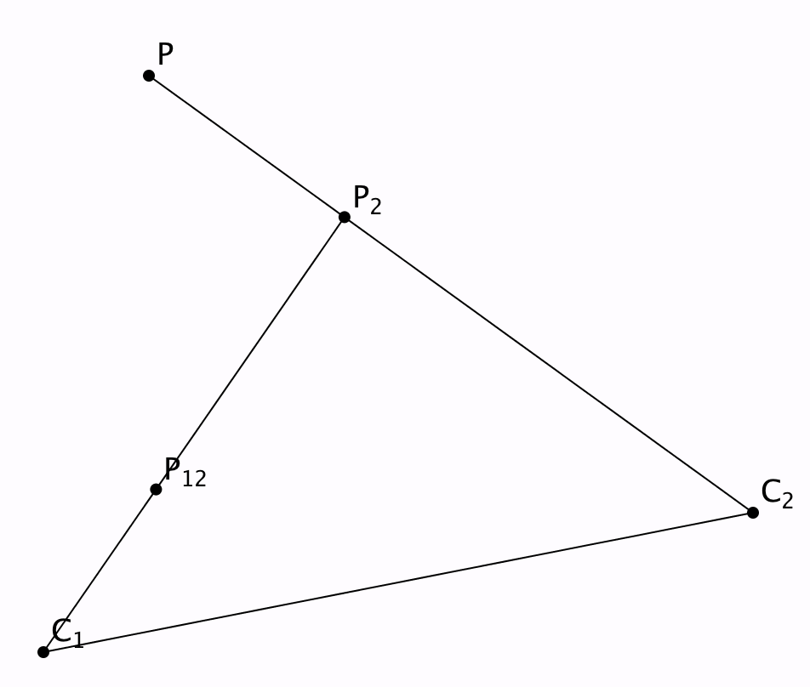
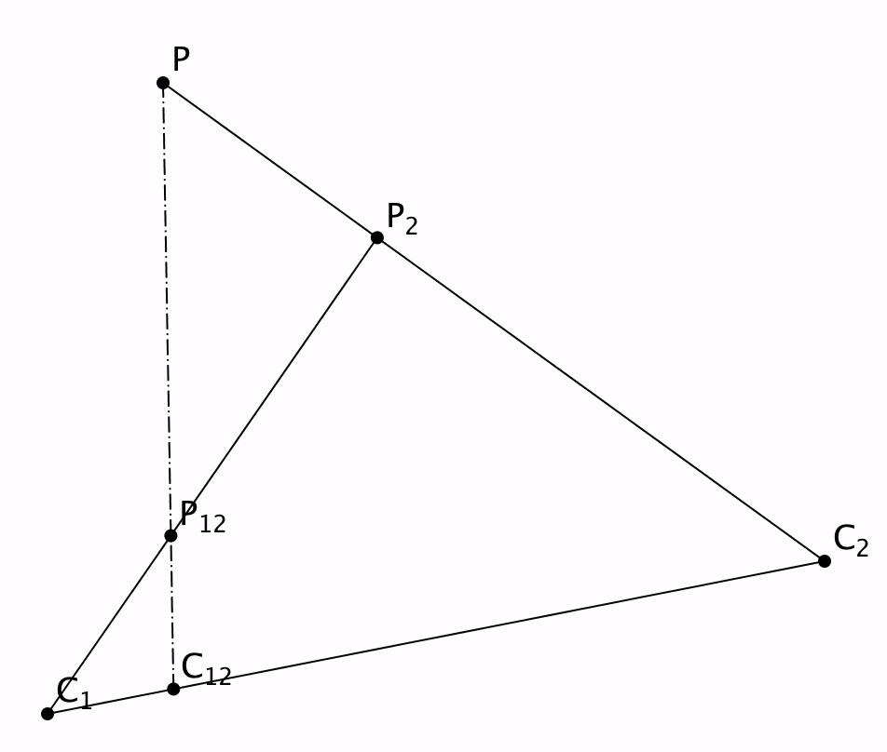
Compound Scaling (2D)
What is the effect of scaling by one factor and then scaling again by another factor, using the same centres?
What if the
centres are
different?

Slide 14
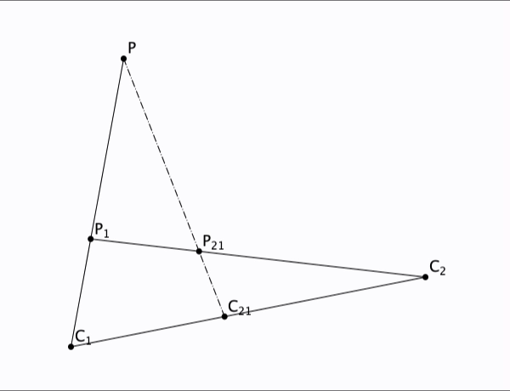
Compound Scaling in and of the Plane

Slide 15
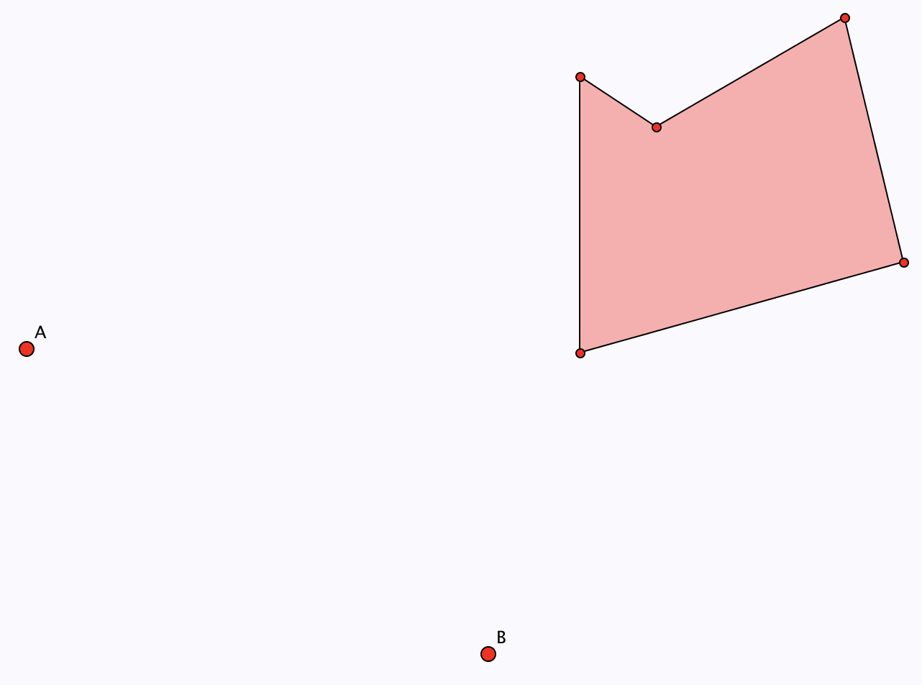
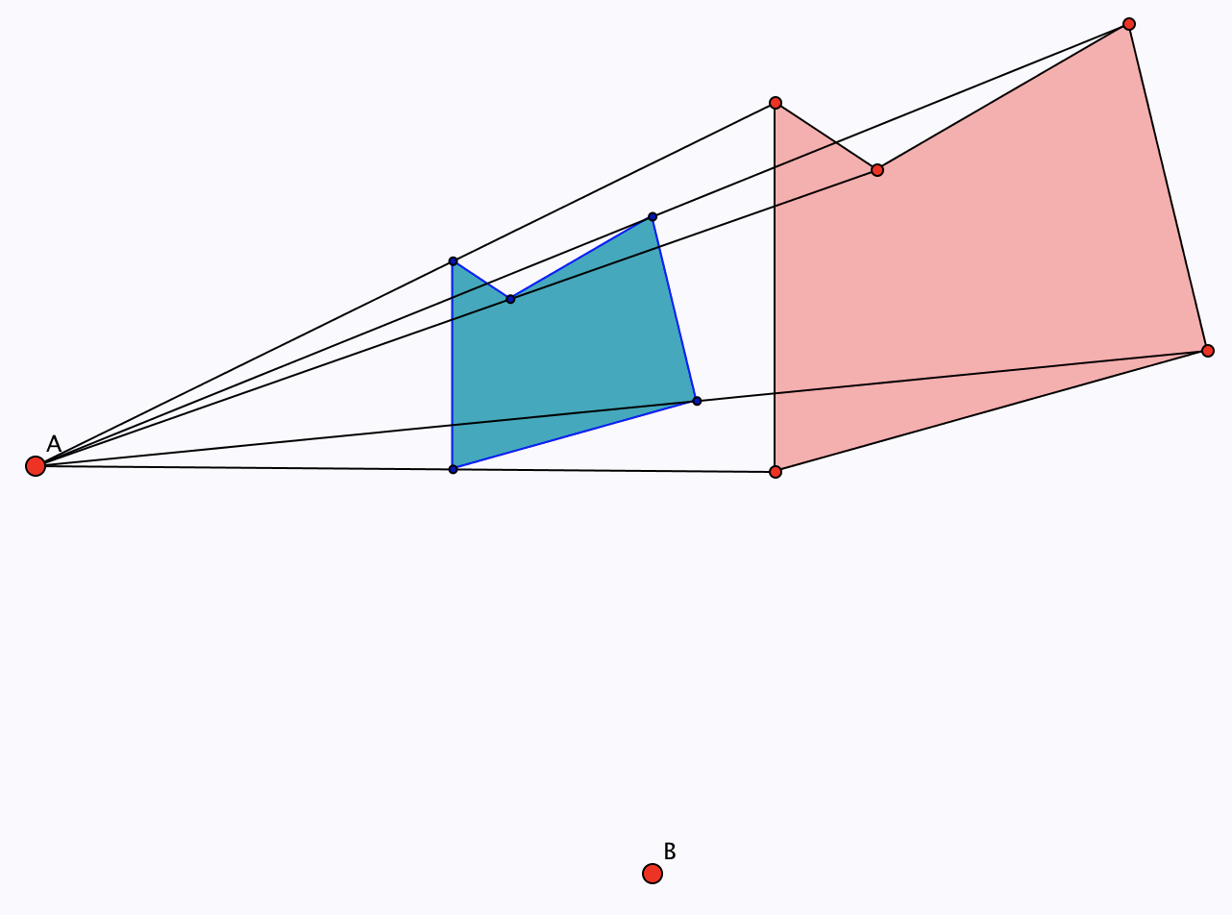
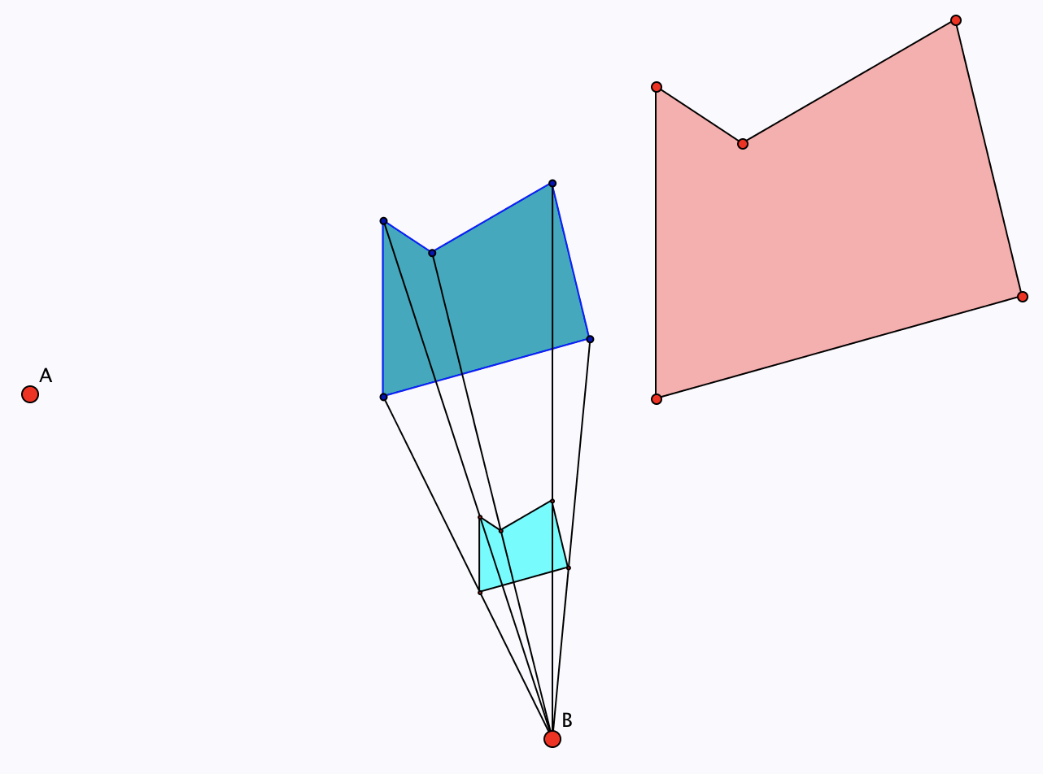
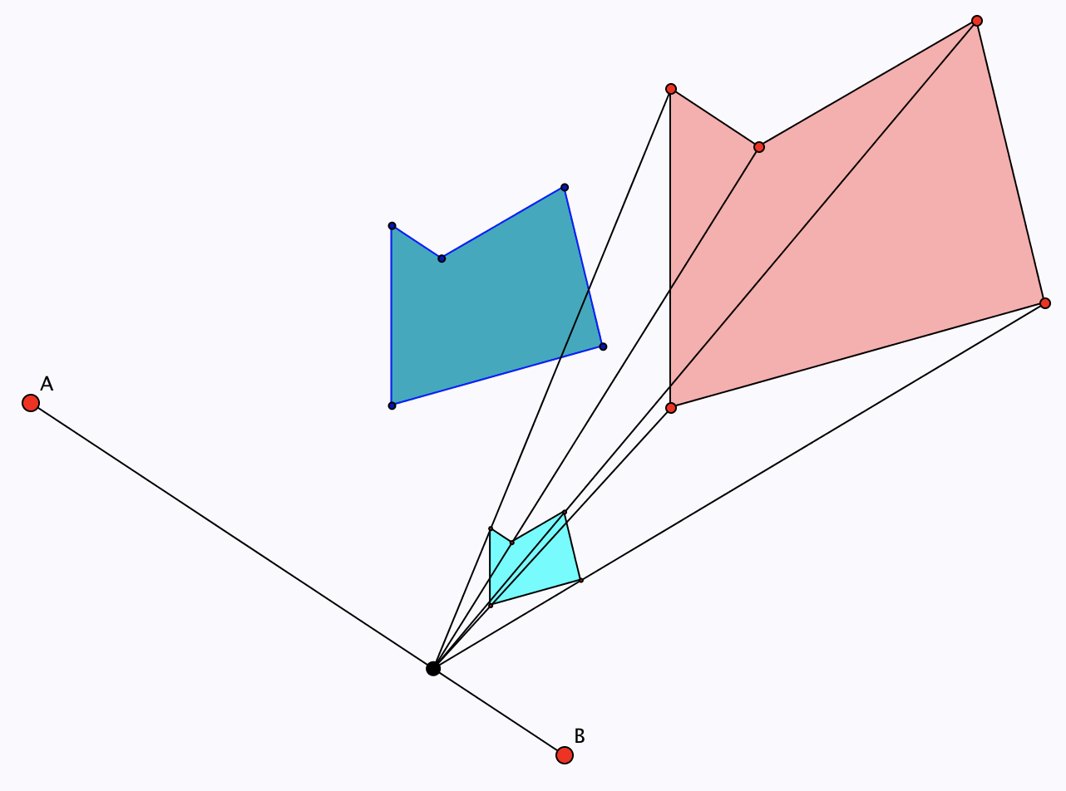
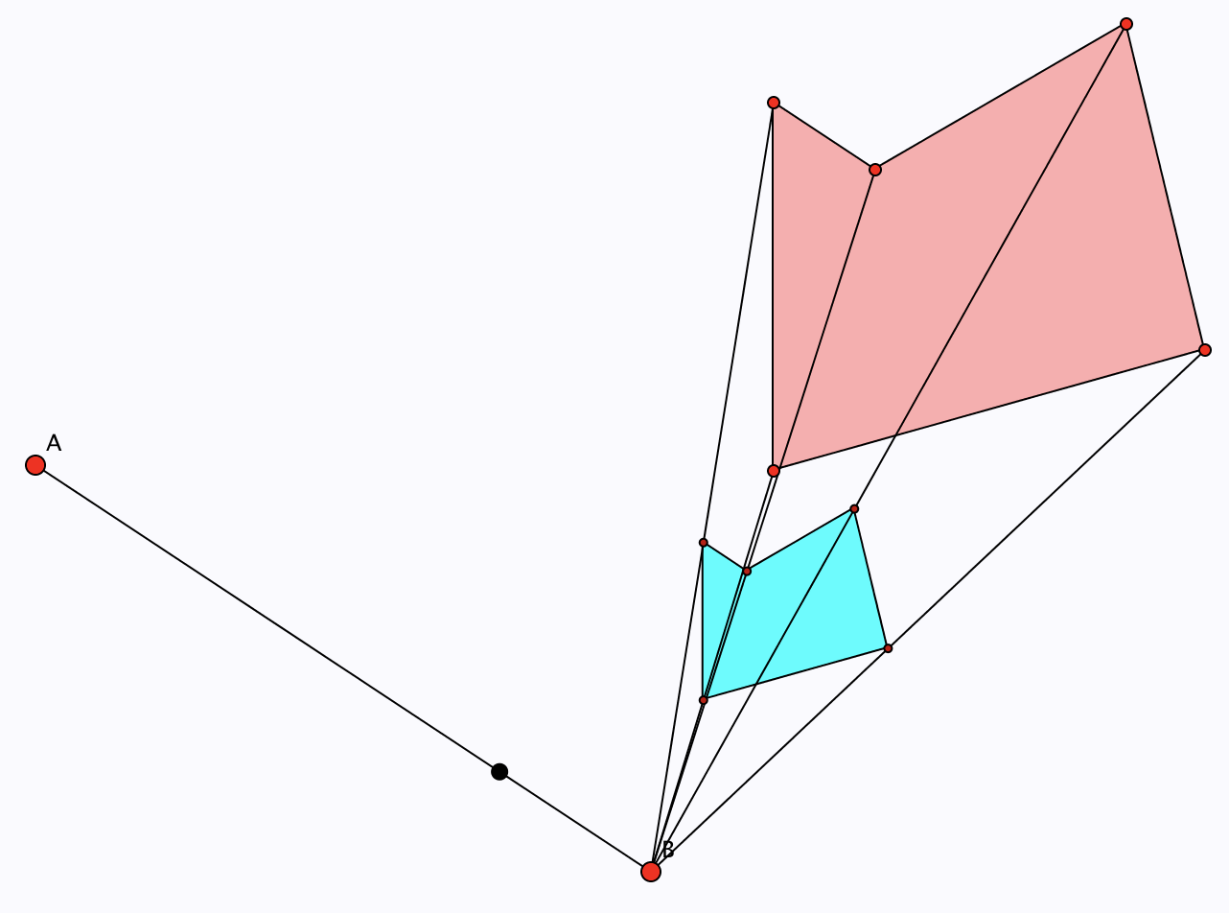
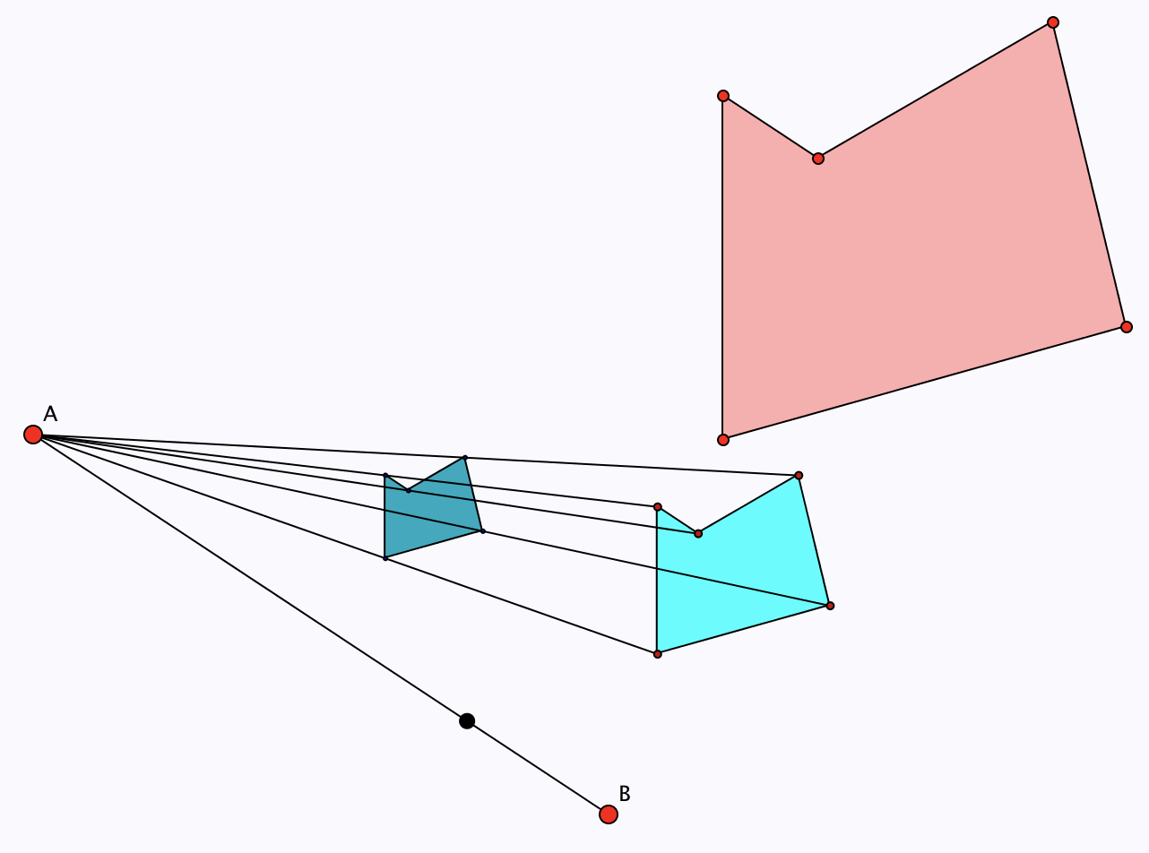
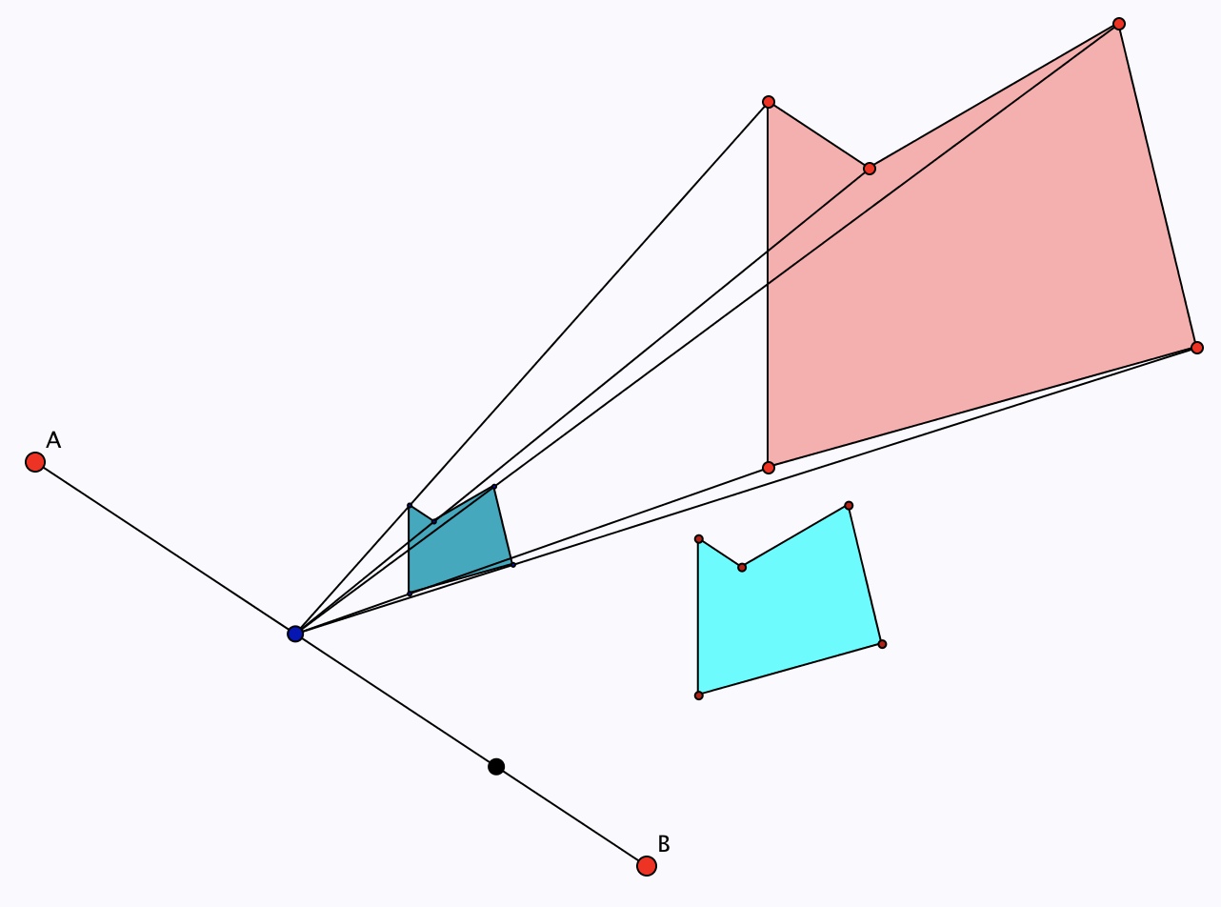
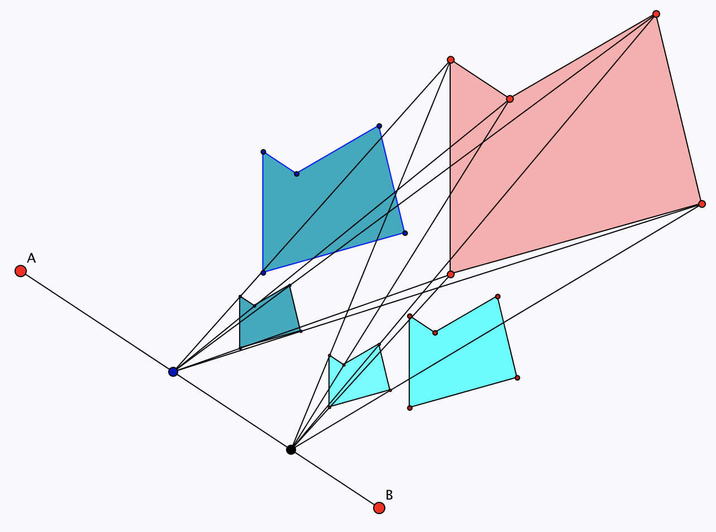
Compound Scaling (2d): Polygons

Slide 16
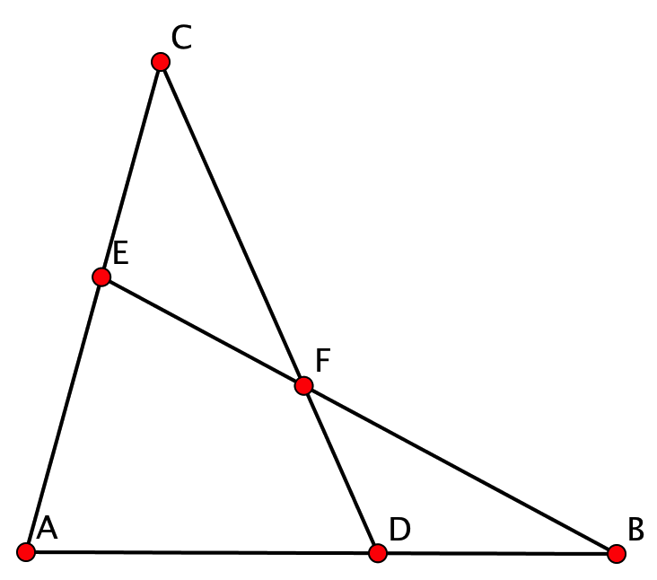
The Scaling Configuration
P | 1st Centre | 2nd Centre | Combined Centre | Image of P
C | A | B | D | F
B | A | C | E | F
A | B | C | E | F
F | D | E | B | A
E | F | D | C | A
…
There are 48 different ways of ‘seeing’ the diagram!

Slide 17
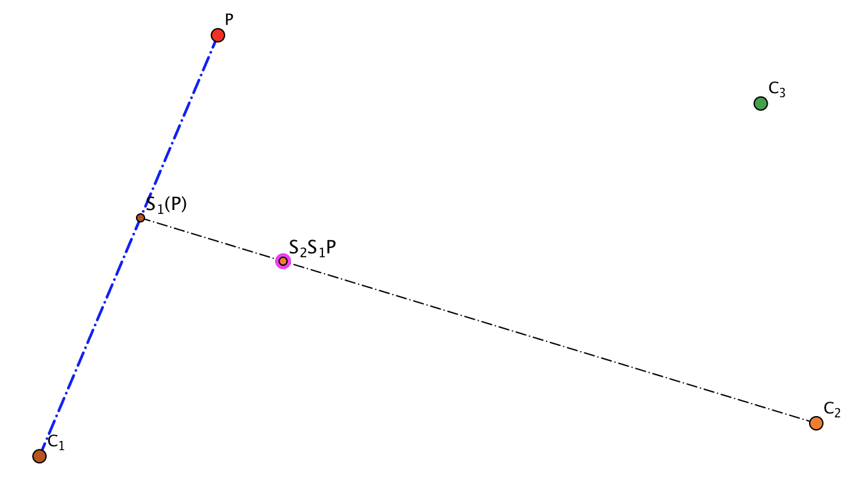
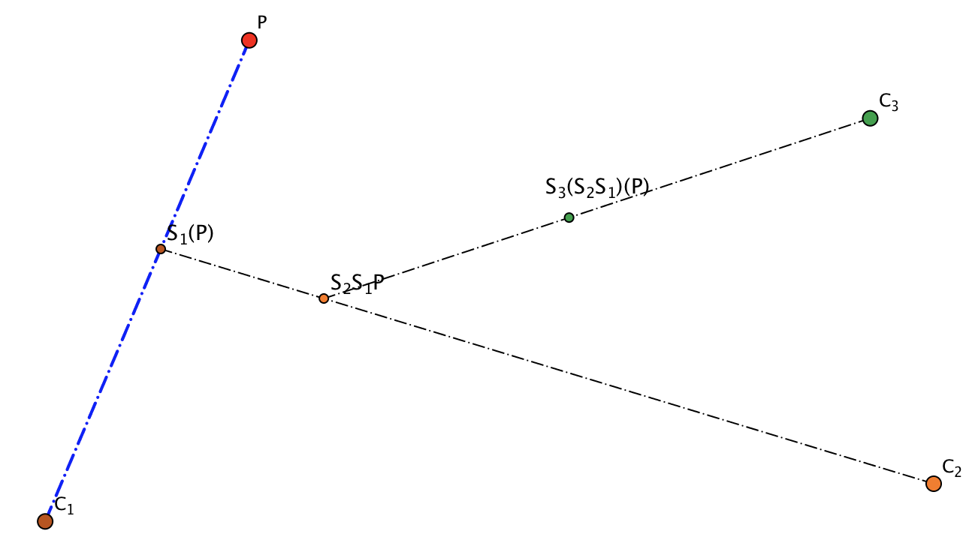
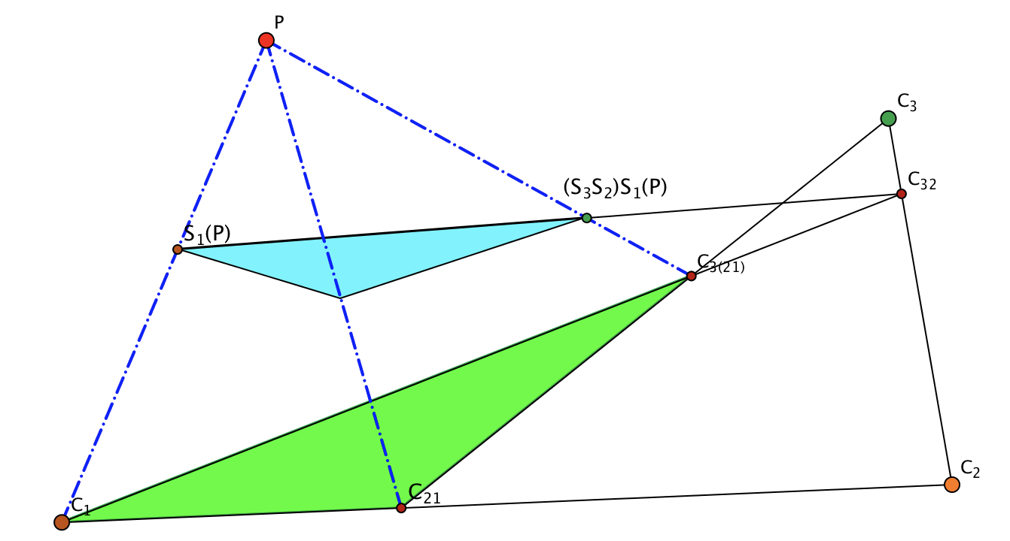
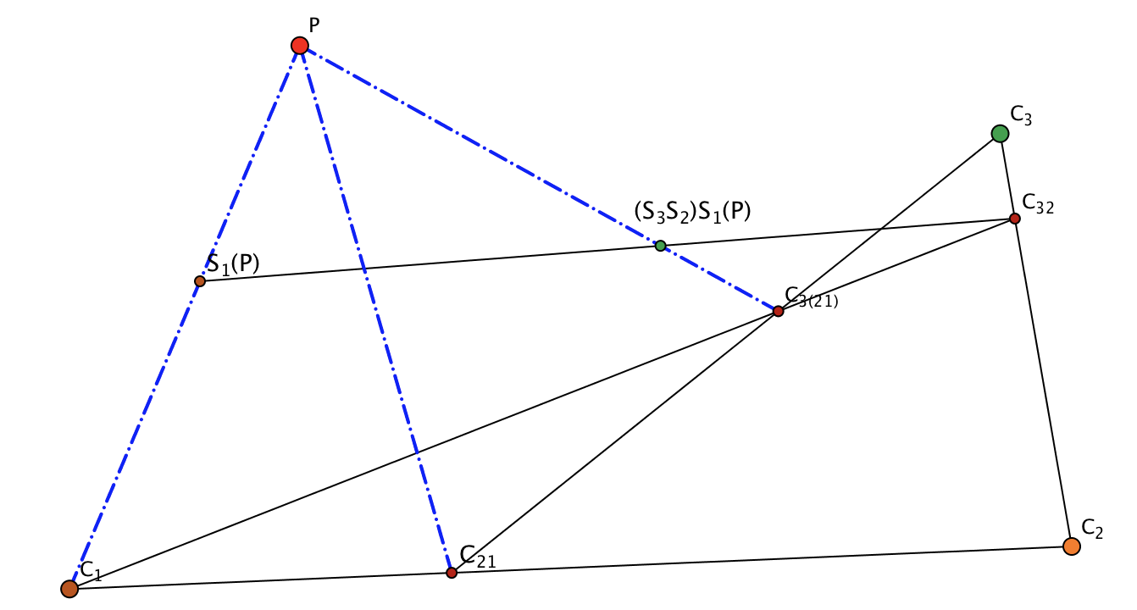
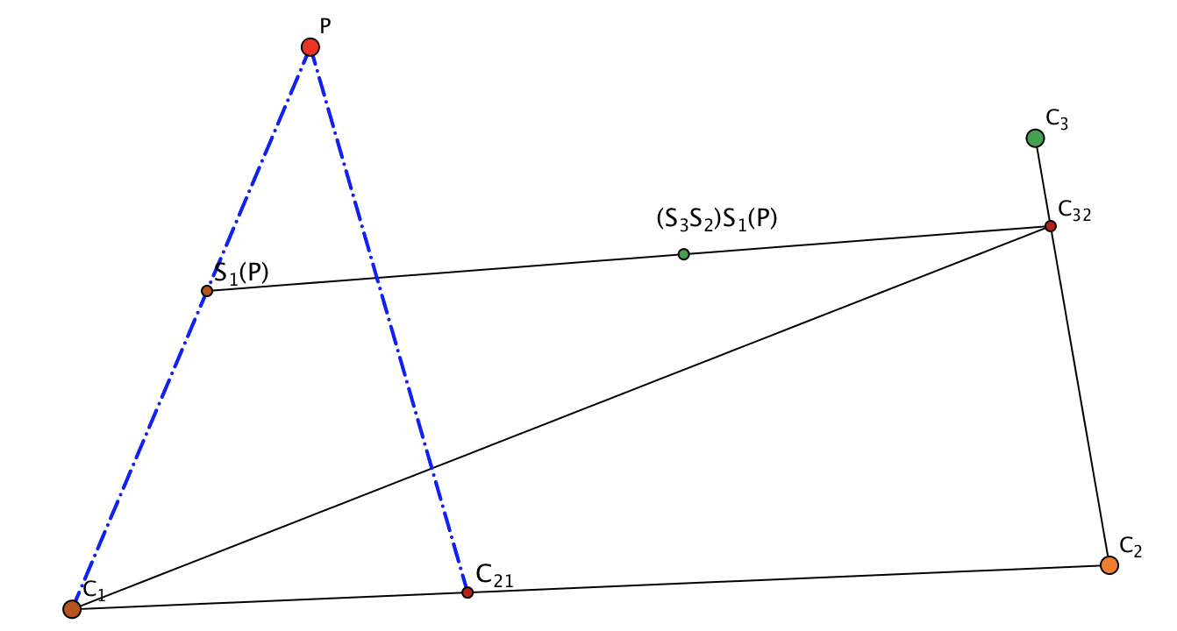
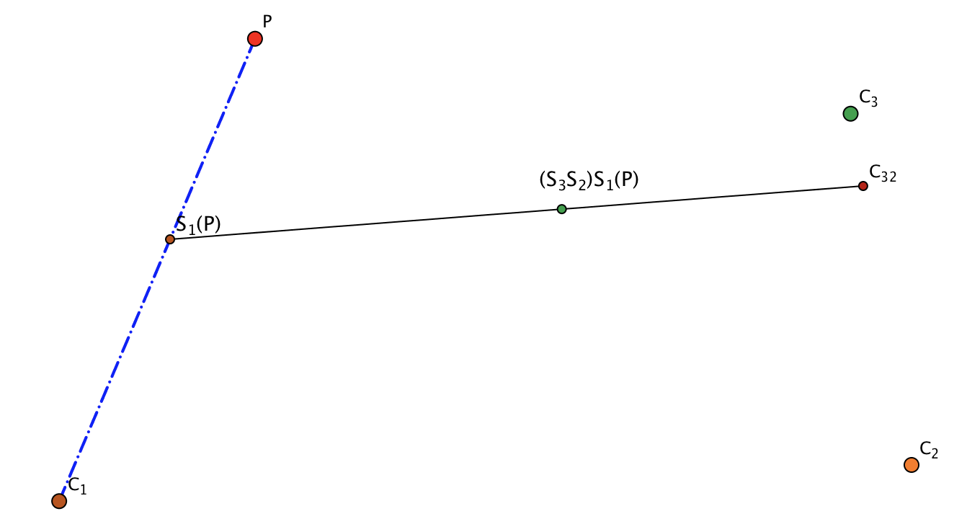
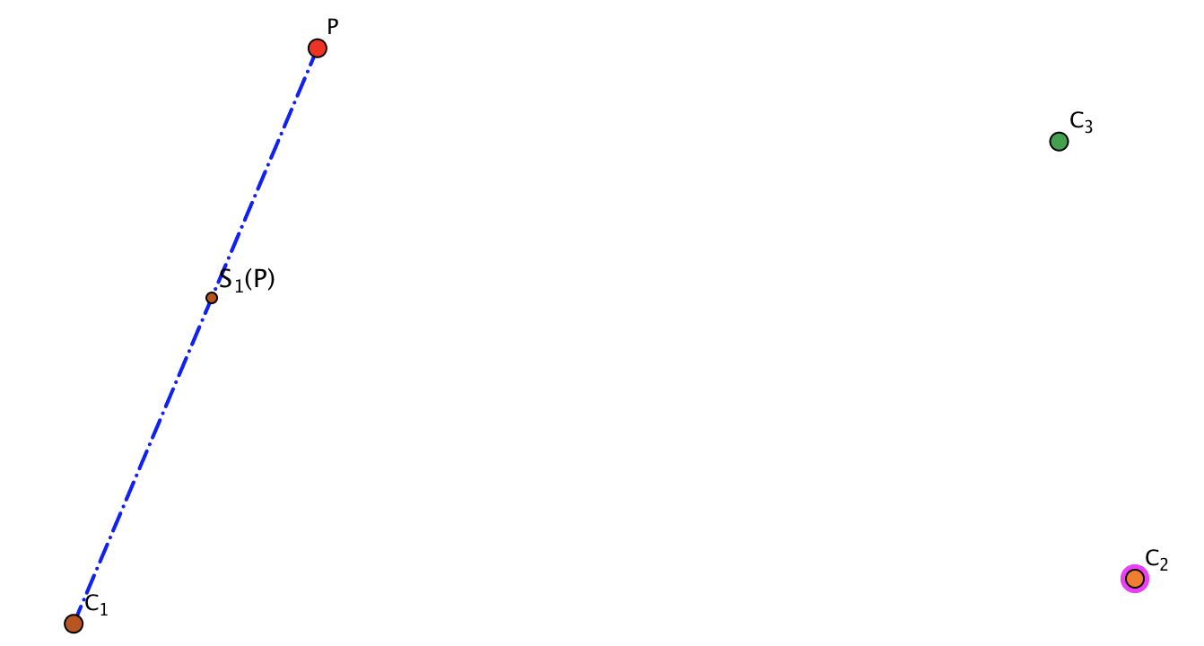
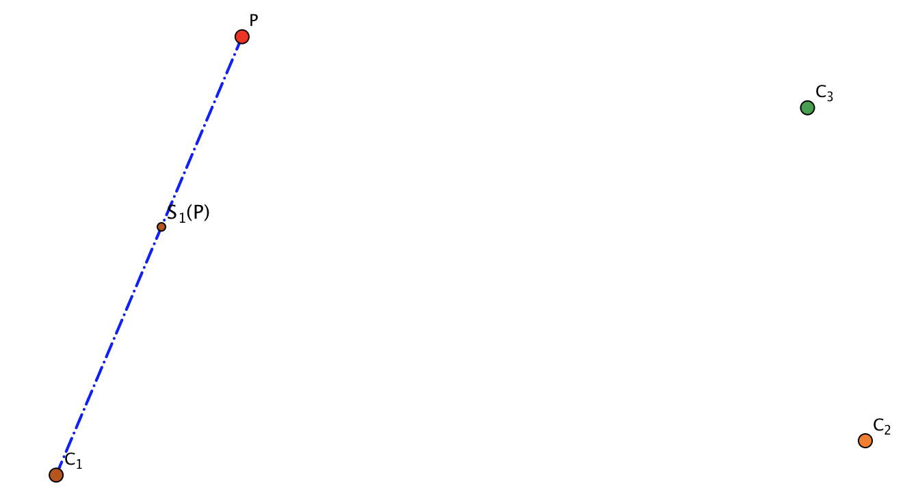
Three Scalings (associativity)
Depict the situation of three scalings looked at associatively.
Start again associating differently

Slide 18
Reflection
What struck you mathematically today?
What triggered emotional response?
What actions might you want to consider taking in the near future?
Imagine yourself working on those aspects in preparation for a lesson.

Slide 19
Follow-Up
John.Mason @ open.ac.uk
PMTheta.com go to John Mason Presentations
  Elastic multiplication workshop ppts
Combining Geometrical Transformations: a meta-mathematical narratiuve. In R. Zazkis & P. Herbst (Eds.) Scripting Approaches in Mathematics Education: mathematical dialogues in research and practice. P21-52. Springer (2018).

