Slide 1
Dysfunctioning with functions
MEI
Anne Watson
2017

Slide 2
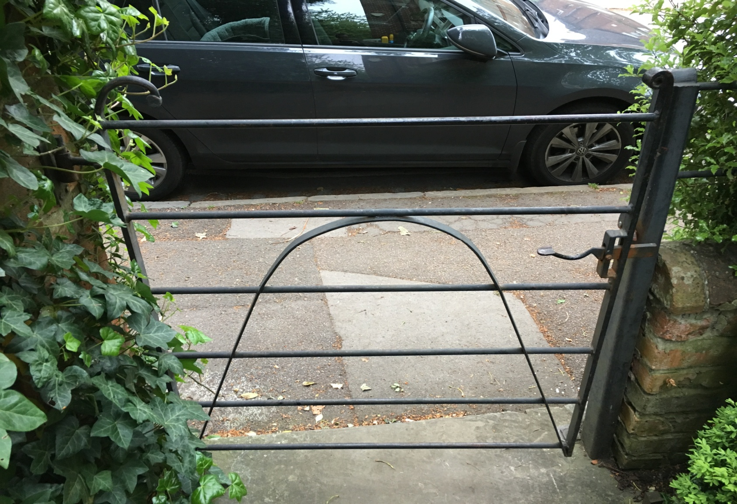

Slide 4
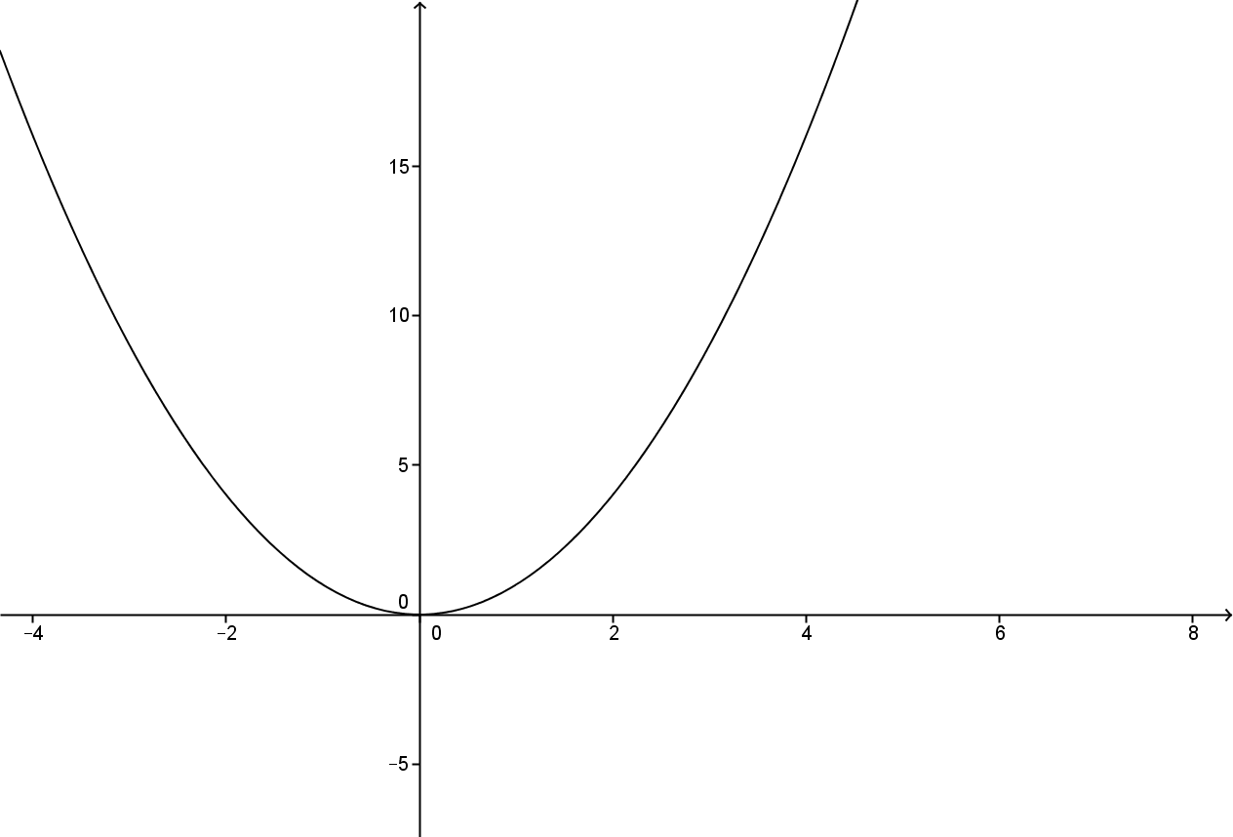

Slide 5
Functions are a unifying idea in mathematics
For whom?

Slide 6
Understanding the functions concept
Representations
Covariation
e.g. instantaneous rate of change; constant and varying rates of change; sequential step sizes
Correspondence
one-to-one; many-to-one
Function as an object in its own right
f as the name of a function; sinθ as a function; f(x-a) as a function
Modelling: identifying variables, graphing relationships between realistic data sets
Algebraic equations/ expressions to generate function values; ditto to represent functions
Sequence reasoning: ‘position-to-term’ generalisation
Input/output models
Expressions for mappings between sets and to describe general relationships

Slide 7
What can go wrong?
mapping discrete sets of data to each other
anything that can be mapped is a function
all functions are continuous, smooth, and calculable
letters stand for numbers
the representation of a function is the function
non-coordination of different conceptualizations:
function as process (e.g. f (g(x))
function as object (e.g. f ◦ g)

Slide 8
The Functions Project
Anne Watson
Michal Ayalon
Steve Lerman
Comparing Israeli and English high-performing students’ responses to function tasks, yrs 7 to 13

Slide 9
Task 1
1.1 Where will the lift be after seven seconds? You can assume constant speed. Explain your answer.
1.2 At what rate does the lift descend? Explain your answer.
1.3 You might want to check whether your answer to question 1.2 fits with your answer to 1.1
Seconds | Floor number
0 | 14
2 | 10
4 | 6
6 | 2
7 | ?

Slide 10
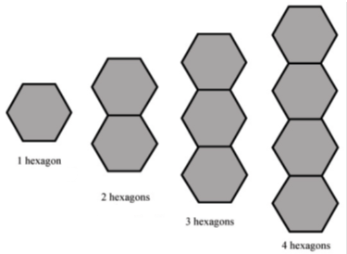
2.1 For 1 hexagon the perimeter is 6
For 3 hexagons the perimeter is 14;
For 2 hexagons the perimeter is ______
For 5 hexagons the perimeter is ______
2.2 Describe the process for determining the perimeter for 100 hexagons, without knowing the perimeter for 99 hexagons.
2.3 Write a formula to describe the perimeter for any number of hexagons in the chain (it does not need to be simplified).
Task 2

Slide 11
Issues from Task 2
UK curriculum: 'find the formula for the nth term in a sequence’. Israeli curriculum: functions not limited to generalising sequences in early secondary
Correspondence, e.g. function machines, is not obviously connected to generalising sequences
Teaching in Israel appears to circumvent proportional assumptions
UK students were more likely to be successful if they used a covariation approach (15/19) than correspondence (5/20). 8/11 Israeli students used convariation successfully cf. correspondence 33/33
Israeli students were using methods they had learnt in school; UK students had to adapt learnt methods.

Slide 12
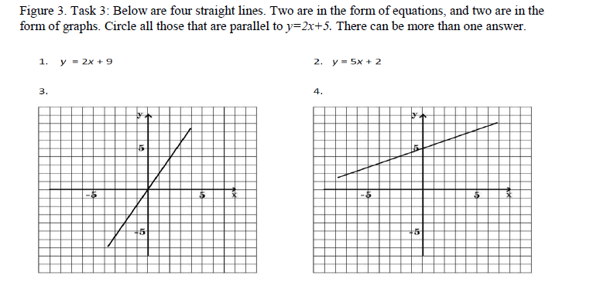
Task 3

Slide 13
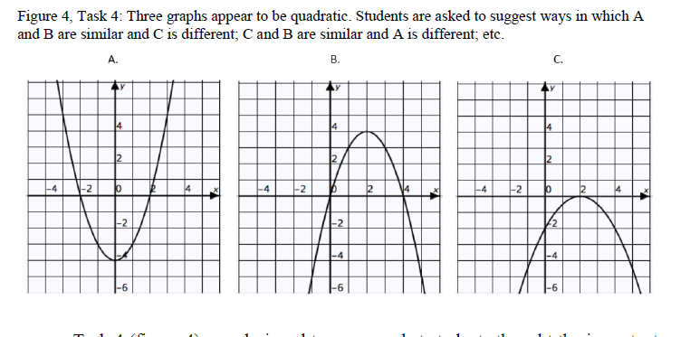
Task 4

Slide 14
Task 5
1. After the concert there was a stunned silence. Then one person in the audience began to clap. Gradually, those around her joined in and soon everyone was applauding and cheering.
3. Prices are now rising more slowly than at any time during the last five years
2. If cinema admission charges are too low, the owners will lose money. On the other hand, if they are too high, fewer people will attend and again the owner will lose money. A cinema must therefore charge a moderate price in order to stay profitable.
4. In a running competition the one who
runs the slowest will take the longest time
to complete the race.

Slide 15
Issues from task 5
combination of everyday and representational reasoning
difficulties: compound variables and not having 'time' on the x-axis
need a sense of covariation: 'going up and down‘ and varying rate of change
in Israel there was no overall progression that we could discern, the strongest success rate being in year 10
there was progress in success in England

Slide 16
Task 6: responses to statements
I see functions as input/output machines, which receive some input and give an appropriate output.
I see function as a mapping of each element of one set to exactly one element of a second set.
Functions for me represent relations between variables.
A function shows how one variable changes in relation to another variable.
I see functions as expressions to calculate y-values from given x-values. For example, y = 4x + 7.

Slide 17
All functions fit X’s description.
Some functions fit X’s description.
X is wrong.
Explanation ……..
Now, after you have responded to these ideas, write what is a function for you

Slide 18
Task 6: UK data

Slide 19
Task 6: Israel data

Slide 23
Summary
Israeli students less likely to make progress in realistic graph-matching tasks than the English students
English students less likely to enact the formal aspects of function understanding
All students displayed strengths in understanding rate of change, and in identifying key characteristics of graphs, whether formally taught or not.
Worrying - English students less likely to be successful in constructing a linear formula when data was presented in a non-sequential form
Worrying – dominant ideas are very different: Israeli students having the idea of ‘relation’ which UK students seem fixed on ‘what you do’

Slide 24
Key ideas arising through analysis of differences in response
identification of variables:
discrete and continuous
simple or compound
identifying relations between variables
recognising covariation
using correspondence reasoning
using covariation reasoning
important role of rate of change
when and how to introduced formal expressions and keep using them

Slide 26
School textbooks
Mêlée of: equation/graph/formula/function
“A function uses a rule”
“An equation contains an equals sign and an unknown number”
Represent functions as sequences of operations
“Functions have inverses”
“Functions represent real-life events”
“A rule that gives a unique output for a given input. The rule is usually written as an equation”
Function machine
Where does the word first appear? Are uses and descriptions consistent throughout the learning management system (textbook or online resource suite?)
“When solving linear equations, if there are brackets you should always expand them first”: 6(x + 2) = 18

Slide 27
More textbooks …
“A function is a way of expressing a relationship between two sets of values”
“A function is a rule that assigns to each x in A a unique element y in B”
“A function is a set of numbers that map to one another: “there are two methods”:
look at inputs as term numbers of a sequence and the outputs as the sequence terms and find the general term
look at inputs as x-coordinates and outputs as y-coordinates, plot a graph and hence find the function”

Slide 28
School textbook definitions of function in UK
Over-simplistic and limiting
Confuse representation with function
Only apply to either discrete (sequential) or continuous data
Do not focus on underlying relationships
Do not connect to what students might already know about functions

Slide 29
Standard limitations of the function concept
The graph of a function is regular and systematic
A function must be a one-to-one correspondence
The correspondence defining a function should be systematic and established by a rule; arbitrary correspondences are not functions
The function must have an algebraic expression, formula, or equation; it is a manipulation carried out on the independent variable in order to obtain the dependent variable
A function has two representations, a graphical one (either a curve in a Cartesian plane or an arrow diagram) and a symbolic one given by y = …
A function cannot have more than one rule; a piece-wise function is more than one function

Slide 30
Some teacher views
'this book makes the fundamental confusion between discrete and continuous data and mappings'
'this is why I don't ever talk about mappings'
Mapping diagrams give misleading visual images
Using the word 'function' for linear is ‘a bit pointless’ because you do not need to discuss domain and range
Linda said she does not use the word ‘function’ until it is necessary to describe a collection of graphs or even until they being to talk about 'functions of functions’

Slide 31
Maverick book ……..
“A mathematical function is, roughly speaking, a recipe for taking one or more values and spitting out another. They’re a big deal, mathematically speaking: being able to talk about functions in the abstract, without explaining what the recipe is, means you can do interesting things with graphs and calculus without getting bogged down in the details. For example, if you compare the graph of with the graph of , you can say, ‘The graph has moved two units to the right’ without caring whether the function is quadratic, reciprocal, trigonometric or other.”

Slide 32
Eye Gaze Generalisation Study
Dave Hewitt
Irene Biza
Anne Watson
John Mason
Maths-related undergraduates generalising linear and quadratic functions from sequential data

Slide 33
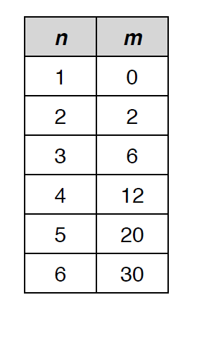
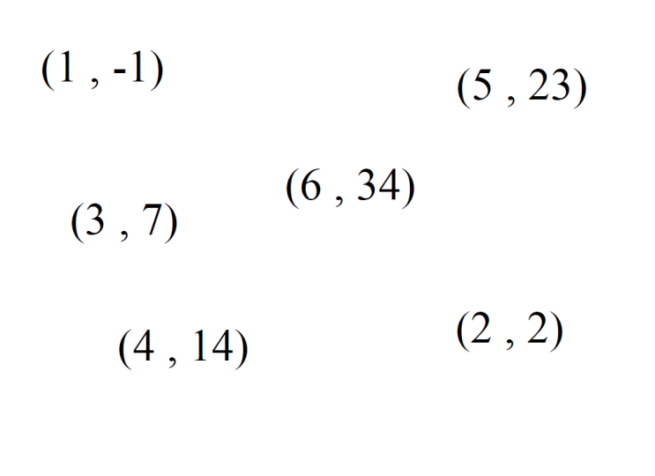
Data presentations

Slide 34
Tentative findings
Linear functions from tabular data:
Check differences, check early terms
Some had no method
Very few checked independent variable
Quadratic functions from linear data:
Check differences
Announce difference pattern
Get stuck! OR deduce deviations from x²

Slide 35
x | y
1 | -2
2 | 0
3 | 4
4 | 10
5 | 18
6 | 28

Slide 36
Strategies
fiddling with differences (common)
avoid the first y value because it is negative (common)
avoid the second y value because it is zero (common)
construct a horizontal rule acting on a particular x value to get the y value, then test (common)
find an adjustment from x² values (occasional)
get inspiration from properties of the higher values (rare)
use a method of finite differences (one instance)

Slide 37
x | y | Δ | Δ²
1 | 3
2 | 8 | 5
3 | 15 | 7 | 2
4 | 24 | 9 | 2
5 | 35 | 11 | 2
6 | 48 | 13 | 2

Slide 38
Having established it is quadratic ….
Look for factors in terms of x
Subtract (k)x² and then identify a linear term
Cuoco:
Student:
Taylor series:

Slide 39
If not sequences, then what …?
Move from what to do to ‘what is it?’
Function as object?

Slide 40
Midlands Mathematics Experiment ‘O’ level (1965)
“Fasten graph paper round a plastic bottle and then make a cylinder of tracing paper which is free to slide on the bottle. Make a device for carrying out the transformations of this section of y = x²”

Slide 41
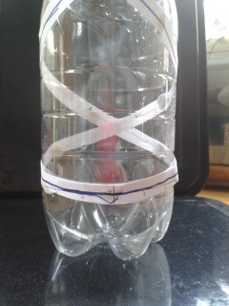

Slide 42
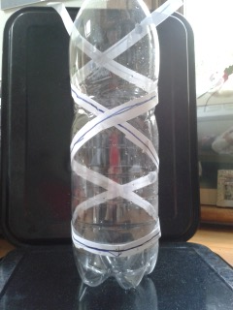

Slide 43
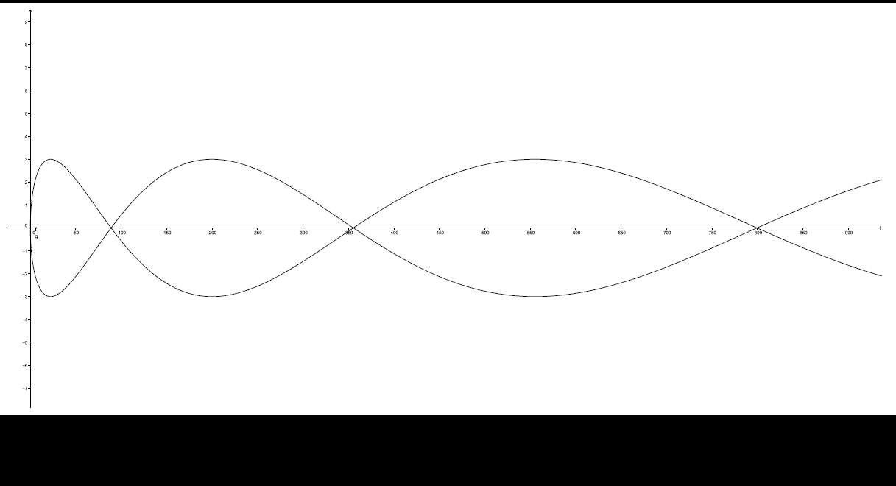

Slide 45
Current textbooks …
A function uses a rule
A functions is a sequence of operations
Functions have inverses
Functions represent real-life events
A rule that gives a unique output for a given input. The rule is usually written as an equation
A function is a rule that assigns to each x in A a unique element y in B
A function is a way of expressing a relationship between two sets of values
A function is a set of numbers that map to one another: there are two methods:
look at inputs as term numbers of a sequence and the outputs as the sequence terms and find the general term
look at inputs as x-coordinates and outputs as y-coordinates, plot a graph and hence find the function

Slide 46
Extreme function finding Find … and another of a different type … and another
… a function whose graph passes through (0,1)
… a function whose graph passes through (π/2, 0)… through (π/3, 0) ...
.... a function whose graph is symmetrical about the y-axis … about y = 1 ...
… a function whose graph is symmetrical about the line y = x … and another…
… a function with maximum value equal to 2 … and another…
… a function which is always increasing… and another…
… a function with no turning points… and another….
… a function for which f(x) = − f(− x) … and another… and another...
… a function whose graph has an asymptote at x = 0 … at x = 1… at x = k ...
… a function whose graph has an asymptote at y = 0 …
… a function which has one irrational root … more than one irrational root … a mixture of rational and irrational roots…
… a function which has no real roots …
... an exponential function that doesn’t pass through (0,1) ...
… an exponential function for which f(x) < 0 for some values of x…
… a trigonometric function with period less than 1 … and another…
… a function such that f’(x) = f⁻¹ (x) … and another …?

Slide 48
Publications (see pmtheta.com)
​Ayalon, M., Watson, A. & Lerman, S. (2016) Students' conceptualisations of function revealed through definitions and examples. Research in Mathematics Education. Ayalon, M., Watson, A. & Lerman, S. (2016) Reasoning about variables in 11 to 18 year olds: informal, schooled and formal expression in learning about functions. Mathematics Education Research Journal Ayalon, M., Watson, A., & Lerman, S. (2015). Progression Towards Functions: Students’ Performance on Three Tasks About Variables from Grades 7 to 12. International Journal of Science and Mathematics Education, 1-21. Online DOI 10.1007/s10763-014-9611-4 Ayalon, Watson and Lerman (2015) Functions represented as linear sequential data: relationships between presentation and student responses Educational Studies in Mathematics.online DRAFT Ayalon, M., Watson, A., and Lerman, S. (2014) Comparison of Students’ Understanding of Functions throughout School Years in Israel and England. In Adams. G. (Ed.) Proceedings of the British Society for Research into Learning Mathematics 34(2) June 2014 Ayalon, M., Lerman, S., & Watson, A. (2013). Development of Students’ Understanding of Functions throughout School Years . Proceedings of the BSRLM, 33(2), 7-12. Ayalon, M., Lerman, S., & Watson, A. (2013) Progression towards understanding functions: What does spatial generalisation contribute?. BCME-8, 16. Ayalon, M., Lerman, S., & Watson, A. (2013). Graph-matching situations: some insights from a cross year survey in the UK. Research in Mathematics Education, 16(1) 73-74. Watson, Anne, and Guershon Harel. (2013) The role of teachers’ knowledge of functions in their teaching: A conceptual approach with illustrations from two cases. Canadian Journal of Science, Mathematics and Technology Education 13.2, 154-168. ​Crisp, R., Inglis, M., Mason, J. and Watson, A. (2012) Individual differences in generalization strategies. Research in Mathematics Education 14(3) 291-292

Slide 49
pmtheta.com
anne.watson@education.ox.ac.uk

