Slide 1
The Mystery of Mastery: what could it mean?
Promoting Mathematical Thinking
John Mason
Mastery in Mathematics Symposium
Nottingham Jan 2016
The Open University
Maths Dept
University of Oxford
Dept of Education

Slide 2
Abstract
I for one have never mastered mathematical thinking, nor ever expect to. But I know from experience that I can develop my mathematical thinking, and I can support others to do the same. Participants will be invited to engage in some mathematical thinking in order to become more attuned to opportunities for pupils to develop their thinking.

Slide 3
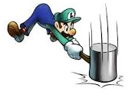
Throat Clearing
Everything said here is a conjecture …
… to be tested in your experience
My approach is fundamentally phenomenological … I am interested in lived experience.
Radical version: my task is to evoke awareness (noticing)
So, what you get from this session will be mostly …
… what you notice happening inside you!
Avoid the teaching of speculators, whose judgements are not confirmed by experience. (Leonardo Da Vinci)
Who or what is progressing towards mastery?
Who makes choices?
What is being attended to, and how?

Slide 4
Conjectures
Mastery
What ‘things’ have you mastered so far in your life?
No possible surprises?
Mastery as a direction
“Man’s reach must exceed his grasp, or what’s a heaven for?” (Robert Browning: Andrea del Sarto)
Expert (relative expert)
Makes the difficult look easy; displays facility
Uses minimum attention to act, so as to notice opportunities and threats
Has multiple possible actions come to ‘mind’ (become available) to enact

Slide 5
Teaching ‘For’ Mastery
Anyone who gets to school can think mathematically by using the natural powers by which they learned and use language
Keeping everyone on the same topic, but working on what they need to work on through pedagogic variation
Accessing core concepts through varying critical ‘dimensions’ in a structured manner; then inviting expressions of generality.

Slide 6
Conjectures
How is progress made towards mastery?
Not always monotonic: there are ups and downs
Cf. Onion Model of Understanding (Pirie & Kieren)
Does practice always make perfect?
If more than training in behaviour is sought, then NO!
Progression involves transformation of
Opportunities noticed
Actions to enact
What is attended to
How attention is directed

Slide 7
Concepts & Procedures
What exactly is a concept?
Example: Divisor; Factor
Example: Decimal; ‘close to’; greater than
Example: Multiplication; Division
What exactly is a procedure?
Example: Long Division
Example: Counting
Cast in terms of attention:
A concept is a state in which attention is organised around or based on a label for some properties that express relationships and that are supposed to hold in order to be an example (concept image); access to relevant actions
A procedure is a sequence of actions to be enacted; organised by underlying concept(s)
If “Knowing is Enacting”, what is the difference between a concept and a procedure?

Slide 8
Mastering
‘Mastering a technique’ must mean reducing to a minimum the amount of attention required to carry through the technique
but this does NOT mean ‘practicing on routine tasks.
‘Mastering a concept’ must mean having a strong personal narrative, awareness of all of the possible dimensions of possible variation, using the concept to express mathematical relationships in a variety of contexts, and access to a rich space of examples and example construction

Slide 9
Alternative Formulation
Developing Masterful Mathematical Thinking
Through experiencing and exploring variation
In contrast to mindless rehearsal and meaningless exercising
Nothing wrong with some memorisation, but what really matters is own-narratives making connections, integrating thought and action

Slide 10
Decimal Numbers
Well known issue is ordering decimals
Please write down a decimal number between 3 and 4
Please write down a decimal number between 3 and 4 that does not use the digit 5
Please write down a decimal number between 3 and 4 that does not use the digit 5 and that does use the digit 8
Please write down a decimal number between 3 and 4 that does not use the digit 5 and that does use the digit 8 and that is as close as possible in value to 7/2
How close can you get?

Slide 11
Counting
1, 2, 3, 4
2, 3, 4, 5
3, 4, 5, 6
…
To my rhythm

Slide 12
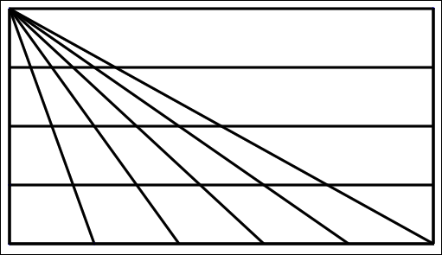
Triangle Count
In how many different ways might you count the triangles?
(5 + 4 + 3 + 2 + 1) x 4 + 1
What are you attending to?
Notes:
15 x 4 + 1

Slide 13
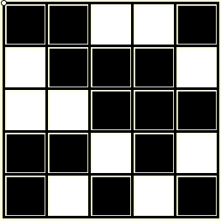
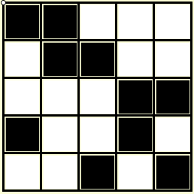
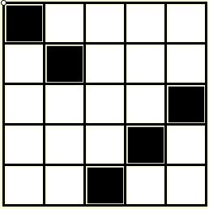
Counting
Here is a grid with exactly one cell in each row and column painted black.
Here there are exactly two painted cells in each row and column.
Here there are exactly three painted cells in each row and column.
How many such paintings are there?
Notes:
Counting seems pretty straigtforward!

Slide 14
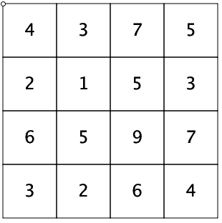
Covered-Up Sums
Cover up 4 cells, exactly one from each row and column
Add their values together
How many different answers can you get?
How do you know?
Say What You See
What relationships can you find?

Slide 15
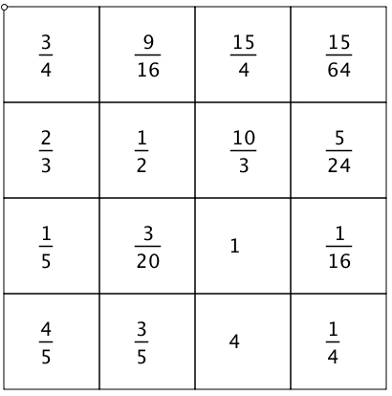
Covered-Up Products
Cover up 4 cells, exactly one from each row and column
Multiply their values together
How many different answers can you get?
How do you know?

Slide 16
Twisted
Alex Bellos
Notes:
https://twitter.com/OxfordEdMaths?ref_src=twsrc%5Etfw

Slide 17
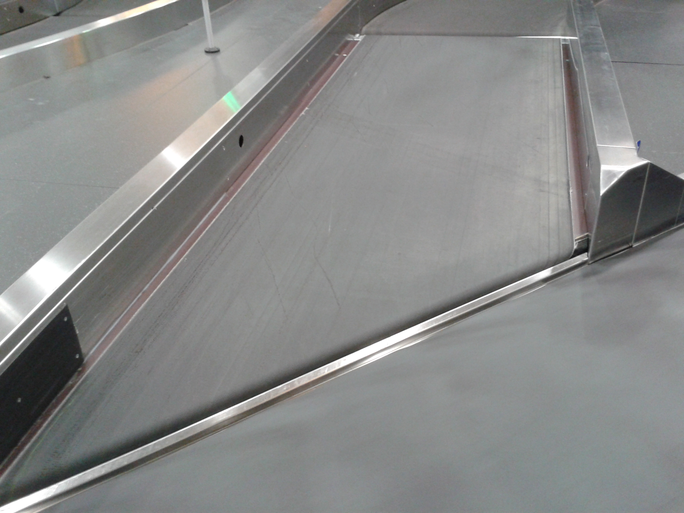
Belted

Slide 18
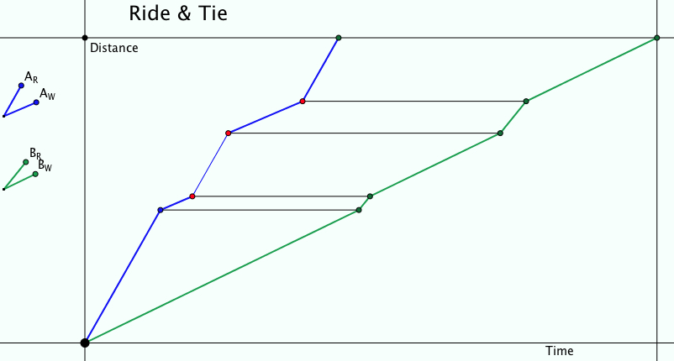
Ride & Tie

Slide 19
Attribute Grids: functions
Range
Domain
0<y<1
0≤y<1
0<y≤1
0≤y≤1
0<x<1
0≤x<1
0<x≤1
0≤x≤1

Slide 20
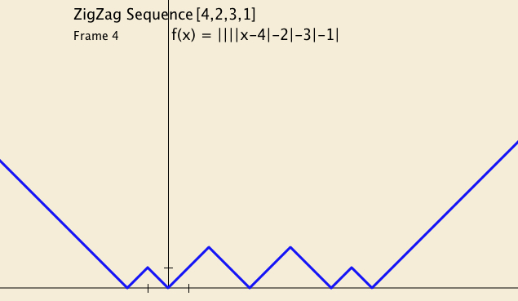
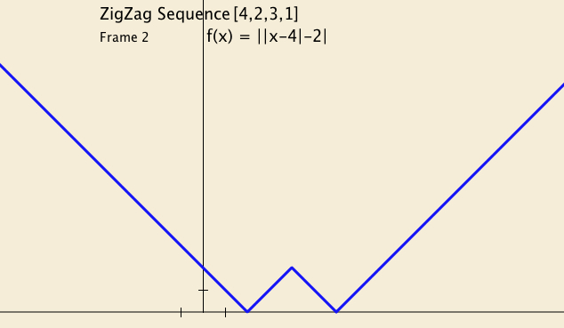
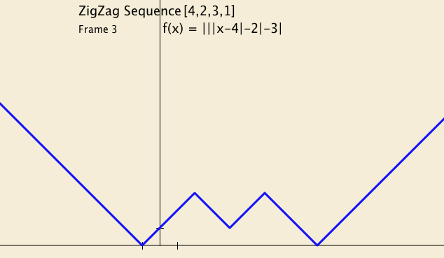
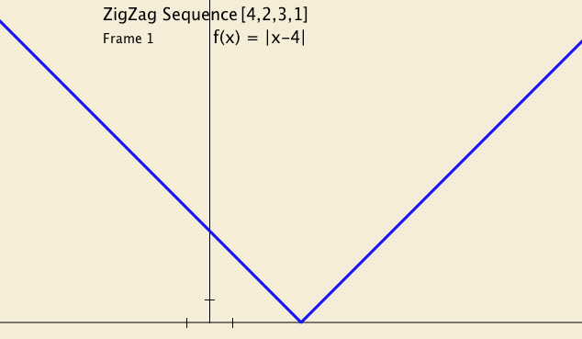
ZigZag Sequences

Slide 21
Compound Functions

Slide 22
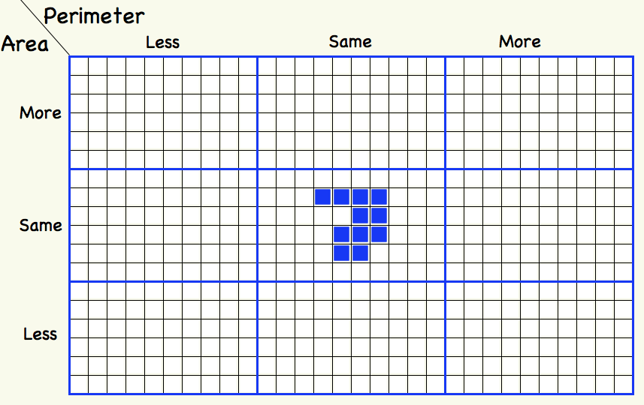
More or Less

Slide 23
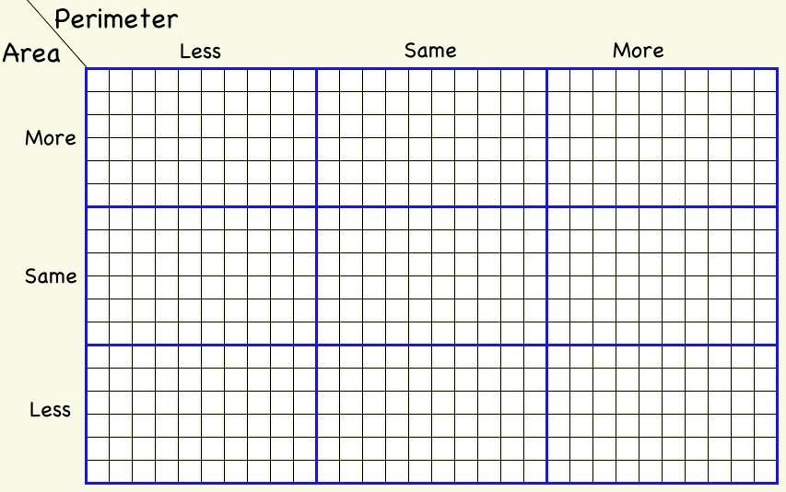
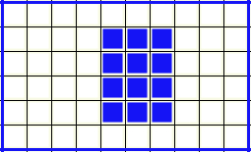
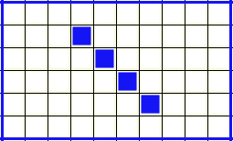
More or Less Extended
For each of the following, which parts cannot be filled?

Slide 24
HCF
What is the HCF of 12 and 18 (written (12, 18))?
What are all the pairs of numbers which have 6 as their HCF?
(6A, 6B) = 6
A
6
B
6A
6B
A & B are relatively prime or (A,B) = 1

Slide 25
LCM
What is the LCM of 12 and 18 (written [12, 18])?
12 x p = 18 x q so 2p = 3q so p=3, q=2, [12, 18] = 36
In how many different ways can 36 be the LCM of two numbers?
[6A, 6B] = 6AB
6A
A
6
B
6B
A & B are relatively prime or (A,B) = 1

Slide 26
HCF with LCM
LCM of 12 and 18
Times
HCF of 12 and 18
What is the same and what different about
[12, 18] x (12, 18) and 12 x 18?
How do you know? Is it sometimes or always true?
6A
6B
A
6
B
[6A, 6B] = 6AB
(6A, 6B) = 6
A & B are relatively prime or (A,B) = 1

Slide 27
More HCF & LCM
LCM of (the HCF of 30 and 42, the HCF of 42 and 70, and the HCF of 70 and 30)
What is [(30, 42), (42, 70), (70, 30)]?
[6, 14, 10] = 2 x 3 x 5 x 7
42 = 2x3x7x1
1
What is the diagram about?
How is it constructed?
How can it be read?
3
7
2
1
5
1
30 = 2x3x5x1
70 = 2x5x7x1
HCF of (the LCM of 30 and 42, the LCM of 42 and 70, and the LCM of 70 and 30)
What is ([30,42], [42,70], [70, 30])?
(6 x 5 x 7, 6 x 7 x 5, 10 x 7 x 3)
= 2 x 3 x 5 x 7
Always? Sometimes?

Slide 28
HCF & LCM of Rationals
The rational number a/b is said to divide exactly into the rational number c/d if and only if a/b divided by c/d is an integer.
Make up some examples so as to get a feel for divisibility of Rationals
What is the HCF of 10/21 and 14/15?
Divisors of 10/21 are of the form x/y where 10y/21x is an integer
So x is a divisor of 10 and y is a multiple of 21; (x, y) = 1
Divisors of 14/15 are of the form x/y
So x is a divisor of 14, and y is a multiple of 15; (x, y) = 1
So HCF must be (10, 14)/[21, 15]
What is the LCM of 10/21 and 14/15?
What is the product of the HCF and the LCM?

Slide 29
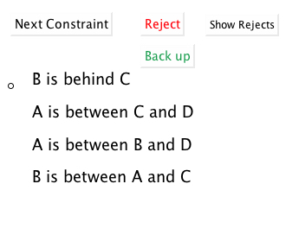
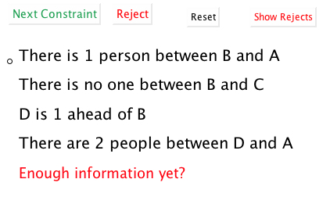
Reasoning About Order

Slide 30
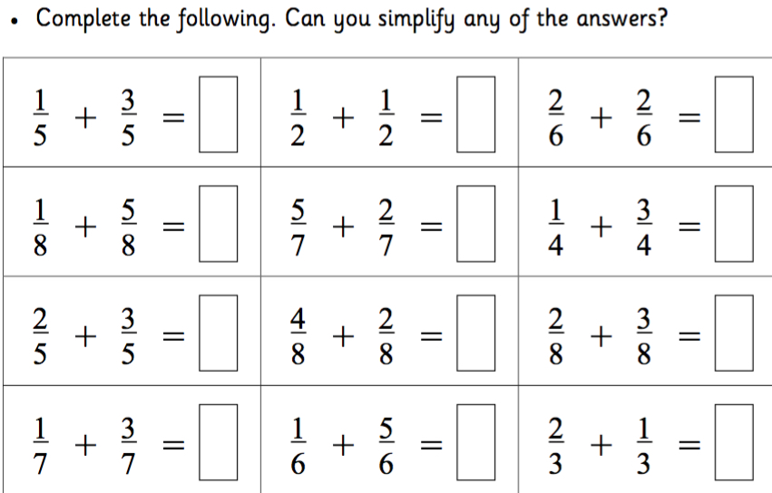
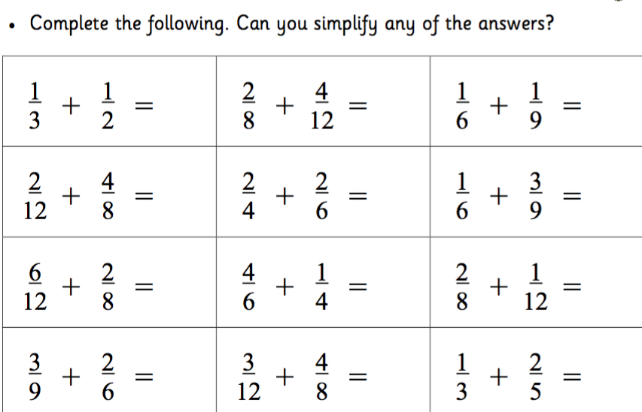
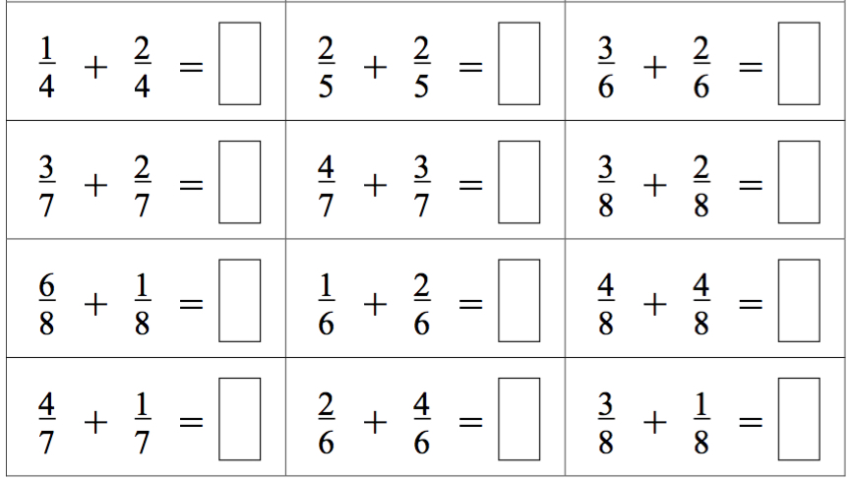
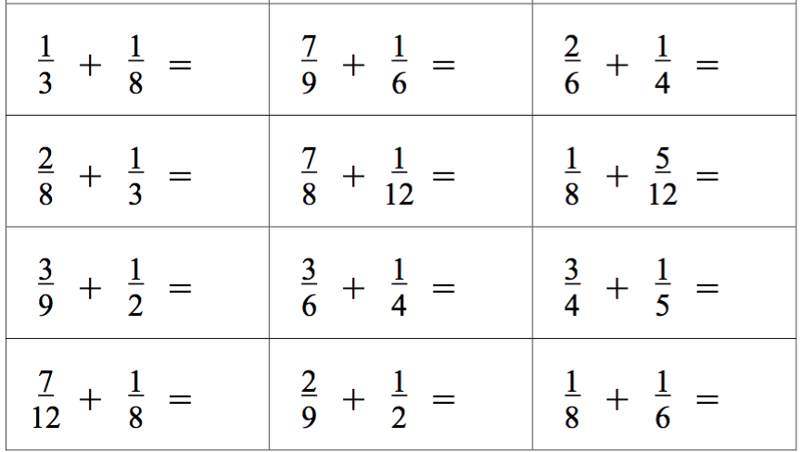
Fraction Assessment
What is available to be learned?
Notes:
Snappy Maths
http://www.snappymaths.com/counting/fractions/fractions.htm

Slide 31
Multi-Level Initiating of Tasks
In how many ways can a unit fraction be expressed as the difference of two unit fractions?
Notice that
Notice that
Notes:
Ways of initiating activity through presentation of a task

Slide 32
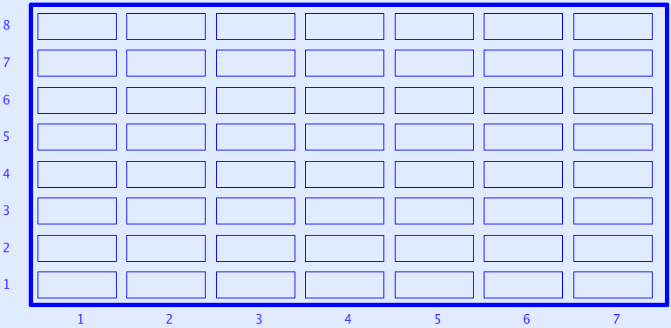
Sundaram Grids
7
12
4
7
If a number appears in this grid (extended to the right and up) then
doubling it and adding 1
gives a composite number.
All rows and columns are arithmetic progressions
How many entries do you need to fill out the grid?
Notes:
Drc=6, Dr=4 Dc=3 S=1 –> numbers that are the product of two numbers, one odd, the other congruent to 1 mod 3
Drc*rc+r(Dr-Drc)+c(Dc-Drc)+Drc-Dr-Dc+S
Disturbance; challenge + Trust that it is not excessive

Slide 33
Related Polygons

Slide 34
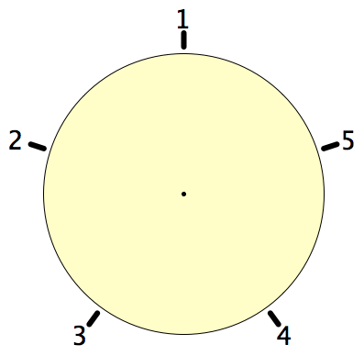
Secret Places
One of these five places has been chosen secretly.
You can get information by clicking on the numbers.
If the place where you click is the secret place, or next to the secret place, it will go red (hot), otherwise it will go blue (cold).
How few clicks can you make and be certain of finding the secret place?
Can you always find it in 2 clicks?

Slide 35
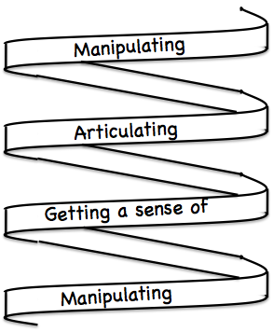
Frameworks
Doing – Talking – Recording (DTR)
(MGA)
See – Experience – Master (SEM)
Enactive – Iconic – Symbolic (EIS)
Specialise … in order to locate structural relationships …
then re-Generalise for yourself
Stuck?
What do I know?
What do I want?

Slide 36
Mathematical Thinking
How might you describe the mathematical thinking you have done so far today?
How could you incorporate that into students’ learning?
What have you been attending to:
Results?
Actions?
Effectiveness of actions?
Where effective actions came from or how they arose?
What you could make use of in the future?

Slide 37
Towards Mastery
“Man’s reach must exceed his grasp, or what’s a heaven for?” [Robert Browning: Andrea Del Sarto]
Mastery is an ideal, something to reach for; an on going developmental process, never completed
There are strategies for deepening appreciation and comprehension of concepts by
Enriching example spaces and methods of example construction
Refining personal narratives
Extending connections
There are ways to gain procedural facility by
Engaging in tasks in which the learner constructs and works examples for themselves in exploration

Slide 38
Everyone on the Same Topic
Didactic Contract
Displaying ways in which learners can complexify, vary and extend for themselves
Doing & Undoing
Extending & Varying
Providing tasks that inspire and provoke mathematical thinking
Learner constructed examples for a purpose
Making ‘real’ through mental imagery, through posing own questions, through situations in the material world.
More about learner confidence and trust than about ‘material world applications’

Slide 39
Reflection as Self-Explanation
What struck you during this session?
What for you were the main points (cognition)?
What were the dominant emotions evoked? (affect)?
What actions might you want to pursue further? (Awareness)
Notes:
Chi et al

Slide 40
To Follow Up
PMTheta.com and mcs.open.ac.uk/jhm3
john.mason@open.ac.uk
A Brief Guide to Modelling in Secondary School: estimating big numbers (TEAMAT 34 p223-228)
Designing & Using Mathematical Tasks (Tarquin)
Mathematics as a Constructive Enterprise (Erlbaum)
Thinking Mathematically (Pearson)
Key Ideas in Mathematics (OUP)
Researching Your own Practice Using The Discipline of Noticing (RoutledgeFalmer)
Questions and Prompts: (ATM)
Fundamental Constructs in Mathematics Education (RoutledgeFalmer)
Annual Institute for Mathematical Pedagogy (end of July: see PMTheta.com)

