Slide 6
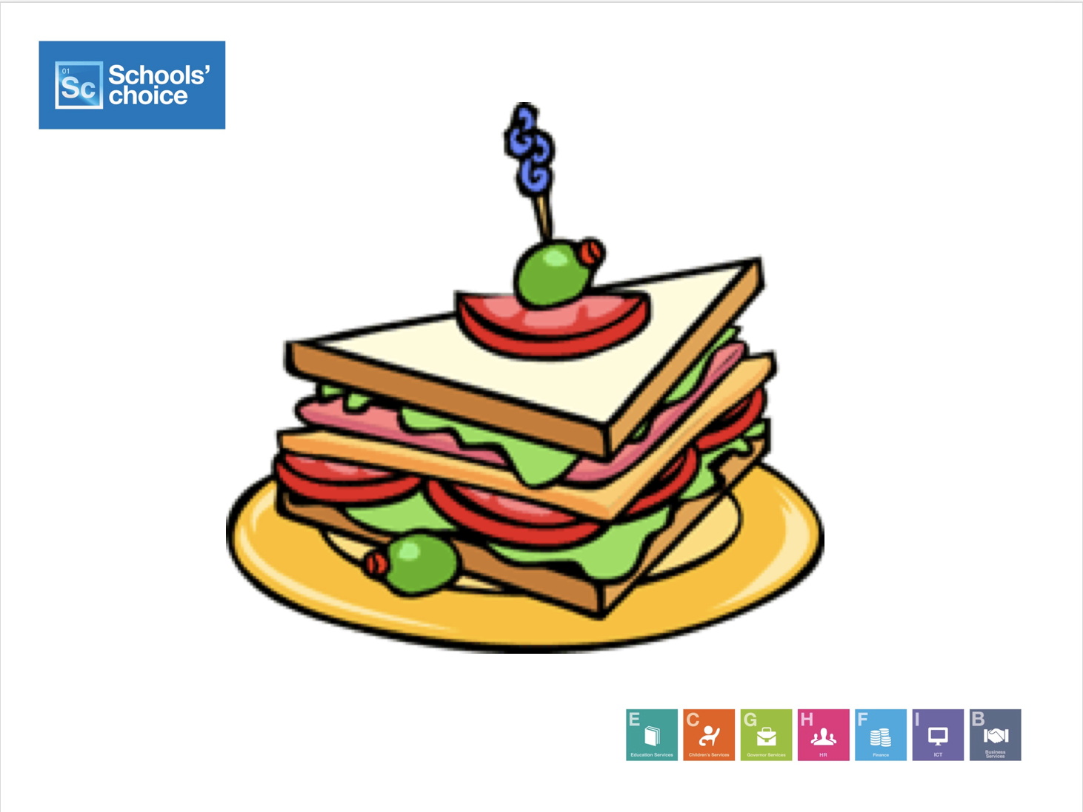

Slide 10
Mastering Mastery Teaching of Primary Mathematics
The Open University
Maths Dept
Promoting Mathematical Thinking
University of Oxford
Dept of Education
John Mason
Raising Achievement in Primary Mathematics
School’s Choice
Ipswich June 2017

Slide 11
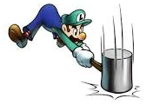
Throat Clearing
Everything said here is a conjecture …
… to be tested in your experience
My approach is fundamentally phenomenological … I am interested in lived experience.
Radical version: my task is to evoke awareness (noticing)
So, what you get from this session will be mostly …
… what you notice happening inside you!
Avoid the teaching of speculators, whose judgements are not confirmed by experience. (Leonardo Da Vinci)
Who takes initiative?
Who makes choices?
What is being attended to?

Slide 12
Blurb
Participants will be invited to work together on some mathematical tasks through which it will be possible to experience something of what ‘mastery teaching’ (Shanghai style) could mean for us in our culture and situation.
We will probe beneath the surface of slogans such as Concrete-Pictorial-Abstract and Meet-Encounter-Begin to Master by linking these to practical actions.

Slide 13
Outline
Arithmetic as study of relationships
Adding & Subtracting as actions
In and out of bags
Back & Forth on the numberline
Working with numbers
Multiplying and Dividing as Actions
Elastics & Scaling
Presenting Multiplication

Slide 14
What’s The Difference?
I have two bags of counters, but I don’t know what is in them.
I am going to see how many more one bag has than the other.
But first, someone puts one new counter in each bag.
How would the difference change?
What if instead, someone puts one new counter in the bigger bag and takes one away from the smaller bag?
How would the difference change?
What could be varied?
Notes:
• 153 – 87 = ? Orally; visibly;
•That is arithmetic; Now let’s do some mathematics!
Two volunteers: think of a three digit number and a two digit number.
• We’re going to subtract the smaller from the larger but before we do, lets add one to both.
What’s the difference now?

Slide 15
What’s The Difference?
Two people are standing on a numberline
They want to know how far it is between them
Before they measure, the both take one stepto the right
What if instead, one of them walks two steps away from the other, and the other takes one step twpoards the first?
How would the difference change?
How would the difference change?
What could be varied?
Notes:
• 153 – 87 = ? Orally; visibly;
•That is arithmetic; Now let’s do some mathematics!
Two volunteers: think of a three digit number and a two digit number.
• We’re going to subtract the smaller from the larger but before we do, lets add one to both.
What’s the difference now?

Slide 16
What’s The Difference?
There are some people standing at a bus stop, and when the bus arrives, there are people on the bus.
I am going to see how many more people are on the bus than in the queue.
But first, someone sneaks off the bus, and someone leaves the queue.
How would the difference change?
What if instead, someone sneaks on the bus and someone leaves the queue, before I do the comparison?
How would the difference change?
What could be varied?
Notes:
• 153 – 87 = ? Orally; visibly;
•That is arithmetic; Now let’s do some mathematics!
Two volunteers: think of a three digit number and a two digit number.
• We’re going to subtract the smaller from the larger but before we do, lets add one to both.
What’s the difference now?

Slide 17
What’s The Difference?
–
=
First, add one to each
How would the difference change?
How would the difference change?
First, add one to the larger and subtract one from the smaller
What could be varied?
Notes:
• 153 – 87 = ? Orally; visibly;
•That is arithmetic; Now let’s do some mathematics!
Two volunteers: think of a three digit number and a two digit number.
• We’re going to subtract the smaller from the larger but before we do, lets add one to both.
What’s the difference now?

Slide 18
Variation Contributing to Mastery
Of the context
Of the numbers involved
Opportunity eventually to get children to express a generality

Slide 19
Doing & Undoing (adding & subtracting)
What operation undoes ‘adding 3’?
What operation undoes ‘subtracting 4’?
Does order matter?
Contexts
Bag of counters
Numberline movements
Buses

Slide 20
Multiplicative Thinking
Exchanging counters in bags
Elastic Multiplication & Division
Scaling

Slide 21
Presenting Multiplication
Drakensberg grid

Slide 22
Doing & Undoing (multiplying & dividing)
What undoes ‘multiplying by 3’?
What undoes ‘dividing by 4’?
Does the order matter?
Contexts
Scaling
Arrays
Bar diagrams
What undoes ‘multiplying by 3/4’?
Two different expressions!
Dividing by 3/4 or Multiplying by 4 and dividing by 3
Notes:
Dave Hewitt’s THOAN sequences

Slide 23
More Doing & Undoing
What operation undoes ‘subtracting from 7’?
What operation undoes dividing into 12?
Notes:
Dave Hewitt’s THOAN sequences

Slide 24
Reasoning Reasonably in Mathematics
The Open University
Maths Dept
Promoting Mathematical Thinking
University of Oxford
Dept of Education
John Mason
Raising Achievement in Primary Mathematics
School’s Choice
Ipswich June 2017

Slide 25
Path Length

Slide 26
Appreciating & Comprehending Division
I tell you that 10101 is divisible by 37.
What is the remainder upon dividing 1010137 by 37?
What is the remainder upon dividing 1010123 by 37?
What is the remainder upon dividing 10124 by 37?
What is the remainder upon dividing 232323 by 37?
Make up your own similar question
What is the same and what different about your task and mine?
How do you know?
0
Did you write it down for yourself?
How do you know?
1010100+37
23
How do you know?
23
0
How do you know?
It’s all about what you are attending to, and how you are attending to it
Attention is directed by what is being varied
Notes:
Student initiative

Slide 27
-1 x -1

Slide 28
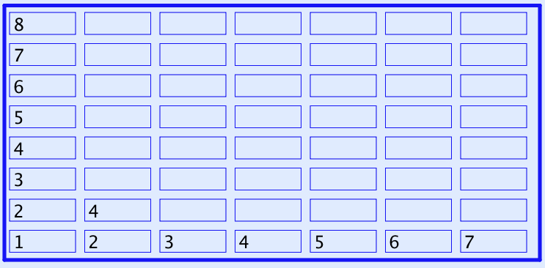
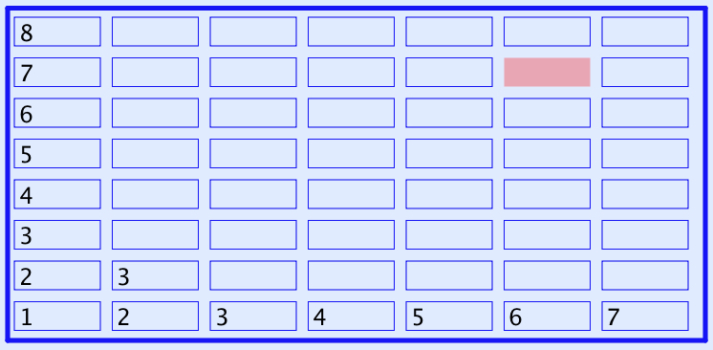
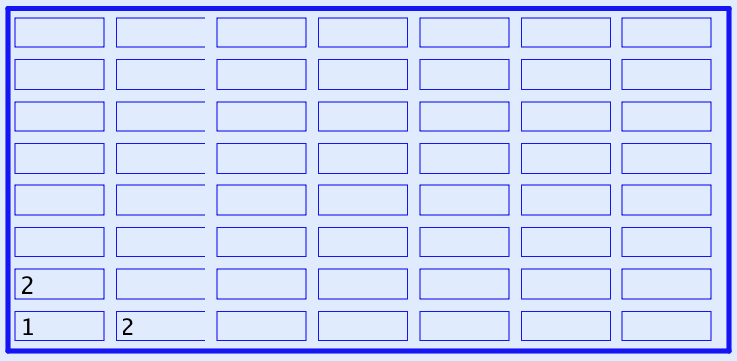
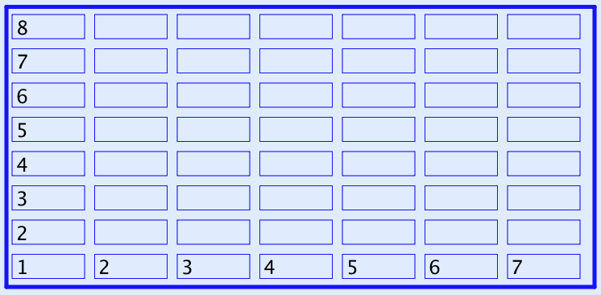
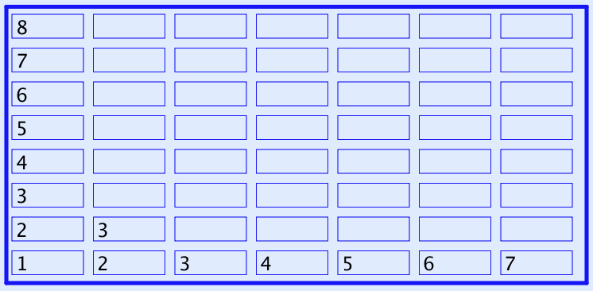
What Next?
Every row and column is an arithmetic progression (constant difference)

Slide 29
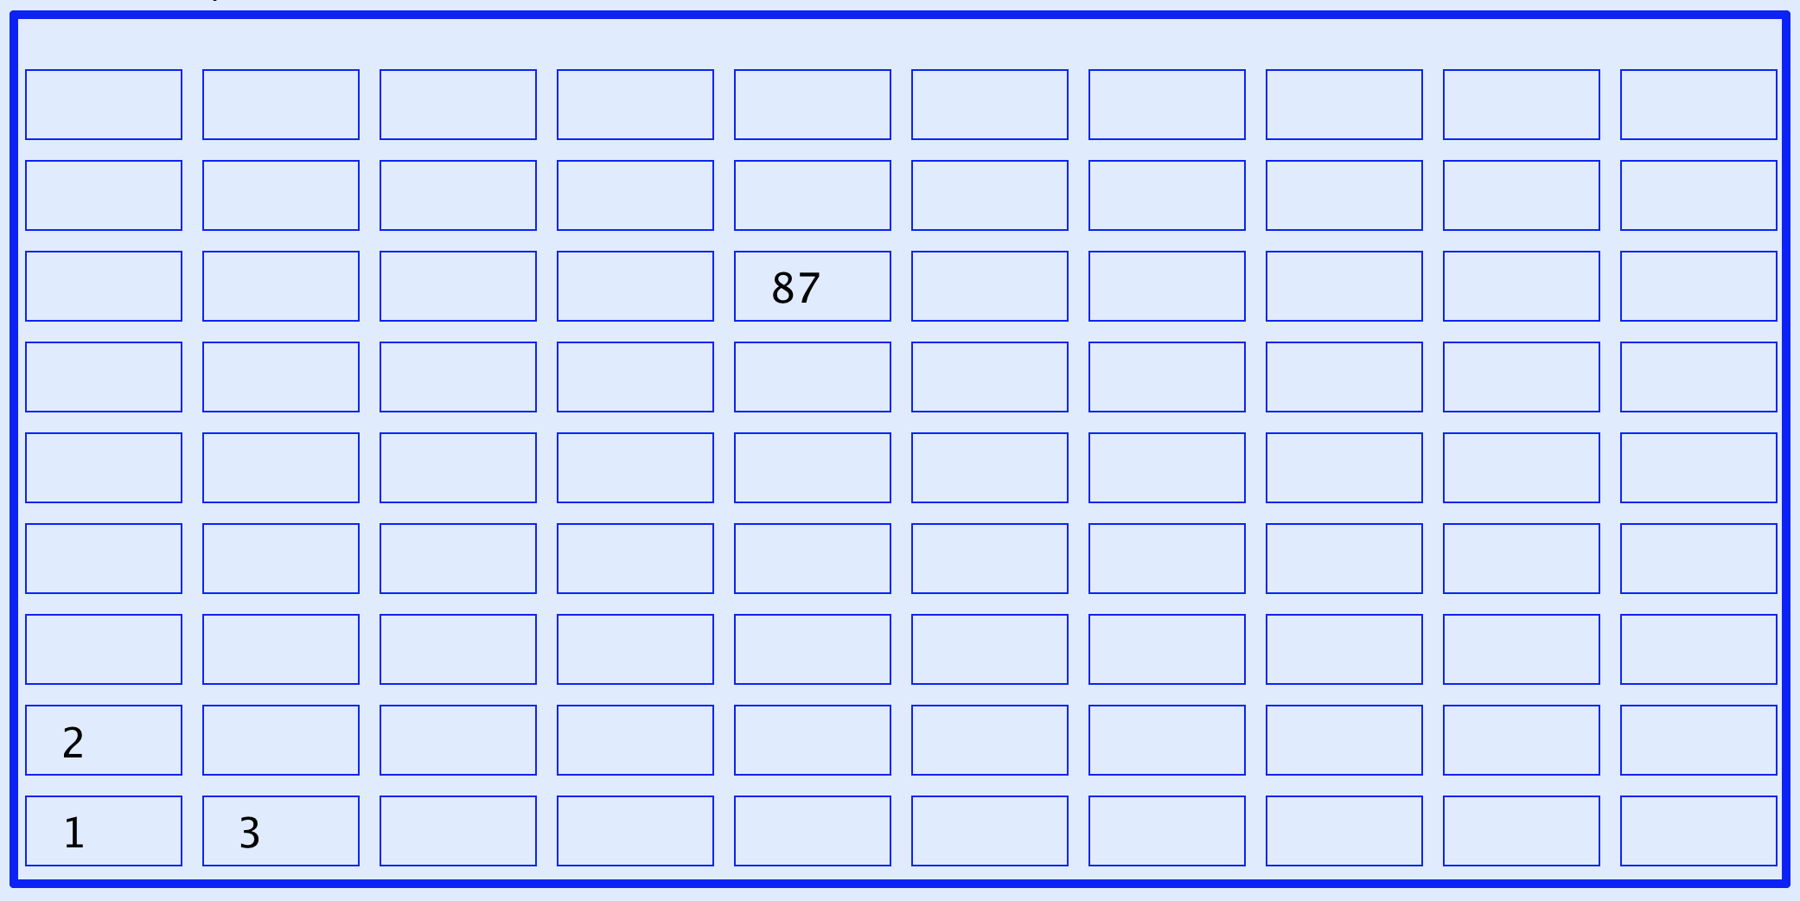
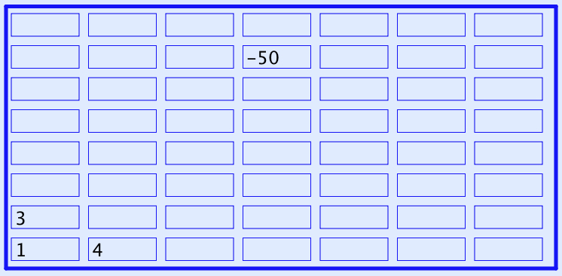
Now What Next?
A lesson without the opportunity to express generality is not a mathematics lesson
Notes:
Expressing Generality

Slide 30
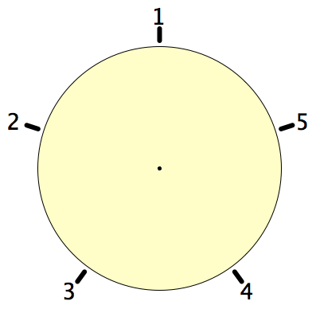
Secret Places
One of these five places has been chosen secretly.
You can get information by clicking on the numbers.
If the place where you click is the secret place, or next to the secret place, it will go red (hot), otherwise it will go blue (cold).
How few clicks can you make and be certain of finding the secret place?
Can you always find it in 2 clicks?
Notes:
Imagine a round table …

Slide 31
Frieze
It is known that this frieze pattern is generated by a repeating block of cells, and that a generating block appears at least twice.
What question(s) might you ask?
What colour is the 100th cell?
In what position is the 100th green cell?
Make up your own
Make an easy one
Make a challenging one
What makes it challenging?
Notes:
Chant the sequence of colours … you might find your chanting falling into a rhythm! (Watch What You Do)

Slide 32
Covered Up Sums
Cover up one entry from each row and each column. Add up the remaining numbers.
The answer is (always) the same!
Why?
0
-2
2
-4
6
4
8
2
3
1
5
-1
Stuck?
Specialise!
1
-1
3
-3
Example of seeking invariant relationships
Example of focusing on actions preserving an invariance
Opportunity to generalise
Notes:
Use fractions to urge practice with fractions
Get students to make up their own with their age or some other number as the answer

Slide 33
Covered Up Sums
How much freedom of choice do you have when making up your own?
a
b
c
d
a
e
b
e
a
b
f
c
f
?
g
d
e
e-(a-b)
g
Opportunity to generalise
Opportunity to quantify freedom of choice
Notes:
Use fractions to urge practice with fractions
Get students to make up their own with their age or some other number as the answer

Slide 34
Progression & Development
DTR (do, talk, record)
MGA (manipulating, getting-a-sense-of, articulting)
EIS (enactive, iconic, symbolic: Bruner)
(weaning off material objects)
PES (enriching Personal Example Space)
LGE (Learner Generated Examples)
Re-construction when needed
Communicate effectively with others

Slide 35
Reasoning Conjectures
What blocks children from displaying reasoning is often lack of facility with number.
Reasoning mathematically involves seeking and recognsing relationships, then justifying why those relationships are actually properties that always hold.
Put another way, you look for invariants (relationships that don’t change) and then express why they must be invariant.
A task like Cover up can be used to get children to practice adding (you could use fractions or decimals!) while trying to work out what is happening, or even while trying to construct their own!

Slide 36
Inner, Outer & Mediating Aspects of Tasks
Outer
What task actually initiates explicitly
Inner
What mathematical concepts underpinned
What mathematical themes encountered
What mathematical powers invoked
What personal propensities brought to awareness
Mediating
Between teacher and Student
Between Student and Mathematics (concepts; inner aspects)
Activity
Enacted & lived objects of learning
Object of Learning
Resources
Tasks
Current State
Notes:
Tahta
Bennett

Slide 37
Concrete-Pictorial-Abstract
(re)-presentations
Enactive – Iconic – Symbolic
Manipulating – Getting-a-sense-of – Articulating
Doing – Talking – Recording

Slide 38
Powers & Themes
Are students being encouraged to use their own powers?
Powers
or are their powers being usurped by textbook, worksheets and … ?
Imagining & Expressing
Specialising & Generalising
Conjecturing & Convincing
(Re)-Presenting in different modes
Organising & Characterising
Themes
Doing & Undoing
Invariance in the midst of change
Freedom & Constraint
Restricting & Extending
Exchanging

Slide 39
Reflection and the Human Psyche
What struck you during this session?
What for you were the main points (cognition)?
What were the dominant emotions evoked? (affect)?
What actions might you want to pursue further? (enaction)
What initiative might you take (will)?
What might you try to look out for in the near future (witness)
What might you pay special attention to in the near future (attention)?
What aspects of teaching need specific care (conscience)?
Notes:
Chi et al

Slide 40
Reflection
Withdrawing from action
Becoming aware of an action, or a relationship
NOT ‘telling them so they remember’ BUT rather immersing them in a culture of mathematical practices

Slide 41
Mathematical Thinking
How might you describe the mathematical thinking you have done so far today?
How could you incorporate that into students’ learning?
What have you been attending to:
Results?
Actions?
Effectiveness of actions?
Where effective actions came from or how they arose?
What you could make use of in the future?

Slide 42
Reflection as Self-Explanation
What struck you during this session?
What for you were the main points (cognition)?
What were the dominant emotions evoked? (affect)?
What actions might you want to pursue further? (Awareness)
Notes:
Chi et al

Slide 43
To Follow Up
PMTheta.com
john.mason@open.ac.uk
Designing & Using Mathematical Tasks (Tarquin)
Mathematics as a Constructive Enterprise (Erlbaum)
Thinking Mathematically (Pearson)
Key Ideas in Mathematics (OUP)
Researching Your Own Practice Using The Discipline of Noticing (RoutledgeFalmer)
Questions and Prompts: (primary) (ATM)
Annual Institute for Mathematical Pedagogy (early August: see PMTheta.com)

