Slide 1
Linearity is a special case: a curriculum rethink
We gather some functions together in a visual perspective on some key curriculum ideas that deserve more attention than the label 'non-linear' suggests

Slide 2
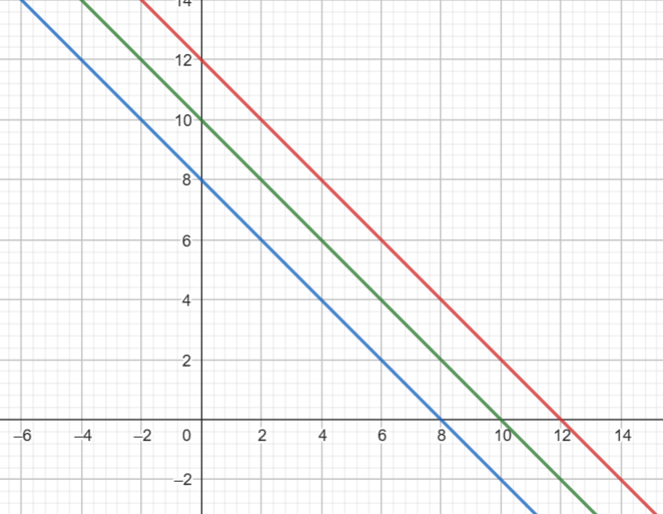
What characteristics can you see?
Why are the lines parallel?
What relationships are represented?
Number bonds!!

Slide 3
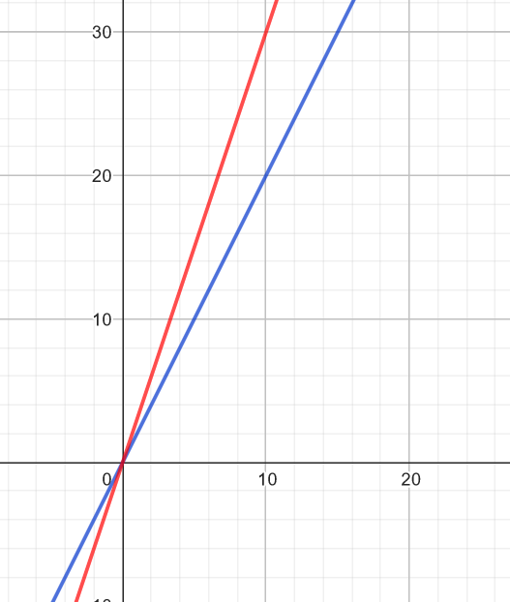
What characteristics can you see?
Why do the lines go through the origin?
What relationships are represented?
Multiplication facts!!
Proportionality

Slide 4
Building on the idea of ‘fact families’
A straight line goes through (0,5) and (3,0) on the usual axes
Write an equation to represent this line
… and another
… and another
Compare equations
How does each equation tell you about the function - in particular how does it relate to features of the graph?

Slide 5
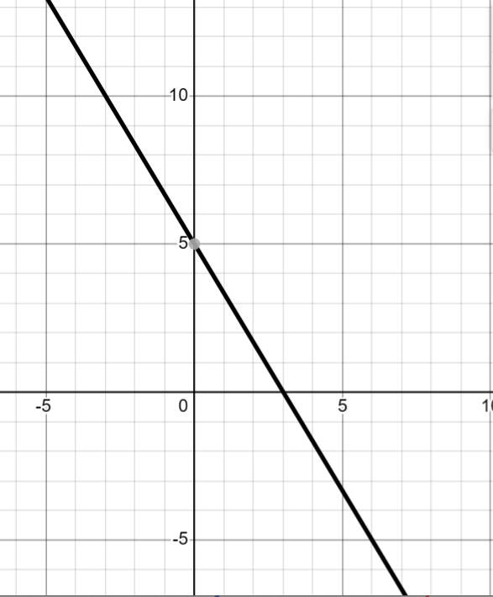
Examples
y=5(1-x/3)
3y + 5x=15
15 – 5x = 3y
...
1=5(15-x)/3y
(3/x) + (5/y) = 15/xy

Slide 7
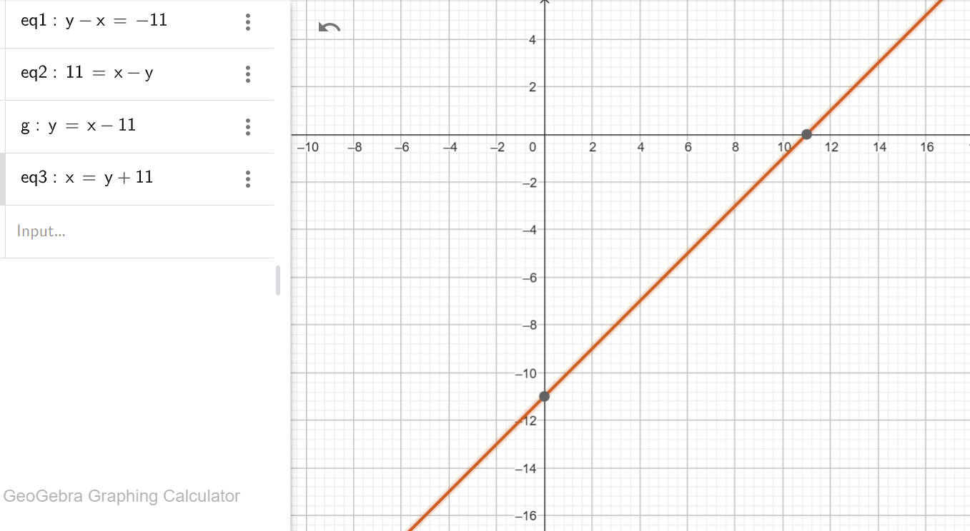
Looks like reflection of a ‘number bond’ line. Why?

Slide 8
Add 2 to one of the lengths
x + y = 8
(x + 2) + y = 8 + 2
x + (y + 2) = 8 + 2
What effect does that have on the graph?
Ambiguity

Slide 9
Making fractions (Griffiths, Back & Gifford 2023)
If one cake is shared between 5 people, each person gets a fifth
If one cake is shared between 6 people, each person gets a sixth
etc.
Number of people | Size of portion
2
3
4
5
6

Slide 10
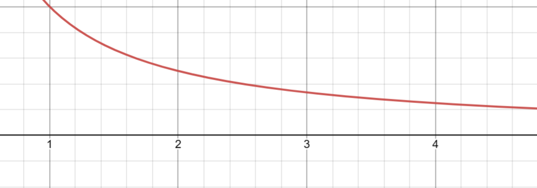
1

Slide 11
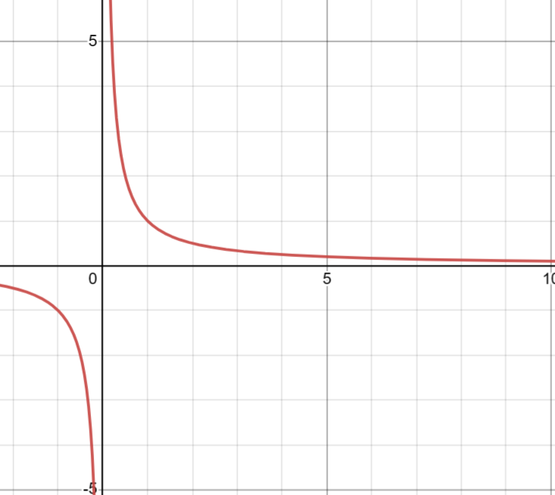

Slide 12
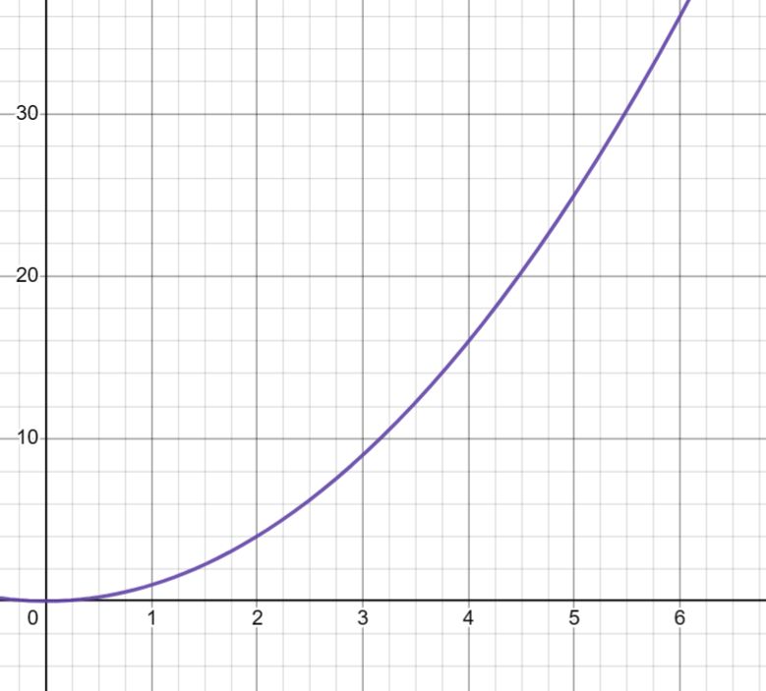
Area of square and side of square

Slide 13
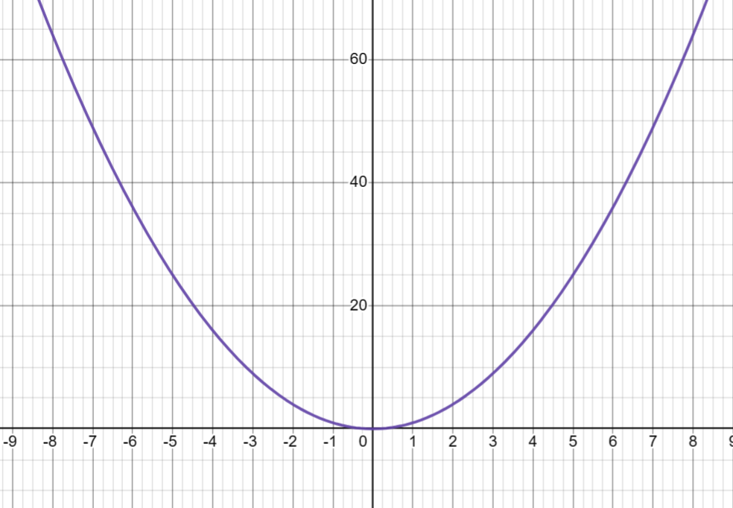

Slide 14
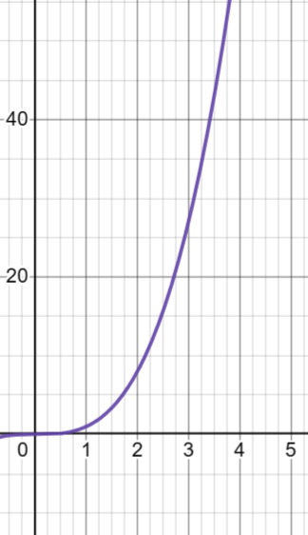
Volume of cube and side of cube

Slide 15
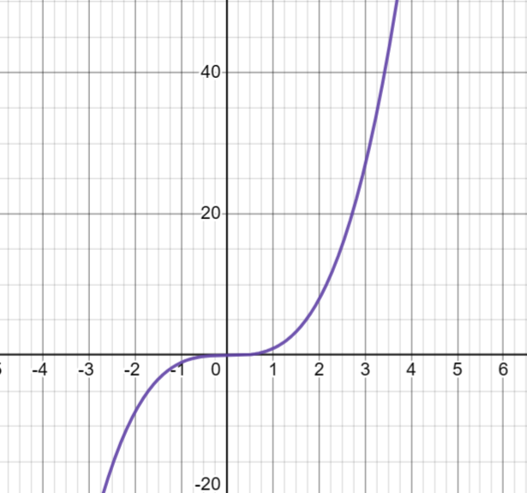

Slide 16
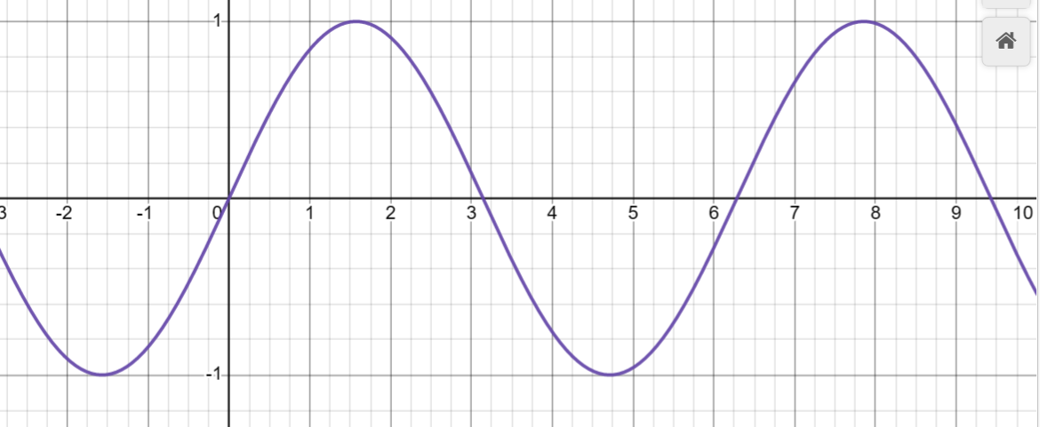

Slide 17
Sequences

Slide 18
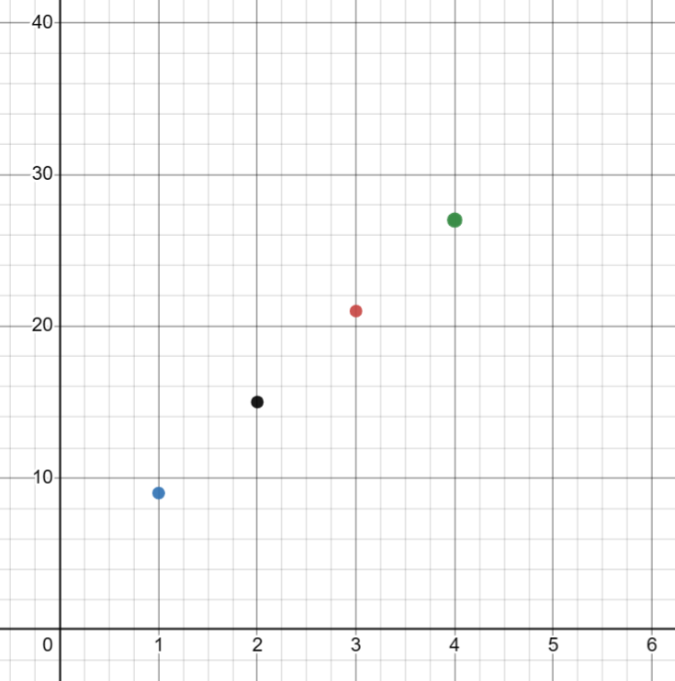
Join the dots?
Artificial contexts?

Slide 19
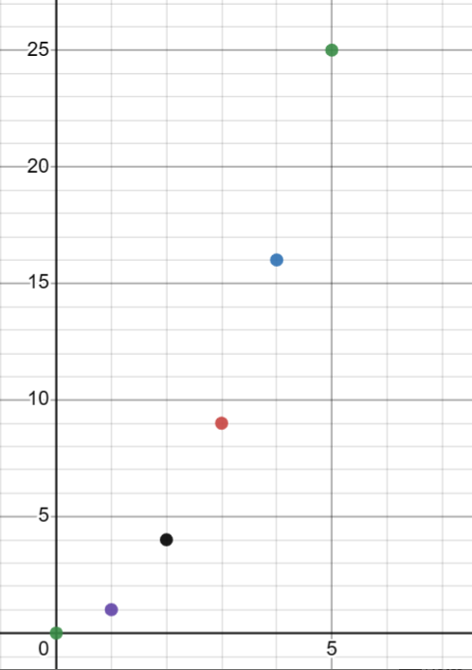
Join the dots?

Slide 20
Playing with functions as objects

Slide 21
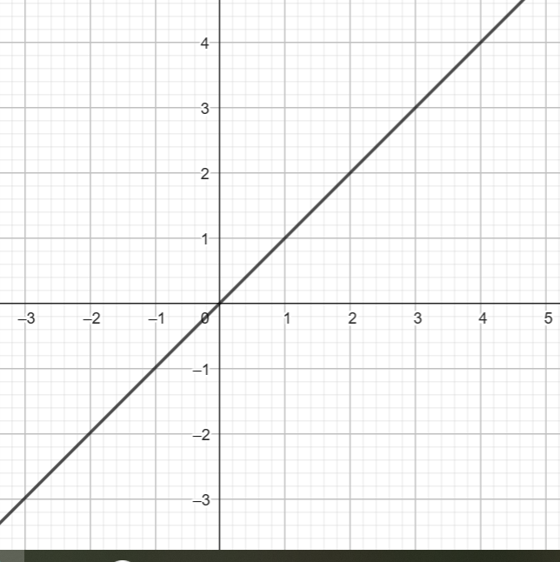
Add 2 to one of the variables
Which way does the graph move?

Slide 22
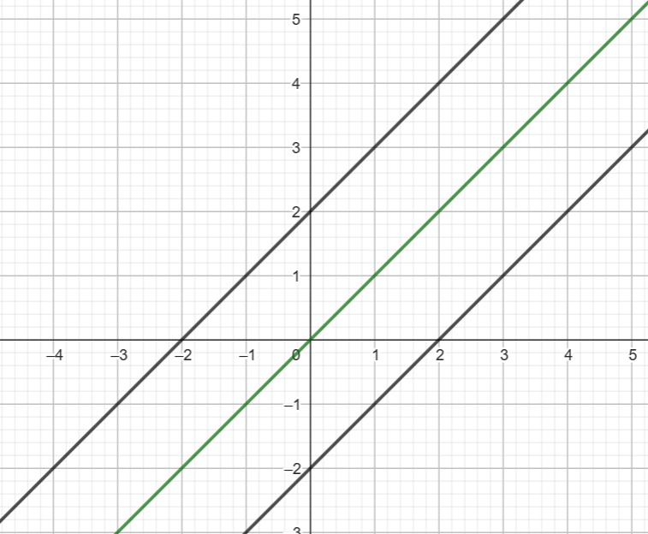
The underlying equalities
y = x
y + 2 = x
y = x + 2
y - 2 = x
y = x - 2
Does the line move up or down or sideways?

Slide 23
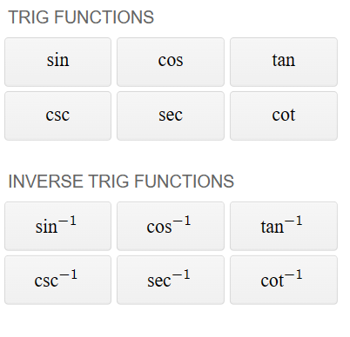
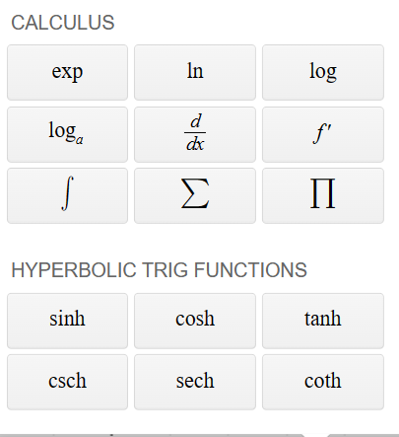

Slide 24
Playing with a graph plotter

Slide 25
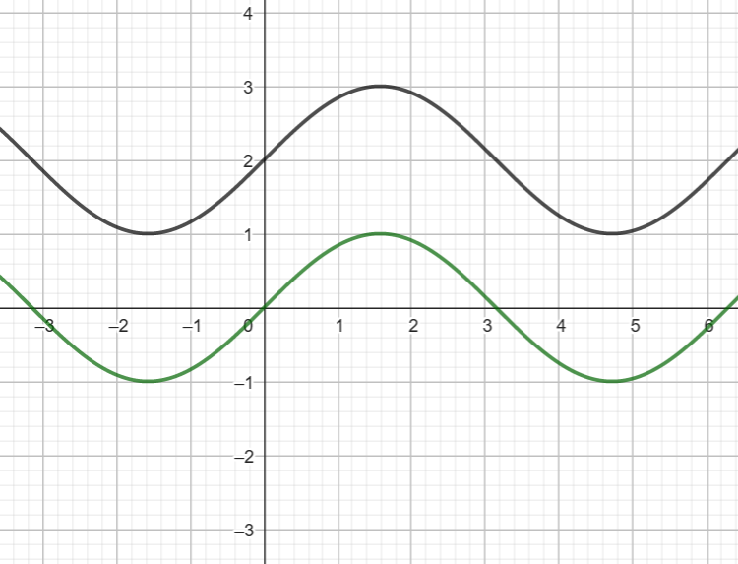
Add 2 to the ‘something’ in y = something

Slide 26
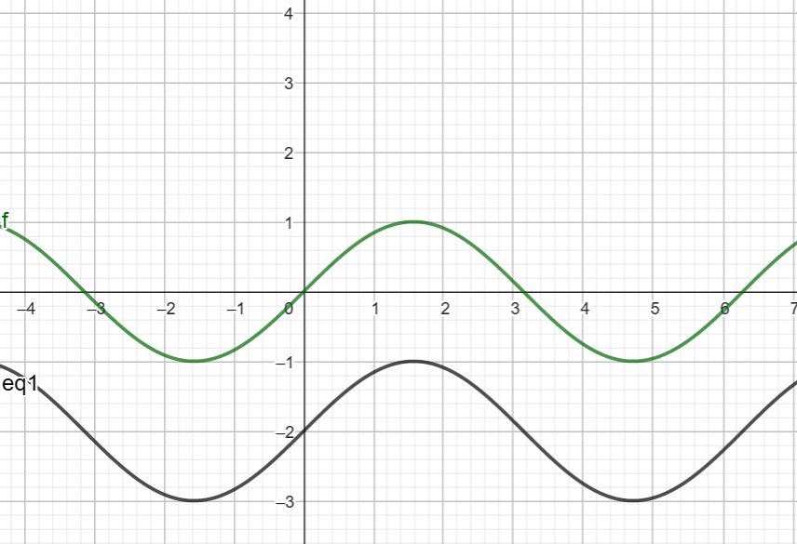
Add 2 to x in ‘y = something’

Slide 27
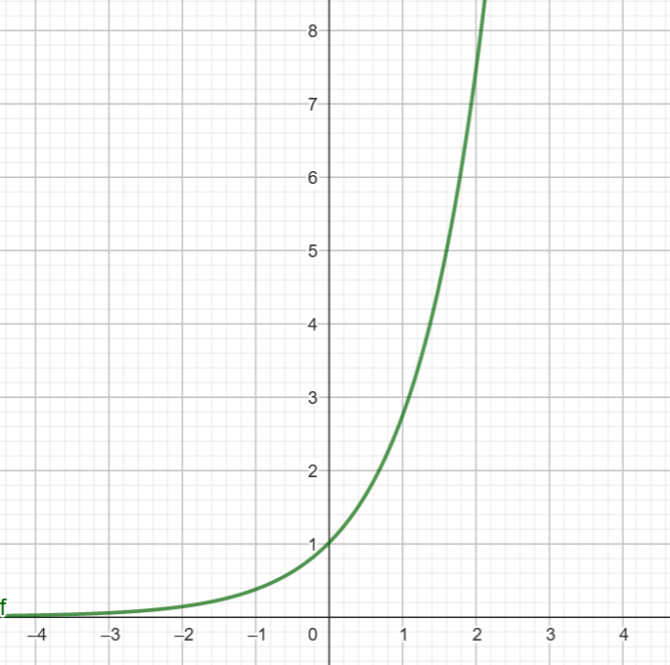

Slide 28
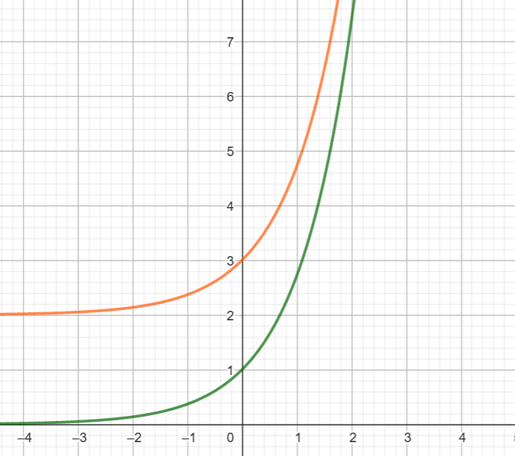
Add 2 to the ‘something’ in y = something

Slide 29
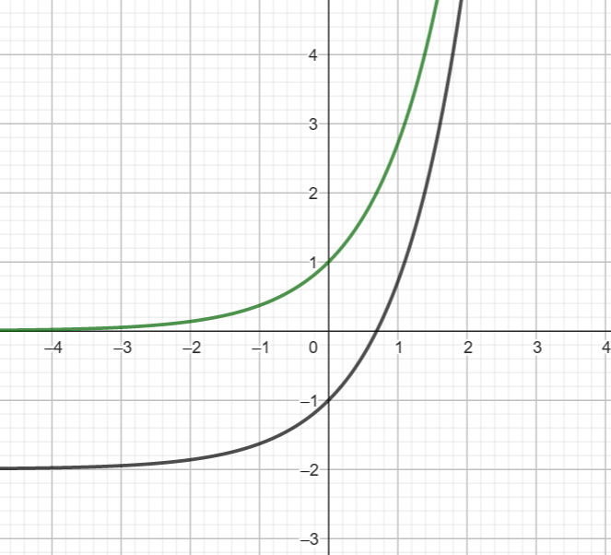
Add 2 to x in ‘y = something’

Slide 30
Function machines

Slide 31
Function machines
x
Subtract from 8
y
Squared
Add 3
y
x

Slide 32
Functions in mathematics and in real contexts
Varying rates of change
How gradient changes is important
Turning points
Inverses and no inverses
Continuous or not continuous
Not usually/always proportional
Not always increasing
Rarely constructed by joining dots
Zeroes on x-axis important
Translations non-ambiguous
Function machines/mapping diagrams rarely give useful information about the function

Slide 33
What learners know
Varying rates or change – speeding up and slowing down
How gradient changes is important – climbing hills
Turning points – area and perimeter puzzles
Inverses and no unique inverses – square roots, undoing binary operations
Continuous or not continuous – staircases
Not usually/always proportional – sharing cake
Not always increasing
Rarely constructed by joining dots – very small changes
Zeroes on x-axis important – repeated subtraction sequences
Translations non-ambiguous -
Function machines/mapping diagrams rarely give useful information about the function – functions found on calculators

Slide 34
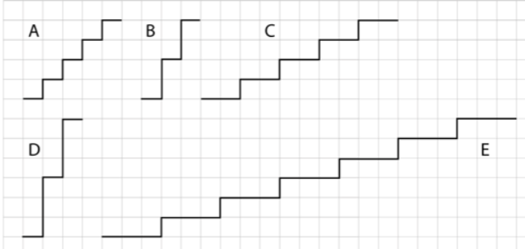
Emphasising a positive constant gradient

Slide 35
Why bother about constant gradients (apart from in proportional contexts)?

Slide 36
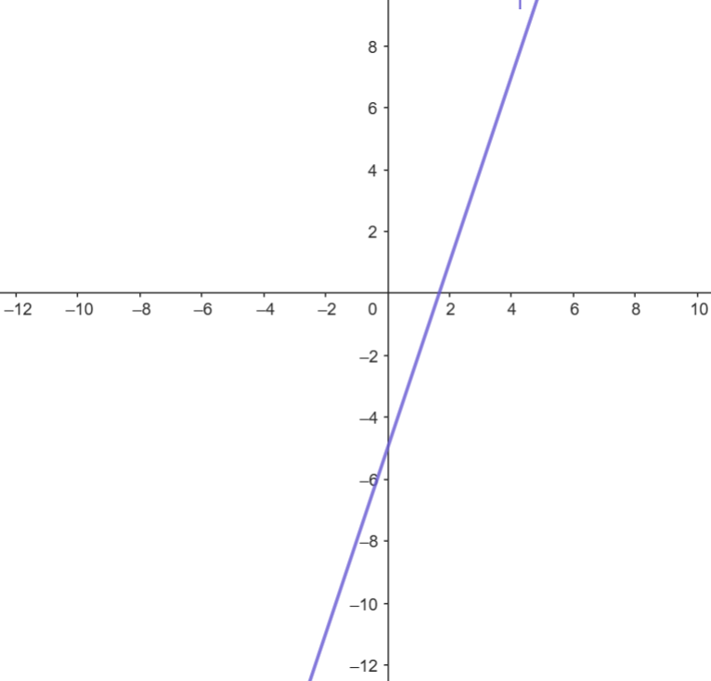

Slide 40
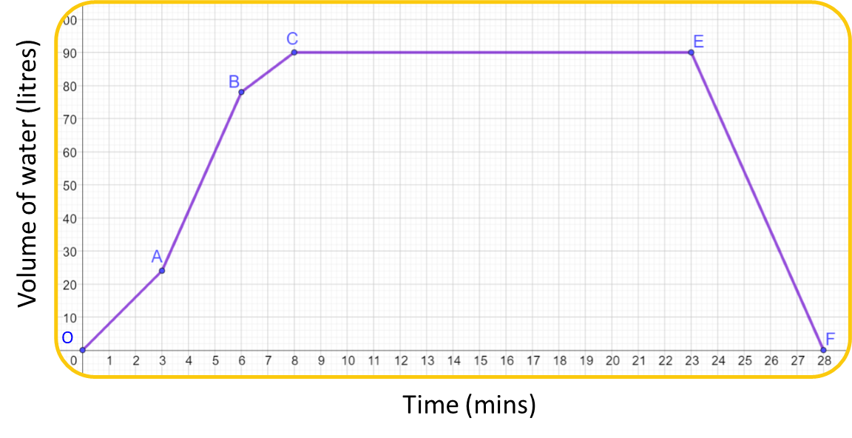
What best describes the highlighted section of the graph?
Filling fastest
Filling slowest
Not filling or emptying
Emptying

Slide 41
What best describes the highlighted section of the graph?
Filling fastest
Filling slowest
Not filling or emptying
Emptying

Slide 42
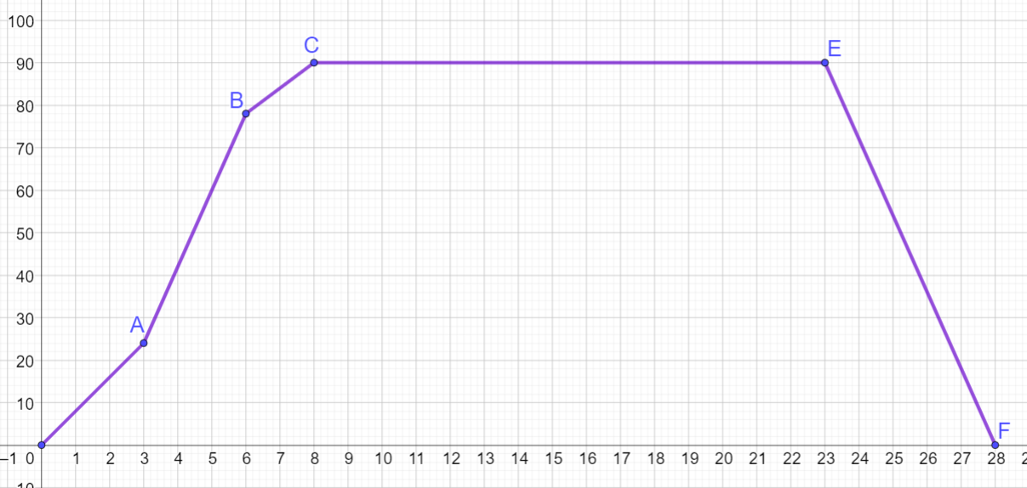
Piecewise relationships can describe values increasing and decreasing.
Work out the gradient for each of the sections marked.
What does this tell you about the rate and direction of water flow?
$$?$$
$$?$$
Volume of water (litres)
$$54$$
$$?$$
$$?$$
$$24$$
$$3$$
$$?$$
Time (mins)

Slide 43
The sketch graph shows the depth of water in a container over time.
Which option best describes how the depth is changing?
Depth
Time
Depth decreasing at a constant rate
Depth increasing more and more slowly
Depth increasing more and more quickly
Depth increasing at a constant rate

Slide 44
The sketch graph shows the depth of water in a container over time.
Which option best describes how the depth is changing?
Depth
Time
Depth decreasing at a constant rate
Depth increasing more and more slowly
Depth increasing more and more quickly
Depth increasing at a constant rate

Slide 45
The sketch graph shows the depth of water in a container over time.
Which option best describes how the depth is changing?
Depth
Time
Depth decreasing at a constant rate
Depth increasing more and more slowly
Depth increasing more and more quickly
Depth increasing at a constant rate

Slide 46
The containers below are filled with water at the same rate.
Sketch a depth-time graph for each.
Hint: Think about how fast the depth of water is changing at the beginning, middle and end.

Slide 47
When is linearity helpful?
Proportionality (always go through origin)
Approximating rate of change
Building polynomials from linear factors

Slide 48
Insert interaction about gradient of curves
Maxbox and Maxfield??

Slide 49
Problems with KS3 focus on linear relations
Usually increasing
Usually introduced by joining points
Gives wrong impression about inverse functions
Gives wrong impression about continuity of functions
Constant rate of change
Ambiguous about direction of translations
Confuses relative importance of x and y intercepts
Ignores early experiences with number relations and equations

Slide 50
Suggestion
KS3 could include graphing of familiar situations of all kinds from KS1&2
KS3 could include consideration of graphs many contexts within and outside mathematics itself, that are familiar and have the critical features of functions
Linearity is a toolkit that codifies proportional relationships and contributes simplifications for dealing with more complex relations.

