Slide 1
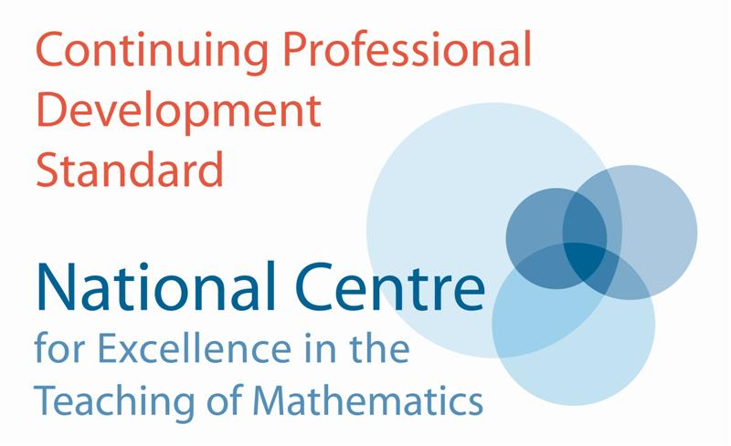
Geometry at Kings
Promoting Mathematical Thinking
John Mason
Dec 2015
The Open University
Maths Dept
University of Oxford
Dept of Education

Slide 2
Outline
Reconstructing Transformations
Undoing a Doing
Combining Transformations
Using Transformations
Vecten and Extensions
Reasoning Geometrically
Eyeball theorem
Straight Line Meetings Theorem
Parallelo-Hexagon Areas
Exploring Spiral Similarities

Slide 3
Conjecturing
Everything said in this room is to be taken as a conjecture, to be tested in experience or mathematically, or both.
Conjecture: Thinking Geometrically involves subtle shifts of attention
Gazing (holding wholes); Discerning Details Recognising Relationships in the situation Perceiving Properties as being instantiated Reasoning on the basis of agreed properties

Slide 4
Reconstructing Transformations
Given the effect of a transformation decide which one it is

Slide 5
Combining Transformations
Reflect (line)
Translate
Rotate
Scale
Translate
Rotate
Reflect (line)
Scale

Slide 6
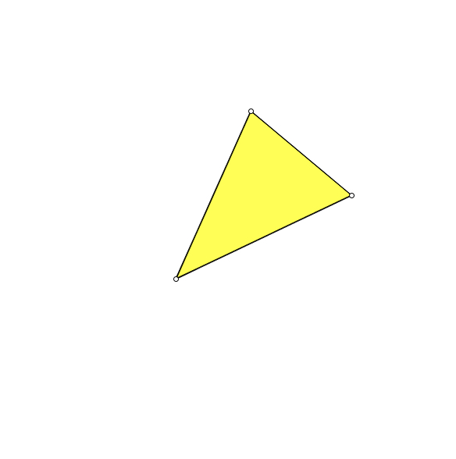
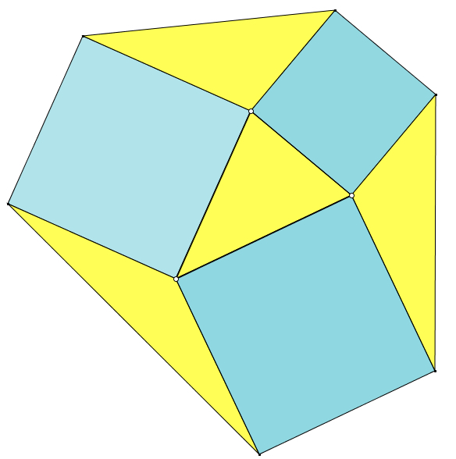
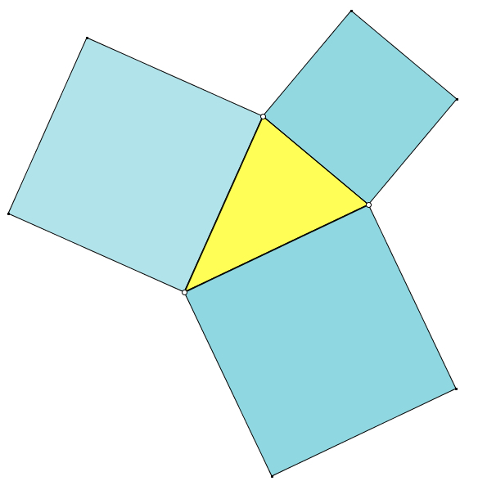
Vecten

Slide 7
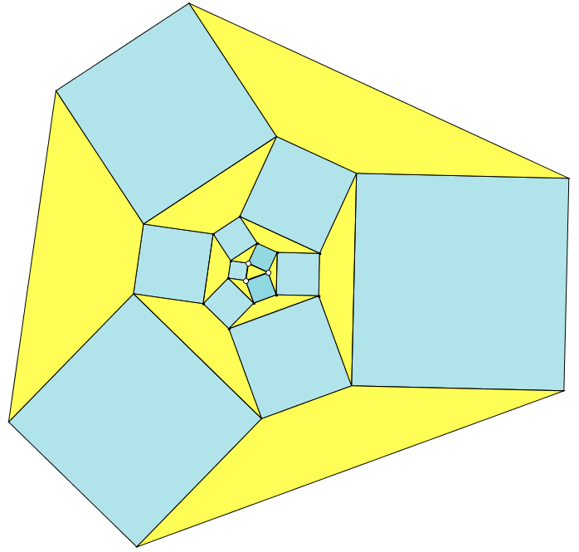
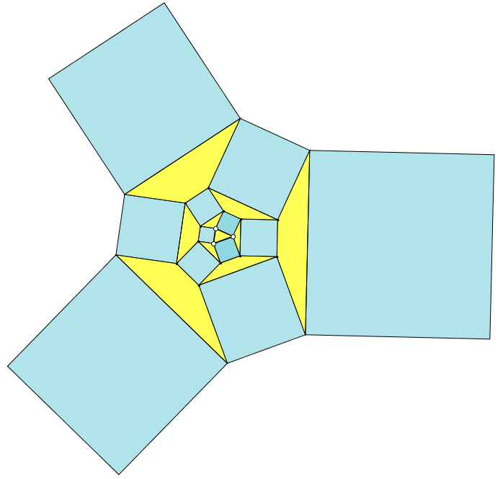
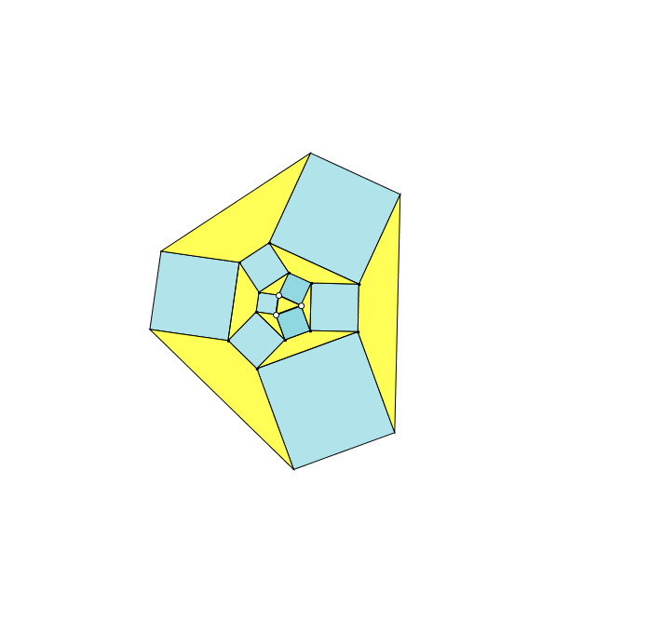
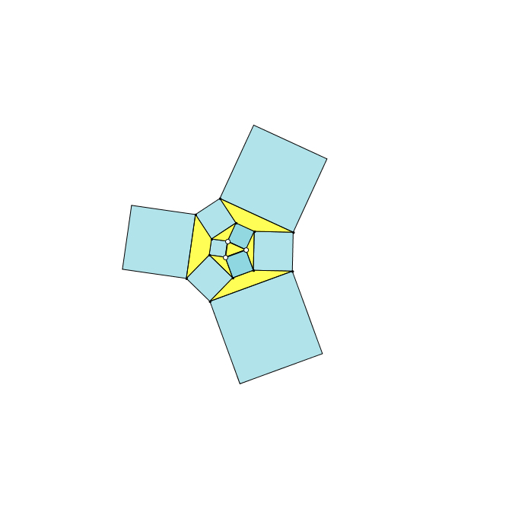
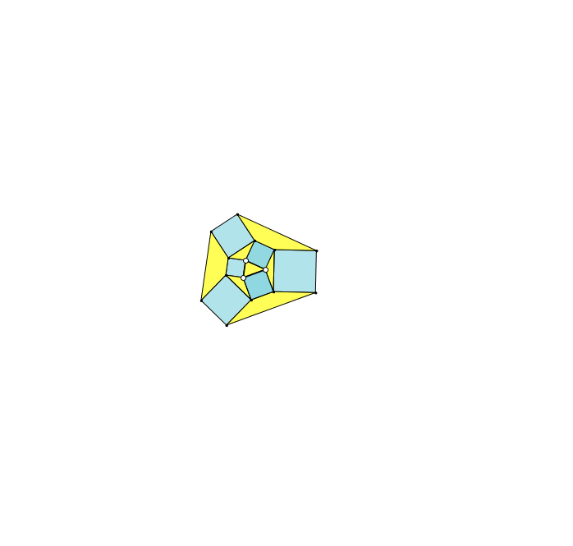
Vecten Continued
Notes:
Vecten was a Belgian Geometer.
His configuration has arisen spontaneously in classrooms here and in other countries.

Slide 8
Vecten Extensions
Why squares?
What might be the effect of rhombuses?
of parallelograms?

Slide 9
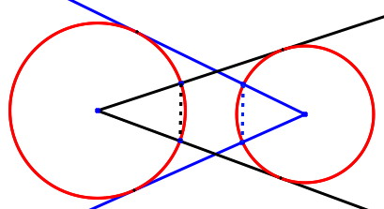
Eyeball Theorem
Imagine two circles, not intersecting.
Imagine lines from the centre of each tangent to the other. Where they meet the other circle, draw the chord.
The chords are equal in length

Slide 10
Eyeball Reasoning

Slide 11
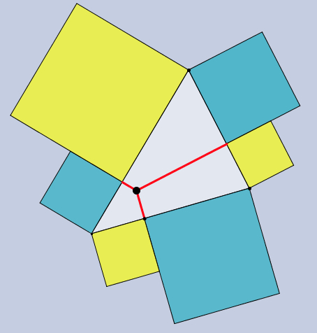
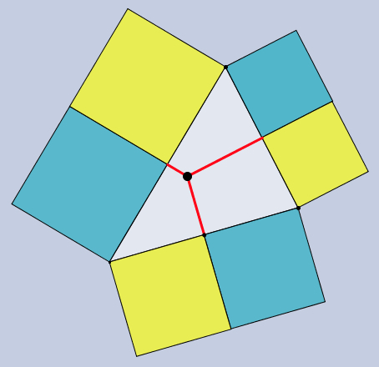
Altitudinal Squares
The sum of the areas of the yellow squares is equal to the sum of the areas of the cyan squares.
Is the alternating sum of the areas of the squares still 0?
The alternating sum of the areas of the squares is 0

Slide 12
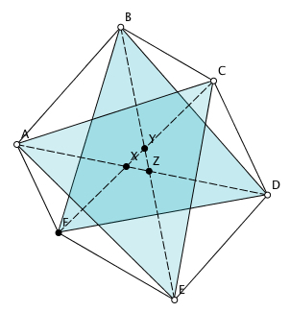
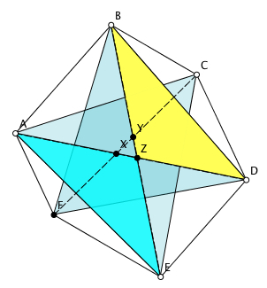
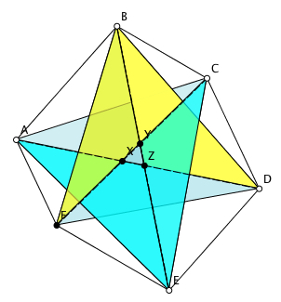
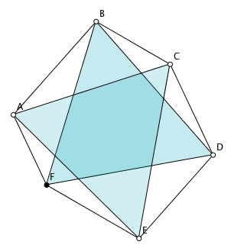
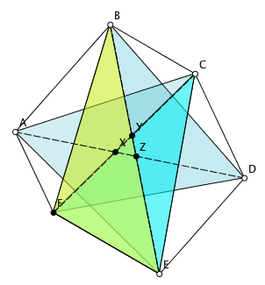
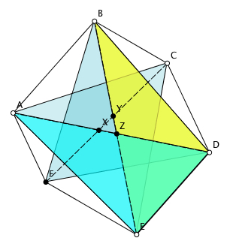
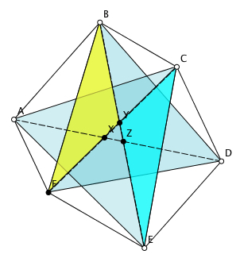
Parallelo-Hexagon Reasoning
The two blue triangles are equal in area
AED = BED
AZE = BZD
CFE = BFE
CYE = BFY
AFC = AFD
AXC = DXF
The alternating sum of the white triangles is 0.
The alternating sum of the vertex angles is 0.

Slide 13
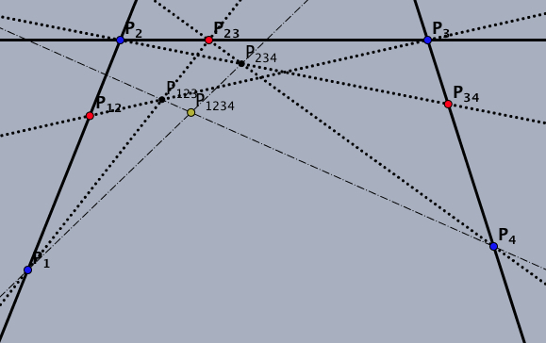
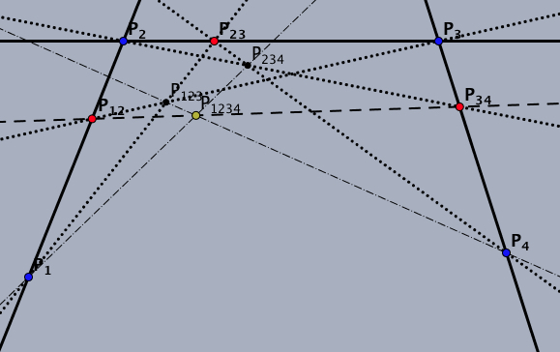
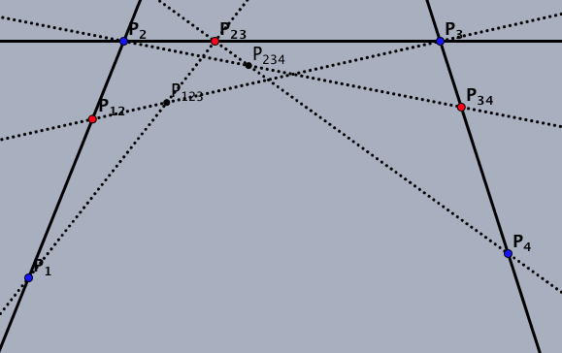
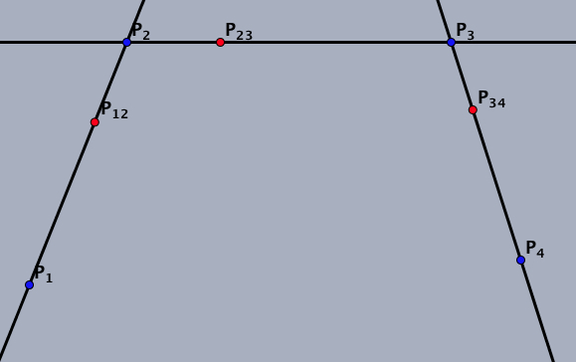
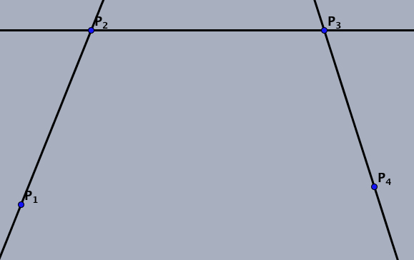
4-Point Meetings
Imagine four points P1, P2, P3, P4; Imagine the lines P1P2; P2P3; P3P4;
Imagine points P12 on P1P2; P23 on P2P3; P34 on P3P4;
Imagine points P123 = P1P23.P12P3; P234 = P23P4. P23P4;
Imagine point P1234 = P1P234.P123P4;
Then P1234 lies on P12P34;

Slide 14
4-Point Meetings Reasoning
P₁₂ = P₁ + λ₁₂P₂
P₂₃ = P₂ + λ₂₃P₃
P₃₄ = P₃ + λ₃₄P₄
P₁₂₃ = P₁ + λ₁₂P₂ + λ₁₂λ₂₃P₃
P₂₃₄ = P₂ + λ₂₃P₃ + λ₂₃λ₃₄P₄
P₁₂₃₄ = P₁ + λ₁₂P₂ + λ₁₂λ₂₃P₃ + λ₁₂λ₂₃λ₃₄P₄

Slide 15
Follow Up
John.Mason@open.ac.uk
Mathematics as a Constructive Activity: learner generated examples (Erlbaum)
PMTheta.com for applets, PPTs, and more

