Slide 1
Key understandings in learning secondary mathematics
Anne Watson
BCME 2010
Notes:
1

Slide 2
Agenda
spatial reasoning
multiplicative reasoning
algebraic reasoning
harder mathematics
common themes

Slide 3
Spatial reasoning
early knowledge of space is relational, not just descriptive:
size and transitivity
distance between
corners and edges
fitting in and together
turn
length, volume and angle are more intuitive than area
Notes:
3

Slide 4
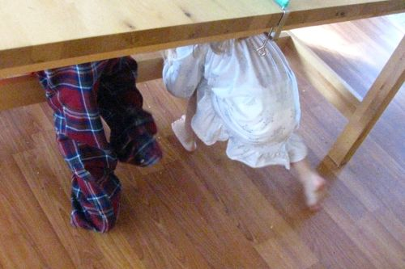

Slide 5
Spatial understanding
the concept of area is not intuitive
numerical measures of area, volume and angle are not intuitive
comparing quantities is easier than measuring them
Notes:
5
5

Slide 6
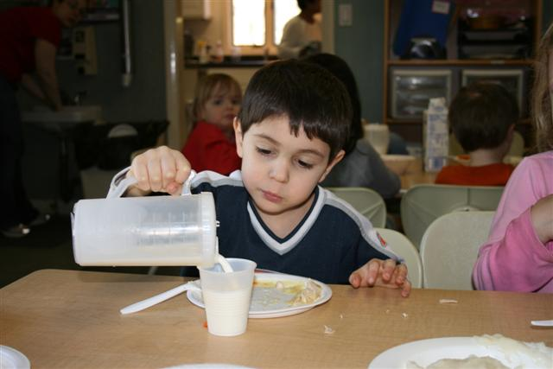

Slide 7
Numerical reasoning
knowledge of quantities and counting develop separately through:
interacting with objects
stretching/scaling
fitting
sharing out
pouring
cutting up
Notes:
7
7

Slide 8
Additive reasoning
a + b = c c = a + b
b + a = c c = b + a
c – a = b b = c - a
c – b = a a = c - b

Slide 9
Multiplicative reasoning
a = bc bc = a
a = cb cb = a
b = a a = b
c c
c = a a = c
b b

Slide 10
Inexact measurement: what do children do?

Slide 12
37 + 49 – 49
100000 x 10000
99 + 1
+

Slide 13
29 x 42
x 3 +
x 10
of (
x 2)

Slide 14
17 - 9
27 - 9
37 - 9

Slide 15
Non-computational arithmetic
knowledge of quantities and counting develop separately
additive understanding does not precede multiplicative
three principles relate to success in mathematics: the inverse relation between addition and subtraction; additive composition; one-to-many correspondence
thinking about relations is key to later success
Notes:
15

Slide 16
Teaching about relations
focus on the connections between informal knowledge (e.g. of pouring) and formal learning
experts use multiple representations to explore relations
include the study of relations explicitly to enable a shift away from computational assumptions
Notes:
16

Slide 17
Thinking about teaching relationally
Algebra
Modelling
Problem-solving
Harder concepts

Slide 18
Anne Watson
anne.watson@education.ox.ac.uk
Key Understandings in Learning Mathematics by Nunes, Bryant and Watson
www.nuffieldfoundation.org

