Slide 1
Prepare
Say hello to the people nearby – do they have favourite numbers?
If you are online: Open Big Number Calculator:
https://www.calculator.net/big-number-calculator.html

Slide 2
Joint Conference Number: a helter-skelter ride through some shifts of meaning
^{March 2023}
^{Anne Watson}

Slide 3
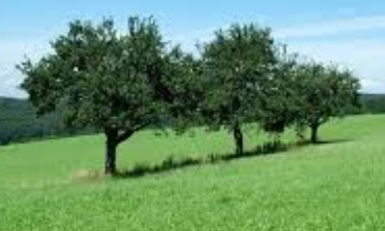
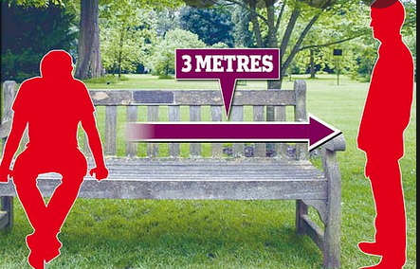
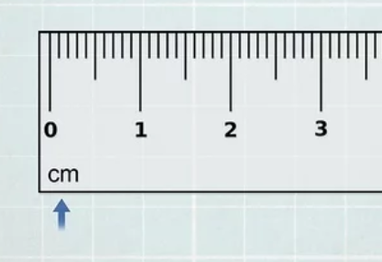
3

Slide 8
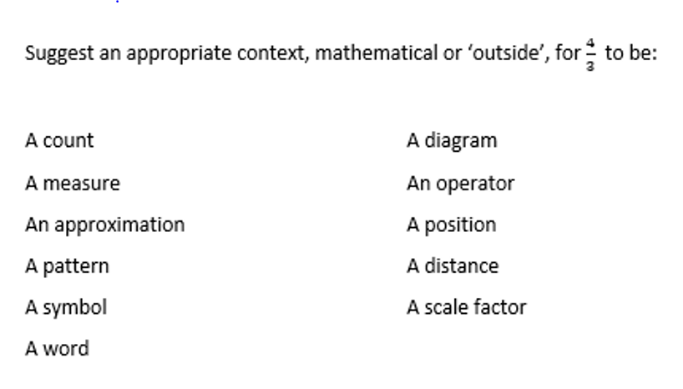

Slide 11
Rates, ratios, measures, cabbages etc.
a = bc bc = a
a = cb cb = a
b = a a = b
c c
c = a a = c
b b

Slide 12
Converging series
2/3 = 2 x 0.3333….. = 2 x (
) + …

Slide 13
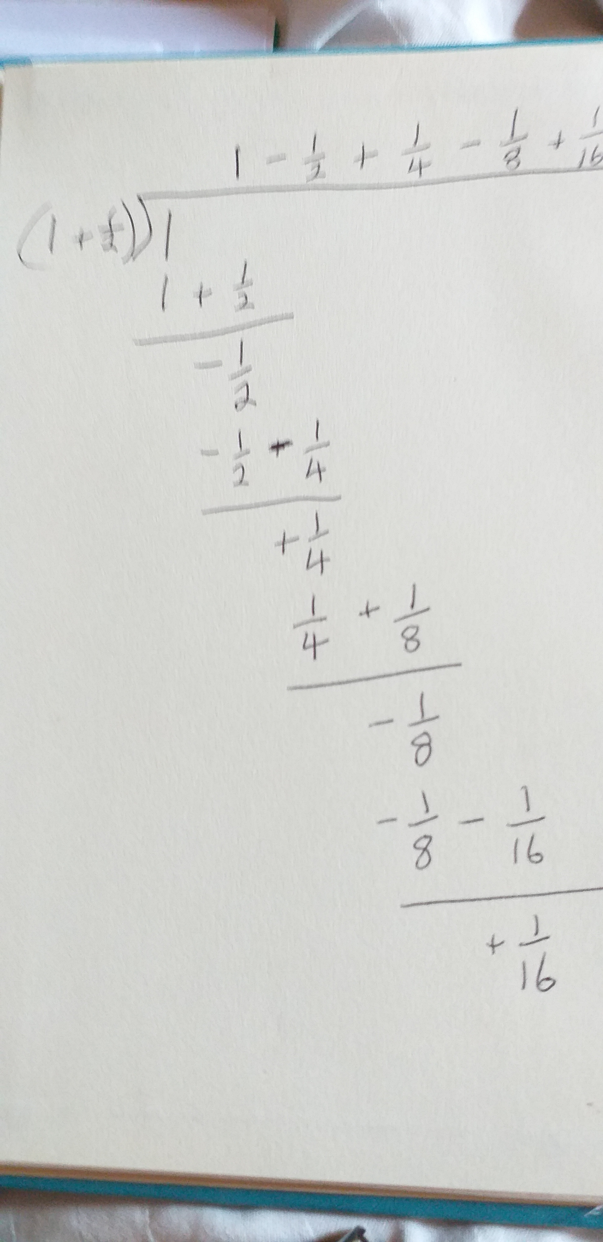
Use long division!!

Slide 16
Is the mapping from a number to its first significant digit a function?
n
????
0.9999999999 ……………………
3.9999999999999 ……………………..
0.0299999999…………..

Slide 17
Significant digit ???
The first non-zero digit from the left?
Rounded to non-zero from the left?
The first digit from the left that is known with certainty?
Dependent on the measuring device and hence possible accuracy and certainty?

Slide 18
From Wikipedia:
… if a length measurement gives 114.8 mm while the smallest interval between marks on the ruler used in the measurement is 1 mm, then the first three digits (1, 1, and 4, showing 114 mm) are certain and so they are significant figures. Digits which are uncertain but reliable are also considered significant figures. In this example, the last digit (8, which adds 0.8 mm) is also considered a significant figure even though there is uncertainty in it.

Slide 19
Is the mapping from a number to its first significant digit a function?
0.9999999999 ……………………
3.9999999999999 ……………………..
0.0299999999…………..

Slide 20
Does every addition of two real numbers have a unique answer?
What if the next 200 places are nines?
… and the following 200 digits are not 9?
Does every addition of two terminating numbers have a
unique answer?

Slide 21
Computer science:
Problems with defining ‘number’ by using Dedekind cut
N.J.Wildberger (health warning)
https://www.youtube.com/watch?v=4DNlEq0ZrTo
Infinitesimals:
Katz, M. G., & Sherry, D. (2013). Leibniz’s infinitesimals: Their fictionality, their modern implementations, and their foes from Berkeley to Russell and beyond. Erkenntnis, 78(3), 571-625.

Slide 22
Nineteenths (thanks to an unremembered ATM conference presenter for this)
https://www.calculator.net/big-number-calculator.html
Open Big Calculator and select the number of digits you might need to convert 1/19 to its decimal format.
Post your guessed ‘number of digits’ in the chat.
Calculate 1/19
Carefully observe the digits of the repeated string from right to left

Slide 23
0.052631578947368421 …

Slide 24
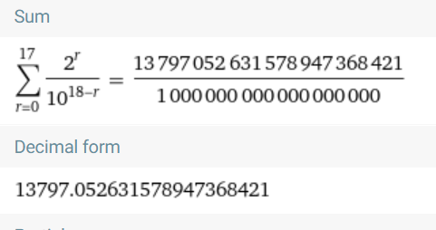

Slide 25
Geometric series/progressions (the R number!)
1 + 3 + 9 + 27 + ……
1 + 3 + 3² + 3³ + 3⁴ …..
OR
2 + 6 + 18 + 54 + …
2x1 + 2x3 + 2x3² + 2x3³ + 2x3⁴ …..
a + ar + ar² + ar³ + ar⁴ …..

Slide 26
1 + ($\frac{1}{2}$) + ($\frac{1}{2}$)² + ($\frac{1}{2}$) ³ + ($\frac{1}{2}$) ⁴ ….. = 1 + $\frac{1}{2}$ + $\frac{1}{4}$ + $\frac{1}{8}$ …
3 + $\frac{3}{2}$ + $\frac{3}{4}$ + $\frac{3}{8}$ …
a + ar + ar² + ar³ + ar⁴ …..

Slide 27
$$\frac{1}{19} = \frac{1}{20 −1} = \frac{\frac{1}{20}}{1 −\frac{1}{20}}$$

Slide 28
$\frac{1}{20}$ + $\frac{1}{20}$($\frac{1}{20}$) + $\frac{1}{20}$($\frac{1}{20}$)² + $\frac{1}{20} (\frac{1}{20} )$³ + …..

Slide 29
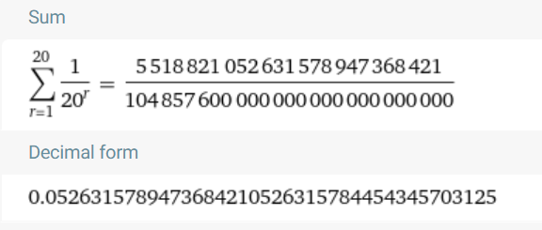

Slide 30
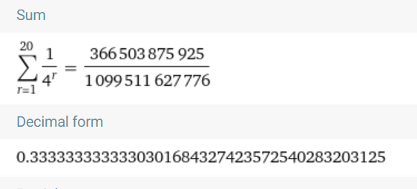
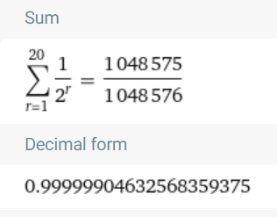

Slide 32
There are numberlike objects wherever we usually make assumptions about sudden behaviour changes:
When one focus of an ellipse ‘goes off to infinity’ we get a parabola
When the denominator of a rational function approaches zero, the graph ‘shoots off to infinity’.
When r<1 the sum of a GP changes from a(1-r^{n})/(1-r) to a/(1-r) when n -> ∞
The gradient of f(x)=x² when x = 1 can be found by imagining the tangent of the limit of a sequence of triangles formed by chords at x=1:
$\frac{(f(1) – f(0.\dot{9}))}{(1 − 0.\dot{9})}$ = $\frac{({1 }^{2}– {0.\dot{9}}^{2})}{(1 − 0.\dot{9}) }$ = $\frac{(1 − 0.\dot{9})(1 + 0.\dot{9})}{(1 − 0 \dot{9}) }$ = 1 + 0.$\dot{9}$
so we say the gradient is 2 when x = 1
v) When a learner insists there must be something between 0.$\dot{9}$ and 1.

Slide 33
…. this all depends on some beliefs about real numbers BUT
IF infinitesimals exist they are smaller than the smallest real number
If ∂ is infinitesimal, then so are all its polynomials such as: 2∂; ∂²+ 3∂; ∂³- ∂^{4 etc.}
so we cannot get to the infinitesimals from the reals
we cannot get from the reals to the infinitesimals
but we can have compound numbers such as: r ± k∂
and what about 99∂³- 23∂⁴ ?

Slide 34
Suppose that there are 3 signs for ‘directed’ numbers: s, t and r. Explore combinations using an invented operation Ꚛ that is binary, associative & commutative s.t. for any magnitudes a & b:
a_{s} Ꚛ b_{s} = c_{s}
a_{s} Ꚛ b_{t} = c_{t}
a_{t} Ꚛ b_{s} = c_{t}
a_{t} Ꚛ b_{t} = c_{r}
Could this be a consistent system?

Slide 35
PPT & communication
http://www.pmtheta.com/publications.html
annewatson1089@gmail.com

