Slide 1
§2 Functions
IMM 2021

Slide 2
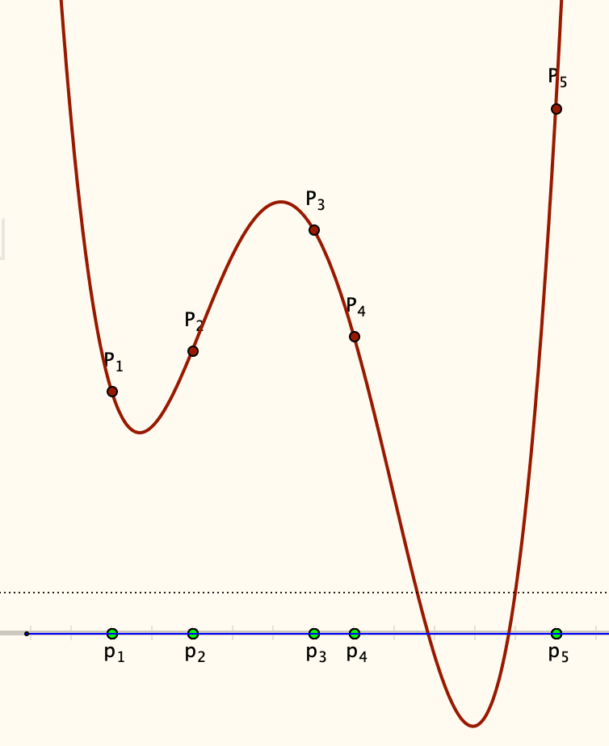
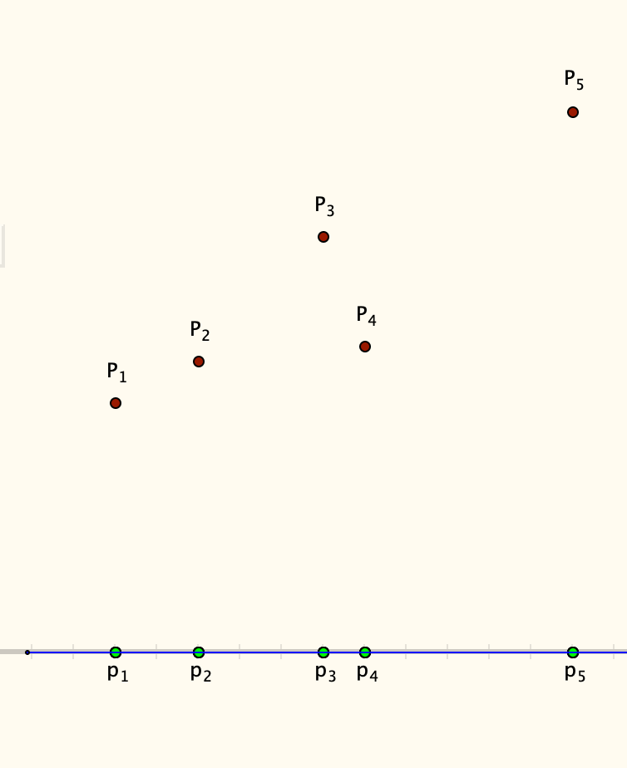
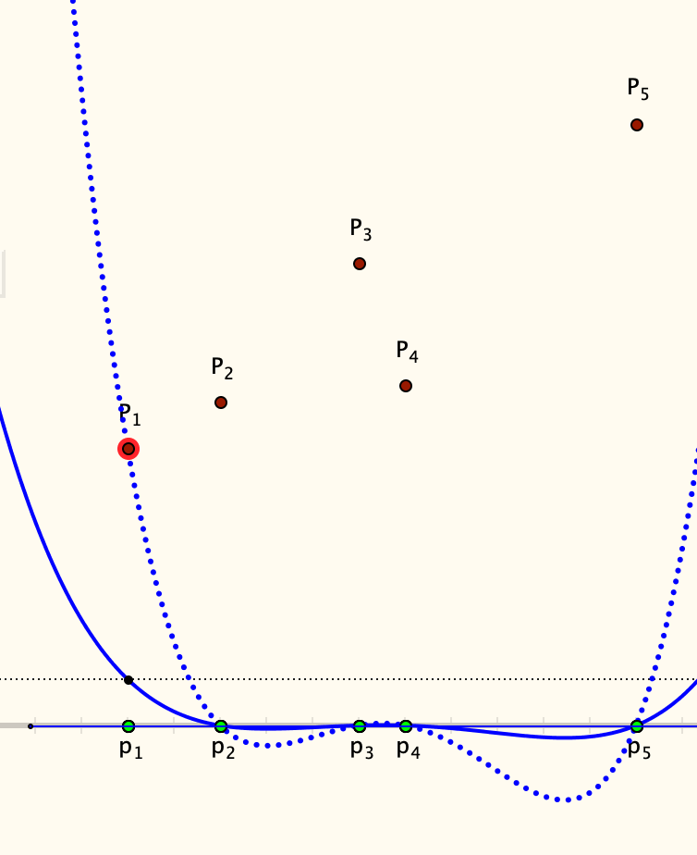
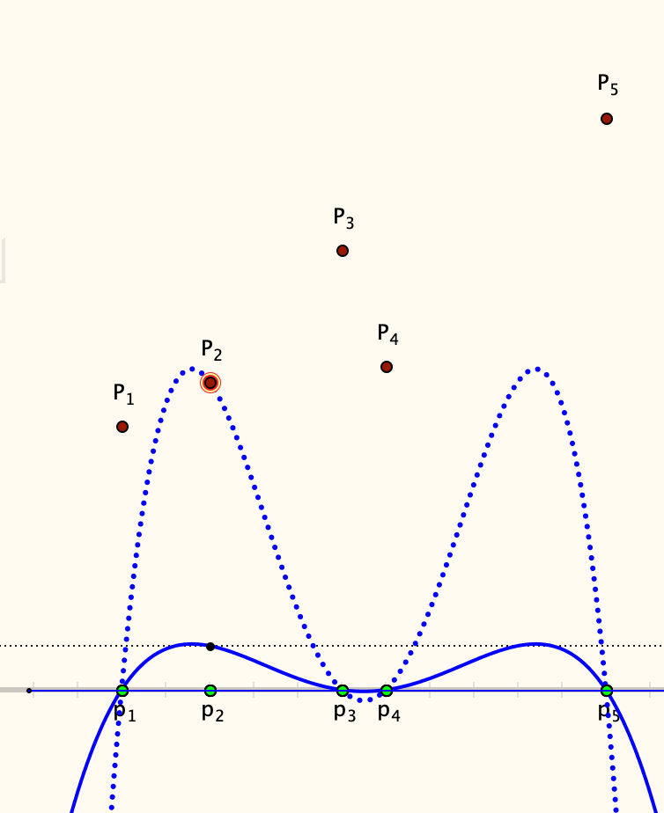
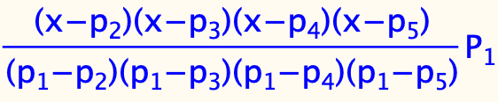

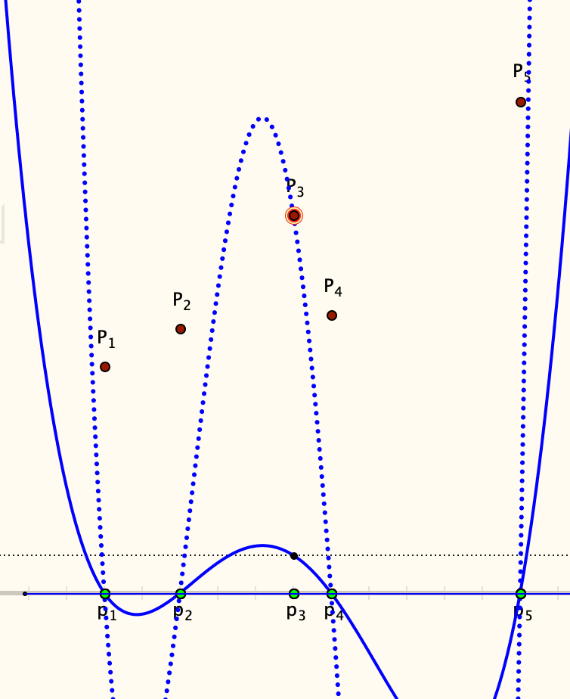
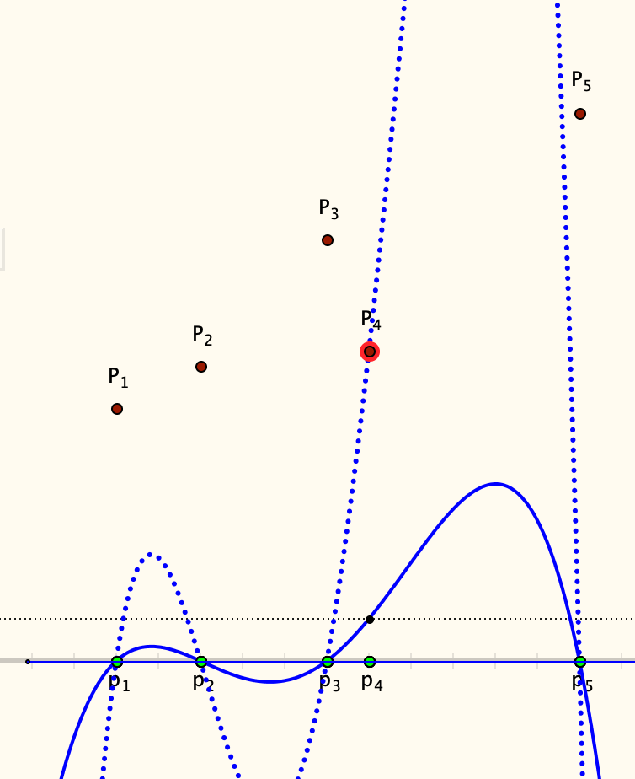
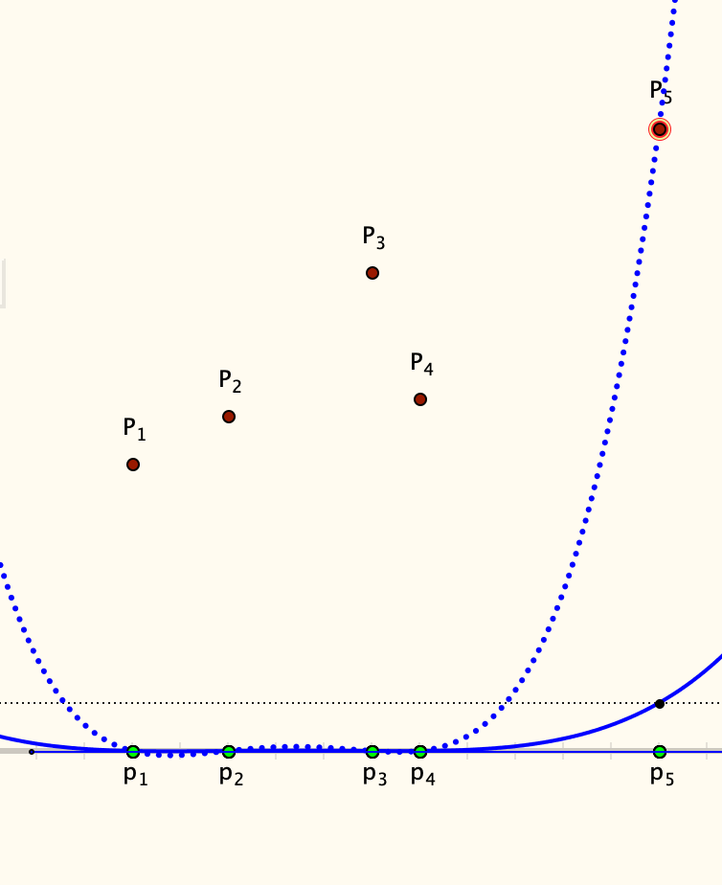
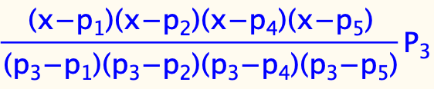

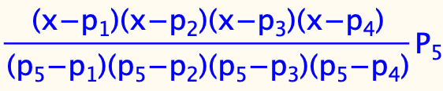
Lagrange Polynomials
Imagine a polynomial through these five points, of smallest possible degree
Tell yourself a story about what is going on in these five pictures
Tell yourself a story about how the five dotted graphs relate to the original question
What is the relationship between the dotted graphs, the formulae, and the brown graph?

Slide 3
Reflection
What role does 0 play in the construction?
Constructing a Personal Narrative (own explanation)
Making use of
  Gazing at the whole
  Discerning Details
  Recognising Relationships
  Perceiving Properties (as being instantiated)
  Reasoning on the basis of agreed properties

Slide 4
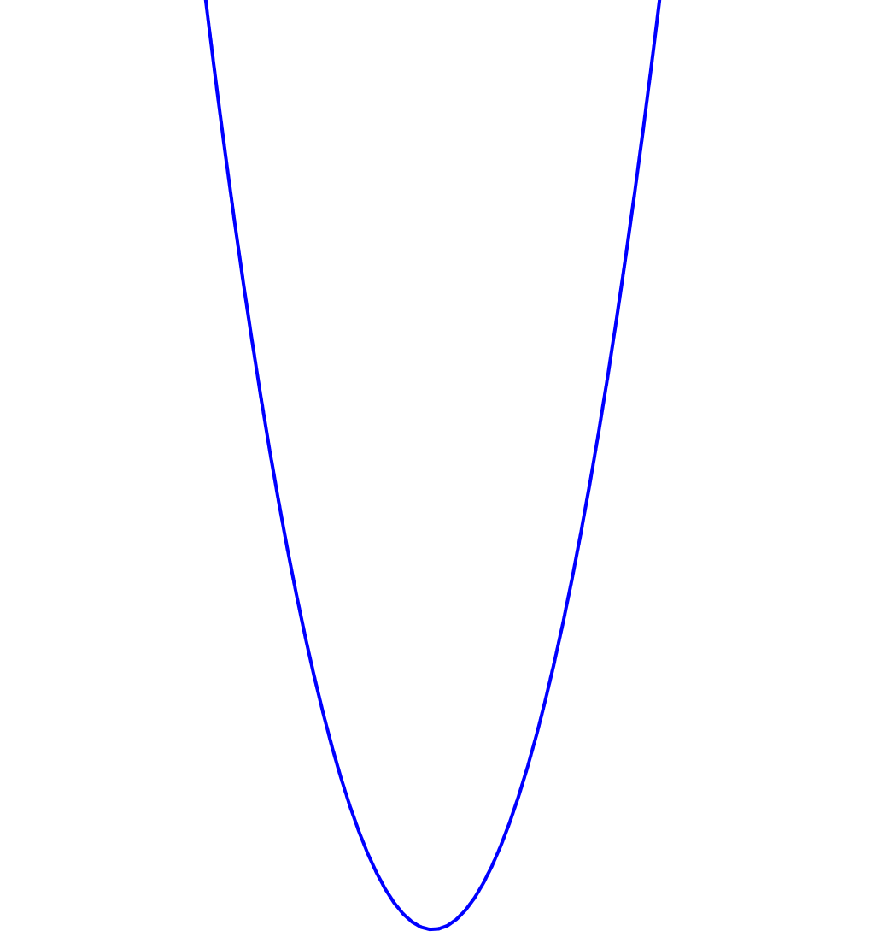
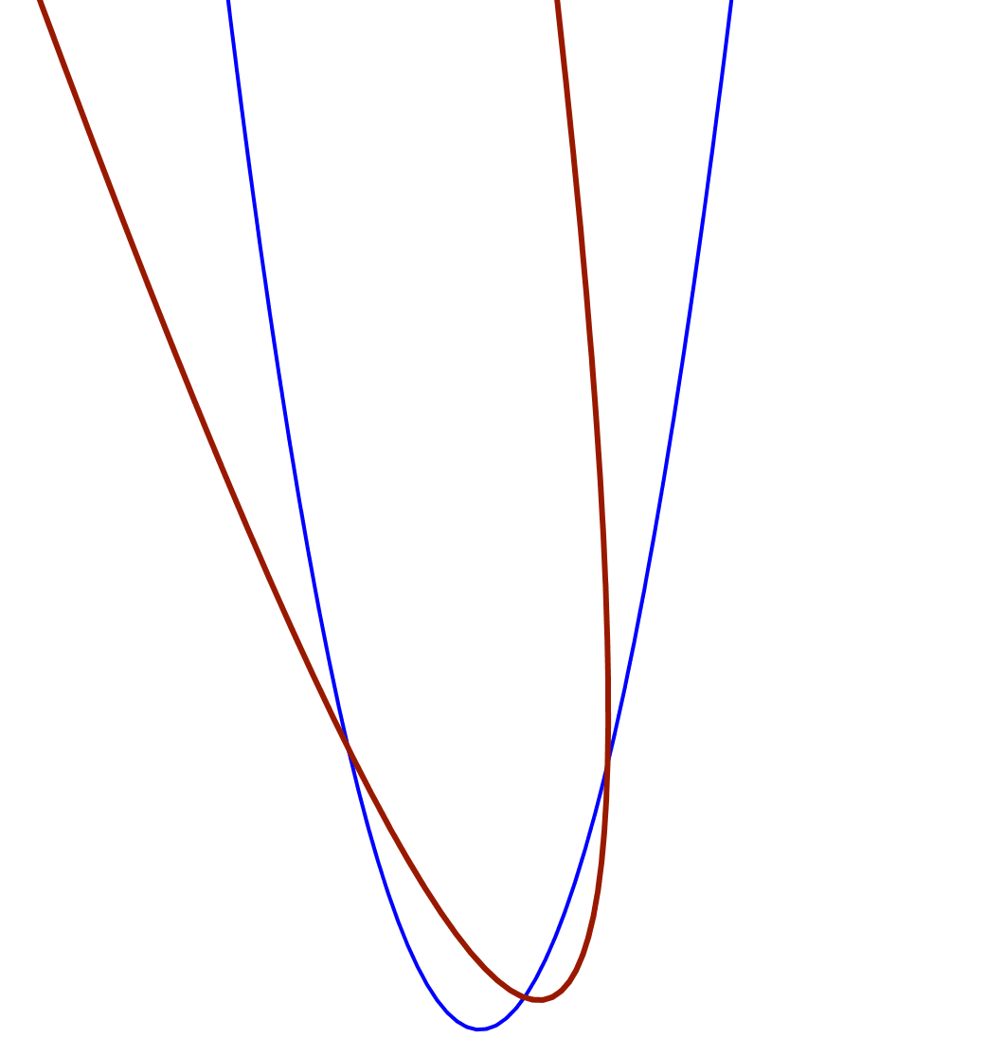
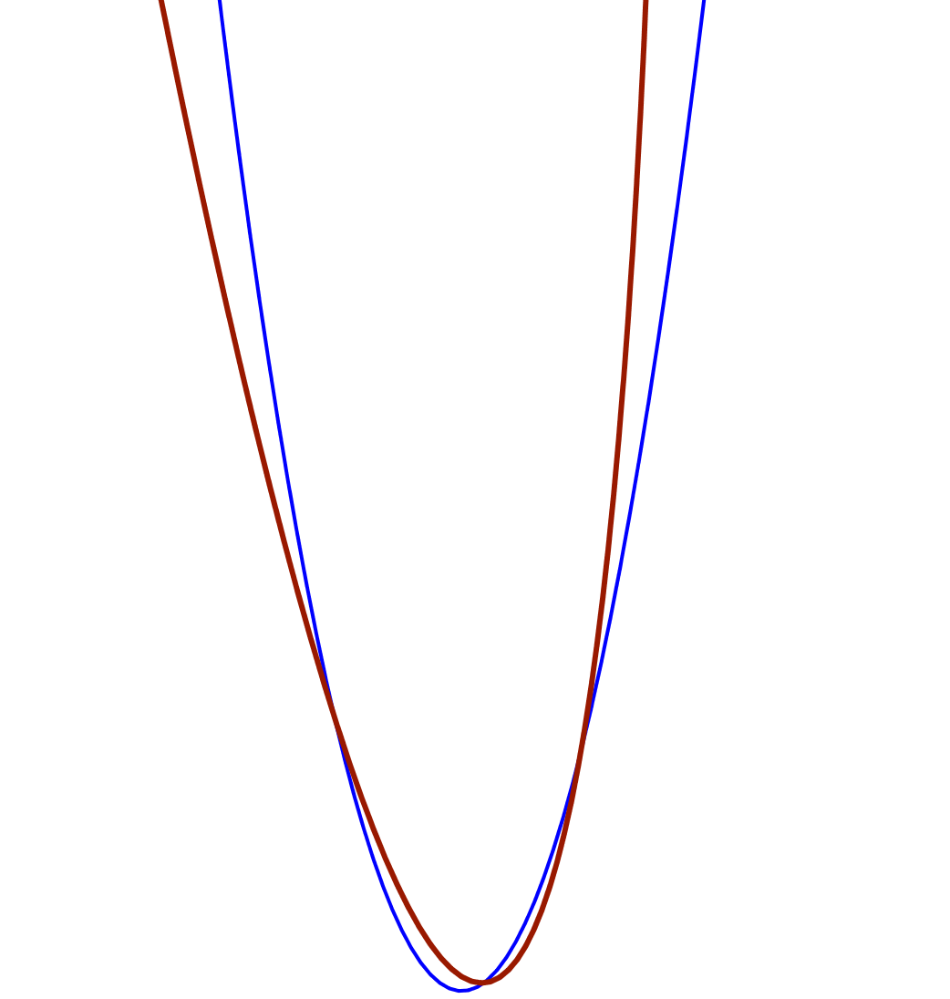
Rotating Graphs
Imagine the graph of a quadratic function
Imagine rotating the graph anti-clockwise through an angle of about 10°
Could the rotated graph be the graph of a function?
What about rotating through a very small angle?
Through what angles could the graph be rotated and still be the graph of a function?

Slide 5
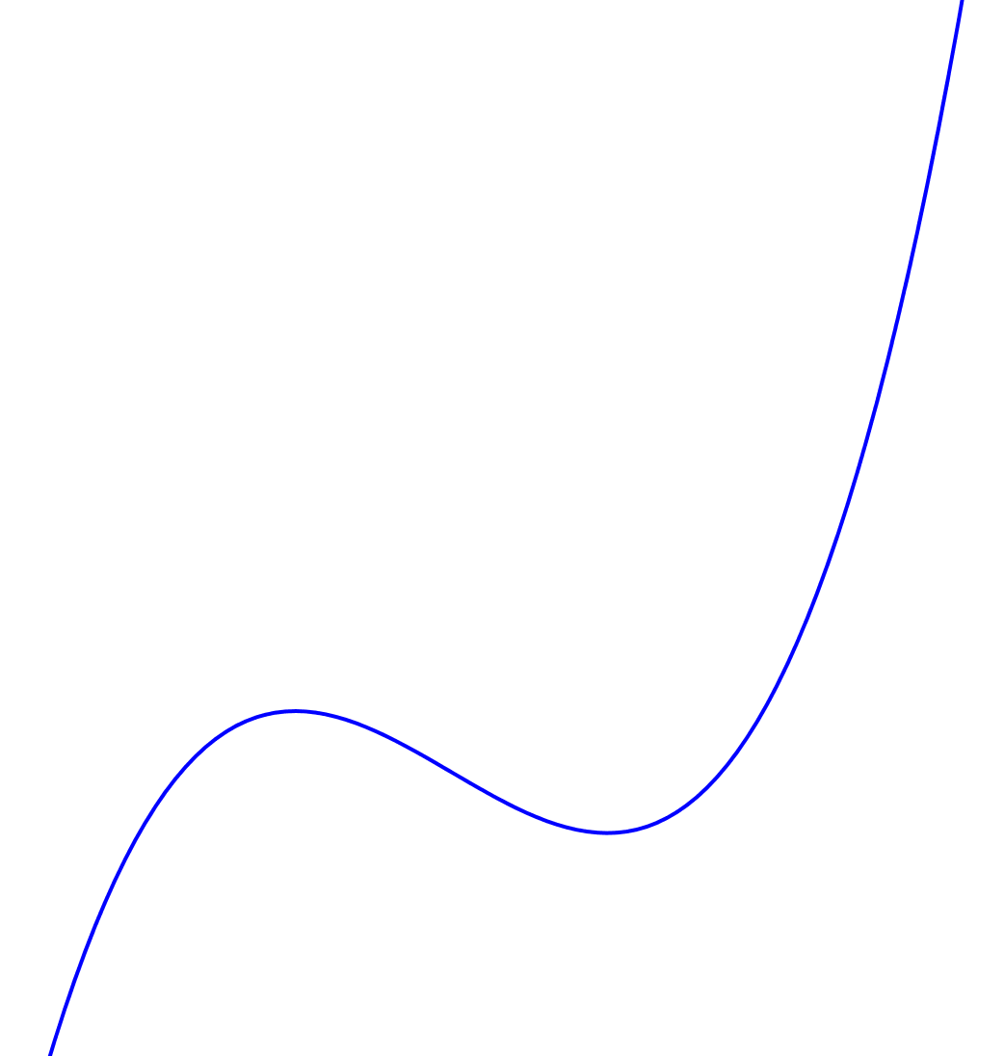
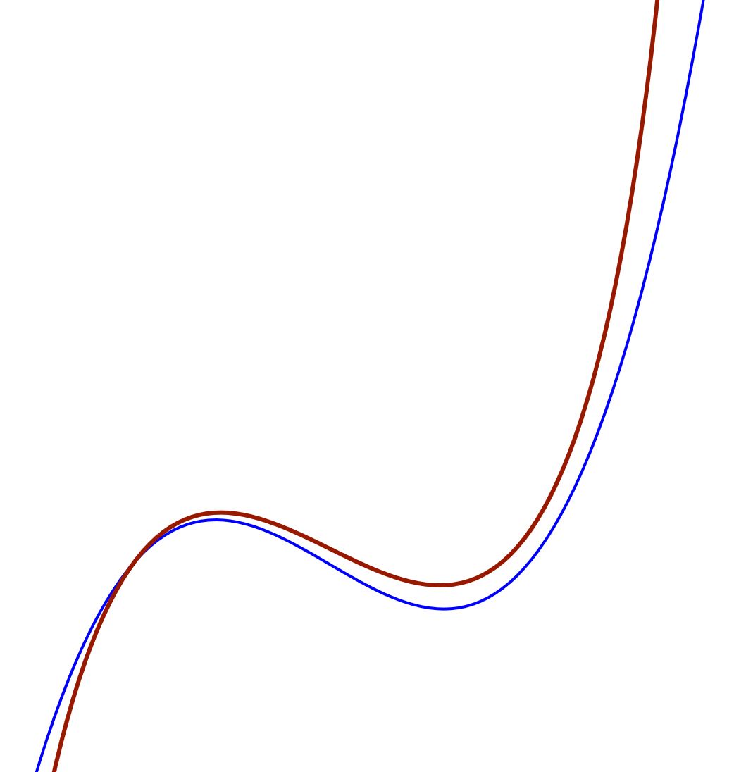
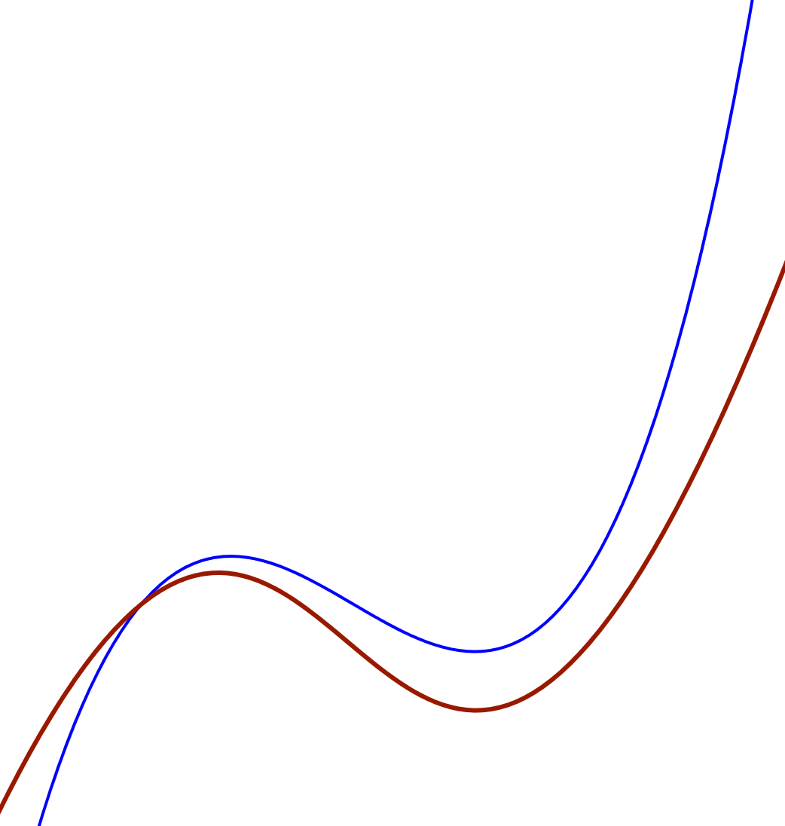
Rotating a Cubic
Through what angles could the graph of a cubic be rotated and still be the graph of a function?

Slide 6
Did You Notice:
Use of natural powers?
  Imagining & Expressing
  Specialising & Generalising
  Conjecturing & Convincing
  Organising & Characterising
  Others?
Encountering Mathematical Themes?
  Doing & Undoing
  Invariance in the midst of change
  Freedom & Constraint
  Making the implicit explicit
  Others?
Shifts of Attention?
  Gazing (Holding Wholes)
  Discerning Details
  Recognising Relationships
  Perceiving Properties as being instantiated
  Reasoning on the basis of agreed properties

Slide 7
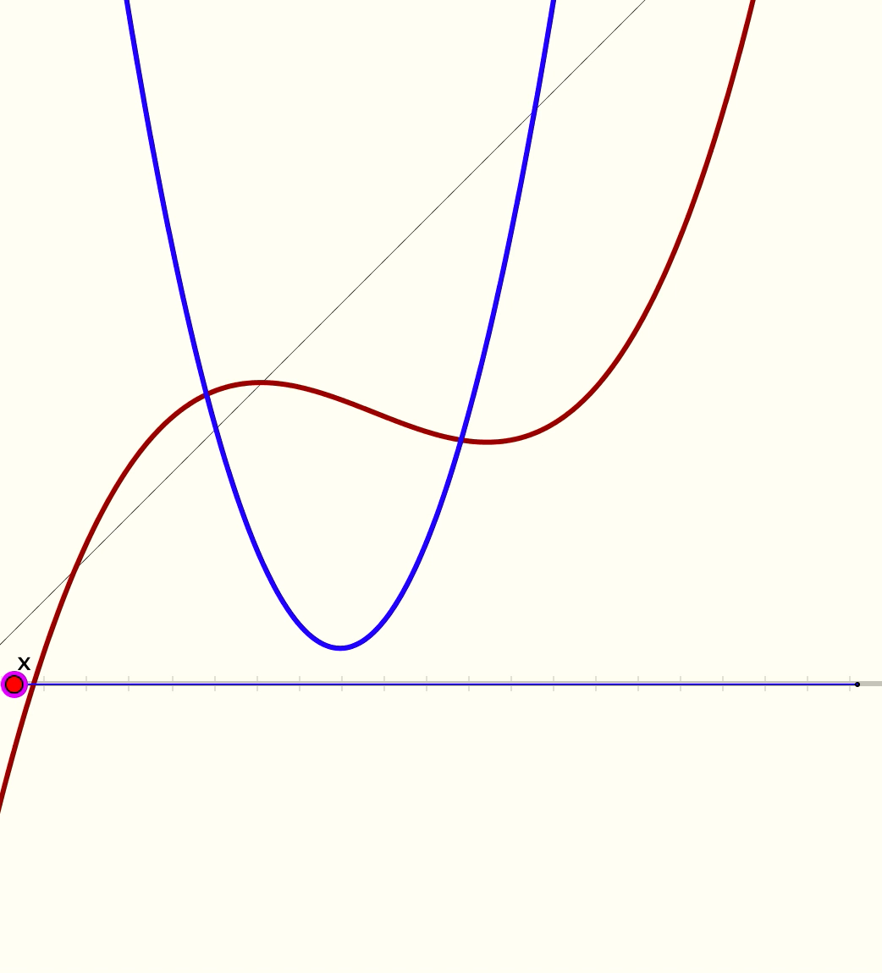
Combining Two Functions
Here are the graphs of a quadratic and a cubic, and the line
y = x
Describe the construction shown in the animation

Slide 8
Did You Notice:
Use of natural powers?
  Imagining & Expressing
  Specialising & Generalising
  Conjecturing & Convincing
  Organising & Characterising
  Others?
Encountering Mathematical Themes?
  Doing & Undoing
  Invariance in the midst of change
  Freedom & Constraint
  Making the implicit explicit
  Others?
Shifts of Attention?
  Gazing (Holding Wholes)
  Discerning Details
  Recognising Relationships
  Perceiving Properties as being instantiated
  Reasoning on the basis of agreed properties

Slide 9
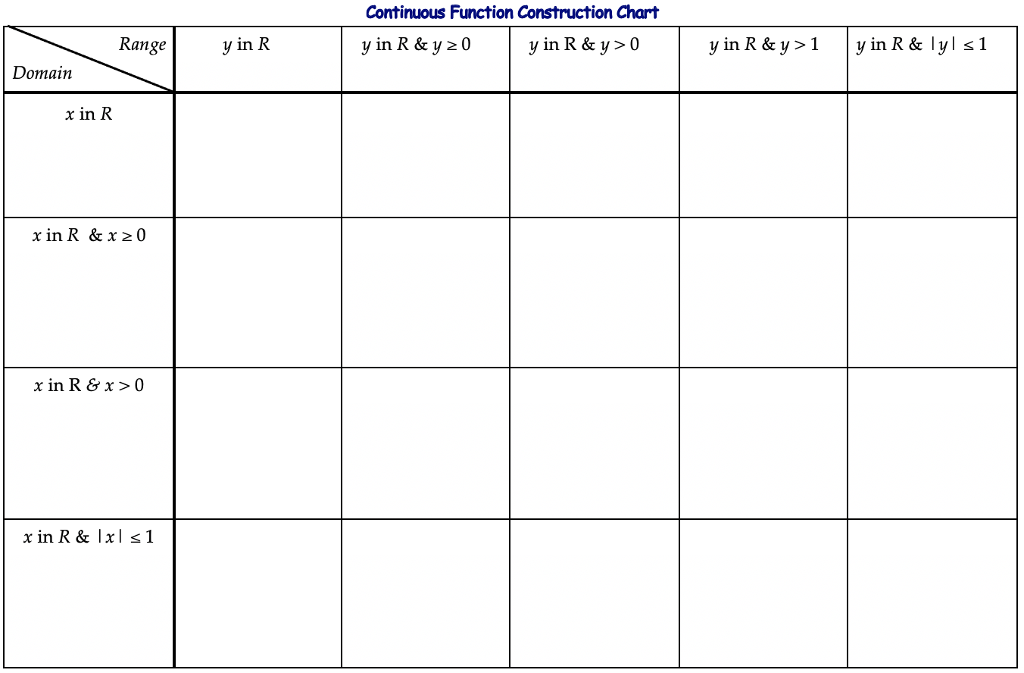
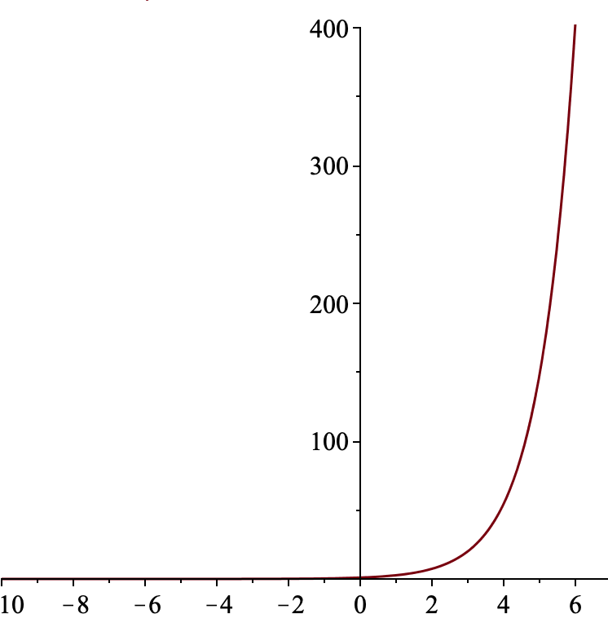
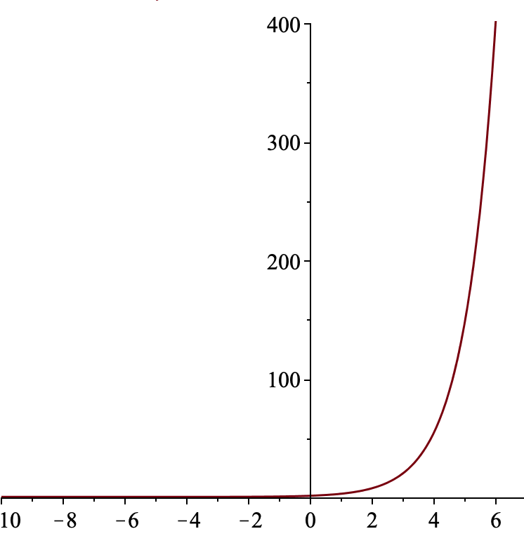
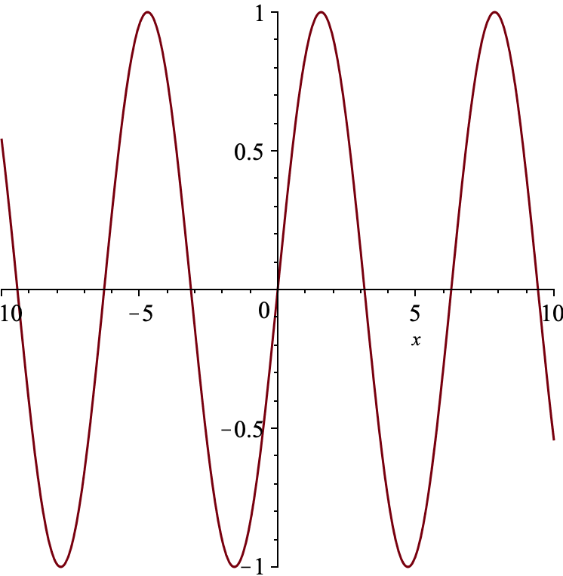
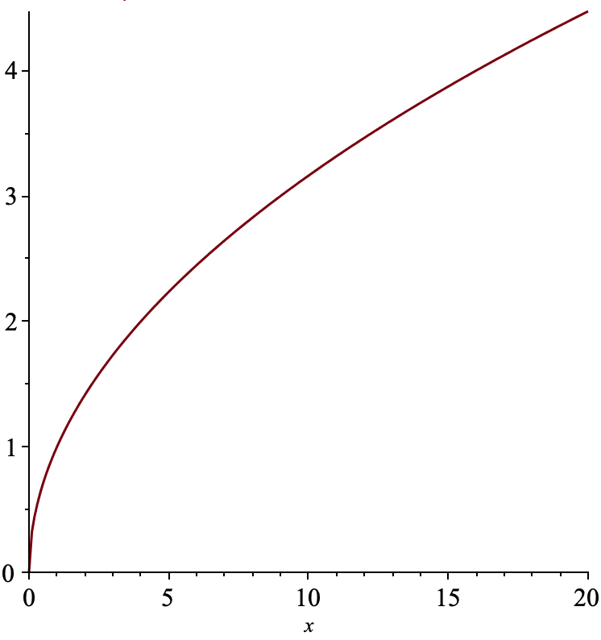
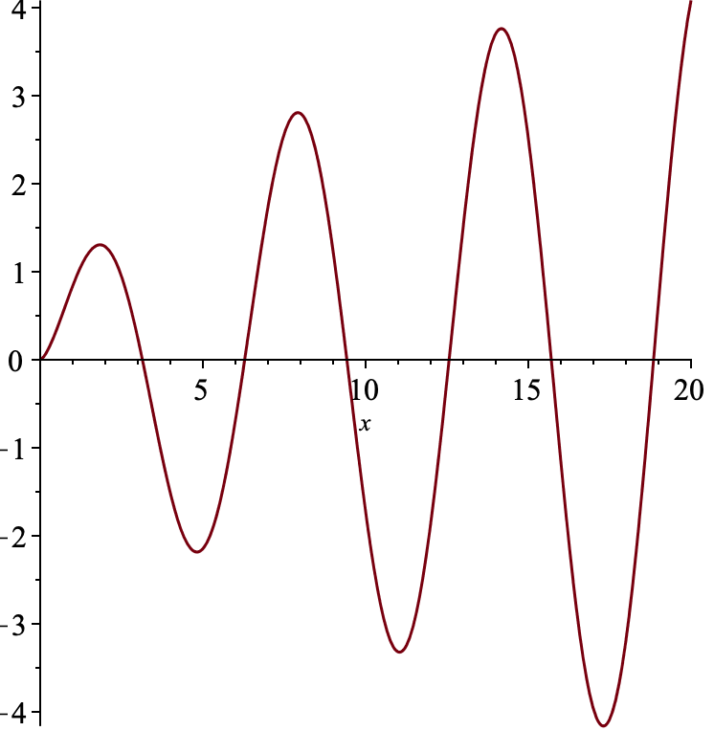
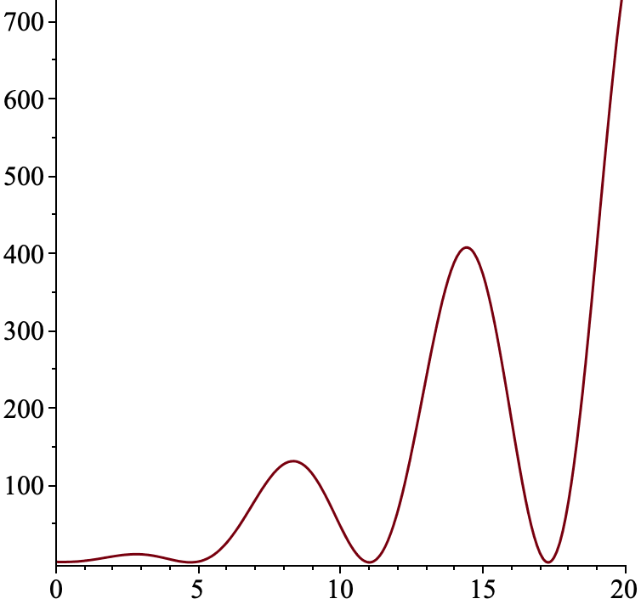
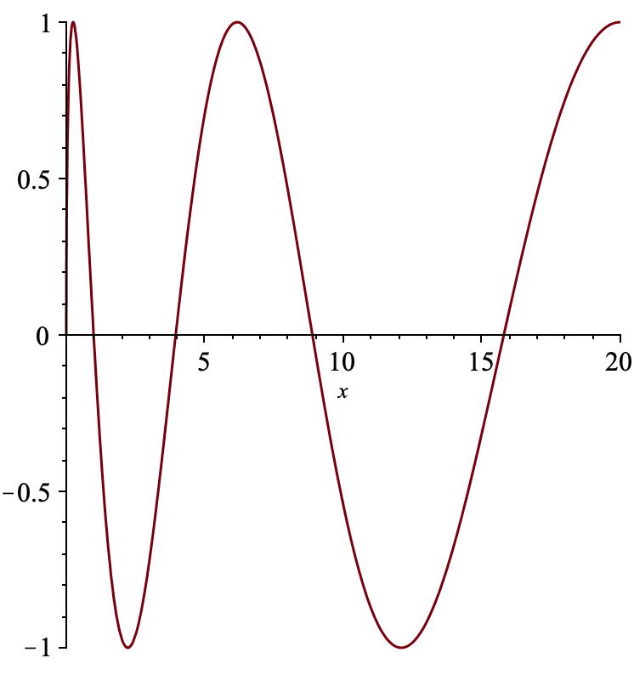
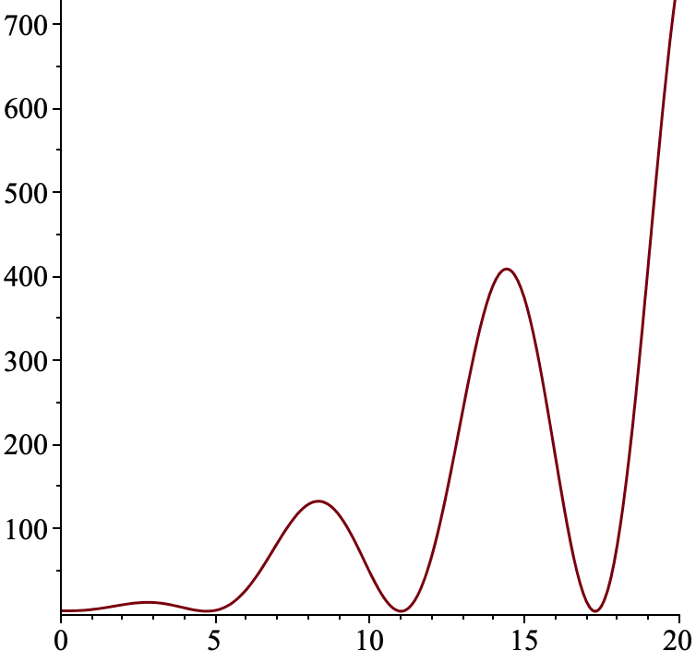
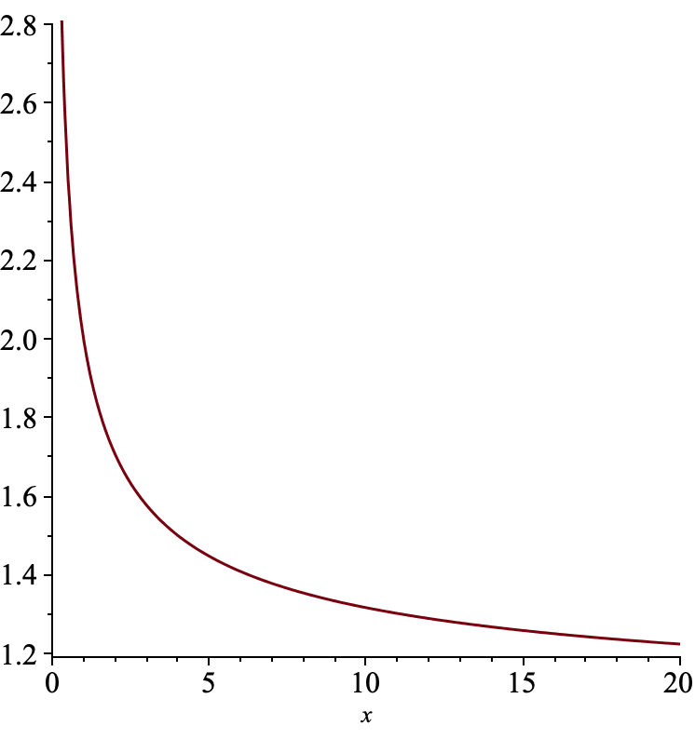
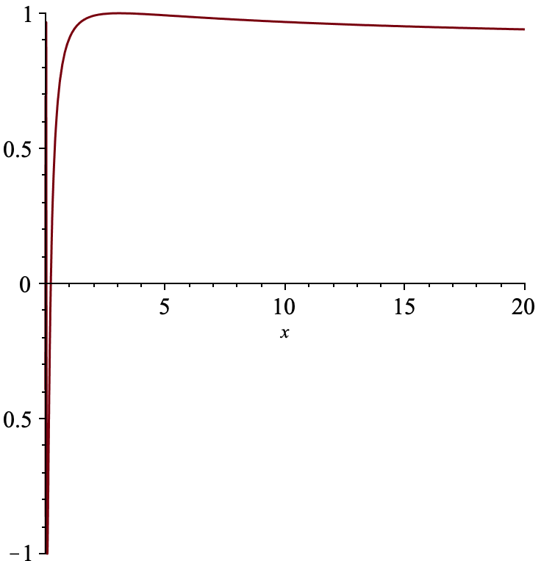
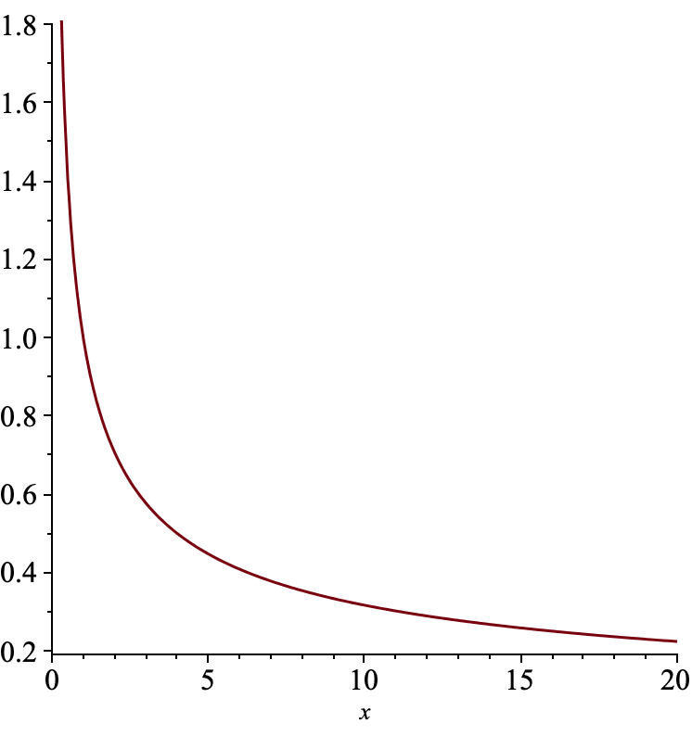
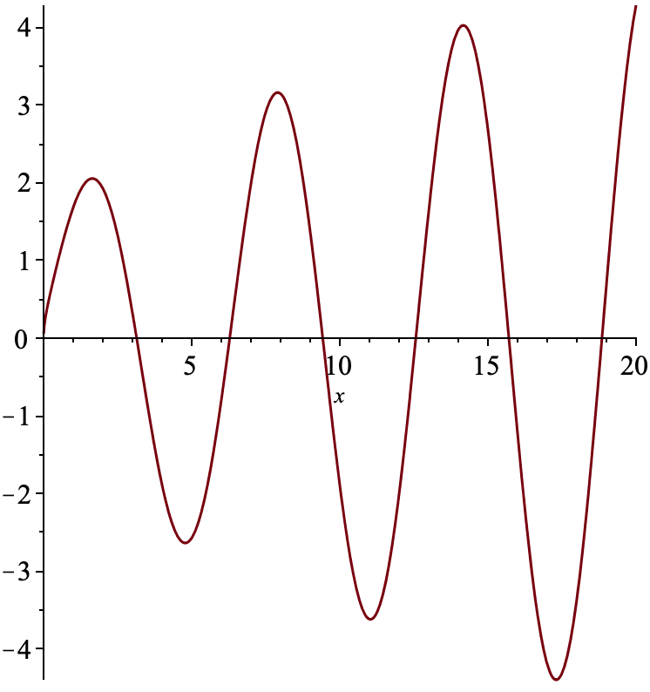
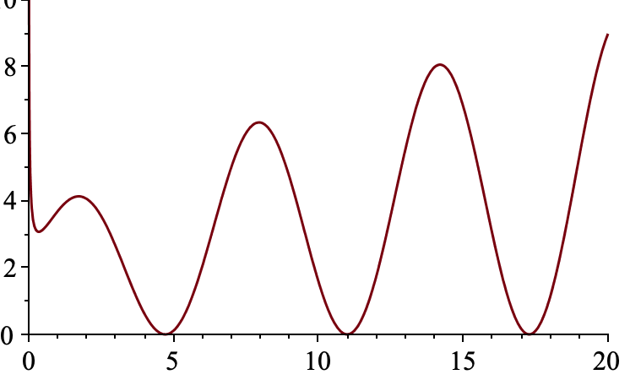
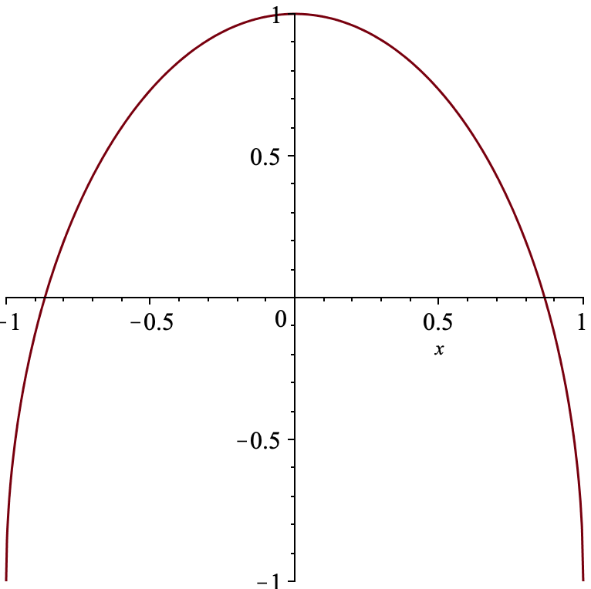
Constructing Examples
In each cell, write down a formula for a continuous function whose maximal domain and full range are indicated by the row and column headings
Impossible?
Impossible?
Impossible?
Impossible?

Slide 10
Did You Notice:
Use of natural powers?
  Imagining & Expressing
  Specialising & Generalising
  Conjecturing & Convincing
  Organising & Characterising
  Others?
Encountering Mathematical Themes?
  Doing & Undoing
  Invariance in the midst of change
  Freedom & Constraint
  Making the implicit explicit
  Others?
Shifts of Attention?
  Gazing (Holding Wholes)
  Discerning Details
  Recognising Relationships
  Perceiving Properties as being instantiated
  Reasoning on the basis of agreed properties

Slide 11
Next Session …
… will focus on Reasoning

Slide 12
Reflection
What did you notice yourself doing?
Where you aware of
  Imagining & Expressing
  Specialising & Generalising
  Conjecturing & Convincing
  Organising & Characterising
Did you encounter
  Doing & Undoing
  Invariance in the midst of change
  Freedom & Constraint
  Restricting & Expanding

