Slide 1


Imagine That! making use of the natural powers to imagine and to express
Ark Conference
April 2021

Slide 2
Preparation
You will want to be able to write things down: paper and pen!
I am going to invite you to imagine some things
  Some people sort of ‘see’ things;
  Other people ‘hear’ descriptions;
  Other people ‘have a sense of’;
Imagine yourself responding to some instructions to imagine, then describing what you imagine to someone else
  That’s what we will be doing together
Notice the use of mental imagery as preparation for activity
Imagine how I have been imagining leading this session

Slide 3
Main Point
The power to imagine, and to express that in words, symbols, actions, movement, drawing etc. …
… is natural to humans, and perhaps the most important power possessed.
It is the way we try to inform our future actions
One thing people don’t seem to learn from experience
Is that we don’t often learn from experience alone
Something more is required …
Looking back,
and imagining forward

Slide 4
Prelude to Henry Vth
O for a Muse of fire, that would ascend
The brightest heaven of invention,
A kingdom for a stage, princes to act
And monarchs to behold the swelling scene!
Then should the warlike Harry, like himself,
Assume the port of Mars; and at his heels,
Leash'd in like hounds, should famine, sword and fire
Crouch for employment. But pardon, and gentles all,
The flat unraised spirits that have dared
On this unworthy scaffold to bring forth
So great an object: can this cockpit hold
The vasty fields of France? or may we cram
Within this wooden O the very casques
That did affright the air at Agincourt?
O, pardon! since a crooked figure may
Attest in little place a million;
And let us, ciphers to this great accompt,
On your imaginary forces work.
Suppose within the girdle of these walls
Are now confined two mighty monarchies,
Whose high upreared and abutting fronts
The perilous narrow ocean parts asunder:
Piece out our imperfections with your thoughts;
Into a thousand parts divide on man,
And make imaginary puissance;
Think when we talk of horses, that you see them
Printing their proud hoofs i' the receiving earth;
For 'tis your thoughts that now must deck our kings,
Carry them here and there; jumping o'er times,
Turning the accomplishment of many years
Into an hour-glass: for the which supply,
Admit me Chorus to this history;
Who prologue-like your humble patience pray,
Gently to hear, kindly to judge, our play.

Slide 5
Preliminaries
Imagine Stone Henge
What questions arise inside you in relation to Stone Henge?

Slide 6
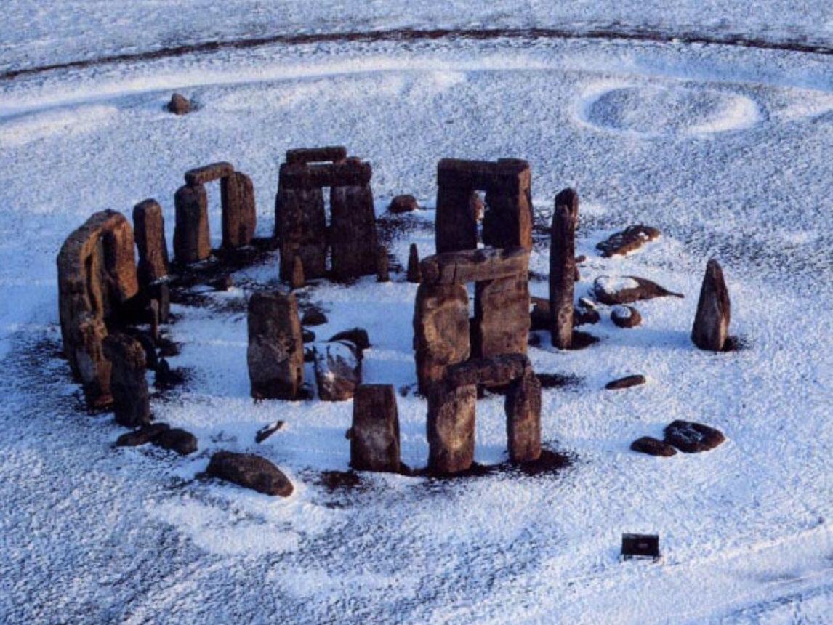
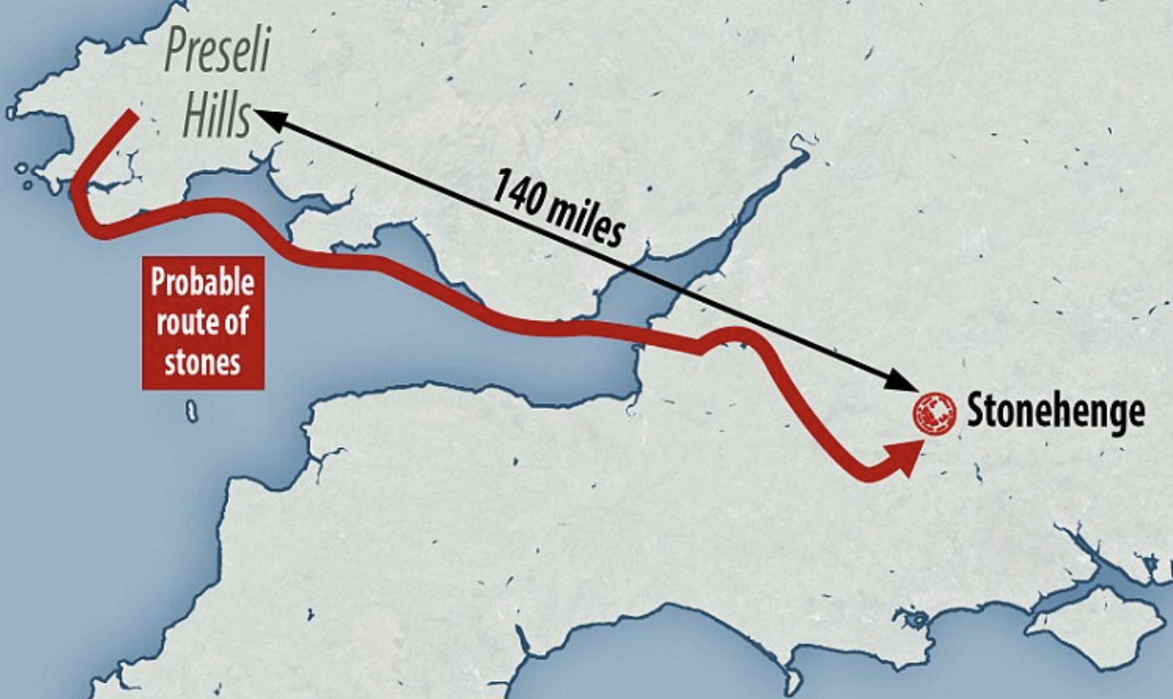
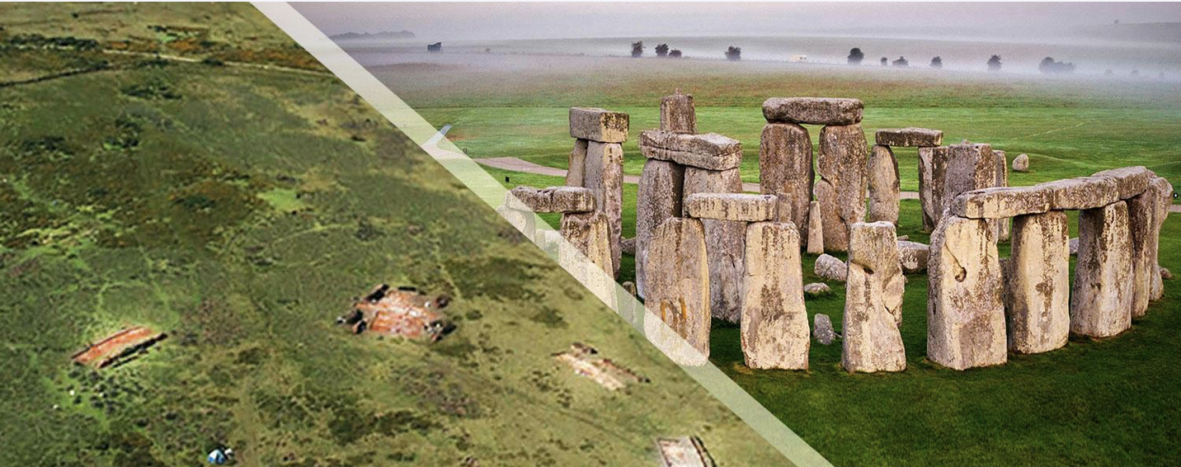
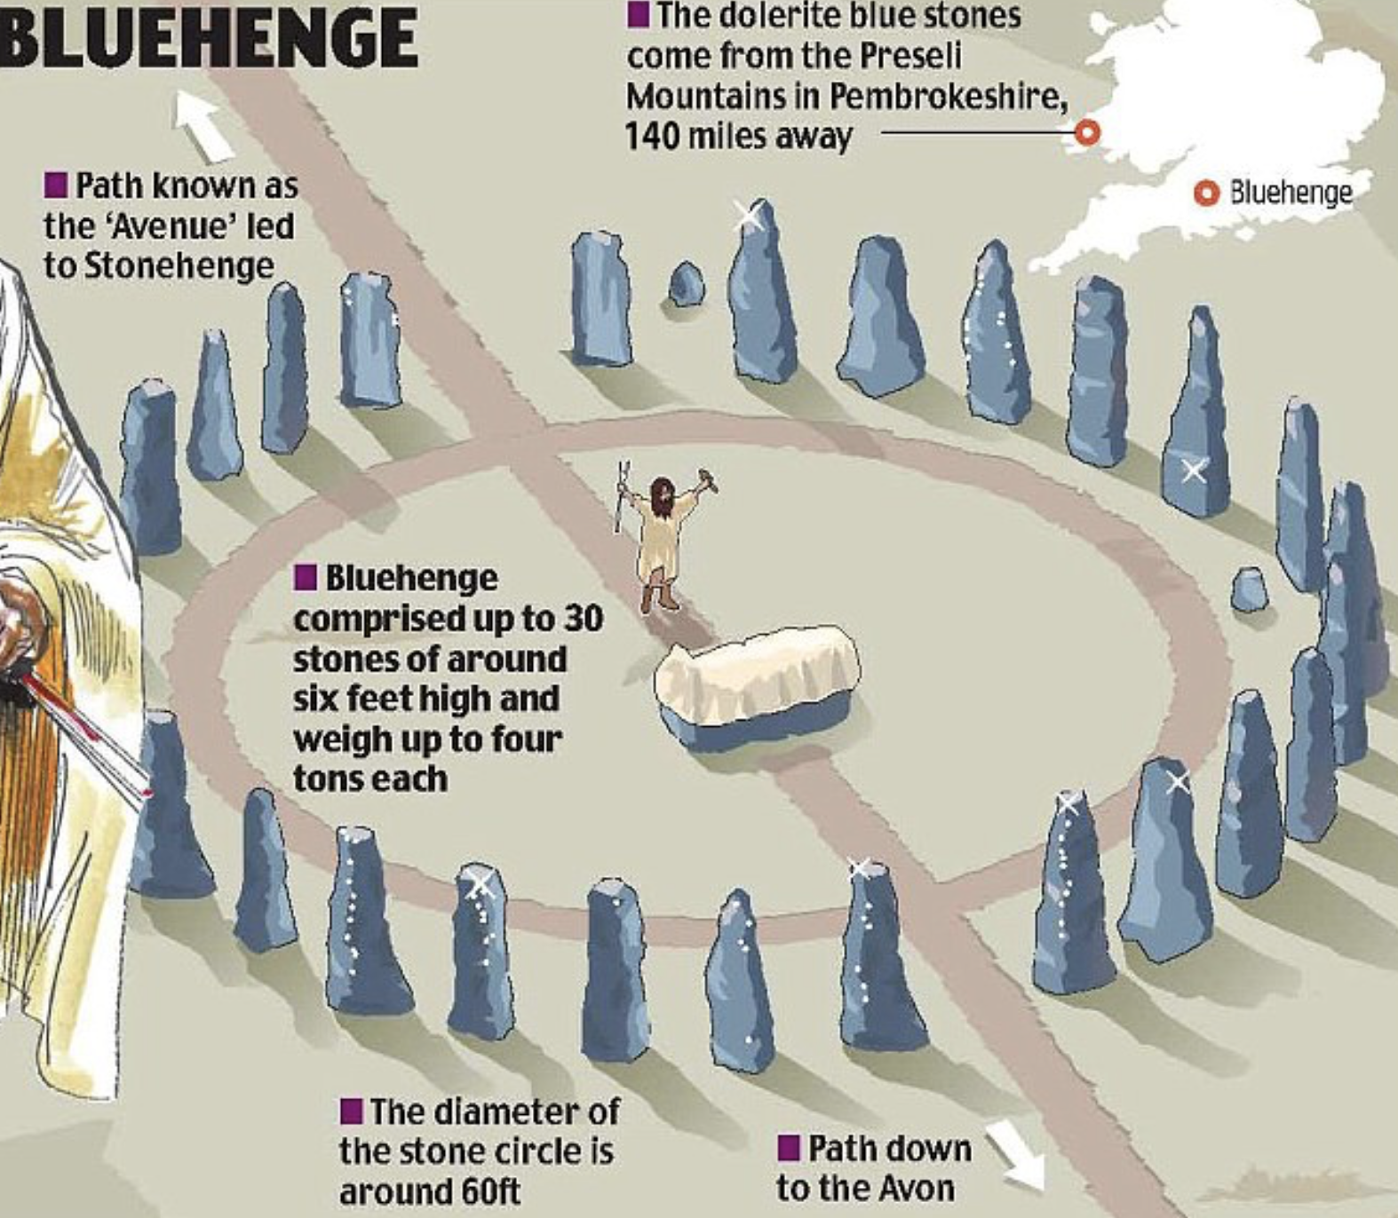
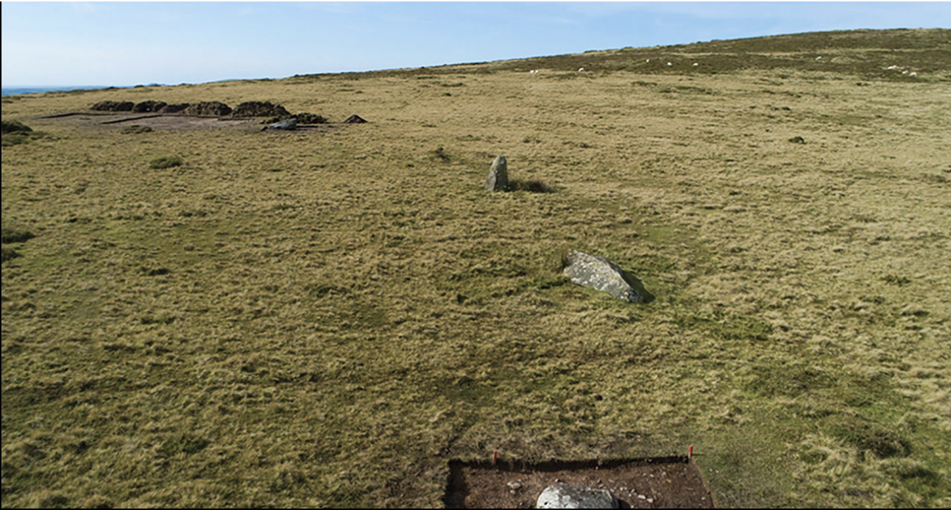
Stone Henge
It is possible that the stones transported had special ‘ringing’ qualities when struck appropriately

Slide 7
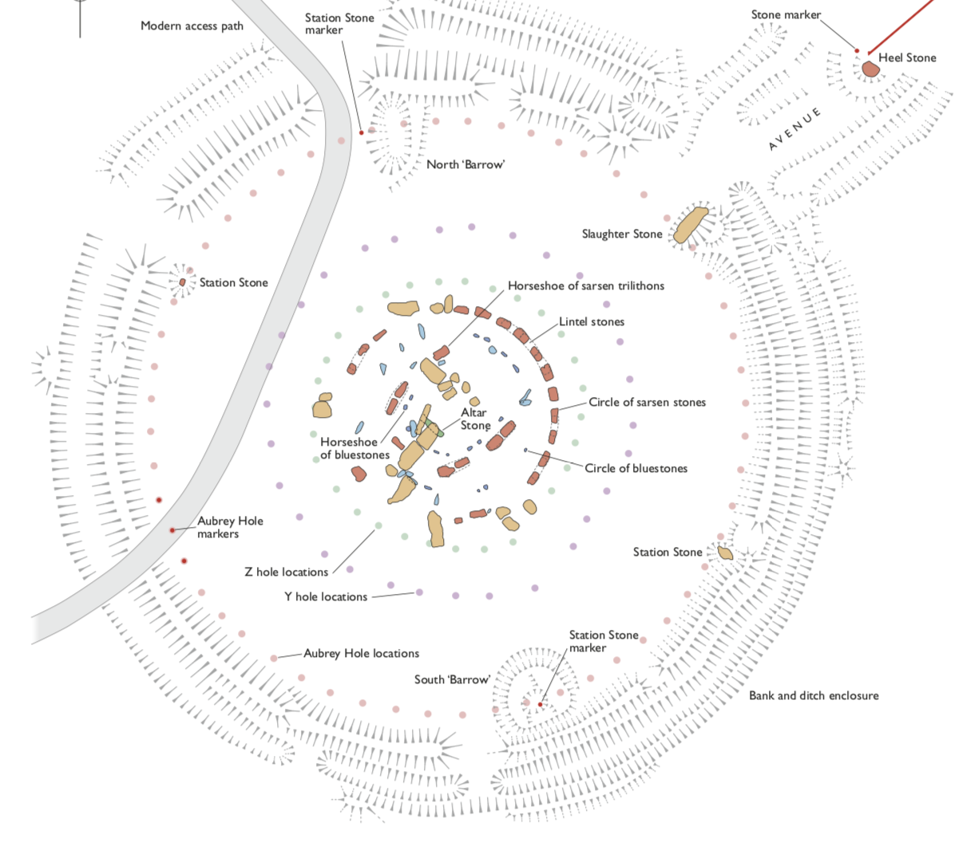
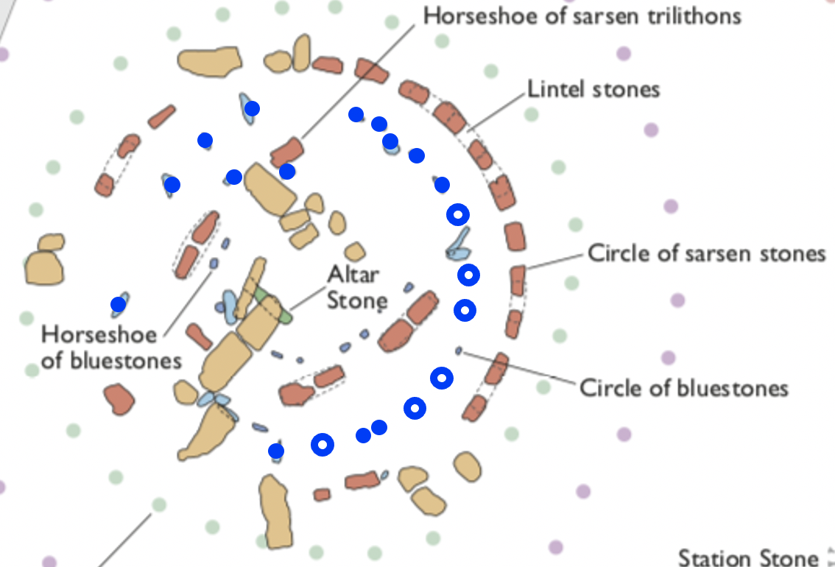

Slide 8
Potential Tasks
Imagine you were one of the people who decided to transport the stones from the Preseli hills. Describe your thinking and possible motivation. Describe the planning you would need to do.
Imagine you were one of the people drafted in to move the stones. Describe what your life might have been like.
Imagine you were one of the stones being moved. Describe what that might have felt like.
Imagine you were in charge of setting out the stones at Stone Henge when the bluestones were to be moved to their current positions. Give instructions to the workers as to how to do it.

Slide 9
Asking Questions
Tempting to provide details, especially those relevant to the next task
Alternative: ask learners what questions they feel they need to ask; even set them to find out on the web

Slide 10
Stone Henge Facts
The bluestones (show a bluish tint when wet) come from Preseli
They are between 2 and 4 tons each
They are around 2m long, 1 to 1.5 m wide, and about .8m thick
Roughly one-quarter to one-third of the stone is below the ground
They were moved from Wales some 5000 years ago, about 140km;
then moved within the henge some 700 years later
Presented as facts
Conjecture:
you imagined the stones, perhaps in situe,
perhaps detached from a site
Possibility:
How might a circle have been specified?
How might equi-distribution have been achieved?
Possibility:
To invite your learners to imagine the stones in situe,
then being moved

Slide 11
Reflection
Literature as an opportunity to experience vicarious emotions
Writing as capturing your own imagination so that others might experience something similar
Conjectural nature of imagination
Theorem in mathematics means literally “a way to see”
‘Proving a theorem’ (justifying a conjecture by reasoning) is trying to enable others to ‘see what you see’.

Slide 12
Word Problems
Anne has 7 marbles and John has 3. How many marbles do they have together? How many more marbles has Anne than John?
Anne & John together have 24 marbles. If Anne were to give John 3 of her marbles, they would then have the same number. How many do they each have?
Anne & John together have 24 marbles. If Anne gives John 3 of her marbles, she would then have twice as many as John. How many do they each have?
Anne, John & Lydia together have 24 marbles. If Anne were to give 3 of her marbles to John and 2 to Lydia, they would each have the same number of marbles. How many do they each have.
What other variations can you think of?
Imagining yourself into the situation
Working backwards
(“jumping o’er times”)

Slide 13
Geometry
Imagine a circle
And a point P (keep P well separated from the circle, and in the same plane please!)
Now imagine a point Q travelling around the circle at constant speed
  You are using a birds-eye view to imagine P fixed and Q moving.
What is it like to be at P watching Q … how does Q move in your vision?
What is it like to be at Q watching P … how does P appear to move?
Now imagine M is midway between P and Q.
What path does M take in the plane? (birds-eye view)
What is it like to be at M: how do P and Q appear to move?

Slide 14
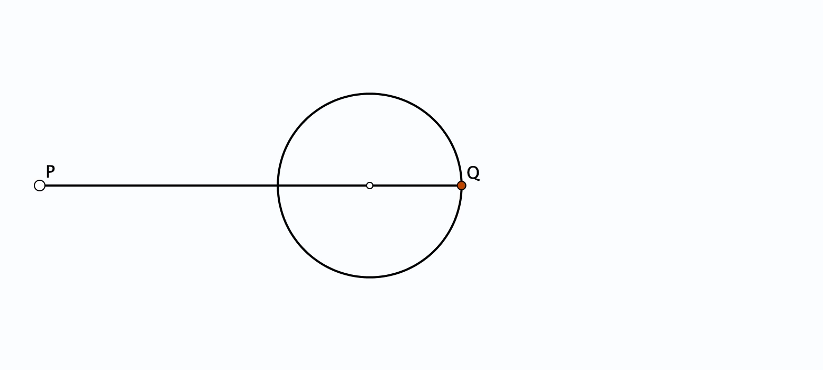
Seeing

Slide 15
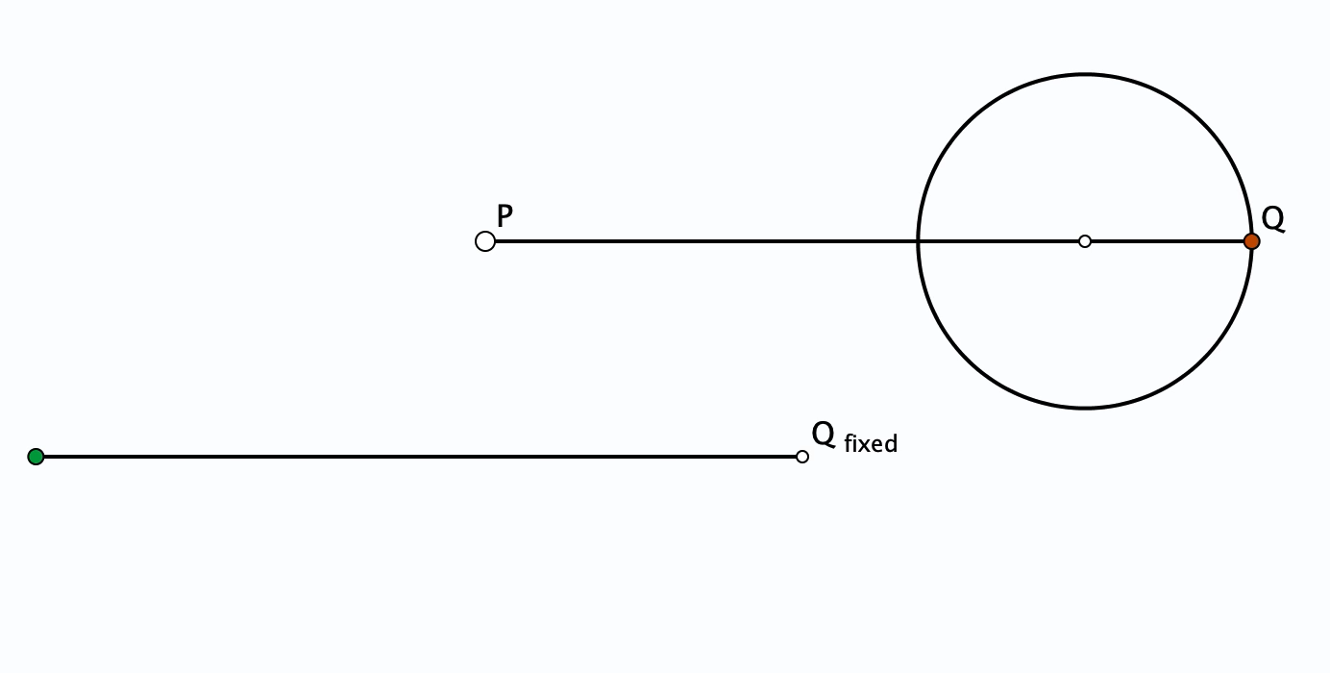
Seeing

Slide 16
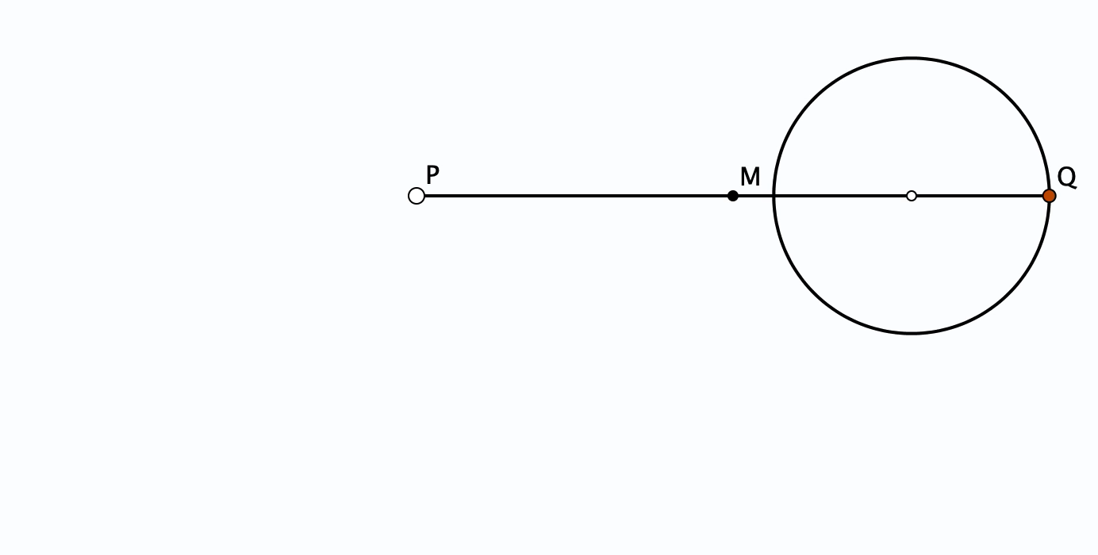
Mid-Point between P and Q

Slide 17
Reflections
Imagining yourself IN the situation, not just looking at it.
Prompting learners to imagine themselves IN the situation.

Slide 18
Students
Planning involves imagining oneself in the situation
Imagining, then Acting Out, then analysing as observer
Learners preparing to act could be encouraged to spend a bit of time imagining
Blocking immediately enacting the first action that becomes available
Engaging with task
Teachers
Planning involves imagining oneself in the situation
Imagining,
  What you hope learners will experience;
  what learners will do;
  What pedagogic actions might be useful to initiate;
then Acting Out, then analysing as observer
Engaging with task with colleagues to gain familiarity with possible actions and potentially unhelpful actions

Slide 19
Main Point
The power to imagine, and to express that in words, symbols, actions, movement, drawing etc. …
… is natural to humans, and perhaps the most important power possessed.
It is how people try to inform future actions
One thing people don’t seem to learn from experience
Is that we don’t often learn from experience alone
Something more is required …
Looking back,
and imagining forward
Personal Narratives
Own Explanations

Slide 20
Follow-Up
john.mason@open.ac.uk
pmtheta.com/jhm-presentations/html
Geometric Imagery (ATM)
Mathematical Imagery (ATM)
Mathematical Imagining (Christof Weber; Stenhouse)

