Slide 1




Effective Use of
Examples and Case-studies in Teaching and Learning
(Mathematics)
Promoting Mathematical Thinking
John Mason
IDEAS
Calgary
May 2017
The Open University
Maths Dept
University of Oxford
Dept of Education

Slide 2
Outline
Innovation is most effective when it refreshes old insights that have been overlayed
  Variation (Confucian heritage; Herodotus; Ference Marton)
  Genetic Epistemology
  Neo-Pythagorean Qualities of Number (J G Bennett) (6 modes)
  The Role of Attention (William James & Caleb Gattegno)
  Teaching by Listening-to not Listening-for (Brent Davis)
the role of variation in what is available to be learned;
modes of interaction between subject matter, learner and teacher according to initiative and responsiveness;
the locus and focus of attention of both learners and teachers and associated pedagogic choices.
The role of tasks in mediating between student and mathematics, and between teacher and student
The nature of mathematical activity

Slide 3
My Current Interests
The role and nature of attention in teaching and learning mathematics
Drawing on the full human psyche:
  Cognition, Affect, Enaction; Attention, Will, Witness; Conscience
Developing Dual Systems Theory to the whole psyche
  S1: automaticity
  S1.5: emotivity
  S2: consideration (particularly cognitively)
  S3: openness to creative energy
How tools and tasks mediate between student, teacher and mathematics

Slide 4
Examples and Case Studies
What do students do with examples (or case studies)?
What would you like students to do with examples?
What do you do with examples publicly so that students learn what it is possible to do with examples?

Slide 5
What do students say?
“I seek out worked examples and model answers”
“I practice and copy in order to memorise”
“I skip examples when short of time”
“I compare my own attempts with model answers”
NO mention of mathematical objects other than worked examples!
Notes:
These are Oxford ugs starting their 2nd year in mathematics

Slide 6
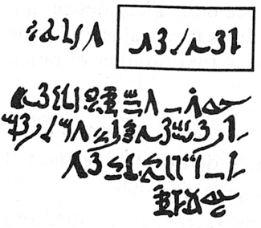

Rhind Mathematical Papyrus problem 28
Two-thirds is to be added.
One-third is to be subtracted.
There remains 10.
Make 1/10 of this,
there becomes 1.
The remainder is 9.
The answer!
2/3 of this is to be added.
The total is 15.
1/3 of this is 5.
Lo! 5 is that which goes out,
And the remainder is 10.
9 + 2/3 x 9 = 15
15 – 5 = 10
Checking!
validating
The doing as it occurs!
Notes:
Problem 28 of the Rhind Mathematical Papyrus Gillings p182

Slide 7
Worked Examples
A 4000 year old practice
“Thus is it done”; “Do it like this”; …
What is the student supposed to do?
  Follow the sequence of acts
  Distinguish structural relations and values from parameters
Templating
What does the student need from a worked example?
  What to do ‘next’
  How to know what to do next
Chi & Bassok
Renkl & Sweller
Watson & Mason
Notes:
Atkinson, R. Derry, S. Renkl, A. & Wortham, D. (2000). Learning from examples: Instructional principles from the worked examples research Review of Educational Research; 70(2), 181-214.
Renkl, A. (1997). Learning from worked-out examples: A study on individual differences. Cognitive Science, 21, 1-29.
Renkl, A. (2002) Worked-out examples: Instructional explanations support learning by self-explanations. Learning and Instruction, 12, 529–556.
Chi, M. & Bassok, M. (1989). Learning from examples via self-explanation. In L. Resnick (Ed.) Knowing, learning and instruction: essays in honour of Robert Glaser. Hillsdale, NJ: Erlbaum.
Chi, M. Bassok, M. Lewis, P. Reiman, P. & Glasser, R. (1989). Self-explanations: How Students Study and Use Examples in Learning to Solve Problems. Cognitive Science. 13 p145-182.
Watson, A. & Mason, J. (2006) Seeing an Exercise as a Single Mathematical Object: Using Variation to Structure Sense-Making. Mathematical Thinking and Learning. 8(2) p91-111.

Slide 8
Rhind Mathematical Papyrus problem 28
Two-thirds is to be added.
One-third is to be subtracted.
There remains 10.
(1 + 2/3)
(1 – 1/3)(1 + 2/3)
=
=
/ (1 + 2/3)(1 – 1/3)
= / (10/9)
Make 1/10 of this,
there becomes 1.
The remainder is 9.
= (9/10)
The doing as it occurs!
Notes:
Problem 28 of the Rhind Mathematical Papyrus Gillings p182

Slide 9
Appreciating & Comprehending Division
I tell you that 10101 is divisible by 37.
What is the remainder upon dividing
1010137 by 37?
What is the remainder upon dividing
1010123 by 37?
What is the remainder upon dividing
10124 by 37?
What is the remainder upon dividing
232323 by 37?
Make up your own similar question
  What is the same and what different about your task and mine?
How do you know?
0
Did you write it down for yourself?
How do you know?
23
How do you know?
23
0
How do you know?
It’s all about what you are attending to,
and how you are attending to it
Attention is directed
by what is being varied

Slide 10
What is Being Exemplified?
Of what is 0.9 an example?
  The decimal name for a number
  The decimal name for the rational number 9/10
    or indeed 18/20, …, 90/100, ...
  The decimal name for 9 divided by 10
  The decimal value of the ratio of 9 : 10
  The decimal name for 90%
Of what is 0.9 an example?
  A number whose square is smaller than itself
  A counter-example to the conjecture that “squaring makes bigger”
  A number whose square is less than 1
  A number specified to one decimal place

Slide 11
Example Construction
Please write down a decimal number
between 2 and 3
2.5
  That does not use the digit 5;
    and another
    and yet another
  That does not use the digit 5 but does use the digit 7
2.7
    and another
    and yet another
  That does not use the digit 5
  but does use the digit 7
  and is as close to 5/2 as possible
2.47
2.497
2.499… 97
2.479
2.4979
2.499… 9799..

Slide 12
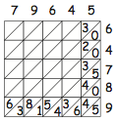
CopperPlate
Multiplication
Notes:
Or with deliberate mistake!

Slide 13
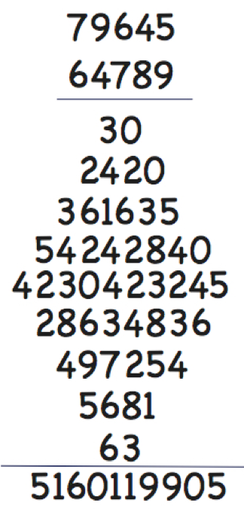
Copper Plate Multiplication (alternate)
Spot the deliberate mistake!

Slide 14
Exercises as Examples
for developing facility
Varying
type
Varying
structure
Doing & Undoing
for deepening comprehension
for extending appreciation
Varying context
Complexifying
& Embedding
for enriching accessible example spaces
Extending, & Restricting
Learners
generating own examples
subject to constraints
Generalising & Abstracting

Slide 15
Strategies for Use with Exercises
Sort collection of different contexts, different variants, different parameters
Characterise odd one out from three instances
Put in order of anticipated challenge
Do as many as you need to in order to be able to do any question of this type
Construct (and do) an Easy, Hard, Peculiar; and where possible, a General task of this type
Decide between appropriate and flawed solutions
Describe how to recognise a task ‘of this type’;
Tell someone ‘how to do a task of this type’
What are tasks like these accomplishing (narrative about place in mathematics)

Slide 16
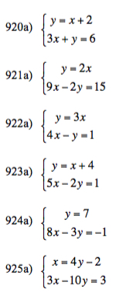
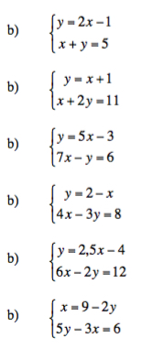
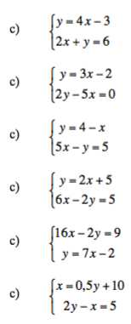
Exercises
What is being varied?
To what effect?
Notes:
Haggstrom ch 5 p7

Slide 17
Alternative Exercises

Slide 18
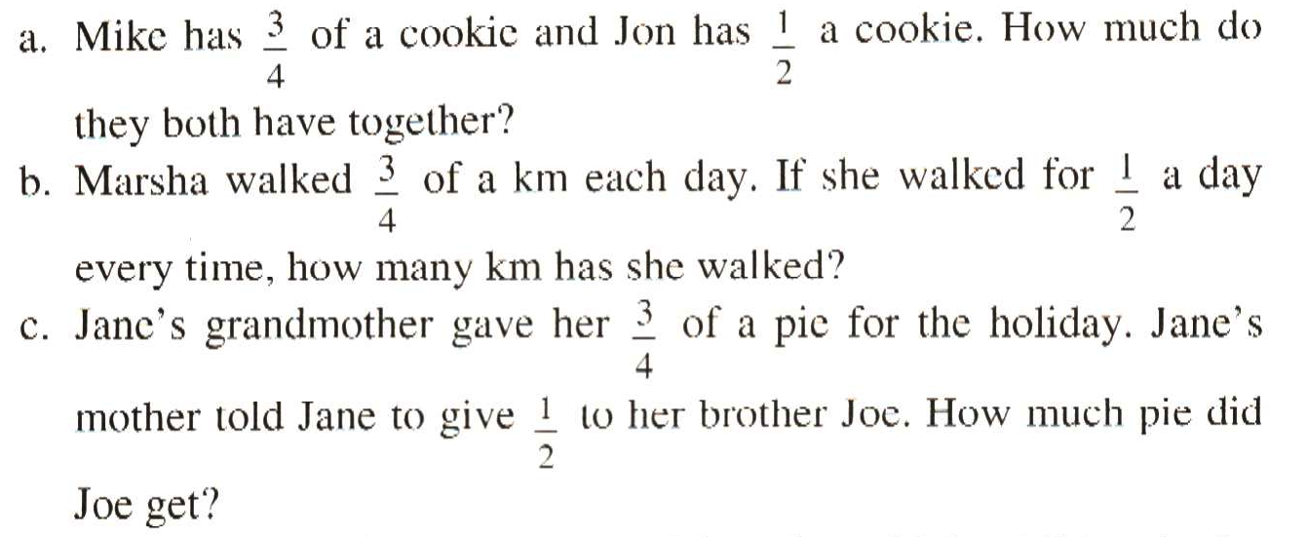
¾ and ½
What distinguishes each from the other two?
What ambiguities might arise?
What misconceptions or errors might surface?

Slide 19
Ratio Division
To divide $100 in the ratio of 2 : 3
2 : 3
…
…
2 : 3
2
3
2
3
2 : 3
2
3
2
3
2 : 3
…
2 : 3
…
…
…
…
…
1
1
1
1
1
1
1
1
1
1
1
1
1
1
1
1
1
1
1
1
What is the same, and what different
about these three approaches?

Slide 20
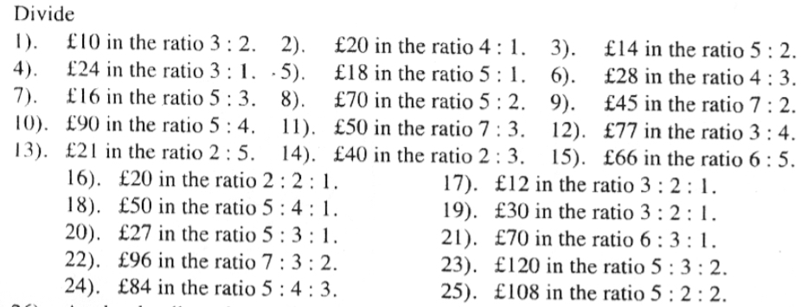
Ratio Division & Variation
Consider the sums of the ratio parts
What is it possible to learn
from a set of exercises like this?
Consider the use of full stops /decimal points
When is the amswer not a whole number?
Notes:
Ten Ticks (source)

Slide 21
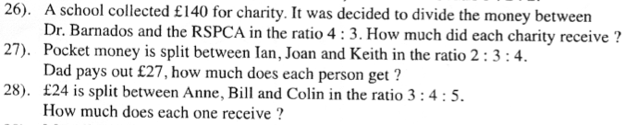


What is being varied?
Is this a triangle?
What can be done with these exercises?
Notes:
TenTicks

Slide 22
Exploring Ratio Division
The number 15 has been divided in some ratio and the parts are both integers. In how many different ways can this be done? Generalise!
If some number has been divided in the ratio 3 : 2, and one of the parts is 12, what could the other part be? Generalise!
If some number has been divided in the ratio 5 : 2, and the difference in the parts is 6, what could the original number have been? Generalise!

Slide 23
Initial Playfulness
Luis baked muffins. He sold of them. How many muffins were left?
  What kinds of numbers could be hidden?
  What relationships must there be between the number baked and the number sold?
  How might the number sold be described?
  What numbers would be possible if 10 was the answer?
  If you knew that 8 were sold and 12 left over, what must the first number be?
Notes:
(Janet Mock )
Problems Without Numbers Hunt. (2015) Teaching Children Mathematics, 21 (5) 320

Slide 24
Problem Solving via Covering-Up
If Anne gives John 5 of her marbles, and then John gives Martina 2 of his marbles, Anne will have one more marble than Martina and the same number as John. How many more marbles has Martina than John at the start?
If Anne gives John 5 of her marbles, and then John gives Martina 2 of his marbles, Anne will have one more marbles than Martina and one less than John. How many more marbles has Martina than John at the start?
If Anne, John and Martina give each other some marbles of their marbles. …
Notes:
Janet Mock ATM 2017
Beginning Generally and Playfully before introducing constraints
Freedom & Constraint

Slide 25
Multi-Level Initiating of Tasks
In how many different ways can a unit fraction be expressed as the difference of two unit fractions?
Notice that
Anticipating &
Conjecturing
Notice that
Anticipating &
Conjecturing

Slide 26
The Calleja Spiral
Imagine a cartesian grid based on integers
Imagine the following points
[0, 1]
[2, 0]
[0, -3]
[-4, 0]
[0, 5]
[6, 0]
[0, -7]
[-8, 0]
[0, ...]
[..., 0]
[0, ...]
[..., 0]
…
Now join them in sequence by straight lines
Say What You See to a neighbour
Notes:
James Calleja at ATM Stratford-upon-Avon, 2017.

Slide 27
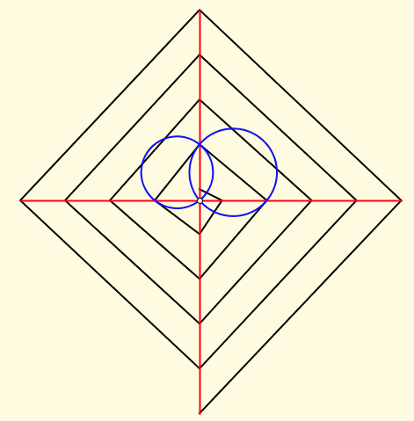
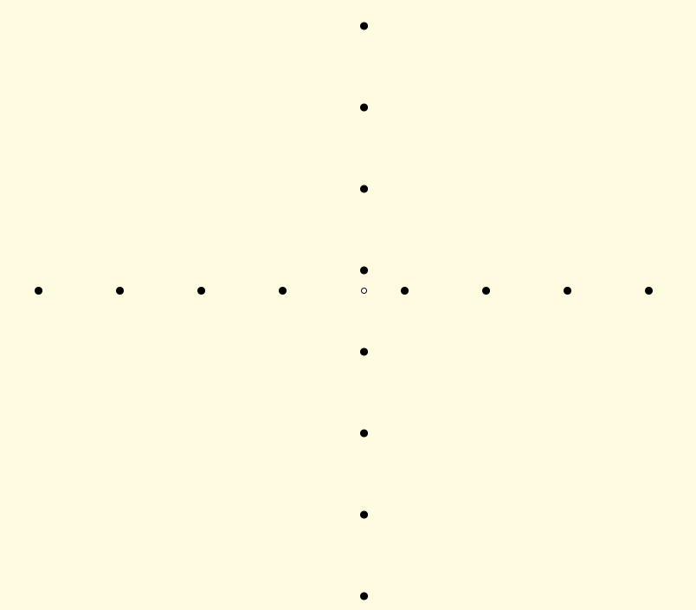
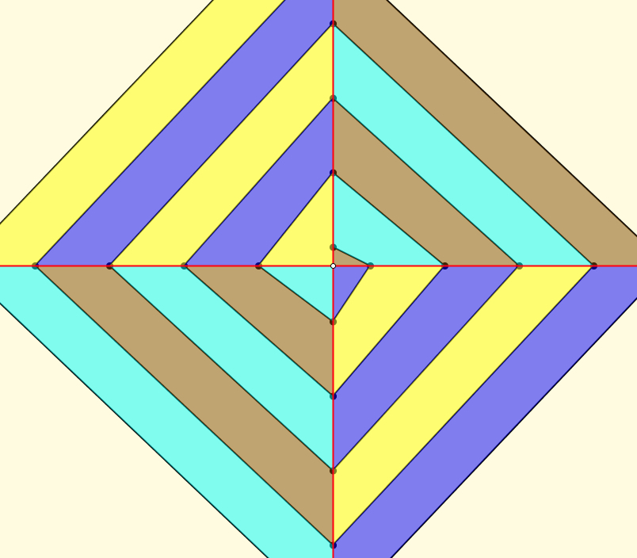
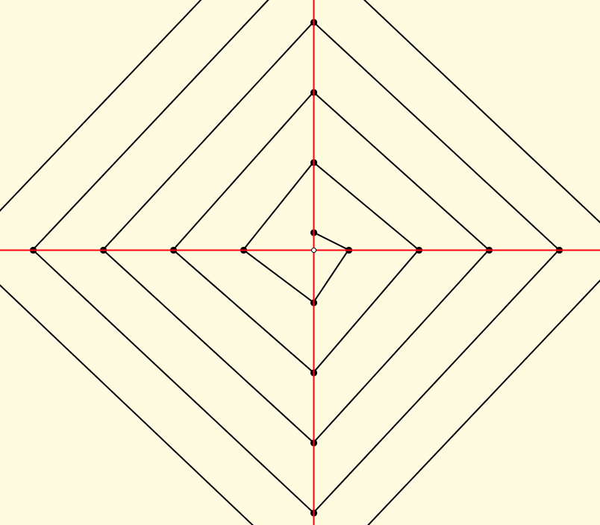
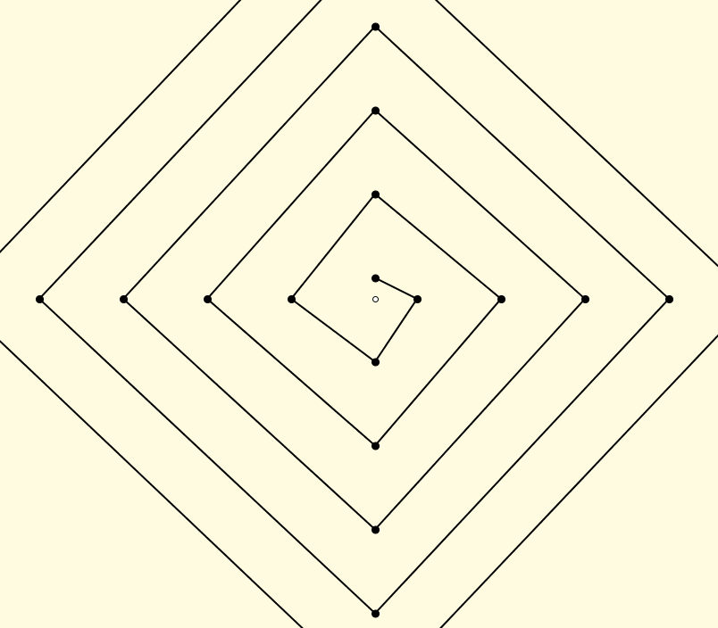
What more can you ‘see’?
Almost parallel lines
Right-angled triangles
Almost trapezia
Lengths
Slopes
Areas
Sequences of
  lengths, areas, slopes, …
Sums of Sequences (series)
Circles
Almost right-angled Triangles

Slide 28
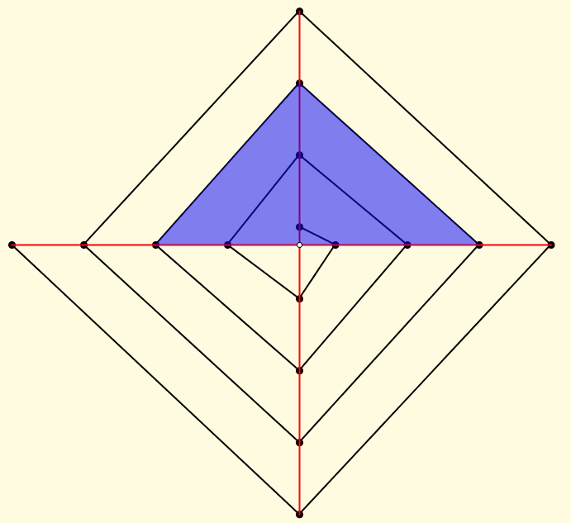
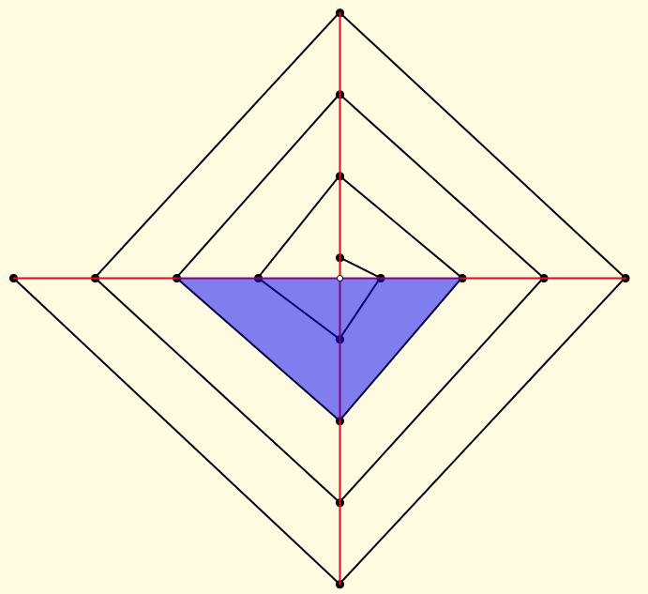
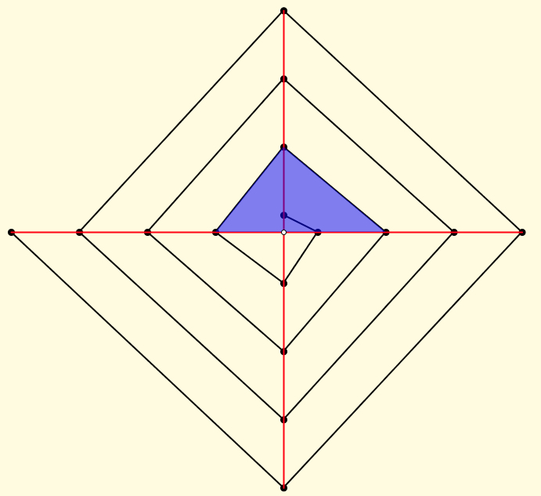
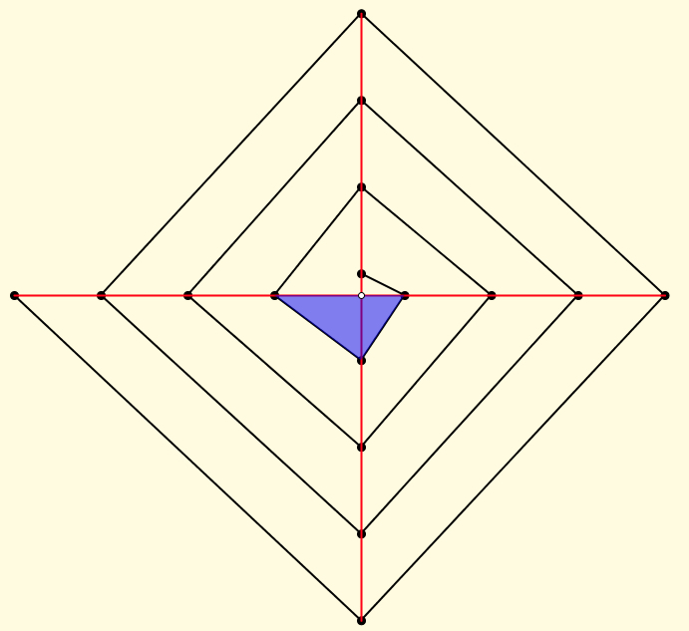

Slide 29
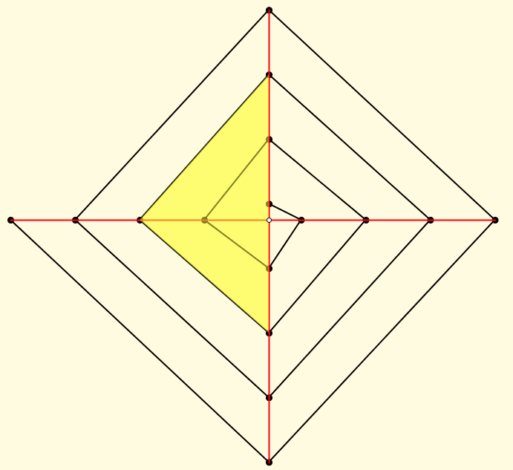
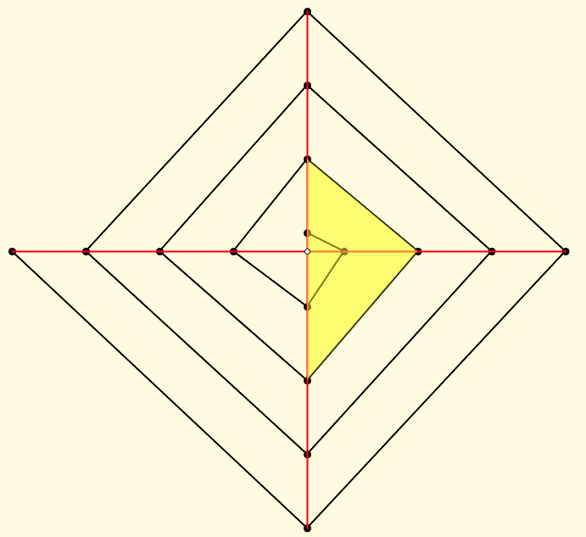
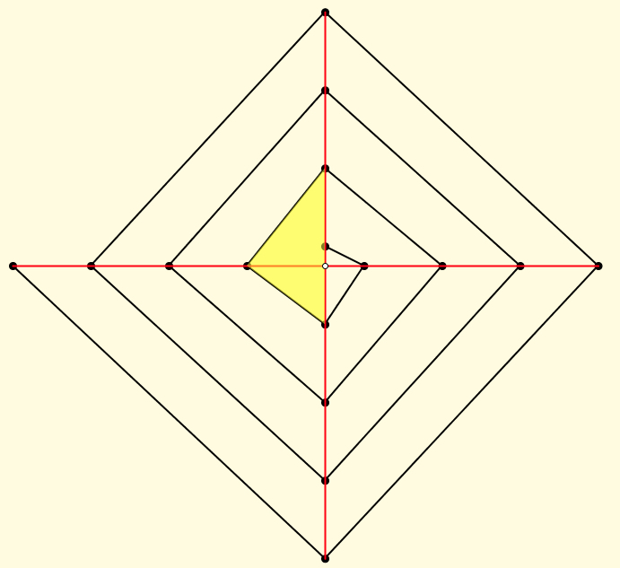
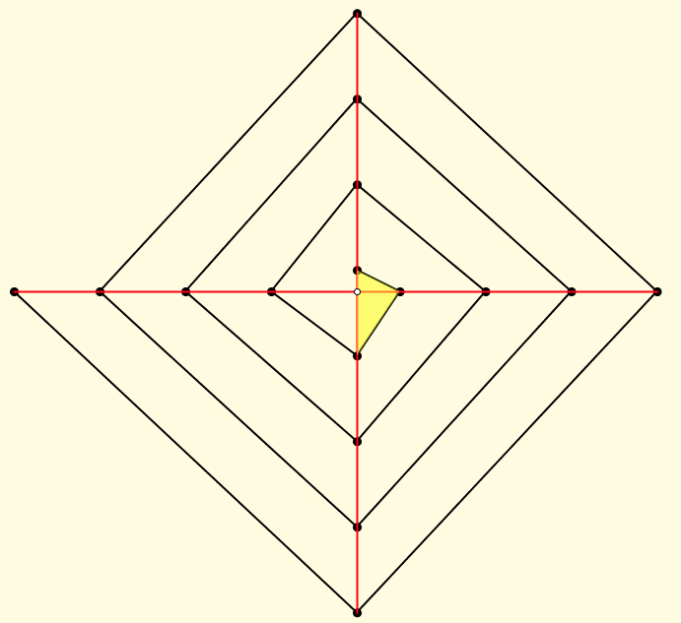

Slide 30
Relevant Curriculum Topics
Area of triangles
  Triangular numbers (formula)
  Using triangles to form other figures
Slopes and Equations of lines
Conditions for lines being parallel
Lengths (Pythagoras; vertex coordinates)
Area of Quadrilaterals
Expressing n^{th} term of a sequence
Expressing n^{th} sum of a sequence
Limits of sequences
Constructing a line through a point and the virtual intersection of two lines

Slide 31
Example Spaces & Variation
Populating
Generativity
Connnectedness
Generality
Intended Object of Learning (IOL)
Enacted Object of Learning (EOL)
Lived Object of Learning (LOL)
Conventional (canonical)
Personal
Invariant or Varying

Slide 32
Progression & Development
DTR (do, talk, record)
MGA (manipulating, getting-a-sense-of, articulting)
EIS (enactive, iconic, symbolic: Bruner)
  (weaning off material objects)
PES (Enriching Personal Example Space)
LGE (Learner Generated Examples)
Re-construction when needed
Communicate effectively with others

Slide 33
Inner, Outer & Mediating Aspects of Tasks
Outer
  What task actually initiates explicitly
Inner
  What mathematical concepts underpinned
  What mathematical themes encountered
  What mathematical powers invoked
  What personal propensities brought to awareness
Mediating
  Between teacher and Student
  Between Student and Mathematics (concepts; inner aspects)
Activity
  Enacted & lived objects of learning
Object of Learning
Resources
Tasks
Current State
Notes:
Tahta
Bennett

Slide 34
Powers & Themes
Are students being encouraged
to use their own powers?
Powers
or
are their powers being usurped by textbook, worksheets and … ?
Imagining & Expressing
Specialising & Generalising
Conjecturing & Convincing
(Re)-Presenting in different modes
Organising & Characterising
Themes
Doing & Undoing
Invariance in the midst of change
Freedom & Constraint
Restricting & Extending
Exchanging

Slide 35
‘Problems’
Krutetskii
Having been subtracting numbers for three lessons, children are then asked:
  If I have 13 sweets and eat 8 of them, how many do I have left over?
What is being attended to and how?
A question has arisen in a discussion about journeys to and from school:
  Mel and Molly walk home together but Molly has an extra bit to walk after they get to Mel’s house; it takes Molly 13 minutes to walk home and Mel 8 minutes. For how many minutes is Molly walking on her own?
What is being attended to and how?
A question about numbers:
  If two numbers add to make 13, and one of them is 8, how can we find the other?
What is being attended to and how?
Notes:
Orall, with equipment; written

Slide 36
Example Types
Procedures
  Worked examples
Case studies
Concept Examples
  Instances
Directing attention to
  Concept boundaries
  Generalisation
  Uncommon
  Example, non-example & counter-example
Zodik & Zaslavsky

Slide 37
Exercises
for developing facility
Varying
type
Varying
structure
Doing & Undoing
for deepening comprehension
for extending appreciation
Varying context
Complexifying
& Embedding
for enriching accessible example spaces
Extending, & Restricting
Learners
generating own examples
subject to constraints
Generalising & Abstracting

Slide 38
Mathematical Thinking
How might you describe the mathematical thinking you have done so far today?
How could you incorporate that into students’ learning?
What have you been attending to:
  Results?
  Actions?
  Effectiveness of actions?
  Where effective actions came from or how they arose?
  What you could make use of in the future?

Slide 39
Reflection Strategies
What technical terms involved?
What concepts called upon?
What mathematical themes encountered?
What mathematical powers used (and developed)?
What links or associations with other mathematical topics or techniques?

Slide 40
Reflection and the Human Psyche
What struck you during this session?
What for you were the main points (cognition)?
What were the dominant emotions evoked? (affect)?
What actions might you want to pursue further? (enaction)
What initiative might you take (will)?
What might you try to look out for in the near future (witness)
What might you pay special attention to in the near future (attention)?
What aspects of teaching need specific care (conscience)?
Notes:
Chi et al

Slide 41
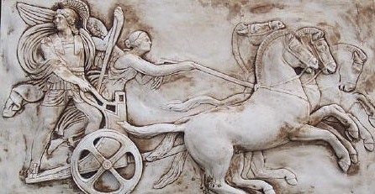
Making Use of the Whole Psyche
Assenting & Asserting
Awareness (cognition)
Imagery
Will
Emotions
(affect)
Body (enaction)
Habits
Practices

Slide 42
Practising Practices
Principles (Tom Francome & Dave Hewitt ATM 2017)
  Exploration to gain further insight
  Learners make significant choices
  Opportunity to notice and become familiar with relationships
  Opportunity to justify and prove
  Adaptable & extendable
Conjectures
  A practice is a sequence of actions often repeated
  To practise is to use a practice effectively (professionally)
  To develop a practice is to rehearse actions in multiple contexts so as to appreciate and to comprehend those actions and their significance.
Notes:
Tom Francome & Dave Hewitt

Slide 43
Reflection as Self-Explanation
What struck you during this session?
What for you were the main points (cognition)?
What were the dominant emotions evoked? (affect)?
What actions might you want to pursue further? (Awareness)
Notes:
Chi et al

Slide 44
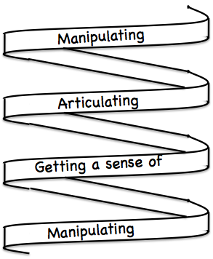
Frameworks
Enactive – Iconic – Symbolic
Doing – Talking – Recording
See – Experience – Master
Concrete – Pictorial– Symbolic

Slide 45
What Can Teachers Do?
It is not the task that is rich
  but the way the task is used
Teachers can guide and direct learner attention
What are teachers attending to?
  powers
  Themes
  heuristics
  The nature of their own attention

Slide 46
To Follow Up
www.pmtheta.com
john.mason@open.ac.uk
Thinking Mathematically (new edition 2010)
Developing Thinking in Algebra (Sage)
Designing & Using Mathematical Tasks (Tarquin)
Questions and Prompts: primary (ATM)
Mathematics as a Constructive Activity
(with Anne Watson)

