Slide 1
Examples of Variation
ATM-MA Conference 2023
Laurie Jacques, Anne Watson & John Mason
Choose one task
Work on it even if you are familiar with it
Consider, with colleagues, what (important, curriculum-relevant) awarenesses it is likely to bring to the surface for discussion.
Consider how the task does this or how it could do better

Slide 2
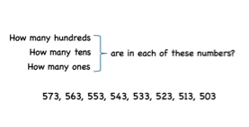

Slide 3
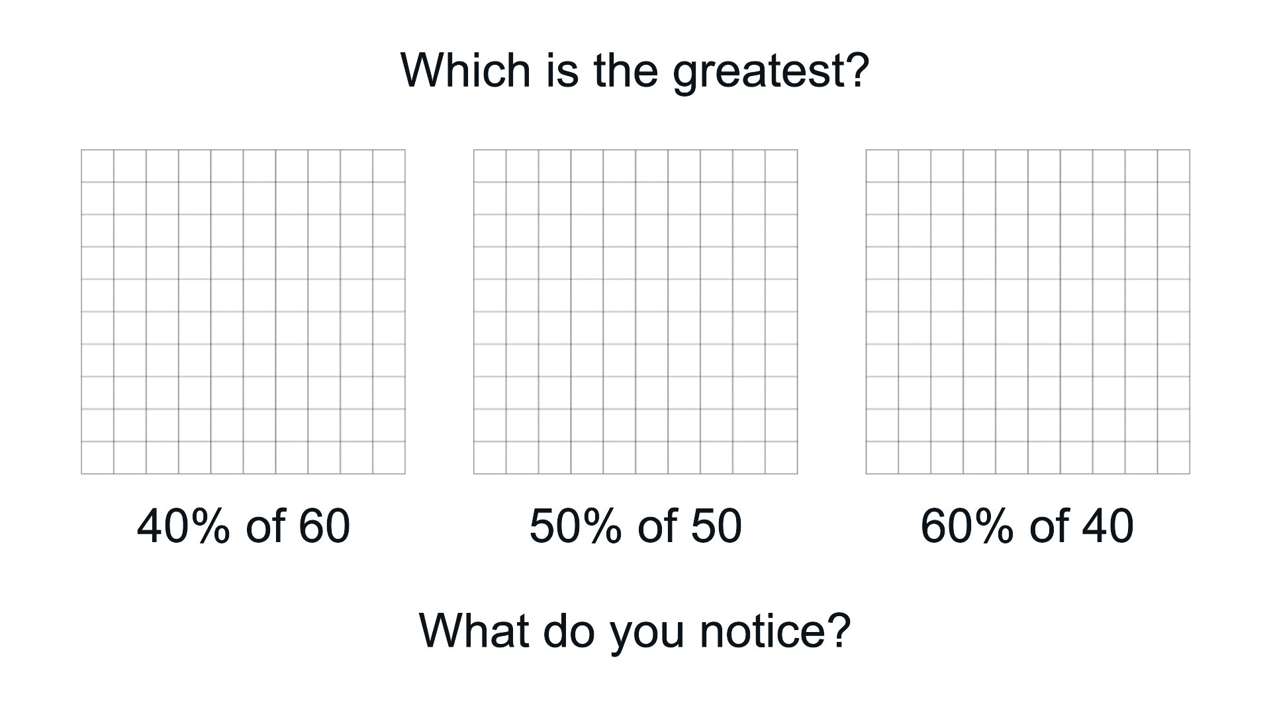
Source Jonathan Hall
Notes:
Source Jonathan Hall on Twitter https://twitter.com/SmartJacques/status/1757835632456478985

Slide 4
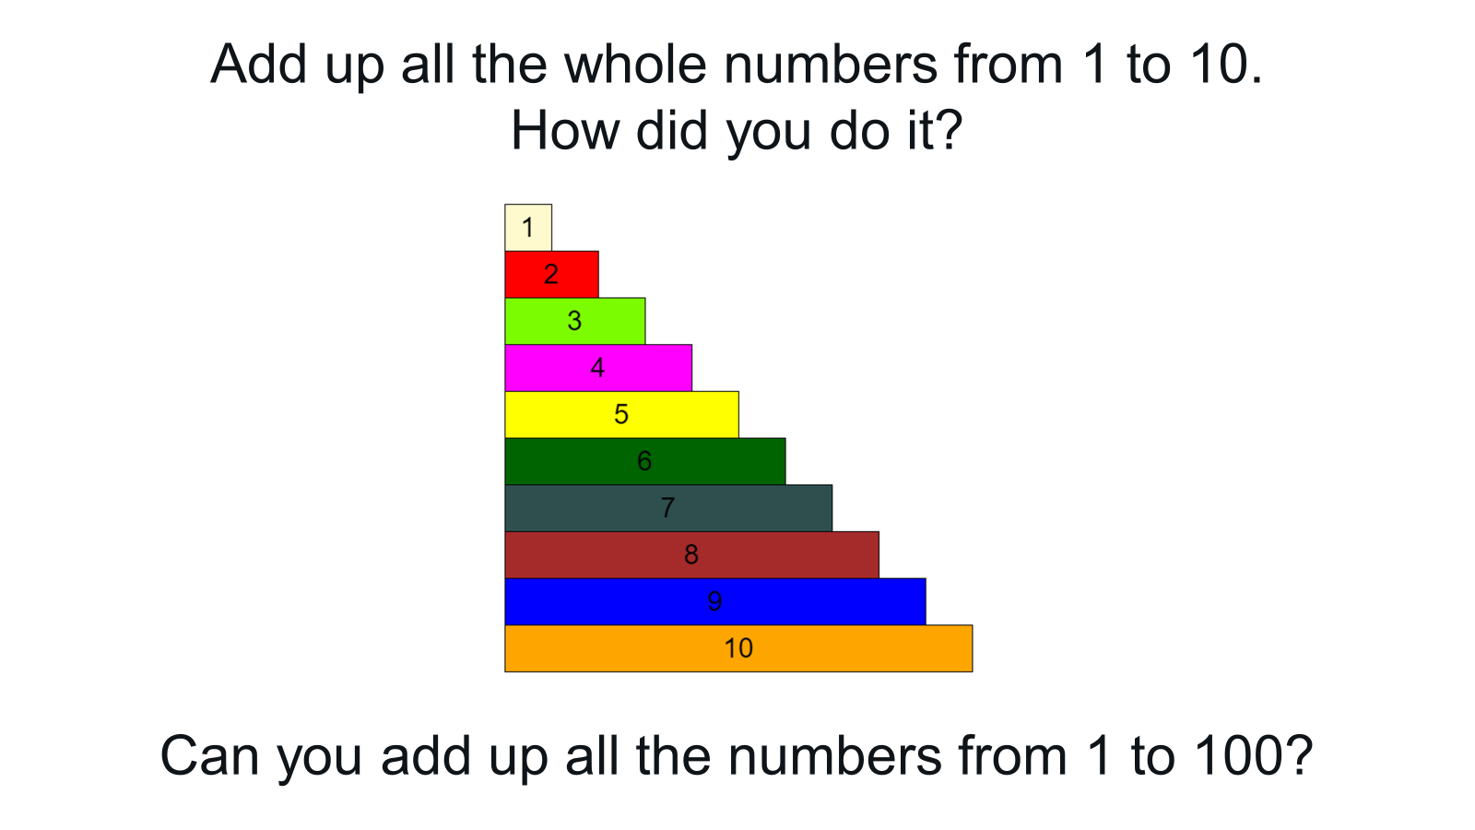
Source Jonathan Hall
Notes:
https://twitter.com/SmartJacques/status/1757835632456478985

Slide 5
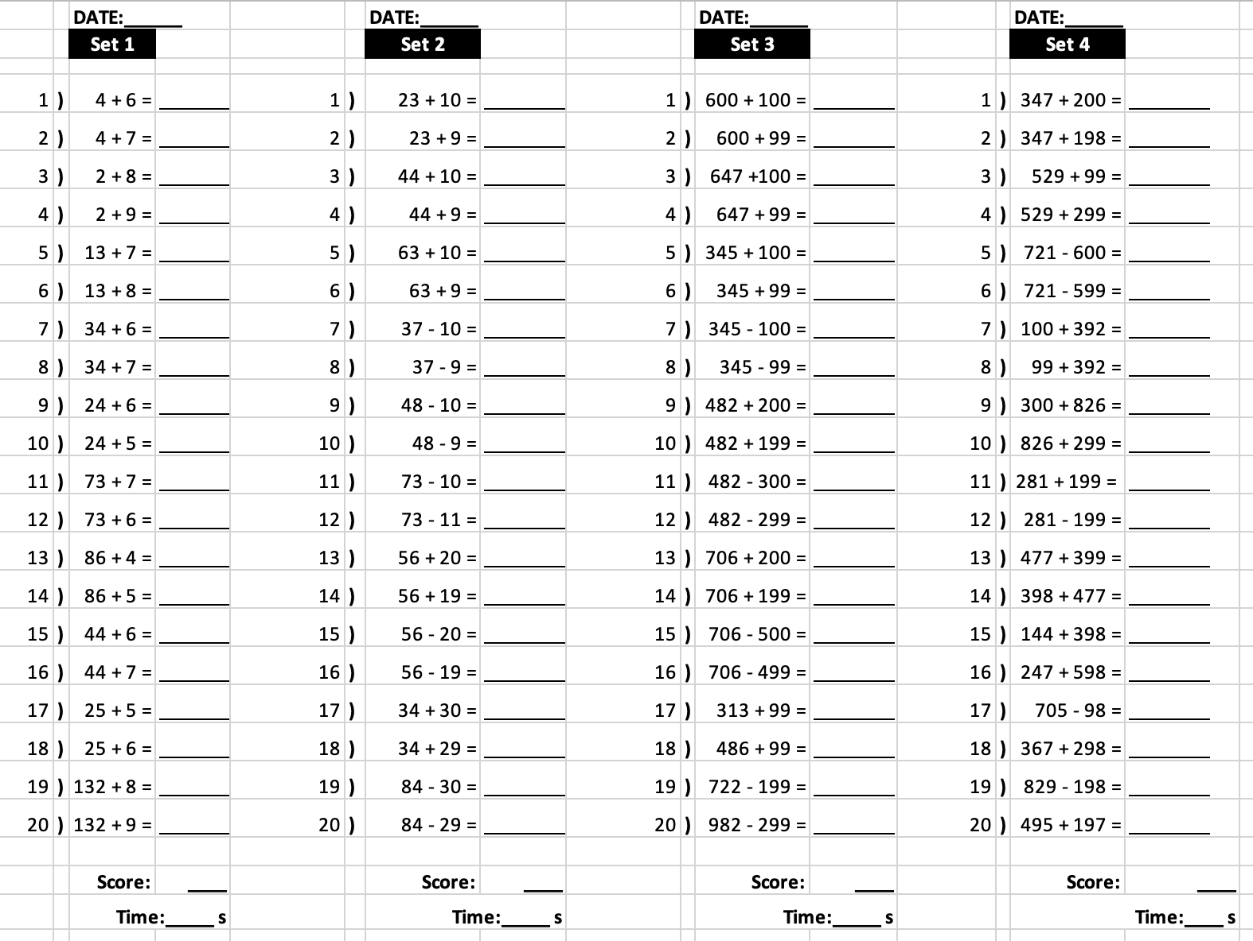
Source Andrew Jeffrey
Notes:
Source Andrew Jeffrey https://twitter.com/i/bookmarks?post_id=1734938205869215910

Slide 6
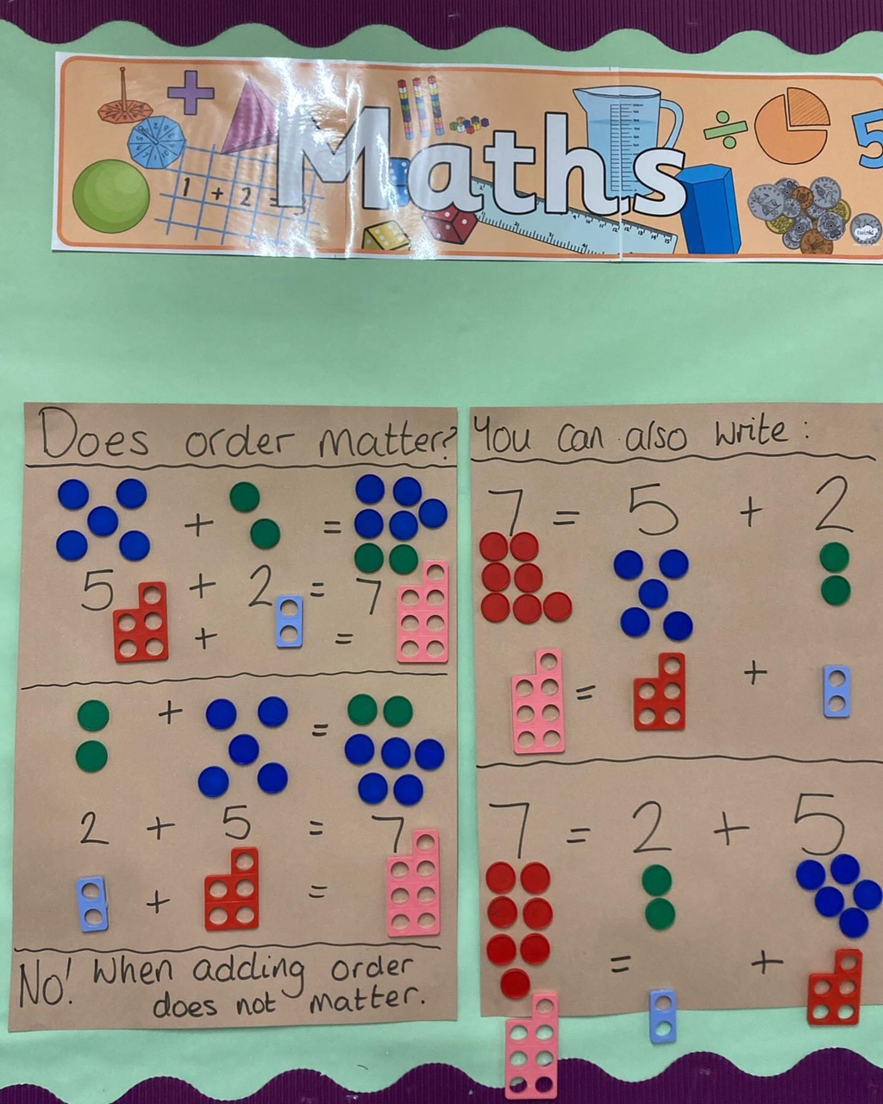
Notes:
White Rose

Slide 7
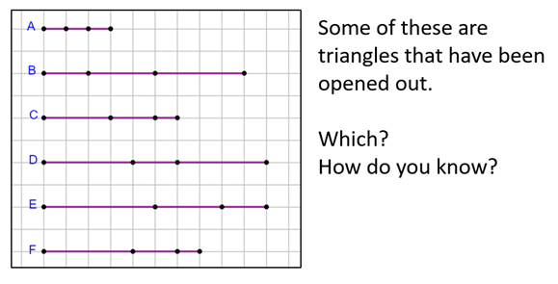
Source Jay Timotheus
Notes:
Jay Timotheus https://twitter.com/jaytimotheus/status/1758106741428912526/photo/1 from MT282

Slide 8
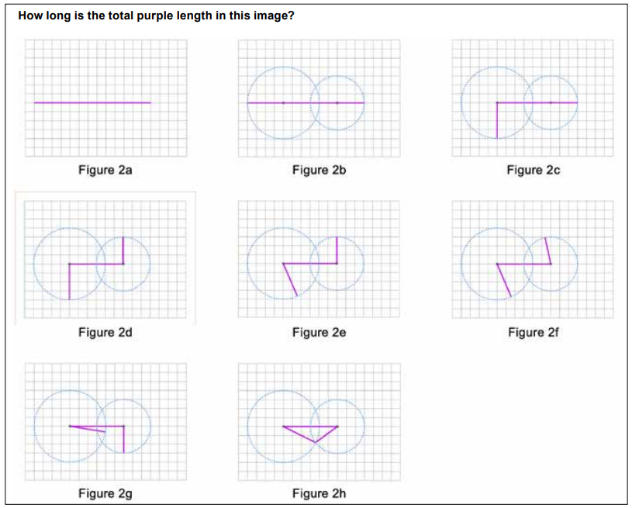
Source Jay Timotheus
Notes:
Jay Timotheus https://twitter.com/jaytimotheus/status/1758106741428912526/photo/1 from MT282

Slide 9
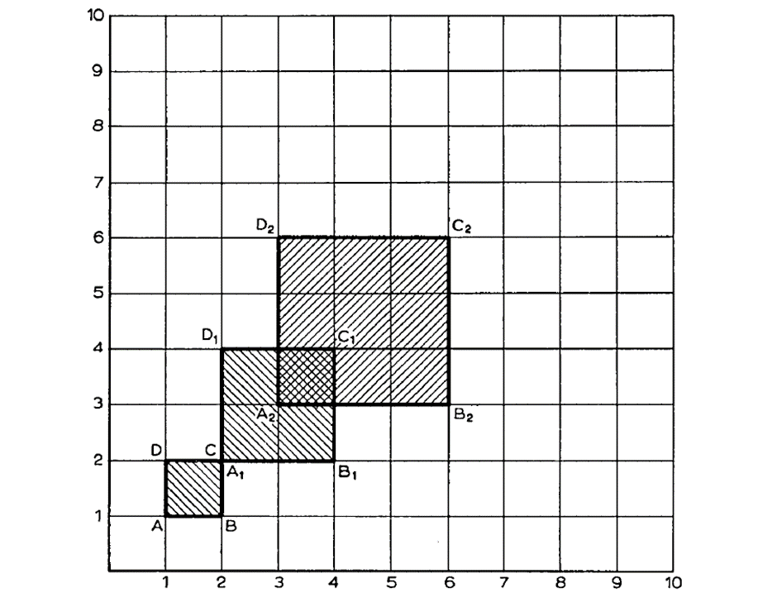
Changing … is related to changing …? How?

Slide 12
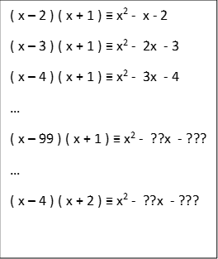

Slide 14
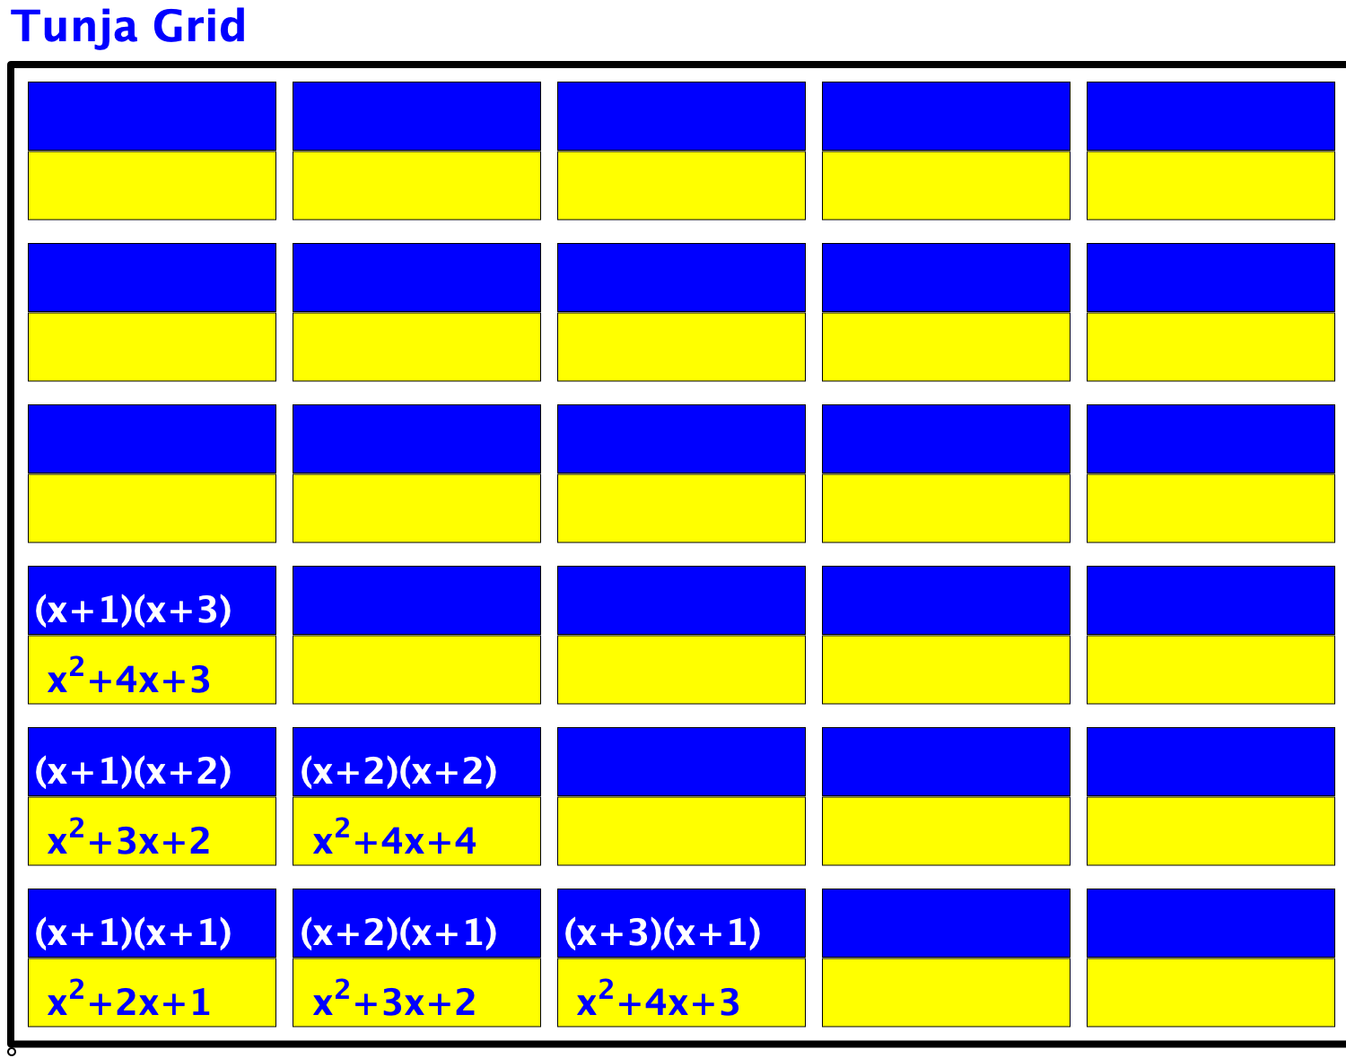
Tunja Grid 1
Tunja Grid 2

Slide 15
Two Problems
Problem 1: In a room with 12 people, everyone shakes hands with everybody else exactly once. How many handshakes are there?
Problem 2: How many diagonals in dodecagon?

Slide 17
Curious multiplications
A
3 x 5 =
4 x 4 =
4 x 6 =
5 x 5 =
5 x 7 =
6 x 6 =
D
11 x 13 =
19 x 21 =
29 x 31 =
89 x 91 =
E
B
F
C
8099
What relationship do you notice here?

