Slide 1
Inner & Outer Aspects
Outer
What task actually initiates explicitly
Inner
What mathematical concepts underpinned
What mathematical themes encountered
What mathematical powers invoked
What personal propensities brought to awareness

Slide 2
Using Variation to Prepare a Lesson
Dimensions of possible variation (scope of the concept)
Dimensions of necessary variation (to bring difficult points and hinge points into focus)
Range of possible (permissible?) change
What conjectures?
What generalisations? (the difficult points)
Conceptual variation
Procedural variation (process; proceed; progress)
Who provides the variation?
Scaffolding (Pu Dian)

Slide 3
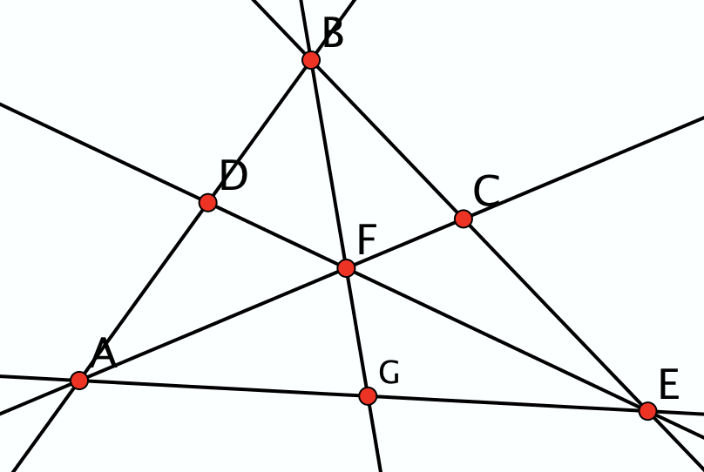
Opposite Angles
How many pairs of opposite angles can you find?
Developing facility in discerning opposite angles
Before engaging with their equality

Slide 4
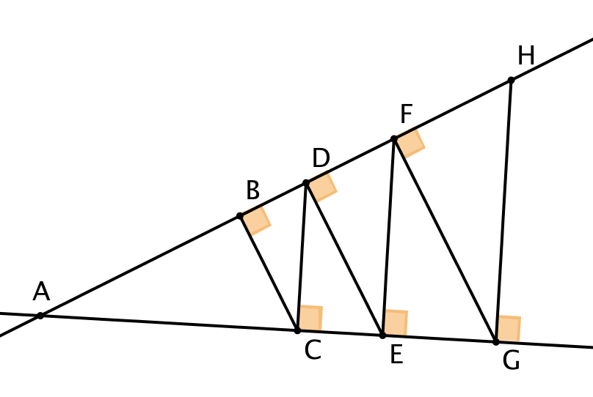
Similar Right Angled Triangles
How many right-angled triangles can you find with one angle equal to θ?
θ
Developing facility in discerning
right-angled triangles; then common angles;
only then consider consequences

Slide 5
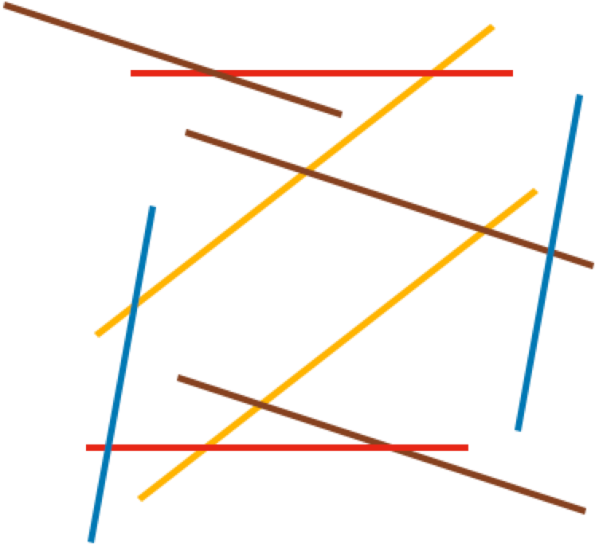
Parallelism
How many angles do you need to know to work out all the angles?
What did you need to do with your attention?
Notes:
Taking in the whole;
Discerning colours as parallel lines;
Selecting an angle and chasing round?
Extending lines to form triangles to display relationships?
From properties, angles between one family and all the others:
Brown-Red; Brown-Yellow; Brown-Blue;
Brown-Red; Red-Yellow; Yellow-Blue

Slide 6
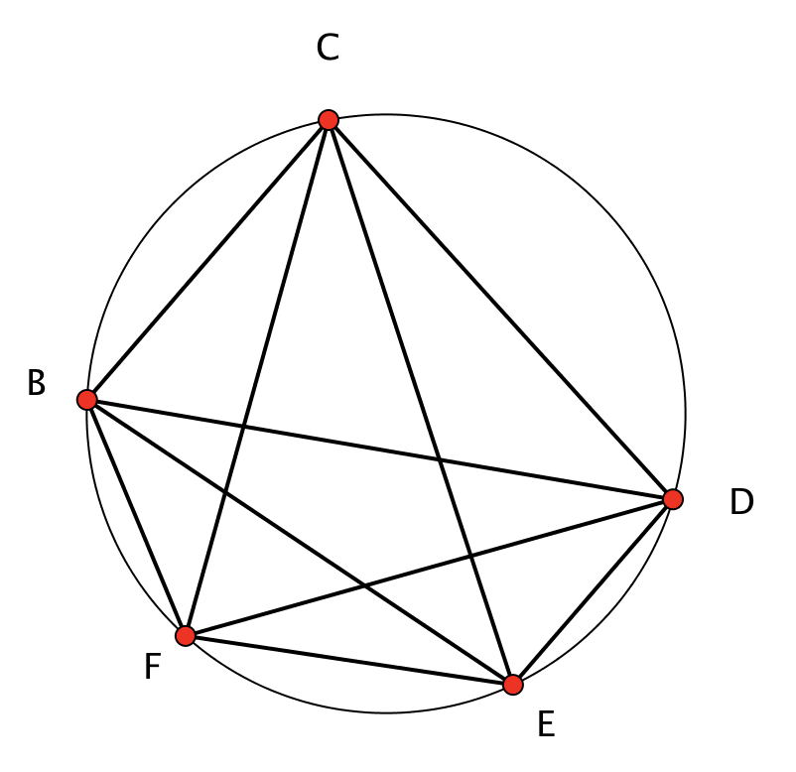
Subtended Angles
Find and describe three angles which are all subtended from the same chord.
Developing facility in recognising subtended angles before encountering a theorem about them
How few angles do you need to be told so as to work out all of the others?

Slide 7
Reflection
Intended enacted lived object of learning
Critical aspects; focal point; difficult point; hinge
Use of variation to bring lived object of learning and intended object of learning together
Notes:
J: then A:

Slide 8
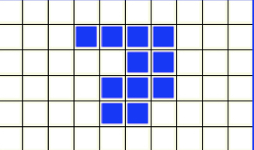
Area & Perimeter
Well known stumbling block for many students
An action becomes available so it is enacted
Perhaps because …
to find the area you count squares
To find the perimeter you (seem to) count squares!
Notes:
Conjectures to consider and modify:
The perimeter is always the perimeter of the smallest rectangle that just covers the shape
The perimeter is always 4 less than the number of squares needed to make a frame around the shape.

Slide 9
Two-bit Perimeters
What perimeters are possible using only 2 bits of information?
2a+2b
Holding one feature invariant
a
Tell yourself, then tell a friend what you can vary and what is invariant
b
Notes:
Here I am changing what is invariant (previously perimeter, now bits of data).

Slide 10
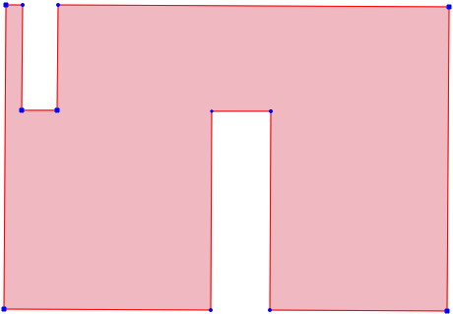
Two-bit Perimeters
What perimeters are possible using only 2 bits of information?
4a+2b
a
b
Notes:
How do you use your attention to verify the perimeter?

Slide 11
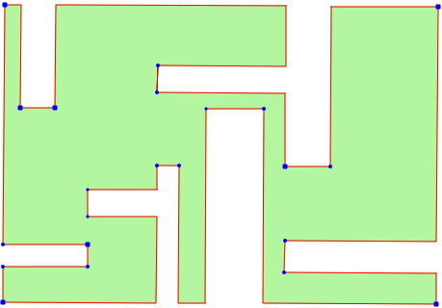
Two-bit Perimeters
Draw yourself a shape that requires only two pieces of information, made from an initial rectangle that is a by b, and having a perimeter of 6a + 4b.
Holding one feature invariant
Tell yourself, then tell a friend what you can vary and what is invariant
a
b
Notes:
So, make a conjecture about what is possible!
Next task would be to articulate in words, then try to justify!

Slide 12
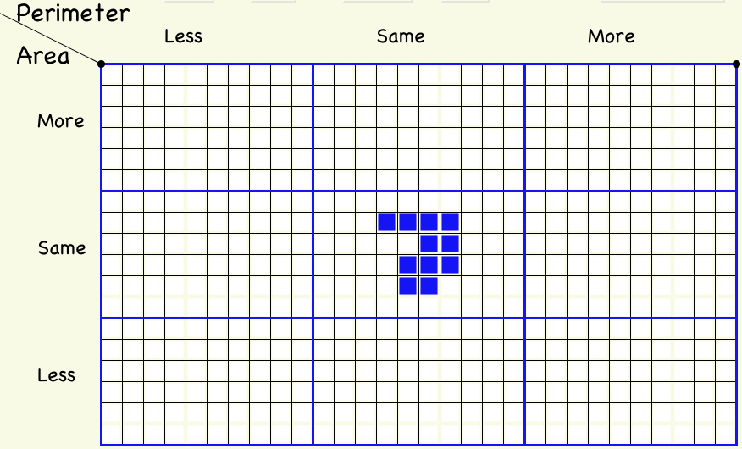
More or Less Grid
Notes:
The perimeter is always the perimeter of the smallest rectangle that just covers the figure.
It is also 4 less than the number of squares needed to make a frame to surround the shape.
This is an example

Slide 13
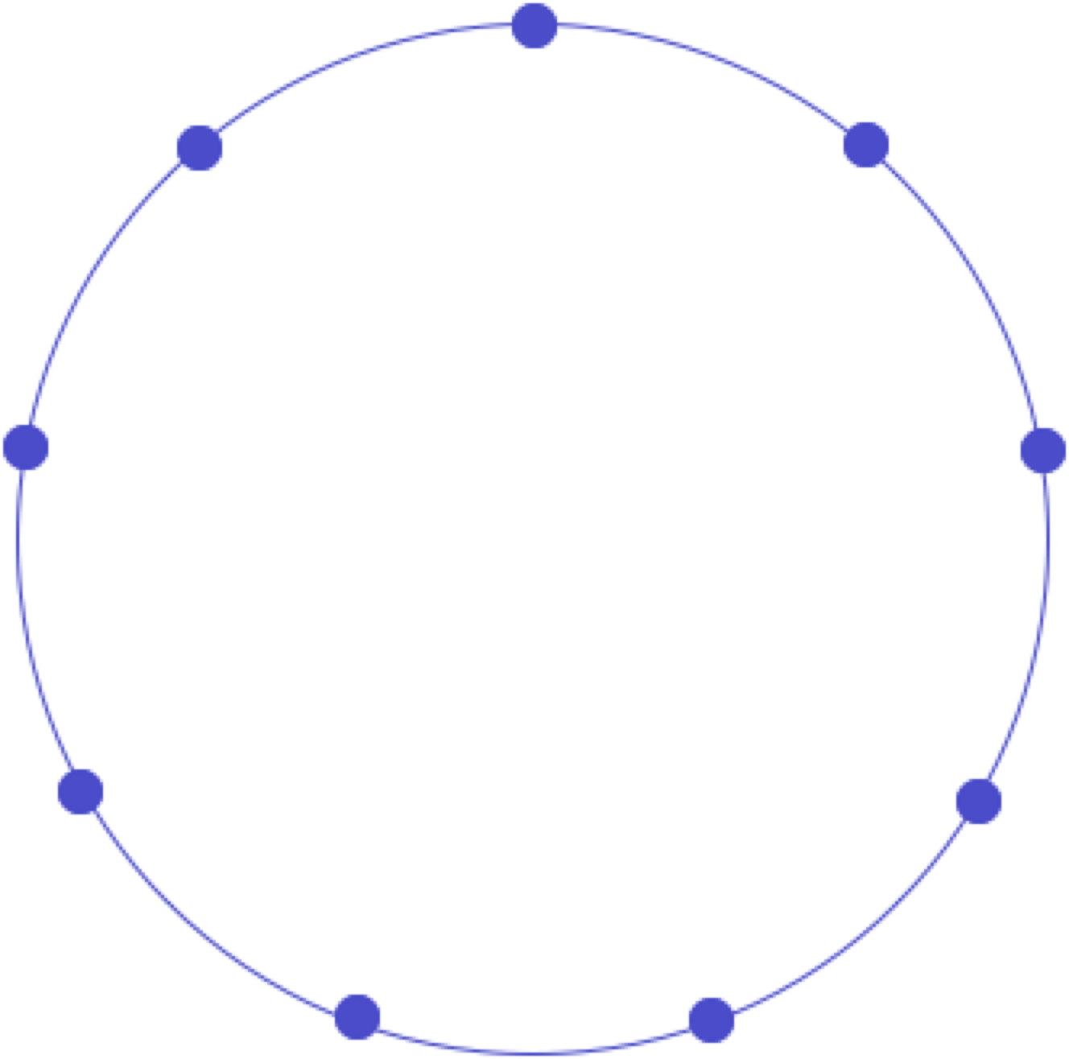
9-Pin Triangles
How many triangles?
How many different triangles?
What do you need to do with your attention?
Geoff Faux
Notes:
Discerning triangles;
Recognising potentially parallel lines and using using properties to justify, leading to similar triangles
Recognise need for angles; leading to use of angle properties;

Slide 14
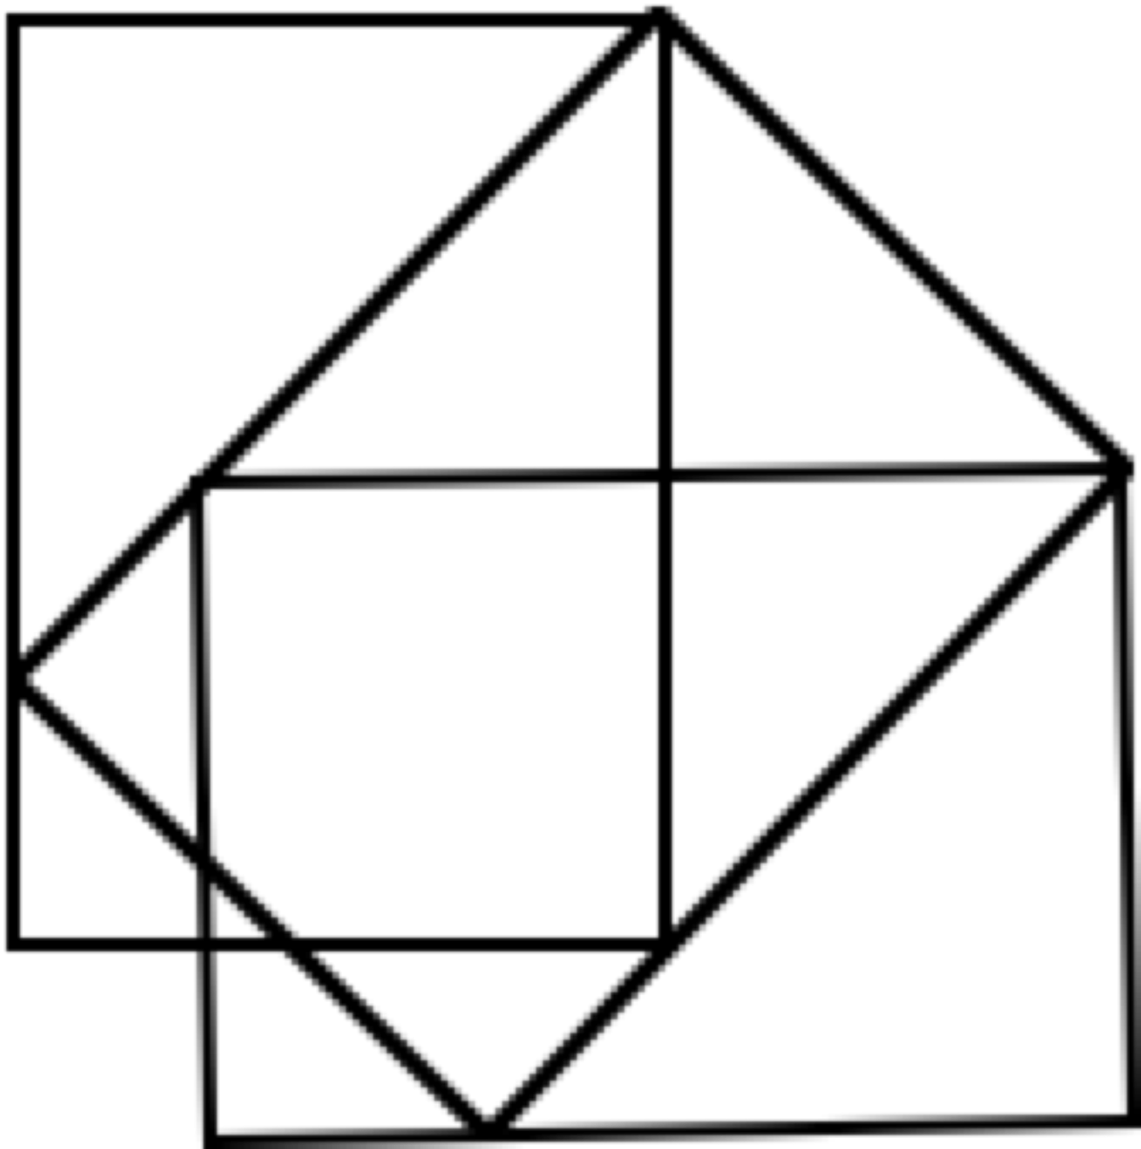
Rectangular Layout
Say What You See!
Arrange some sheets of paper similarly, and continue
Conjecture; explain; vary
Phenomenon ––> exploration; exercise;
Extending awareness; Training behaviour; Harnessing emotions

Slide 15
Which region looks …
1
2
3
4
5
the largest?
the smallest?

Slide 16
Which region is…
the largest?
the smallest?
Notes:
View 1: each little rectangle is a by b
View 2: the big rectangle is A by B

Slide 17
What are the relative areas?
Notes:
View 1: each little rectangle is a by b
View 2: the big rectangle is A by B

Slide 18
Relative Area … Be Careful!

Slide 19
Task 3: Design of Question Sequence
Construct an object
and another
and another
Variation on the object (and another, and another)
Introduce a new constraint (no others ...)
Ask similar questions of a new object
and another
and another
Variation in method
New kind of question/insight/concept
and another
and another (opportunity to experience)
Notes:
A:

Slide 20
Types of variation
Conceptual:
presentations;
representations;
examples/non examples approaches;
connections with what we already know;
what mathematical problems this new idea is going to help us with;
multiple experiences and perspectives; various critical aspects
Procedural:
Multiple problems - one solution method
One problem - multiple solution methods
One situation - multiple presentations
Notes:
A:

Slide 21
Implications for quality of teaching
Anticipate what variation is necessary to develop procedural mastery (process; proceed; progress), and conceptual mastery
Critical aspects; focus; difficult points; hinges
Dimensions of variation to draw attention to the critical aspects and focus
Ranges of change that will focus attention
Examples and non-examples to delineate the concept
Representations (because the concept is abstract)
Lived object of learning;
what they see, hear, do;
what generalisations is it possible to make from their experiences?
Notes:
A:

Slide 22
Powers & Themes
Are students being encouraged to use their own powers?
Powers
or are their powers being usurped by textbook, worksheets and … ?
Imagining & Expressing
Specialising & Generalising
Conjecturing & Convincing
(Re)-Presenting in different modes
Organising & Characterising
Themes
Doing & Undoing
Invariance in the midst of change
Freedom & Constraint
Restricting & Extending
Exchanging

Slide 23
Summary
Concepts
Vary aspects or features that can be varied without changing the concept
Problems
Vary parameters
Vary contexts while retaining the same calculations
Above all else …
What can be varied (dimensions of possible variation)
Over what range or scope (range of permissible change)

Slide 24
Reflection as Self-Explanation
What struck you during this session?
What for you were the main points (cognition)?
What were the dominant emotions evoked? (affect)?
What actions might you want to pursue further? (Awareness)
Notes:
Chi et al

Slide 25
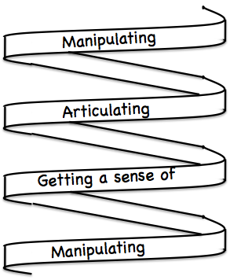
Frameworks
Enactive – Iconic – Symbolic
Doing – Talking – Recording
See – Experience – Master
Concrete – Pictorial– Symbolic

Slide 26
Reflection
It is not the task that is rich
but the way the task is used
Teachers can guide and direct learner attention
What are teachers attending to?
powers
Themes
Heuristics
The nature of their own attention

Slide 27
Forms of Attention
Holding Wholes (gazing): unfocused
Discerning Details
Recognising Relationships (in the situation)
Perceiving Properties (as being instantiated)
Reasoning on the basis of agreed properties
NOT levels as in van Hiele
BUT stances which may last for a very short time, or which may be habitual or persistent
Conjecture: if teacher and students are attending to different things
OR attending to the same thing but differently
Effective communication may be difficult!

Slide 28
To Follow Up
pmtheta.com
john.mason@open.ac.uk

